Slide 1
Birefringence Variation in 10 cm Diameter AlGaAs on Silica Mirror
Andri Gretarsson, Breck Meagher
Embry-Riddle

Slide 2

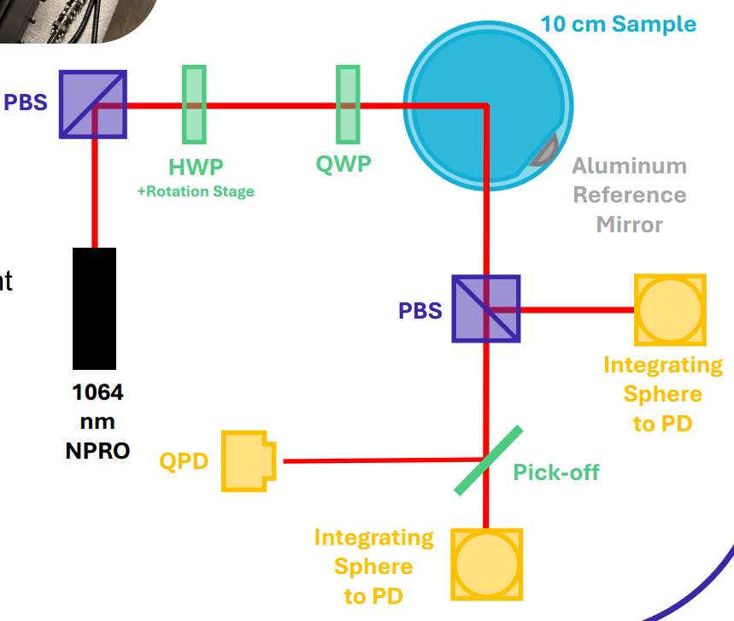

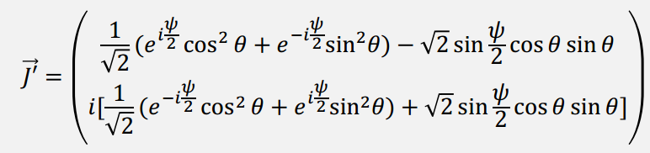
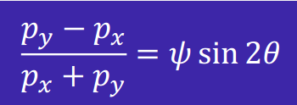

Single-reflection Measurement
$θ$=
Sample angle
(Angle between fast axis and analyzing polarizer)
Reflected phase shift b/w fast & slow axes
Fast axis angle wrt. analyzer
(beam steering)
Powers in the two polarizations

Slide 3
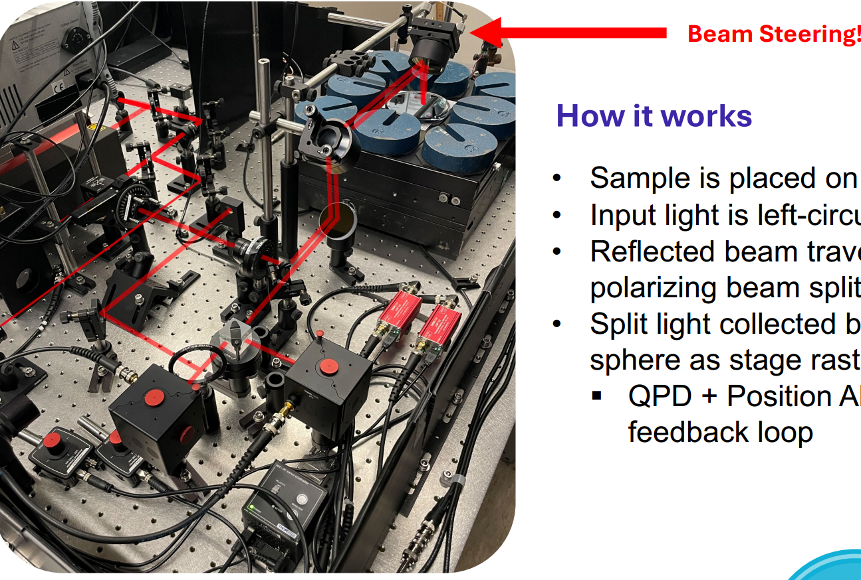
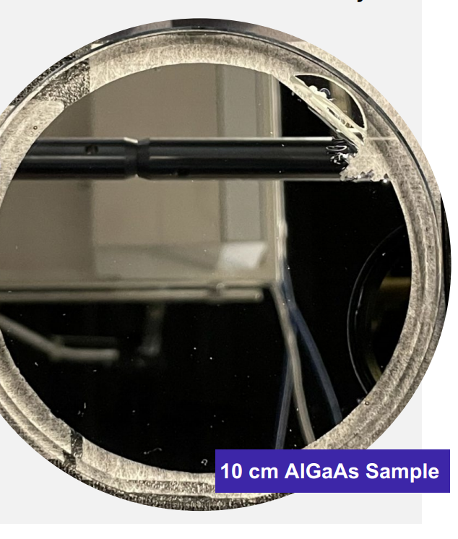
Recent Photo

Slide 4
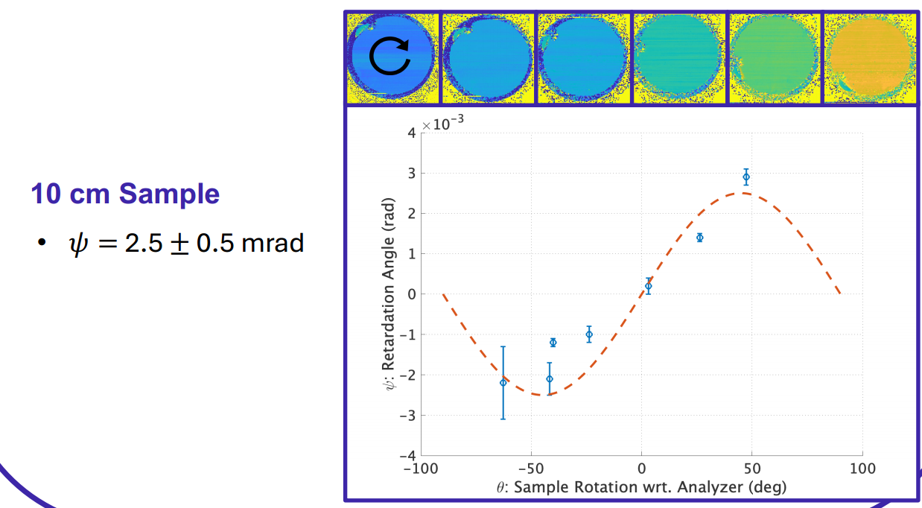
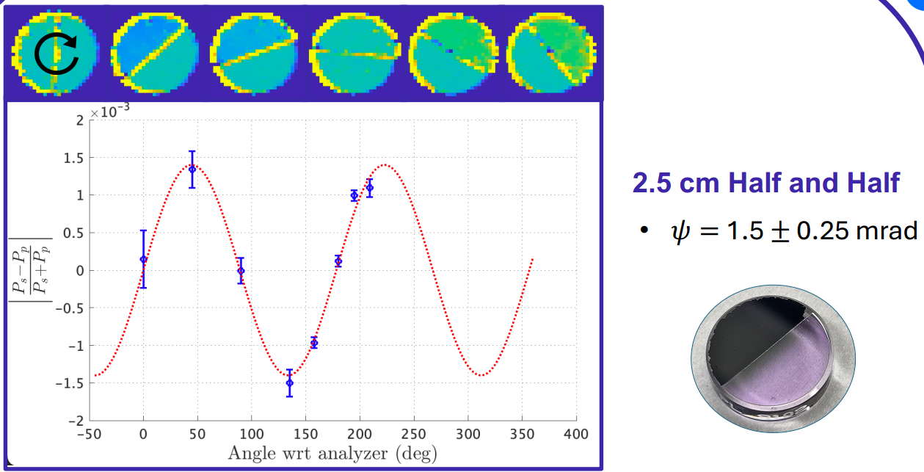
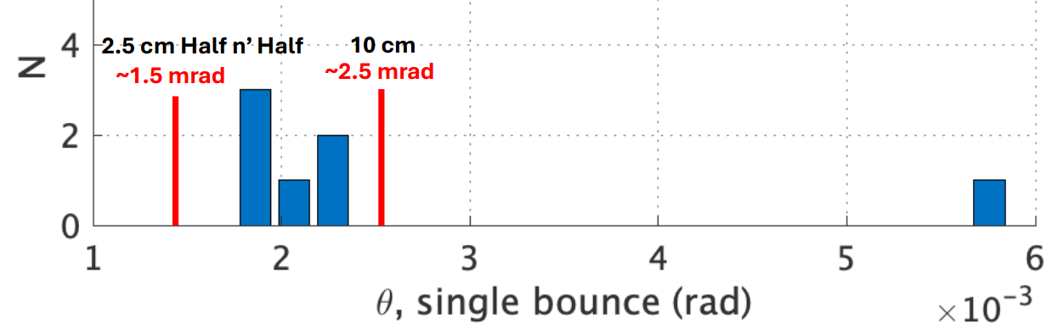

Stress-induced birefringence
$ψ$,

Slide 5
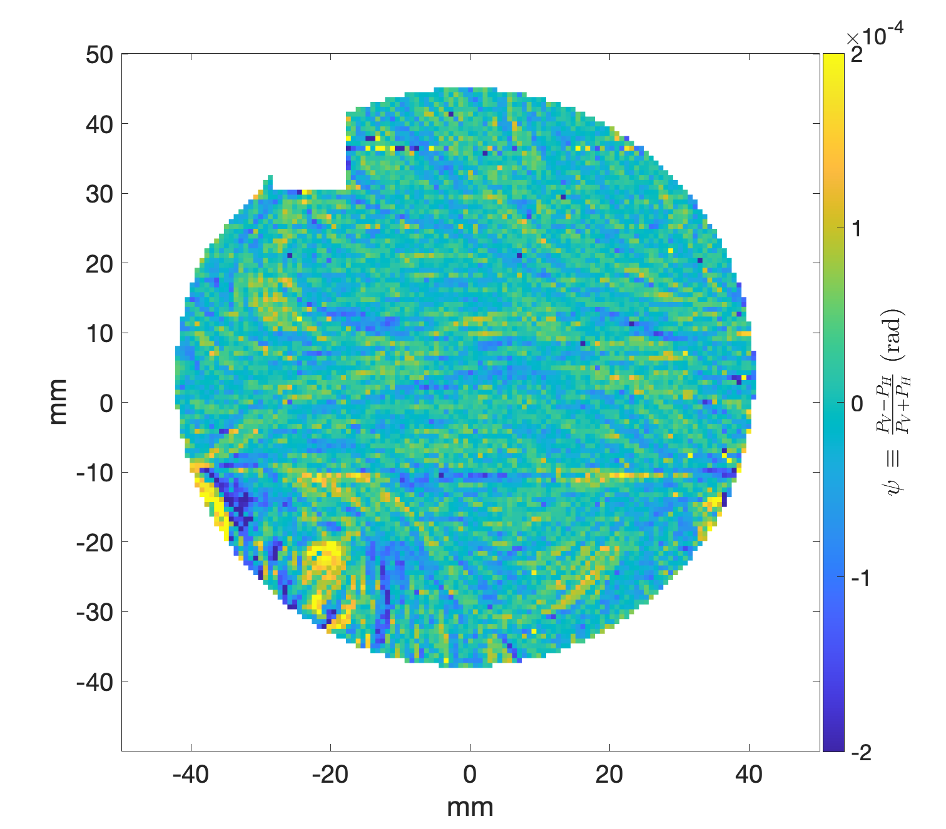
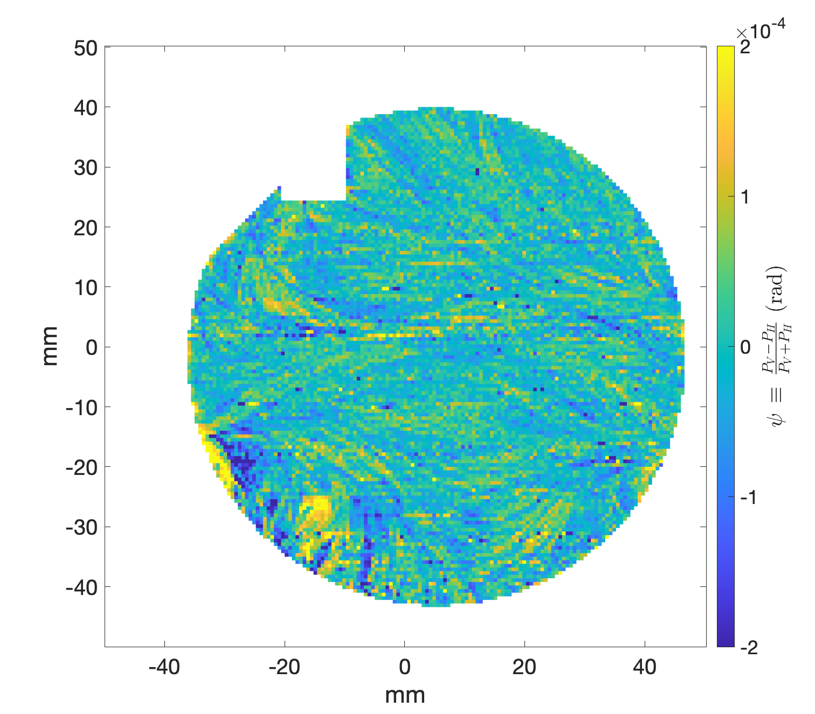
(Non) Effect of Cleaning with First Contact
Before
After

Slide 6
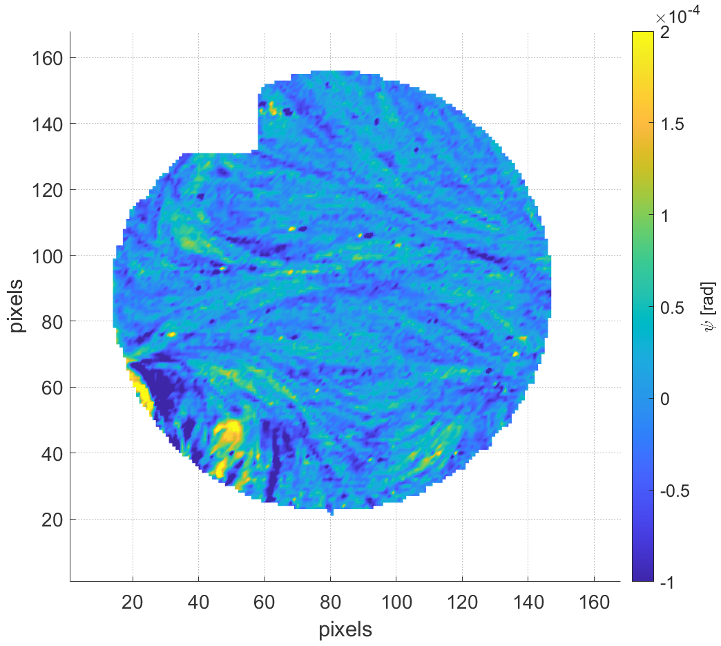
Average of Two Scans
Horizontal lines pattern is due to filtering, but swirly features are real
Probably
dust
Al(0.92)Ga(0.08)As/GaAs, TO-optimized stack

Slide 7
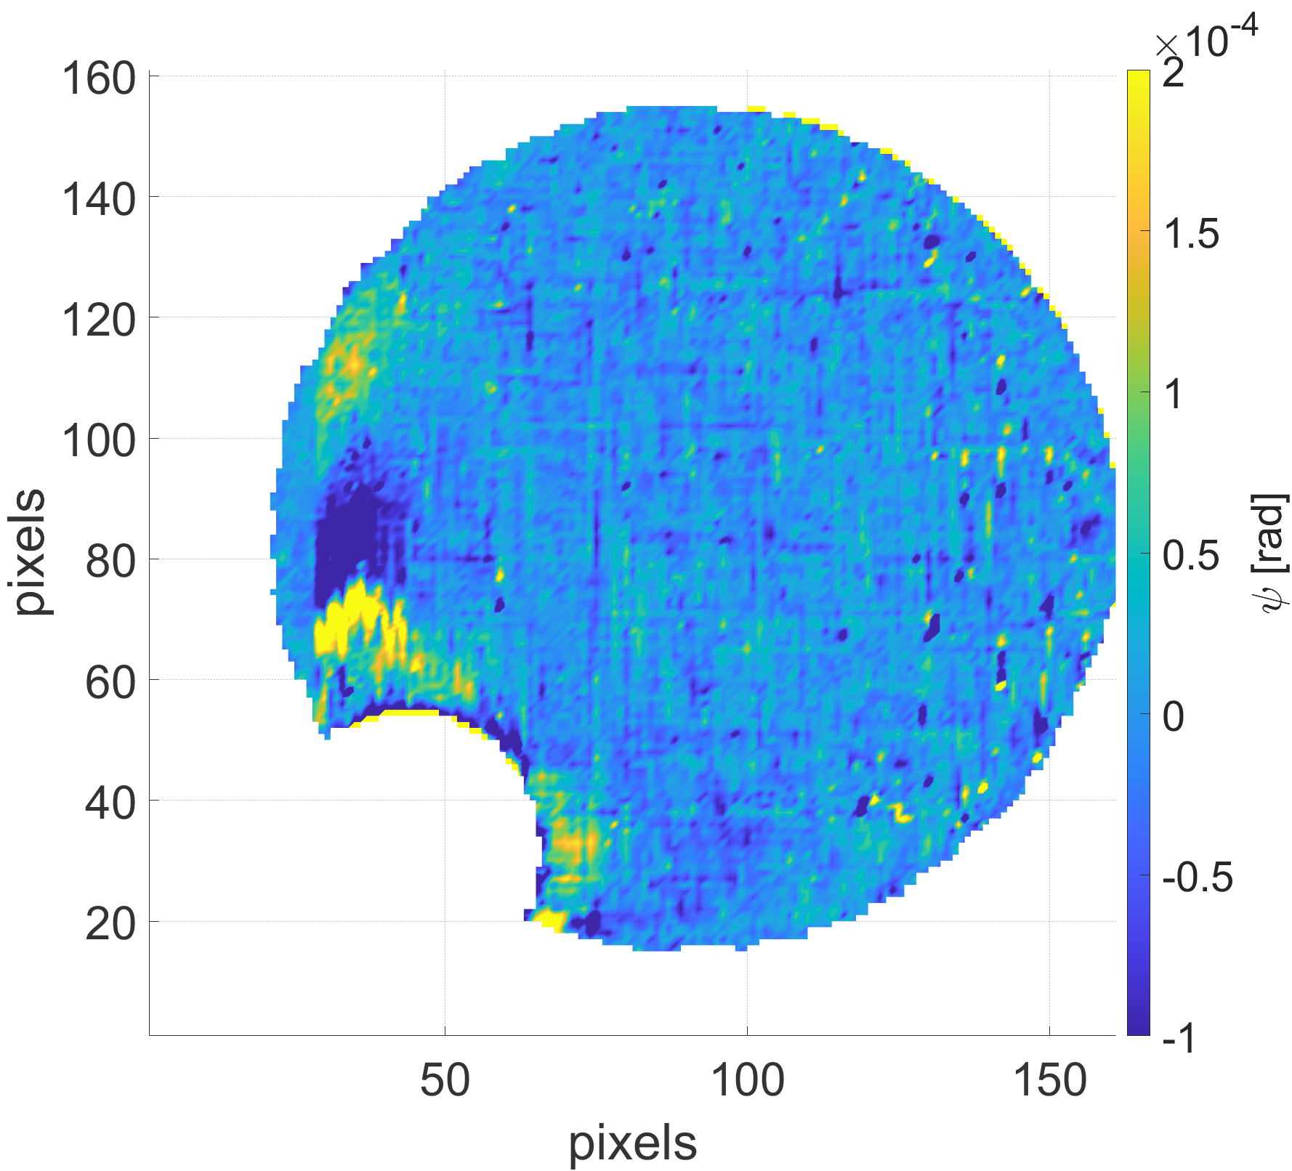
Birefringence Scans
Horizontal lines pattern is due to filtering, but swirly features are real
Point defects and/or dust
Spatial filter “ringing” due to sudden large stress-induced birefringence nearby (i.e. not real)
Perpendicular hash pattern is due to filtering, but diagonal features are real
Stress-induced
Birefringence from
Heating
TiO2(40%)Ta2O5(60%) / SiO2 lambda/4 stack
Al(0.92)Ga(0.08)As/GaAs, TO-optimized stack

Slide 8
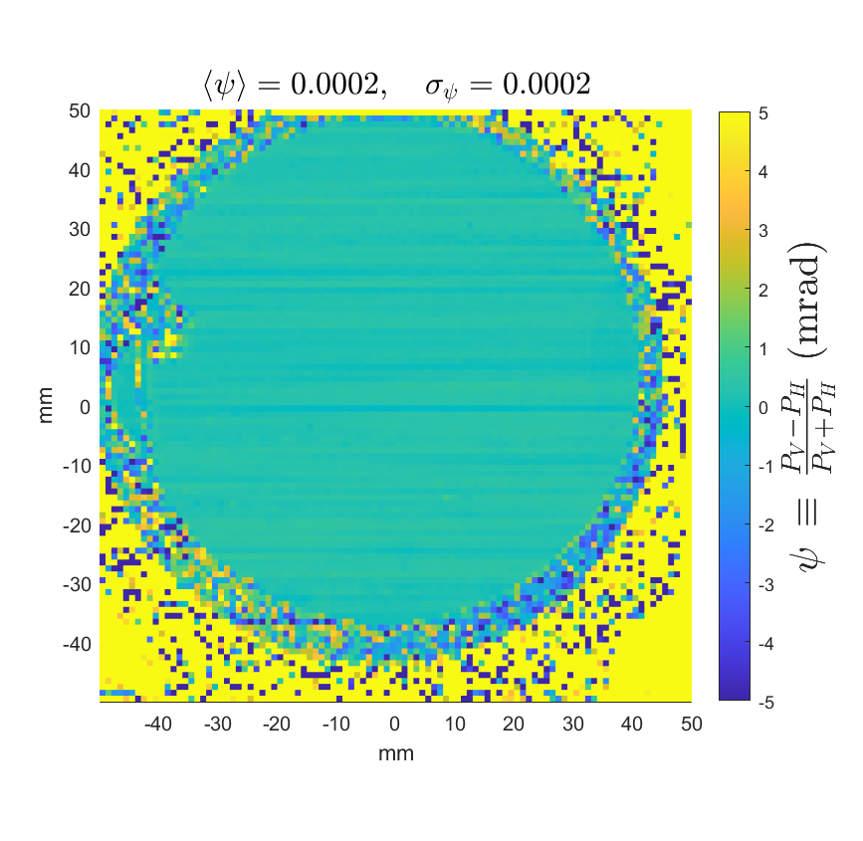
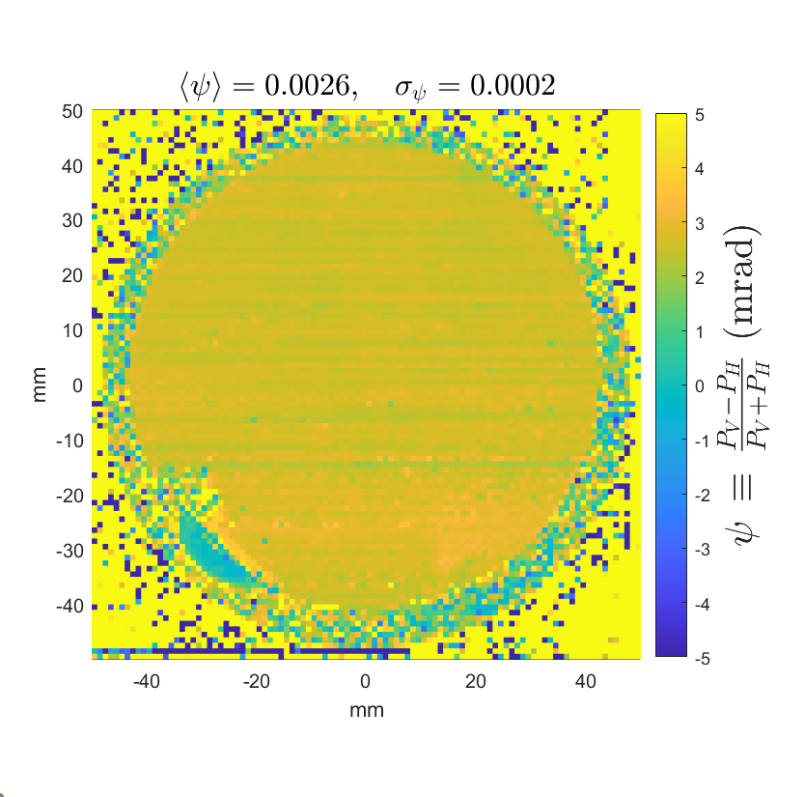
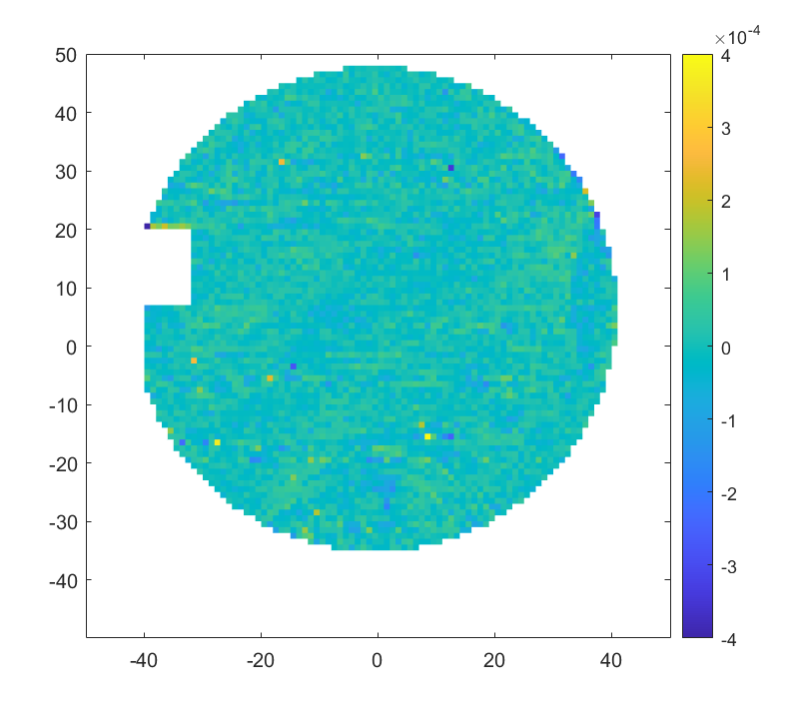
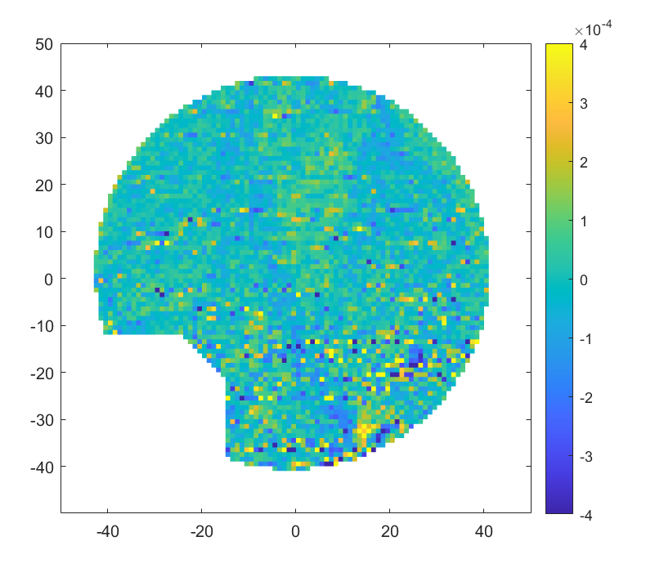
Fast axis of variation is approximately aligned with main birefringence axis

