Slide 1
Review of AlGaAs Mirror Noise Scalings
Andri Gretarsson, Garrett Cole, Gregg Harry, Steve Penn

Slide 2
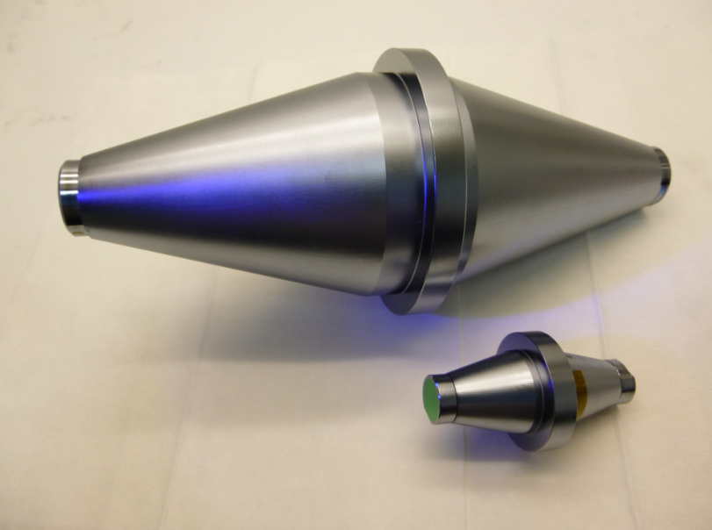
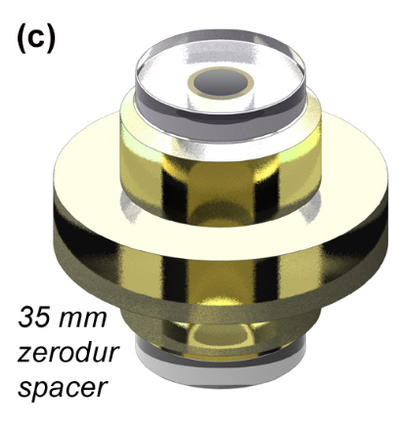
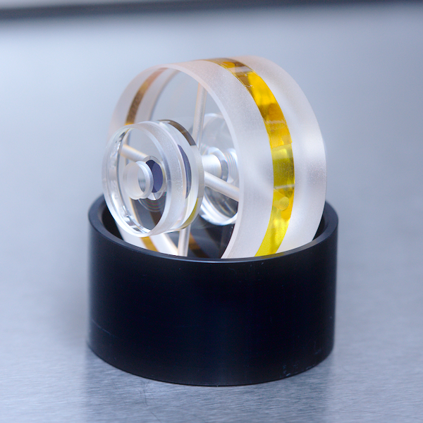
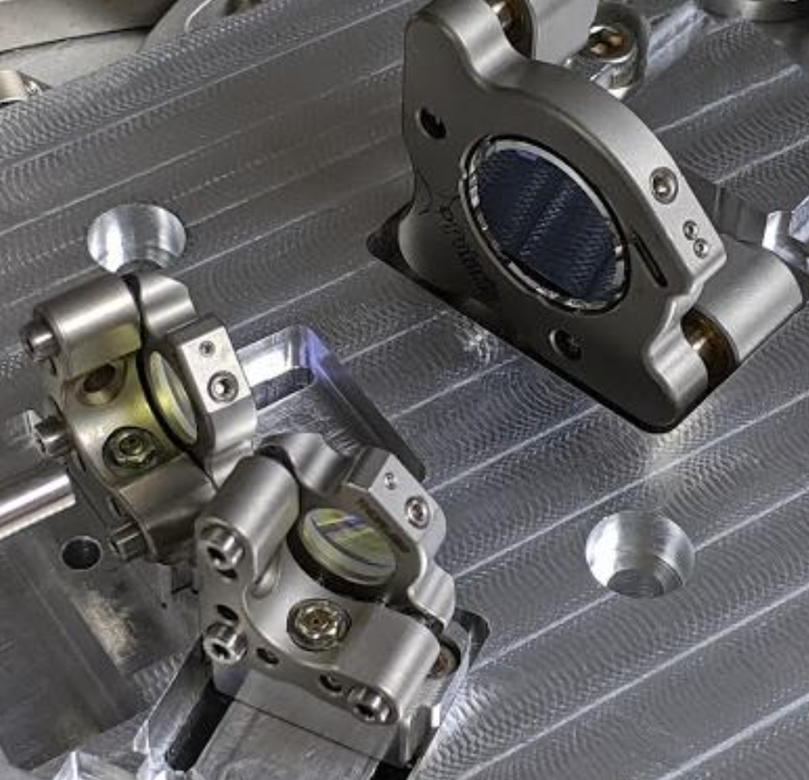
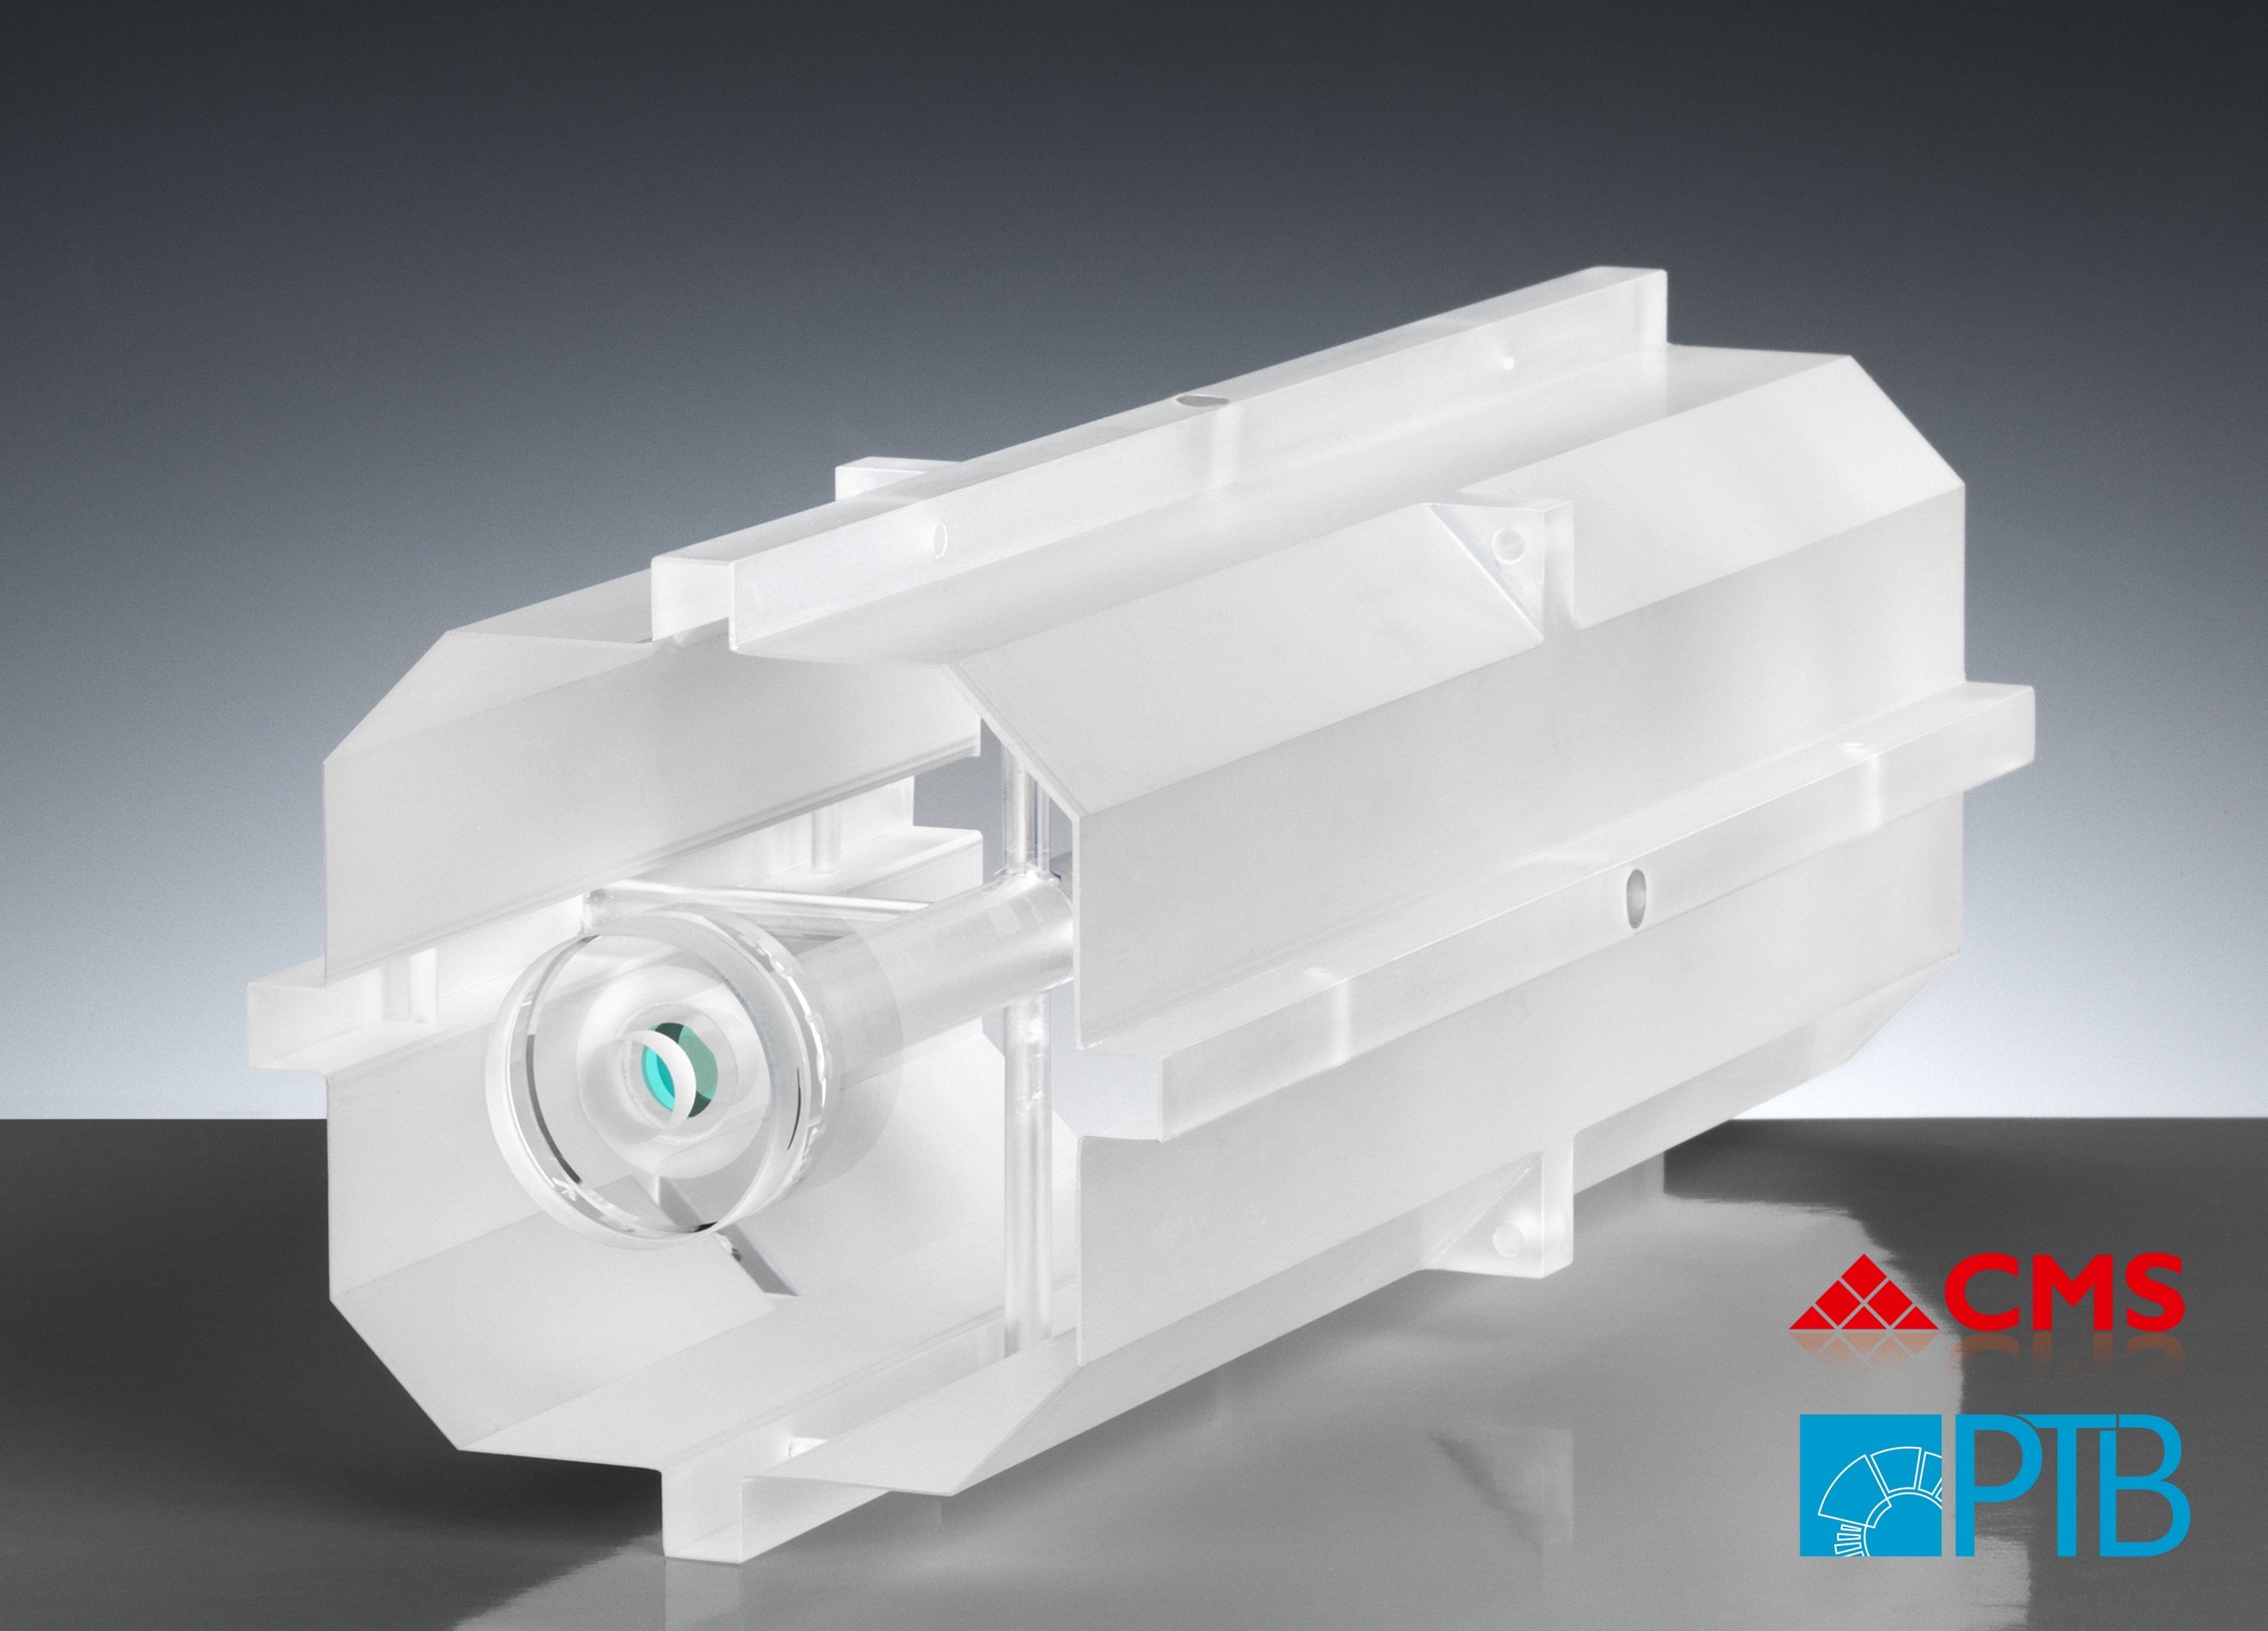
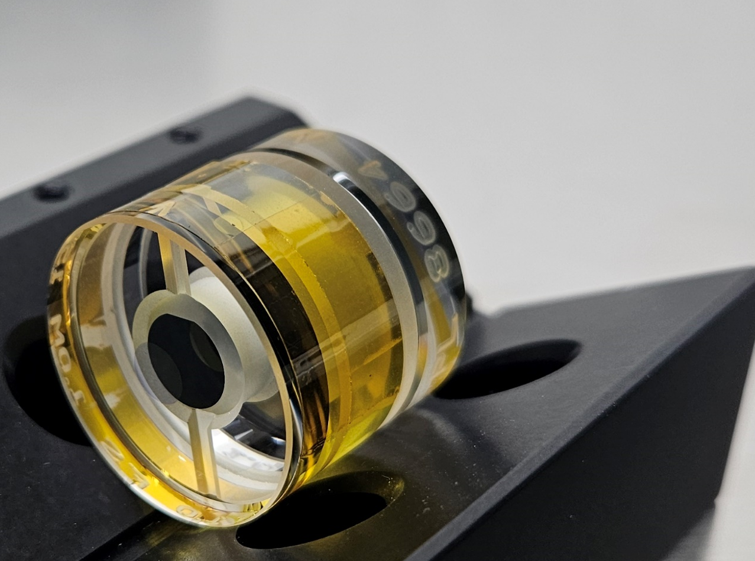
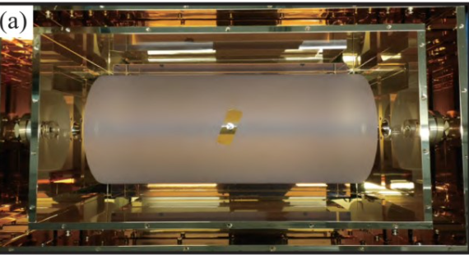
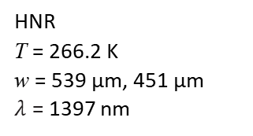
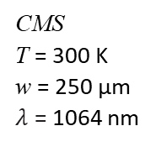


AlGaAs Cavity Measurements
CMS
T = 300 K
w = 250 μm
$λ$ = 1064 nm
NIST
T = 295 K
w = 343 μm
𝜆 = 1156 nm
PTB, JILA (2023)
T = 124K, and 4K, 16K.
w = 482 microns, 294 microns
$λ \text{=}$ 1542 nm
MIT
T = 295 K
w = 50 μm
𝜆 = 1064 nm
PTB (2022)
T = 295 K
w = 471.5 μm ,421.7 μm
$λ \text{=}$ 1397 nm
Thorlabs
T = 295 K
w = 422 μm
𝜆 = 1550 nm
HNR
T = 266.2 K
w = 539 μm, 451 μm
$λ$ = 1397 nm

Slide 3
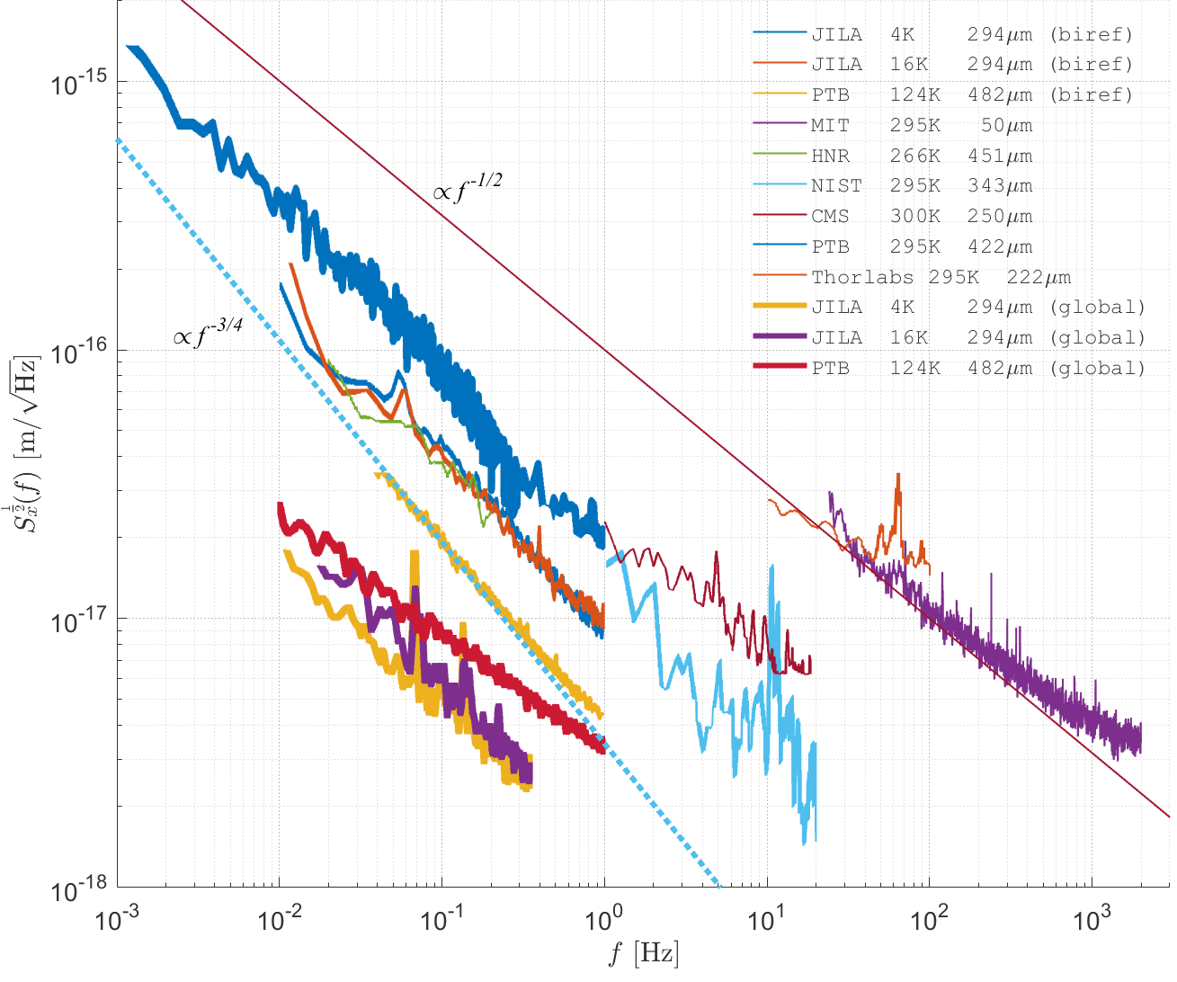
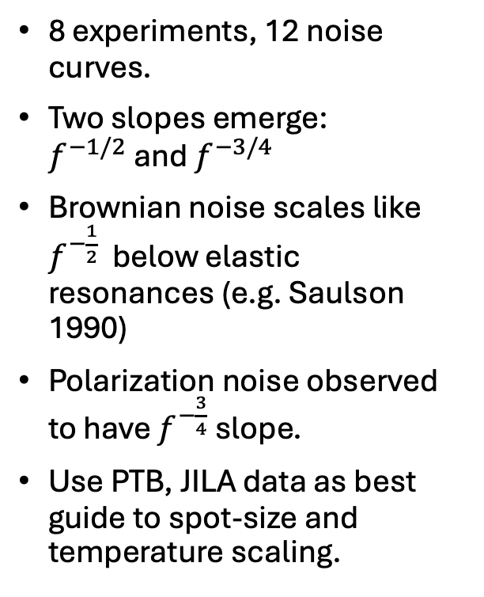
Convert to Single Mirror Displacement and Compare
8 experiments, 12 noise curves.
Two slopes emerge:
$f^{−1/2}$ and $f^{−3/4}$
Brownian noise scales like $f^{−\frac{1}{2}}$ below elastic resonances (e.g. Saulson 1990)
Polarization noise observed to have $f^{−\frac{3}{4}}$ slope.
Use PTB, JILA data as best guide to spot-size and temperature scaling.

Slide 4
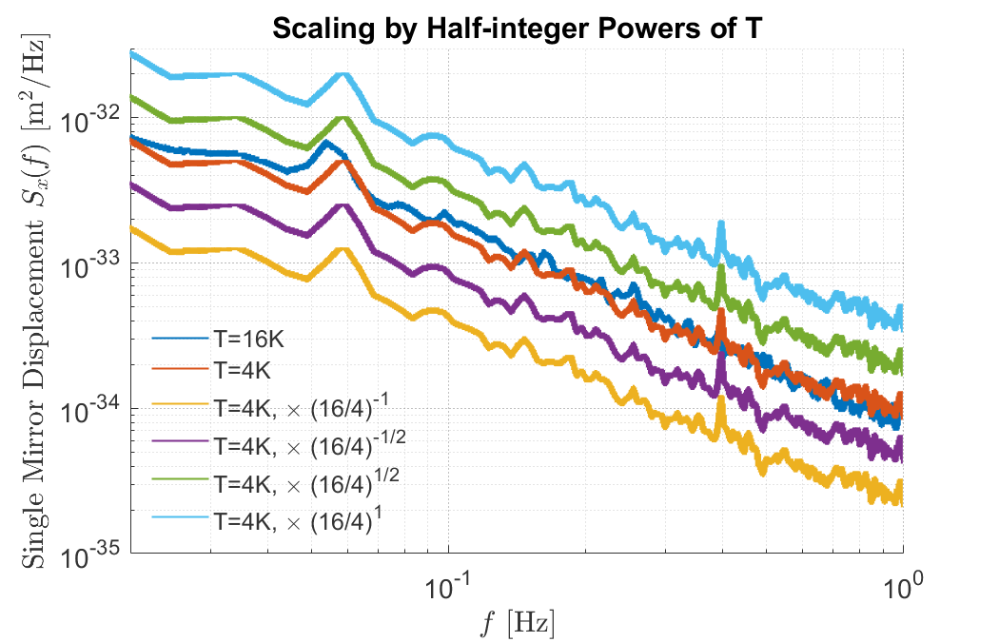
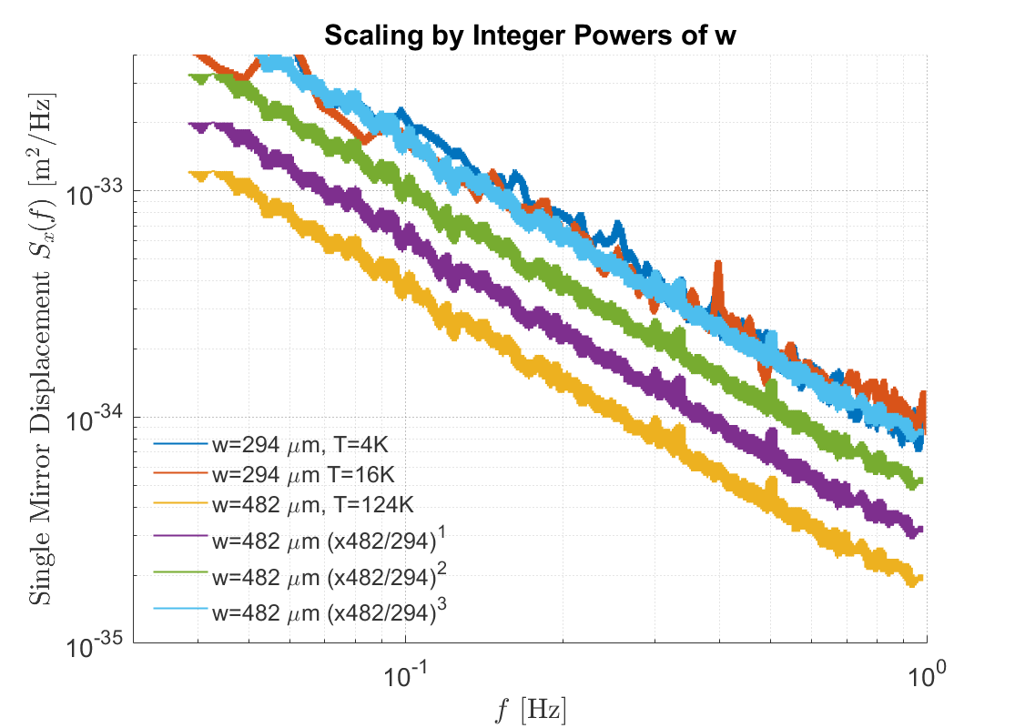

Temperature and Spot-size scaling for PTB+JILA polarization noise
PTB cavity has approximately twice the spot size as the JILA cavity.
Both JILA data sets are on the same cavity, so same spot size but factor of 4 different in temperature.
Can’t rule out temperature dependence entirely, but significantly constrained by room temperature cavities.
No significant T-scaling
PSD scales like $w^{−3}$

Slide 5
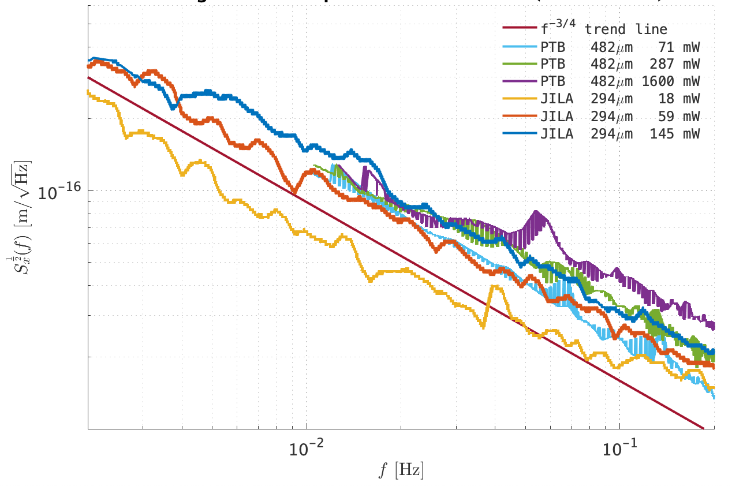
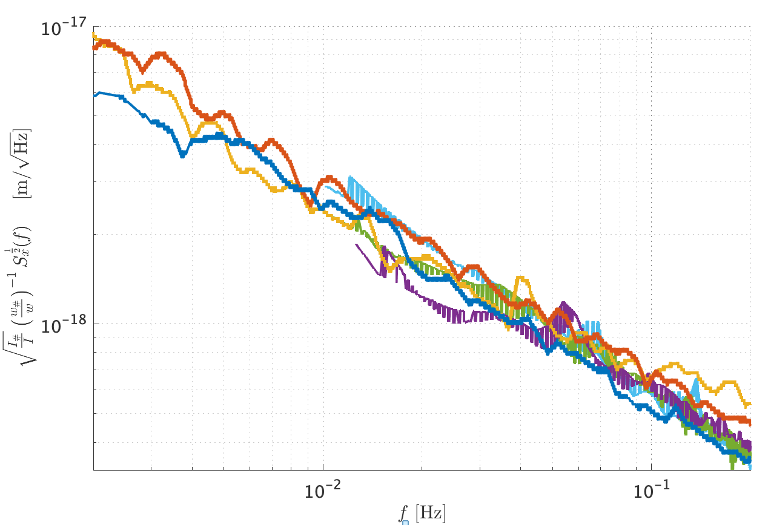
Intensity Dependence
4

Slide 6
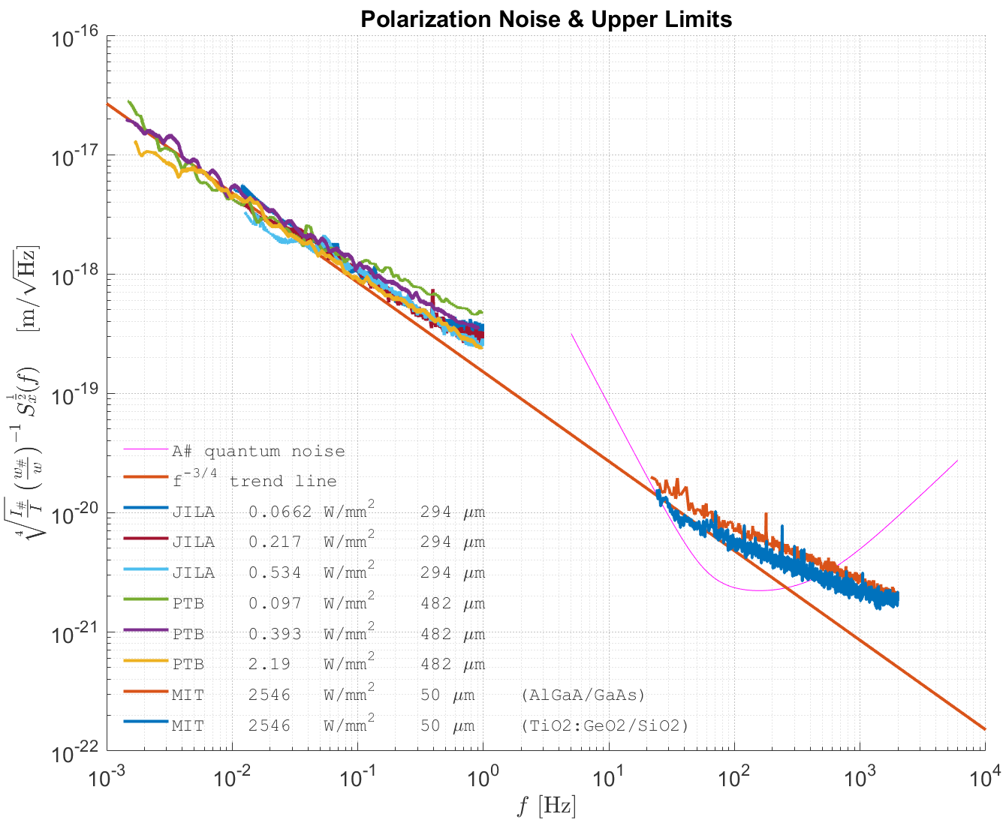
MIT cavity is close to birefringence noise extrapolation at room temperature
Use scalings found in JILA and PTB data to scale to the same beam radius and irradiance.
MIT thermal noise experiment is very close to pol. Noise extrapolation at low frequency. Just needs another factor of 2!

Slide 7
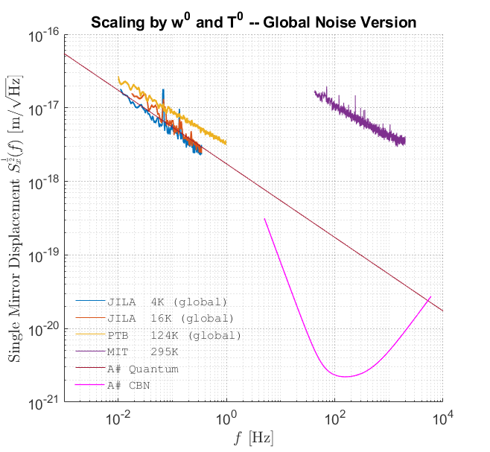
What about Global Noise?
Scary physics-free noise scaling

Slide 8
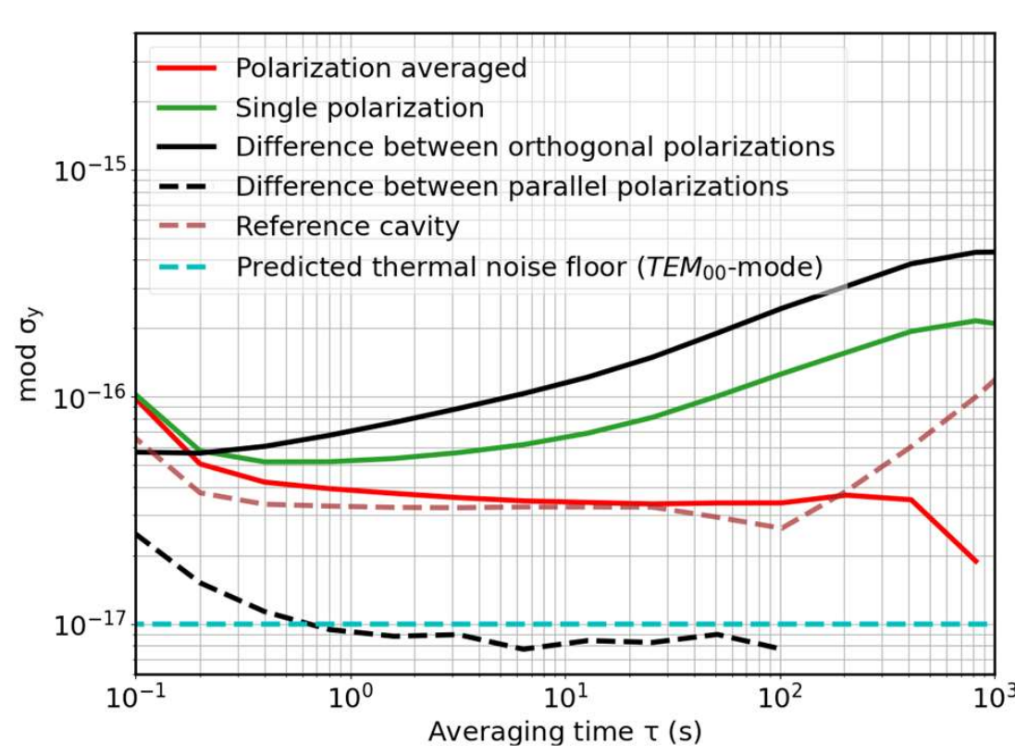
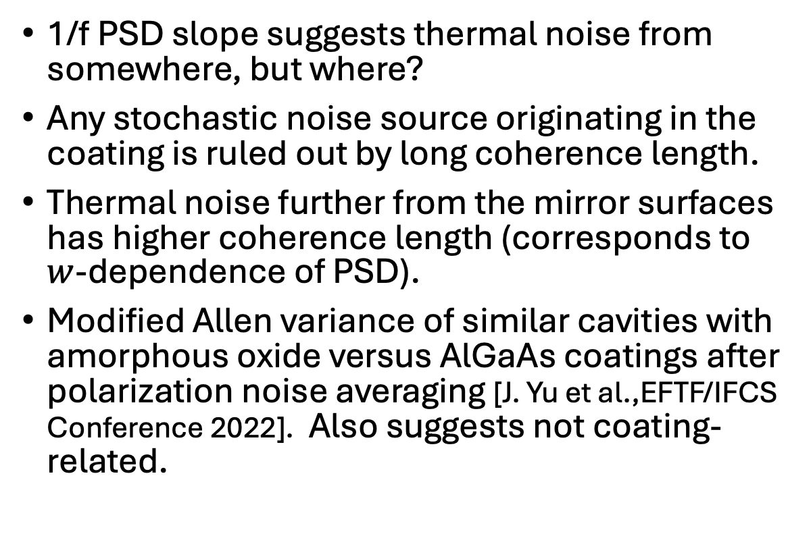
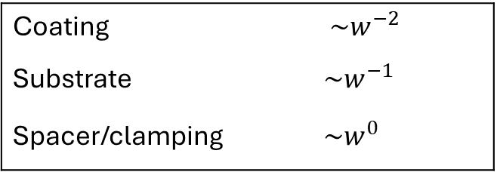
What about “Global Noise”?
Coating | $\sim w^{−2}$
Substrate | $\sim w^{−1}$
Spacer/clamping | $\sim w^{0}$
1/f PSD slope suggests thermal noise from somewhere, but where?
Any stochastic noise source originating in the coating is ruled out by long coherence length.
Thermal noise further from the mirror surfaces has higher coherence length (corresponds to $w$-dependence of PSD).
Modified Allen variance of similar cavities with amorphous oxide versus AlGaAs coatings after polarization noise averaging [J. Yu et al.,EFTF/IFCS Conference 2022]. Also suggests not coating-related.
(AlGaAs)
(Amorphous Oxide)

Slide 9
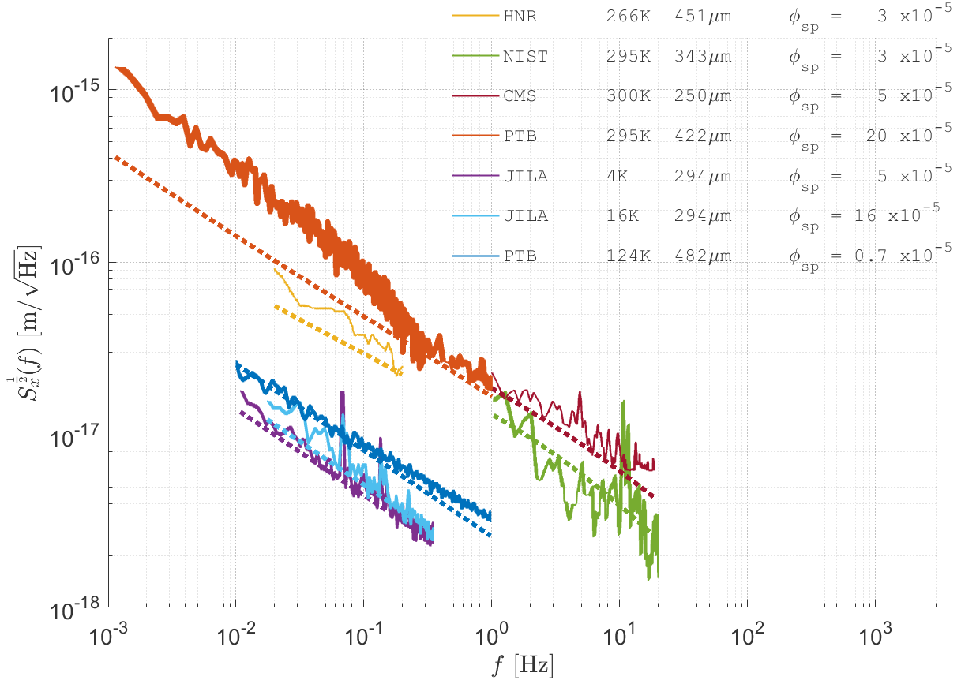
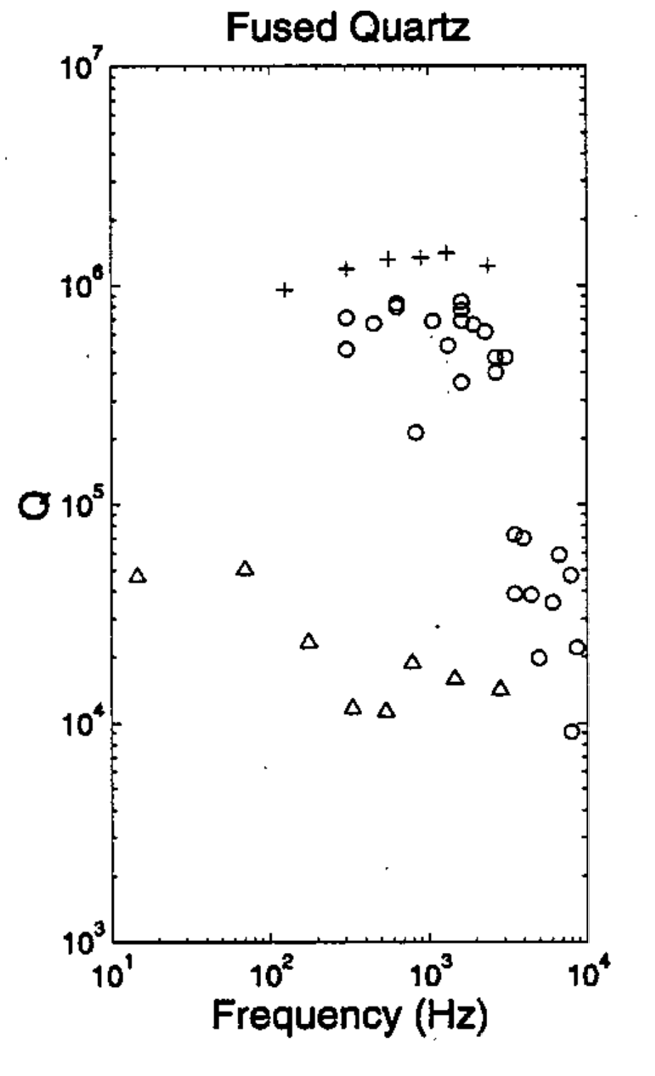
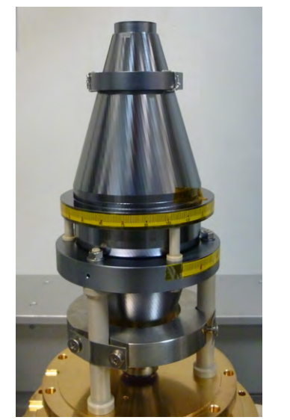
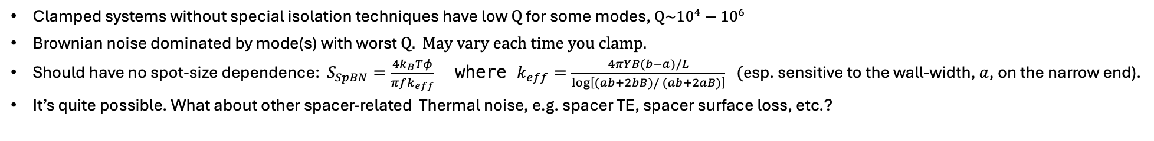
Is “Global Noise” Spacer Brownian Noise?
b
a
B
Clamped systems without special isolation techniques have low $Q$ for some modes, $Q\sim {10}^{4}−$ ${10}^{6}$
Brownian noise dominated by mode(s) with worst $Q. May vary each time you clamp.$
Should have no spot-size dependence: $S_{SpBN}=\frac{4k_{B}Tφ}{πfk_{eff}}$ where $k_{eff}=\frac{4πYB(b−a)/L}{\log\left[(ab+2bB)/ (ab+2aB)\right]} (e$sp. sensitive to the wall-width, $a$, on the narrow end).
It’s quite possible. What about other spacer-related Thermal noise, e.g. spacer TE, spacer surface loss, etc.?
L
Change in stick-slip or recoil loss with temperature?

Slide 10
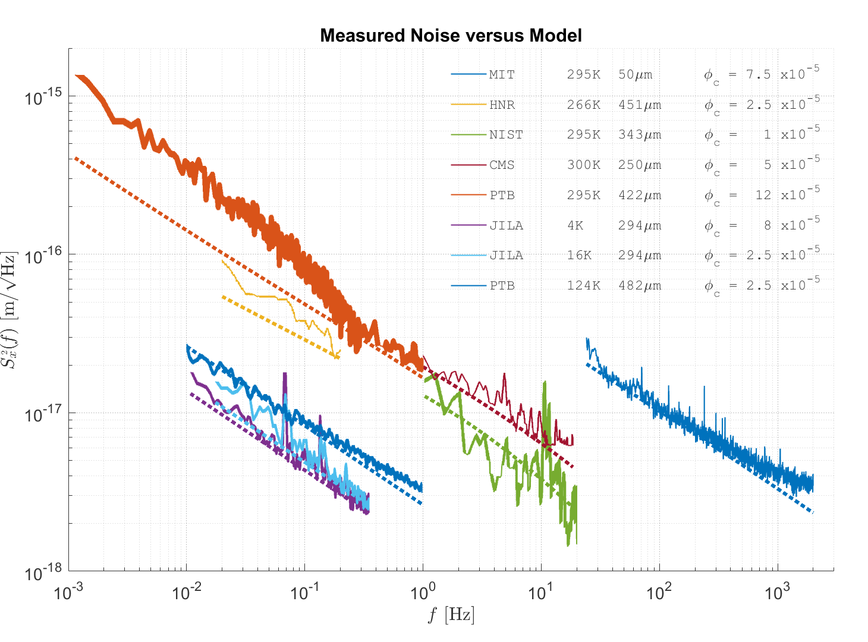
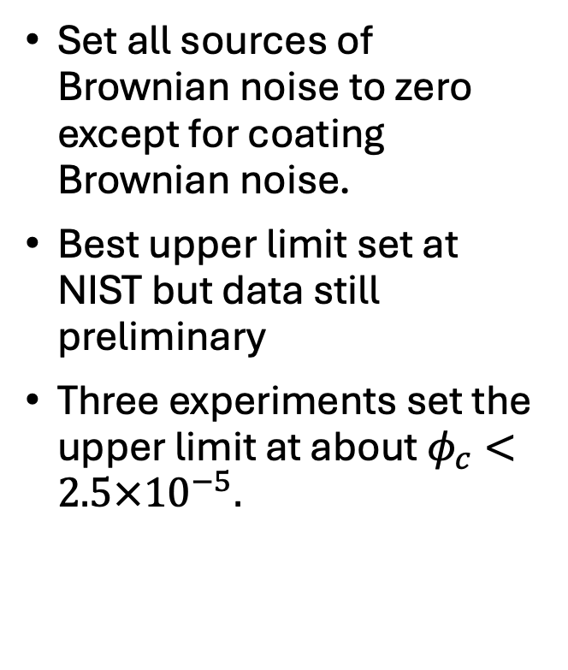
Direct Upper Limits on AlGaAs Loss Angle
Set all sources of Brownian noise to zero except for coating Brownian noise.
Best upper limit set at NIST but data still preliminary
Three experiments set the upper limit at about $φ_{c}<2.5×{10}^{−5}.$

Slide 11
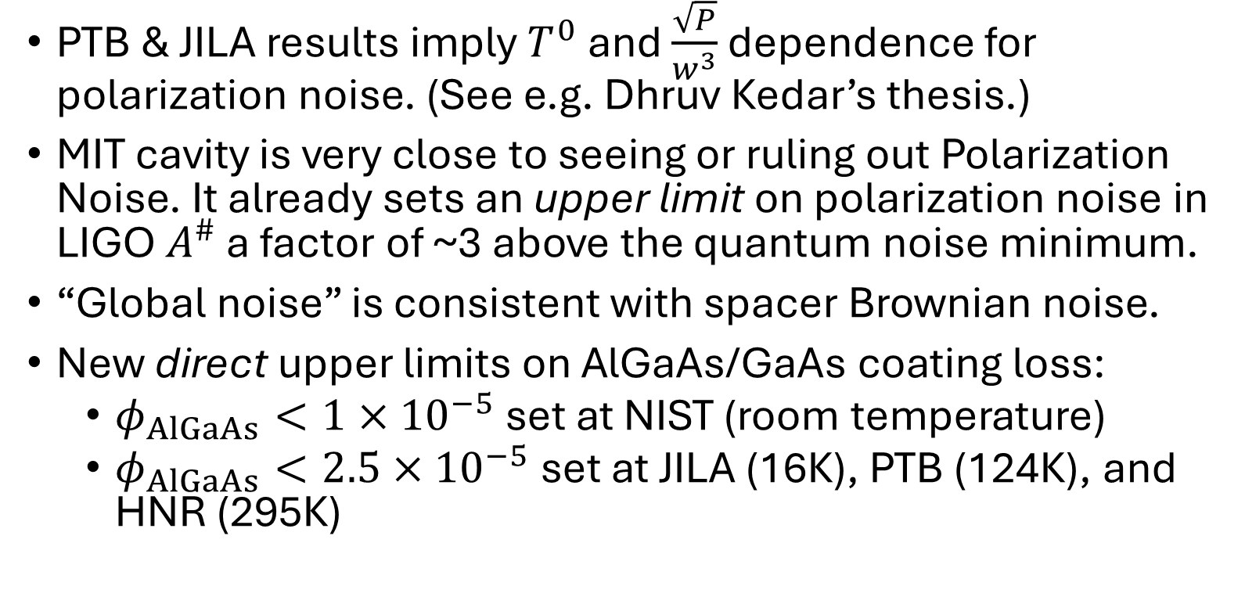
Summary
PTB & JILA results imply $T^{0}$ and $\frac{\sqrt{P}}{w^{3}}$ dependence for polarization noise. (See e.g. Dhruv Kedar’s thesis.)
MIT cavity is very close to seeing or ruling out Polarization Noise. It already sets an upper limit on polarization noise in LIGO $A^{\#}$ a factor of ~3 above the quantum noise minimum.
“Global noise” is consistent with spacer Brownian noise.
New direct upper limits on AlGaAs/GaAs coating loss:
  $φ_{AlGaAs}<1×{10}^{−5}$ set at NIST (room temperature)
  $φ_{AlGaAs}<2.5×{10}^{−5}$ set at JILA (16K), PTB (124K), and HNR (295K)

Slide 12
Additional Slides

Slide 13
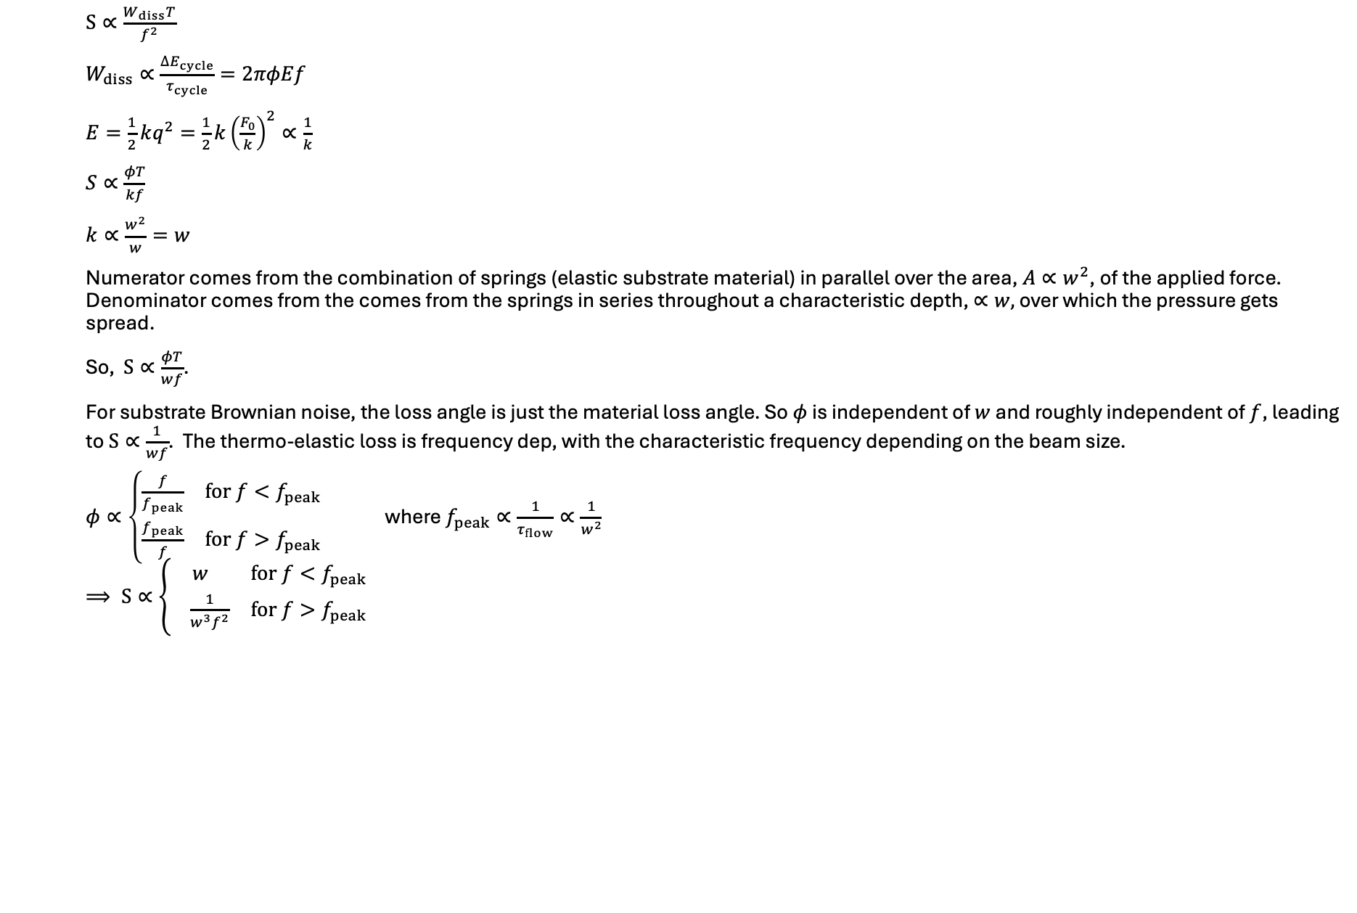
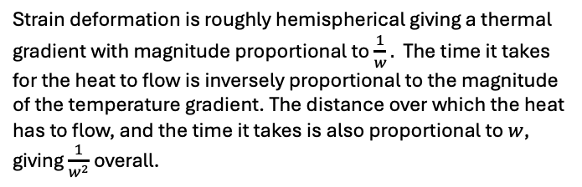
Spot size and frequency dependence for substrate thermal noises
$S∝\frac{W_{diss}T}{f^{2}}$
$W_{diss}∝\frac{∆E_{cycle}}{τ_{cycle}}=2πφEf$
$E=\frac{1}{2}kq^{2}=\frac{1}{2}k{\left(\frac{F_{0}}{k}\right)}^{2}∝\frac{1}{k}$
$S∝\frac{φT}{kf}$
$k∝\frac{w^{2}}{w}=w$
Numerator comes from the combination of springs (elastic substrate material) in parallel over the area, $A∝w^{2}$, of the applied force. Denominator comes from the comes from the springs in series throughout a characteristic depth, $∝w,$ over which the pressure gets spread.
So, $S∝\frac{φT}{wf}$.
For substrate Brownian noise, the loss angle is just the material loss angle. So $φ$ is independent of $w$ and roughly independent of $f$, leading to $S∝\frac{1}{wf}$. The thermo-elastic loss is frequency dep, with the characteristic frequency depending on the beam size.
$φ∝\left\{\begin{matrix}\frac{f}{f_{peak}} & for f<f_{peak} \\ \frac{f_{peak}}{f} & for f>f_{peak}\end{matrix}\right.$ where $f_{peak}∝\frac{1}{τ_{flow}}∝\frac{1}{w^{2}}$
$⟹ S∝\left\{\begin{matrix}w & for f<f_{peak} \\ \frac{1}{w^{3}f^{2}} & for f>f_{peak}\end{matrix}\right.$
Strain deformation is roughly hemispherical giving a thermal gradient with magnitude proportional to $\frac{1}{w}.$ The time it takes for the heat to flow is inversely proportional to the magnitude of the temperature gradient. The distance over which the heat has to flow, and the time it takes is also proportional to $w$, giving $\frac{1}{w^{2}}$ overall.
Notes:
Delta E_cycle is the energy lost per cycle, tau_cycle is the period of the gaussian pressure force, E is the energy stored by the sample, phi is the loss angle of the response, f is the drive frequency, F_0 is the amplitude of the drive force, q is the displacement response coordinate (gaussian-weighted average of actual displacement field) and k is the spring constant between F_0 and q. S is the power spectral density.

Slide 14
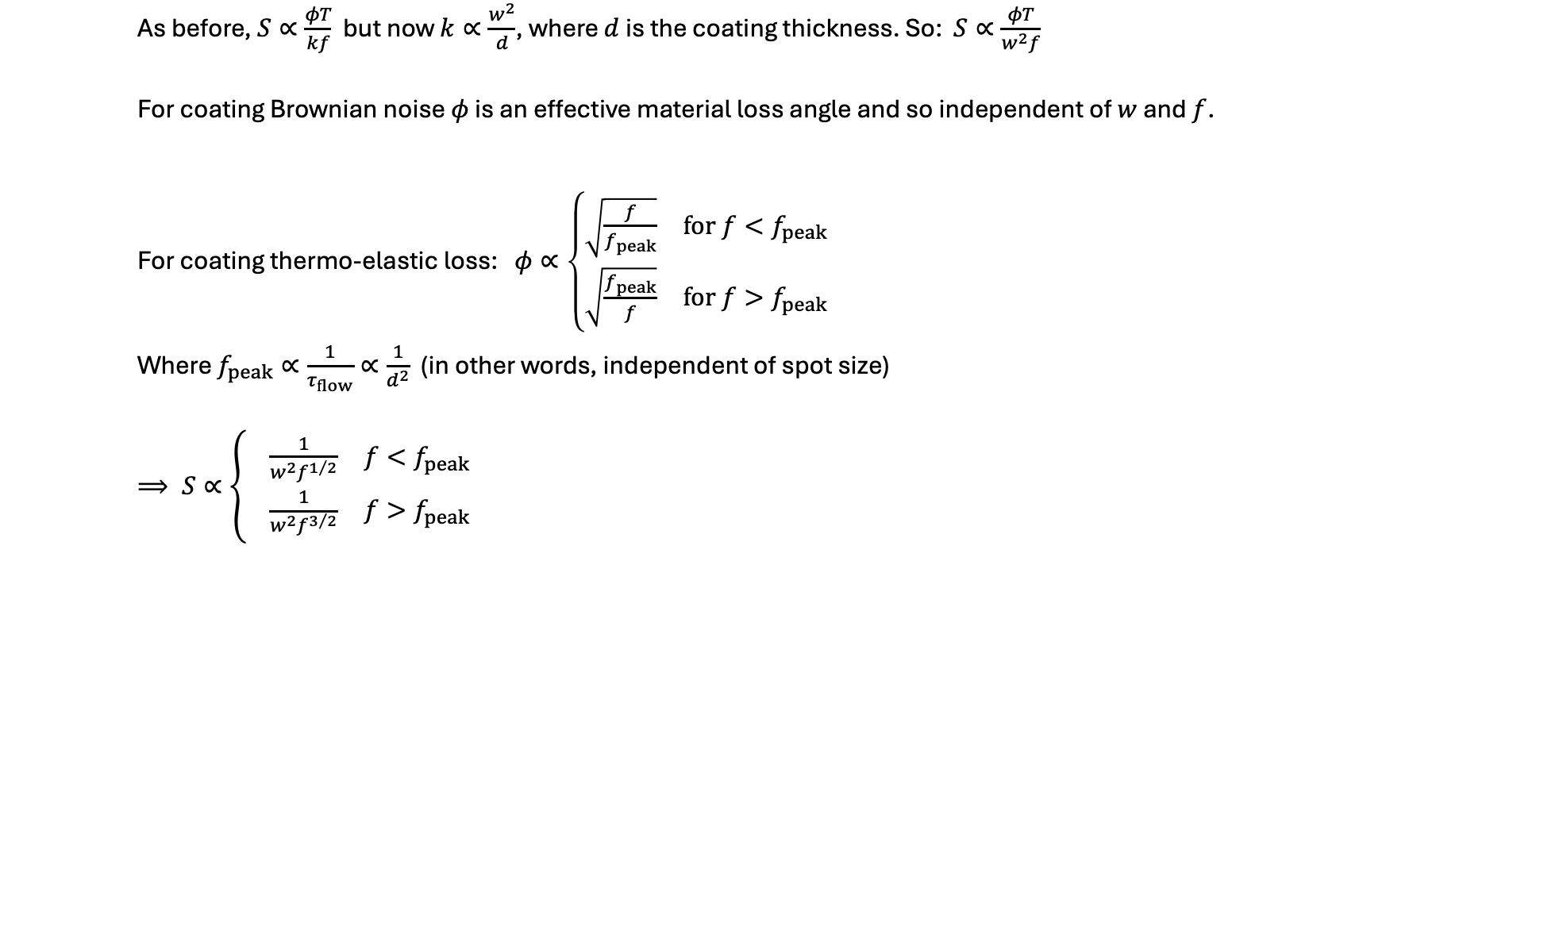
Spot size and frequency dependence for coating thermal noises
As before, $S∝\frac{φT}{kf}$ but now $k∝\frac{w^{2}}{d}$, where $d$ is the coating thickness. So: $S∝\frac{φT}{w^{2}f}$
For coating Brownian noise $φ$ is an effective material loss angle and so independent of $w$ and $f$.
For coating thermo-elastic loss: $φ∝\left\{\begin{matrix}\sqrt{\frac{f}{f_{peak}}} & for f<f_{peak} \\ \sqrt{\frac{f_{peak}}{f}} & for f>f_{peak}\end{matrix}\right.$
Where $f_{peak}∝\frac{1}{τ_{flow}}∝\frac{1}{d^{2}}$ (in other words, independent of spot size)
$⟹ S∝\left\{ \begin{matrix}\frac{1}{w^{2}f^{1/2}} & f<f_{peak} \\ \frac{1}{w^{2}f^{3/2}} & f>f_{peak}\end{matrix}\right.$

Slide 15
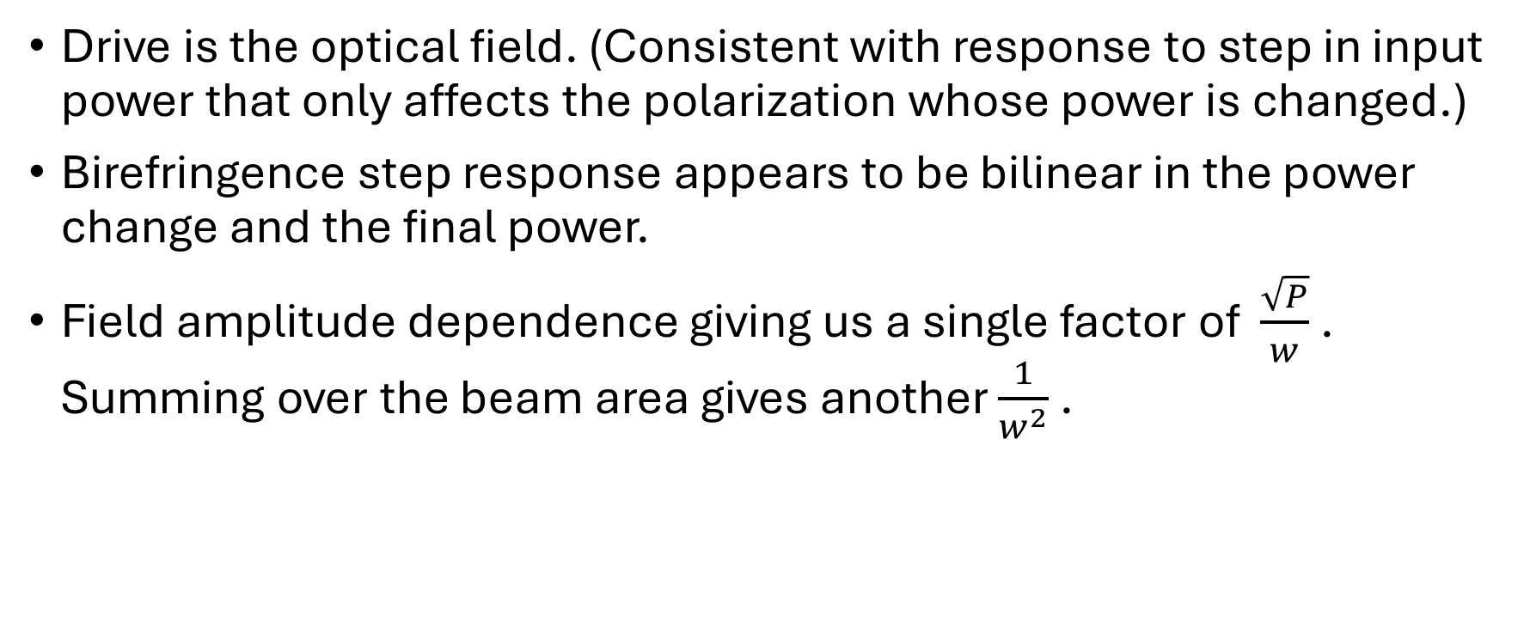
Origin of polarization noise
Drive is the optical field. (Consistent with response to step in input power that only affects the polarization whose power is changed.)
Birefringence step response appears to be bilinear in the power change and the final power.
Field amplitude dependence giving us a single factor of $\frac{\sqrt{P}}{w}$ . Summing over the beam area gives another $\frac{1}{w^{2}}$ .

Slide 16
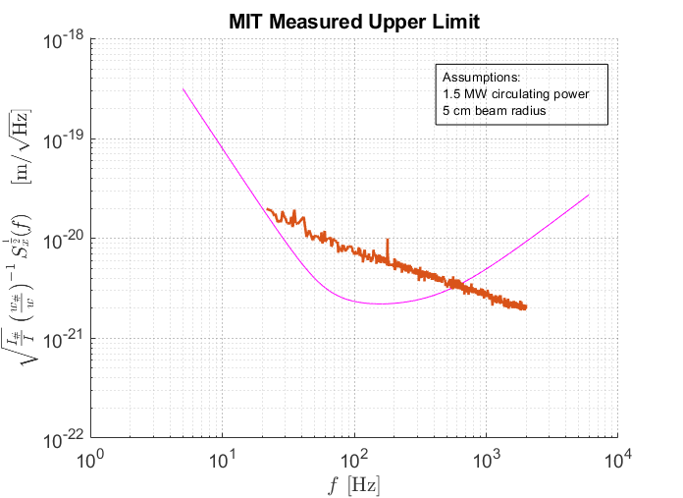
Best Polarization Noise Limit for A# set at MIT
MIT noise curve is limited by Brownian noise but sets an upper limit for polarization noise (which would also have a steeper slope).

