Slide 1
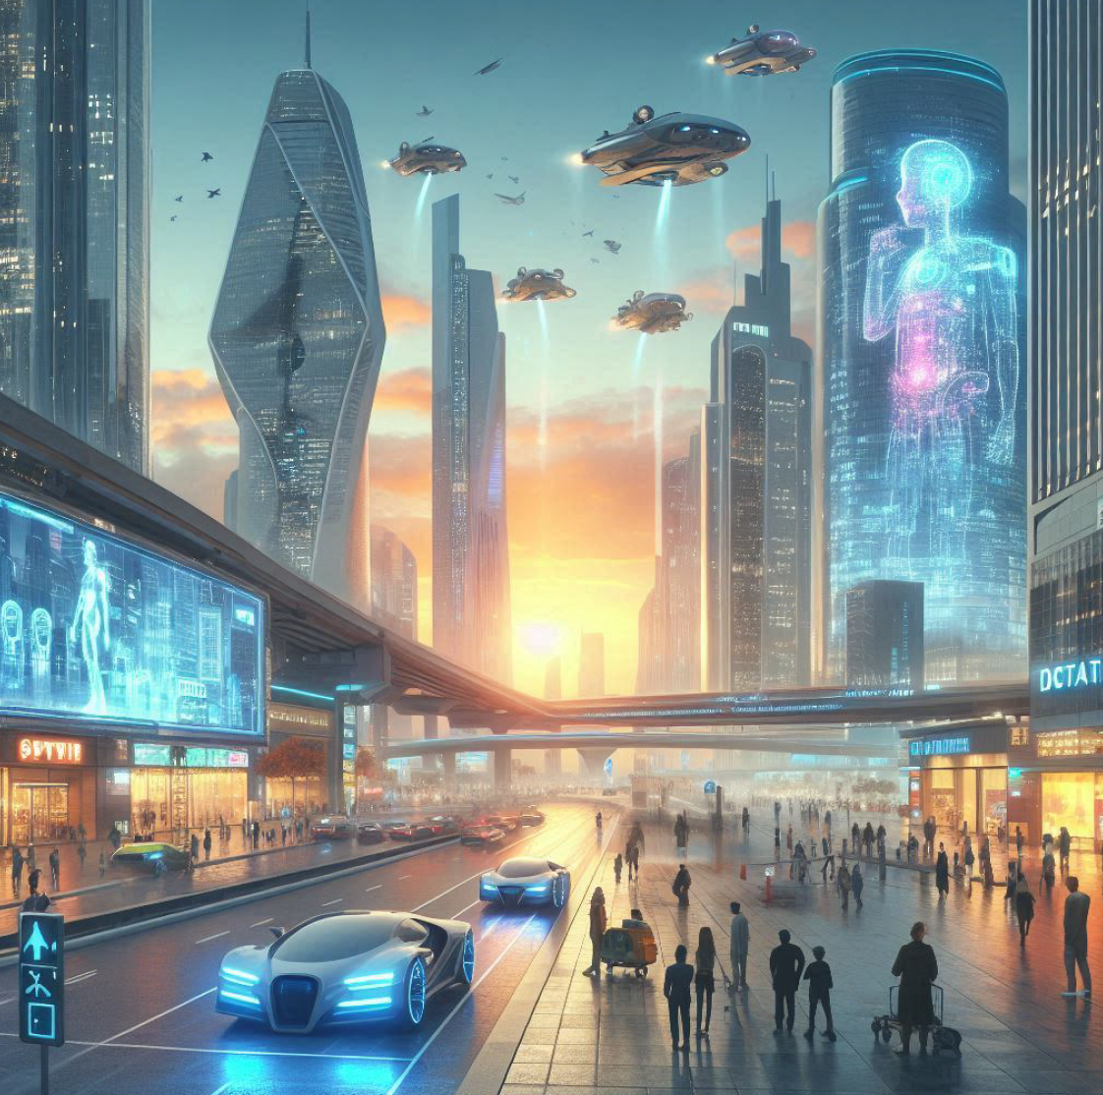
LIGO-G2401261-v1
Perspectives on Dawn VII
David Reitze
Executive Director, LIGO Laboratory
Slide Credit: Jeremy Heyl, UBC

Slide 2
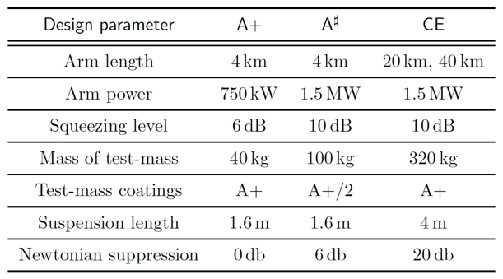
A# (& Virgo_nEXT)
There are two compelling rationales for A#
A# is a discovery machine (a la yesterday's science/astro presentations).
It is also an essential step toward realizing CE ('retiring risk'...).
CE faces challenges in delivering 10 dB squeezing levels, 1.5MW arm cavity power (with concomitant challenges in coatings, thermal compensation, controls, …), low frequency Newtonian noise cancellation.
As well as managing and process large numbers of GW events.
A# will have to address these also.
Time scale for A# likely paced by availability of funding.
I estimate that A# could be online in 2033 based on current schedules for O4, O5.
NB: Schedules are beholden to Time’s Arrow 😎
Top Level Design Parameters for A+, A#, CE

Slide 3
LIGO Aundha Observatory
Th current ‘official’ schedule is for LAO to come online in 2030.
Using A+ technologies (squeezing/filter cavity, A+ O5 coatings)
In my opinion, that is optimistic. I would estimate 2032-2033 based on current pace of progress
What sensitivity? 100 Mpc? 150 Mpc? Anybody’s guess at this point…

Slide 4
Cosmic Explorer (& Einstein Telescope)
CE is the US pillar of the future of GW astrophysics
The LIGO Lab fully supports the CE design effort.
LIGO Lab has no formal role in the CE Project.
And yet, many key Lab staff are involved in CE design efforts.
Vacuum system, many aspects of IFO design, site identification/evaluation, Education/Public Outreach
Maintaining this support while continuing to carry out LIGO-Virgo-KAGRA (→ IGWN) mission will require resource careful management.
The field GW astrophysics is still growing, limited by i) funding and ii) people

