Slide 1
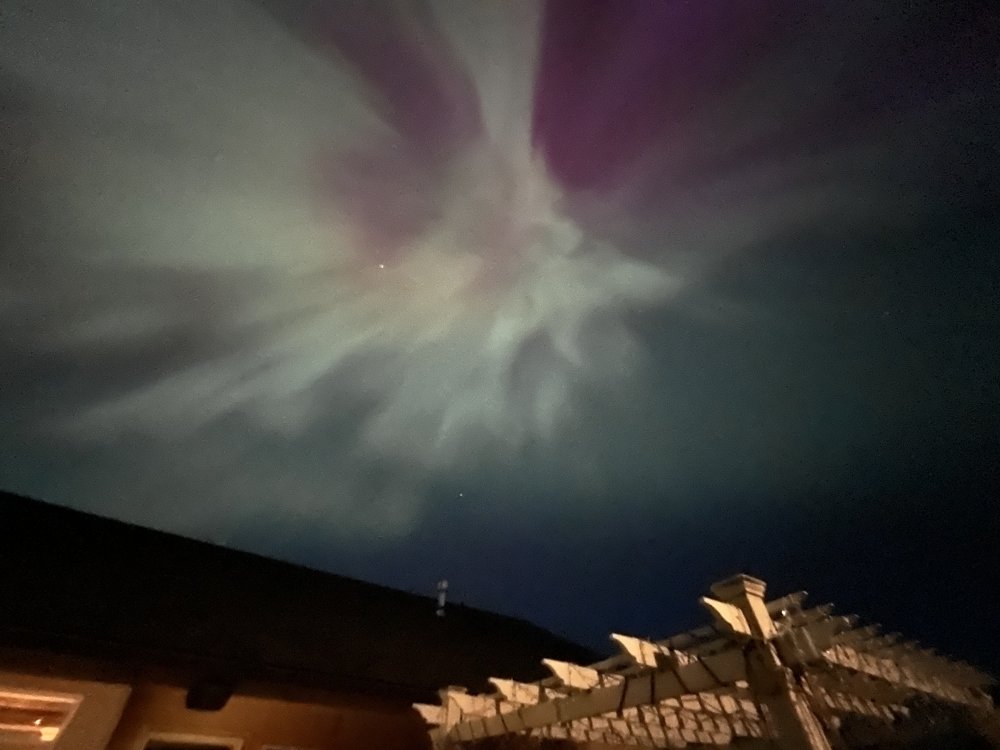
Gravitational Wave Astronomy North-West 7th Annual GWANW Jun 24-26 2024

Slide 2
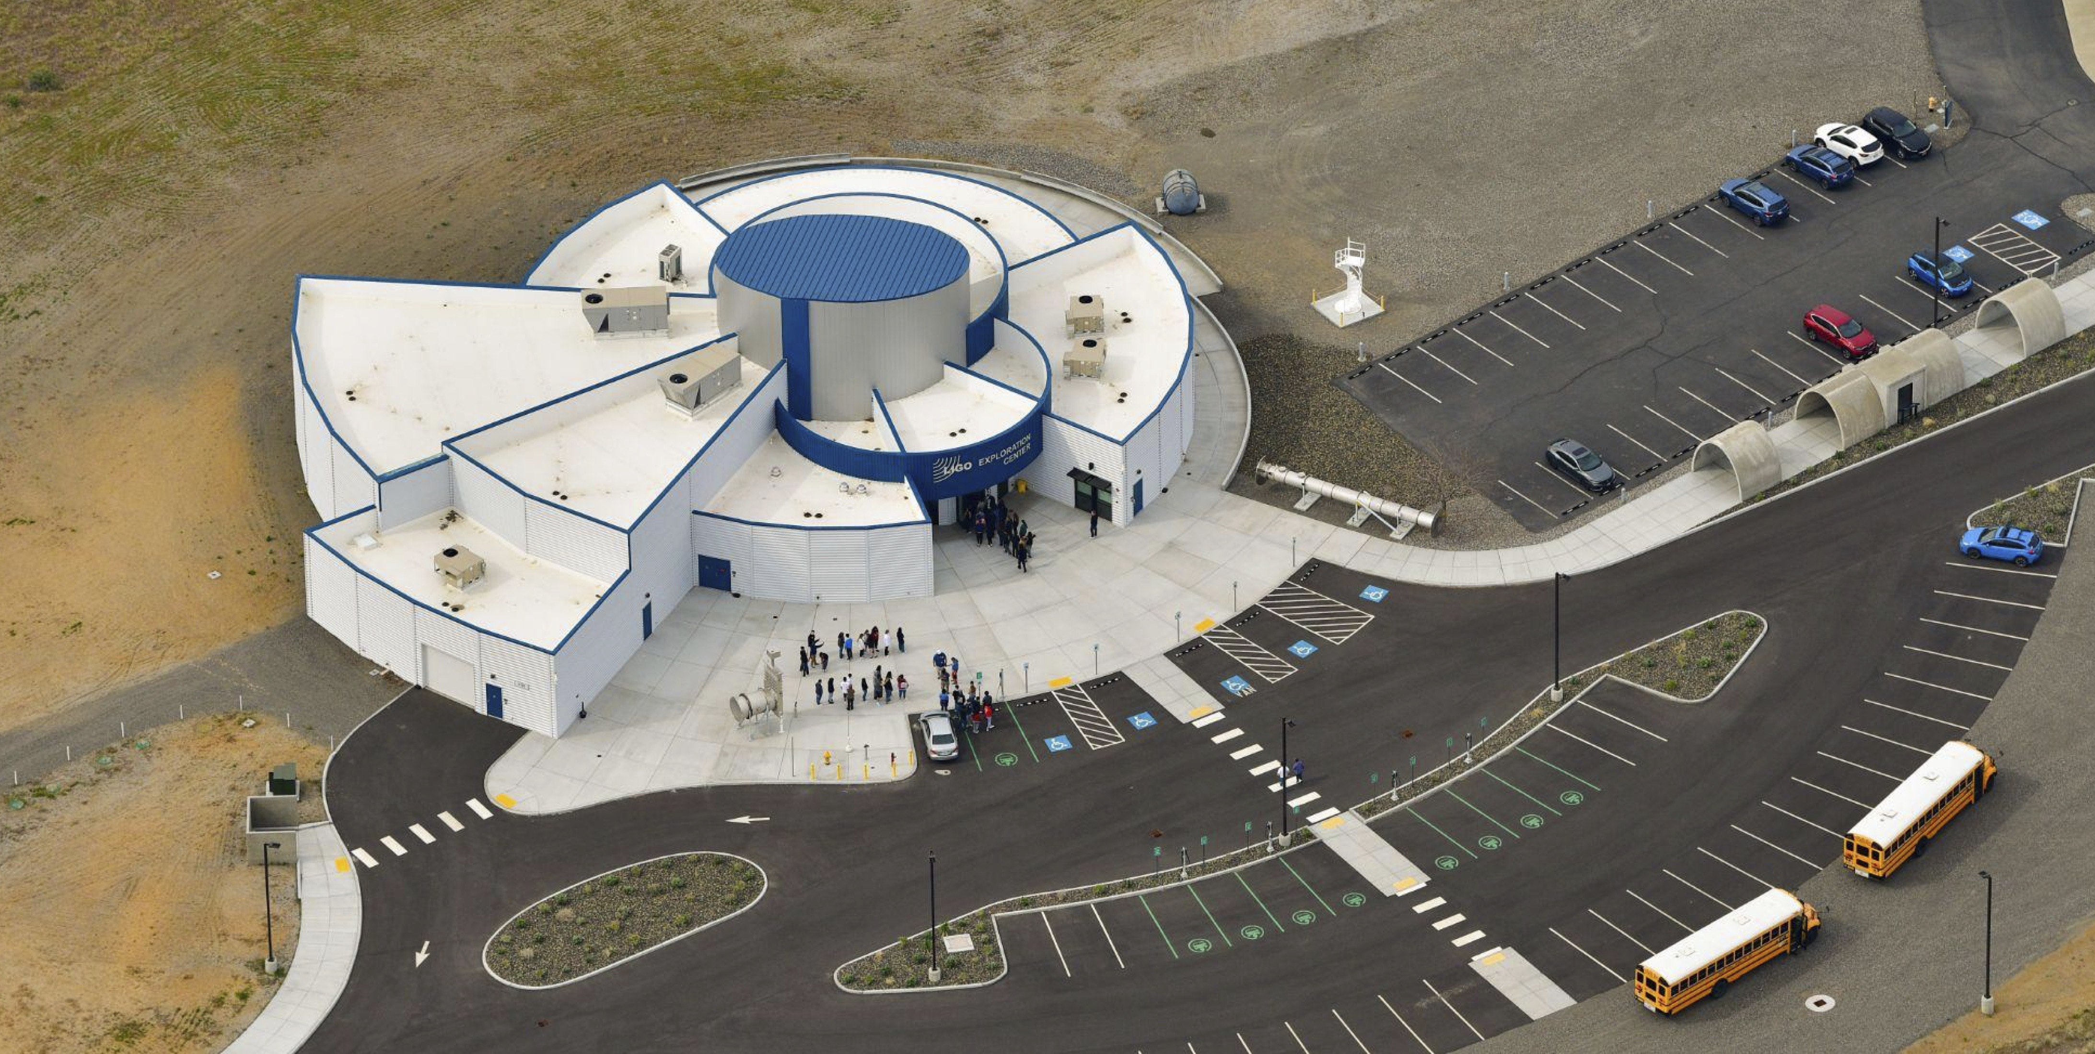
Human Things
Bathrooms and Water Stations are Behind You
Evacuation Areas for Fire and Lock-down Emergencies
Coffee and Tea mugs are available for your sustainable use
Lunch, snacks, and dinner are provided for each day

Slide 3
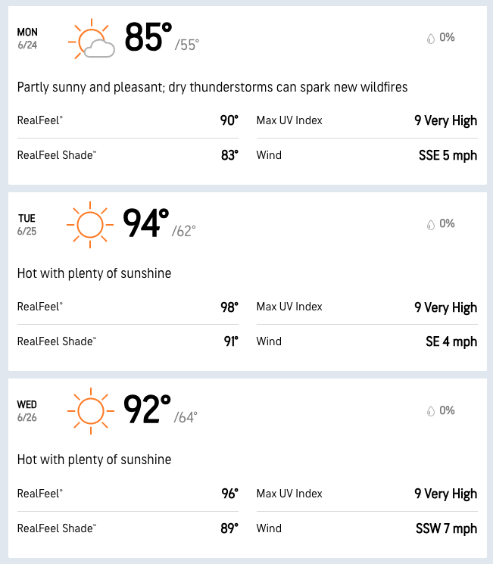
Human Things
It’s HOT in the desert.
The UV index is VERY HIGH
The wind is NON-EXISTENT
Fire Danger HIGH
When outside, we strongly recommend
Wear a hat
Wear sunscreen
Have a personal source of water
Drink that water
Holler if you’re feeling it and would like help
Watch out for others

Slide 4
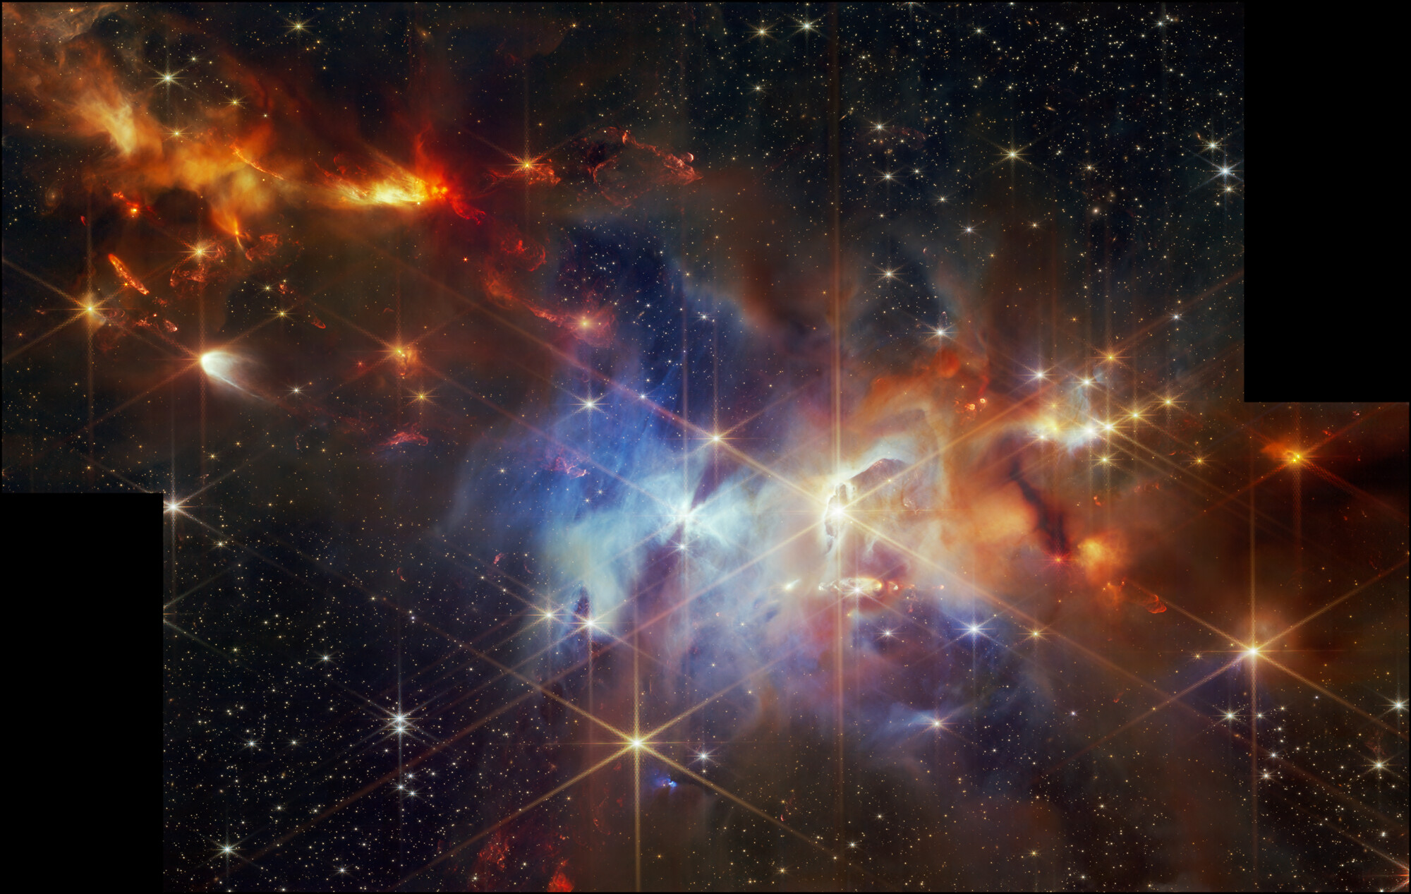
This is a safe space.
Take your time. Be patient. Listen.
Take a break.
Do whatever you need to do.
In here, we set aside the world for a moment to look
– and “listen” –
up.
Welcome!
JWST NIRCam Image of Serpens Nebula

Slide 5
GWANW 2024: Essential Links
https://www.npl.washington.edu/eotwash/https%3A//www.npl.washington.edu/eotwash/gwanw2024
https://dcc.ligo.org/cgi-bin/private/DocDB/DisplayMeeting?conferenceid=1182
https://washington.zoom.us/j/95644215436
Zoom Meeting ID: 956 4421 5436

Slide 6
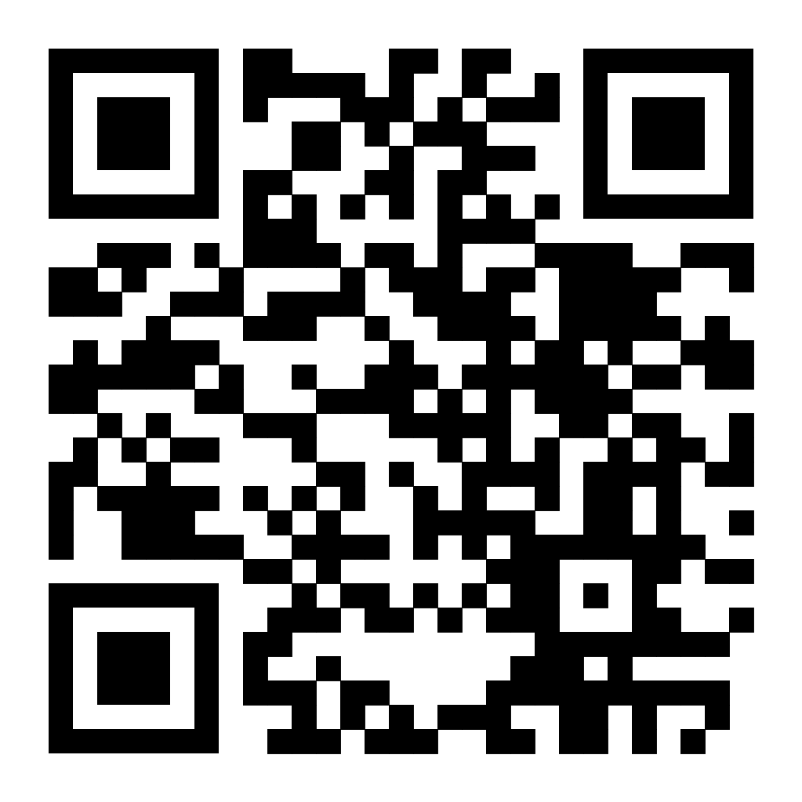
Conference Dinner: Essential Food Order!!
Dinner at Proof Pasco
Teusday 6/25
18:30 PDT
Use the QR Code, or tinyurl Link below to order your food via Google Forms
6627 Burden Blvd Suite C, Pasco, WA 99301
(1/2 hour drive from LHO)
https://tinyurl.com/GWANW2024
Please Complete the form by 12:00p TODAY

Slide 7
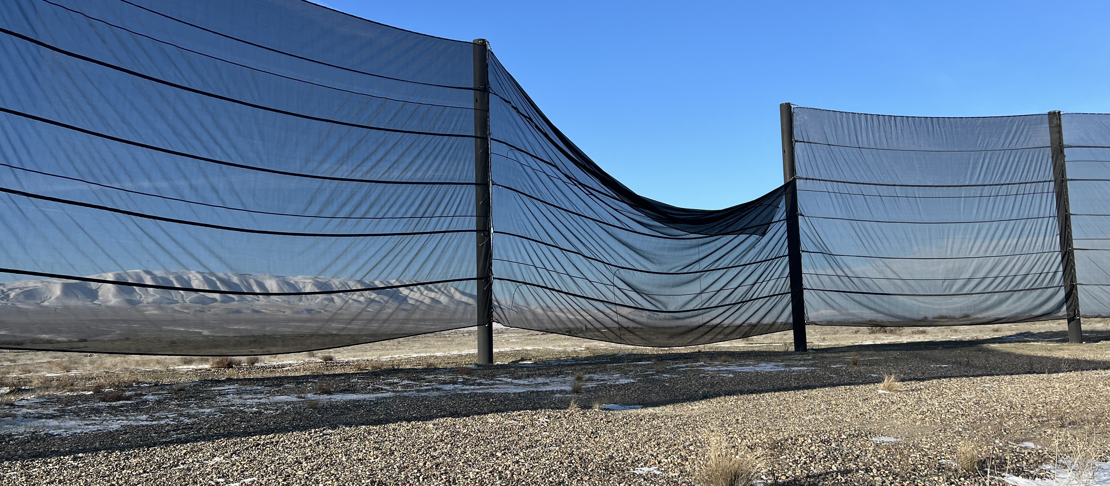
GWANW 2024: Day 1
LHO:75543 “The wind fence needs repair again…”
Today (DAY 1)
10:15 GW Astronomy Tutorial
11:15 Coffee Break
11:45 LIGO Tutorial
13:15 Lunch Break
14:15 NANOGrav Tutorial
15:00 Coffee Break
15:30 LISA Tutorial
18:00 Optional Evening Activity: Board games and Pizza!

Slide 8
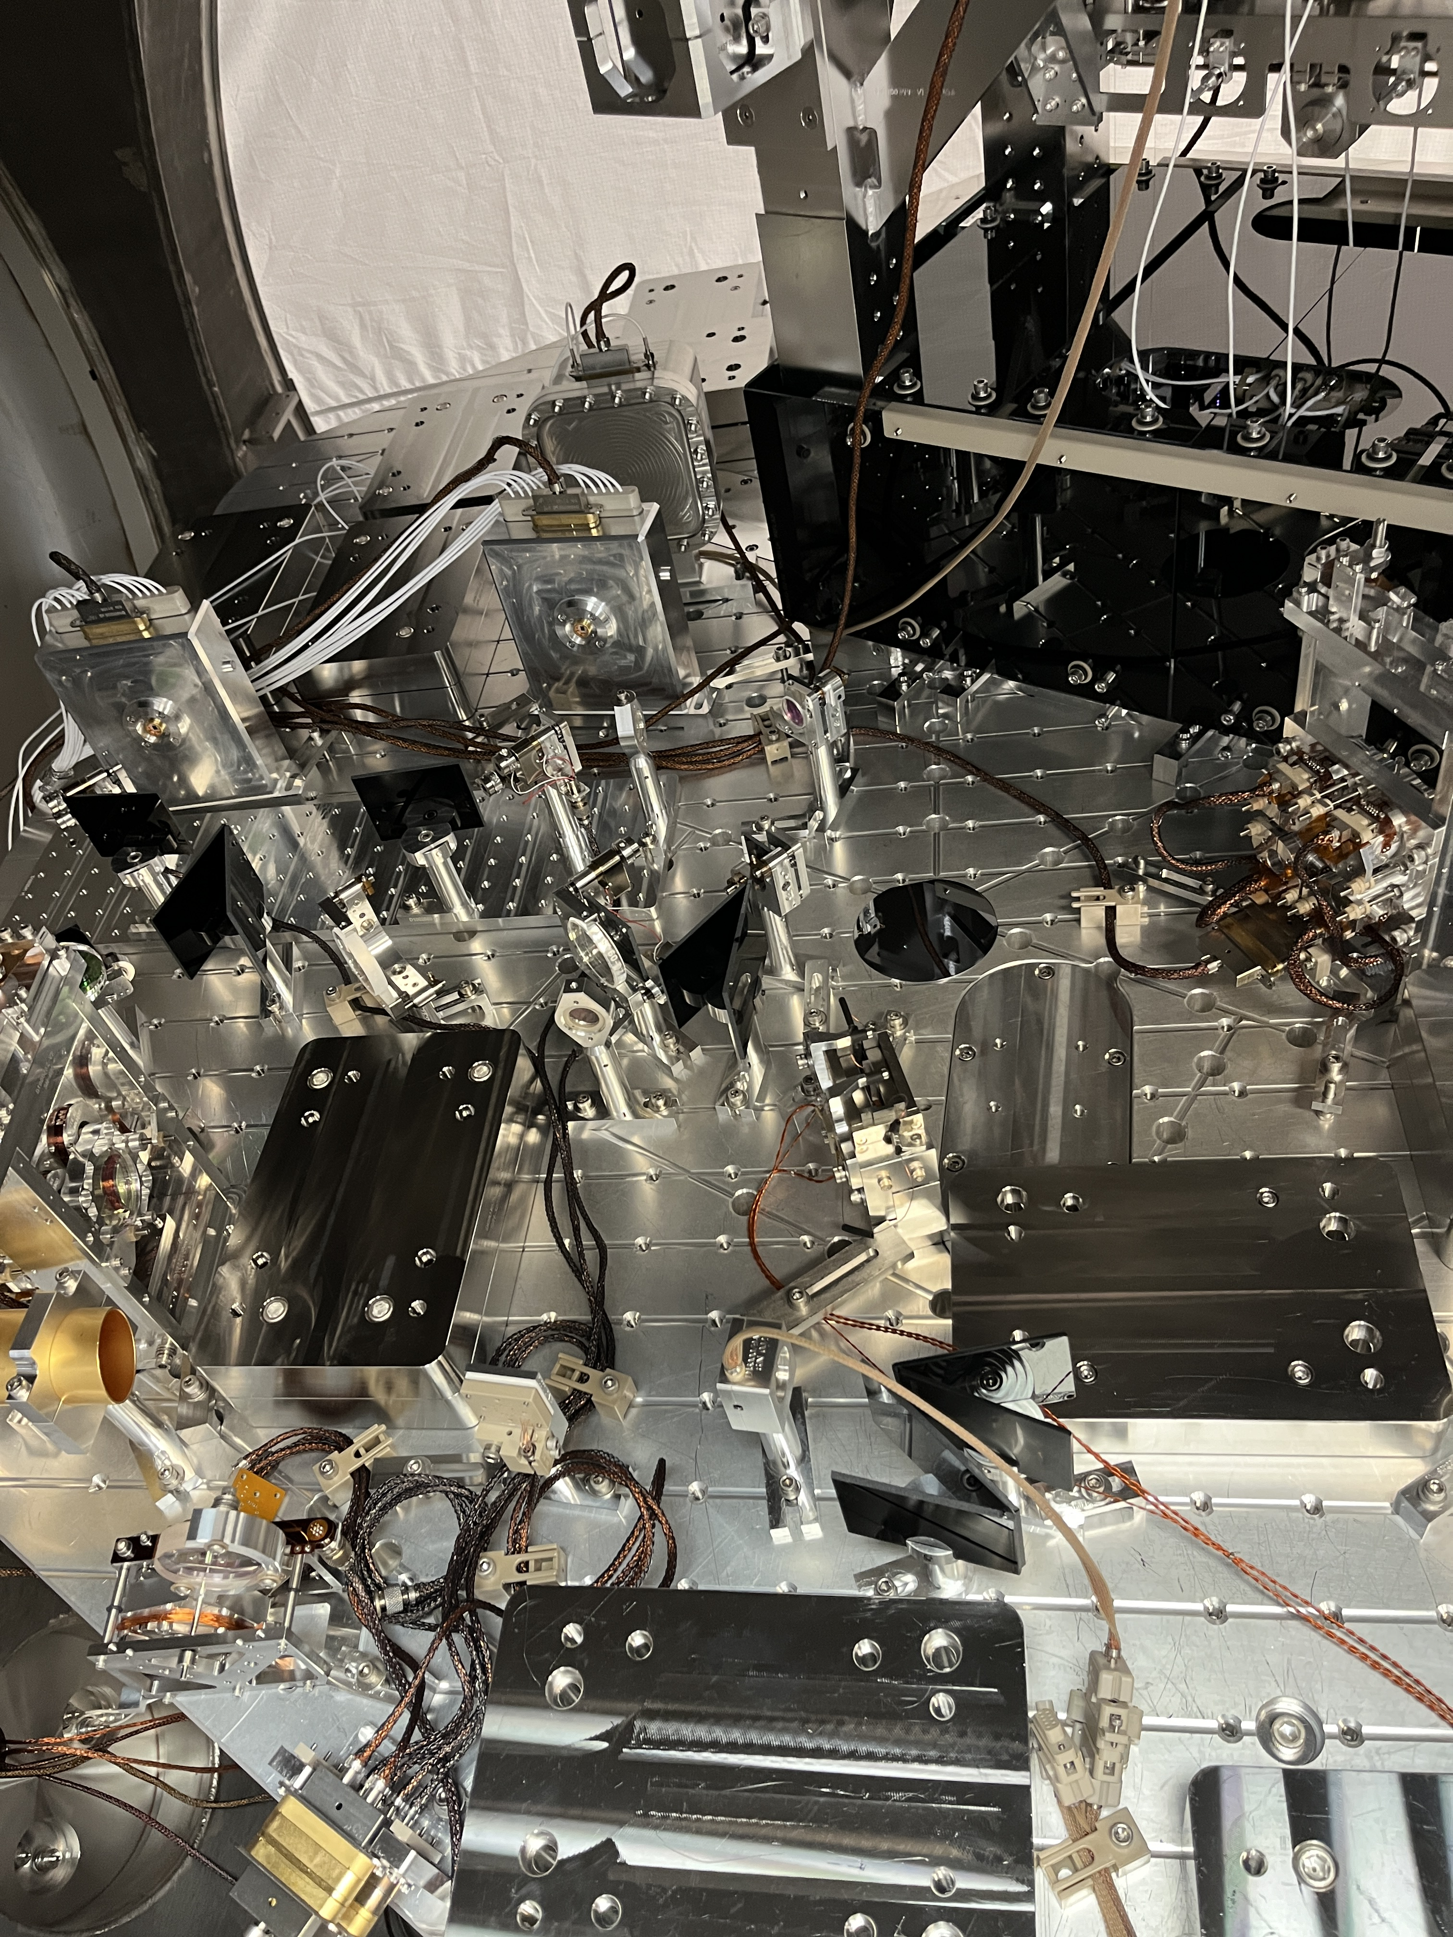
GWANW 2024: Day 2
9:00 Welcome
9:30-10:45 LIGO Lab Tour
11:00 Observatory Status Updates
12:00 Lunch Break
13:30 PNW Group Updates
14:45 Coffee Break
15:00 Outreach Discussions
16:00 Small Group Chat Time
18:30 Optional Evening Activity: Conference Dinner at Proof (Pasco)
Inside HAM6 after OMC Swap LHO:75791

Slide 9
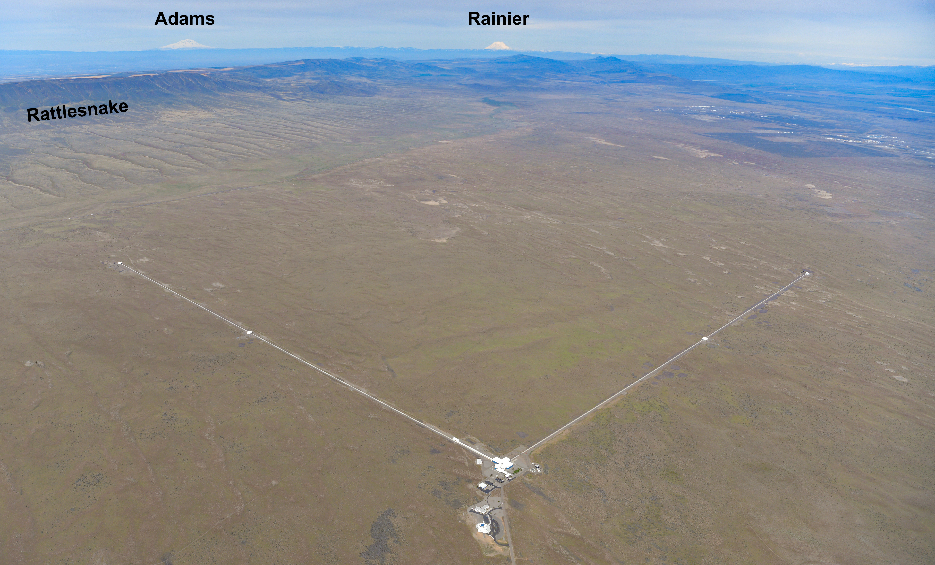
GWANW 2024: Day 3
Pahto
Tahoma
Columbia River
Lalíik
9:00 Morning Coffee
10:00 Group Projects & Challenges
9:45 Student Talks
12:30 Lunch Break
13:30 Science Talks
15:30 Career Talks
16:00 Close out & Safe Travels Home!
Nch’i-Wàna
G2301207 Aerial Photos Collection circa May 2023
(Indigenous names for geographical features are shown in the Yakama Language)

Slide 10
LHO Site Tour 9:30a – 10:45a
Please split into yourself into the following groups:
BEGINNER “I’m new to gravitational wave physics, let alone the detector” [main location, control room; “highlight location” on to the roof]
INTERMEDIATE “I do data analysis, and I think I know a bit about how the detector works, but I’d love to see in person, and I can take in *some* details.” [a bit of time in the control room, “highlight location" high-level, general walk through the LVEA]
EXPERT “I’ve been to the observatories before, I’d love to hear what’s new since last year, and to pick your brain about some specific technical details.” [“highlight location" is the Electronics Racks and the HAM567 area]
I DON’T WANNA “I need a break from people,” “My email inbox is on fire,” “It’s too hot outside,” “I’m too old for that” “I’d rather to talk with long-lost colleagues instead” Whatever the reason – you do you! LExC will remain open and cool.
We have 4 tour guides, so we can split up one of the groups if one is big Camilla Compton, Sheila Dwyer, Jeff Kissel, TJ Shaffer
All tour guides can cover all levels, so Ask Us Anything!
Please wear comfortable, close-toed shoes.

Slide 11
Conference Dinner: Essential Food Order!!
Dinner at Proof Pasco
Teusday 6/25
18:30 PDT
Use the QR Code, or tinyurl Link below to order your food via Google Forms
6627 Burden Blvd Suite C, Pasco, WA 99301
(1/2 hour drive from LHO)
https://tinyurl.com/GWANW2024
Please Complete the form by 12:00p TODAY

