Slide 1


NANOGrav Data Analysis Tutorial
Jerry Sun
6/24/24

Slide 2
Goals for today
Understand the fundamental concepts behind using pulsar timeseries to look for gravitational waves (GWs)
Understand how Bayes’ theorem can be applied to compute probability distributions for GW signal parameters
Analyze a pulsar timing array (PTA) data set for a simple GW signal using the state-of-the-art analysis software (PTMCMCSampler, ENTERPRISE)

Slide 3
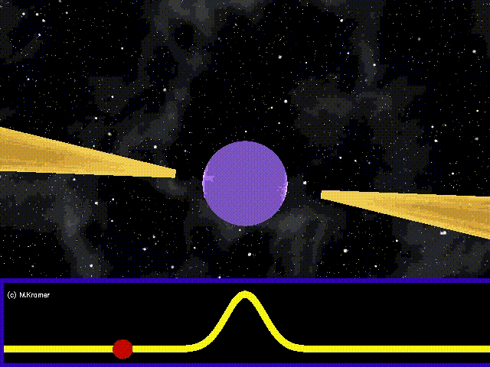
The Idea
Millisecond pulsars are extremely stable rotating objects
Image credit: Michael Kramer

Slide 4
The Idea
Millisecond pulsars are extremely stable rotating objects
GWs passing through the pulsar-Earth line of sight change the distance between the pulsar and Earth
Image credit: Michael Kramer

Slide 5
The Idea
Millisecond pulsars are extremely stable rotating objects
GWs passing through the pulsar-Earth line of sight change the distance between the pulsar and Earth
This causes the photon arrive a little too soon or a little too late (the timing residual)!
Pulsars are stable enough that we can detect this.
Image credit: Michael Kramer

Slide 6
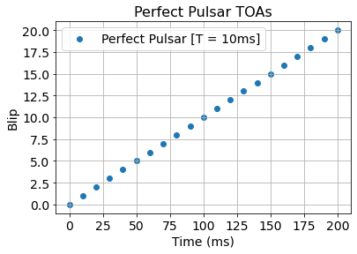
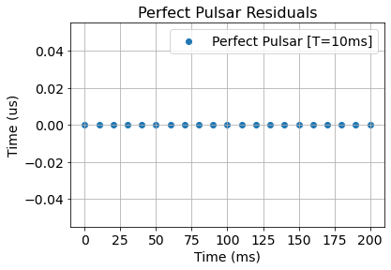
Pulsar Timing Data
If pulsars were perfect, the pulses would arrive exactly on time:
Then, if we subtract the expected arrival time from the actual:

Slide 7

Pulsar Timing Data
A perfect pulsar has no residuals! We get blips exactly on time.
Then, if we subtract the expected arrival time from the actual:

Slide 8
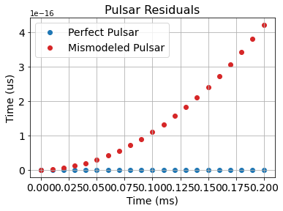

Pulsar Timing Data
Effect of errors in timing model appear as a linear (mismodeled frequency) and a quadratic (mismodeled frequency-derivative)
Don’t worry! We can fit for a quadratic and subtract it out to deterministically remove this effect.
However, we may imperfectly estimate the frequency or frequency-derivative of the pulsar.
design matrix
timing model errors

Slide 9
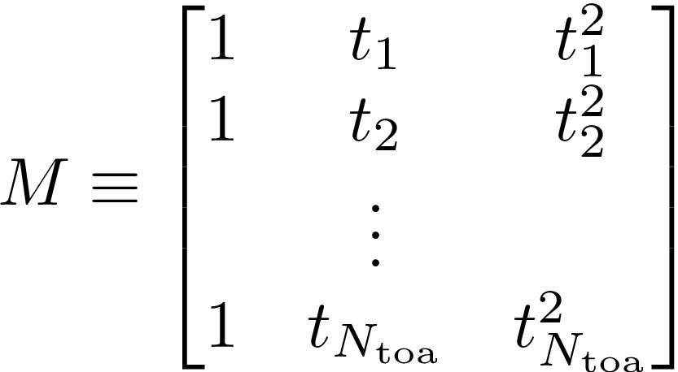
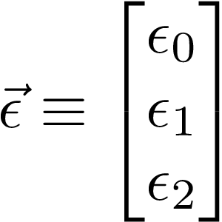
Pulsar Timing Data
Effect of errors in timing model appear as a linear (mismodeled frequency) and a quadratic (mismodeled frequency-derivative)
Don’t worry! We can fit for a quadratic and subtract it out to deterministically remove this effect.
However, we may imperfectly estimate the frequency or frequency-derivative of the pulsar.

Slide 10
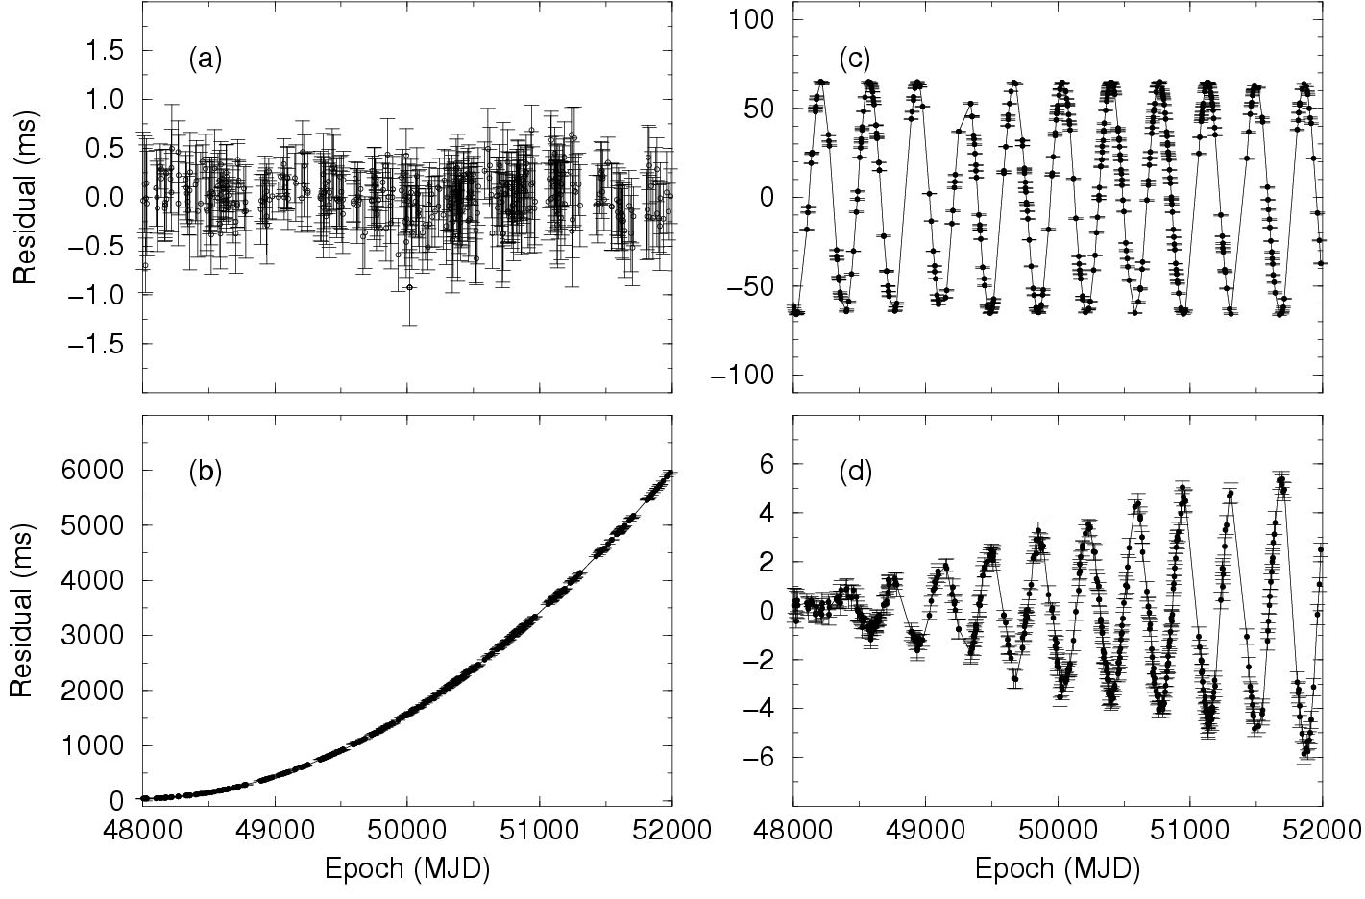
Pulsar Timing Data
In reality, it’s more complicated that just this. There are lots of physical parameters that affect our residuals.
good timing model fit!
bad frequency-derivative
wrong sky position (yearly variation)
wrong proper motion of pulsar (drifting in the sky)
Image credit: Handbook of Pulsar Astronomy, Lorimer and Kramer

Slide 11
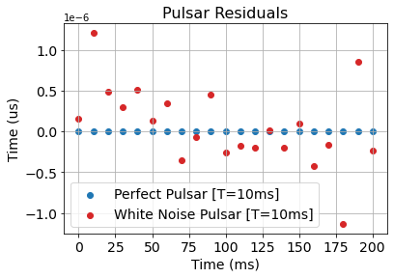


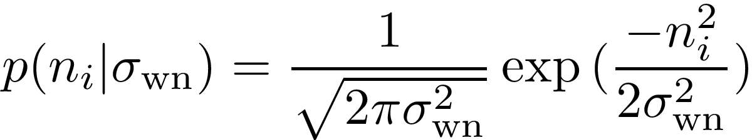
Pulsar Timing Data
Our observations also have some gaussian white noise

Slide 12
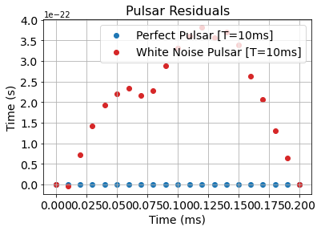

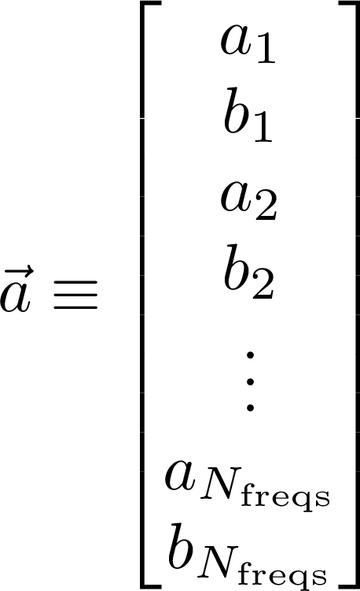
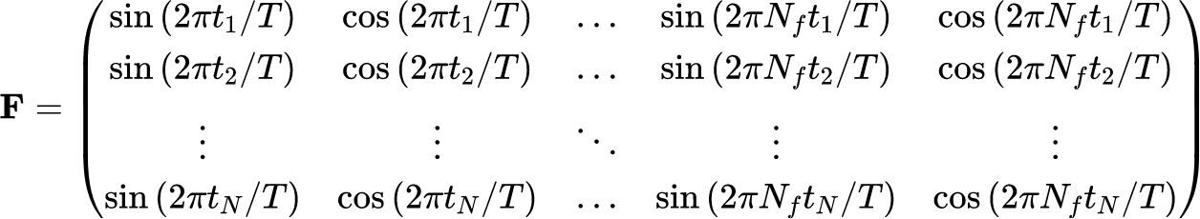
Pulsar Timing Data
Red
Pulsars can also exhibit “random walk” noise.
Over a long timescale, their frequencies wander around a little bit. We model this with a Fourier series

Slide 13
Pulsar Timing Data
Red
Finally, the gravitational wave background also looks like a “random walk” noise!
Thus, we need two terms to track both sources of noise

Slide 14
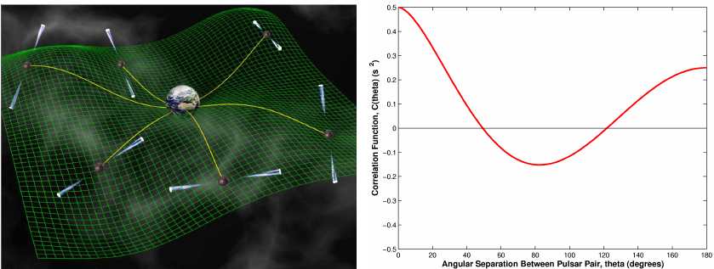
Pulsar Timing Data
credit: David Champion
Because gravitational waves have a quadrupolar (+/⨉-polarization) pattern, we can reliably predict how the background will affect pulsars in different parts of the sky.

Slide 15
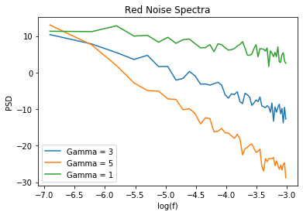
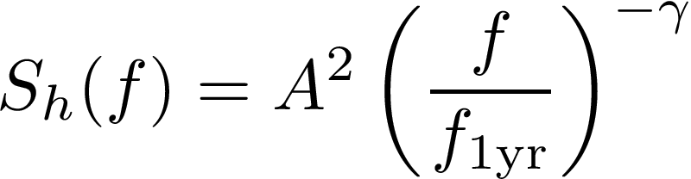
Pulsar Timing Data
We actually don’t care too much about the coefficients themselves. The gravitational wave background can be described statistically as having a red power spectrum (more power at low frequencies).

Slide 16
Pulsar Timing Data
We actually don’t care too much about the coefficients themselves. The gravitational wave background can be described statistically as having a red power spectrum (more power at low frequencies).
Amplitude
spectral index
In reality, rather than estimating individual coefficients, we model the entire process with just these two hyperparameters for both GW and intrinsic pulsar noise

Slide 17
Pulsar Timing Data
Pulsar 1
Red Noise
Timing Model
White Noise
Pulsar 2
Red Noise
Timing Model
White Noise
Common Gravitational Wave Signal

Slide 18
Pulsar Timing Data
These models are all built into ENTERPRISE
https://github.com/nanograv/enterprise
Pulsar 1
Red Noise
Timing Model
White Noise
Pulsar 2
Red Noise
Timing Model
White Noise
Common Gravitational Wave Signal
White Noise Parameters:
EFAC (Scaling factor)
EQUAD (additional noise in quadrature)
ECORR (correlated white noise)
Red Noise Parameters:
Amplitude
Spectral Index
Timing Model Parameters:
None; these can be analytically dealt with!

Slide 19
Pulsar Timing Data
These models are all built into ENTERPRISE
https://github.com/nanograv/enterprise
Pulsar 1
Red Noise
Timing Model
White Noise
Pulsar 2
Red Noise
Timing Model
White Noise
Common Gravitational Wave Signal
White Noise Parameters:
EFAC (Scaling factor)
EQUAD (additional noise in quadrature)
ECORR (correlated white noise)
Red Noise Parameters:
Amplitude
Spectral Index
Timing Model Parameters:
None; these can be analytically dealt with!
Questions?

Slide 20

How do we do analysis?
Key Idea: If I model everything out of my residuals correctly, I should be left with white noise. Then, the “correct” model parameters are the ones which maximize the probability that my final residuals are only white noise.

Slide 21
How do we do analysis?
Key Idea: If I model everything out of my residuals correctly, I should be left with white noise. Then, the “correct” model parameters are the ones which maximize the probability that my final residuals are only white noise.

Slide 22


How do we do analysis?
This is called our likelihood. This quantity tells us the probability that we would have observed the data we have ( ) if these were the underlying model parameters ( )

Slide 23
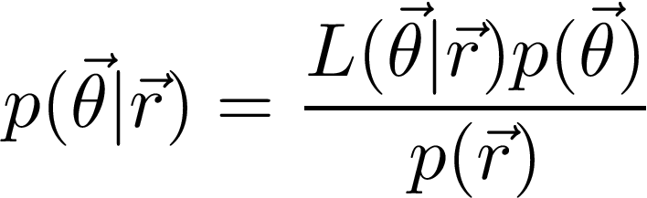
How do we do analysis?
Bayes’ theorem allows us to turn a likelihood into a probability that those model parameters ( ) are correct

Slide 24
How do we do analysis?
Bayes’ theorem allows us to turn a likelihood into a probability that those model parameters ( ) are correct
posterior

Slide 25
How do we do analysis?
Bayes’ theorem allows us to turn a likelihood into a probability that those model parameters ( ) are correct
Likelihood
posterior

Slide 26
How do we do analysis?
Bayes’ theorem allows us to turn a likelihood into a probability that those model parameters ( ) are correct
Likelihood
prior
posterior

Slide 27
How do we do analysis?
Recall the key idea: The “correct” model parameters are the ones which maximize the posterior probability that my final residuals are just white noise.
Question: How do I choose what model parameters to test? Do I test every single combination?

Slide 28
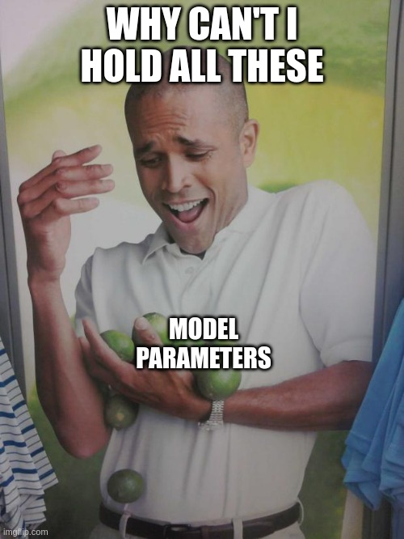
How do we do analysis?
Recall the key idea: The “correct” model parameters are the ones which maximize the posterior probability that my final residuals are just white noise.
Question: How do I choose what model parameters to test? Do I test every single combination?
NO

Slide 29
How do we do analysis?
Question: How do I choose what model parameters to test? Do I test every single combination?
The parameter space is too big. We need to use Markov Chain Monte Carlo sampling to explore the posterior.

Slide 30
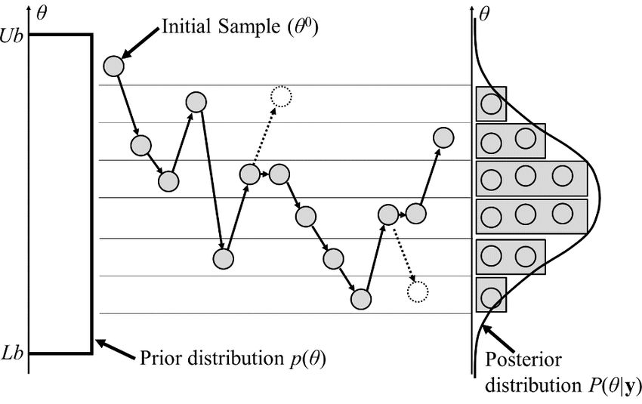
How do we do analysis?
Question: How do I choose what model parameters to test? Do I test every single combination?
The parameter space is too big. We need to use Markov Chain Monte Carlo sampling to explore the posterior.
MCMC Sampling Explained:
Pick a random set of parameters and evaluate likelihood
Pick another set of random parameters and evaluate likelihood
Accept and write down the new set with probability determined by the likelihood-ratio
Repeat 2) and 3) until your advisor wants to see a plot
Jaewook, Woosuk, Joo-Ho. (2015). Energies. 8. 5538-5554. 10.3390/en8065538.

Slide 31
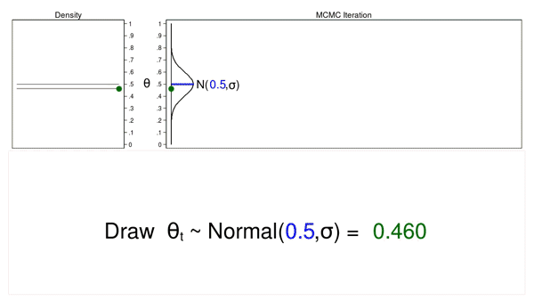

How do we do analysis?
https://github.com/nanograv/PTMCMCSampler

Slide 32
How do we do analysis
We now have numerically computed posterior probability distribution for our white noise and red noise parameters.
We can use these to make inferences about the significance of our gravitational wave!

Slide 33
Summary
Our data look like this:
Pulsar 1
Red Noise
Timing Model
White Noise
Pulsar 2
Red Noise
Timing Model
White Noise
Common Gravitational Wave Signal
Use Bayes’ theorem and MCMC sampling to compute our probability distributions for our model parameters (like the GWB)
tutorial notebooks and data here

