Slide 1
OSEM Estimator for Improved Damping
Brian Lantz
Edgard Bonilla
Pierce Garver
DCC Number: G2401720

Slide 2
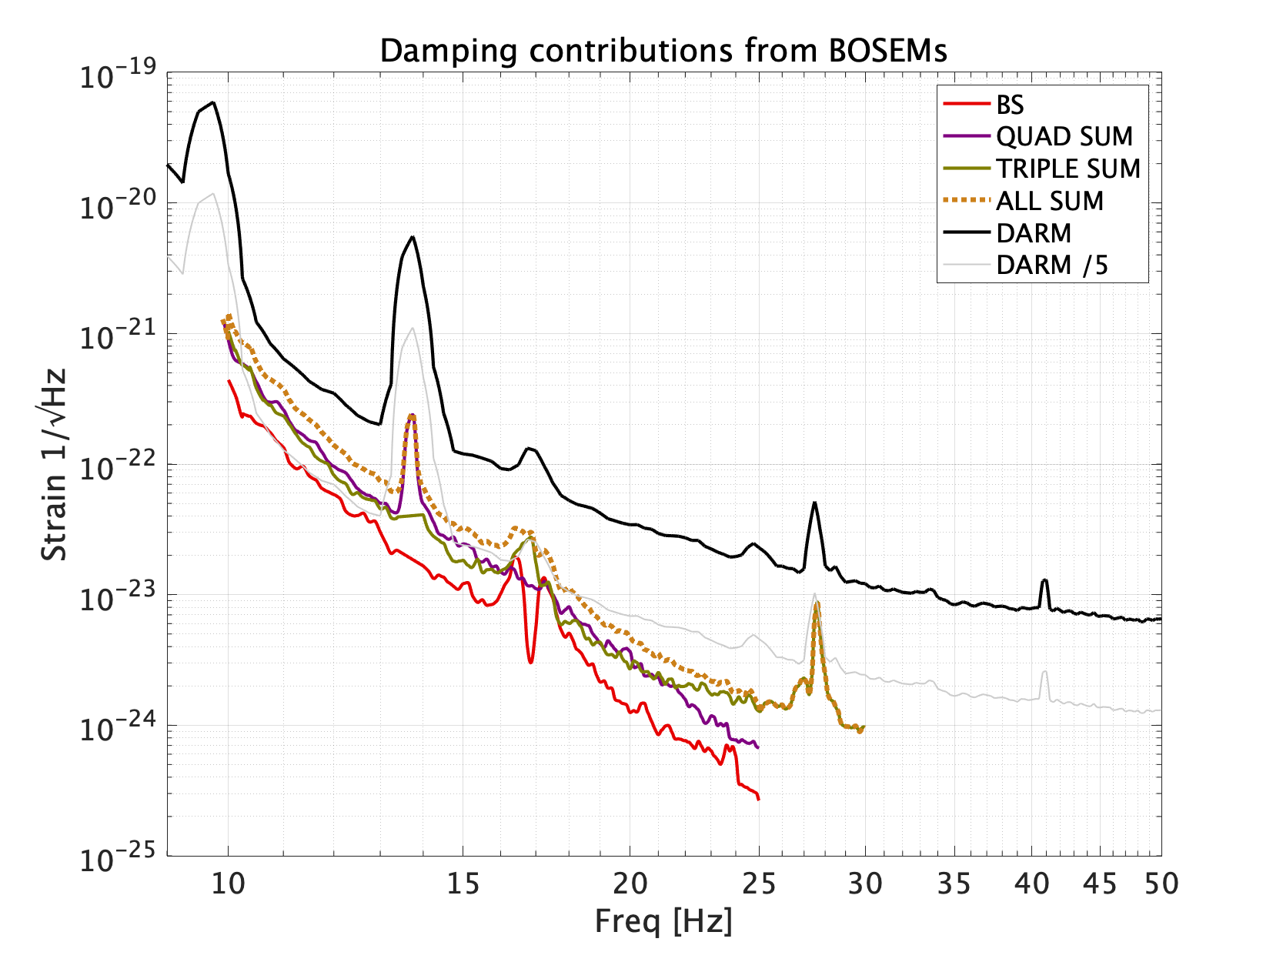
OSEM Limitations
Reduced damping at higher frequency
OSEM noise limits damping performance at higher frequencies
Inertial sensors on the ISI have better performance at higher frequencies
Incorporating these inertial sensors can provide better measurements above 20 Hz enabling quieter damping
OSEMs limit damping ability
A. Effler LLO LOG 68331
Notes:
Explain the plot: dotted brown is the damping from all the OSEMs at the sites. DARM is the total damping at the sites.
OSEM noise above 20 Hz limits total damping
Inertial sensors on ISI have better performance at high freq
GOAL: Incorporate inertial sensors to provide quitter damping above 20Hz
IMPROVE:
Needs to hammer home the point of why people care about this.
Add outline to ALL tittle slides.
Black curve is DARM which is the gravitational wave signal, it’s the background hum of the signal. Anything lower than the black curve cant be seen in LIGO. The ALL SUM curve is the sum of all of the OSEMS on the suspension. The OSEM noises in the suspensions are a leading contributor to the DARM noise.
Two ways to improve this are replace the sensors or low pass out the higher frequency noise of the OSEMS. We will do the latter by incorporating inertial sensors.

Slide 3
Suspensions vs Seismic Table
Suspension:
Seismic Table
Suspension Point
Measured by OSEM
Gap
STG 2
Gap, measured by CPS
STG 1
Seismic Sensor
Notes:
To prototype how to incorporate inertial sensors, we used our seismic table at Stanford.
Our tables are analogous to the different stages of the suspensions
We use CPS to measure gap
Observatories use OSEMs
FIRST THING TO MAKE CLEAR IN THIS SLIDE: But before we try any of that at the sites, we need to prototype it. What we did at Stanford was make an analog to the suspensions using our seismic table at Stanford. Here is how the analogy works: STUFF

Slide 4
Design Concept
Z Drive
To Actuators
Displacement Damper
STG 2
OSEM
Notes:
Damping at the observatories
Signal is taken from the OSEM, sent through a displacement damper, and then to the actuators

Slide 5
Design Concept
Z Drive
To Actuators
Displacement Damper
STG 2
Z Drive
Unit Time Delay
Drive to Gap
Model
+
Modeled Gap
Blend Filter
STG 1 Z
STG 1 to Gap Model
Switch
Estim ator
+
STG 2
OSEM
Measured Gap
Blend Filter
Notes:
We propose adding an alternative option which blends a modeled displacement from inertial sensors and measured displacement from the OSEMs.
-Emphasize the humility that this is a gentle proposal.

Slide 6
Design Concept
Z Drive
To Actuators
Displacement Damper
STG 2
Z Drive
Unit Time Delay
Drive to Gap
Model
+
Modeled Gap
Blend Filter
STG 1 Z
STG 1 to Gap Model
Switch
Estim ator
+
STG 2
OSEM
Measured Gap
Blend Filter
Notes:
The first model takes inertial measurements of our STG1 motion and determines how that changes the gap.

Slide 7
Design Concept
Z Drive
To Actuators
Displacement Damper
STG 2
Z Drive
Unit Time Delay
Drive to Gap
Model
+
Modeled Gap
Blend Filter
STG 1 Z
STG 1 to Gap Model
Switch
Estim ator
+
STG 2
OSEM
Measured Gap
Blend Filter
Notes:
The second model takes the drive signal of the gap actuator and determines how that affects the gap

Slide 8
Design Concept
Z Drive
To Actuators
Displacement Damper
STG 2
Z Drive
Unit Time Delay
Drive to Gap
Model
+
Modeled Gap
Blend Filter
STG 1 Z
STG 1 to Gap Model
Switch
Estim ator
+
STG 2
OSEM
Measured Gap
Blend Filter
Notes:
Summing these two things together provides a complete model of the gap since the gap displacement is a function of our stage 1’s motion and the drives on stage 2.

Slide 9
Design Concept
Z Drive
To Actuators
Displacement Damper
STG 2
Z Drive
Unit Time Delay
Drive to Gap
Model
+
Modeled Gap
Blend Filter
STG 1 Z
STG 1 to Gap Model
Switch
Estim ator
+
STG 2
OSEM
Measured Gap
Blend Filter
Notes:
To create the estimator, we use a high pass filter to use the modeled gap at higher frequencies and a low pass filter to use the measured gap at lower frequencies. The switch allows to easily switch back to just using measurements.

Slide 10
Design Concept
Z Drive
To Actuators
Displacement Damper
STG 2
Z Drive
Unit Time Delay
Drive to Gap
Model
+
Modeled Gap
Blend Filter
STG 1 Z
STG 1 to Gap Model
Switch
Estim ator
+
STG 2
OSEM
Measured Gap
Blend Filter
Notes:
This signal then goes to the same displacement damper as before, and then to the actuators.

Slide 11
Design Concept
GS-13
Inertial Damper
Switch
Z Drive
To Actuators
Displacement Damper
STG 2
Z Drive
Unit Time Delay
Drive to Gap
Model
+
Modeled Gap
Blend Filter
STG 1 Z
STG 1 to Gap Model
Switch
Estim ator
+
STG 2
OSEM
Measured Gap
Blend Filter
Notes:
Specifically for our seismic table, we previously used inertial data for damping. Thus, we added a switch to be able to change to displacement damping.

Slide 12

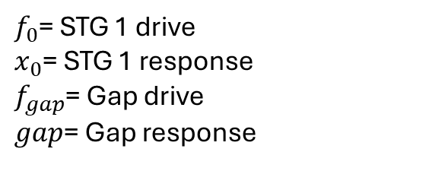
Model Design Process
Model of gap motion
Gap motion is the sum of STG 1 and STG 2 motion from a drive in STG 2 only
STG 2 motion comes from drive and STG1 motion, but we are only interested in STG 2 motion from a drive in STG 2
Best results come from collecting discrete transfer functions, doing calculations with the data, then fitting the result as opposed to fitting the original discrete transfer functions and doing math on the continuous models
$$gap=\frac{gap}{f_{0}}∗{\left(\frac{x_{0}}{f_{0}}\right)}^{−1}∗x_{0}+\left[\frac{gap}{f_{gap}}−\frac{gap}{f_{0}}∗{\left(\frac{x_{0}}{f_{0}}\right)}^{−1}∗\frac{x_{0}}{f_{gap}}\right]∗f_{gap}$$
Gap motion due to STG 1 motion
Gap motion due to STG 1
$f_{0}$= STG 1 drive
$x_{0}$= STG 1 response
$f_{gap}$= Gap drive
$gap$= Gap response
Gap motion due to STG 2 motion from a drive in STG 2
STG 1 Motion Gap Motion
STG 2 Drive STG 2 Motion
Notes:
To build the transfer function from stage 1 motion to gap motion and stage 2 drive to stg 2 motion, we collected four transfer functions used in this equation.
The left most term is gap motion due to stg1 motion and the right most is gap motion due to stg2 motion.
The stg 2 drive drives the gap which also causes stage 1 to move. Thus, to avoid double counting stg1 motion, we needed to subtract away stage 1 motion due to the stg2 drive.

Slide 13
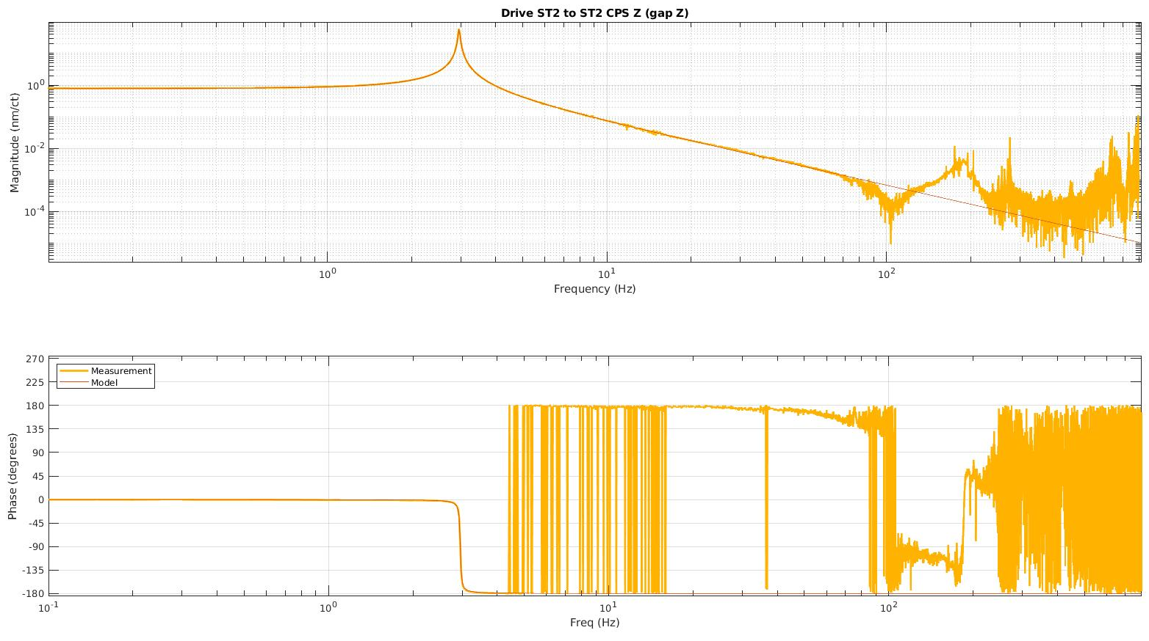
Gap Drive to Gap Model
Fitting done using Gabriele Vajente’s tool, “interactive fitting” powered by VEC FIT
Accurate fit in region of interest
Area not fit
Notes:
We found a simple fit to our stg1 motion to gap data using Gabriele Vajente’s interactive fitting tool.
We don’t care about fitting above 100 Hz because the data is noisy.
Some of the upshoot is internal bending modes of the structure which we didn’t fit because we didn’t want to. We are most interested in the rigid body motion rather than fitting the internal modes.
The upshoot is due to sensor dynamics and doesn’t represent true table motion.

Slide 14
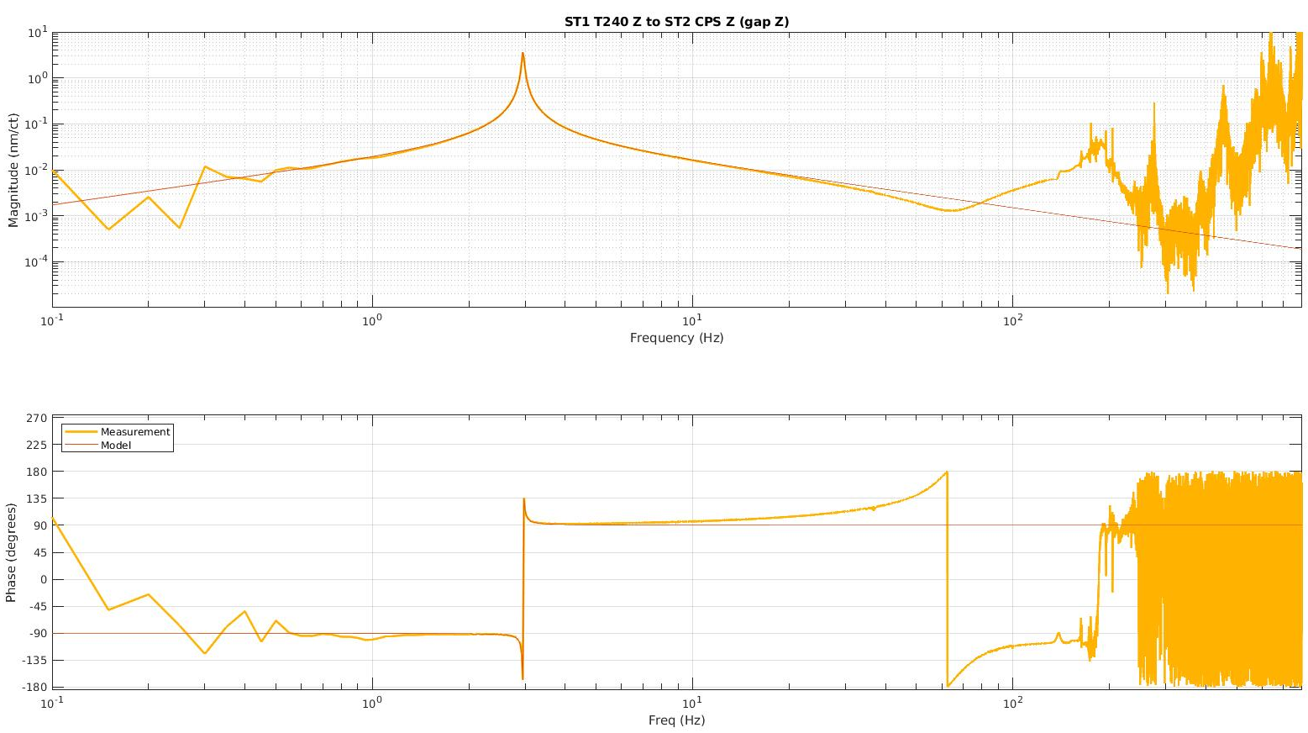
Stage 1 Motion to Gap Model
Fitting done using Gabriele Vajente’s tool, “interactive fitting” powered by VEC FIT
Accurate fit in region of interest
Area not fit
Area not fit
Notes:
We found another simple fit using the same tool for stg2 drive to gap motion. Again we didn’t bother fitting above 100Hz because of sensor noise.

Slide 15
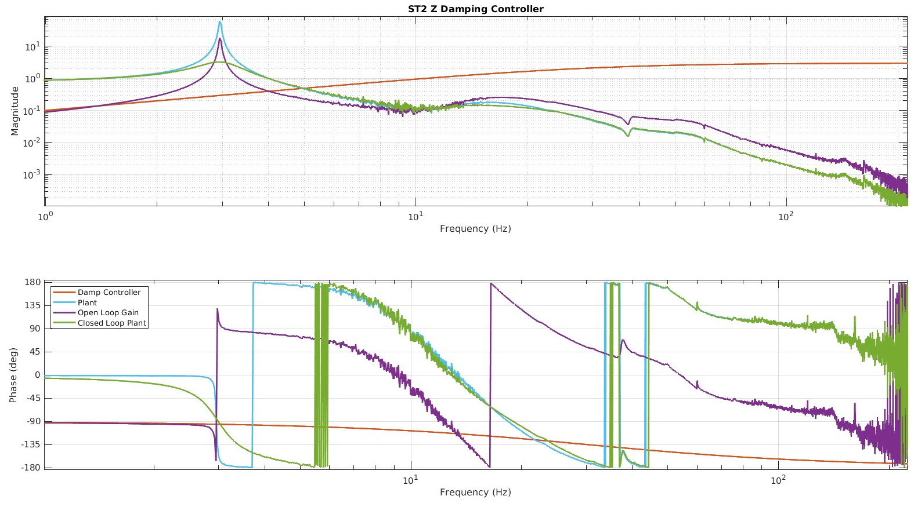
Stage 2 Damping Using CPS
Damping controller for Stage 2 Z DOF using CPS sensors
Specially designed to more accurately reflect observatory systems which use displacement sensors for damping
Simple lead filter to reduce the Q of the peak to less than 3
Resonance at
3 Hz
Notes:
To build the displacement damper, we used a simple lead network. This damps the Q of the plant’s resonance to 3.
We chose to not roll off the damper more aggressively because at the observatories, there is not much room to roll off the dampers any more. By keeping our damping loop this way, we can demonstrate our concept more boldly.
MENTION THAT this was made just for testing quickly. Not necessarily final form of the controller.

Slide 16
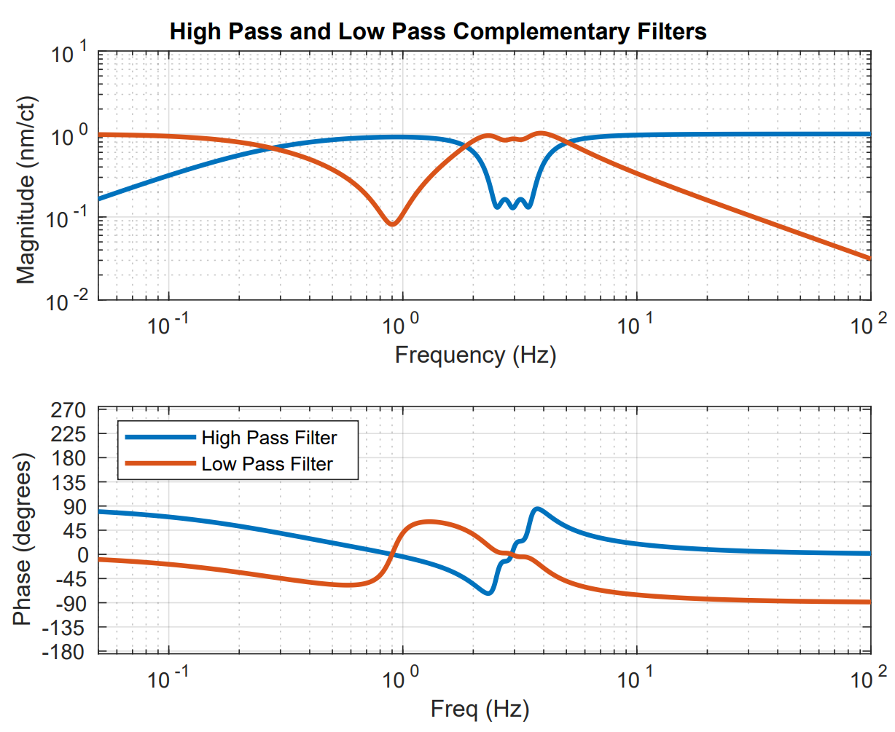
Estimator – CPS Blend
Blend filter used to combine estimator and measured gap
Low pass takes gap measurement from CPS sensors at low frequency and in 3 Hz area
High pass takes the estimated gap at high frequency except for at the 3 Hz area
Bump for resonance
Notes:
This is the complementary high pass and low pass filters which combine the model and measurements. The bump exists to reduce issues caused by a misalignment of plant resonance and model resonanace.
-IMPROVE
-Make very clear that we are about to transition to performance.

Slide 17
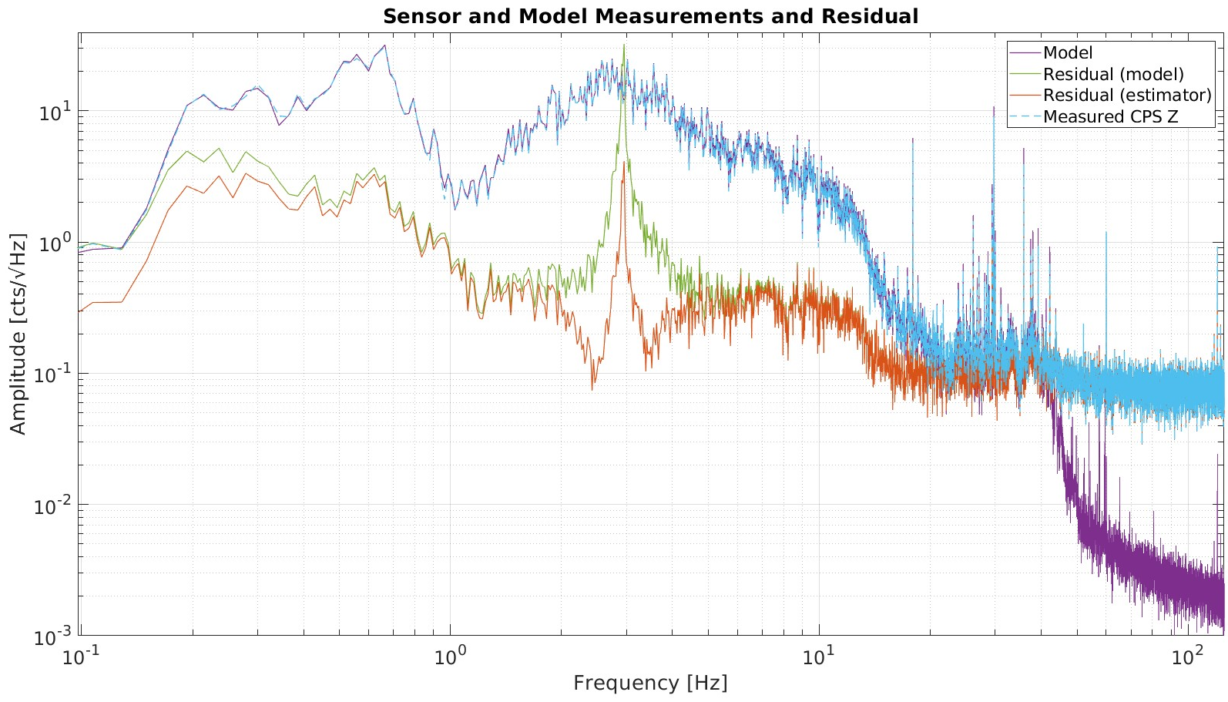
Model Performance
Model Predictions
Accurately tracks what the CPS measures
Residual peaks at approximately 3 Hz. Most likely due to small mismatch in model resonant frequency and table resonant frequency
Residual limit is the difference between CPS noise and Estimator noise
Resonance Peak at 3 Hz
~1.5 order of magnitude improvement
Notes:
Here we have the spectrum of the signal from the CPS sensors and the model. The CPS sensors and model match very well up to 30 Hz.
Beyond 30 Hz, the CPS sensors are hitting their noise floor, but the model is limited by the intertial sensor noise floors which aren’t hit until just beyond 100Hz
At 3 Hz, there is a peak in the residual which we believe is due to a misalignment of the plant resonance and modeled resonance.
The estimator (which combines model and CPS measurements), addresses this by using more of the CPS measurements around 3 Hz rather than the model.

Slide 18
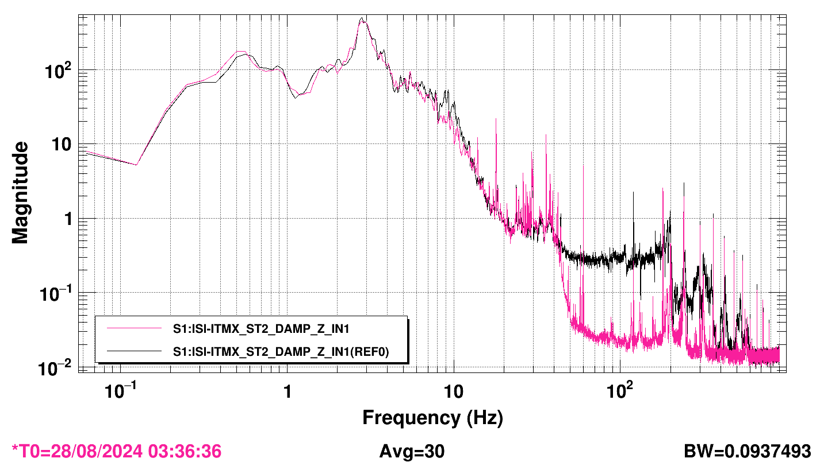
Estimator Performance
Black curve is using CPS measurements for damping. Measurement done by GS-13
Pink curve is using estimator for damping. Measurement done by GS-13
Order of magnitude improvement from 50Hz to 200Hz
Resonance damping at 3 Hz
~1 order of magnitude improvement
Notes:
Here we are looking at the damping of our seismic table under two different states witnessed by an out of loop GS-13.
The pink curve is when the table was damped using the estimator, and the black curve is when the table was damped using only measurements from the CPS.
The chart shows about an order of magnitude performance improvement between 50Hz and 200Hz when using the estimator. However, this chart is limited by the GS-13 noise floor. The previous slide showed the estimator was closer to 1.5 orders of magnitude quieter, so we expect that true performance improvement is better than 1 order of magnitude.

Slide 19
Future Work / Improvements
Test estimator on suspensions at observatories
Safety for estimator stability in event of hardware shutoff
Light plant damping to improve models
Implementing a fader to move smoothly from one control to another
Accounting for cross-coupling present in the suspension but not in the table used for this project

Slide 20
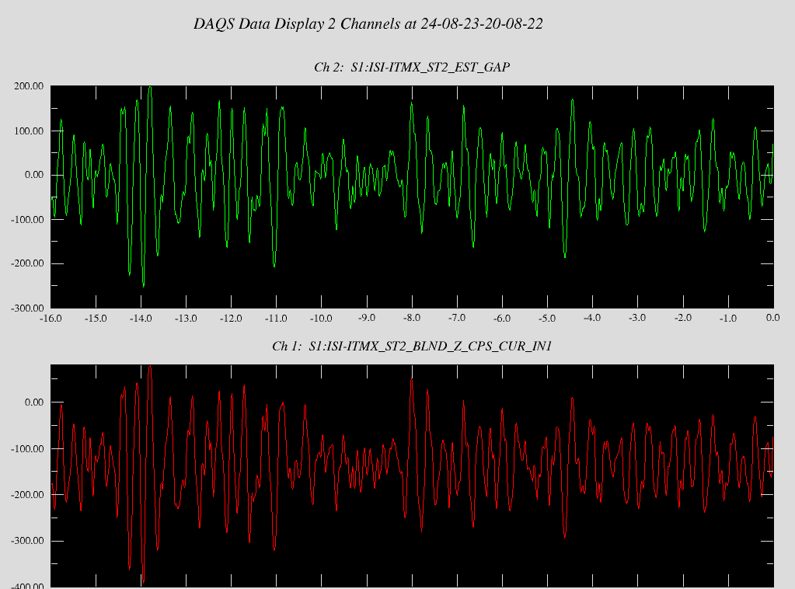
Questions
Estimator
Measurement
Notes:
Say red curve on the bottom graph.

Slide 21
Gap Motion, STG1, STG2
STG 2
Gap Drive → STG1 & STG2 Motion
STG1 & STG2 Motion → Gap Motion
STG 1
The gap changes due to motion in STG2 and STG1. When driving the gap, STG1 and STG2 move, but STG1 motion effecting the gap is already accounted for. Thus, STG1 motion due to a gap drive must be subtracted out to avoid double counting.
STG 1 Motion → Gap Motion
Notes:
- The second term is representing how much a drive between stage 1 and stage 2 effects the relative distance (gap). However, when you drive the gap you are moving stage 1 as well. Because we are moving stage 1, we are also counting the effect that that motion has on stage 2. To keep them separate, we have to subtract out that stage 1 motion.

Slide 22
Design Concept
GS-13
Inertial Damper
Switch
Z Drive
To Actuators
Displacement Damper
STG 2
Z Drive
Unit Time Delay
Drive to Gap
Model
+
Modeled Gap
Blend Filter
STG 1 Z
STG 1 to Gap Model
Switch
Estim ator
+
STG 2
OSEM
Measured Gap
Blend Filter
Notes:
At Stanford we normally use inertial damping. Our system looks like this so that we can switch from inertial damping to displacement damping like at the observatories. Typically at the sites, damping is done by taking the signal from the OSEMS, running it through the OSEM damping, and then to the actuators. We added this estimator using inertial sensors to simulate a displacement damper. Split into two slides. First one has all of this, except the GS-13 and nearby switch. This is what it looks like at the observatories. Next slide add in the GS-13, say this is what our table looks like and we had to add a switch to make this look like inertial damper displacement. Maybe build the slide as it goes. Potentially add a small boarder to the letters on the banner.

