Slide 1
OSEM Estimator for Improved Damping
Brian Lantz
Edgard Bonilla
Pierce Garver
DCC Number: G2401720

Slide 2
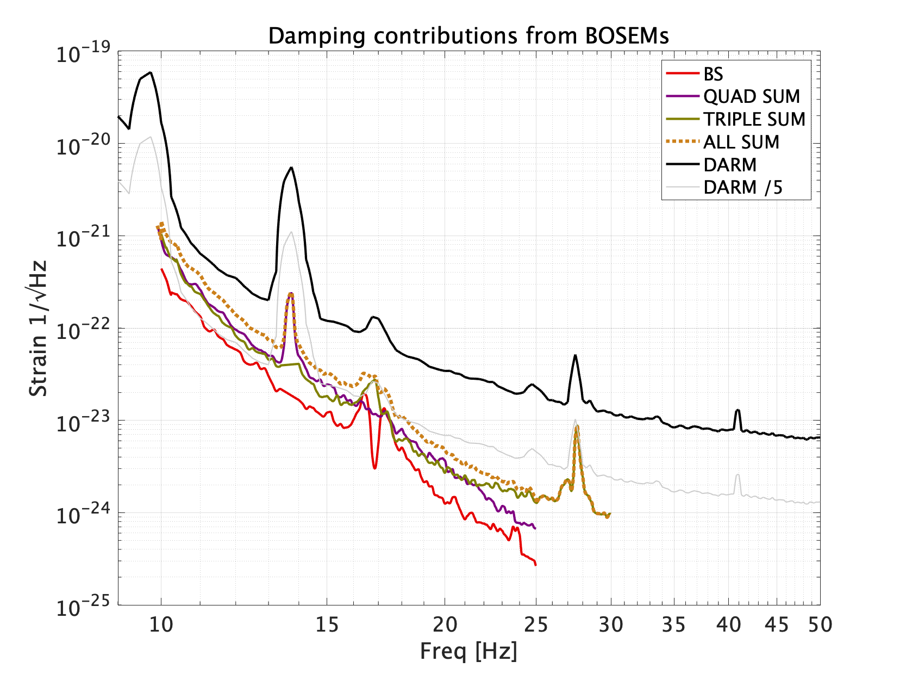
OSEM Limitations
Reduced damping at higher frequency
OSEM noise limits damping performance at higher frequencies
Inertial sensors on the ISI have better performance at higher frequencies
Incorporating these inertial sensors can provide better measurements above 20 Hz enabling quieter damping
OSEMs limit damping ability
A. Effler LLO LOG 68331

Slide 3
Suspensions vs Seismic Table
Suspension:
Seismic Table
Suspension Point
Measured by OSEM
Gap
STG 2
Gap, measured by CPS
STG 1
Seismic Sensor

Slide 4
Design Concept
Z Drive
To Actuators
Displacement Damper
STG 2
OSEM

Slide 5
Design Concept
Z Drive
To Actuators
Displacement Damper
STG 2
Z Drive
Unit Time Delay
Drive to Gap
Model
+
Modeled Gap
Blend Filter
STG 1 Z
STG 1 to Gap Model
Switch
Estim ator
+
STG 2
OSEM
Measured Gap
Blend Filter

Slide 6
Design Concept
Z Drive
To Actuators
Displacement Damper
STG 2
Z Drive
Unit Time Delay
Drive to Gap
Model
+
Modeled Gap
Blend Filter
STG 1 Z
STG 1 to Gap Model
Switch
Estim ator
+
STG 2
OSEM
Measured Gap
Blend Filter

Slide 7
Design Concept
Z Drive
To Actuators
Displacement Damper
STG 2
Z Drive
Unit Time Delay
Drive to Gap
Model
+
Modeled Gap
Blend Filter
STG 1 Z
STG 1 to Gap Model
Switch
Estim ator
+
STG 2
OSEM
Measured Gap
Blend Filter

Slide 8
Design Concept
Z Drive
To Actuators
Displacement Damper
STG 2
Z Drive
Unit Time Delay
Drive to Gap
Model
+
Modeled Gap
Blend Filter
STG 1 Z
STG 1 to Gap Model
Switch
Estim ator
+
STG 2
OSEM
Measured Gap
Blend Filter

Slide 9
Design Concept
Z Drive
To Actuators
Displacement Damper
STG 2
Z Drive
Unit Time Delay
Drive to Gap
Model
+
Modeled Gap
Blend Filter
STG 1 Z
STG 1 to Gap Model
Switch
Estim ator
+
STG 2
OSEM
Measured Gap
Blend Filter

Slide 10
Design Concept
Z Drive
To Actuators
Displacement Damper
STG 2
Z Drive
Unit Time Delay
Drive to Gap
Model
+
Modeled Gap
Blend Filter
STG 1 Z
STG 1 to Gap Model
Switch
Estim ator
+
STG 2
OSEM
Measured Gap
Blend Filter

Slide 11
Design Concept
GS-13
Inertial Damper
Switch
Z Drive
To Actuators
Displacement Damper
STG 2
Z Drive
Unit Time Delay
Drive to Gap
Model
+
Modeled Gap
Blend Filter
STG 1 Z
STG 1 to Gap Model
Switch
Estim ator
+
STG 2
OSEM
Measured Gap
Blend Filter

Slide 12

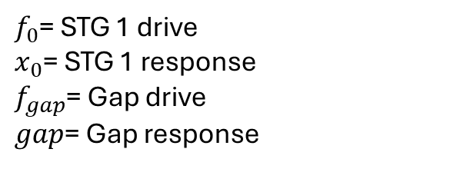
Model Design Process
Model of gap motion
Gap motion is the sum of STG 1 and STG 2 motion from a drive in STG 2 only
STG 2 motion comes from drive and STG1 motion, but we are only interested in STG 2 motion from a drive in STG 2
Best results come from collecting discrete transfer functions, doing calculations with the data, then fitting the result as opposed to fitting the original discrete transfer functions and doing math on the continuous models
$$gap=\frac{gap}{f_{0}}∗{\left(\frac{x_{0}}{f_{0}}\right)}^{−1}∗x_{0}+\left[\frac{gap}{f_{gap}}−\frac{gap}{f_{0}}∗{\left(\frac{x_{0}}{f_{0}}\right)}^{−1}∗\frac{x_{0}}{f_{gap}}\right]∗f_{gap}$$
Gap motion due to STG 1 motion
Gap motion due to STG 1
$f_{0}$= STG 1 drive
$x_{0}$= STG 1 response
$f_{gap}$= Gap drive
$gap$= Gap response
Gap motion due to STG 2 motion from a drive in STG 2
STG 1 Motion Gap Motion
STG 2 Drive STG 2 Motion
Notes:
To build the transfer function from stage 1 motion to gap motion and stage 2 drive to stg 2 motion, we collected four transfer functions used in this equation.
The left most term is gap motion due to stg1 motion and the right most is gap motion due to stg2 motion.
The stg 2 drive drives the gap which also causes stage 1 to move. Thus, to avoid double counting stg1 motion, we needed to subtract away stage 1 motion due to the stg2 drive.

Slide 13
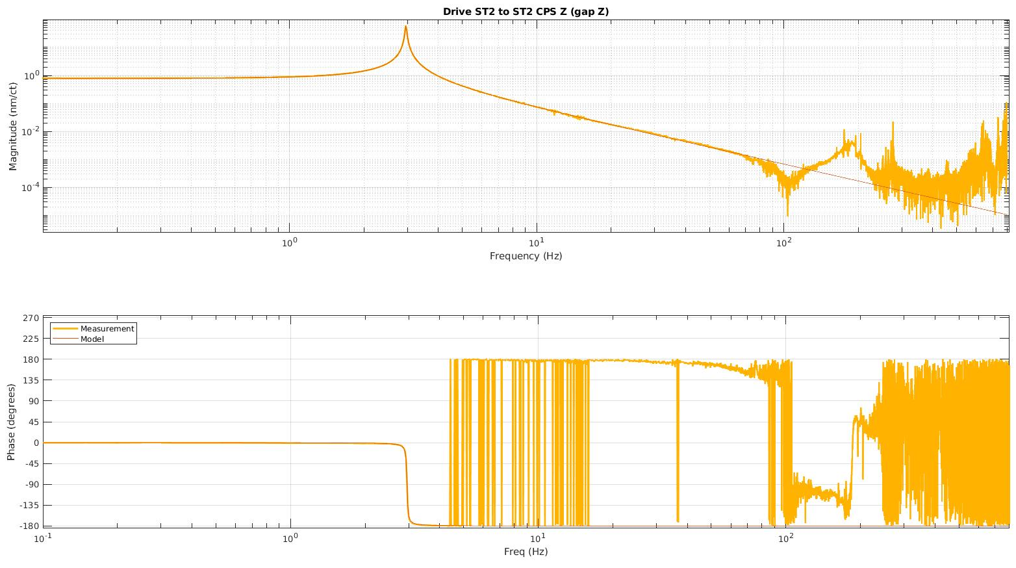
Gap Drive to Gap Model
Fitting done using Gabriele Vajente’s tool, “interactive fitting” powered by VEC FIT
Accurate fit in region of interest
Area not fit

Slide 14
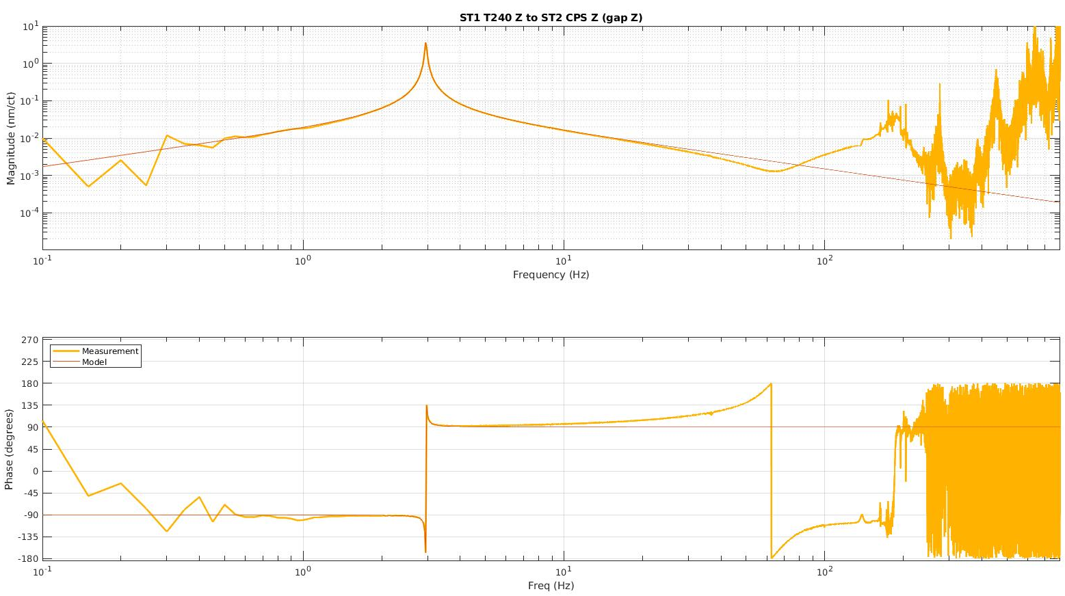
Stage 1 Motion to Gap Model
Fitting done using Gabriele Vajente’s tool, “interactive fitting” powered by VEC FIT
Accurate fit in region of interest
Area not fit
Area not fit
Notes:
We found another simple fit using the same tool for stg2 drive to gap motion. Again we didn’t bother fitting above 100Hz because of sensor noise.

Slide 15
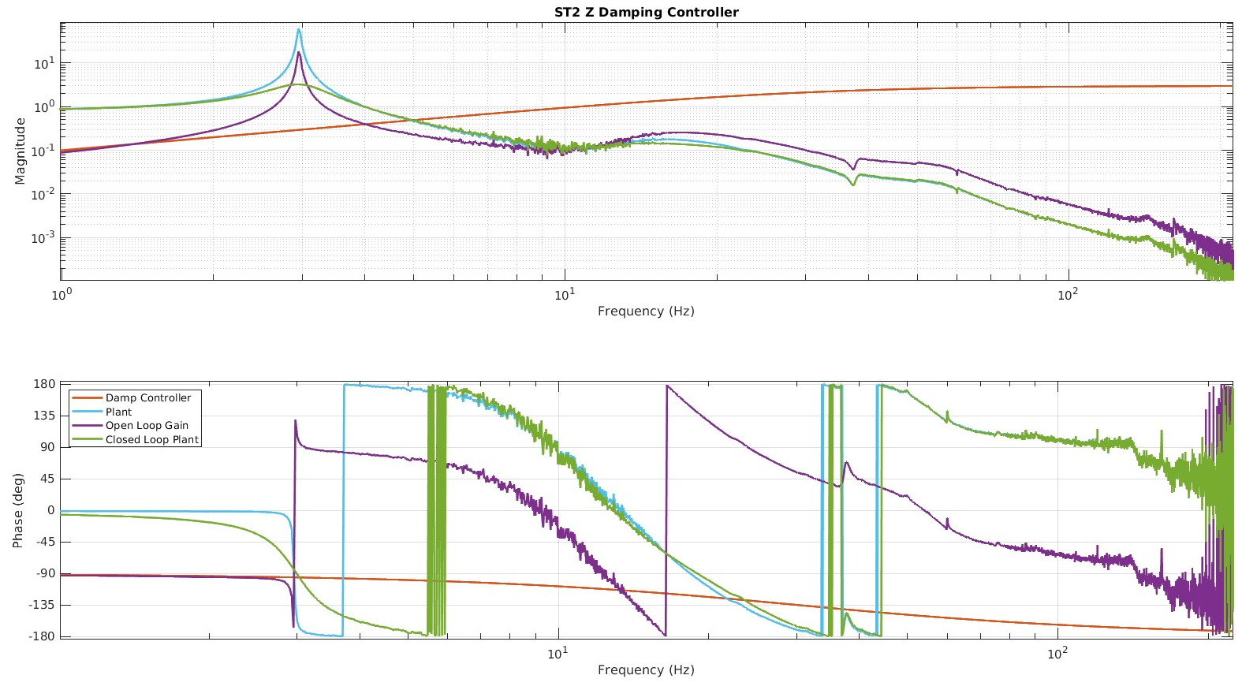
Stage 2 Damping Using CPS
Damping controller for Stage 2 Z DOF using CPS sensors
Specially designed to more accurately reflect observatory systems which use displacement sensors for damping
Simple lead filter to reduce the Q of the peak to less than 3
Resonance at
3 Hz

Slide 16
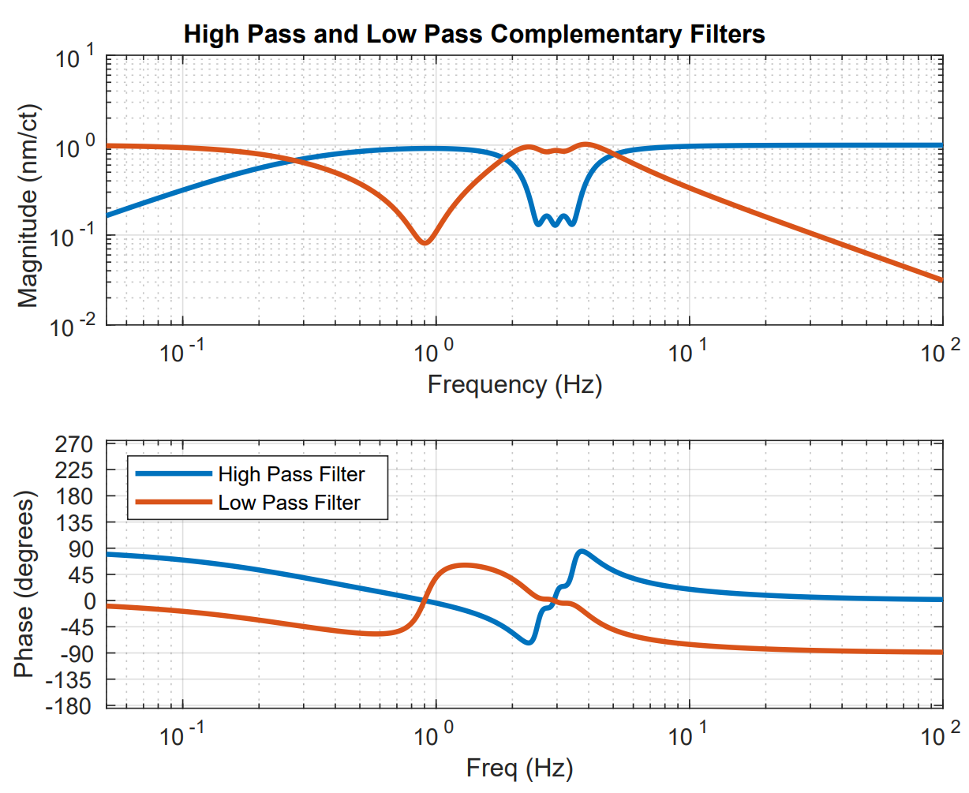
Estimator – CPS Blend
Blend filter used to combine estimator and measured gap
Low pass takes gap measurement from CPS sensors at low frequency and in 3 Hz area
High pass takes the estimated gap at high frequency except for at the 3 Hz area
Bump for resonance

Slide 17
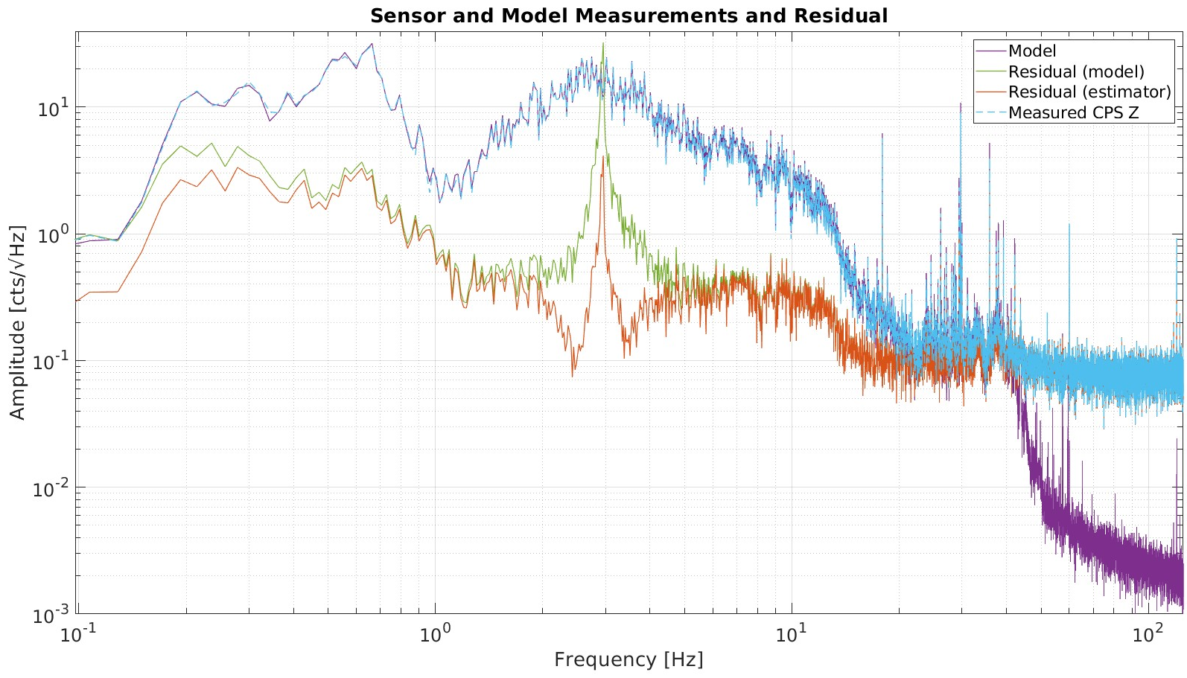
Model Performance
Model Predictions
Accurately tracks what the CPS measures
Residual peaks at approximately 3 Hz. Most likely due to small mismatch in model resonant frequency and table resonant frequency
Residual limit is the difference between CPS noise and Estimator noise
Resonance Peak at 3 Hz
~1.5 order of magnitude improvement

Slide 18
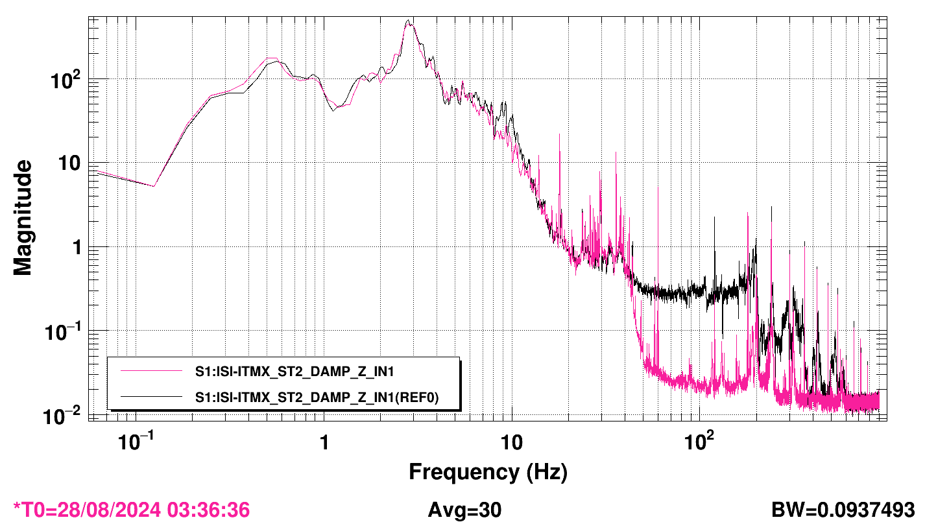
Estimator Performance
Black curve is using CPS measurements for damping. Measurement done by GS-13
Pink curve is using estimator for damping. Measurement done by GS-13
Order of magnitude improvement from 50Hz to 200Hz
Resonance damping at 3 Hz
~1 order of magnitude improvement

Slide 19
Future Work / Improvements
Test estimator on suspensions at observatories
Safety for estimator stability in event of hardware shutoff
Light plant damping to improve models
Implementing a fader to move smoothly from one control to another
Accounting for cross-coupling present in the suspension but not in the table used for this project

Slide 20
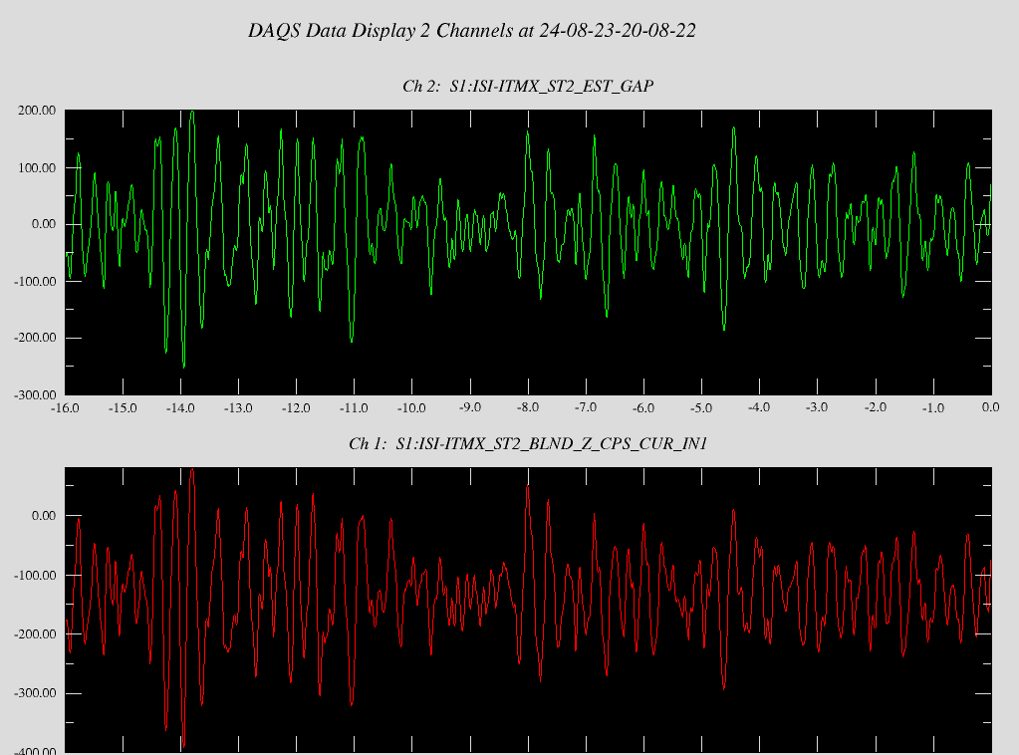
Questions
Estimator
Measurement
Notes:
Say red curve on the bottom graph.

Slide 21
Gap Motion, STG1, STG2
STG 2
Gap Drive → STG1 & STG2 Motion
STG1 & STG2 Motion → Gap Motion
STG 1
The gap changes due to motion in STG2 and STG1. When driving the gap, STG1 and STG2 move, but STG1 motion effecting the gap is already accounted for. Thus, STG1 motion due to a gap drive must be subtracted out to avoid double counting.
STG 1 Motion → Gap Motion

Slide 22
Design Concept
GS-13
Inertial Damper
Switch
Z Drive
To Actuators
Displacement Damper
STG 2
Z Drive
Unit Time Delay
Drive to Gap
Model
+
Modeled Gap
Blend Filter
STG 1 Z
STG 1 to Gap Model
Switch
Estim ator
+
STG 2
OSEM
Measured Gap
Blend Filter

