Slide 1
Optical and Near-Infrared Searches for Gravitational Waves: Exploring Efficiencies
Anurathi Madasi, Tomas Ahumada, Shreya Anand

Slide 2
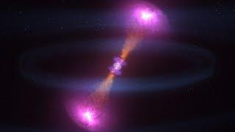
Compact Binary Coalescence (CBCs)
BNS or NSBH merger
Short GRB -> relativistic jets/afterglow -> kilonova
Heavy elements are produced during r-process nucleosynthesis

Slide 3
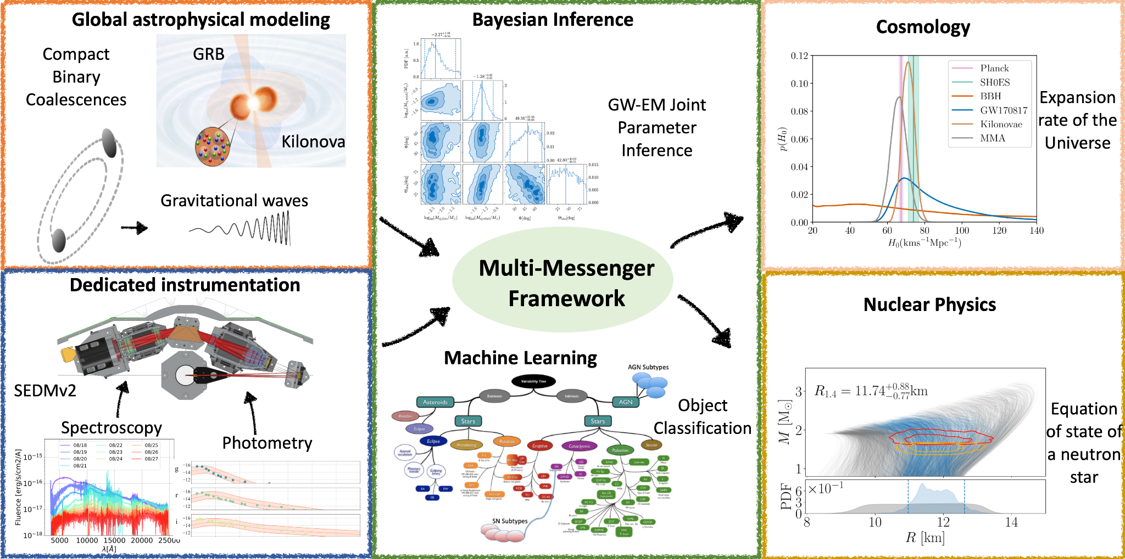
Multimessenger - importance of CBCs
Kilonovae are unique to CBCs
By finding a kilonova, we can pinpoint the source of a GW
MMA events help us determine NS EOS, hubble constant, and r process nucleosynthesis
M. Coughlin

Slide 4
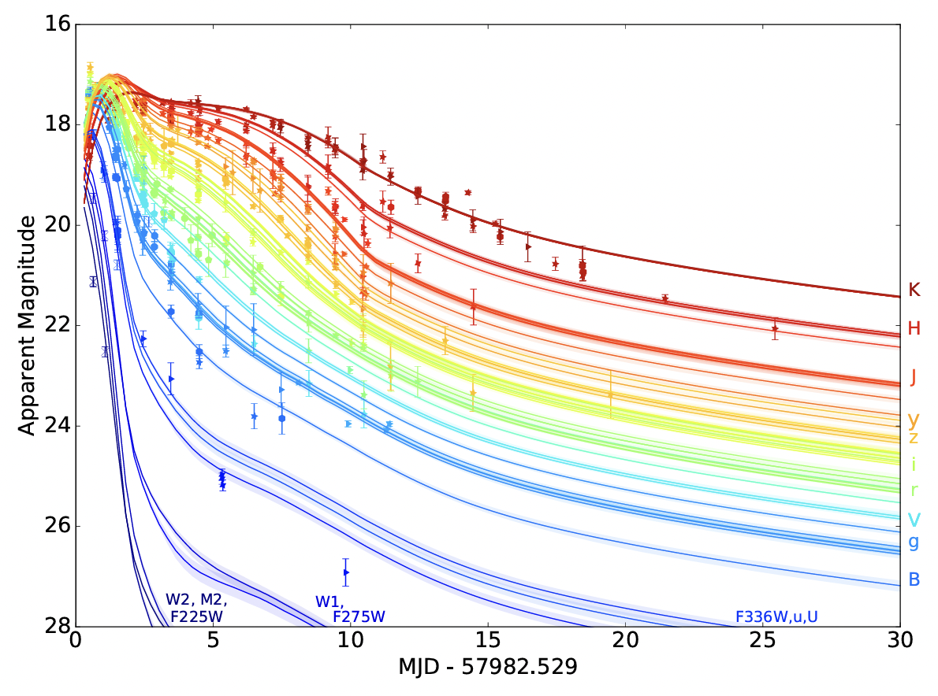
Electromagnetic Emission
GW170817 is the only GW event that has been detected in both GWs and EM emission
Lightcurves of GW170817 ->
After a BNS or NSBH GW is detected, there is a short window to find the kilonova (EM follow-up)
Brightness over time
Brightness
Time

Slide 5
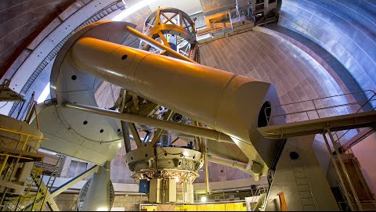
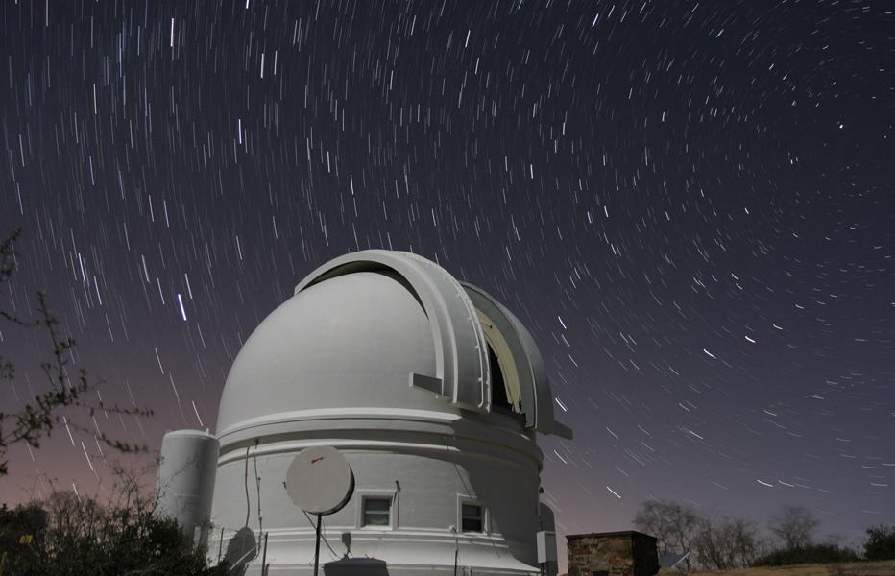
Palomar Observatory 200 inch Hale telescope
nasa jpl
caltech.edu

Slide 6
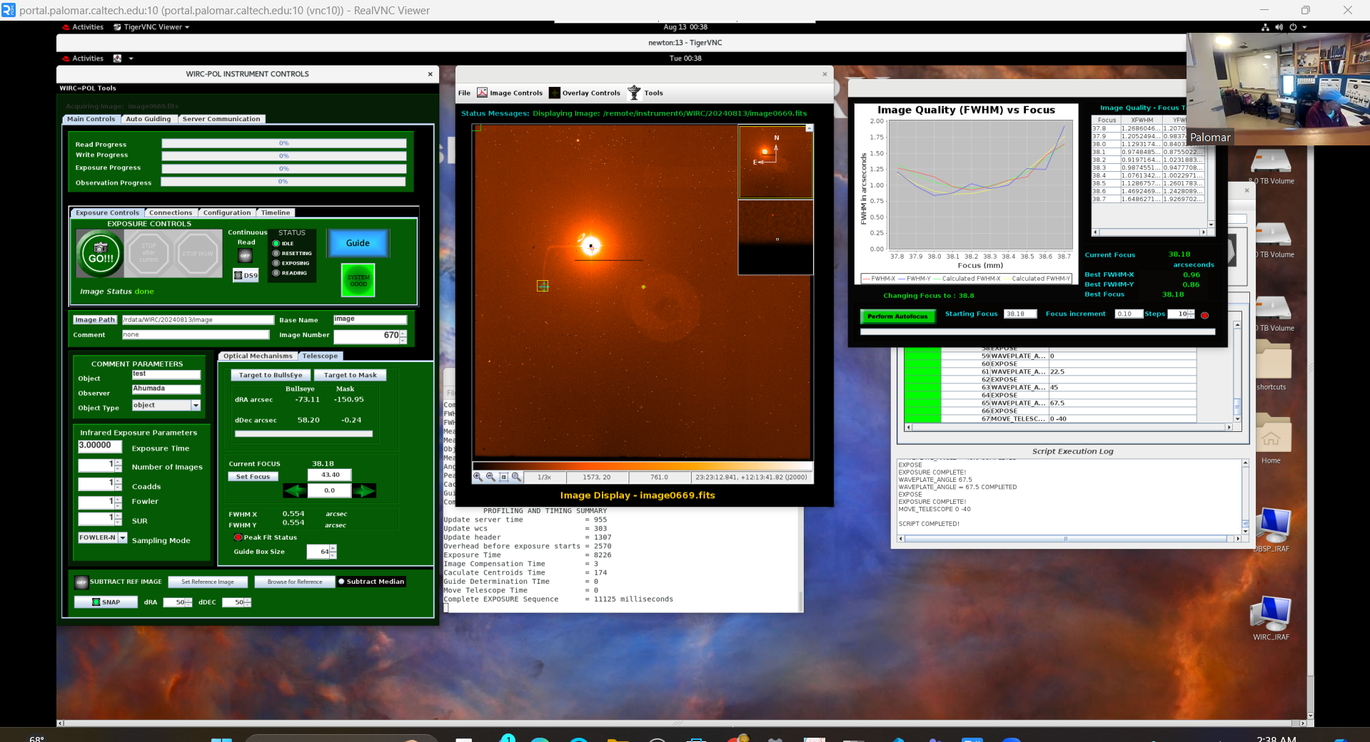
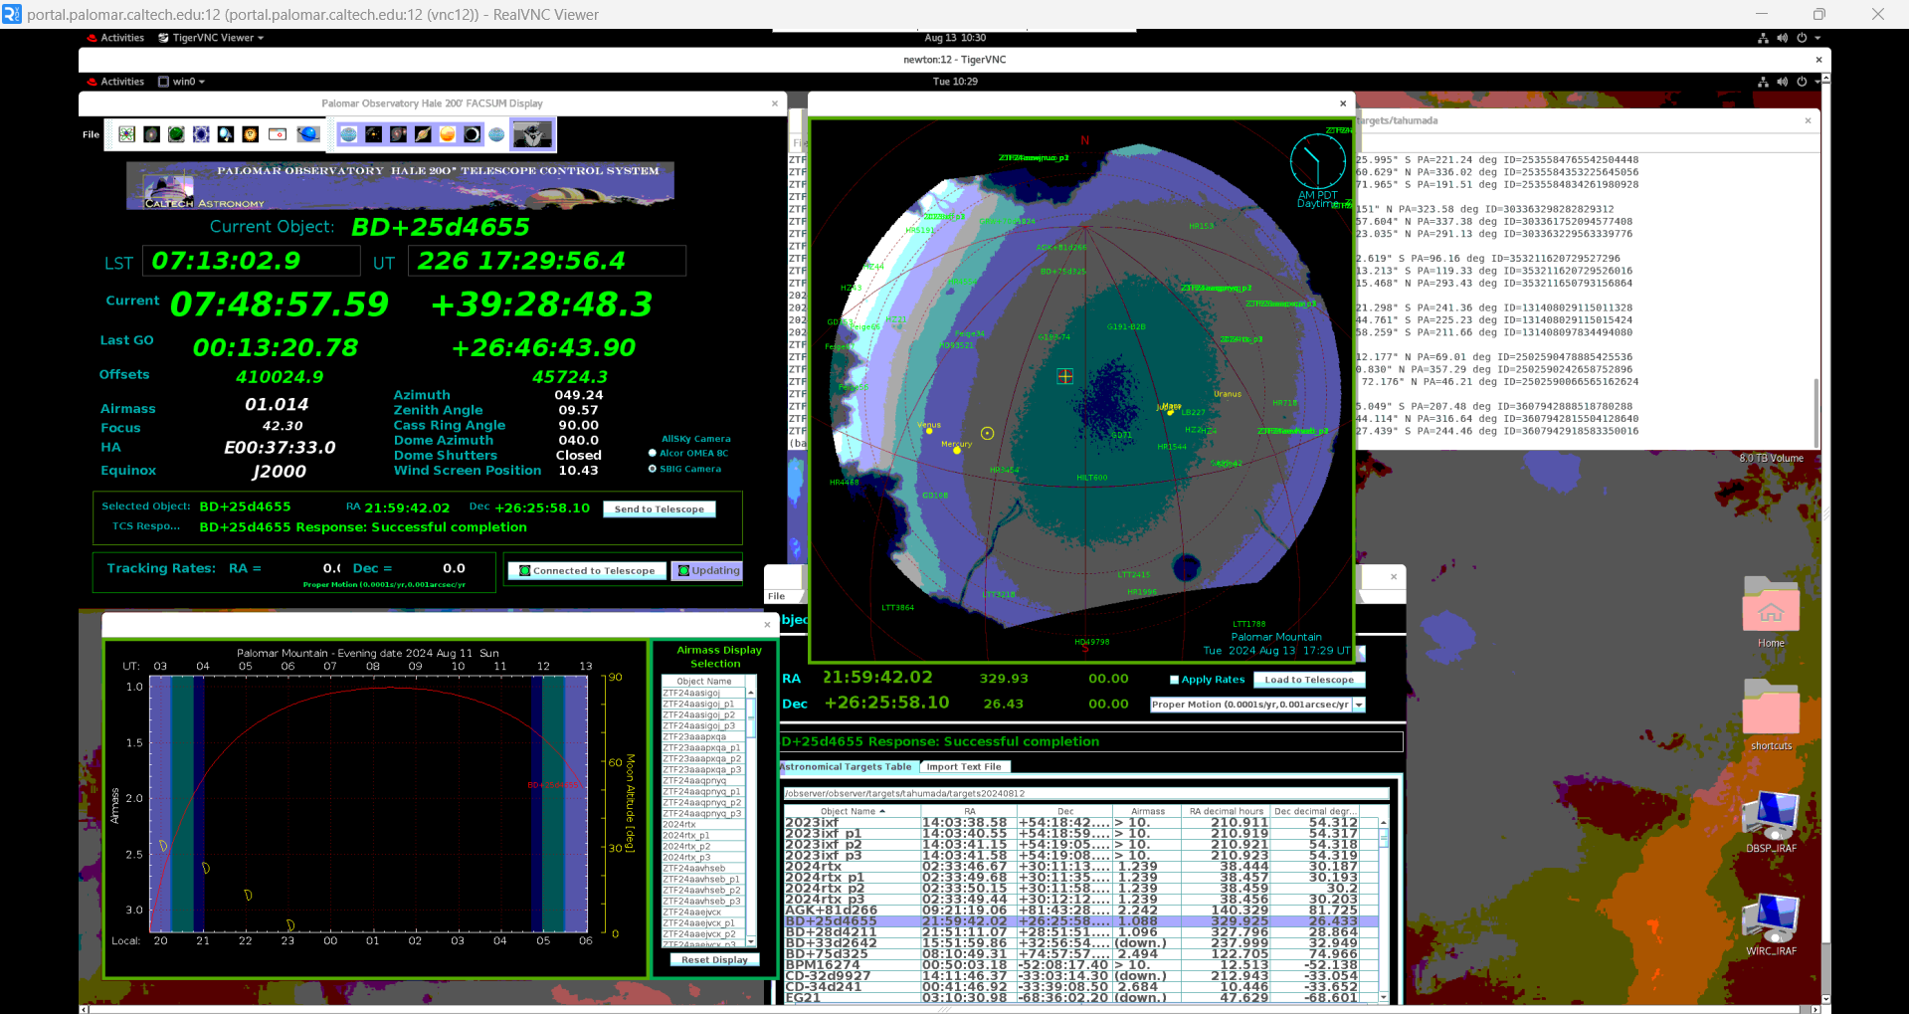
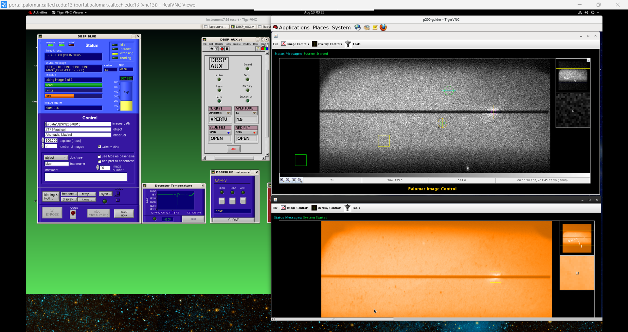
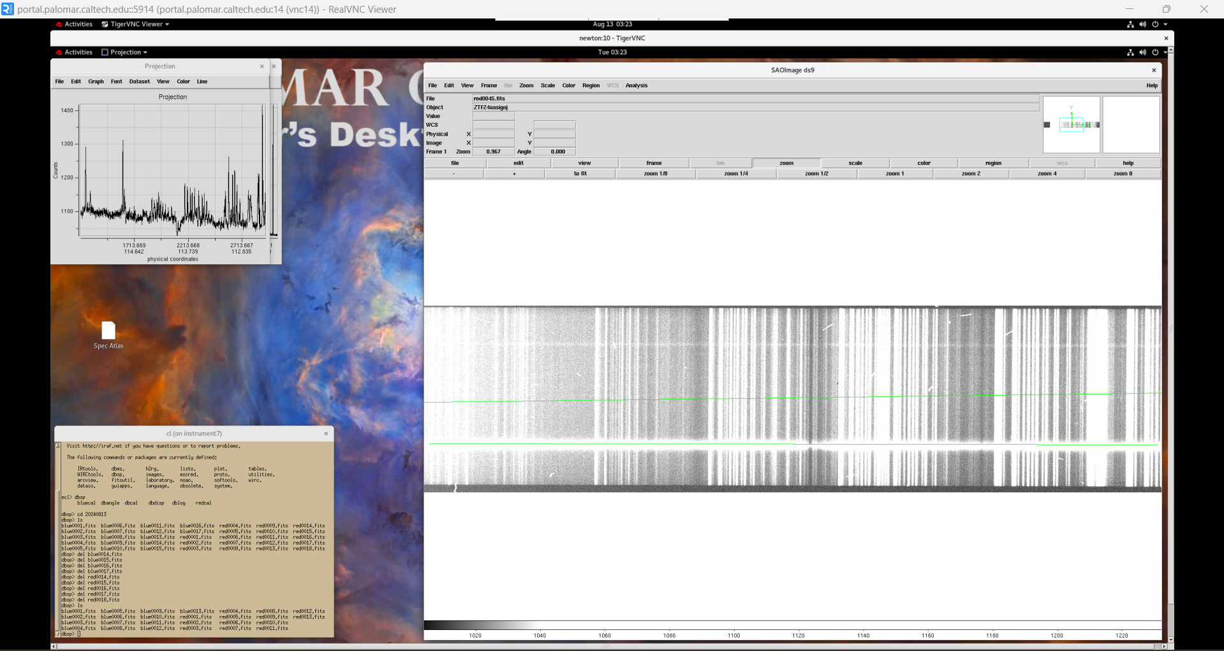

Slide 7
ZTF
Zwicky Transient Facility (ZTF) at Palomar Observatory
Observes in the ZTF-i, ZTF-g, ZTF-r optical bands
i-band is a near infrared filter while the g and r bands are visible light filters in green and red
30s scans of each field every night
Scans the entire northern sky every 2 nights
30s-300s scans when notable events occur (GW follow up)
Limiting magnitude in the r band is ~ 20.6 mag
Large catalogue of sky scans allows for image subtraction

Slide 9
ZTF limit
Brightness
Time

Slide 10
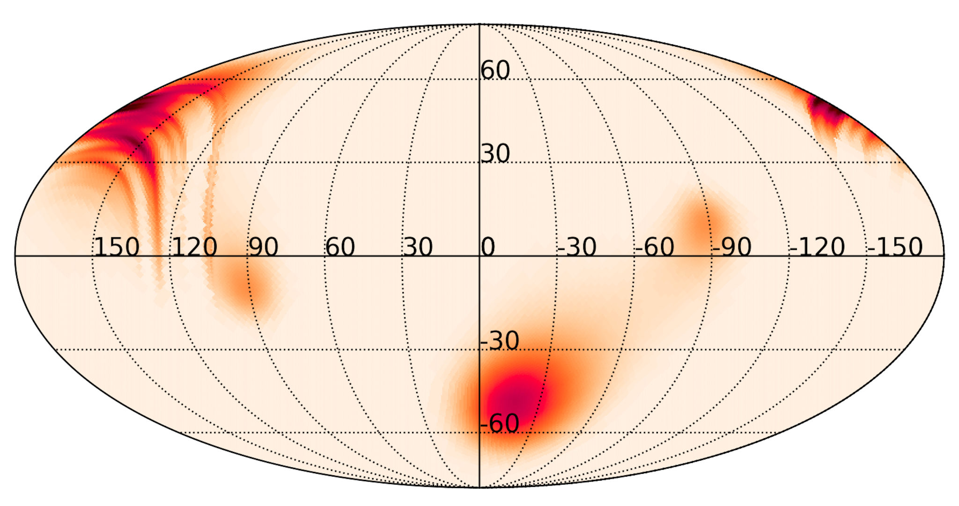
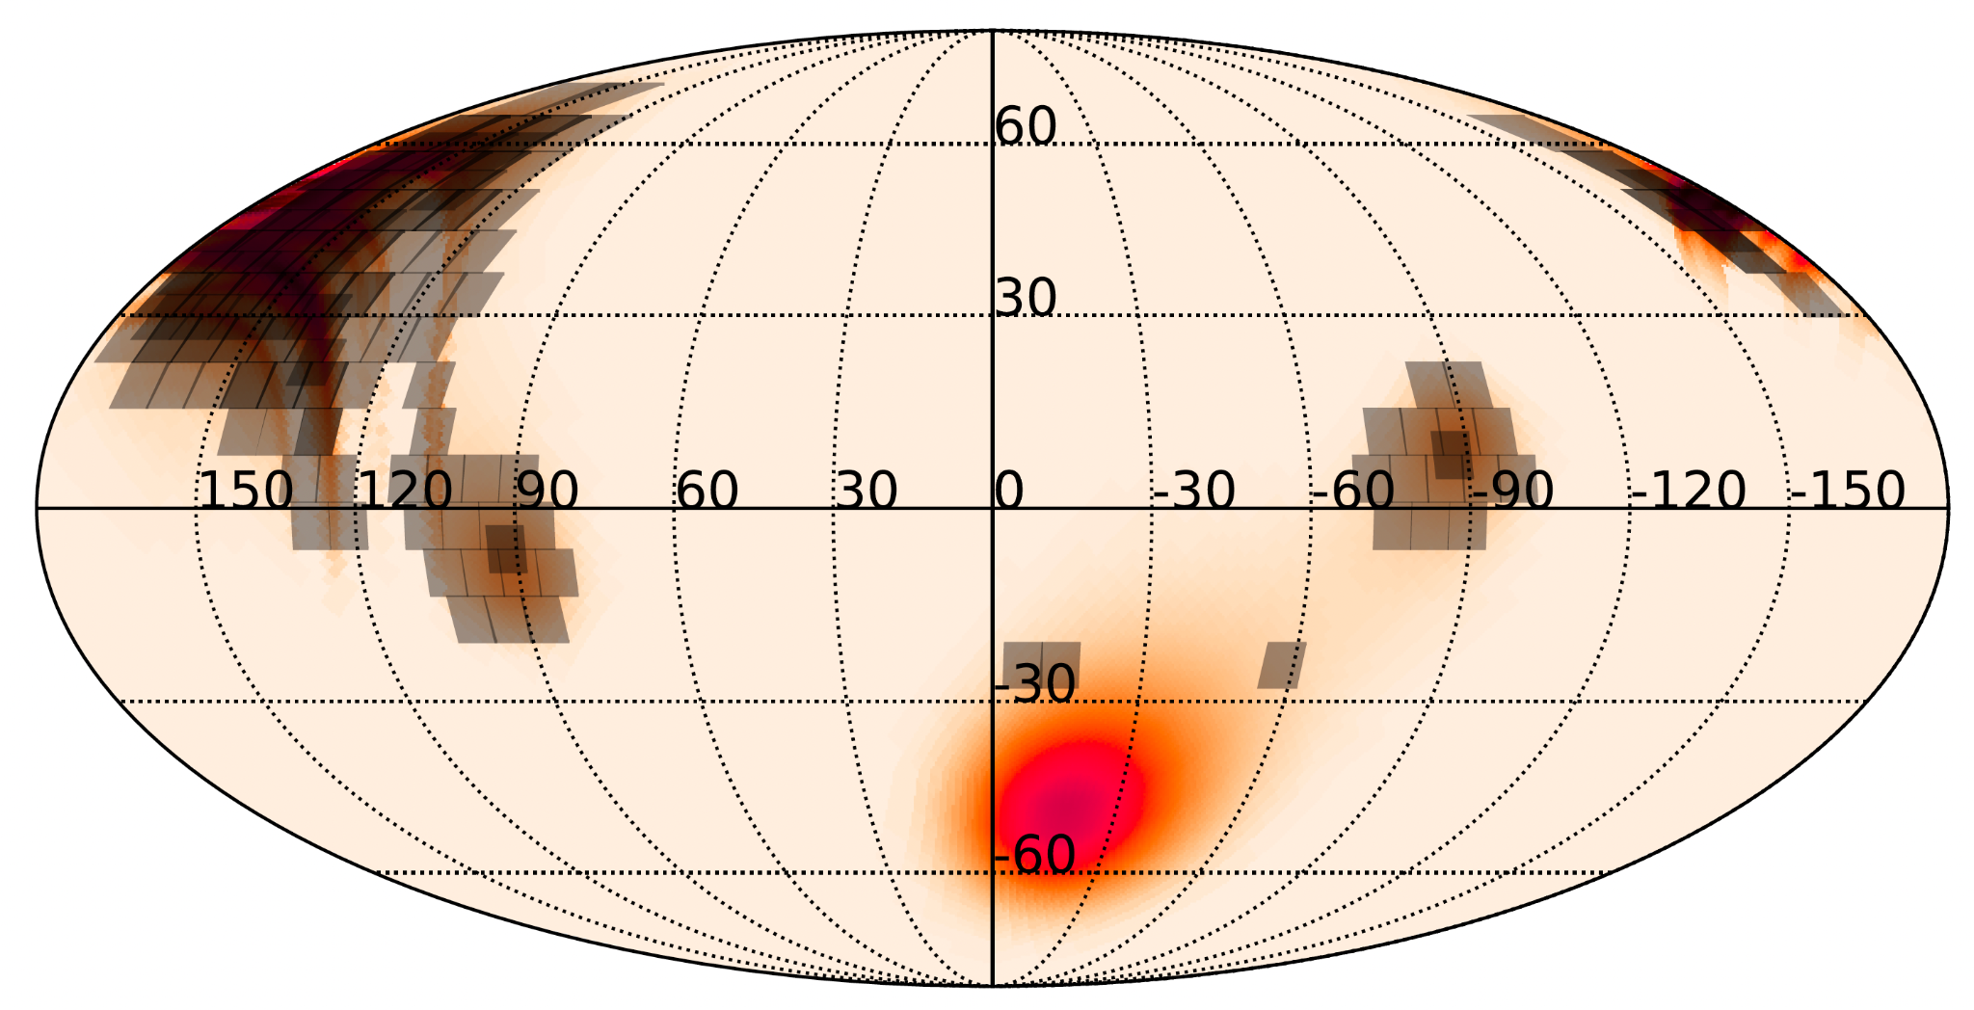
GW Search
Petrov et al. 2022
Skymap
ZTF Tiling

Slide 11
Simsurvey & Skysurvey
How do we know if ZTF can find the kilonova?
We quantify efficiency of ZTF using simsurvey
Simulates transients, modified to read & simulate transients (KN) over a LIGO skymap
Skysurvey is the newer, faster version of simsurvey
Simsurvey is no longer being maintained, we are transitioning code to use skysurvey

Slide 12
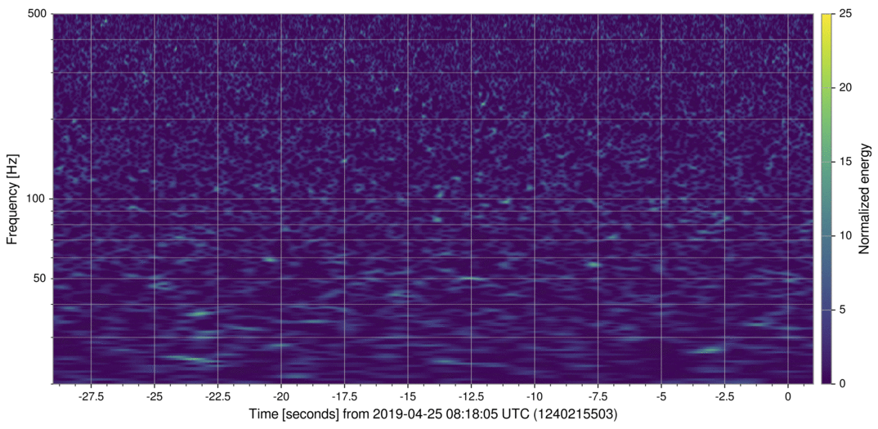
GW190425
The second BNS merger observed, found during LIGO’s O3 run
No EM counterpart found :(
LIGO.org

Slide 13
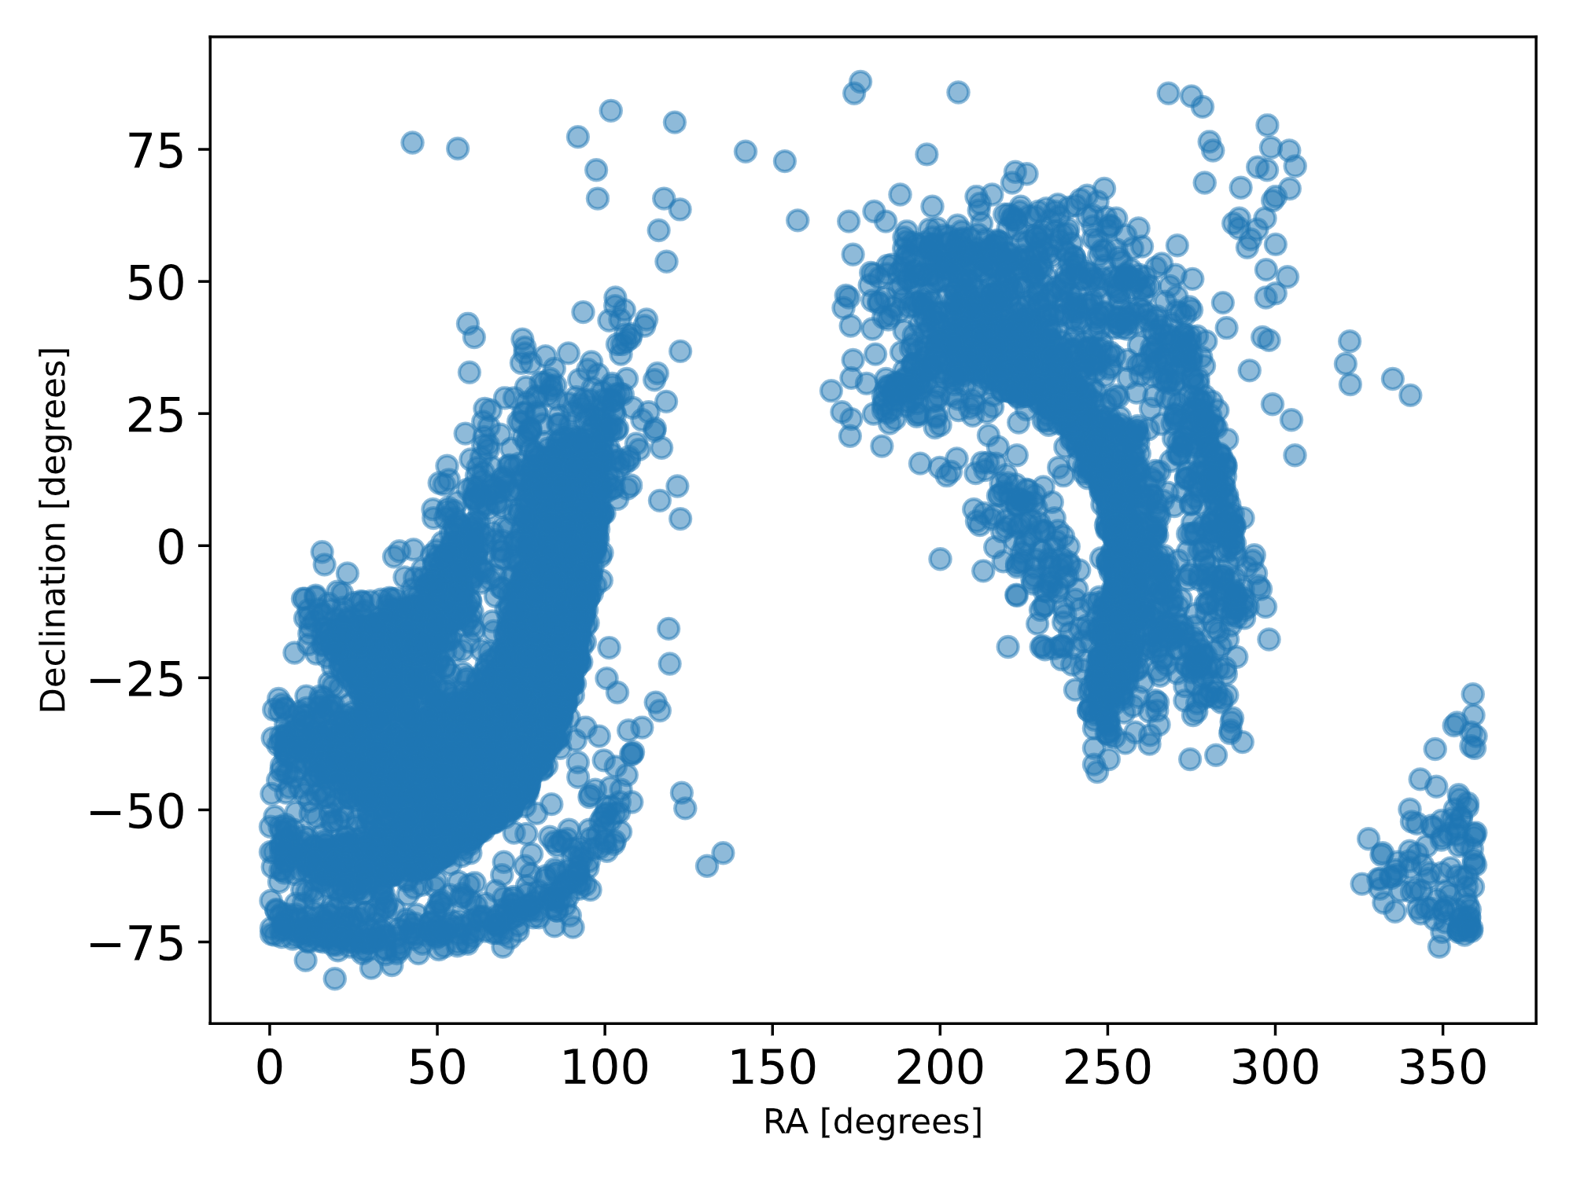
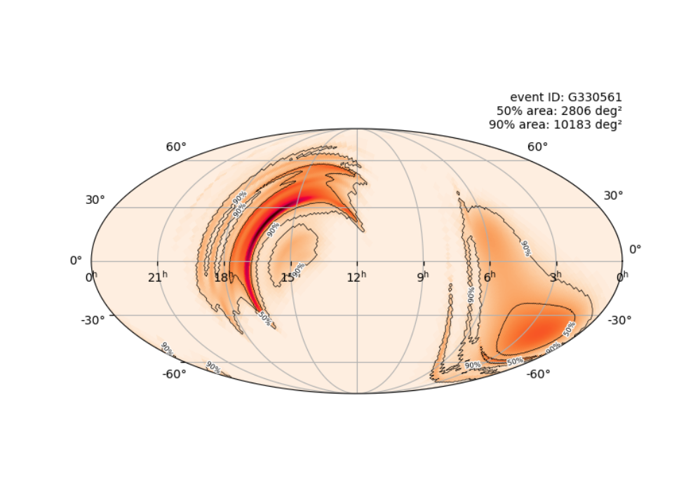
Simulated source map - GW190425
Populated skymap created by simsurvey(blue)
Real skymap below

Slide 14
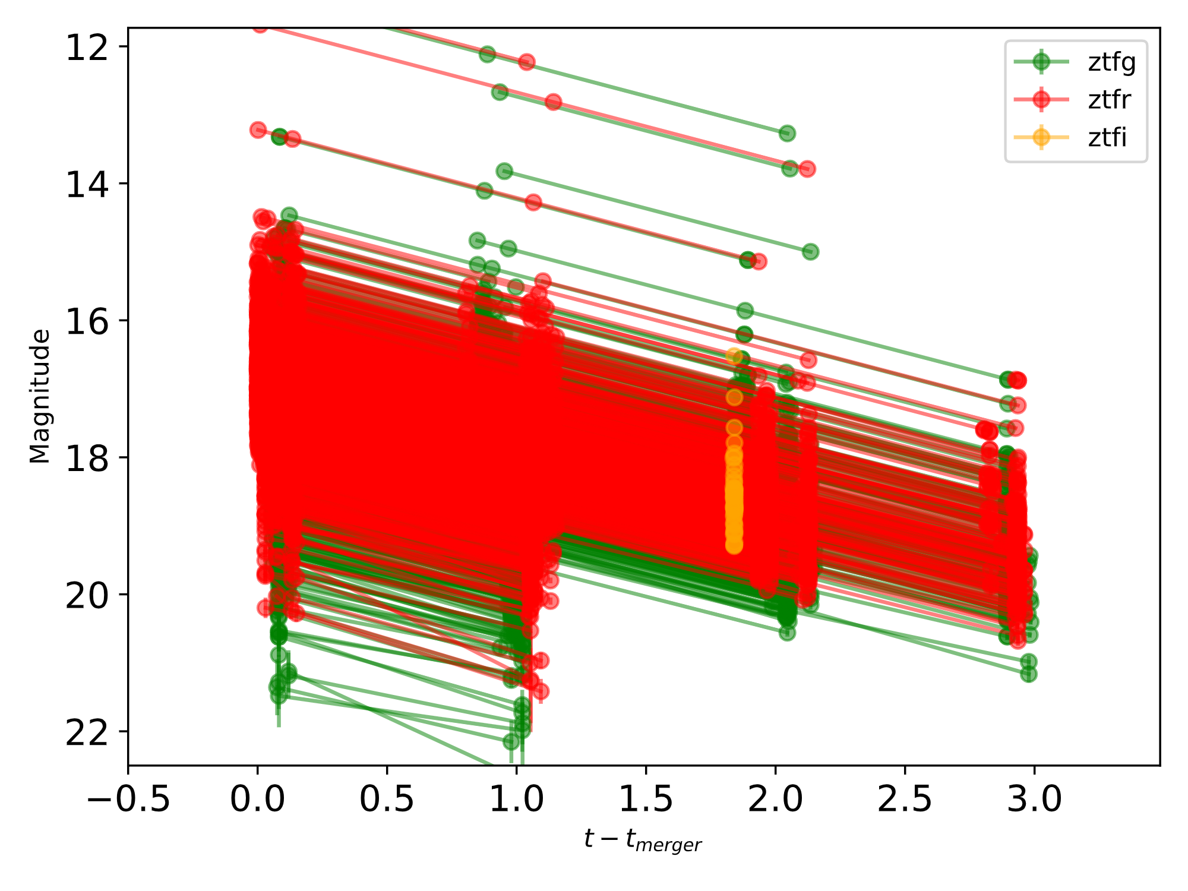
Simulated lightcurves - GW190425
Lightcurves of the simulated kilonova in the ZTF i, g and r bands

Slide 15
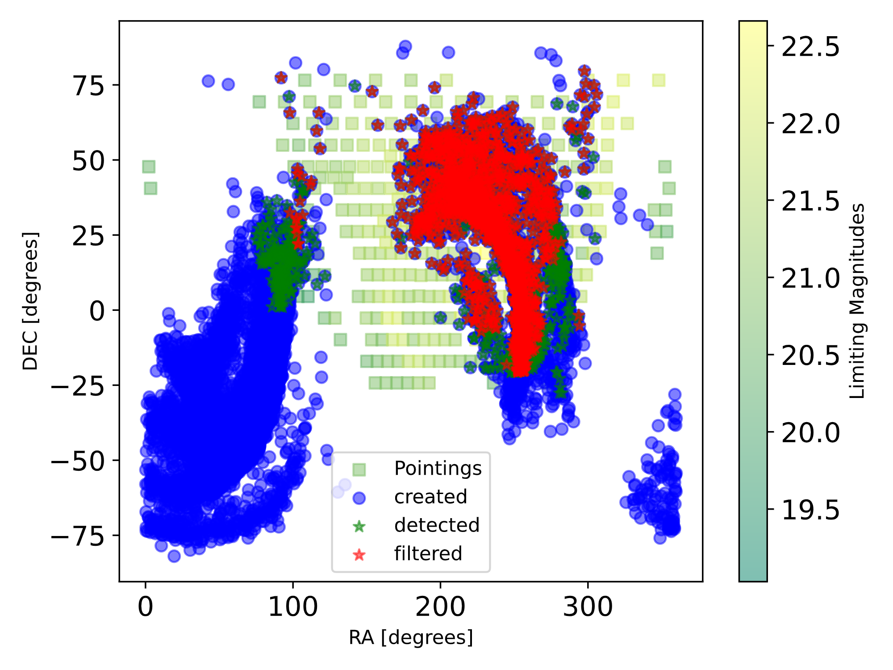
Simulated filtered skymap - GW190425
Green represents ZTF pointings(field of the telescope)
Red represents filtered detections(need 2 detections to be considered a detection)

Slide 16
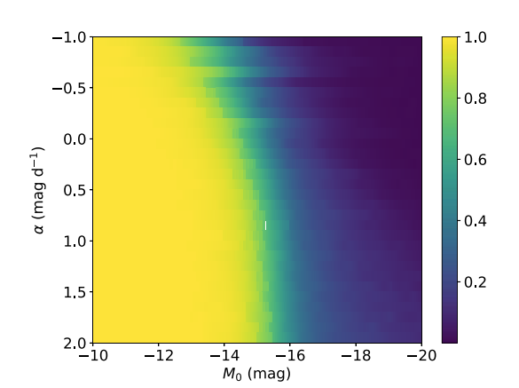
Efficiencies
Each pixel represents a given evolution rate and magnitude
Various combinations gives us the overall efficiency
We want to recreate this for O4 using simsurvey and skysurvey
Mohite et al. 2022

Slide 17
Simsurvey Framework
Plan
Transient
 | Survey strategy
 | ZTF pointings
 | LIGO Skymap
 | KN models
 | Generates KN
 | Based on healpy
 | Code was altered so that KN is generated based on skymap and pointings
Lightcurves
 | Generates dataset with lightcurves
 | flux, time, band, radec, etc.
 | Stored in pickle files

Slide 18
Skysurvey Framework
Survey
Target
 | Survey strategy
 | ZTF pointings, can also create fake pointings
 | LIGO Skymap reader was implemented by us
 | Generates KN
 | Only one KN model so far
 | Generates transients over given skyarea
Dataset
 | Generates dataset with flux, time, band, radec, etc.
 | Easier visualizations
 | Stored in pandas df

Slide 19
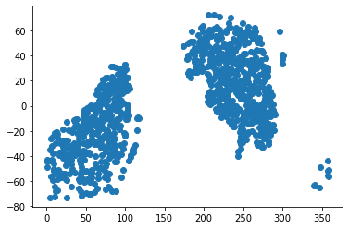
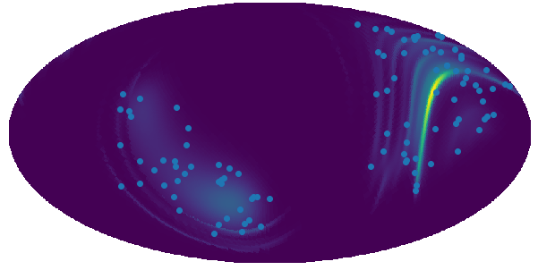
Generating kilonovae over skymap!
DEC
RA

Slide 20
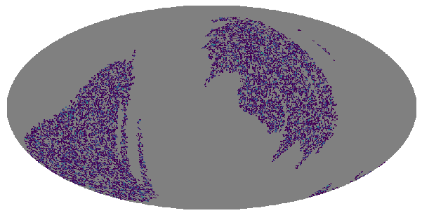
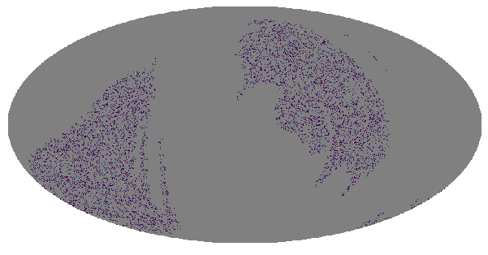
Generating targets over survey!
Fake pointings
Simulated KN over fake pointings

Slide 21
Conclusion/Future
Continue transitioning code from simsurvey to skysurvey
Incorporate pointings/observations into skysurvey
Add different kilonova models
Run O4 events on both simsurvey and skysurvey
Compare efficiencies calculated by both

Slide 22
Acknowledgements
This work was supported by the National Science Foundation Research Experience for Undergraduates (NSF REU) program, the LIGO Laboratory Summer Undergraduate Research Fellowship program (NSF LIGO), and the California Institute of Technology Student-Faculty Programs.

Slide 23
End

