Slide 1

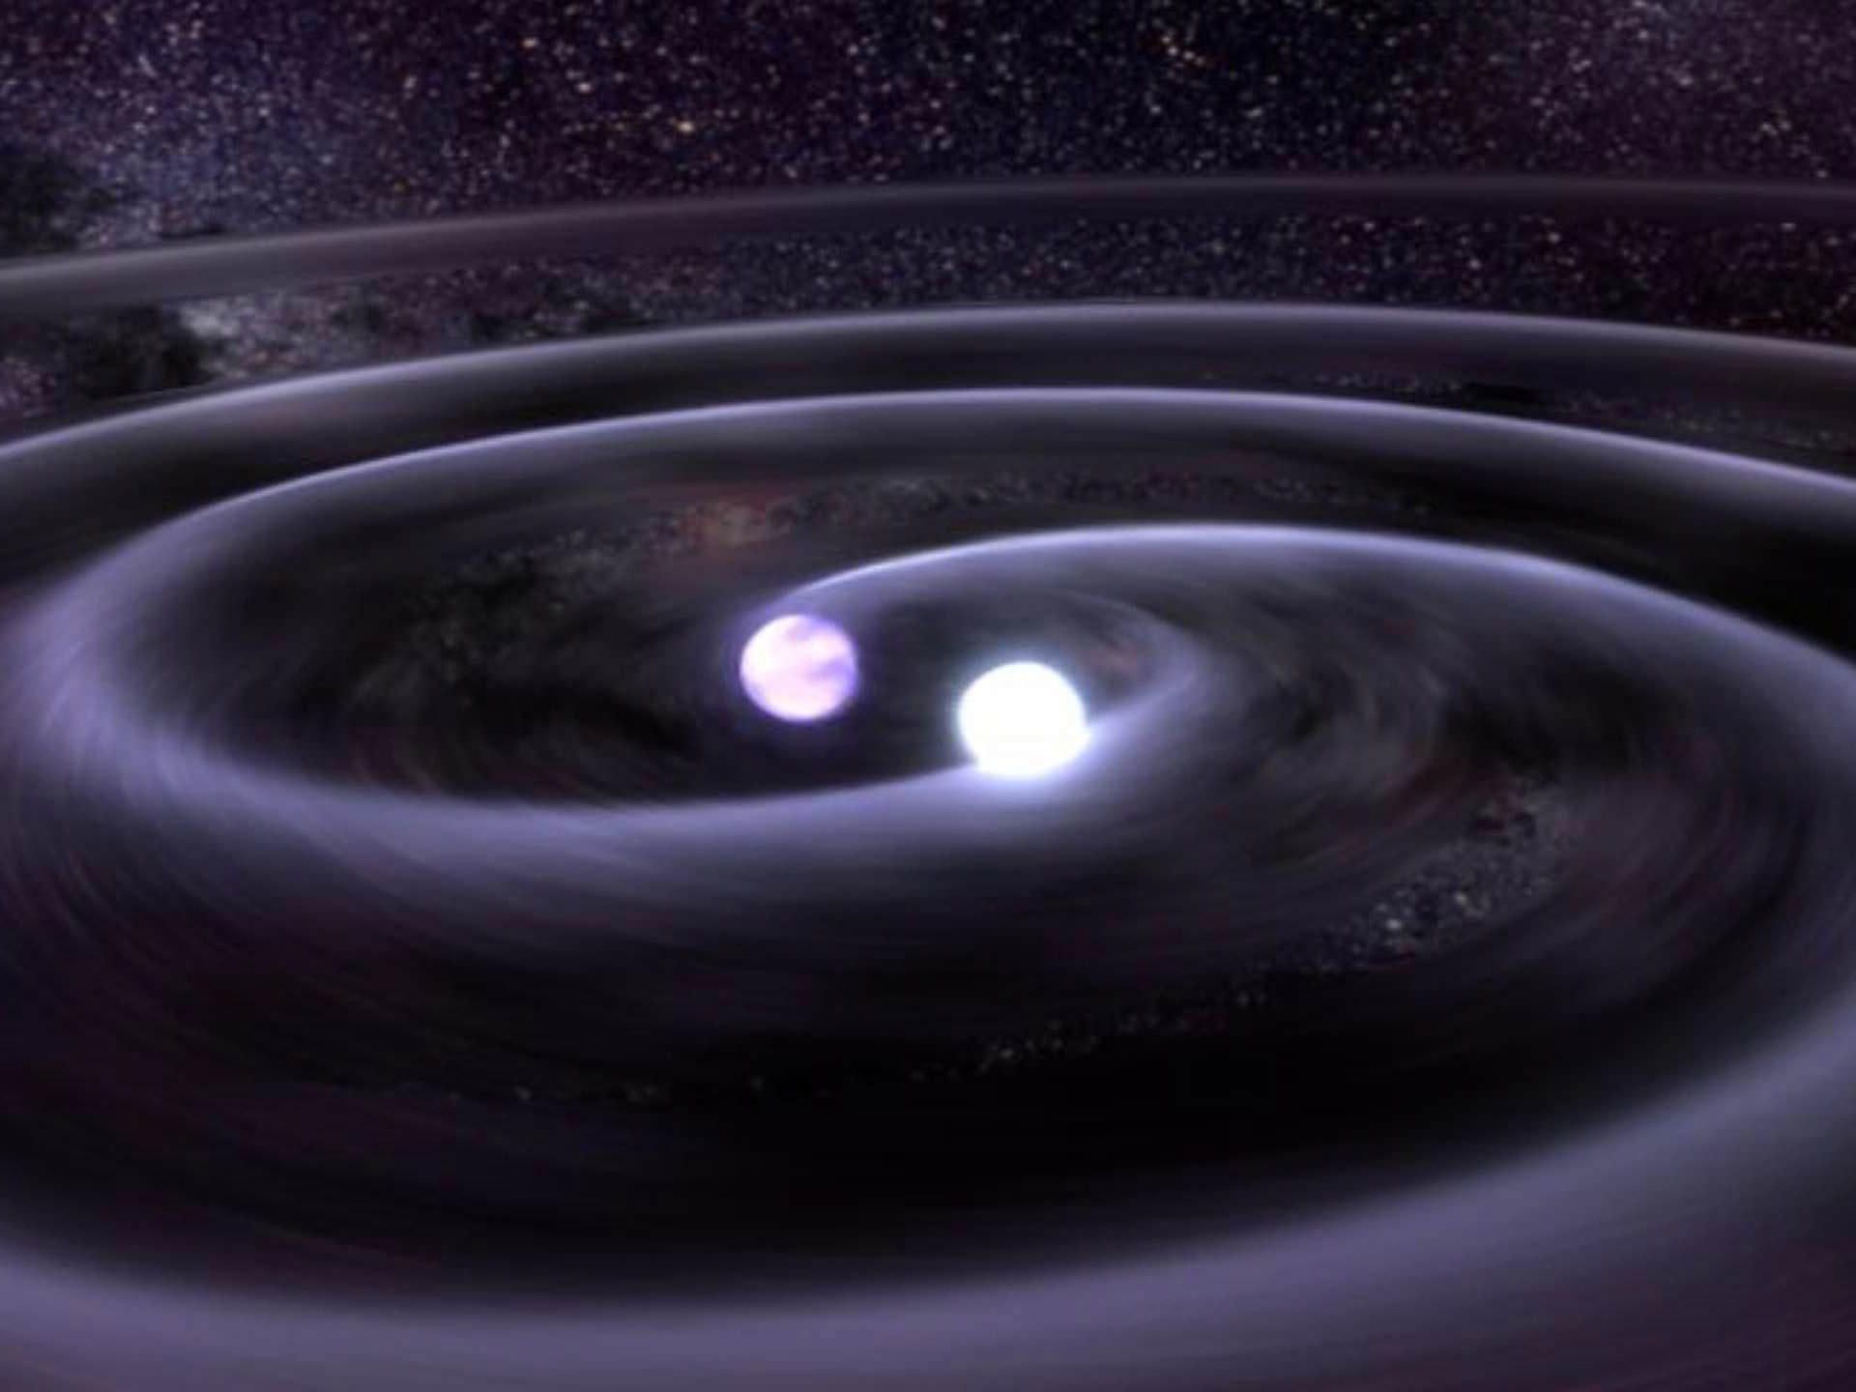






The LIGO-Virgo-KAGRA network and observations in the O4 run
POTOR 10th conference
Kazimierz Dolny, 16-20 September 2024
Thomas Dent
(IGFAE, University of Santiago de Compostela)
For the LIGO-Virgo-KAGRA collaborations
LIGO-G2401768
Image Credit: NASA/GSFC

Slide 2
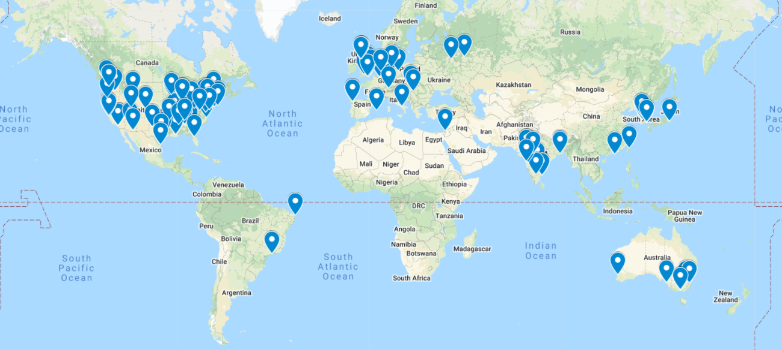

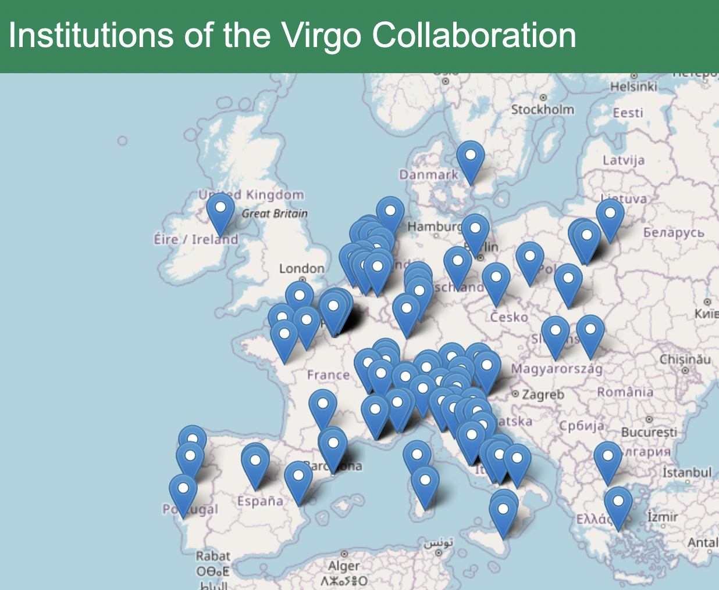
LIGO-Virgo-KAGRA collaborations
& others
outside
Europe !
2

Slide 3
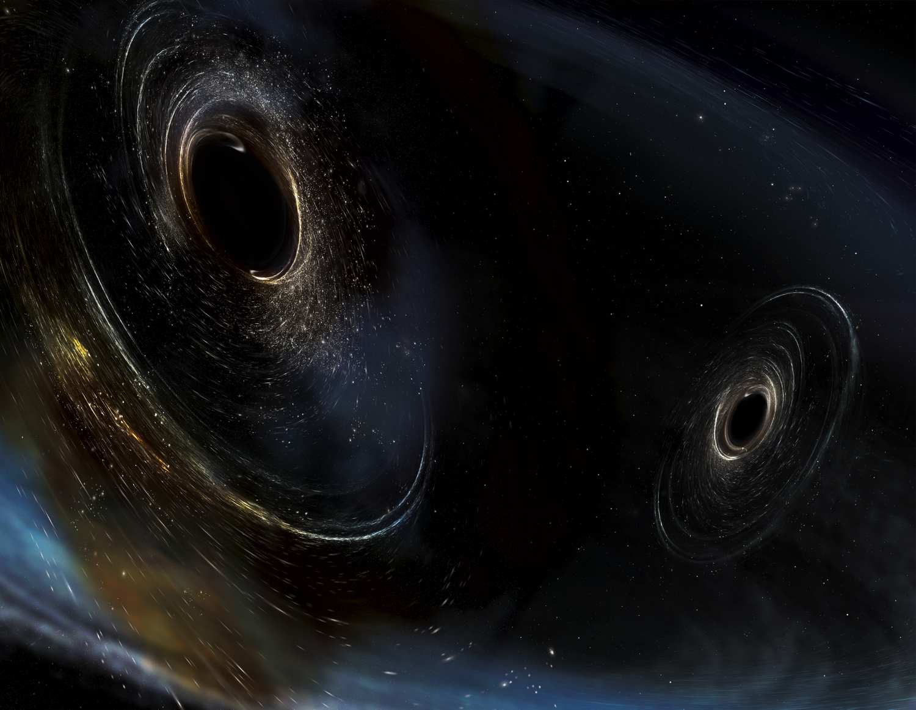
Plan of the talk
The weakest force : gravity
Ground-based GW detectors & sources
GW as a natural relativity laboratory
LVK observations up to O3 (2015-2020)
The O4 run (2023-2025)
O5, XG and looking forward
Image Credit: Aurore Simonnet/SSU

Slide 4
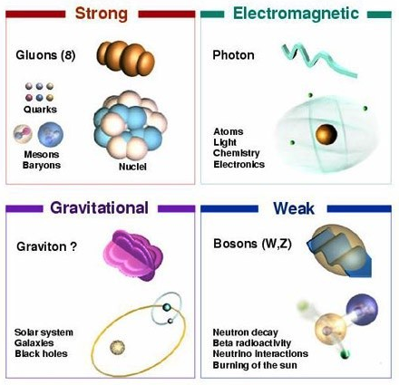
4 (known) fundamental forces

Slide 5
Exploring the cosmos via fundamental forces
Electromagnetism : light ! ([pre-]C17 -)
  optical, UV, IR, radio, X-ray, gamma-ray
Strong force : Cosmic ray astronomy (1912 -)
Weak force : Neutrino astronomy
  solar neutrinos (1968 -)
  supernova neutrinos (1987 -)
  UHE neutrinos (2013 -)
Gravitation : Gravitational Waves (Einstein 1916)
  indirect via effects on binary pulsars (1981 -)
  direct GW detection (2015 -)

Slide 6
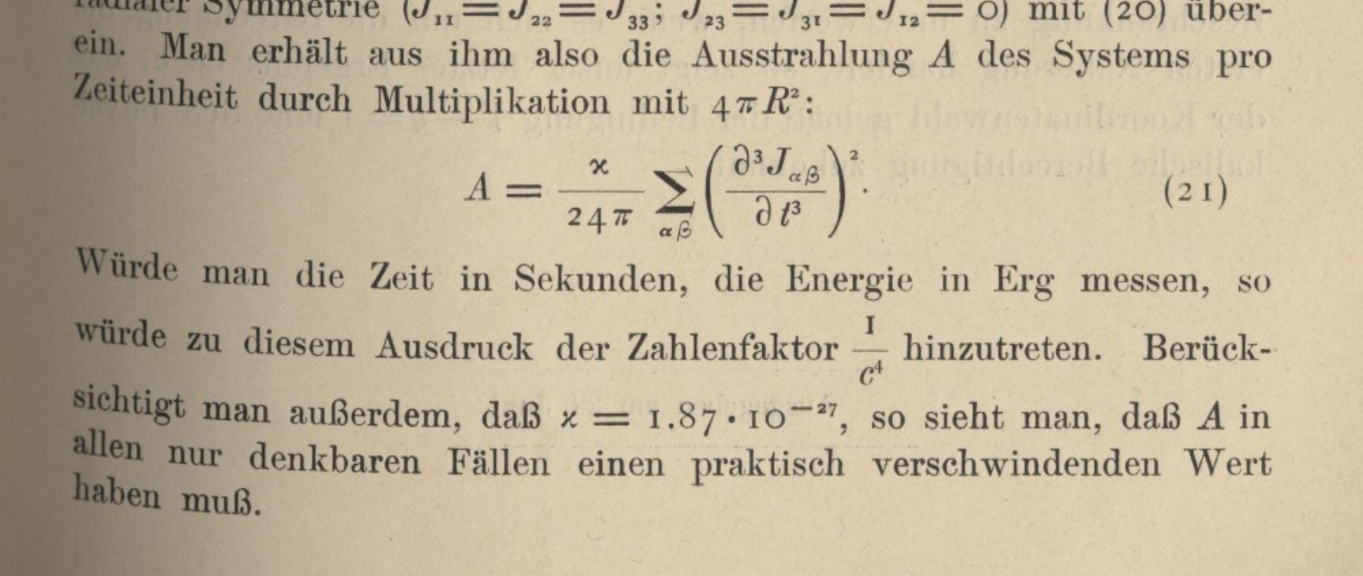
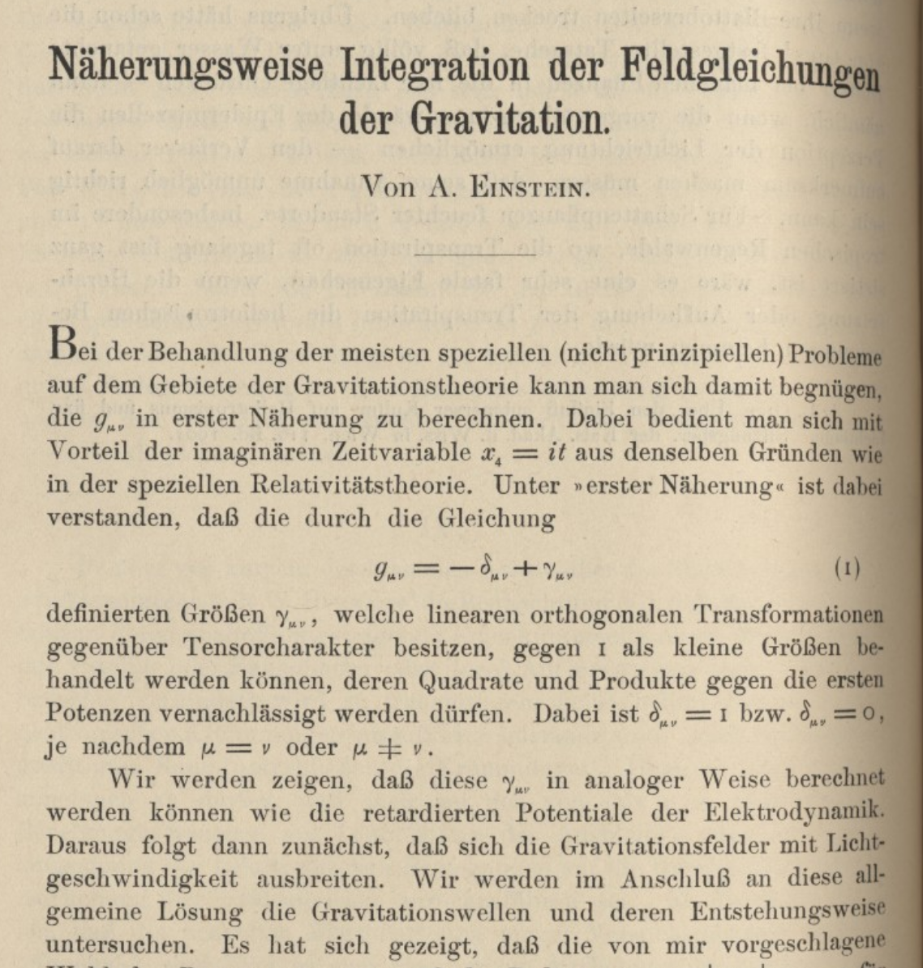
Einstein 1916 : Gravitational waves
~10⁻⁴³
Linearized approximation
GW propagate with light speed
GW emission “vanishingly small in all conceivable cases”

Slide 7


How to ‘see’ GW
Tidal effect on spatially
separated test particles
Can extract energy
– imagine a spring
connecting particles
Measure variations in
distance or travel time
Strain

Slide 8


GW are really small !
Closest known neutron stars 10² − 10³ pc away
(scale of Galaxy ~10⁴ kpc)
Most efficient GW emitters are compact binaries
e.g. binary NS

Slide 9
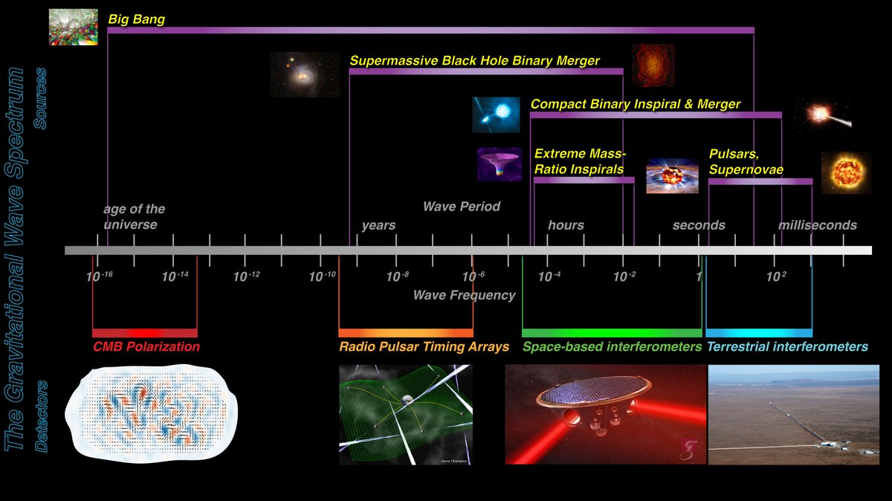
The broad spectrum of GW
Hz
9
NASA / Ira Thorpe

Slide 10
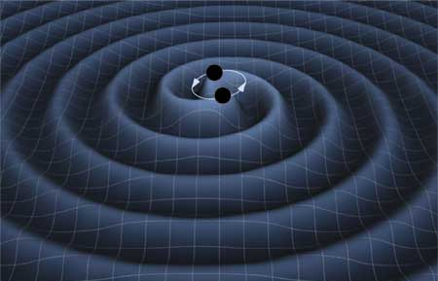
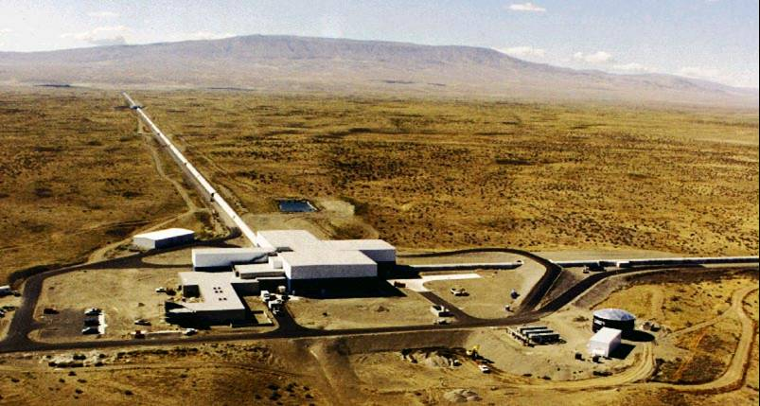
GROUND-BASED GW DETECTORS

Slide 11
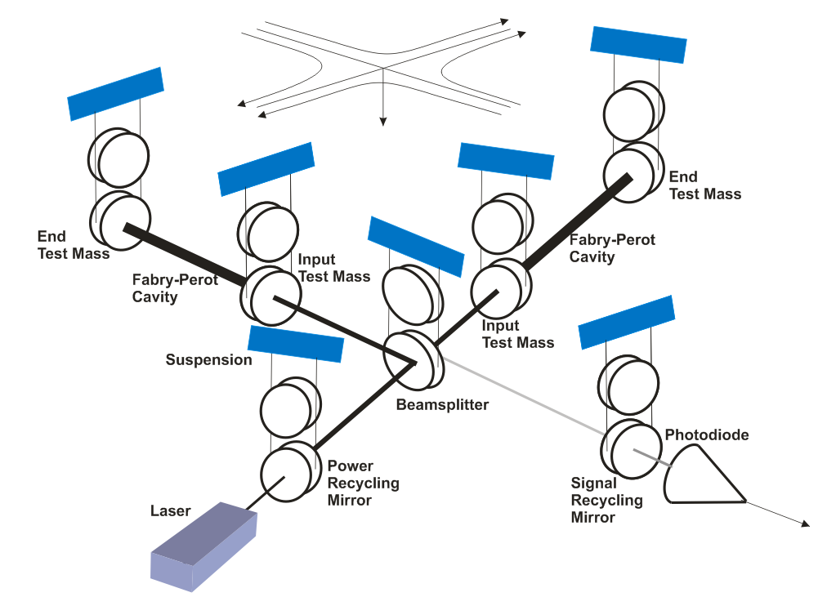
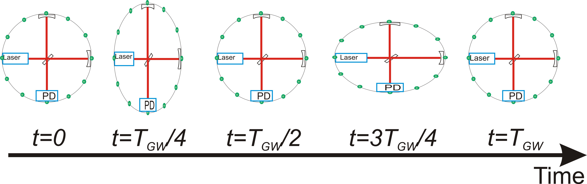
Laser interferometric detection
‘Michelson interferometer’
end mirrors free to move
along arms
Differential length change
δ(L_{x} − L_{y}) = h(t) · L
⇒ time of flight difference
⇒ relative phase difference
@ beam-splitter
⇒ transmitted intensity
variation @ PD

Slide 12
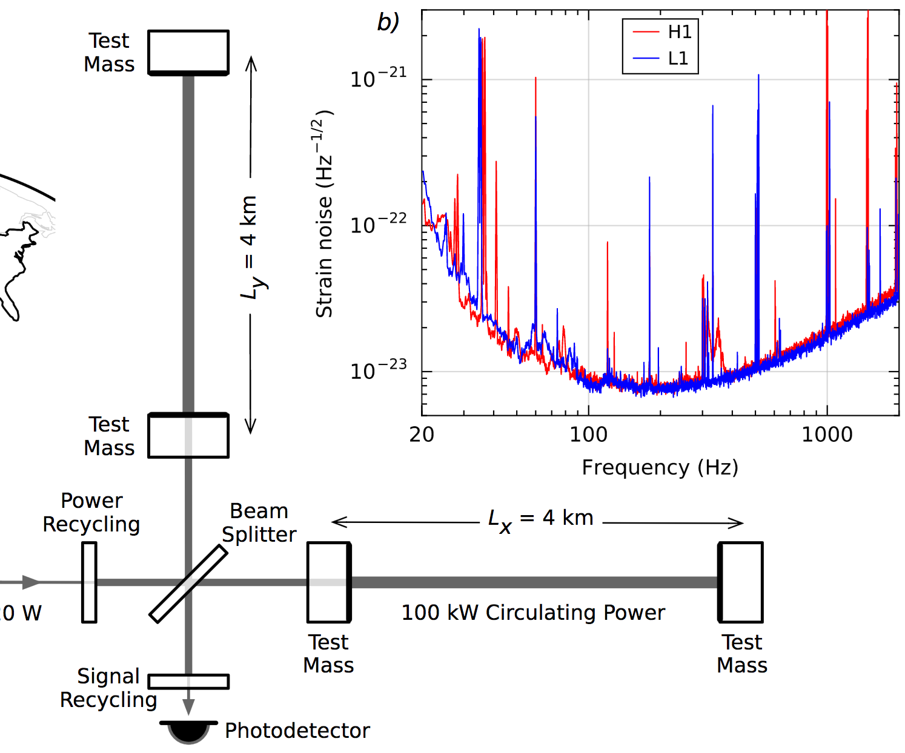
Down to <𝟣e–𝟤𝟥: Enhance the signal
  Long arms
  High power ultra-stable laser
  Power recycling (factor ~𝟥𝟧)
  Resonant arm cavities
  (factor ~𝟥𝟢𝟢)
  Signal recycling
LVC, PRL 116 061102 (2016)

Slide 13
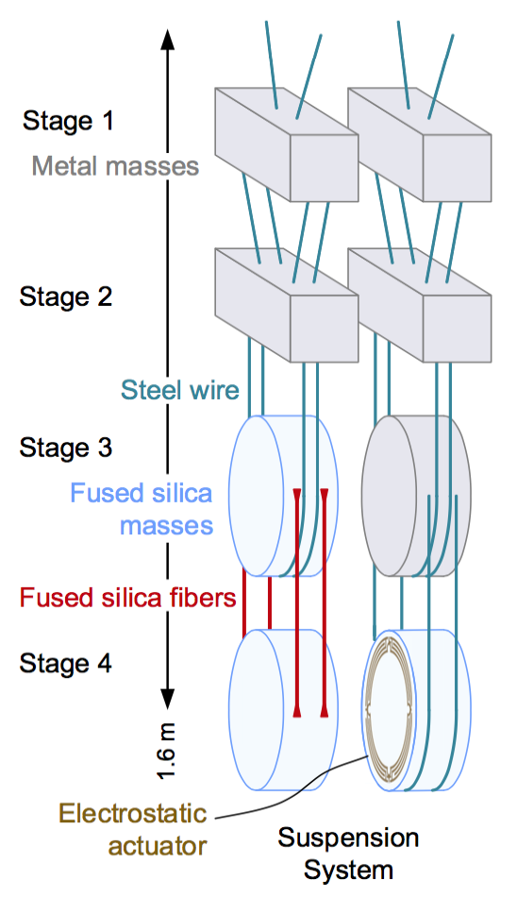
Down to <𝟣e–𝟤𝟥: Suppress noise
Seismic noise reduction
  Active seismic isolation
  Quadruple pendulum
  suspension
  ~𝟣𝟢 orders of magnitude displacement noise suppression above 𝟣𝟢Hz

Slide 14
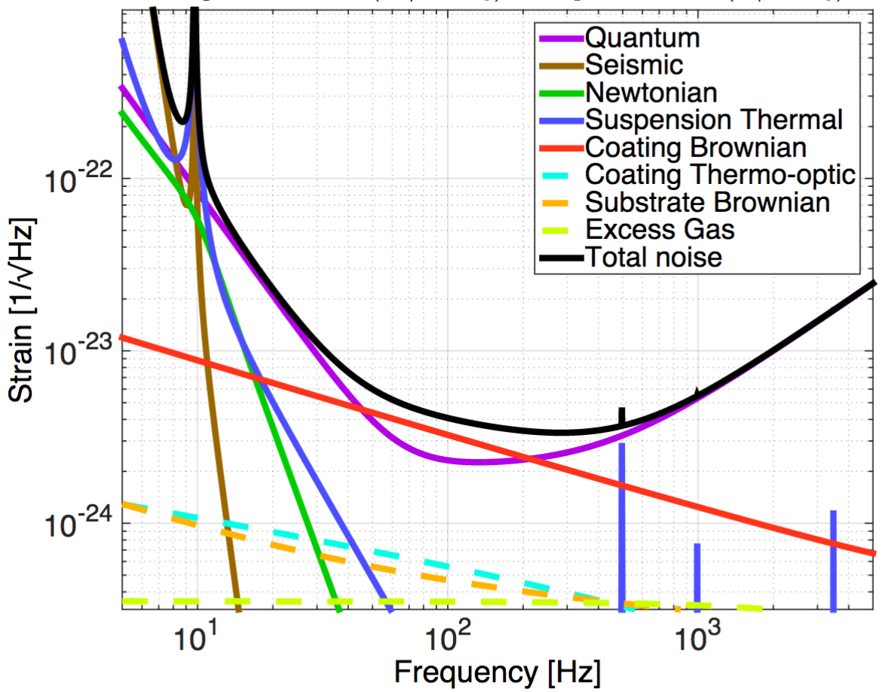
Precision Interferometry =
Understanding Measurement Noises
Fundamental Noises
Displacement Noises
→ 𝚫L(f)
  Seismic noise
  Radiation Pressure
  Thermal noise
    Suspensions
    Optics
Sensing Noises
→ 𝚫t_{photon}(f)
    Shot Noise
    Residual Gas
Technical Noises
Hundreds of them …
Advanced LIGO Design Noise Budget
https://dcc.ligo.org/LIGO-T1800044/public

Slide 15
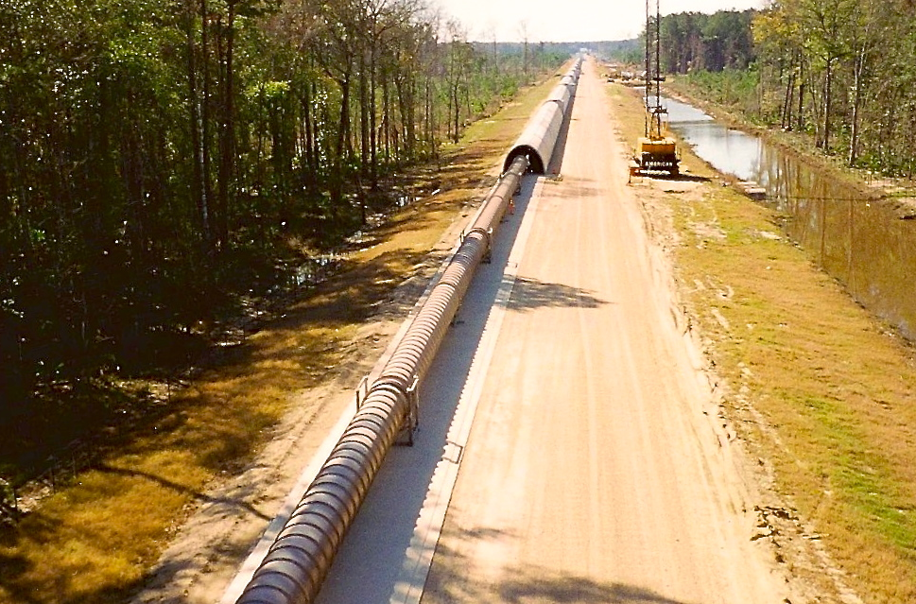
The LIGO Vacuum System
Consists of
  9000 m³ volume
  30000 m² surface area
  50000 m of spiral welds
  10⁻⁸ - 10⁻⁹ torr
At each observatory

Slide 16
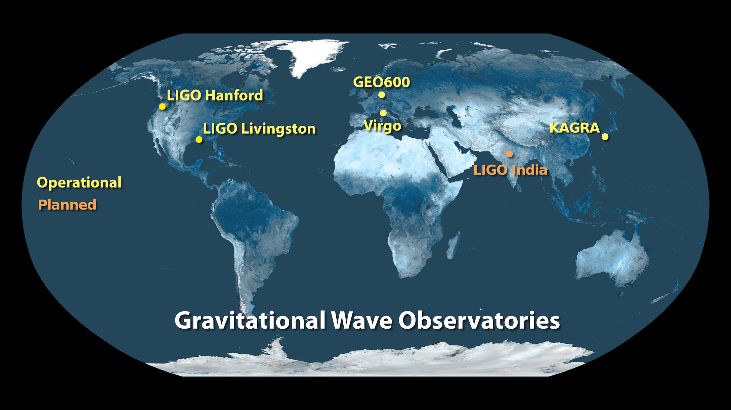
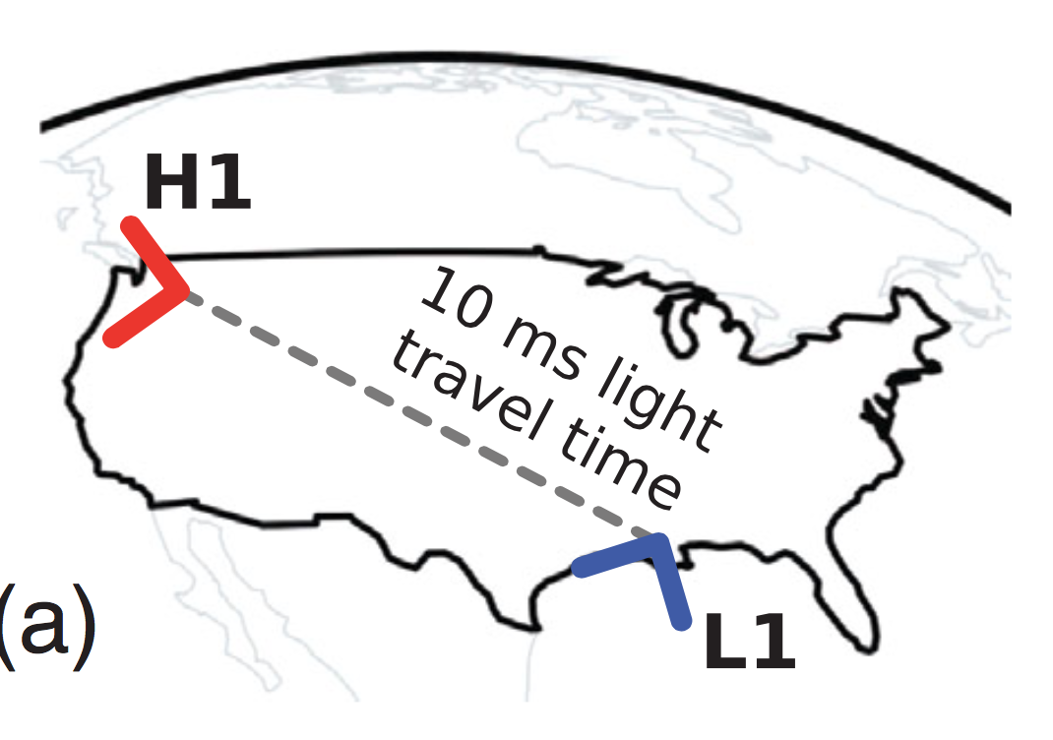
A global network
Image credit: LIGO Lab
Detection rate, sky coverage, network duty cycle
Greater accuracy on source parameters
- Distance, sky location, orientation of source ...

Slide 17
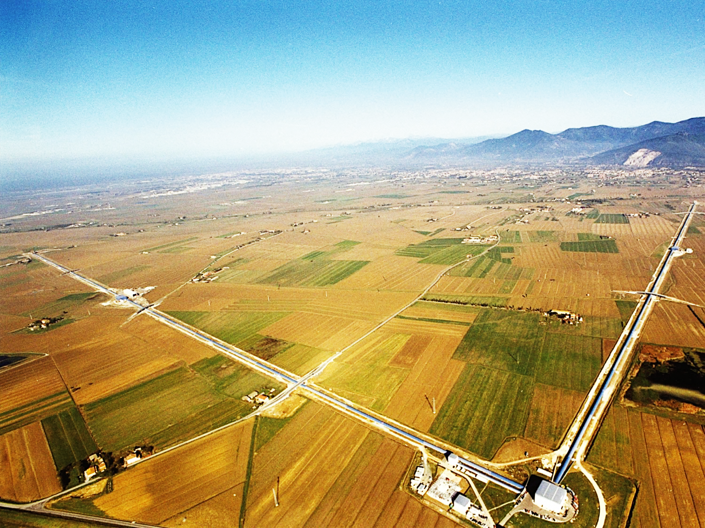

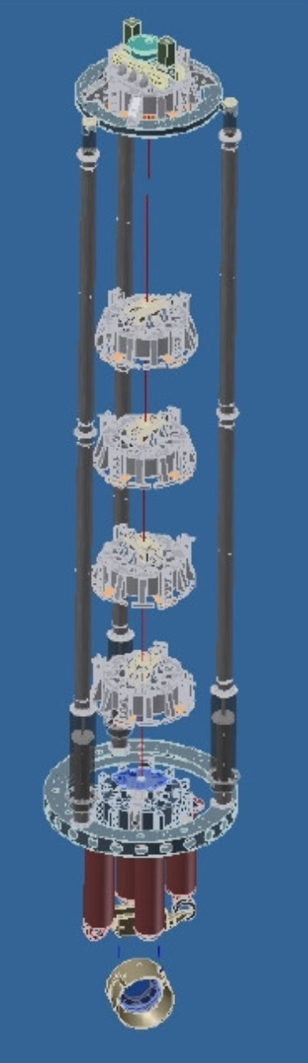
ADVANCED VIRGO
163 Institutions in 20 different countries
~915 collaboration members
Date

Slide 18
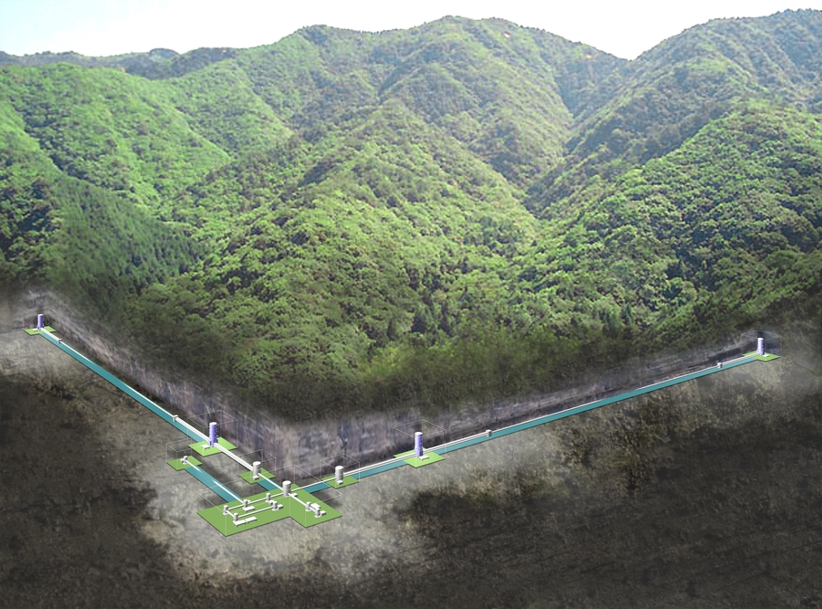
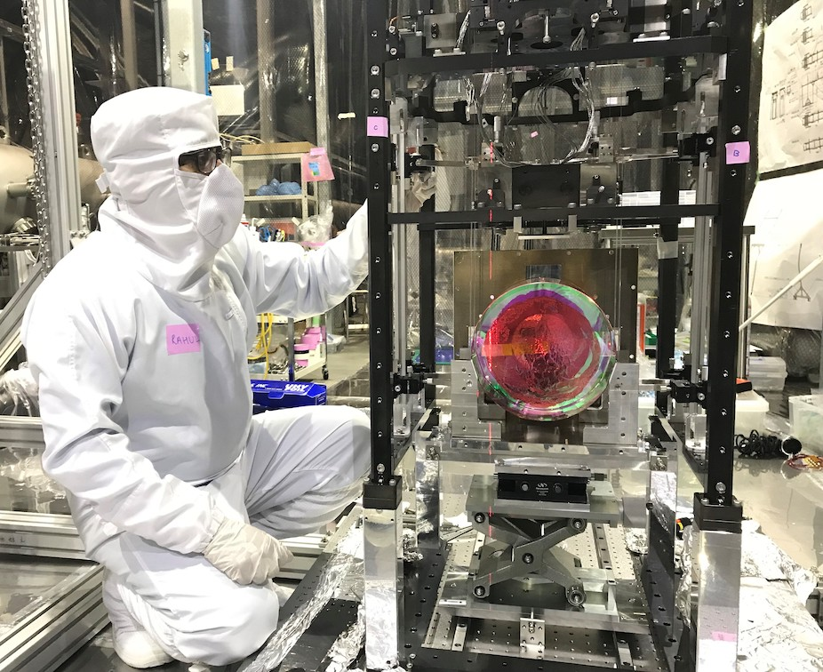
Cryogenic sapphire mirror payload
Image Credit: Rahul Kumar/LIGO Lab

Slide 19
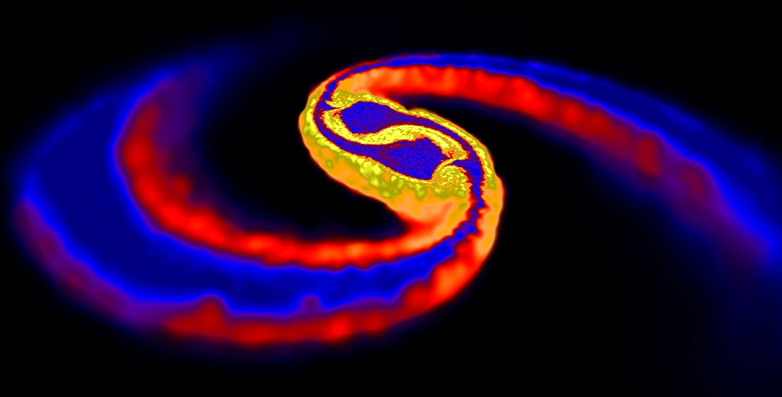
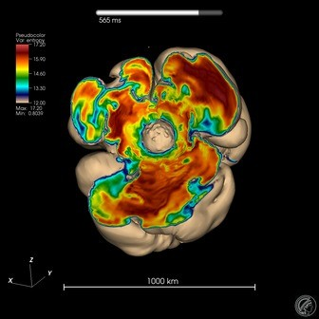
Transient GW sources
Highly relativistic systems …
CBC
Burst
Image : D. Price (Exeter) & S. Rosswog (Bremen)
Cataclysmic events of compact
astrophysical objects
  NeutronStar / BlackHole binary
  mergers
  CoreCollapseSuperNovae
  Pulsar glitches / oscillation modes ?
  Exotics : cosmic string kinks ? ...
Simulation: F. Hanke et al. (MPIA Garching)

Slide 20
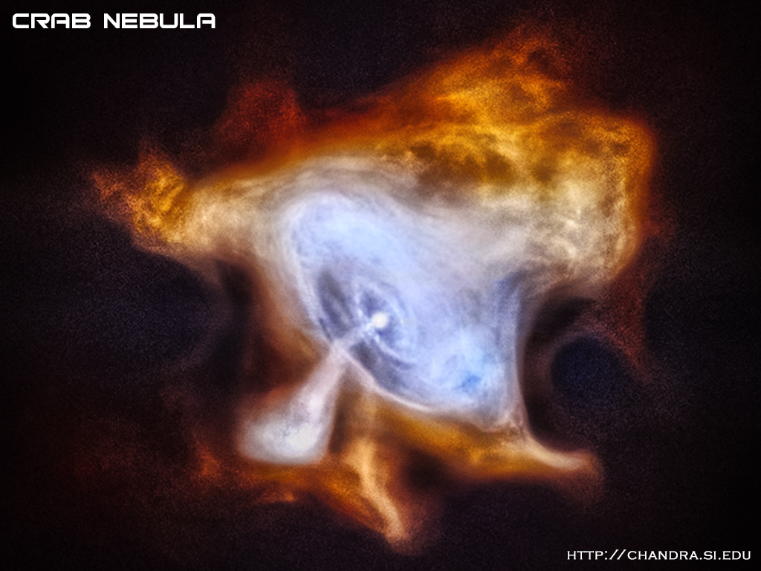
Persistent GW sources
Continuous Wave : sinusoids from rotating NS
  many potential sources in Galaxy
Stochastic : random ‘background’
from superposition of unresolved
sources
  astrophysical
  transients at high redshift
  primordial
  quantum fluctuations / critical
  phenomena in very early Universe
Chandra X-ray images of Crab pulsar

Slide 21
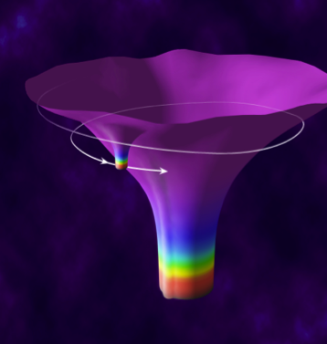
Gw observations and relativity

Slide 22
‘Non-GW’ probes of GR
GR light deflection
Perihelion shift of Mercury
Solar System tests (Lunar Laser Ranging …)
(Strong) Equivalence Principle tests
Precision clock measurements, GPS, …
Dynamics of galaxies & galaxy clusters, cosmological tests

Slide 23
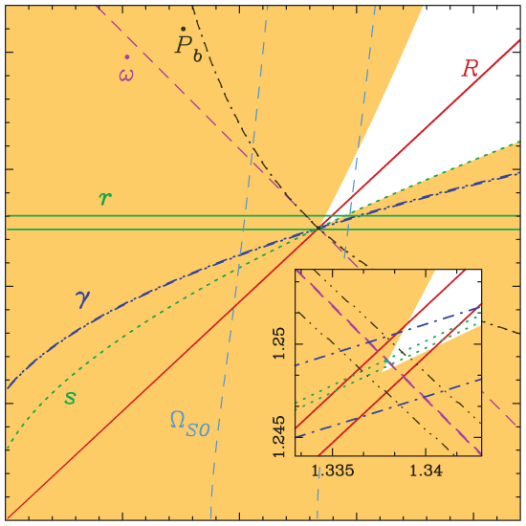
Exploring general relativity with GW sources
Strong field : compact objects (NS, BH)
and behaviour ‘close to’ singularities via NR
Precise constraints on low velocity PN expansion
  v/c up to ~0.4
  ‘Higher modes’ (beyond quadrupole)
Black hole perturbation theory - ‘ringdown’
Small mass ratio expansion – ‘self-force’
  Probe of Schwarzschild / Kerr geometry
Exotics : black hole mimickers, boson stars …
Early Universe : quantum fluctuations … ??
Consistency of relativistic effects in double pulsar J0737–3039A, B (Image M. Kramer)

Slide 24
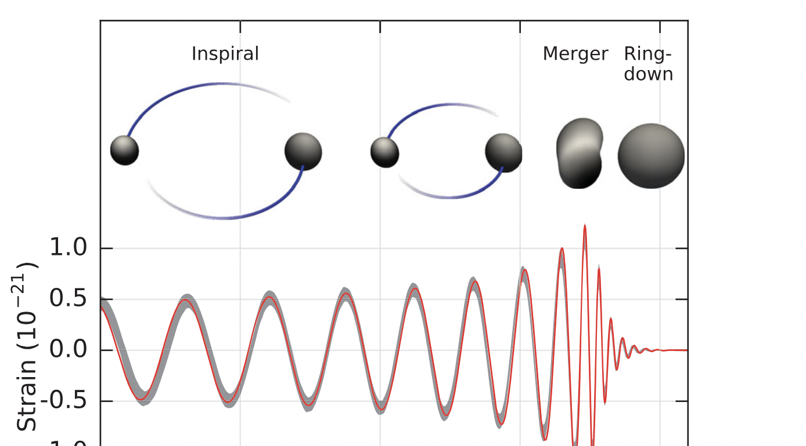
Anatomy of a binary merger
Numerical Relativity
Post-Newtonian
Black Hole
Perturbation
Theory
LVC PRL 116, 061102 (2016)

Slide 25
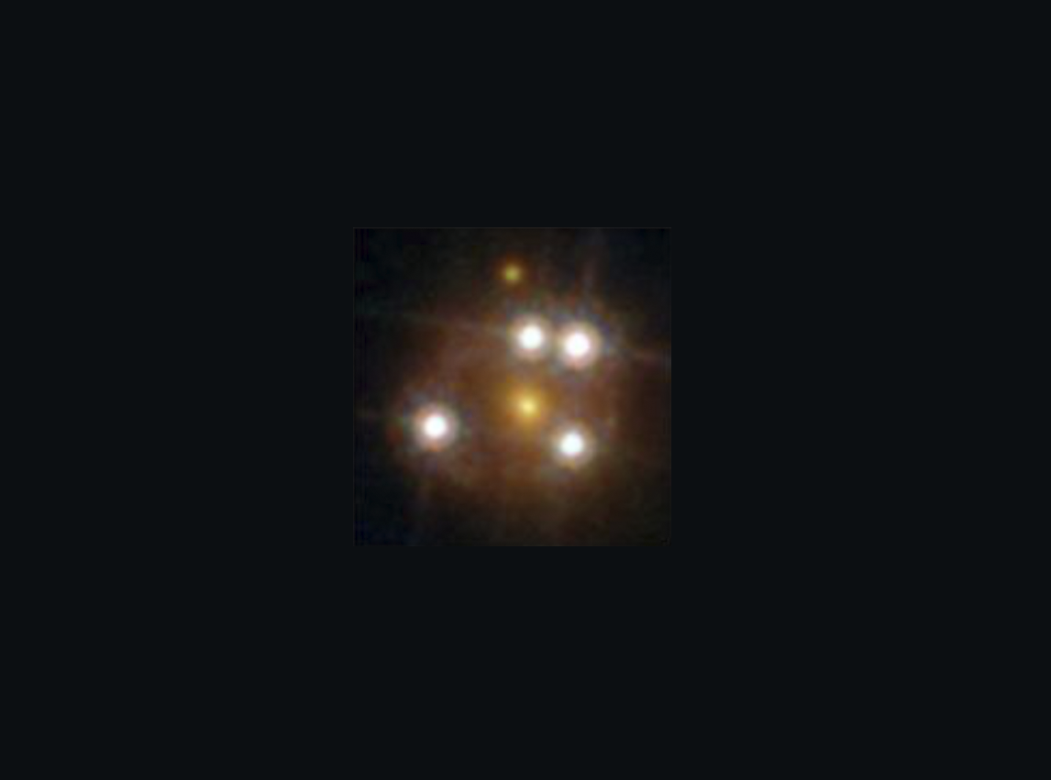
Exploring general relativity with GW propagation
Verify 2 transverse tensor polarizations
Verify speed of GW propagation
  Multi-messenger events with prompt emission
  [GW170817 !]
Constrain non-GR dispersion (eg graviton mass)
(‘Strong’ or ‘Weak’) Gravitational Lensing of GW
  Amplification of signal
  Multiple transient “images”, other possible effects

Slide 26
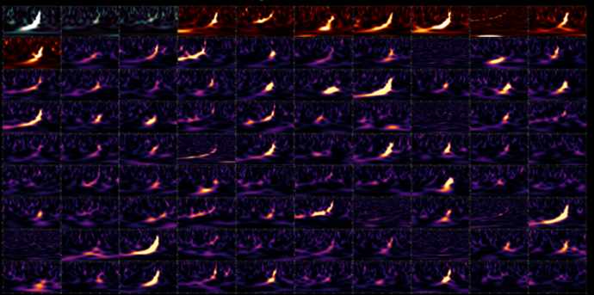
LVK : Highlights up to O3
Detections of compact binary mergers from 2015-2020
Image credit: LVK / S. Ghonge & K. Jani
26

Slide 27
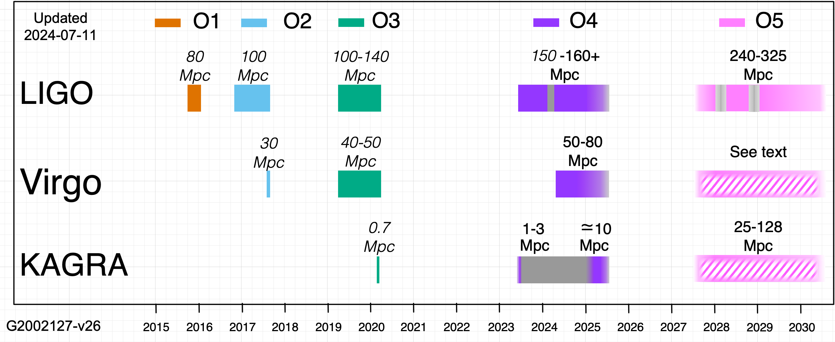
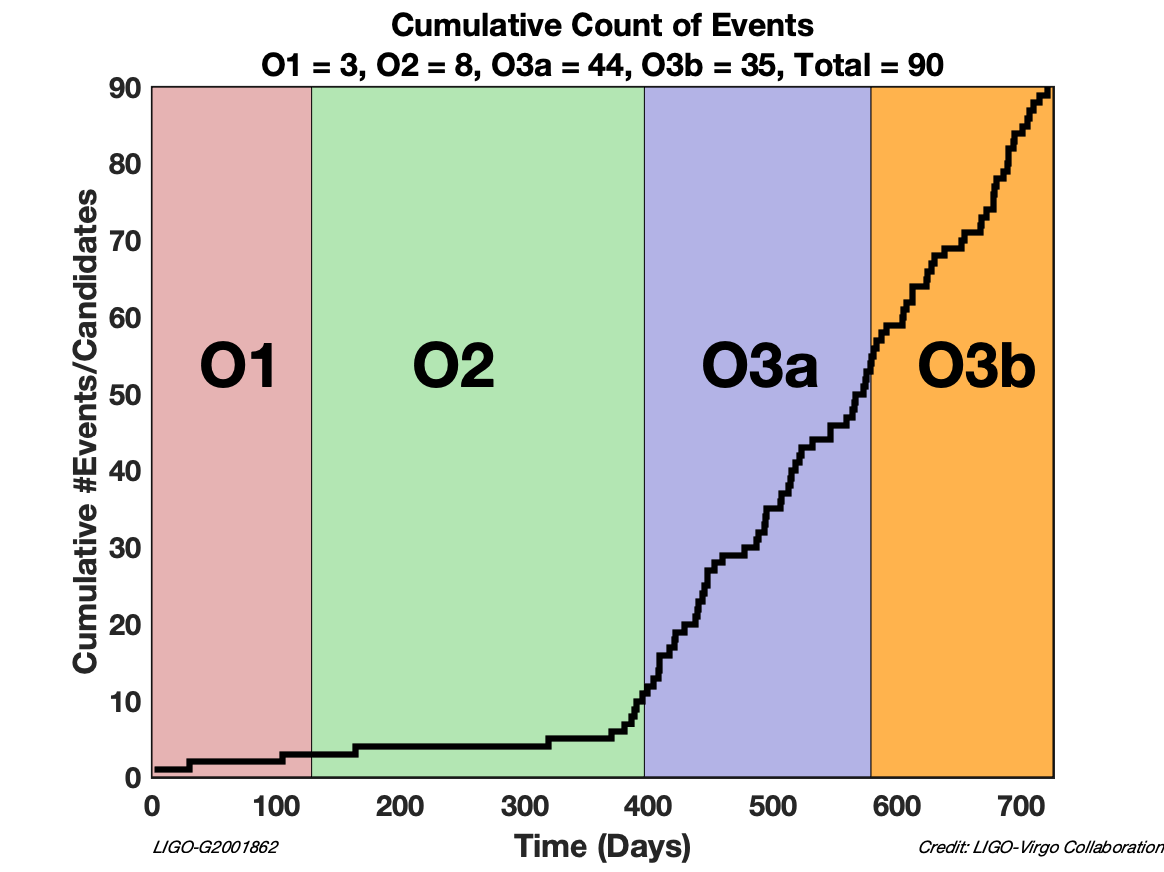
LIGO-Virgo observations up to 2020
O3 run : April 2019 through March 2020
90 ‘significant’ binary merger candidates (cumulative O1-O3)

Slide 28
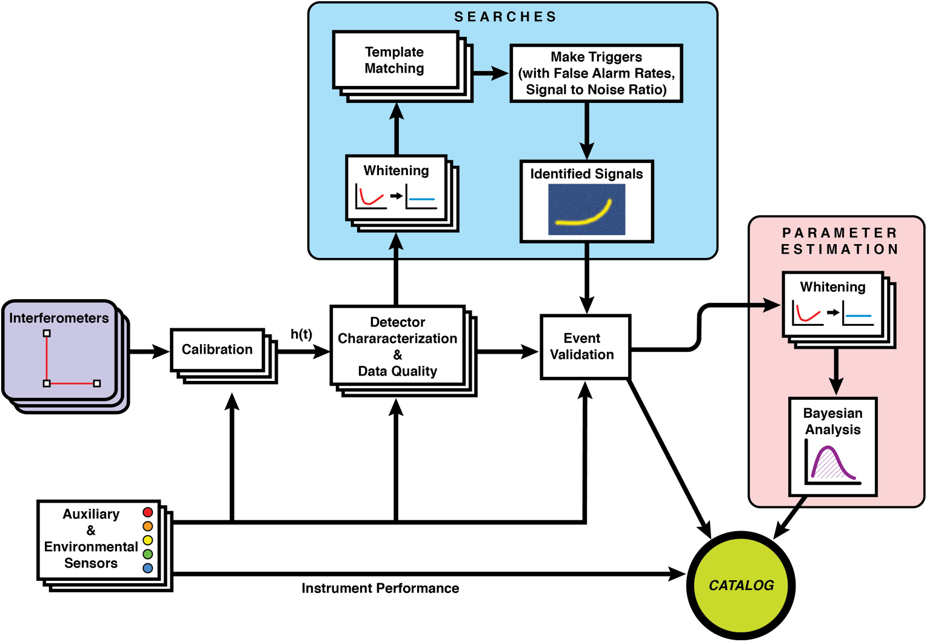
From the detectors to the events
LIGO & Virgo Collaborations
Class. Quantum Grav. 37 055002
(2020)

Slide 29
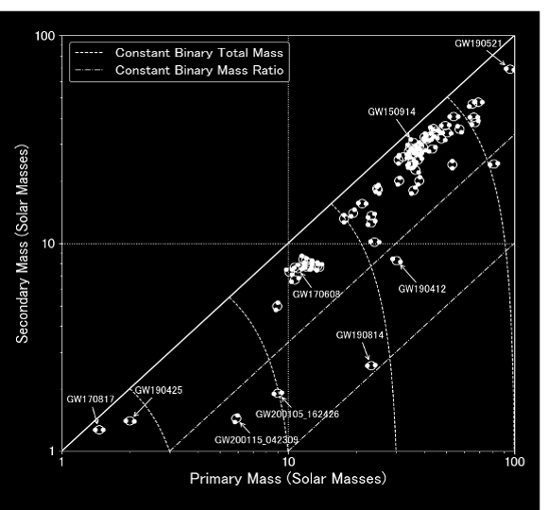
IMBH …
https://www.ligo.org/science/
Publication-O3bAstroDist/
Broad BBH population
Outliers .. ?
BNS detections
NS-BH detections
29

Slide 30
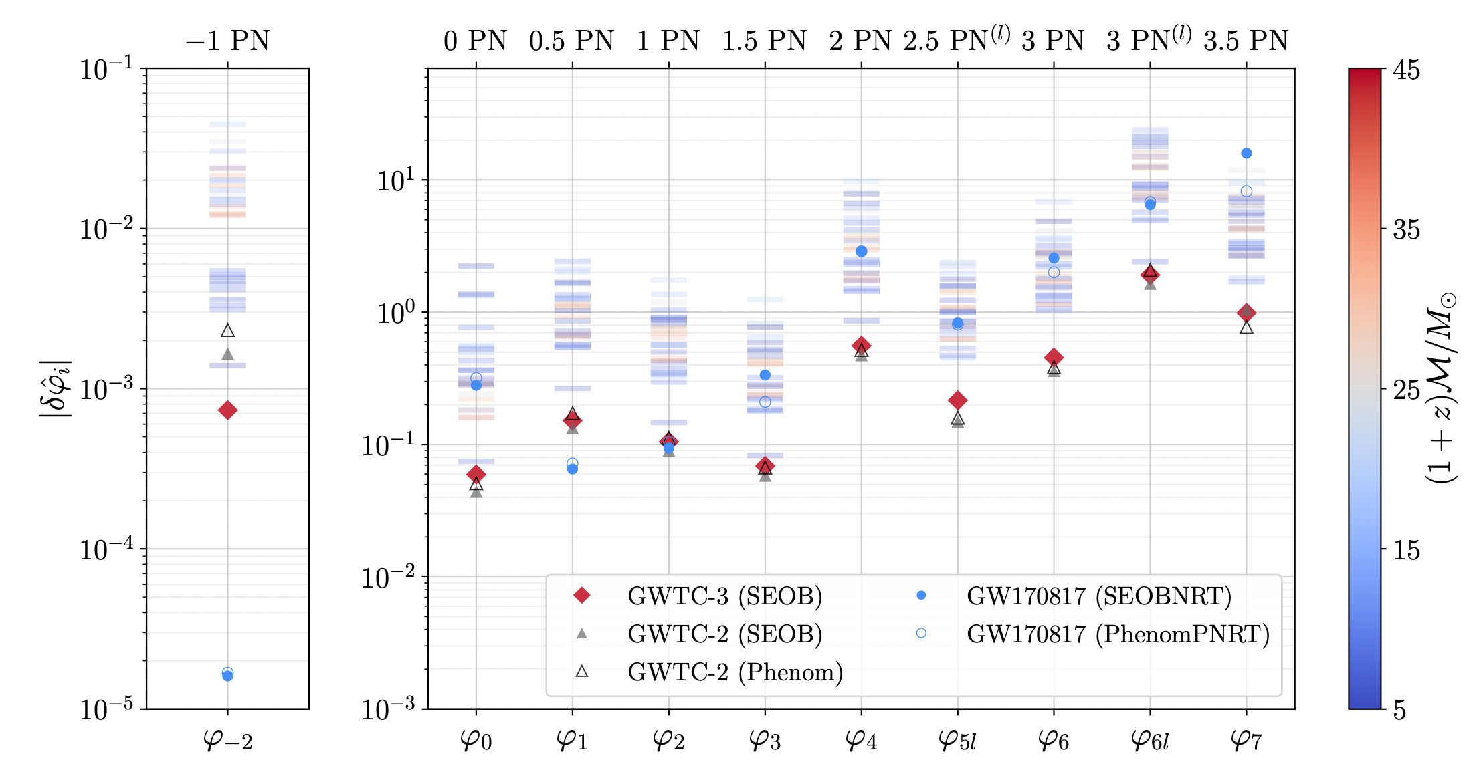
How is relativity doing ?
LVK, arXiv:2112.06861 (accepted, PRD)

Slide 31
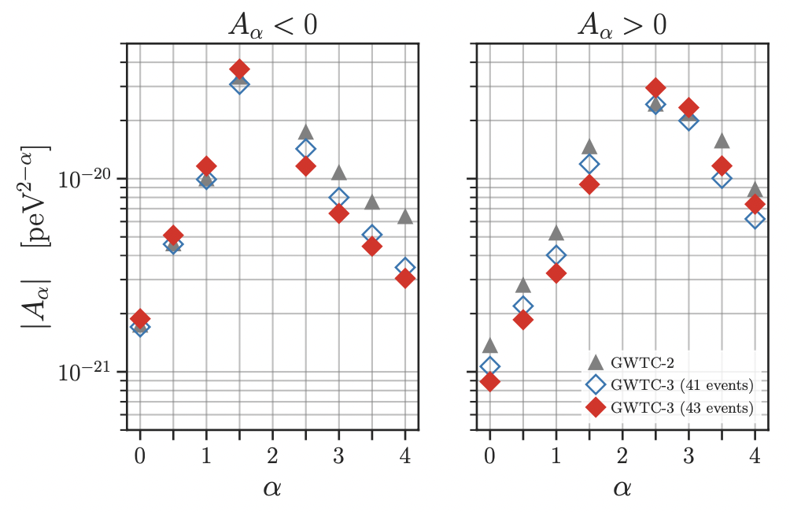
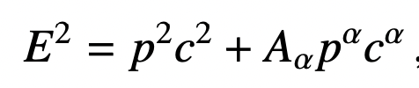
How is relativity doing ?

Slide 32
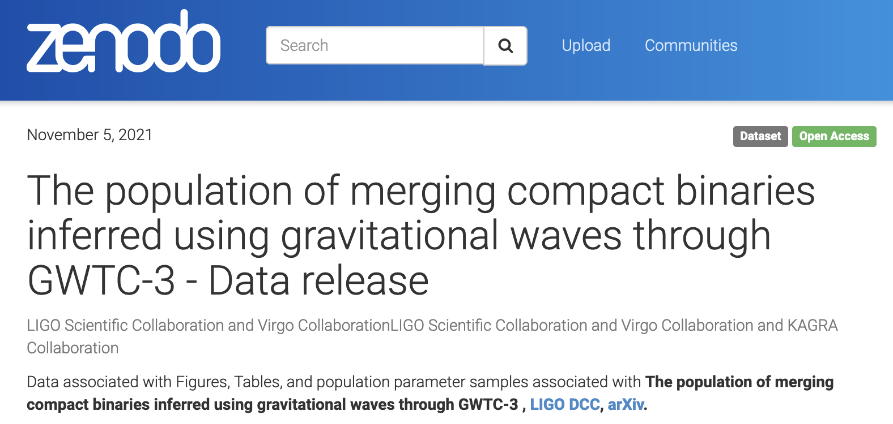
LVK public data products
GW Open Science Center data on GWTC-3
Data release for
papers: inference
samples, table data,
tutorial notebook …
https://www.gw-openscience.org/eventapi/html/GWTC-3/
https://dcc.ligo.org/LIGO-P2100239/public
https://zenodo.org/record/5655785

Slide 33
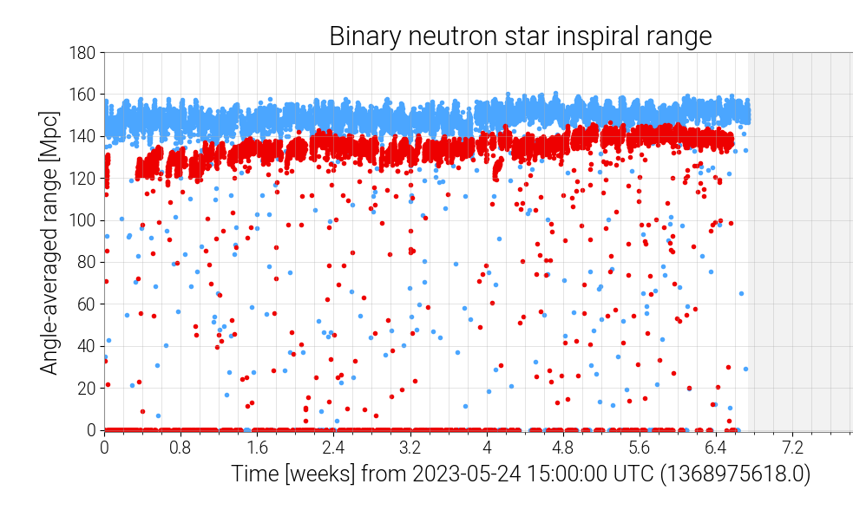
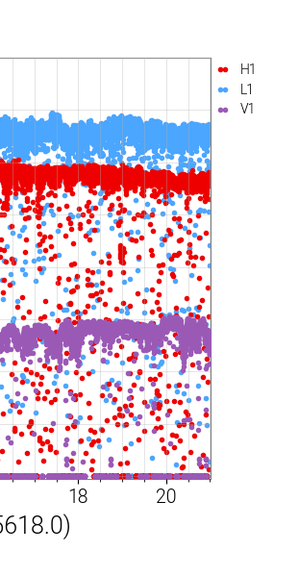
From O3 to O4a …
O4 started May 2023
  Frequency-dependent vacuum squeezing in LIGO
  New 300m filter cavities, increased arm power …
  KAGRA joined for 1mo, working to improve sensitivity
  Virgo commissioning problems joined in O4b (see next slides!)
Last part of
O3 (same scale)

Slide 34
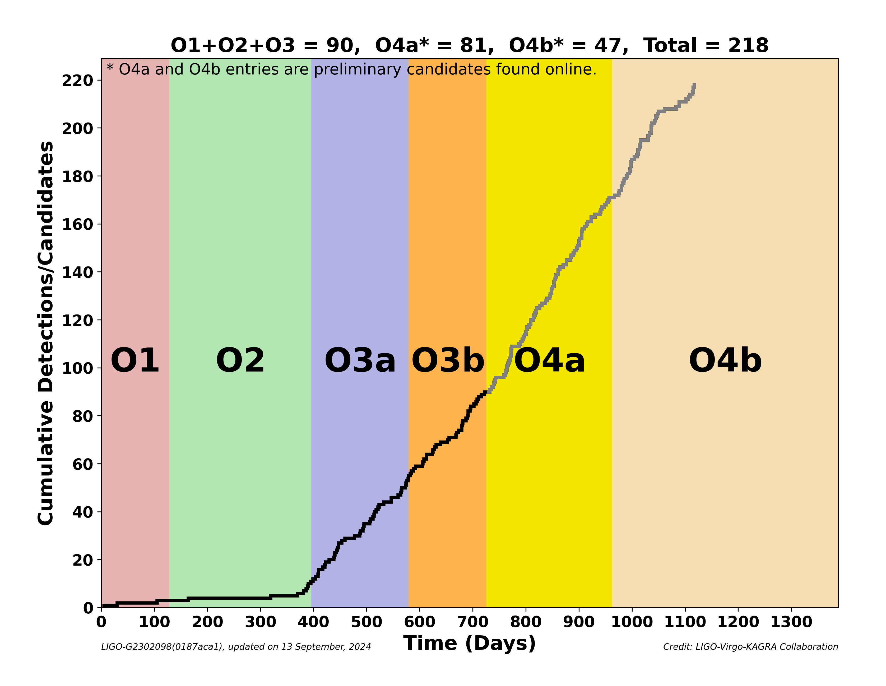
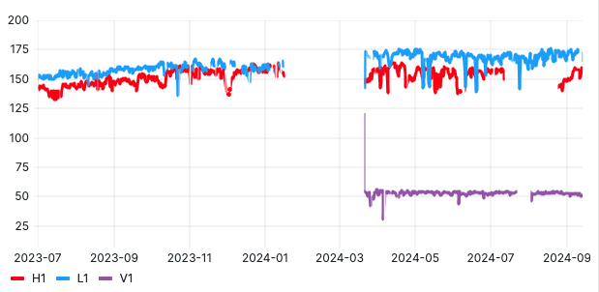
The news from O4b …
April 2024 : Virgo joined
  Sensitivity similar to O3 atm
  ongoing ‘noise hunting’
LIGO continues to improve …
O4 extended to June 2025
  allow for preparation of O5 upgrade hardware
KAGRA had significant setbacks from Noto Peninsula Earthquake (Jan 2024)
  All repairs now complete, commissioning work ongoing
  Goal to rejoin O4 with sensitivity ~10 Mpc or higher

Slide 35
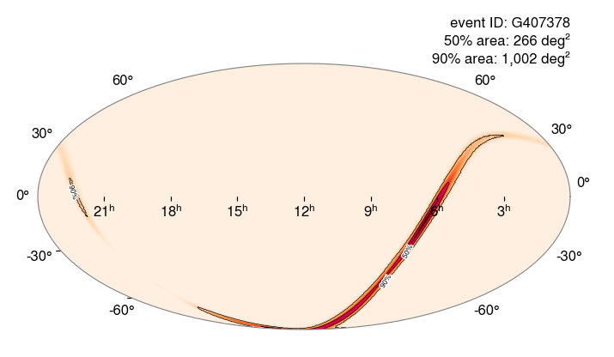
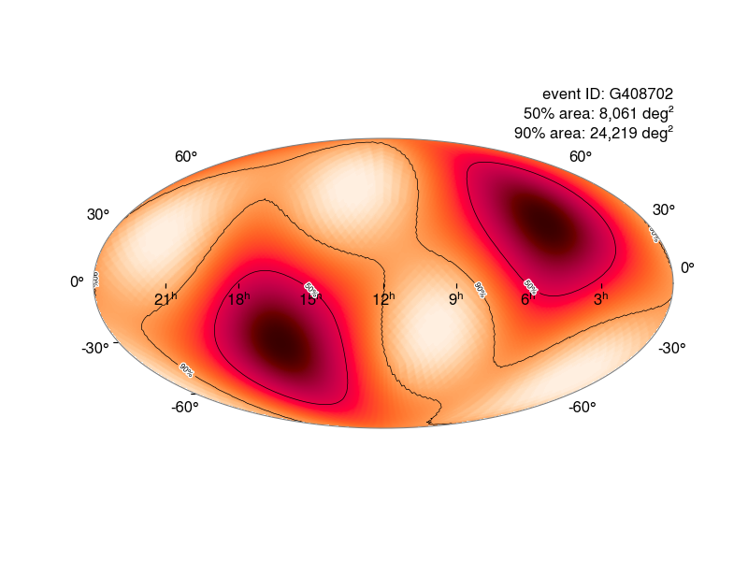
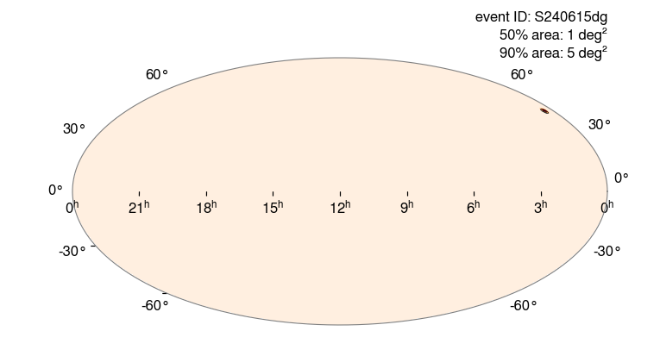
A few O4 public event highlights
230518 : pre-run engineering data
Probable NS-BH merger
230529 : single-detector event
Another possible NS-BH merger
(see next slide …)
240615 : smallest localization area
5 deg² due to 3 detectors
(first of 2 alerts on same day!)
https://gracedb.ligo.org/superevents/public/

Slide 36
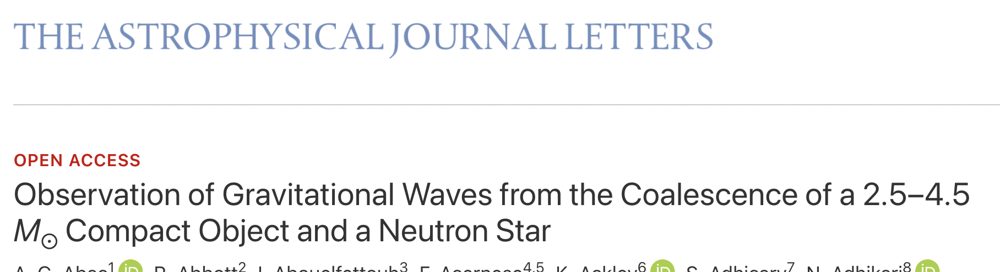
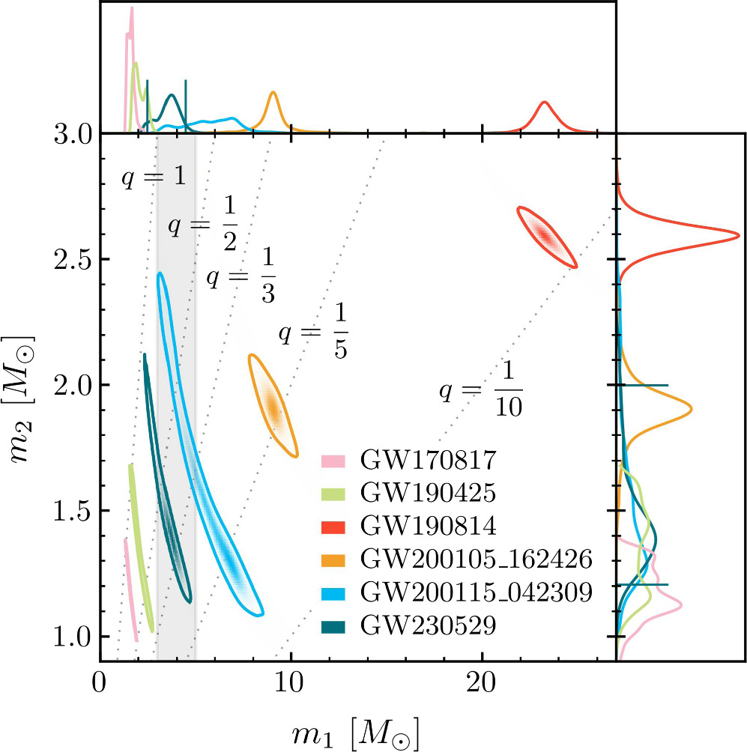
GW230529 : the lightest NS-BH ?
First publication of O4 run
Strengthens evidence
against supposed
‘mass gap’ 3-5 M☉
No direct measurement
of tidal (NS matter) effects
Increases our estimates
for future NS-BH mergers
with EM emission

Slide 37
INTO The future . . .

Slide 38
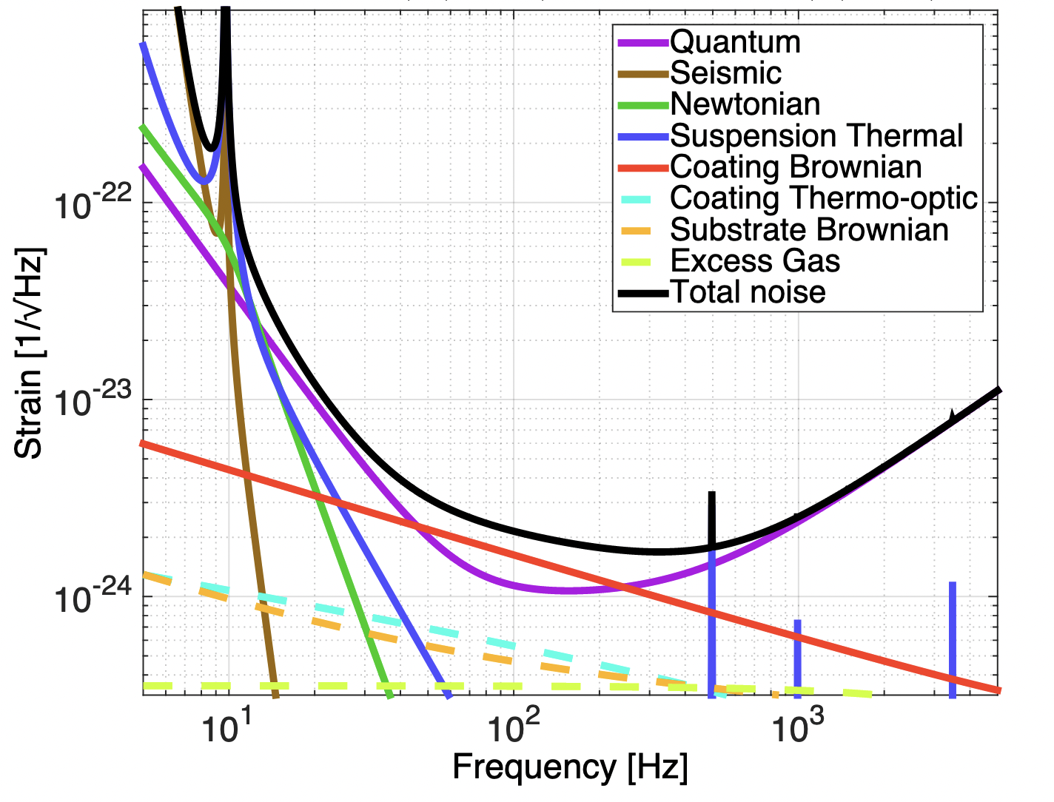
O5 : the ‘A+’ design
Mid-scale upgrade of
original ‘Advanced LIGO’
Frequency-dependent
squeezing already in O4
(LIGO) !
LIGO-G2002127-v26
Most critical technology :
improved mirror coatings
to deal with higher arm power
Virgo O5 plans & sensitivity currently under reassessment
https://observing.docs.ligo.org/plan/
LIGO-T1800042

Slide 39
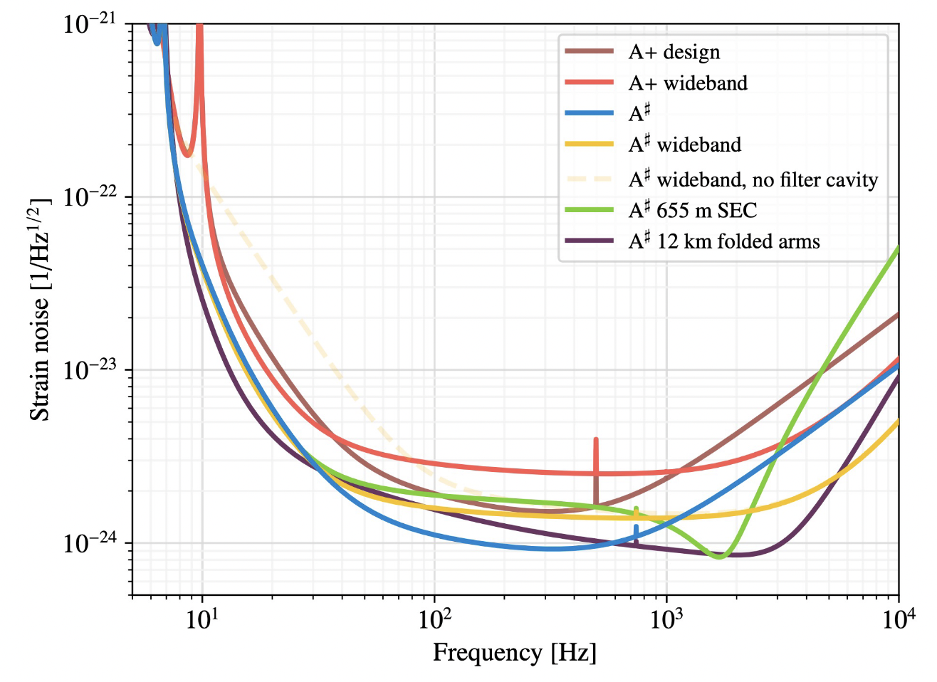
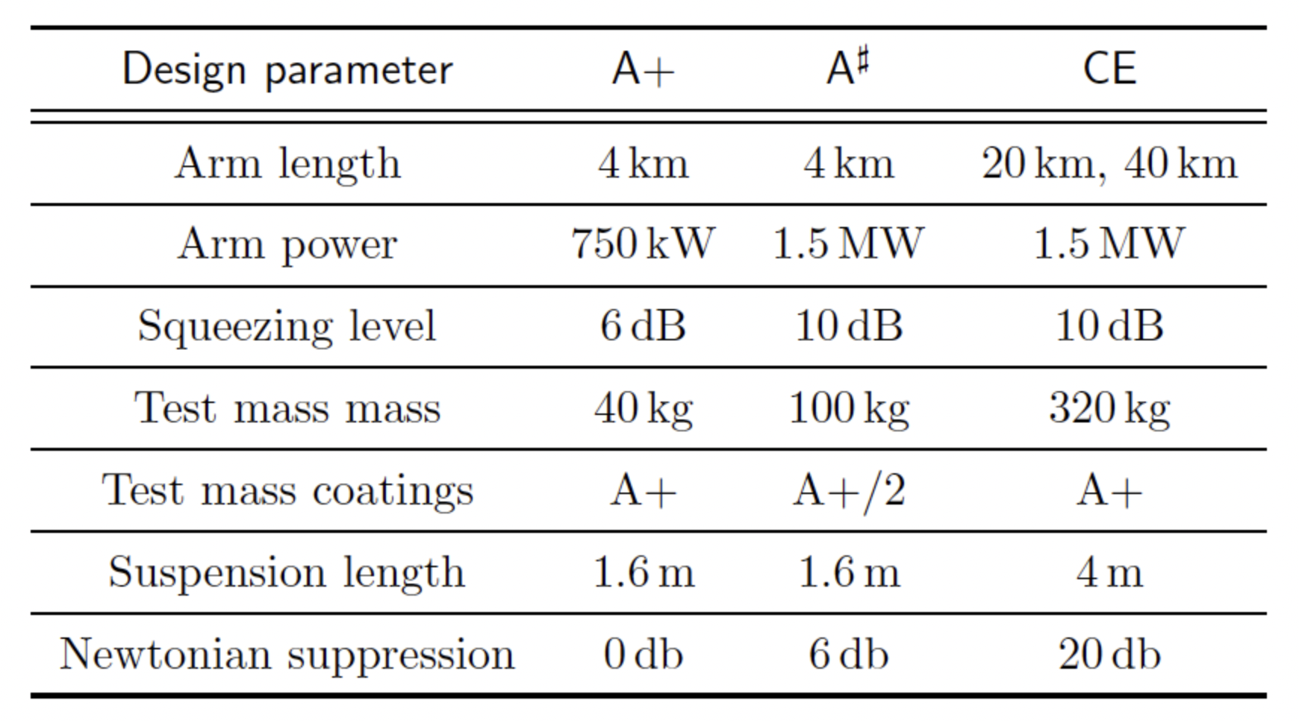
Post-O5 : A# / Virgo_nEXT /...
Upgrades exploiting existing facilities to the limit
Targets factor ~2 increase in range over O5
Stepping stone to future detector technologies
Fill gap in observational capability to ‘next generation’ of observatories
LIGO-India : (LAO, Aundha) planned to operate early 2030s
D. Reitze, https://www.nsf.gov/mps/phy/nggw/present_ligo.pdf

Slide 40


Further on :
Einstein Telescope, Cosmic Explorer
New facilities to continue
reducing noise floor
10km arms, underground
+ cryogenic : ET
40km arms : Cosmic
Explorer
Einstein Telescope
A future GW observatory in the EU
Cosmic Explorer – A future
GW observatory in the US
Observe BBH mergers
over our entire past
light-cone !

Slide 41

News from space
Jan 2024 : ESA adopted the LISA mission ! Launch planned 2035 …
41

Slide 42

Summary
Gravitational waves are an (observationally)
new arena for relativists
Many surprises for astrophysicists in
the first 9 years of GW detection ...
None (yet) for GR !
LIGO-Virgo-KAGRA continue steady
improvement ⇒ new astro source types ?
The opening of new frequency windows
is in sight (... PTA ?)
This material is based upon work supported by NSF’s LIGO Laboratory which is a major facility fully funded by the National Science Foundation.

