Slide 1
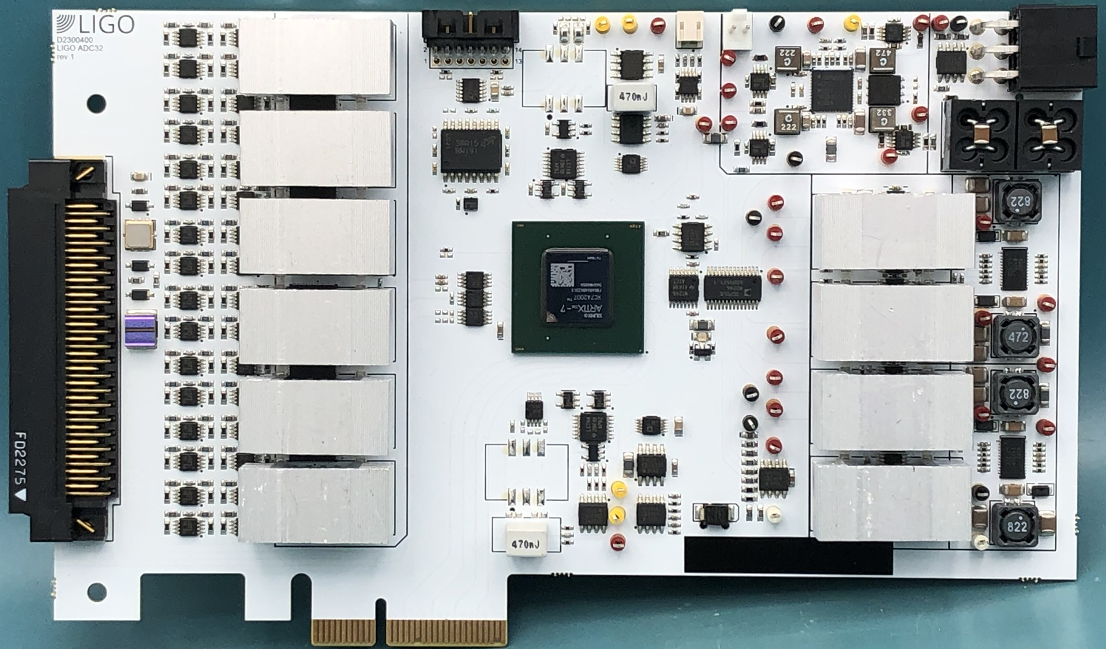
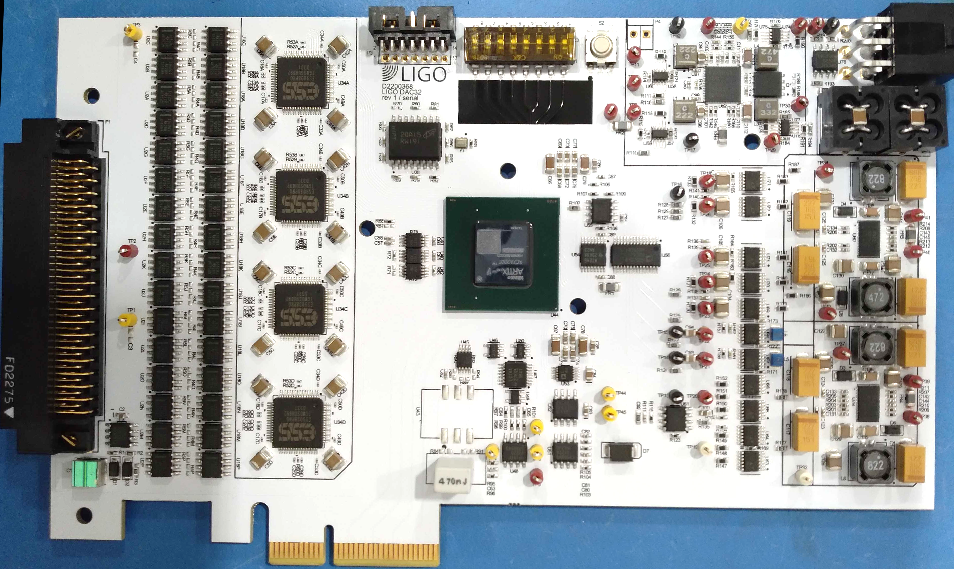
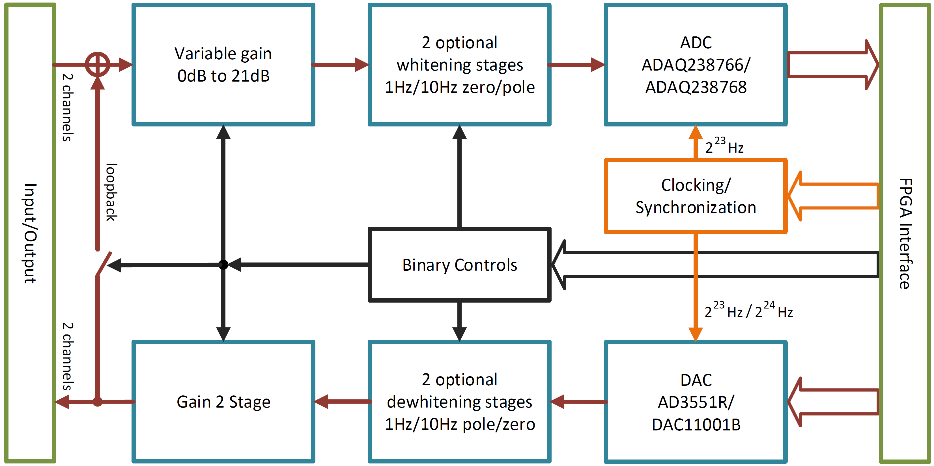
Converter Refresh for Future LIGO Upgrades
Daniel Sigg & Marc Pirello
Features:
32-Channels / Differential
ΣΔ-Technology w/ IIR Filters
Faster Sampling Rates
AA/AI Filters in FPGA
Timing System Integration
Time Stamped Data thru DMA
New ADC
New DAC
Performance:
ADC ±20V / DAC ±10V
DAC: 50nV/√Hz @ 100Hz
ADC: 200nV/√Hz (prelim.)
No Rogue Lines/Oscillators
Full RTCDS Integration
DAC: 6 Months Running at H1
DAC: see T2400066
Future Developments:
Fast Digital Servo 10-100kHz Bandwidth
ADC → FPGA → DAC
Sampling Rate ≈ 8MHz
4-8 Inputs & 2-4 Outputs
Switchable Whitening
Integration with RTCDS
G2500359-v1

