Slide 1
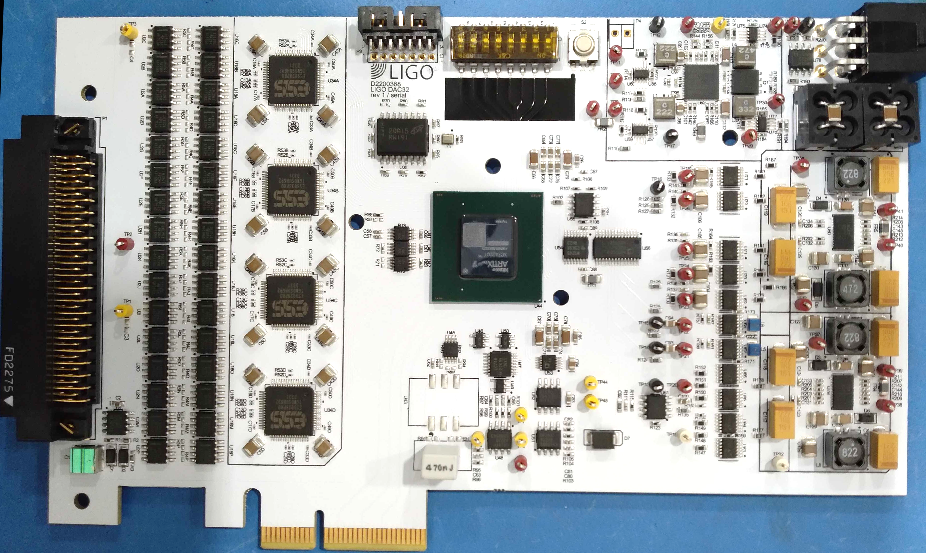
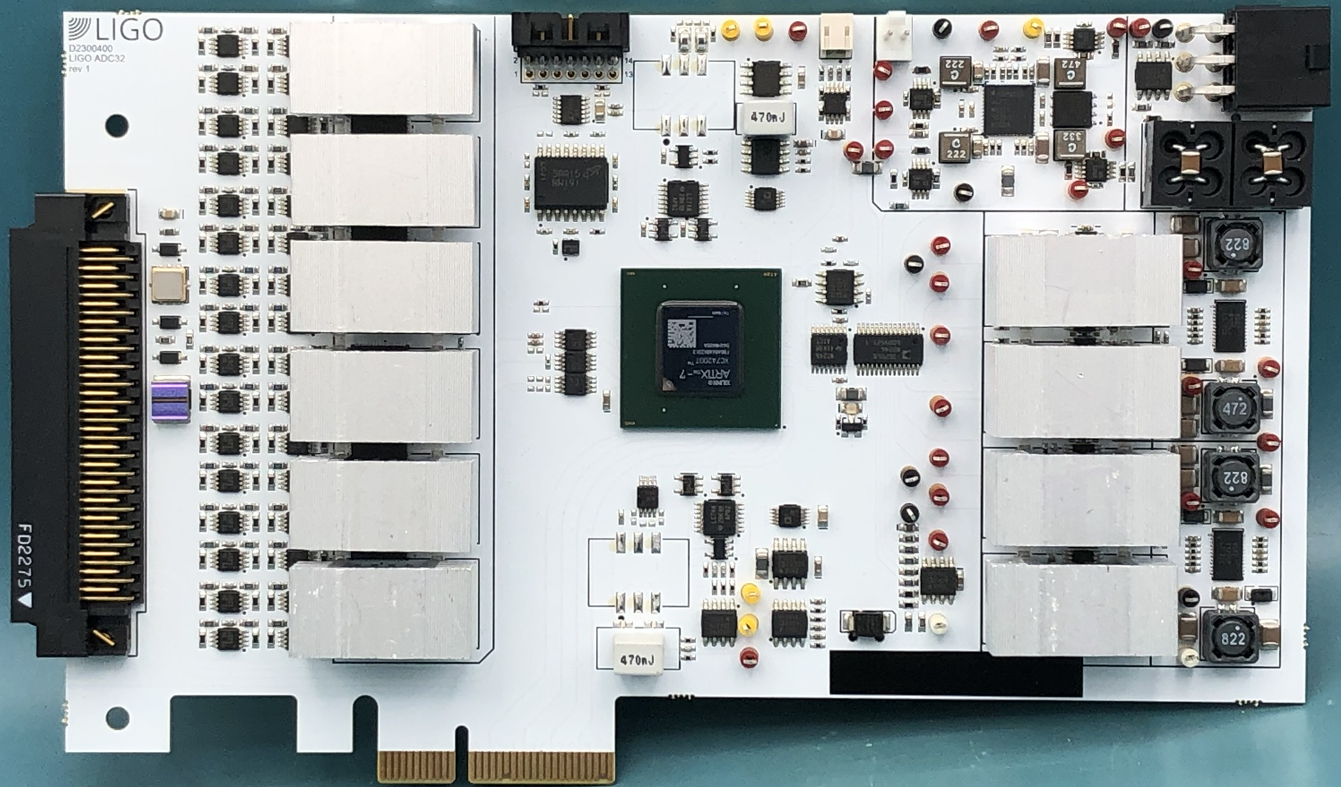
Converter Refresh for Future LIGO Upgrades
Daniel Sigg & Marc Pirello
DAC: 50nV/√Hz @ 100Hz / ADC: 200nV/√Hz (prelim.)
No Rogue Lines/Oscillators
DAC: 6 Months Running at H1
ADC ±20V
DAC ±10V
32-Channels / Differential / ΣΔ-Technology w/ IIR Filters
Faster Sampling Rates / AA/AI Filters in FPGA
Timing System Integration / Time Stamped Data

