Slide 1
Gravitational Wave Searches for Compact Binary Coalescences (CBCs)
PRATHAMESH JOSHI
Postdoctoral Scholar
Georgia Tech University

Slide 2
CONTENTS
1. How do searches for compact binaries work?
2. Searches running during O4
3. O4 results
4. Future Directions

Slide 3
How do searches for compact binaries work?

Slide 4
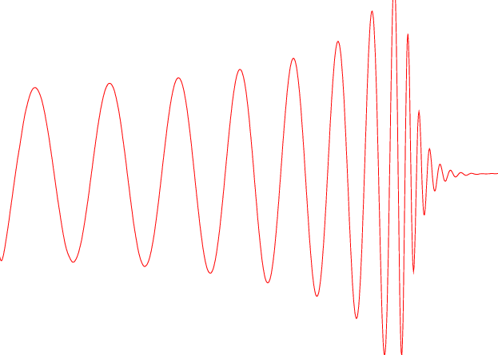

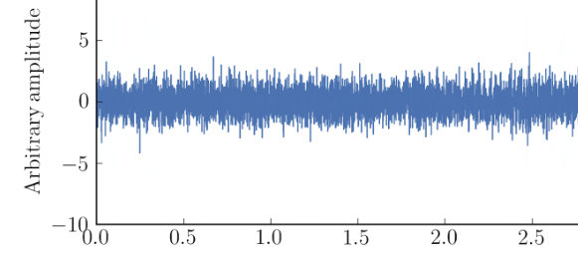
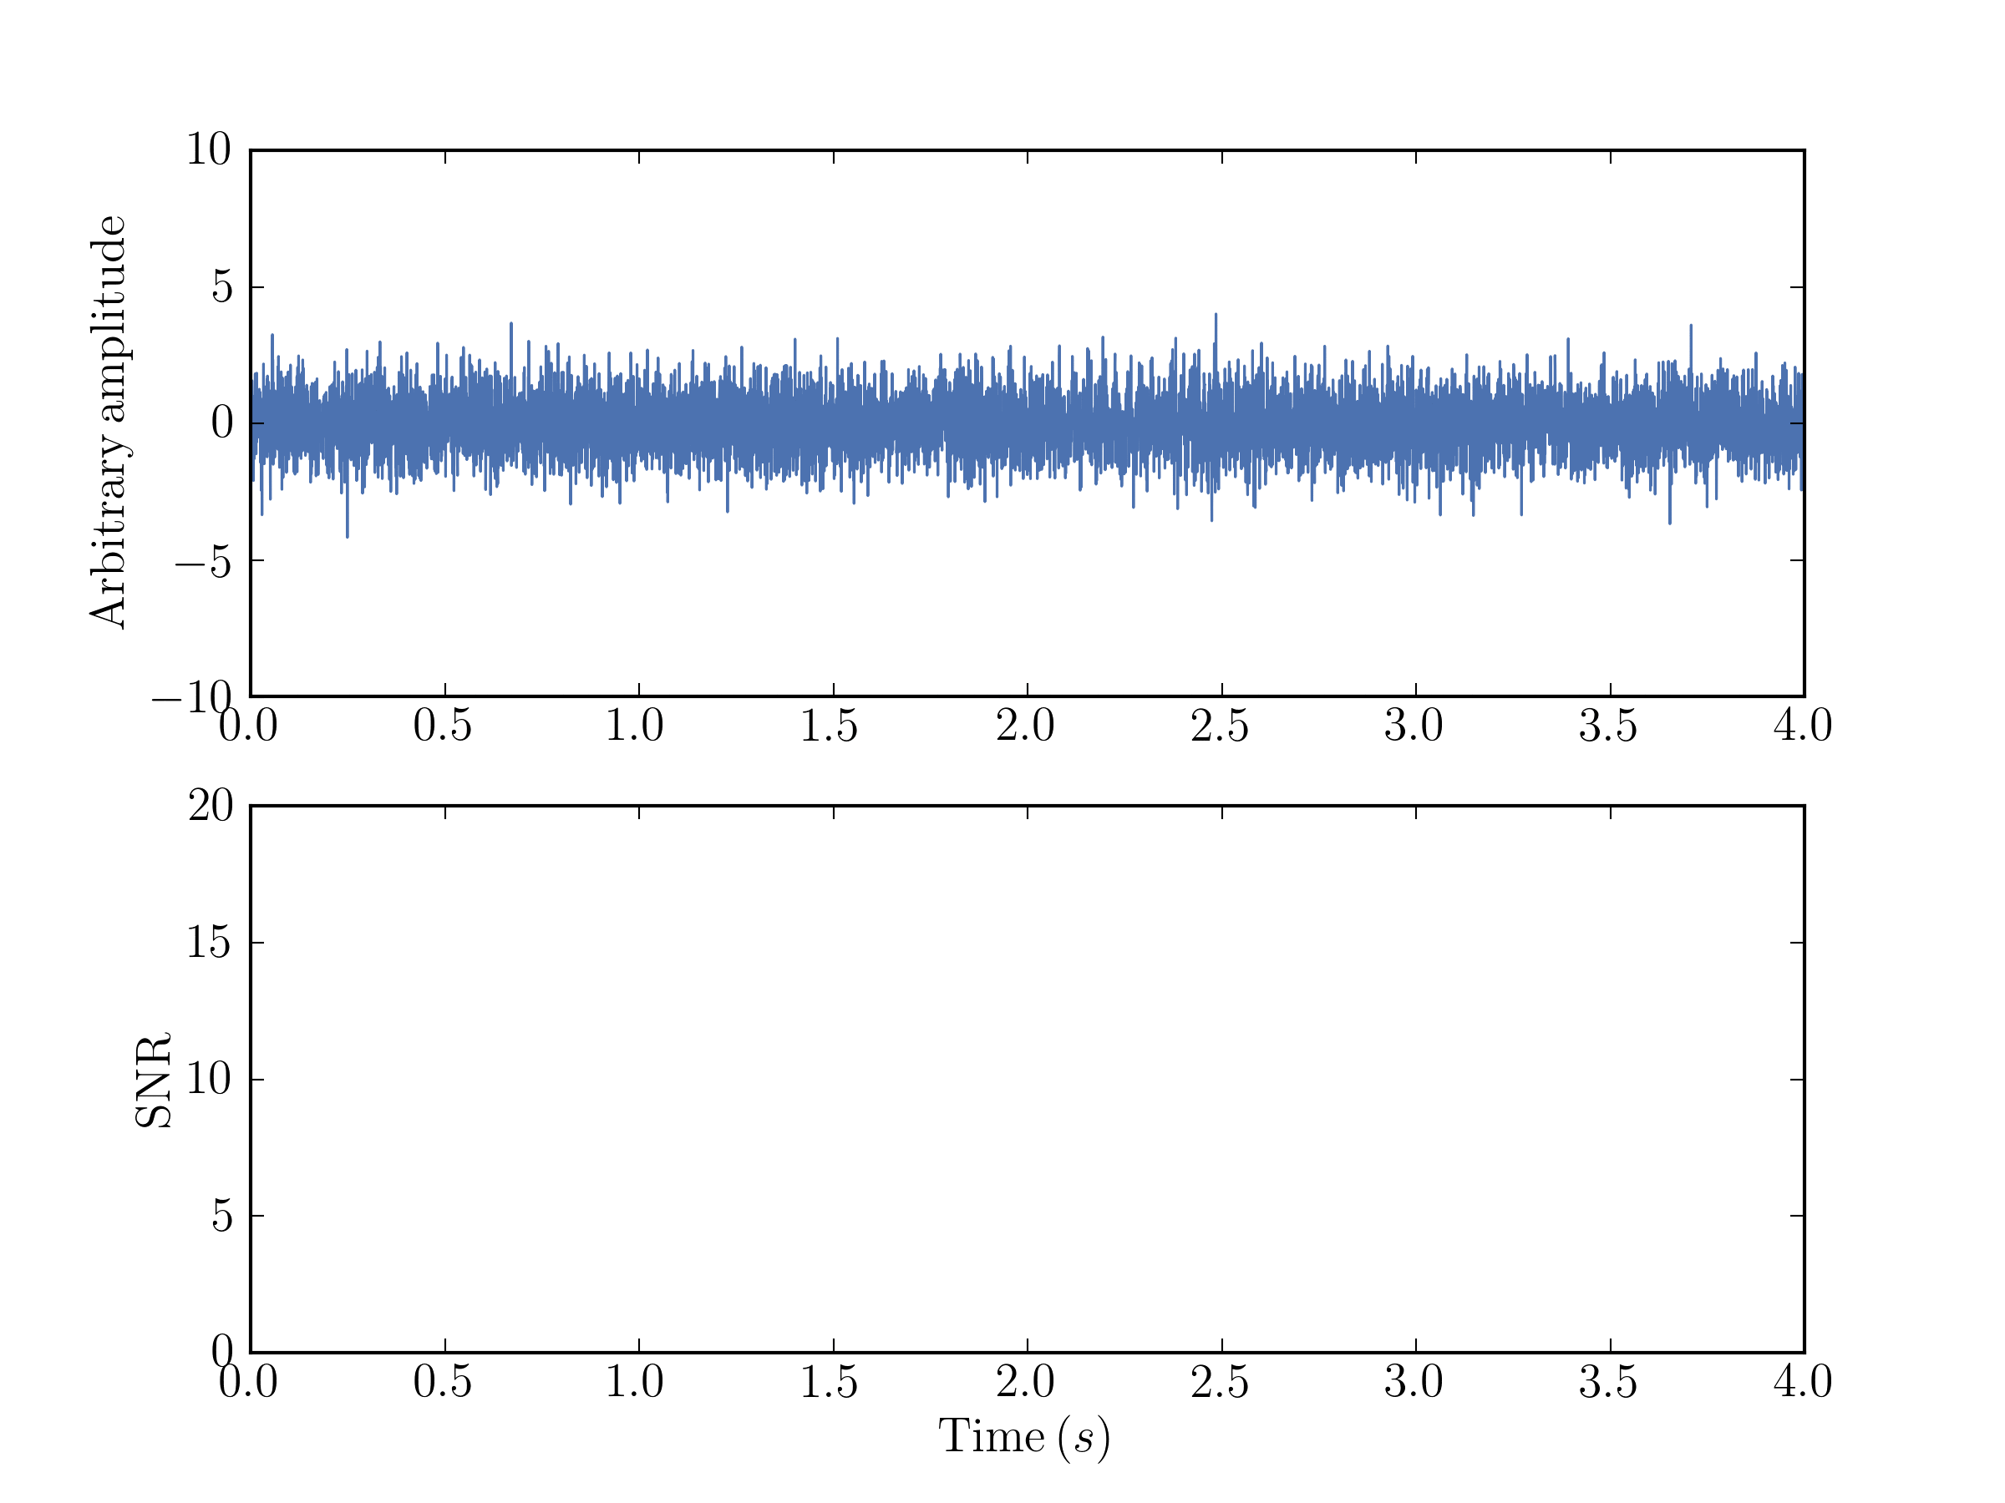
BUT!!
Real data
looks
like this
Solution:
Matched filtering!
Credit: Ryan Magee

Slide 5
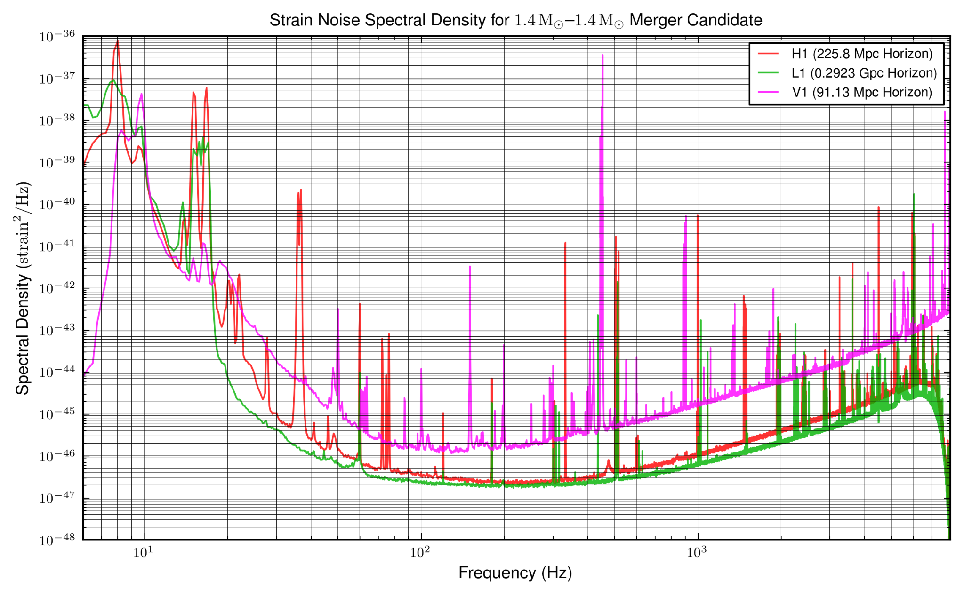


SNR = ⟨d̃∣h̃⟩
SNR is the inner product of (whitened) data and (whitened) template
The PSD (S_{n}(f)) is used to remove frequency correlations in a process called whitening

Slide 6
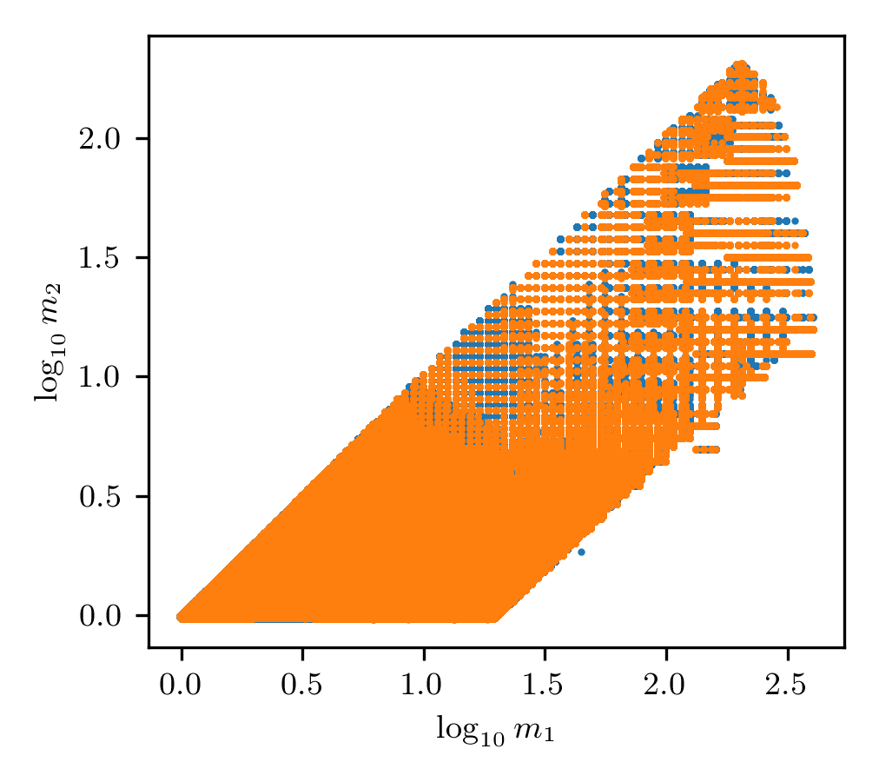
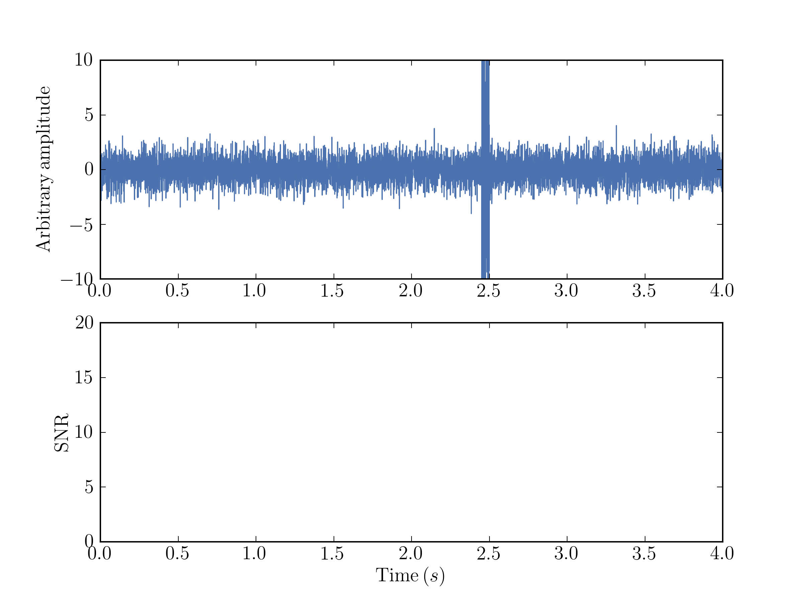
SNR isn’t always the perfect criteria for a GW
Credit: Ryan Magee
We form “banks” of templates in intrinsic parameter space to find all the GWs out there
First solution: Form “coincidences” of triggers across detectors
Trigger = a time when SNR > 4 is a particular detector

Slide 7
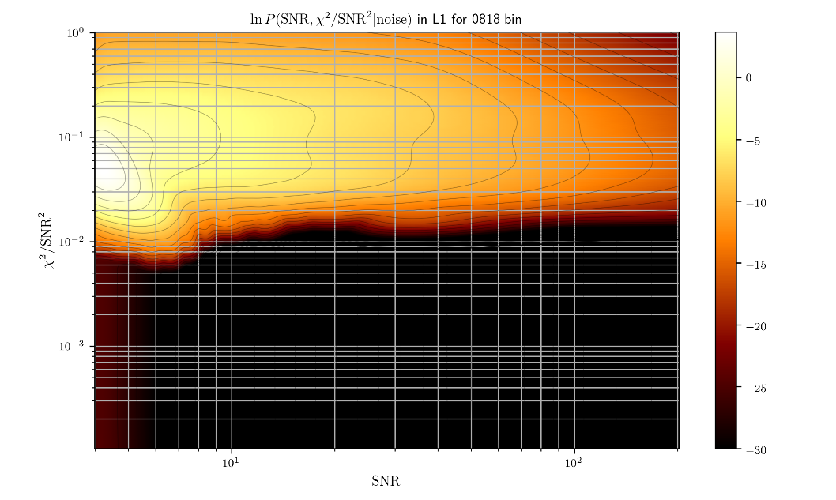
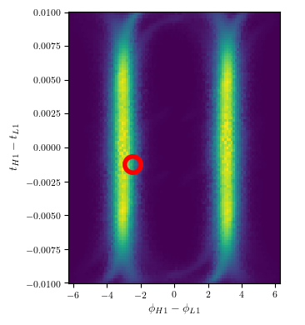
Second solution: create a better statistic than SNR to rank candidates
This ranking statistic should consider things like background statistics, expected signal distributions, etc
A common quantity used as an input to this ranking statistic is a χ² statistic to evaluate signal consistency across time/frequency
The ranking statistic should consider the likelihood of relative arrival times (dt) and phases(dφ) of the GW at different detectors
An example background collected by a GstLAL analysis (top) and an example calculated dt-dφ (right)

Slide 8
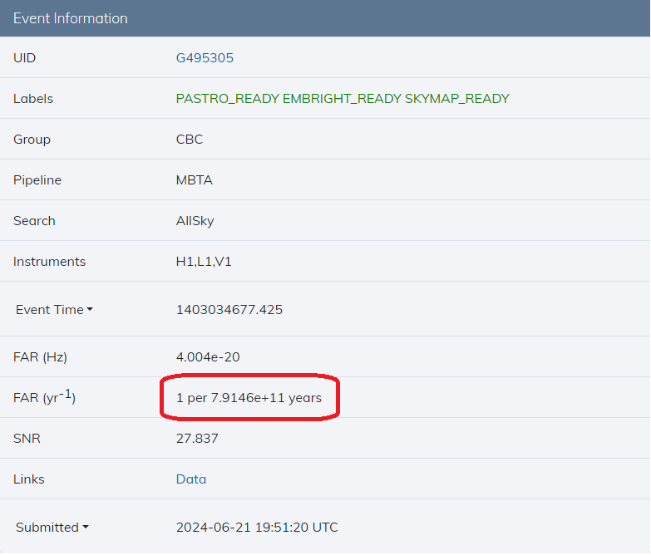
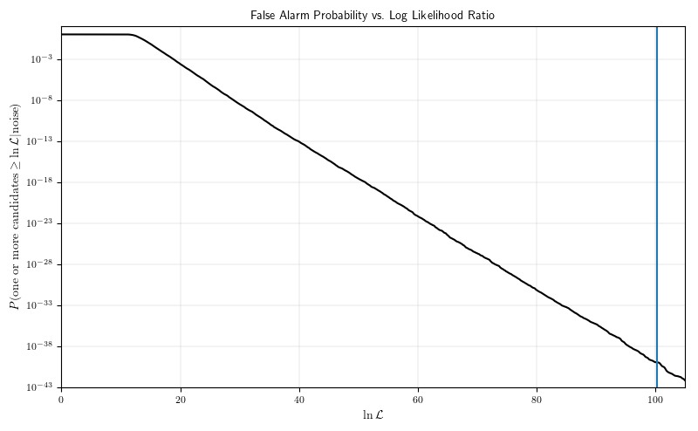
The False Alarm Rate (FAR) of a candidate describes how frequently such a candidate will be produced from noise
How do we
know noise
statistics for
such a long
time?
P(astro) considers the FAR and a prior astrophysical distribution to evaluate the probability of astrophysical origin
Solution: Create new “fake” noise triggers from existing noise triggers
Common methods:
Time slides
Sampling from the noise background
Evaluating the FAR of a candidate with ranking statistic 100

Slide 9
Searches running during O4

Slide 10
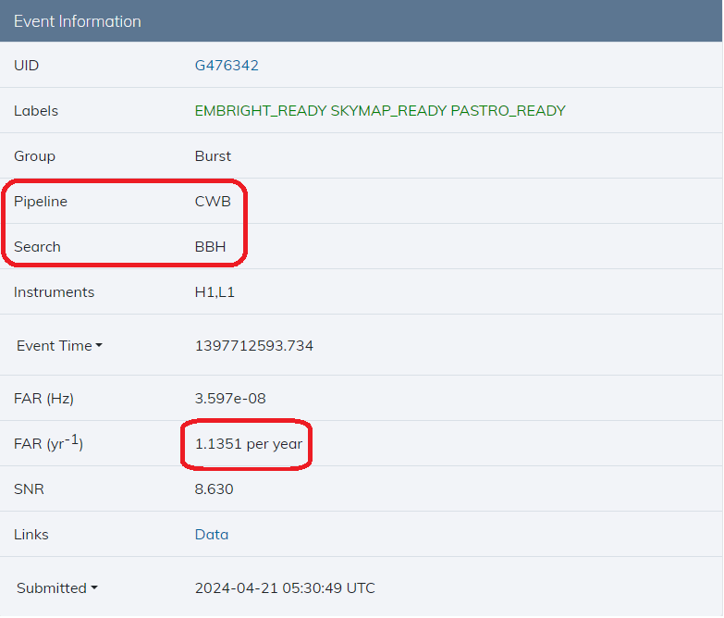
GstLAL
PyCBC
MBTA
SPIIR
MLy
oLIB
cWB
Online searches:
AllSky
Early Warning
Sub-Solar Mass
cWB_BBH
CBC pipelines Burst pipelines
Offline searches:
AllSky
Sub-Solar Mass
Intermediate-mass Black Hole
CBC searches use templates; Burst searches are unmodeled

Slide 11
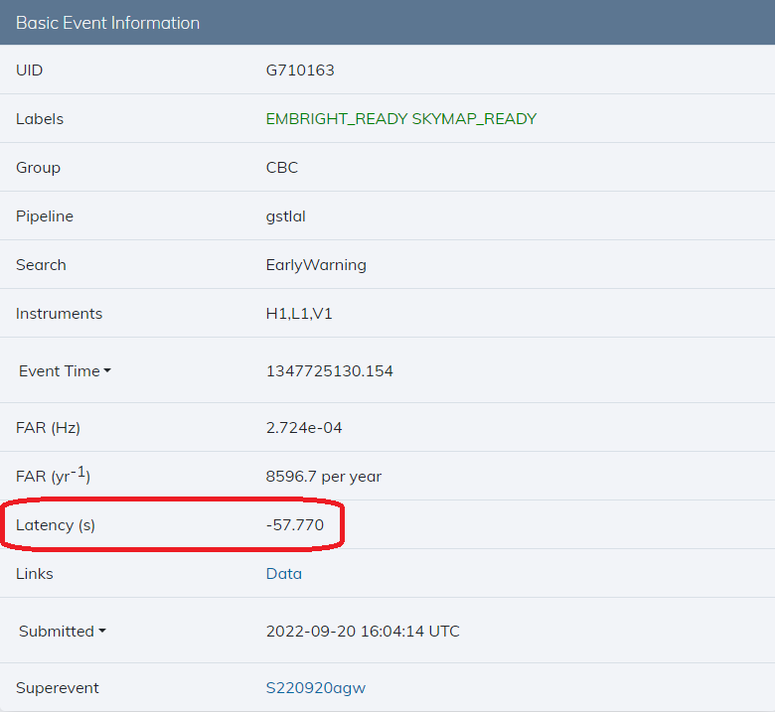
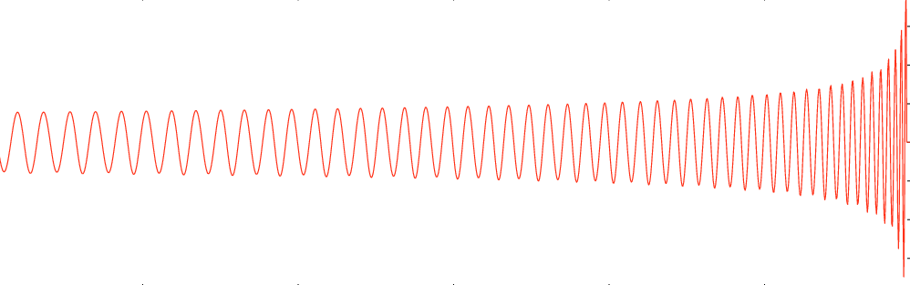
Early Warning Search
Cut off the template at different points, and try to predict the merger time before it happens
Only searches the low mass (BNS) space
Crucial for multi-messenger astronomy

Slide 12
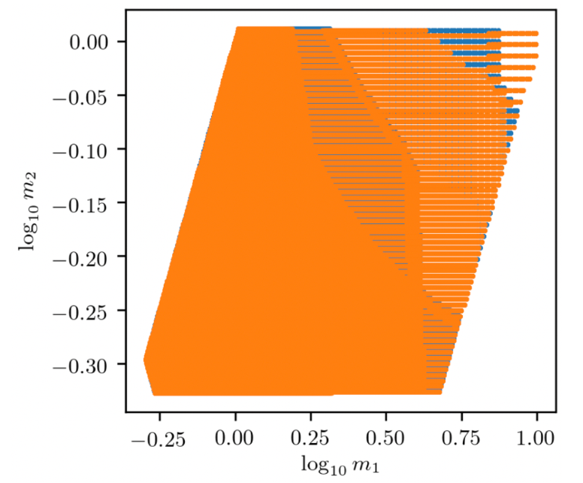
Sub-Solar Mass Search
Searches for compact binaries with at least one component below 1 solar mass
A very computationally expensive search, in terms of both number of templates and calculations per template
Already being run online
Pipelines are running more comprehensive offline searches
New Physics!!!
GstLAL’s online SSM bank

Slide 13
O4 Results

Slide 14
 | O3 | O4a | O4b
Detections (FAR < 1/month) |  | 81 | 103
Retractions | 23 | 8 | 5
Duration (months) | 11 | 8 | 10
Due to multiple pipelines running, we have a trials factor on what qualifies faor a public alert
Trials factors for O4b:
AllSky: 5
Early Warning: 3
Sub-Solar Mass: 2
Burst: 4
A retraction is a GW candidate that we sent out an alert for, but later on lost confidence in

Slide 15
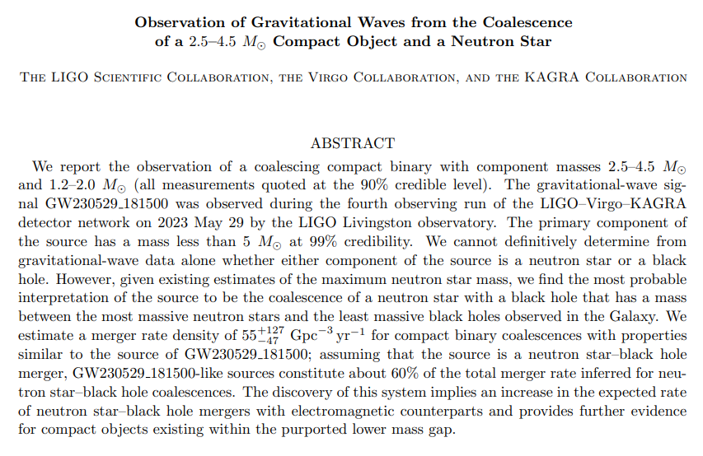
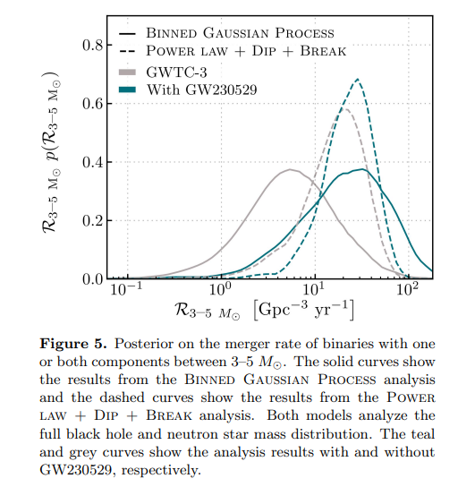
Interesting candidates: GW230529
Probable NSBH during O4a
Single detector candidate
Provides support for objects in the lower mass gap
Has implications for merger rates
https://arxiv.org/abs/2404.04248

Slide 16
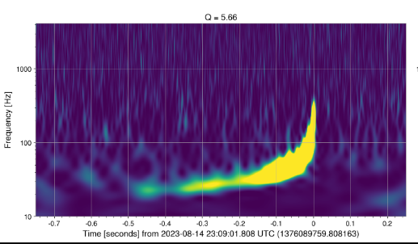
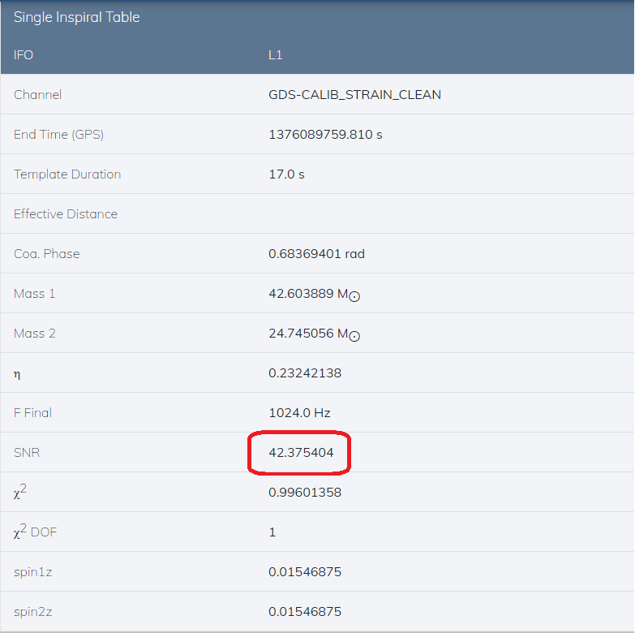
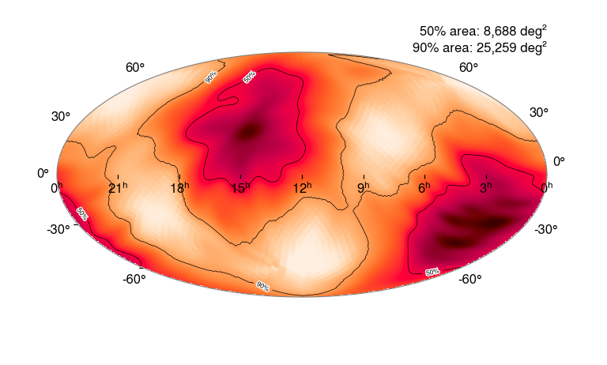
Interesting candidates: S230814ah
Unfortunately, only L1 was observing

Slide 17
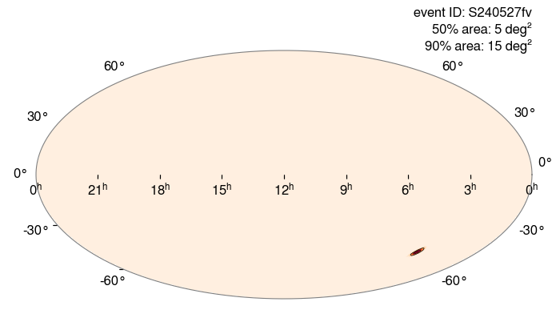
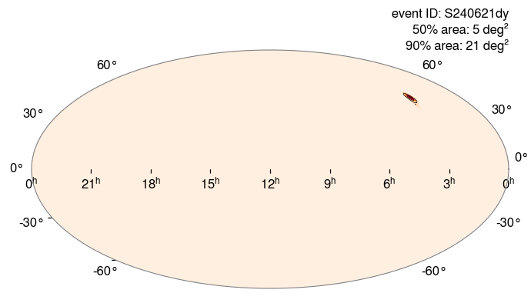
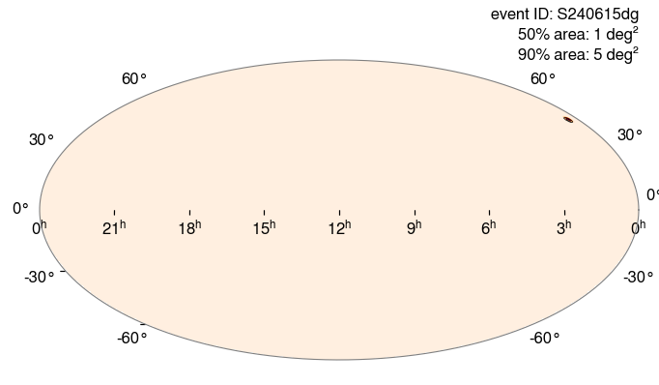
Interesting candidates: S240527fv, S240615dg, S240621dy
Virgo data has helped a lot in sky localization
New SNR Optimization techniques also help make skymaps more accurate

Slide 18
Future Directions

Slide 19
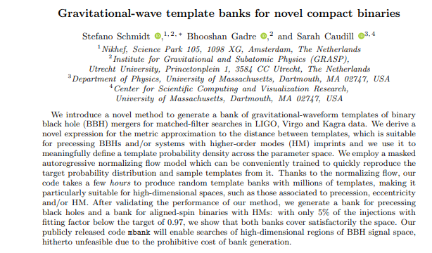
Searches keep getting more robust, more flexible, and more efficient
Precession and higher order modes are the next frontier to conquer for searches
We always want to do more science with searches, and faster. Combining searches and PE would be one such aim.
https://arxiv.org/pdf/2302.00436

Slide 20
THANK YOU!

