Slide 1

Parameter Estimation
Learning about black holes from gravitational waves
Daniel Williams
Institute for Gravitational Research
University of Glasgow · Oilthigh Ghlaschu
Notes:
The field of Gravitational wave science is one, characterised by success. But the level of success which LIGO has had, and which future developments promise, bring challenges.
1

Slide 2
$ whoami
Postdoc in Institute for Gravitational Research at University of Glasgow
Research focused on compact binary coalescences, but worked on unmodelled sources in the past
I led the O3a, O3b, and O4a Parameter Estimation analyses for the LVK

Slide 3
What is parameter estimation?
From wave to black hole properties
Parameter estimation is the analysis which works out what sort of black holes or neutron stars produced a signal which we’ve identified in a GW detector.
Foundational analysis
Most of the scientific information we extract from GW observations relies on understanding the systems which produce these signals, so parameter estimation acts as the foundation for many other analyses.

Slide 4
What is parameter estimation?
Isn’t this what searches are for?
GW searches scour all of the data produced by a detector looking for signals.
They provide a rough guess of the properties of the signal.
In-depth
PE analyses are much more detailed, but only performed over a very small amount of data overall.
We get much more detailed information about the system, and an understanding of the uncertainties from the analysis.

Slide 5
This talk
Bayesian statistics 101
why are all our answers probability distributions?
How the LVK perform PE analyses
Accessing and using samples from the LVK and friends

Slide 6
Bayesian statistics
A whistle-stop tour
Notes:
It’s a little hard to imagine that having too many events should be regarded as a problem just a few years after we were concerned about not having enough (or indeed any).
But analysis of gravitational wave signals is slow and computationally expensive, and where possible we want to avoid repeating analyses.
This means setting up analysis of all of the events in a consistent manner, so that the entire set of events is analysed in a comparable manner.
When we had just eight events from an observing run we could fairly happily do this by having people set everything up by hand and double check all of the settings.
For the first half of the observing run, which we published in its own catalogue, with the snappy title of GWTC-2, we had five times this number.
We needed to come up with a system which would allow us to configure, run, and monitor all of these analyses, trying to avoid introducing human error, and trying not to absorb too much valuable researcher time on writing config files.
6

Slide 7
Bayesian Inference
posterior
likelihood
prior
∝
p(data | parameters)
p(parameters)
p(parameters | data)

Slide 8
Bayesian parameter estimation
Once we’ve detected a gravitational wave we want to work backwards to understand the properties of the astrophysical system which created it
Data from current GW detectors are extremely noisy
Rely on matched filtering

Slide 9
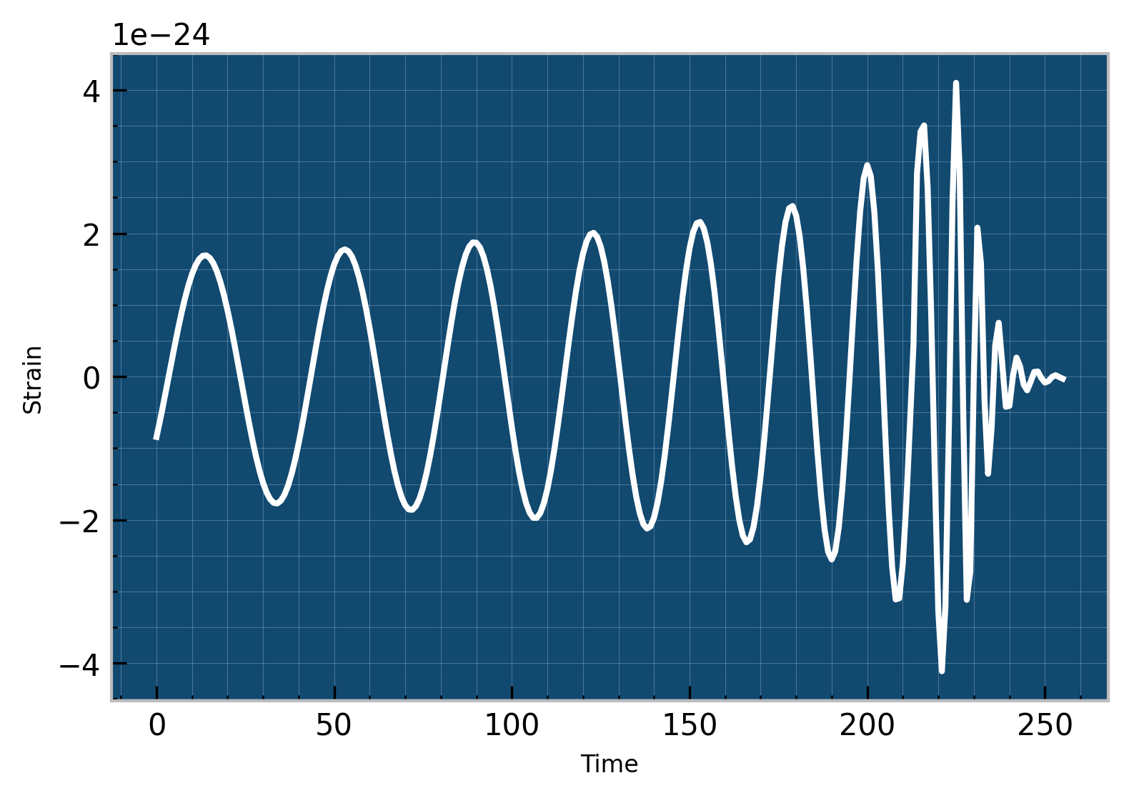
Bayesian Inference
Parameters
Black hole masses
Distance
Position on sky
Black hole spin

Slide 10
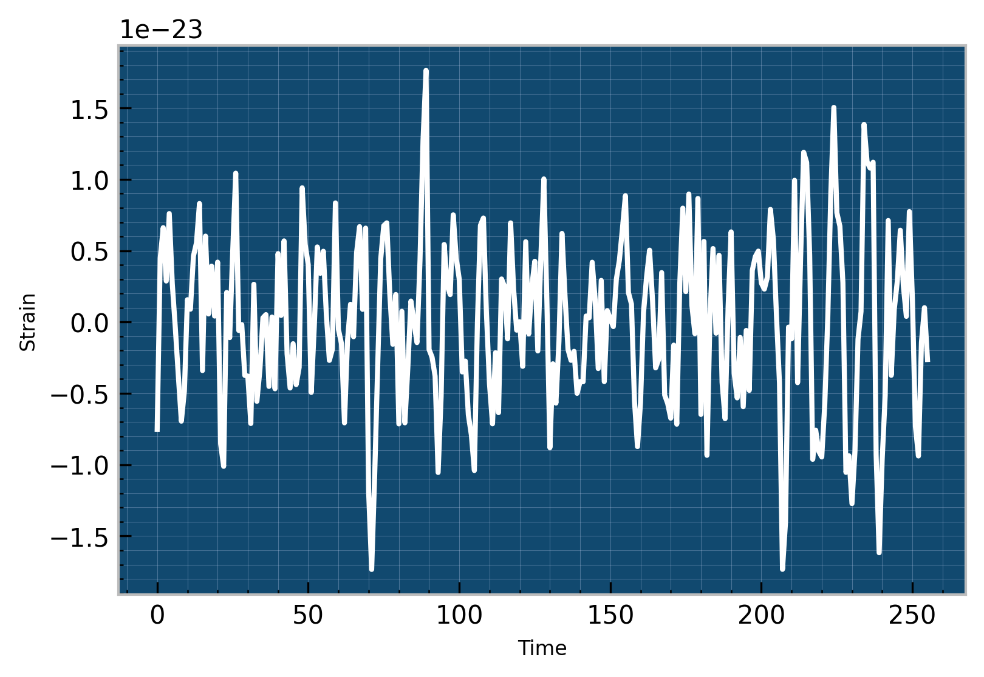

Slide 11
Conventional Parameter Estimation
Evaluate waveform model
  Based on “real” physics (General Relativity) but for speed we need to use an approximation
Cross-correlate with data
  “Noise-weighted inner product”
Calculate likelihood of the signal wrt the waveform model
Multiply likelihood by the prior probability of the waveform model
Repeat (a lot)

Slide 12
Bayesian Inference
posterior
likelihood
prior
∝
p(data | parameters)
p(parameters)
p(parameters | data)
Sampled using stochastic sampling methods
Markov Chain Monte Carlo
pymc pyro emcee
Nested Sampling
dynesty nestle nessai

Slide 13
Bayesian Inference
posterior
likelihood
prior
∝
p(data | parameters)
p(parameters)
p(parameters | data)
Sampled using stochastic sampling methods
Markov Chain Monte Carlo
pymc pyro emcee
Nested Sampling
dynesty nestle nessai
Posterior probability distribution samples

Slide 14
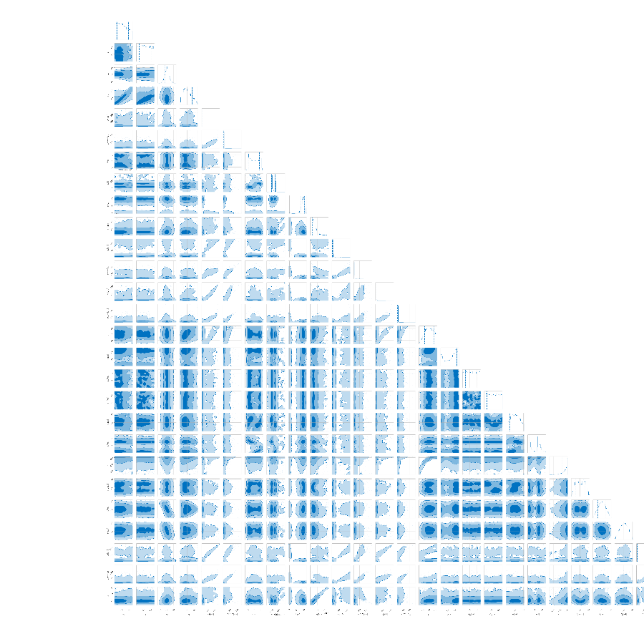
Bayesian Inference

Slide 15
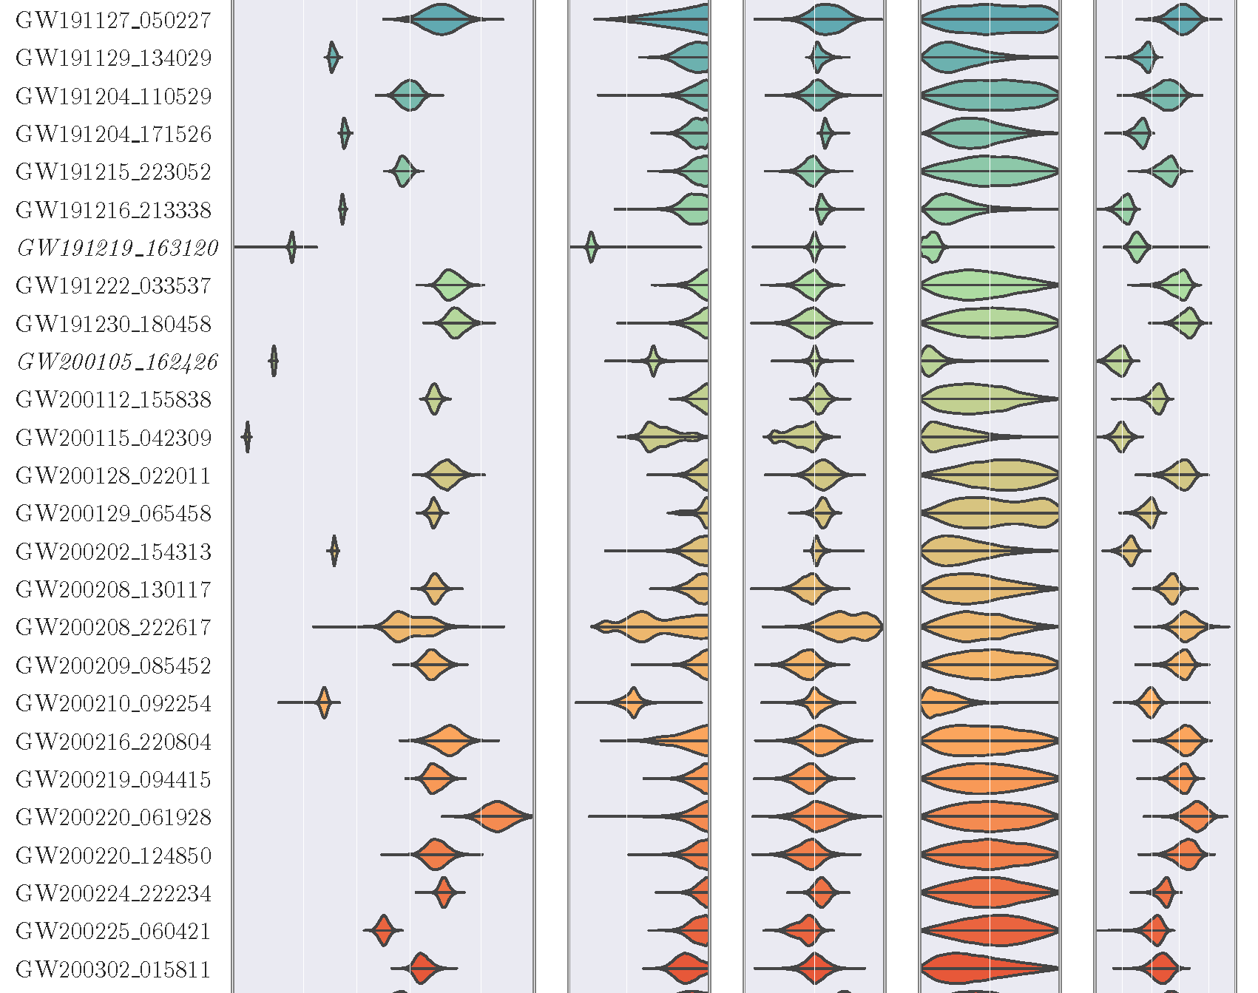
GW Analysis
From raw observations to inferring source properties
Right: O3B event properties
arxiv: 2111.03606

Slide 16
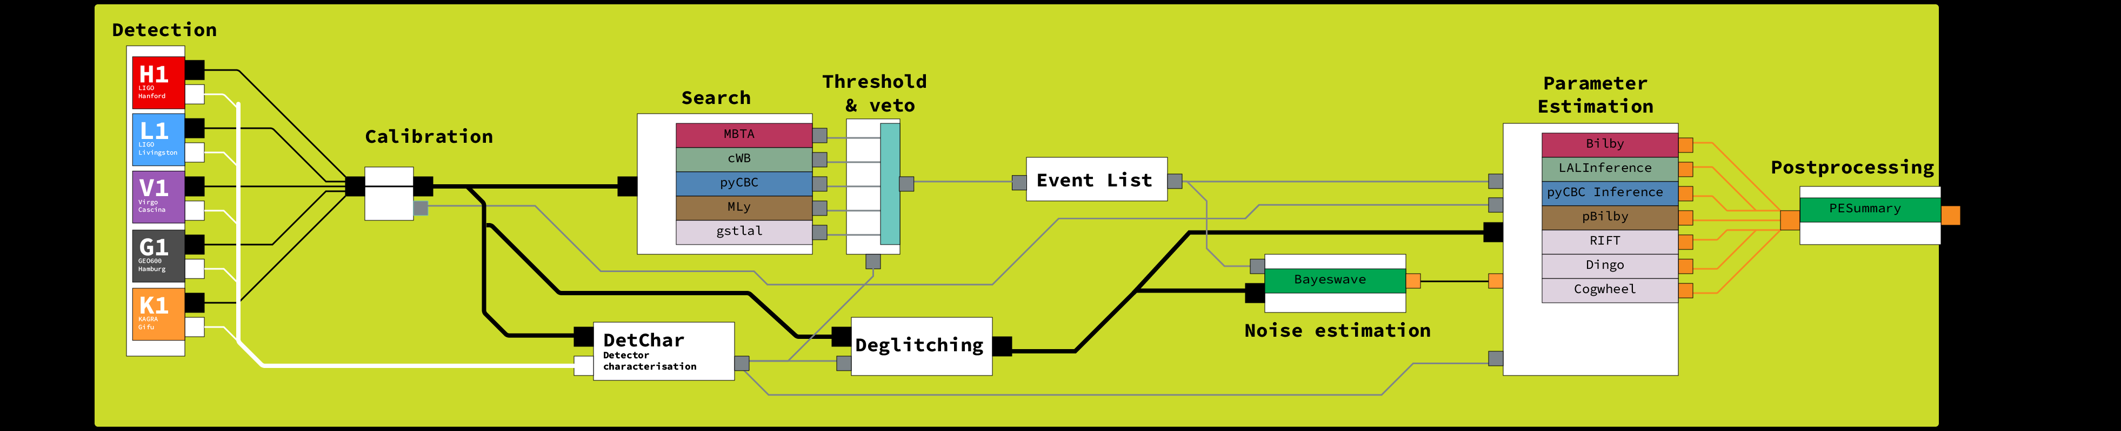
Anatomy of a LIGO analysis

Slide 17
A LIGO Analysis - PE
Multiple analyses per event
Multiple analysis codes

Slide 18
Bayeswave
This code is used to analyse the noise component of our data.
It produces Power spectral density estimates.
These are an essential component of the likelihood function.

Slide 19
Bilby
One of the main analysis codes used by the LVK is bilby.
Designed to be a flexible and easy-to-use package for analysis.
Written in python.

Slide 20
PESummary
This code handles post-processing of our data
It can be used to produce summary plots of the data
It also calculates derived parameters (ones which can be calculated from combinations of measured parameters).

Slide 21
Using our data
The LVK publish samples from probability distributions created by our analyses.
These are available via GWOSC, and are archived on Zenodo.
e.g. GWTC-3.0 which contains analysis from O3b:
https://zenodo.org/records/8177023

Slide 22
Using our data
Samples are distributed in HDF5 format and created with a structure defined by the PESummary tool.
Posterior samples are contained within this alongside prior samples and configuration data for the analysis.

Slide 23

Enter ASIMOV
We had a clear need for automation
  Relying on humans (PhD students & postdocs) was unsustainable
  We needed “robots” to design analyses and then run and monitor them
Aim to maximise reproducibility and minimise error e.g. from transcription
To address this Glasgow led the development of an analysis automation framework written in Python: Asimov
Notes:
I said before that setting up and managing all of these analyses was complicated when we had only a handful of events, but by January 2020 we were half way through the third observing run, O3, and had around 40 candidate events.
At Glasgow we devised Asimov (though it had yet to gain that name!) to automate and “roboticise” the process of setting up analyses, writing configurations, creating pipelines, and gathering together the various required data products from around the collaboration’s computing resources.
Remember how I mentioned that the LVK is made up of a lot of researchers working at institutes all around the world coming together to build something big? Well this is one of those situations where that can be a headache.
For example, we need data about the calibration of the detector for our analyses; this is basically the mapping between the current measured at a photodiode on the interferometer, and the corresponding strain.
This is calculated by one team based at the two detectors, and in the past we needed to have someone go and fetch the files which recorded this for each event, put them somewhere sensible, and then feed them into an analysis pipeline.
This is the sort of thing which is both tedious and error prone if done by a person, but which is perfect for automation.
You just need to find the sucker to write the code!
Our first version of the code-which-would-become Asimov was used to produce the analyses for GWTC-2, and it did things like finding and collecting these auxiliary files, wrote configuration files for each event according to a template, and then submitted the jobs to our computing cluster using htcondor.
That was all great, but it was held together with string and duct tape.
We stored information about each event which was used to produce the templates in issues on a gitlab server, for example, because it was faster and easier (hmm, well, that’s worthy of some discussion) than setting up our own database server for the job.
23

Slide 24
Analysis: a complex process
Event identified by search pipeline
Event added to GraceDB
Git repository created
Event added to asimov
Asimov collects calibration data, adds to repository
Analyst adds detchar information
  Analyst informs asimov of deglitched frame availability
Asimov creates Bayeswave job to create PSD files
Production analyses queued
Production analyses created [once PSDs available]
Productions run
Productions finish
Asimov runs post-processing
Asimov hashes & stores results
Review information added

Slide 25
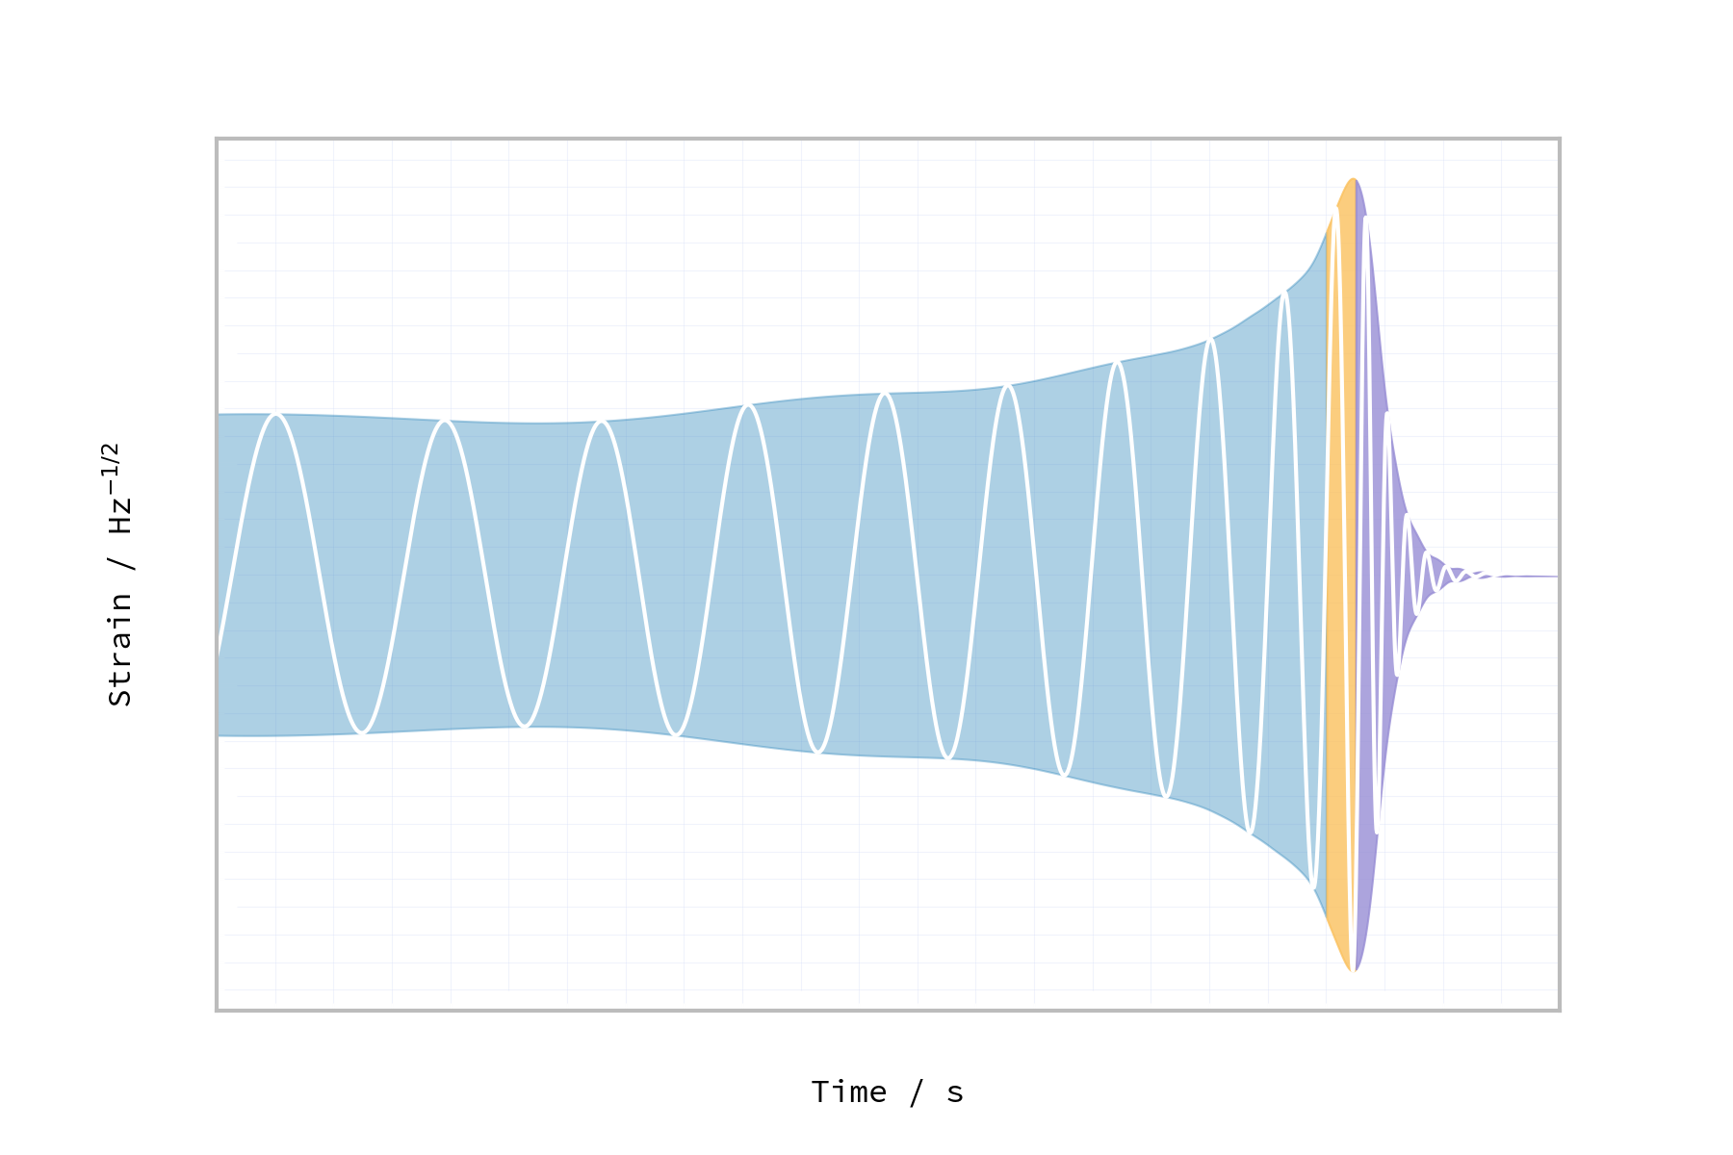
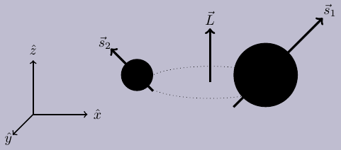
Binary black hole systems
Compact system of two black-holes
Orbit inspirals due to energy lost as GWs
Waveform affected by spin-spin and spin-orbit effects
Strong-field problem: analytically intractable.

Slide 26
Thank you!
daniel.williams@glasgow.ac.uk
🦋: @daniel-williams.co.uk
Notes:
End with own statement: close the loop on “problems of success”, I’m bringing things into the future
26

