Slide 1
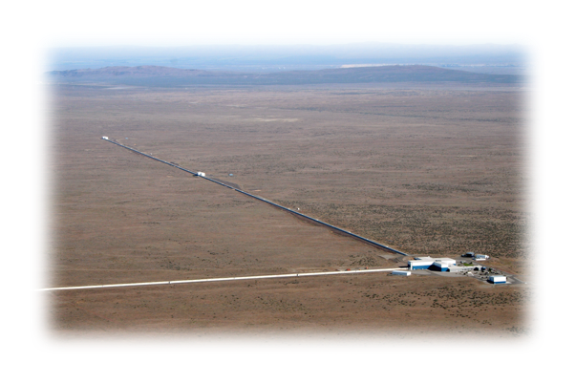
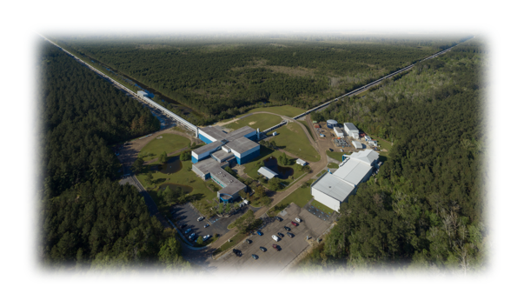
PAX-CE Meeting, UIUC, July 1, 2025
LIGO Hanford Observatory
LIGO Livingston Observatory
Cosmic Explorer Data Policy Discussion
Dave Reitze, LIGO Laboratory, Caltech
LIGO-G2501362-v1

Slide 2
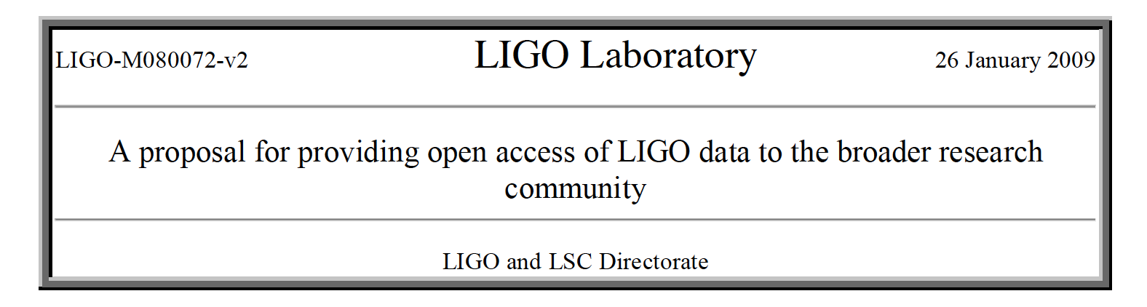
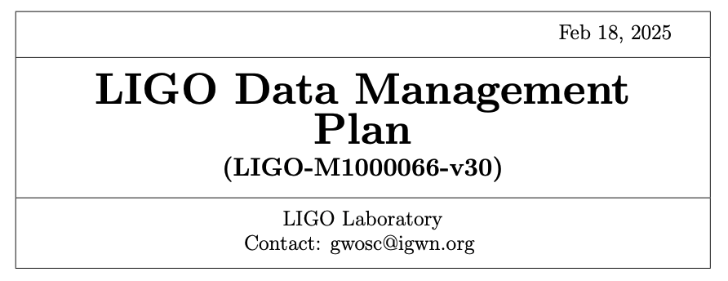

What Do I Know About This?
I was the LSC Spokesperson in 2008 when the National Science Foundation required LIGO to develop and implement an Open Data Policy for LIGO data
This eventually evolved into what is now the LIGO-Virgo-KAGRA Open Data Policy
Gravitational-Wave Open Science Center (GWOSC)
2014 AAAS Meeting Session on Open Data: https://dcc.ligo.org/LIGO-G1400060/public
https://dcc.ligo.org/LIGO-M080072/public
https://dcc.ligo.org/LIGO-M1000066/public

Slide 3
What Should a Data Policy Should Hope To Achieve?
Maximize the scientific productivity of the group/collaboration/facility/… that produces and analyzes the data
At the same time, incentivize the researchers who produce and analyze the data
Or, at the very least, not disincentivize them!
Conform to agency requirements as well as national/international norms (and in some cases laws) on the availability/curation/preservation of data
E.g. Findable, Accessible, Interoperable, Reusable (FAIR), ”Data in Perpetuity”

Slide 4
Major Implementation Issues Facing Public Data Release Programs
What is the nature of the data, the size of the data stream, and what analysis tools are needed to manipulate and analyze the data?
What data products should be released? When should the data products be released?
Who are the broader research community of potential users?
What is the added cost of releasing the data and who pays?
What are the implications regarding intellectual property?
What are the implications of making data publicly available which is ‘owned’ by international collaborations?

Slide 5
Data Policy Issues Specific to CE
Negotiating data release policies with international partnerships: Einstein Telescope (and LIGO-India)
For some science goals, CE cannot ‘go it alone’
Low latency alerts are, by definition, a zero-delay data release policy
What types of information to release? The LVK has only recently evolved to a point where we release coarse mass bins for compact object mergers
Is a ‘Data Verification Period’ needed -- how long does it realistically take to clean, calibrate, and package the data?
This sets the minimum release time for bulk data releases

Slide 6
Lessons from LIGO-Virgo-KAGRA
Once collaborations have privileged access to data, it is difficult to switch to a fully open policy
Collaborations get comfortable with having privileged access!
Even with a proprietary data period, some collaboration members may fear getting scooped once the data is released.
This may be true for certain analyses, however the collaboration is the power user of the data. It’s likely that collaboration papers will be the more cited papers.
No matter what data policy you eventually settle on, not everyone will be happy with it ;-)
Overarching guideline: Maximize the scientific productivity of the group/collaboration/facility/… that produces and analyzes the data!

