Slide 1


Mode-Match optimization: From SQZ to OMC
Leendert (Leo) Schrader
Saint Louis University
Mentors: Camilla Compton and Jennifer Wright
Caltech LIGO Hanford SURF 2025

Slide 2

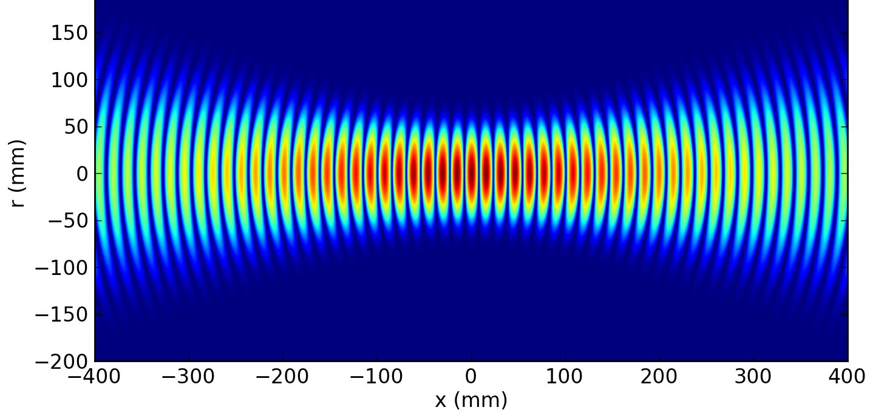

Preliminaries
Gaussian Beams
Mode-matching
Beam intensity propagates like Gaussian distribution:
Simple mathematical characterization [2]:
$$q\left(z\right)=z+\frac{πw_{0}^{2}}{λ}i$$
$$\frac{1}{q(z)}=\frac{1}{R(z)}−\frac{λ}{πw^{2}(z)}i$$
Essentially: “how similar are two curvatures?”
Poor match
Strong match
1
LIGO-T2500228

Slide 3
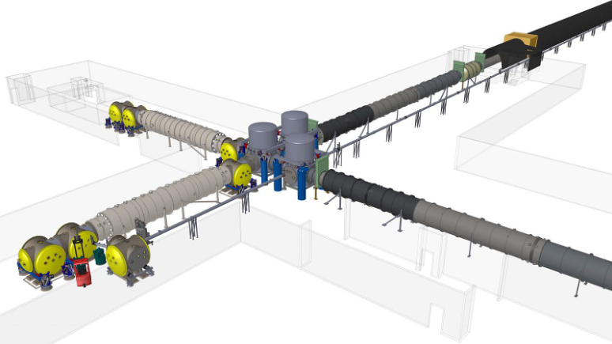
HAM5
HAM6
HAM7
2

Slide 4
Beam Path Schematic
HAM7
HAM5
ZM5
SRM
Main goal:
Understand mode-mismatch at OMC with respect to ZM4 and ZM5 curvature.
Steps:
Model beam path
Characterize ZM4/5 by input voltage.
Collect experimental data.
Fit and validate (and cross fingers!).
ZM6
BM4
OFI
ZM4
SQZ
OM2
PZT actuated curved mirrors.
Change RoC with input voltage.
OMC
OM3
OM1
HAM6
3
LIGO-T2500228

Slide 5
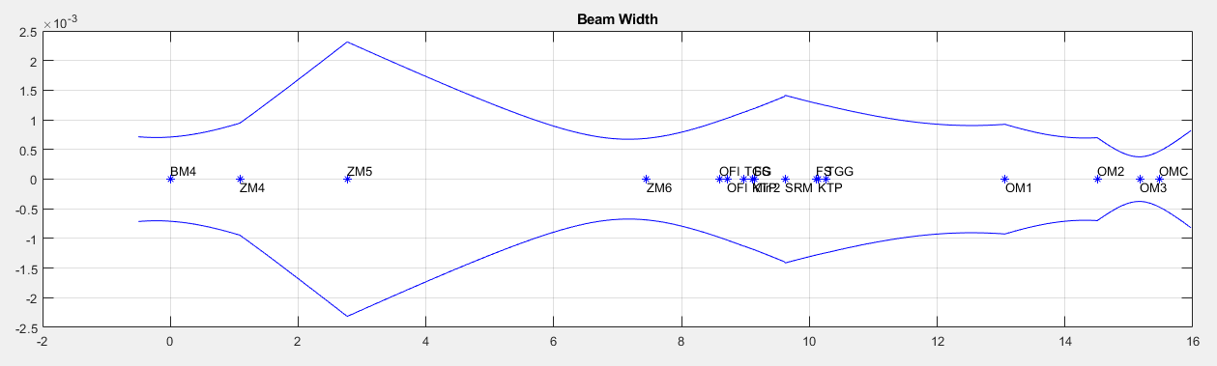
Initial Beam Path Modeling
“a la mode” Matlab library upgraded to take on incidence angles. [2, 3]
All pertinent component information logged in T2500338.
- Distances, RoCs, AoIs, refractive indices, seed beam, target at OMC, etc.
OFI (2nd pass)
OFI (1st pass)
Beam Width (m)
Beam Travel (m)
4
LIGO-T2500228

Slide 6
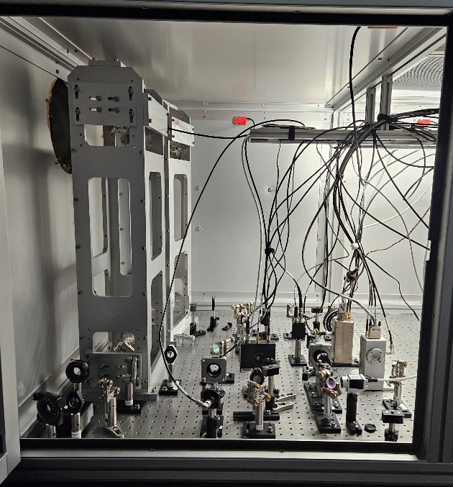
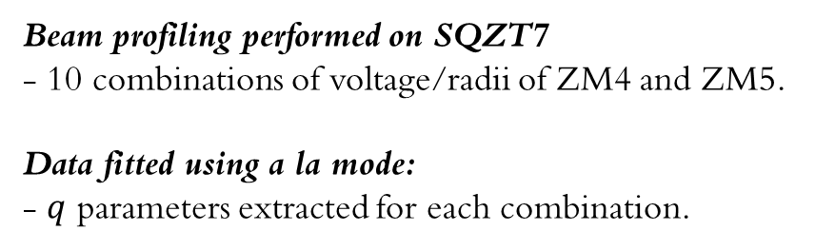
Experimental Beam Data
Beam profiling performed on SQZT7
- 10 combinations of voltage/radii of ZM4 and ZM5.
Data fitted using a la mode:
- $q$ parameters extracted for each combination.
SQZT7
Beam scans
ZM5 (V)
200
ZM5
110
BM4
ZM4
SQZ
0
HAM7
0
90
200
ZM4 (V)
5
aLogs 85917, 85775. LIGO-T2500228

Slide 7
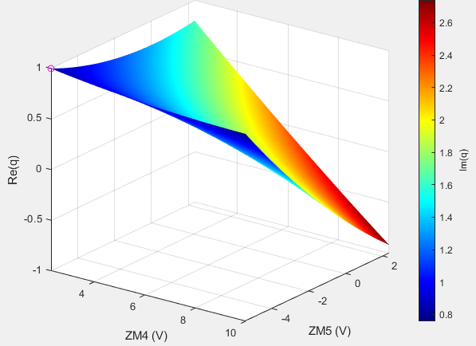
q Manifold
Recipe:
1. Take q parameter at voltage combination.
2. Plot real part on z-axis and imaginary in color.
3. Interpolate (linear, polynomial, etc.)
q Manifold
200
Re(q)
Im(q)
110
ZM5 (V)
ZM4 (V)
ZM4 (V)
ZM5 (V)
0
Allows us to understand the beam post-ZM4/5 by voltage input alone!
0
90
200
6
aLog 86365. LIGO-T2500228

Slide 8
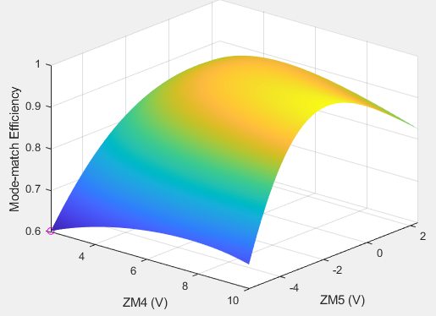
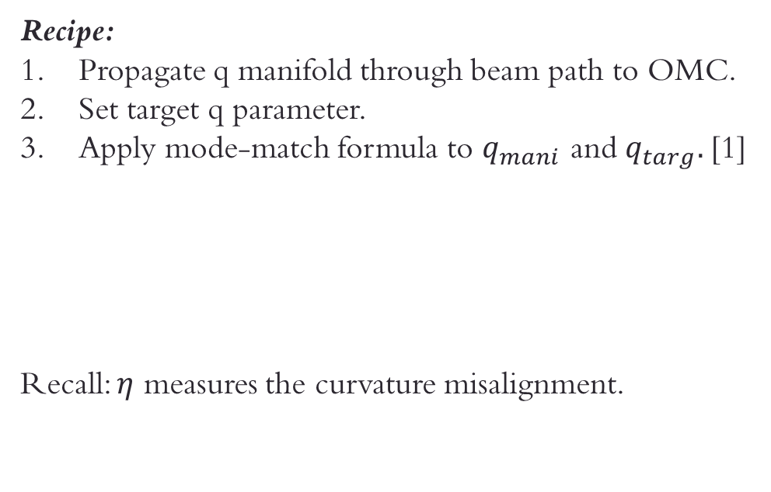
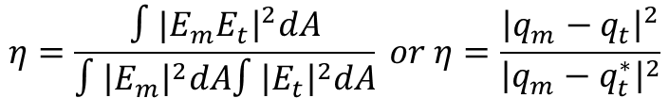
Forward: $η$ Manifold and Optimization
ZM5
(To OMC)
BM4
ZM4
SQZ
Recipe:
Propagate q manifold through beam path to OMC.
Set target q parameter.
Apply mode-match formula to $q_{mani}$ and $q_{targ}.$[1]
Recall: $η$ measures the curvature misalignment.
HAM7
$$η=\frac{∫{|E}_{m}E_{t}{\left.​\right|}^{2}dA}{∫{\left|E_{m}\right|}^{2}dA∫{\left|E_{t}\right|}^{2}dA} or η=\frac{{\left|q_{m}−q_{t}\right|}^{2}}{{\left|q_{m}−q_{t}^{∗}\right|}^{2}}$$
We can now just extract maxima from this structure!
7
LIGO-T2500228

Slide 9
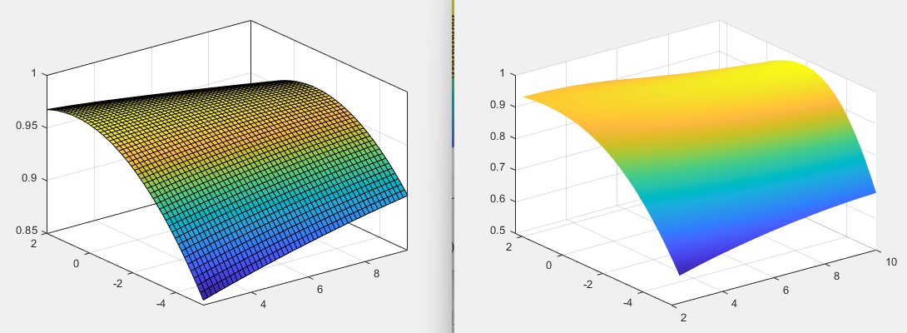
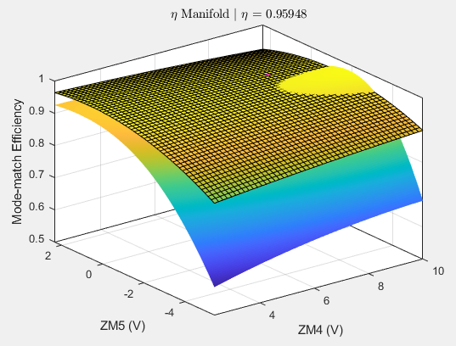
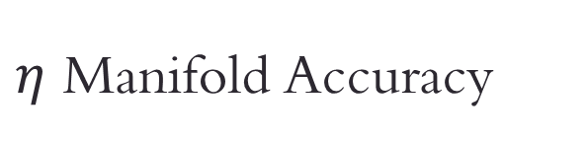
$η$ Manifold Accuracy
OMC beam scans give us experimental mode-match values.
Simulated mode-match
Current nominal settings
Plotted together
Experimental mode-match
Mode-match (%)
ZM5 (V)
ZM4 (V)
ZM5 (V)
ZM4 (V)
8
aLog 86485; LIGO-T2500228

Slide 10






ZM5
Backward: ZM4 and ZM5 Characterization
BM4
Back-propagating q manifold to ZM5
Goal: find curvature radii for ZM4 and ZM5 analytically.
ZM4
SQZ
HAM7
ZM5
If
$$R_{5}$$
$$q_{mani}$$
then,
ZM4
$$q_{seed}$$
$$R_{4}$$
Crucially: we must estimate one RoC to find the other.
Interpolating prior data yields…
9
LIGO-T2500228

Slide 11
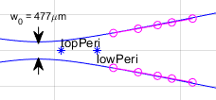
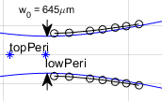
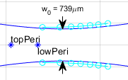

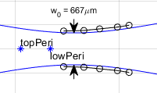
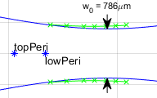

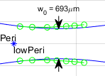
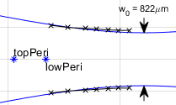
Data Gallery: How good is our RoC estimation?
(V₄,V₅) = (0, 0)
(V₄,V₅) = (0, 110)
(V₄,V₅) = (0, 200)
(V₄,V₅) = (90, 0)
(V₄,V₅) = (90, 110)
(V₄,V₅) = (90, 200)
(V₄,V₅) = (200, 0)
(V₄,V₅) = (200, 110)
(V₄,V₅) = (200, 200)
10
All ordered pairs are PZT values. Units in volts.
LIGO-T2500228

Slide 12
Conclusions
Model fits data great for beam characterization!
We can confidently estimate mirror curvatures when one is assumed.
Simulated mode-matching is robust and promising.
Moving Forward:
Better initial ZM4 curvature estimate (measurements of in-vacuum components).
Understand error in mode-match simulation near fringes.
General runtime optimization for efficiency plots.
11
LIGO-T2500228

Slide 13
References
[1] R. Paschotta. Mode Matching. RP Photonics Encyclopedia. 2005. doi: 10.61835/x1d. url: https://www.rp-photonics.com/mode_matching.html (visited on 07/03/2025).
[2] L. Schrader. alm beam simulation for SQZ. https://git.ligo.org/leendert.schrader/alm-beam- simulation-for-sqz
[3] A.E. Siegman. Lasers. University Science Books, 1986.isbn: 0-935702-11-3.
[4] N. Smith. a la mode. https://github.com/nicolassmith/alm. 2016.
12

Slide 14
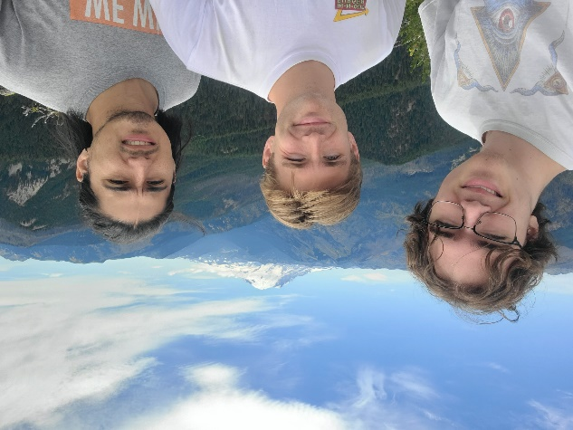
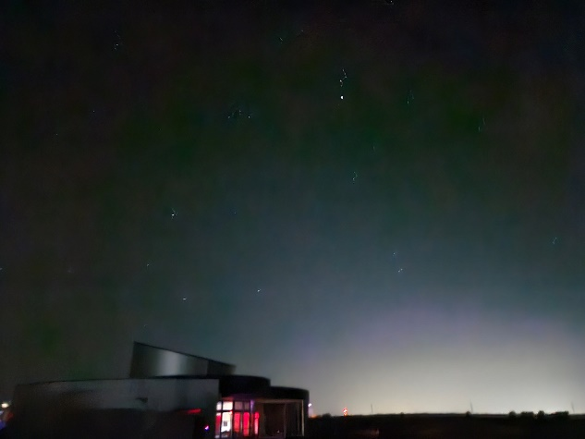
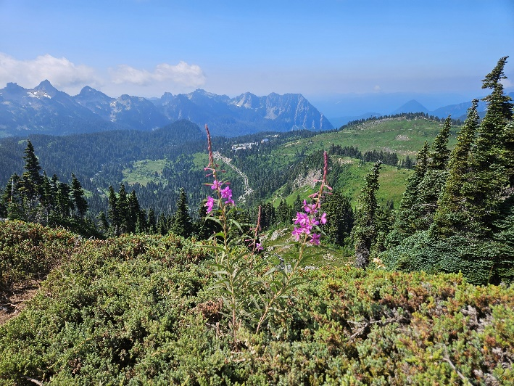
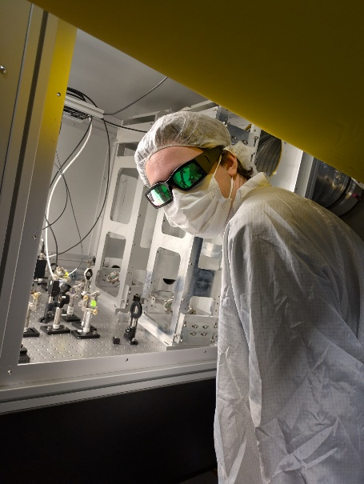
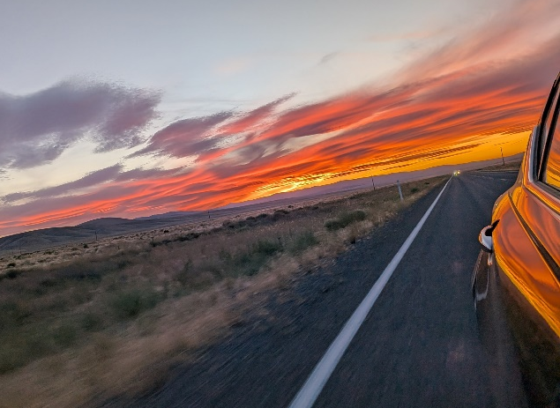

Questions?
13

