Slide 1
Inferring Inspiral Properties of Binary Black Hole Mergers from the Ringdown
Serena Fink
Mentors: Eliot Finch and Simona Miller

Slide 2
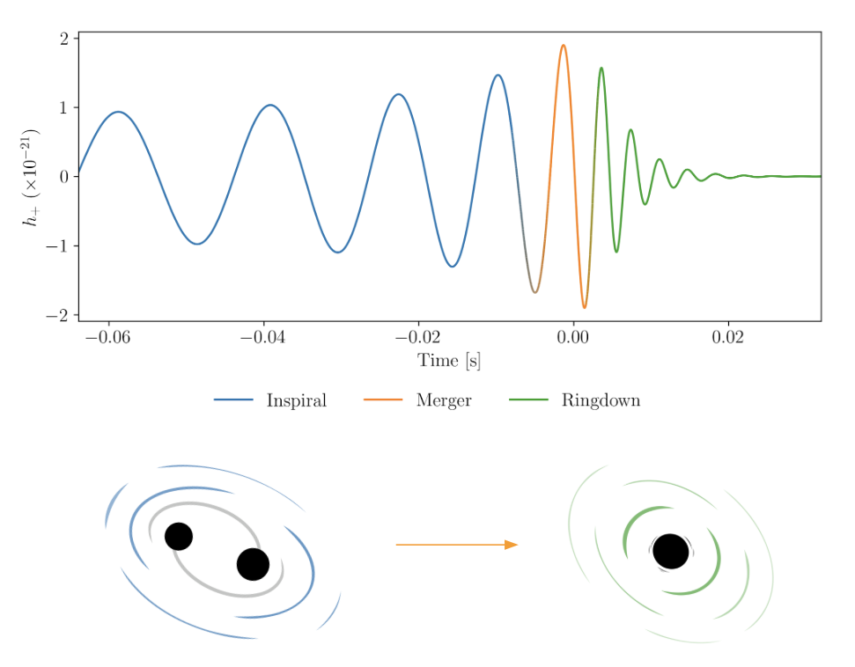
Introduction to Black Hole Ringdown
Ringdown describes the portion of a gravitational wave signal after the merger
Perturbed remnant black hole is losing energy and emitting gravitational waves
Image credit: Eliot Finch

Slide 3
Introduction to Black Hole Ringdown
Observed ringdown signal is impacted by many parameters, including masses and spins of progenitor black holes
q: mass ratio, M₁/M₂
ꭓ₁: spin of M₁
ꭓ₂: spin of M₂
ℒ
ꭓ₁
ꭓ₂
M₁
M₂

Slide 4
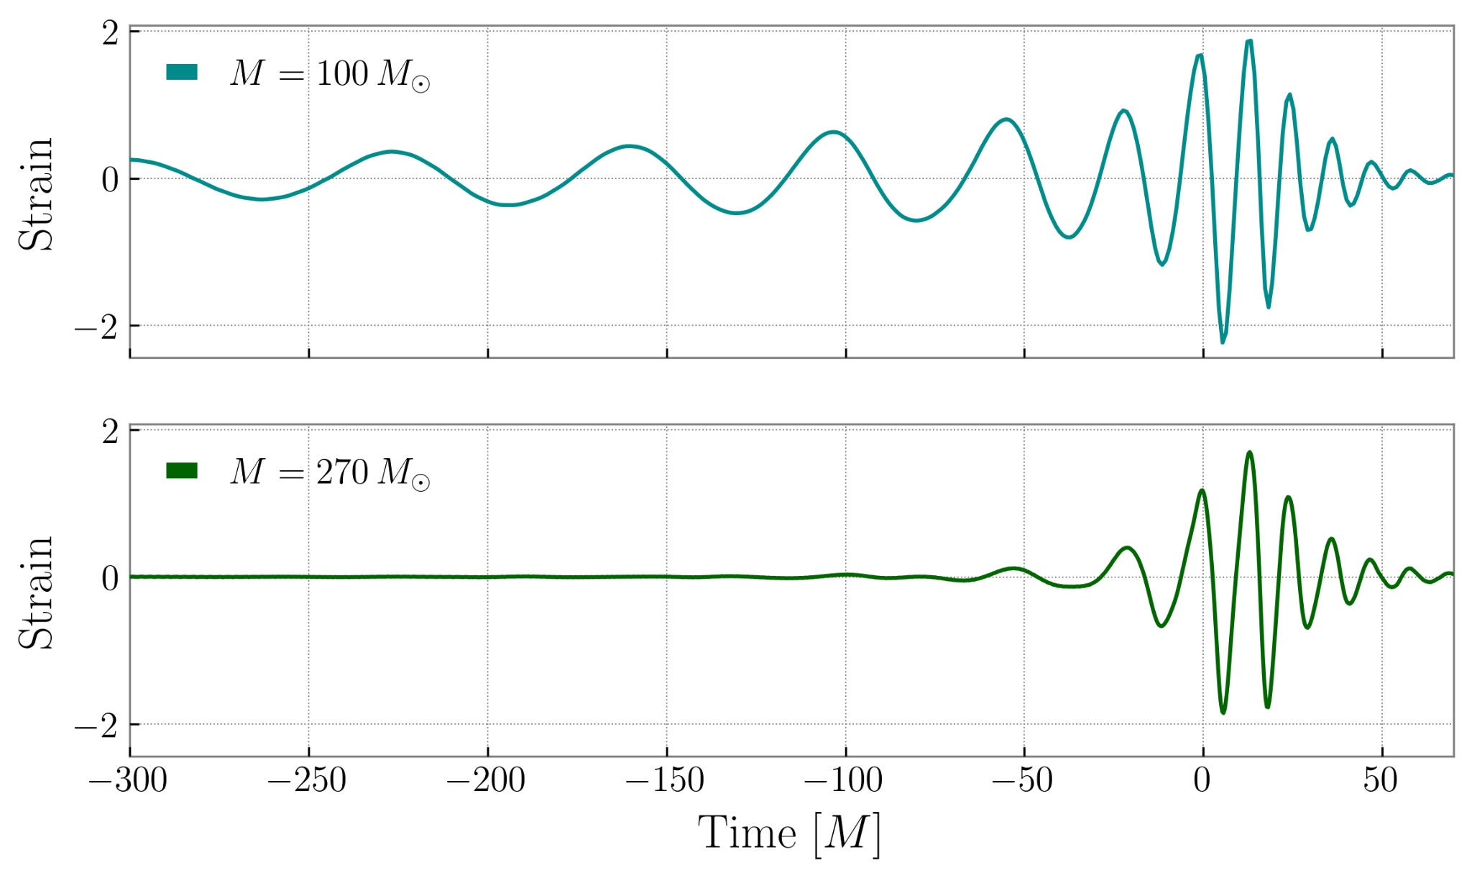
How do we know these parameters?
Measure q, ꭓ₁, ꭓ₂
Ringdown determined by q, ꭓ₁, ꭓ₂
Can we predict q, ꭓ₁, ꭓ₂ from ringdown alone?
Very little visible inspiral

Slide 5
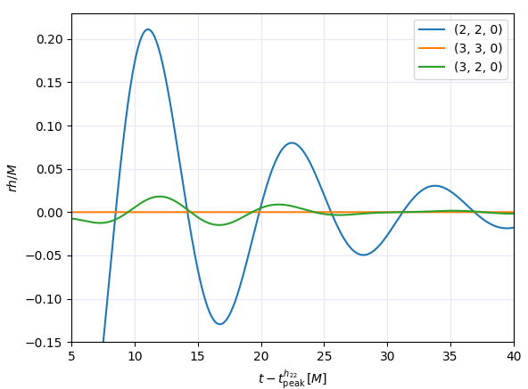

Quasinormal Modes
Ringdown waveform is a sum of damped sinusoids called quasinormal modes
Starts at some time after peak strain to avoid nonlinearities in the merger

Slide 6


What is a ringdown surrogate?
There is no analytic way to map between ringdown and inspiral parameters
A: ringdown strain amplitude
ɸ: phase angle
Surrogate:
Inverted Surrogate:

Slide 7
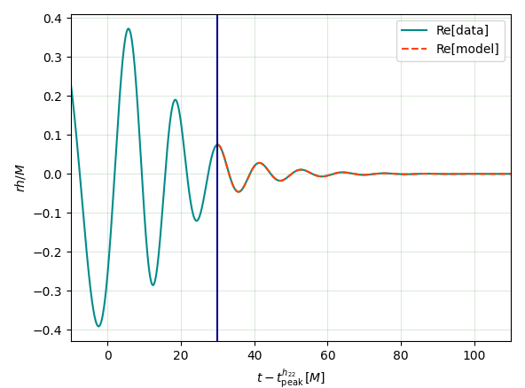
Inferring Inspiral Properties from Ringdown Signal
Create fake inspiral merger ringdown waveform based on q, ꭓ₁, ꭓ₂
We fit for amplitudes and phases in ringdown
Use inverted surrogate to infer q, ꭓ₁, ꭓ₂ from amplitudes and phases
Compare inferred parameters to true parameters

Slide 8
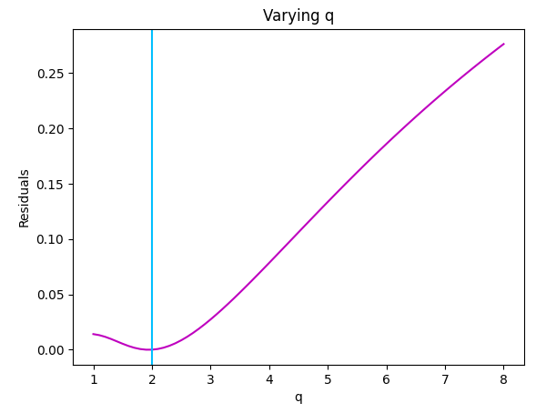

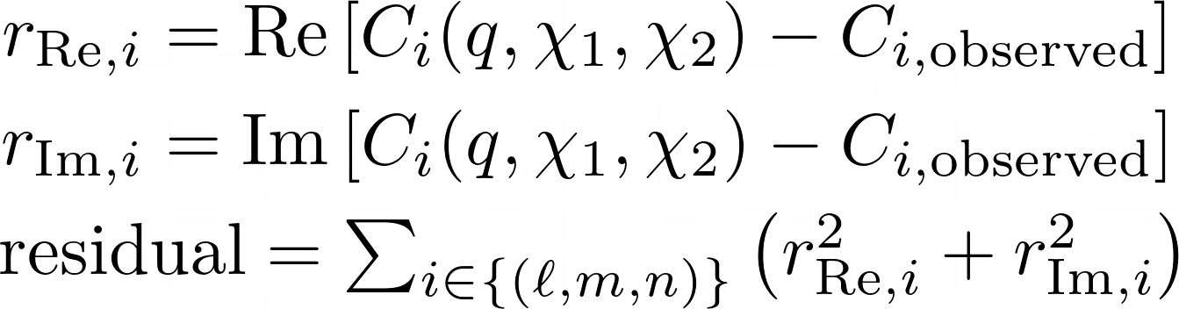
Inverting a Surrogate using Least Squares
Determine for which q, ꭓ₁, ꭓ₂ residual is minimized from least squares
True q

Slide 9
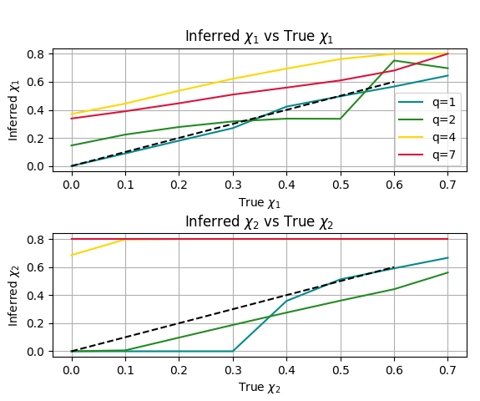
Tests with Inverted Surrogate
Test what regions of [q, ꭓ₁, ꭓ₂] parameter space this fit breaks down
Fit is much worse with higher mass ratio, especially for ꭓ2; does not find a good estimate and gets stuck on boundary

Slide 10
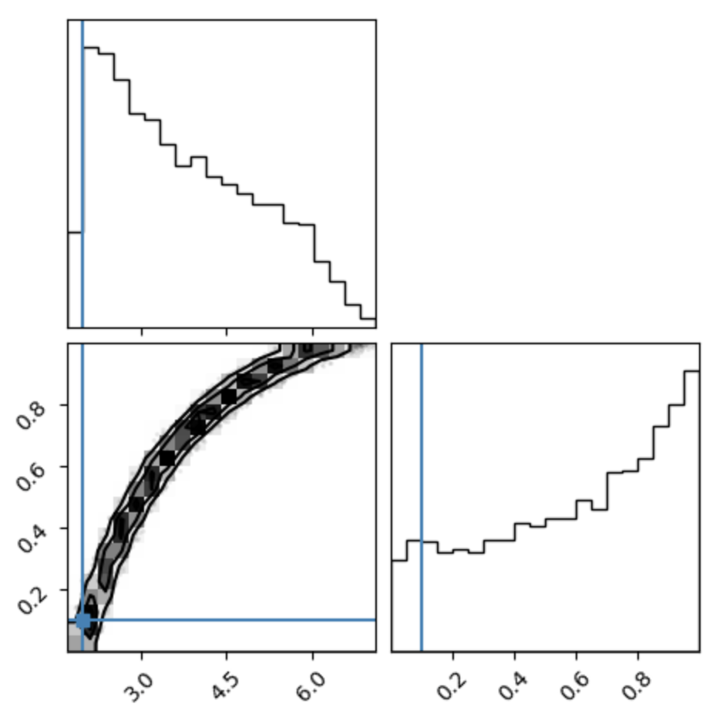
Switching to Sampling
Previous method gives point estimate of q, ꭓ₁, ꭓ₂
In reality, there can be multiple q, ꭓ₁, ꭓ₂ values that work
To explore this, we use sampling and define a likelihood for the inversion
Now we have a probability distribution for q, ꭓ₁, ꭓ₂
q
ꭓ₁
q
ꭓ₁
σ is uncertainty in C

Slide 11
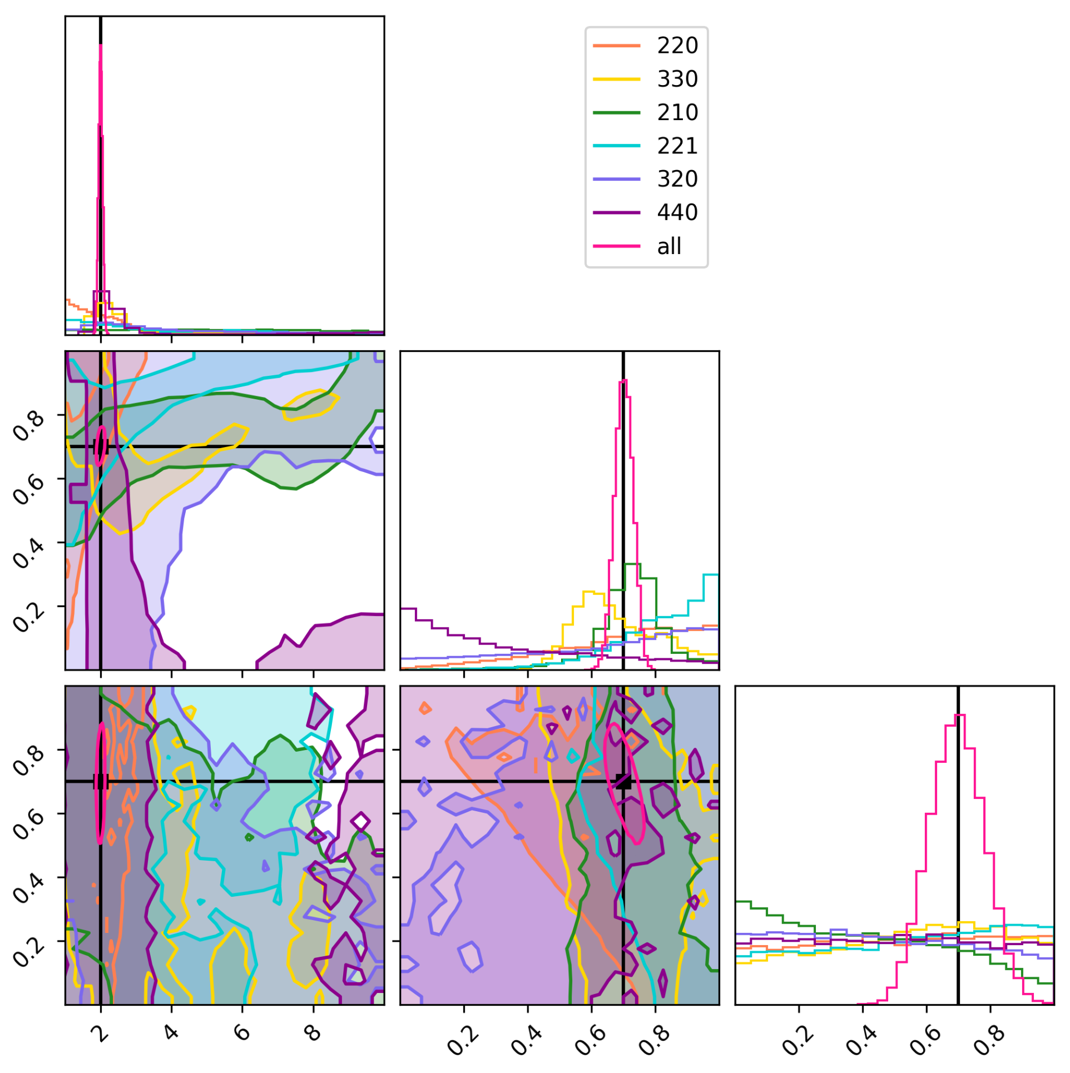
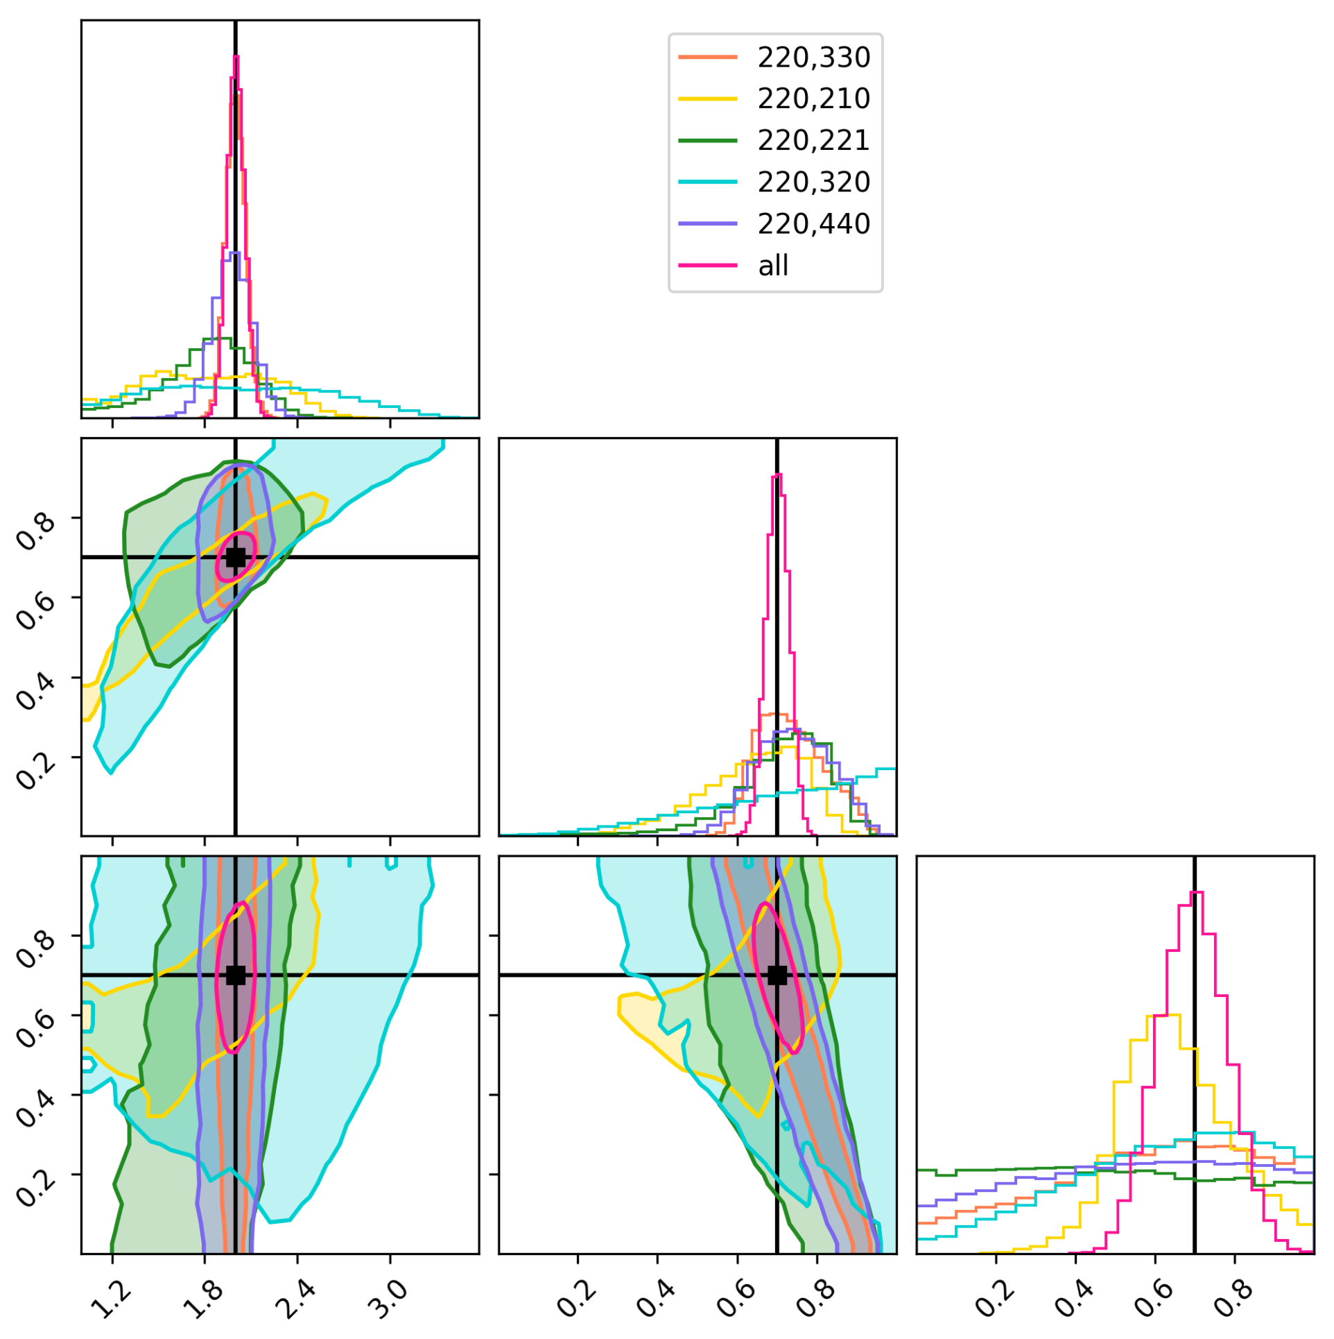
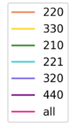
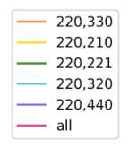
Fit for one mode q=2, ꭓ1=0.7, ꭓ2=0.7
Fit for two modes q=2, ꭓ1=0.7 , ꭓ2=0.7
q
q
ꭓ₁ ꭓ₂
ꭓ₁ ꭓ₂
q
ꭓ₁ ꭓ₂
q
ꭓ₁ ꭓ₂

Slide 12
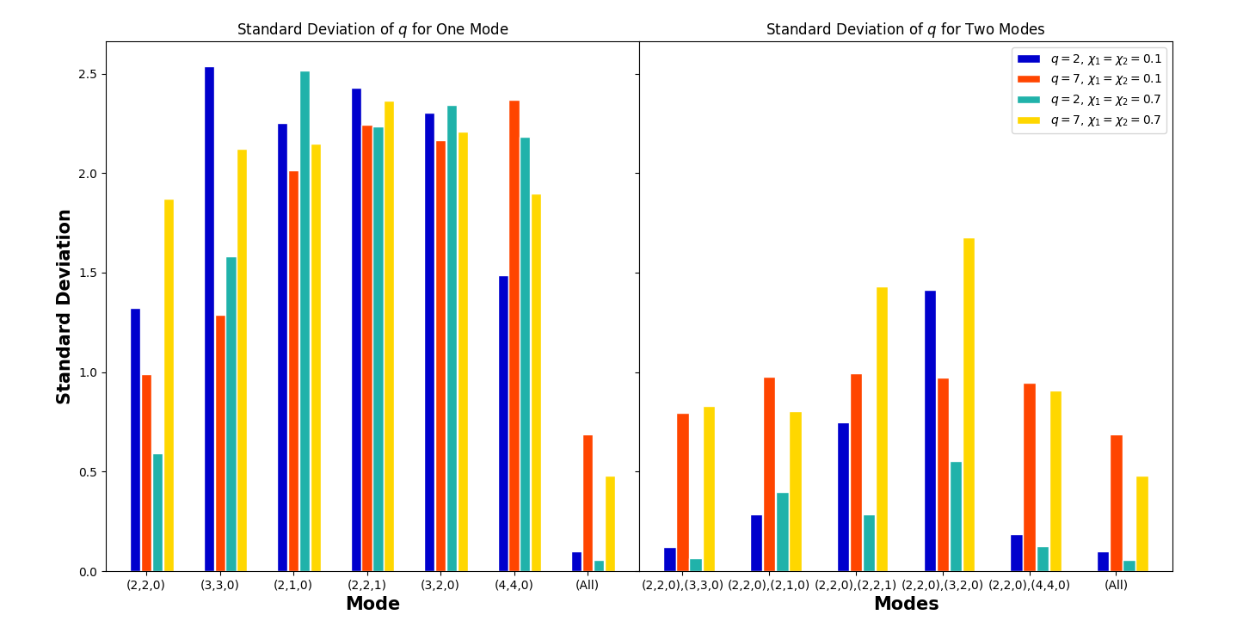
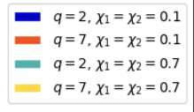

Slide 13
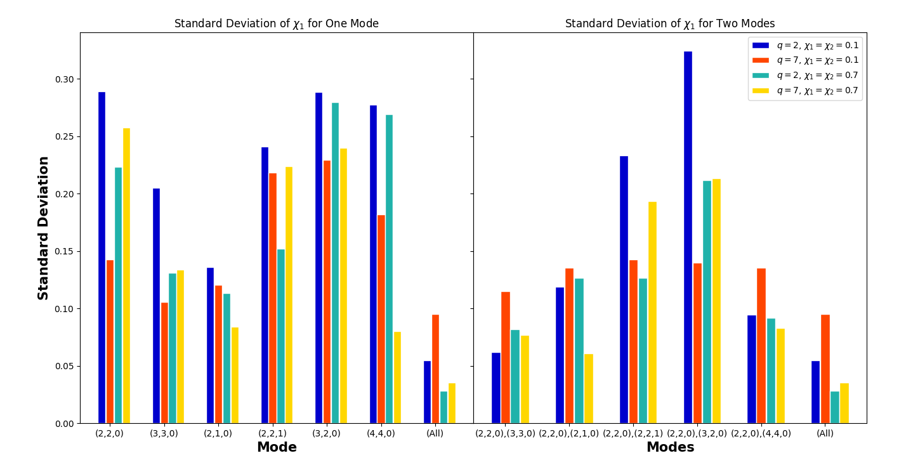

Slide 14
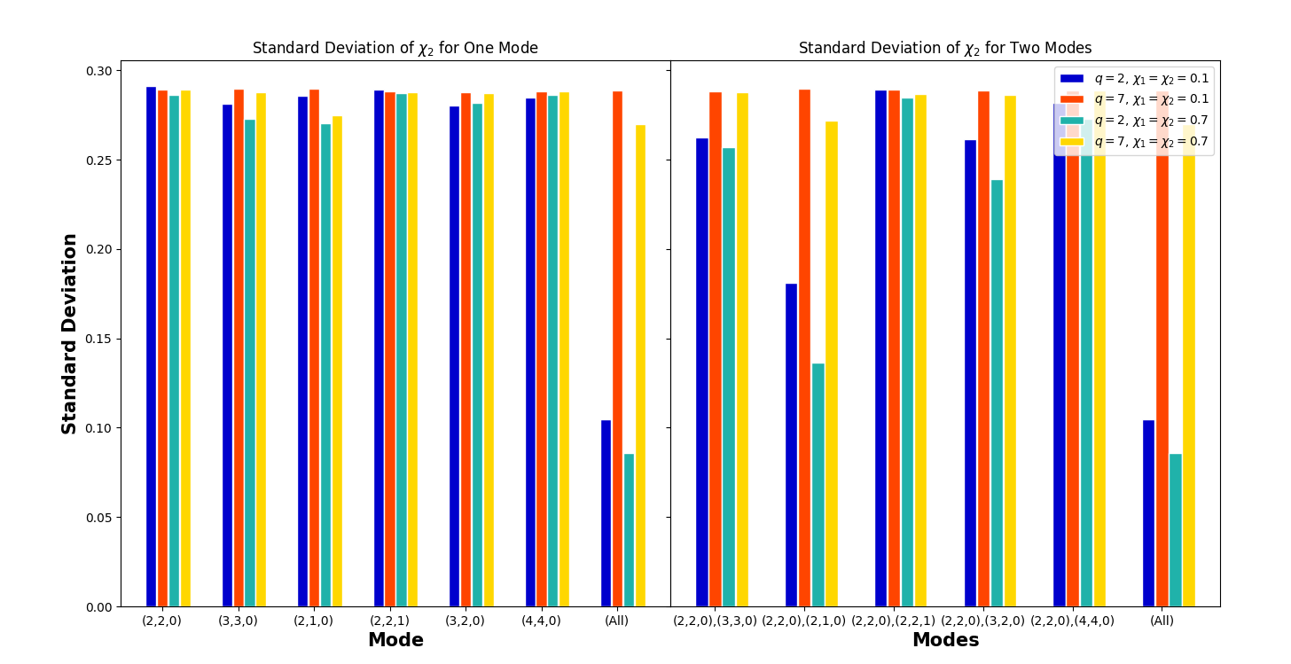

Slide 15
Conclusions Future Work
It is possible to infer inspiral parameters from the ringdown alone
We have inverted a ringdown surrogate to return q, ꭓ₁, ꭓ₂ when given {A_{lmn}, ɸ_{lmn}}
(2,2,0) and (3,3,0) combination gives best constraints on q and ꭓ₁ in the cases we’ve considered, but (2,2,0) and (2,1,0) gives good constraints on spin in some cases
Vary noise to determine at what SNR ꭓ₂ can be constrained
Further explore using residual from strain instead of amplitudes
Repeat similar analysis for precessing systems

Slide 16



Acknowledgements
Mentors: Eliot Finch and Simona Miller
NSF REU program, Caltech SFP, LIGO

Slide 17
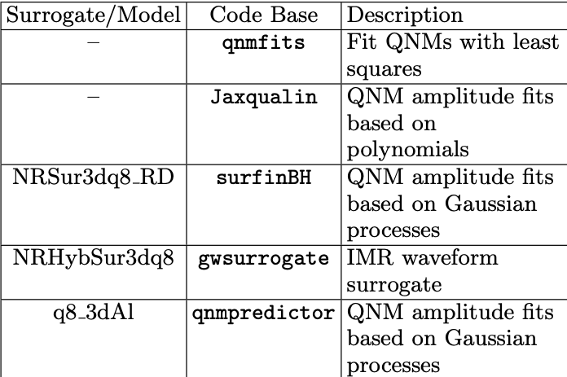
Surrogates and Models Used
qnmfits applied to NRHybSur3dq8 for “observed” data
Jaxqualin, surfinBH, qnmpredictor used for “model” data

Slide 18
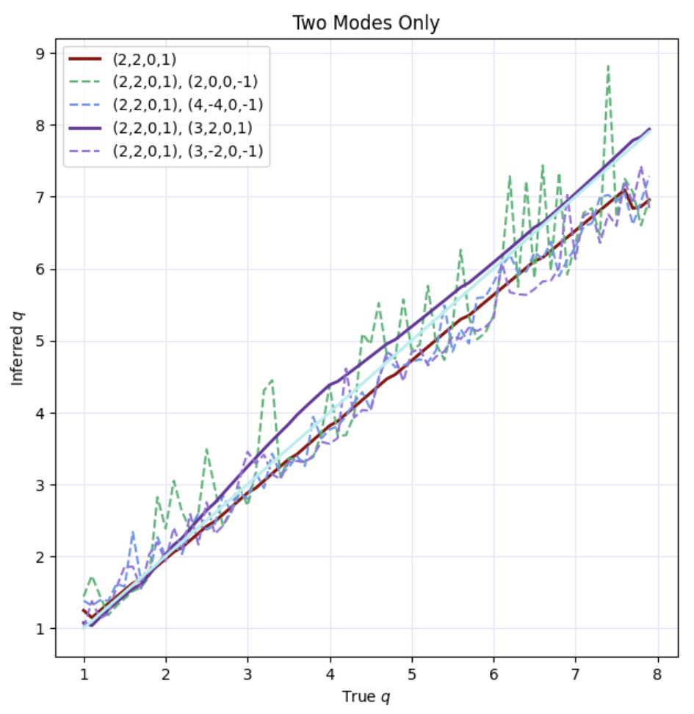
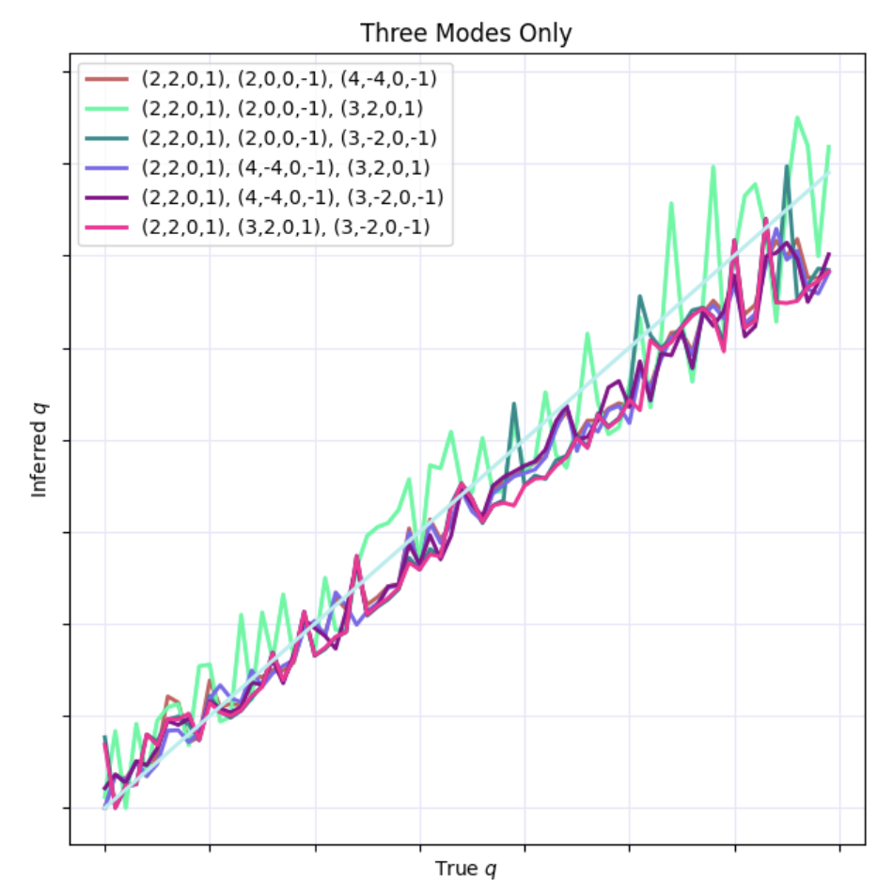
Tests with Least Squares Inversion

