Slide 1

PPLN Crystal Nonlinear Gain Measurements for Tabletop Waveguided Optical Parametric Amplification
Nora Dreslin
Mentors: Professor Rana Adhikari, Peter Carney, and Shruti Maliakal
LIGO SURF REU 2025

Slide 2
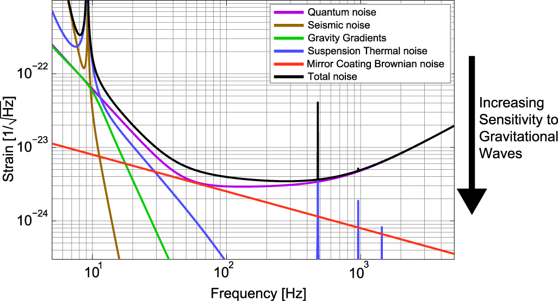
Motivation FOR PROJECT
LIGO’s sensitivity to gravitational waves >500Hz is mostly limited by quantum noise
Shot noise due to uncertainty in phase
Quantum back action/radiation pressure noise due to uncertainty in amplitude
S S Y Chua et al 2014 Class. Quantum Grav. 31 183001

Slide 3
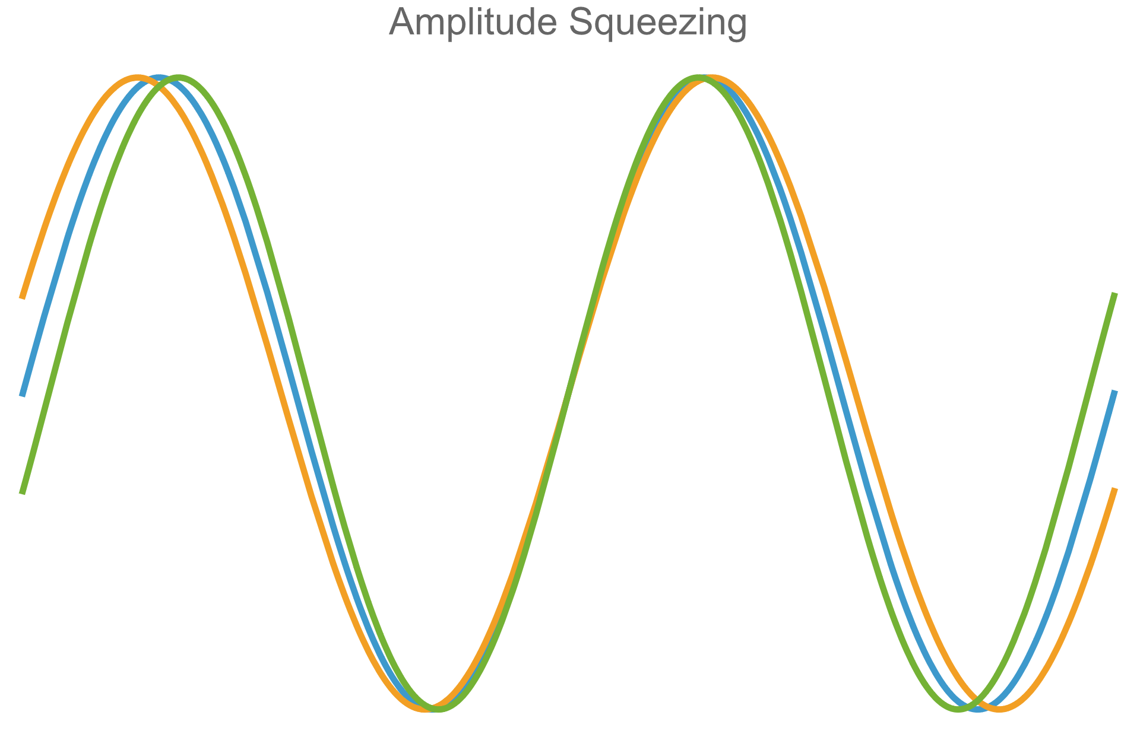
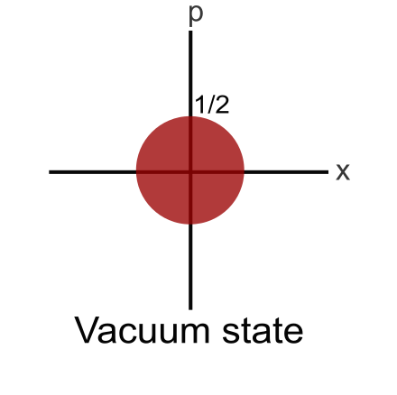
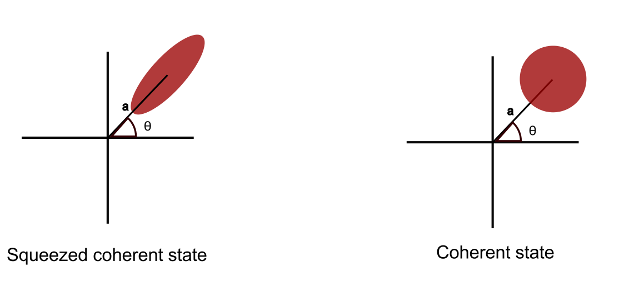
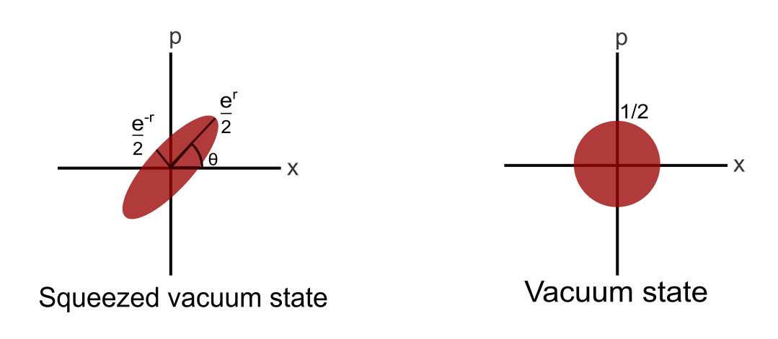
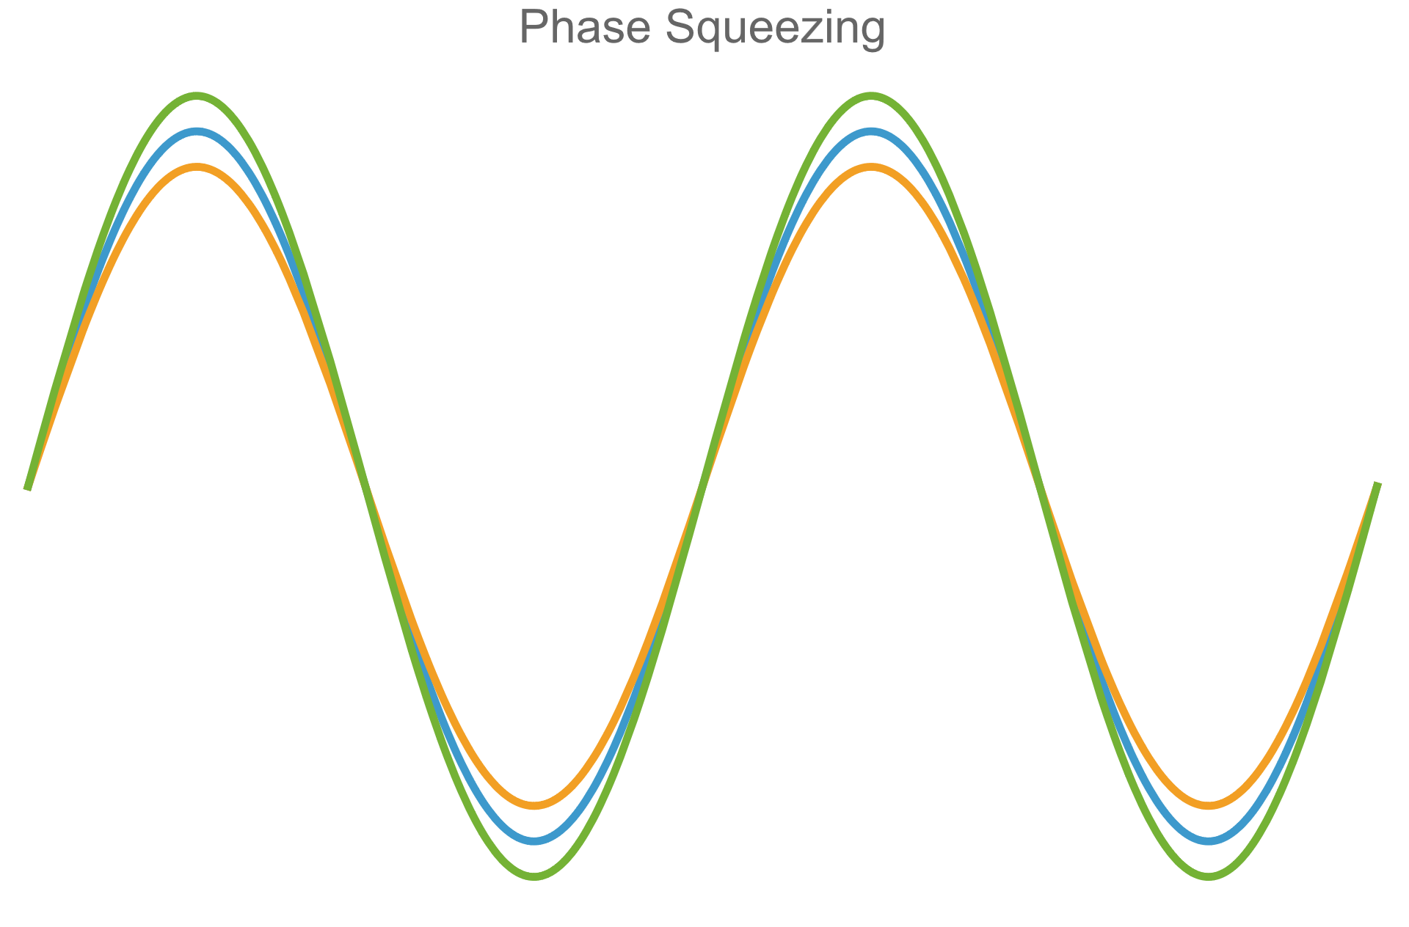
Background: Quantum Squeezing
Quantum squeezing allows us to reduce uncertainty in one quadrature of light
The overall uncertainty of the light must still obey the uncertainty principle, ΔxΔp ≥ ħ/2
The squeezing parameter, r, determines the degree of squeezing
Notes:
Quadratures : Light quantum harmonic oscillator - position and momentum

Slide 4
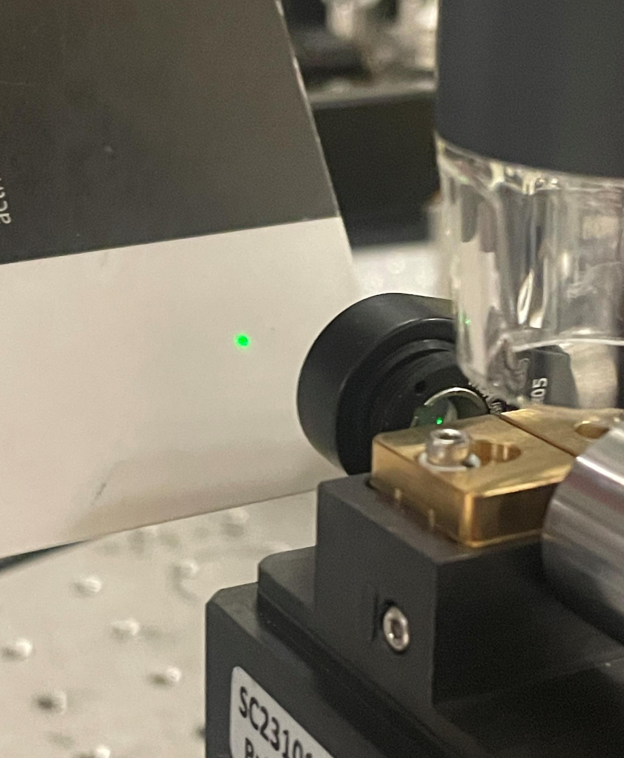



Background: Crash course in nonlinear optics
Ex. Second-harmonic generation (SHG)
The polarization of a material, P(t), can be written as
$$P\left(t\right)=ε_{0}\left(χ^{\left(1\right)}E\left(t\right)+χ^{\left(2\right)}E^{2}\left(t\right)+…\right)$$
where E(t) is the strength of an applied electric field and $χ^{\left(n\right)}$ is the nth-order nonlinear susceptibility of the material
PPLN has a $χ^{\left(2\right)}$ value large enough to allow second-order nonlinear optical interactions
Second-harmonic term
2 pump photons $→$1 signal photon
Energy level diagram of SHG
ω
2ω
ω
Notes:
*energy conservation*
Boyd

Slide 5
Background: Generation of squeezed light
Use a nonlinear optical process called Type 0 spontaneous parametric down conversion (SPDC)
Converts a pump photon to a pair of photons of half the original frequency such that all photons have the same polarization
Generated pairs coupled in polarization and phase and therefore squeezed
Energy level diagram of SPDC
ω/2
ω
ω/2
Radiation of ω/2 frequency light due to nonlinear interactions with vacuum field in crystal
Notes:
Photons in pair indistinguishable -> entangled

Slide 6
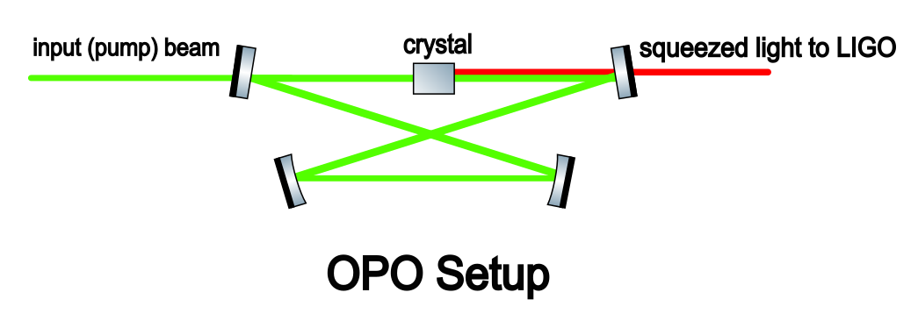
Background: ligo’s current squeezing method
LIGO uses an optical parametric oscillator (OPO) to generate squeezed light which is mixed with the LIGO beam and squeezes it
This consists of a KTP bulk crystal inside of a bowtie cavity
Notes:
Cavity locking and matching complex

Slide 7
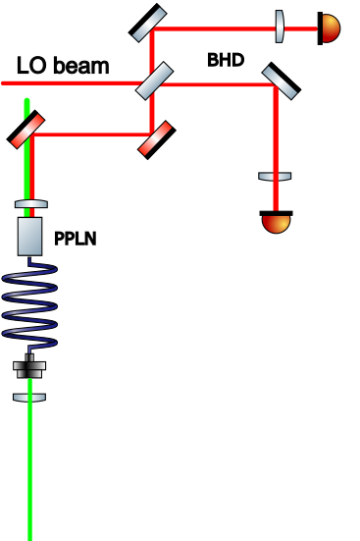
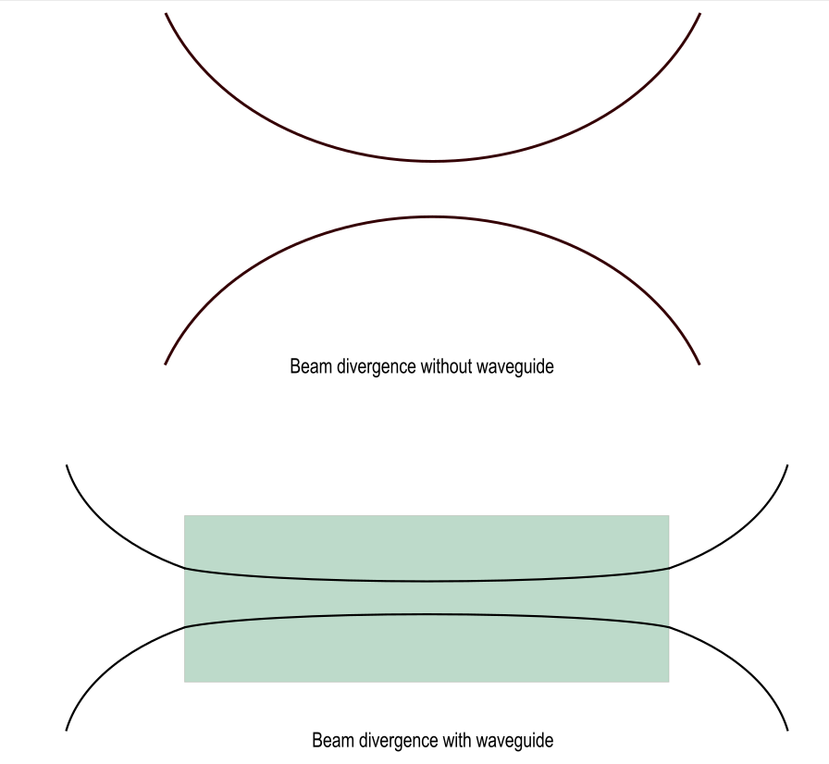
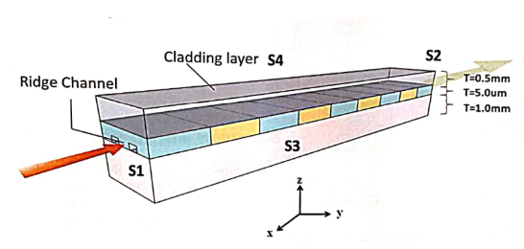
Background: simplifying the squeezing method
This project aims to simplify the current squeezing method and eliminate cavity loss present in OPO
Similar process to OPO called waveguided optical parametric amplification (WOPA)
Generate squeezed light with a single pass through a periodically poled Lithium Niobate (PPLN) waveguide
Simplified WOPA setup
Notes:
All beams from same laser so in phase
Explain squeezing angle as relative phase between lo and signal
Waveguide allows high field intensity and mode confinement

Slide 8
Limits to squeezing level in WOPA
There exist multiple sources of potential loss in the WOPA system
Polarization mismatch
Mode mismatch
Fiber misalignment
BHD visibility
To better identify the sources of loss affecting measured squeezing level, we calculated our expected squeezing level from the nonlinear gain of the process generating the squeezed light

Slide 9
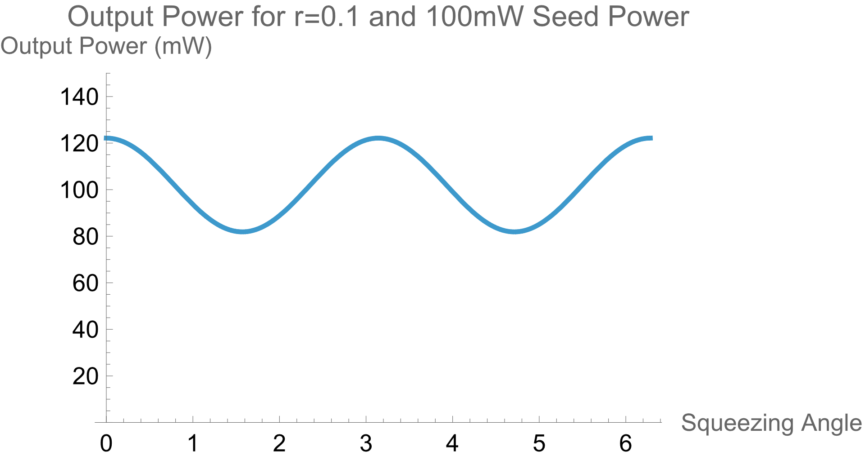


Squeezing level as a function of nonlinear gain
The output power can be written as a function of the squeezing parameter and angle
We can use this to solve for r and calculate the expected squeezing level as
Notes:
Highlight squeezing angle and parameter
Show plot of r and squeezing phase diagram again
Direct measurement of output power – don’t need bhd
Technically OPA, spdc with seed power instead of vacuum – functions of same squeezing parameter
We represent the squeezing operator as $H_{s}=\left(\begin{matrix}e^{r} & 0 \\ 0 & e^{−r}\end{matrix}\right)$, and the initial state of our signal field as $\left(\begin{matrix}a_{1} \\ a_{2}\end{matrix}\right)$ where $a_{1}=αcos0=α$ and $a_{2}=αsin0=0$
Then the squeezed state of the signal field is

Slide 10
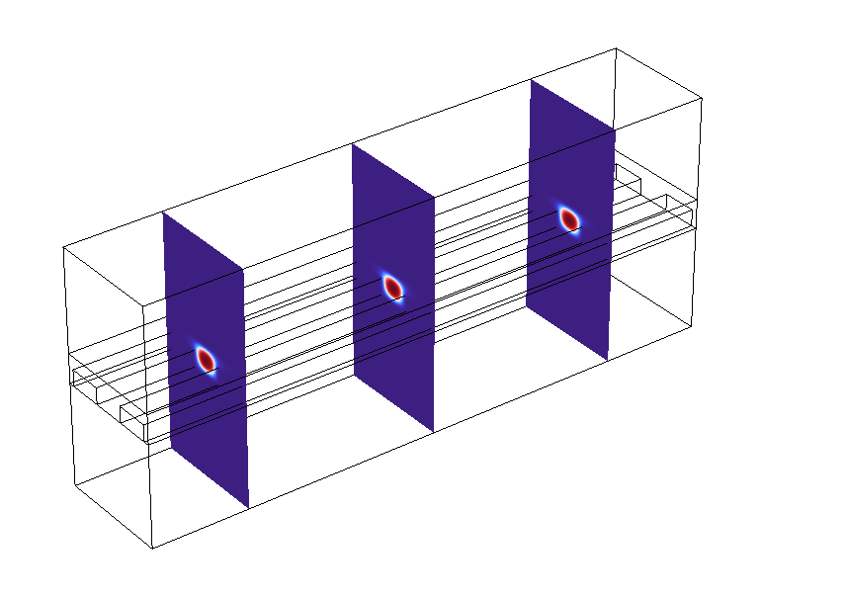
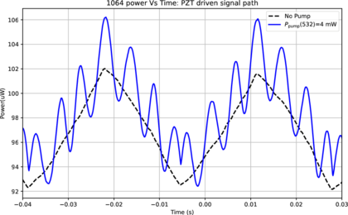
Initial nonlinear gain measurement METHOD
First align 1064nm beam to crystal axis by maximizing SHG
Then maximize 532nm transmission through crystal while maintaining SHG
Modulate signal beam phase and measure amplitude of peaks

Slide 11
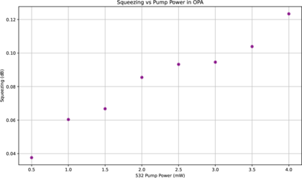
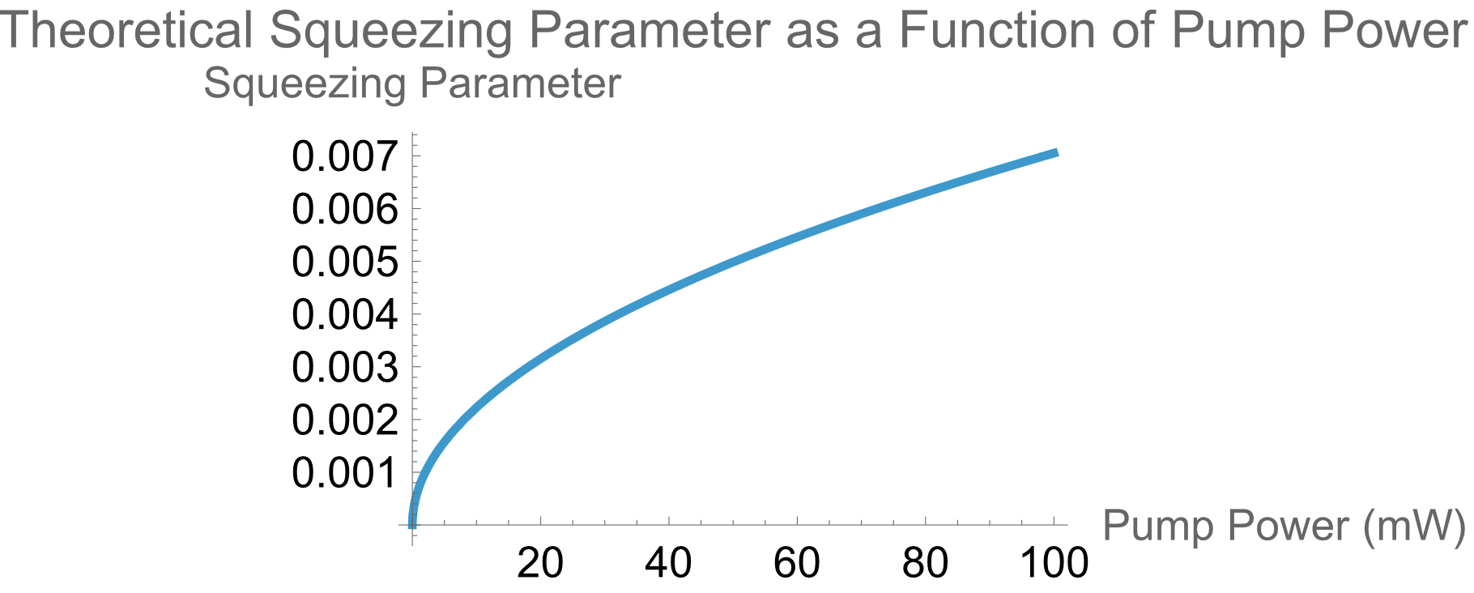
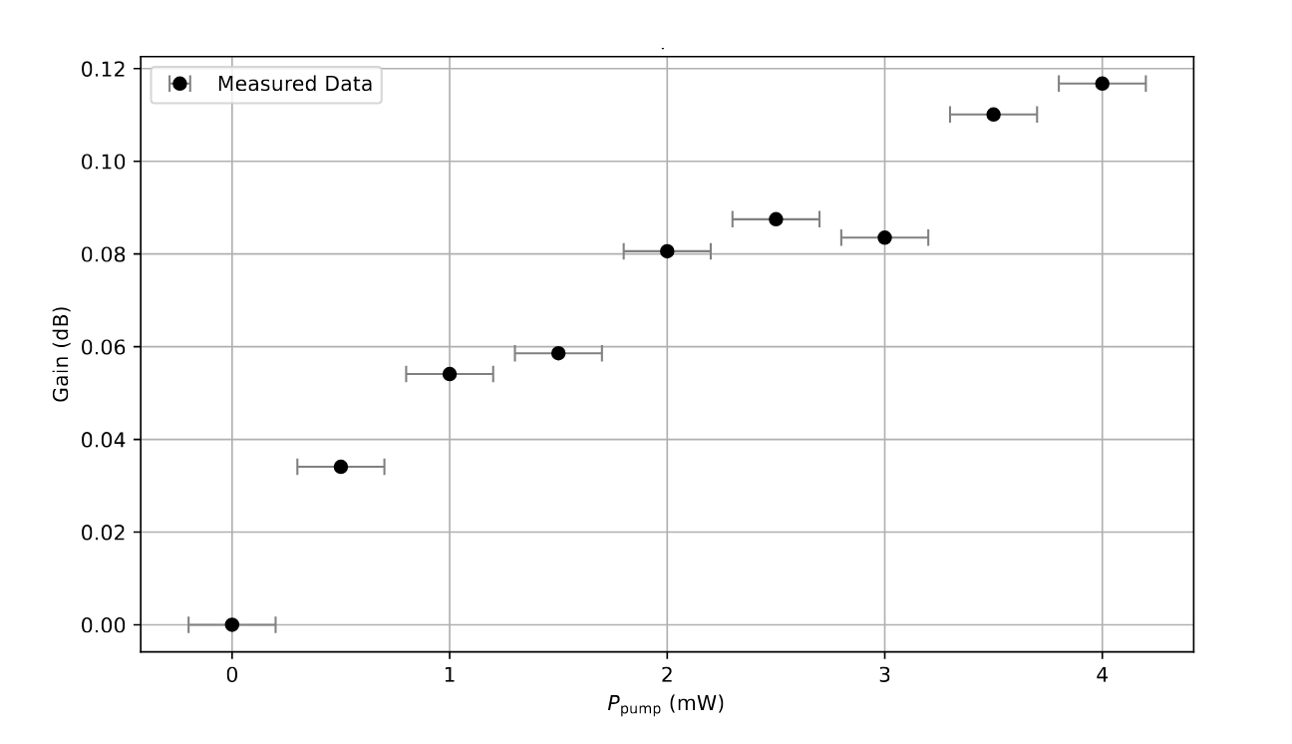
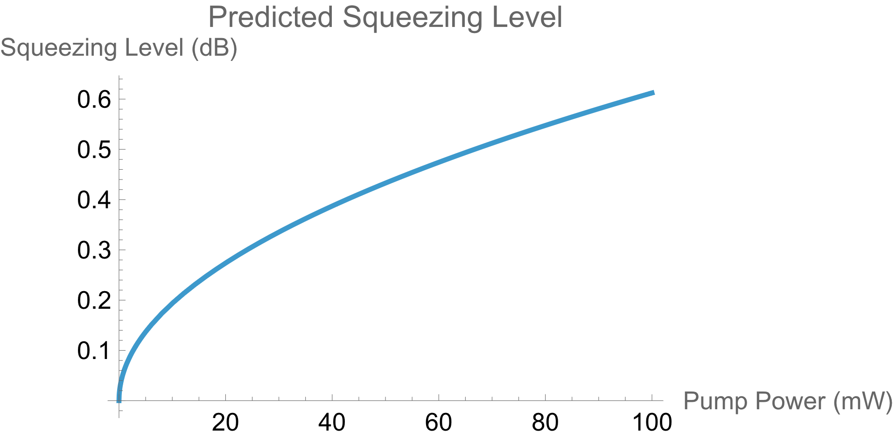
INITIAL NONLINEAR GAIN MEASUREMENT RESULTS
We measure an initial maximum gain of 0.12dB for 4mW of pump power
This agrees with the previously measured maximum squeezing level of 0.13dB
Extrapolating our data predicts a squeezing level of 0.612dB for 100mW of pump power
Notes:
Theoretical calculations assume perfect mode matching to crystal

Slide 12
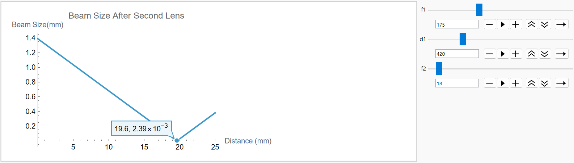
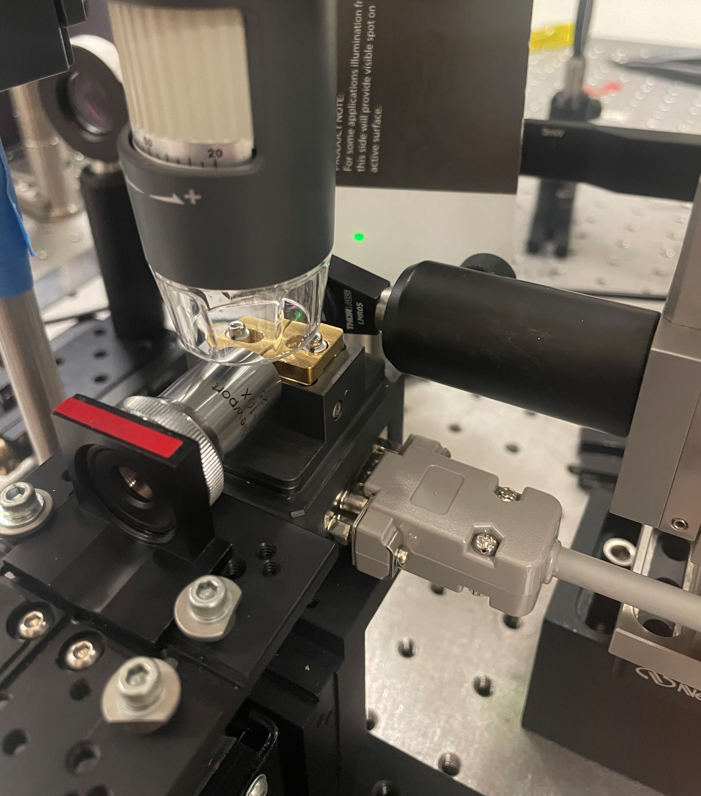
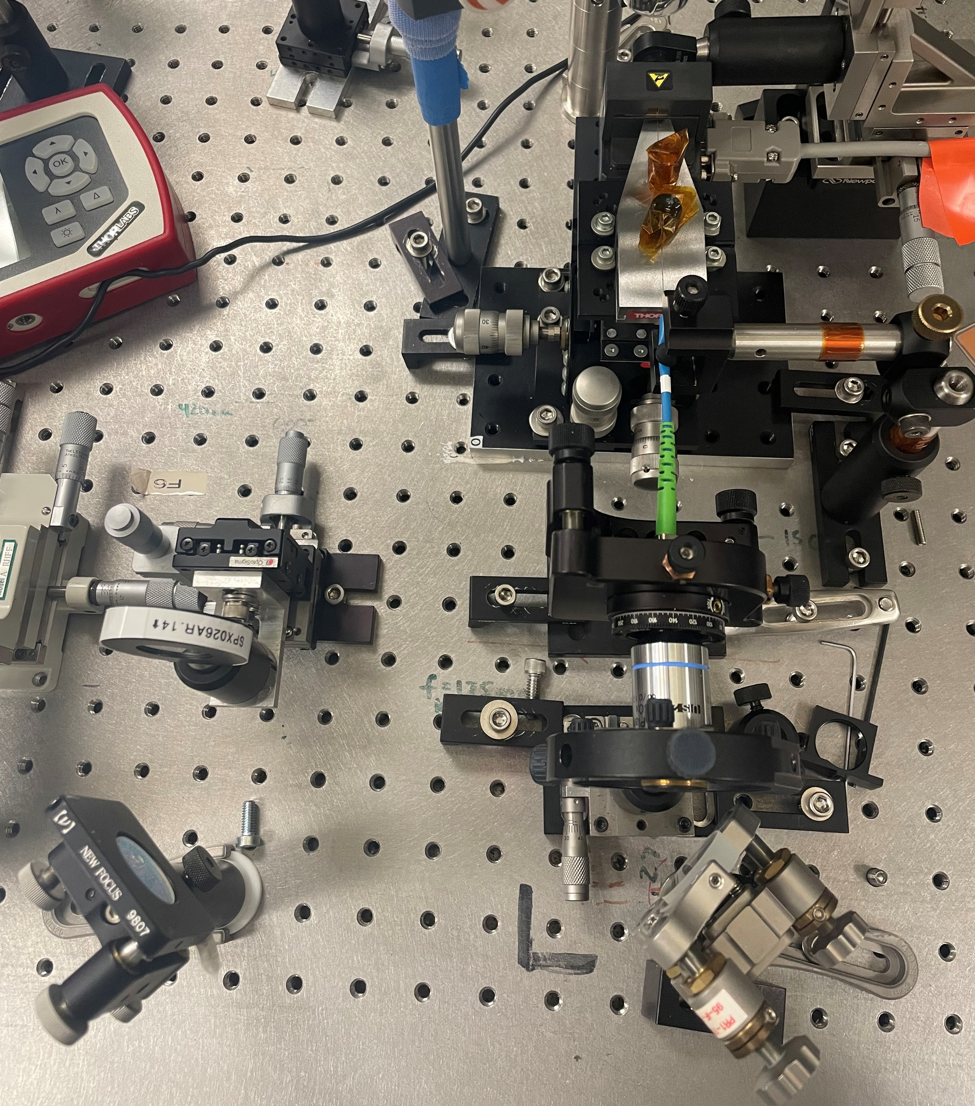
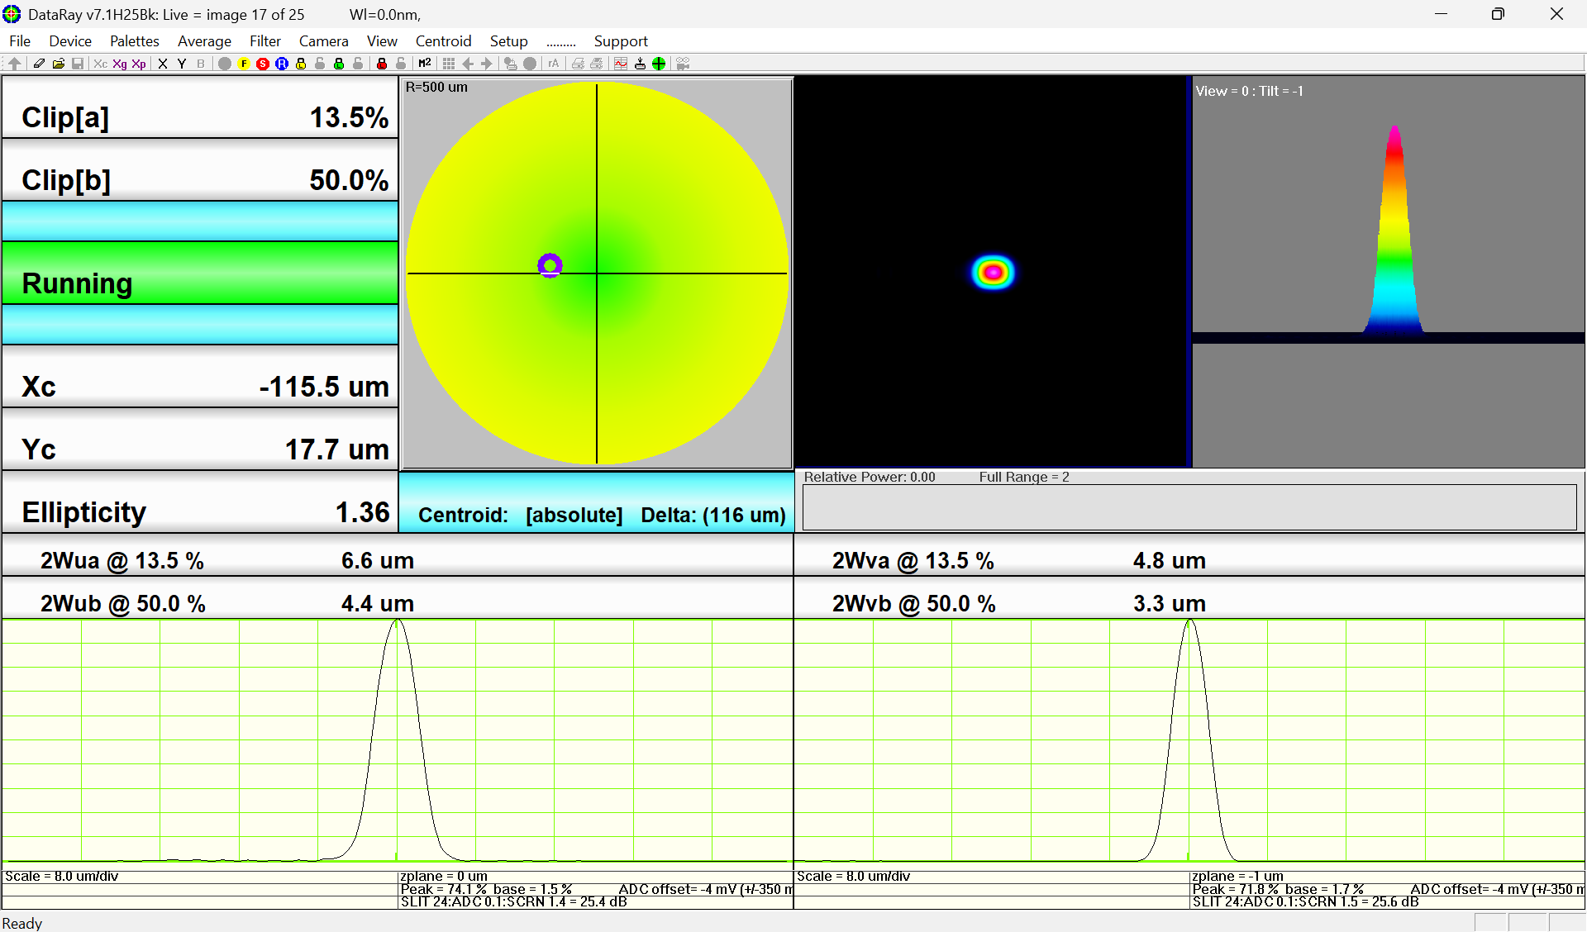
Tuning gain/squeezing level
Polarization measurements and tuning
By tuning the polarization, we were able to increase the nonlinear gain by 0.05dB or 4.25%
Fiber and free-space coupling
MFD of crystal 4.83um x 4.16um
Crystal temperature
Notes:
Rayleigh range and mfd for crystal
Diffraction limited why we need fiber bc of divergence
Difficulties of fiber coupling
Black box abcd just talk about lens combo code to get beam down and then confirm w beam profiler

Slide 13
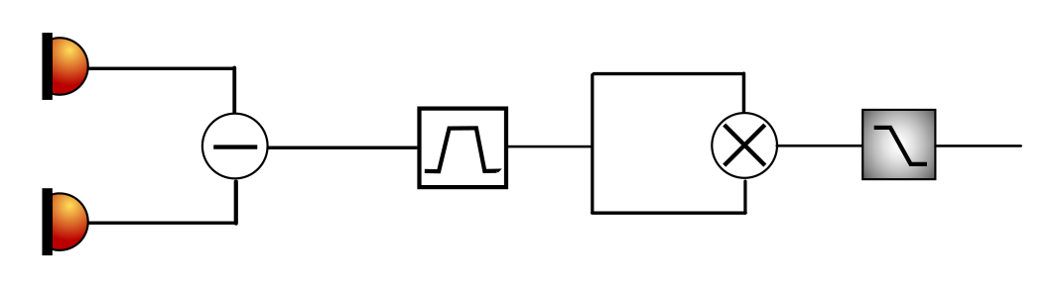
Measuring squeezing
To measure squeezing, we use a balanced homodyne detector (BHD) and modulate the phase of our local oscillator (LO)
BHD visibility improved slightly from previous squeezing measurements to 62%
The two PDs of the BHD measure fluctuations in shot noise due to squeezing and anti-squeezing
Notes:
Mxing is mean square noise envelope

Slide 14
next steps…
Optimize pump power and crystal alignment to measure squeezing
Via simultaneous alignment for SHG or by measuring nonlinear gain
Free space coupling
Would eliminate fiber losses in polarization, mode, and power
Laser realignment
Reduce power fluctuations and loss in the system

Slide 15
Thank You!
My mentors, Peter and Shruti
My lab partner, Tanisha Ray
Professor Adhikari
Everyone in the lab
My parents

