Slide 1
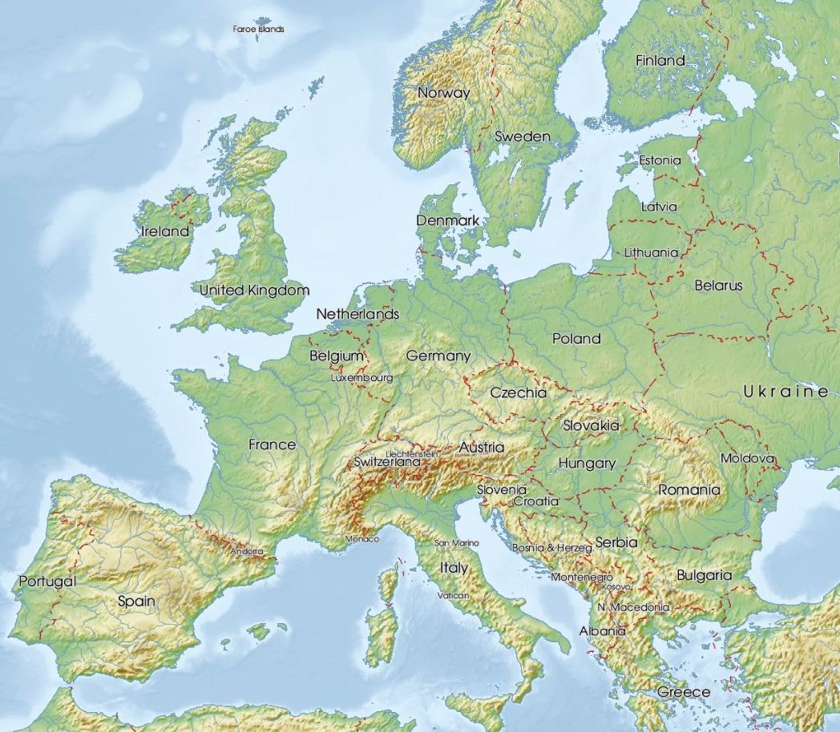



Investigating the source of inferred parameters' discrepancies between LIGO detectors in GW231123
Krzysztof Król &
Sophie Bini
LIGO SURF 2025
22.08.2025

Slide 2
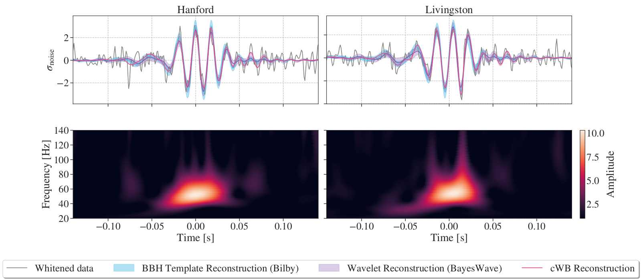
GW231123 as observed by LIGO Hanford (H1) and LIGO Livingston (L1). Virgo was offline at the time of detection.
Time measured relative to 13:54:30 UTC, 23rd November 2023. Figure source: LVK Collaboration, 2025
Notes:
say why we focus on GW231123

Slide 3
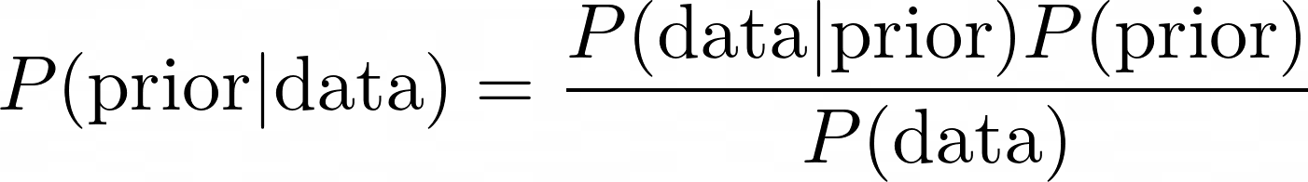
Parameter estimation (PE) and the parameter space we explore
To infer the properties of GW signal sources we employ Bayesian statistics based on Bayes theorem.
We perform PE using bilby, a library for Bayesian inference that samples the parameter space using nested sampling. We use the same settings and similar priors to other LVK analyses.
A quasicircular binary black hole merger can be parameterized using 15 parameters:
masses of the two objects,
spins of the two objects (they are vectors - each spin consists of 3 parameters),
luminosity distance,
inclination, polarization, phase,
coalescence time,
source sky position.
The PE waveforms themselves are generated using a waveform approximant such as NRSur7dq4, IMRPhenomXPHM, SEOB-NRv5PHM, etc.

Slide 4
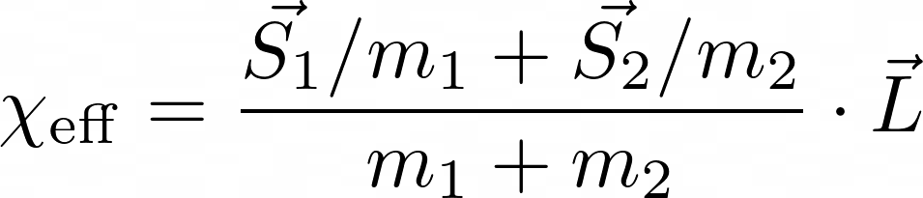
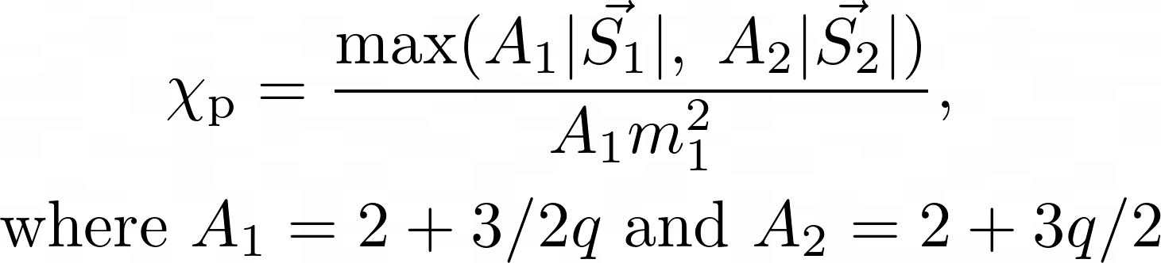
Important spin parameters we infer
Effective aligned spin parameter
bounded by [-1, 1] to avoid naked singularities.
It is a constant of motion up to at least the second post-Newtonian order. It should be easier to reliably measure than individual spins.
Effective precessing spin parameter
bounded by [0, 1] to avoid naked singularities.
We take m1 > m2, q in [0, 1]. Constraining it in a compact binary coalescence is challenging.

Slide 5
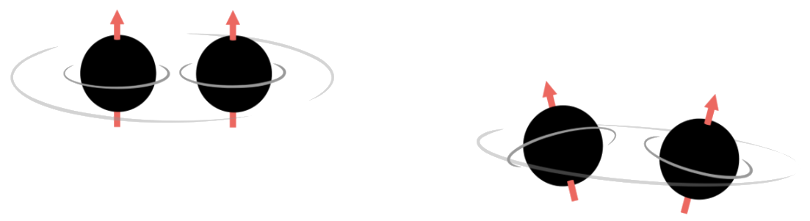
Visualizing the spins
aligned spins:
higher effective aligned spin parameter
lower effective precessing spin parameter
negligible effect of higher order modes
image credit: Eliot Finch
misaligned spins:
lower effective aligned spin parameter
higher effective precessing spin parameter
significant presence of higher order modes
Notes:
say that hms are higher frequency modes that are quieter than the fundamental

Slide 6
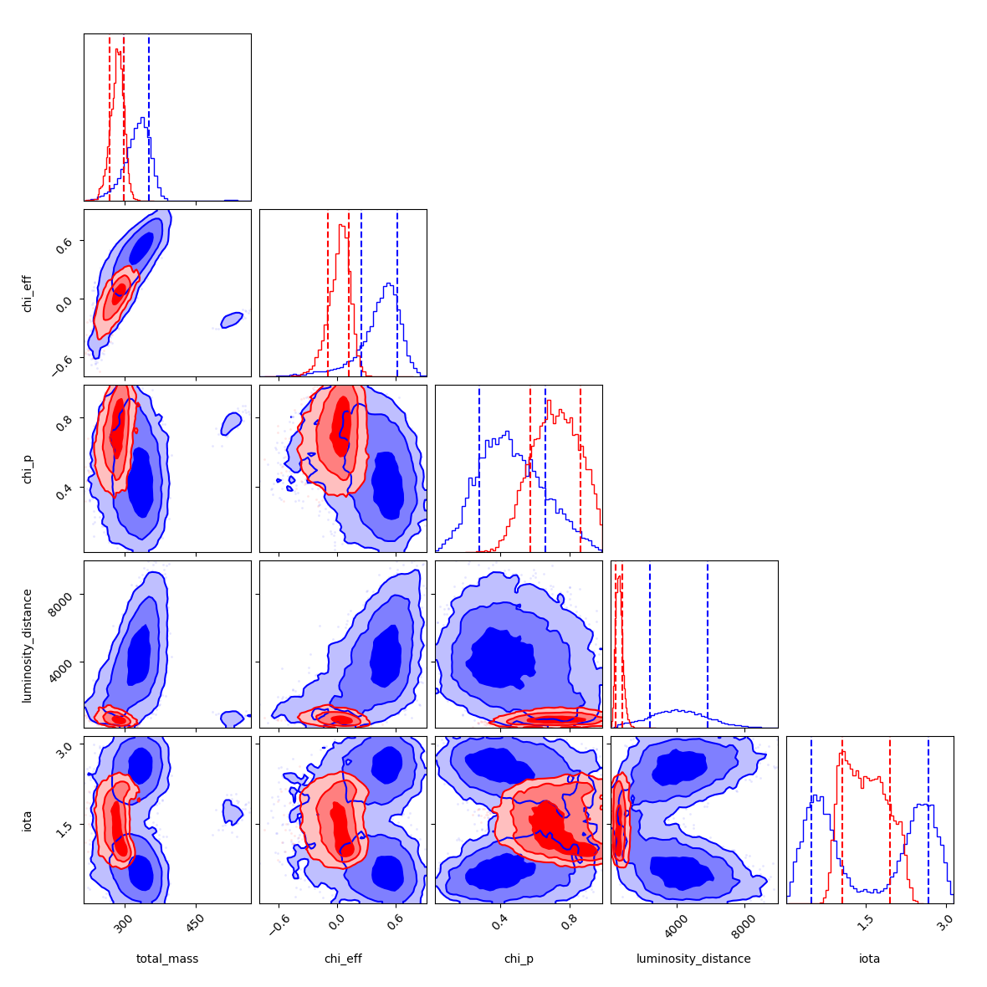
Results of Hanford-only & Livingston-only runs
χeff
χp
Hanford is blue, Livingston is red.
Corner plot showing estimated posterior probability distributions for selected parameters showing the most significant differences between detectors.
Results show that GW231123 is the most massive event ever observed, but constraining its parameters with certainty is challenging.
luminosity
distance
iota
luminosity
distance
‹#›
total mass
χeff
χp
iota
Notes:
say that typically theres only pe on both detectors, in the gw231123 paper they mentioned some differences between detectors

Slide 7
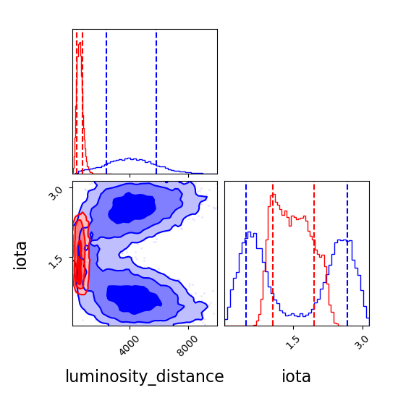
A more physical explanation - higher order modes
Higher order modes allow to resolve the inclination angle-luminosity distance degeneracy, allowing for distance measurement - even using a single detector.
H1-only and L1-only parameter estimation (PE) lead to very different measurements of SNR for higher order modes. The maximum likelihood values for event observed by Hanford are:
Livingston:
edge-on
Hanford: face-on
H1-only SNR:
(2, 2) - 13.3
(3, 3) - 2.0
other modes < 1
combined - 14.35
L1-only SNR:
(2, 2) - 14.9
(3, 3) - 3.0
(3, 2) - 2.9
(2, 1) - 2.8
(4, 4) - 2.6
combined - 14.29

Slide 8
How do GW231123’s posteriors compare to other events? Is the behavior we see normal?
Let’s look at GW230927be - a “standard” event from O4a.

Slide 9
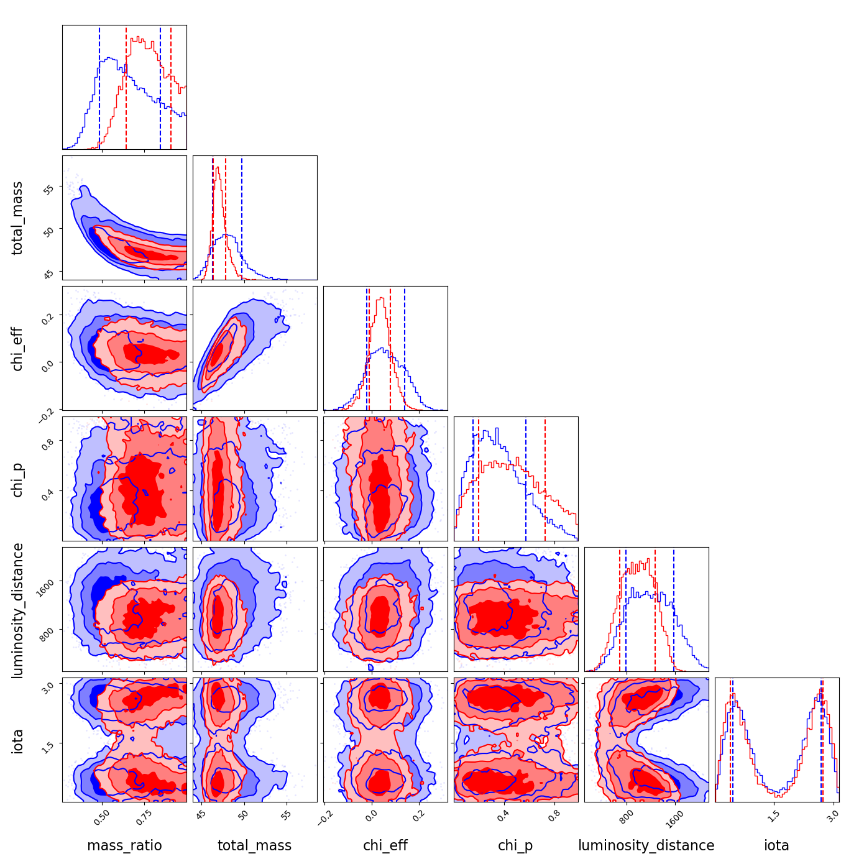
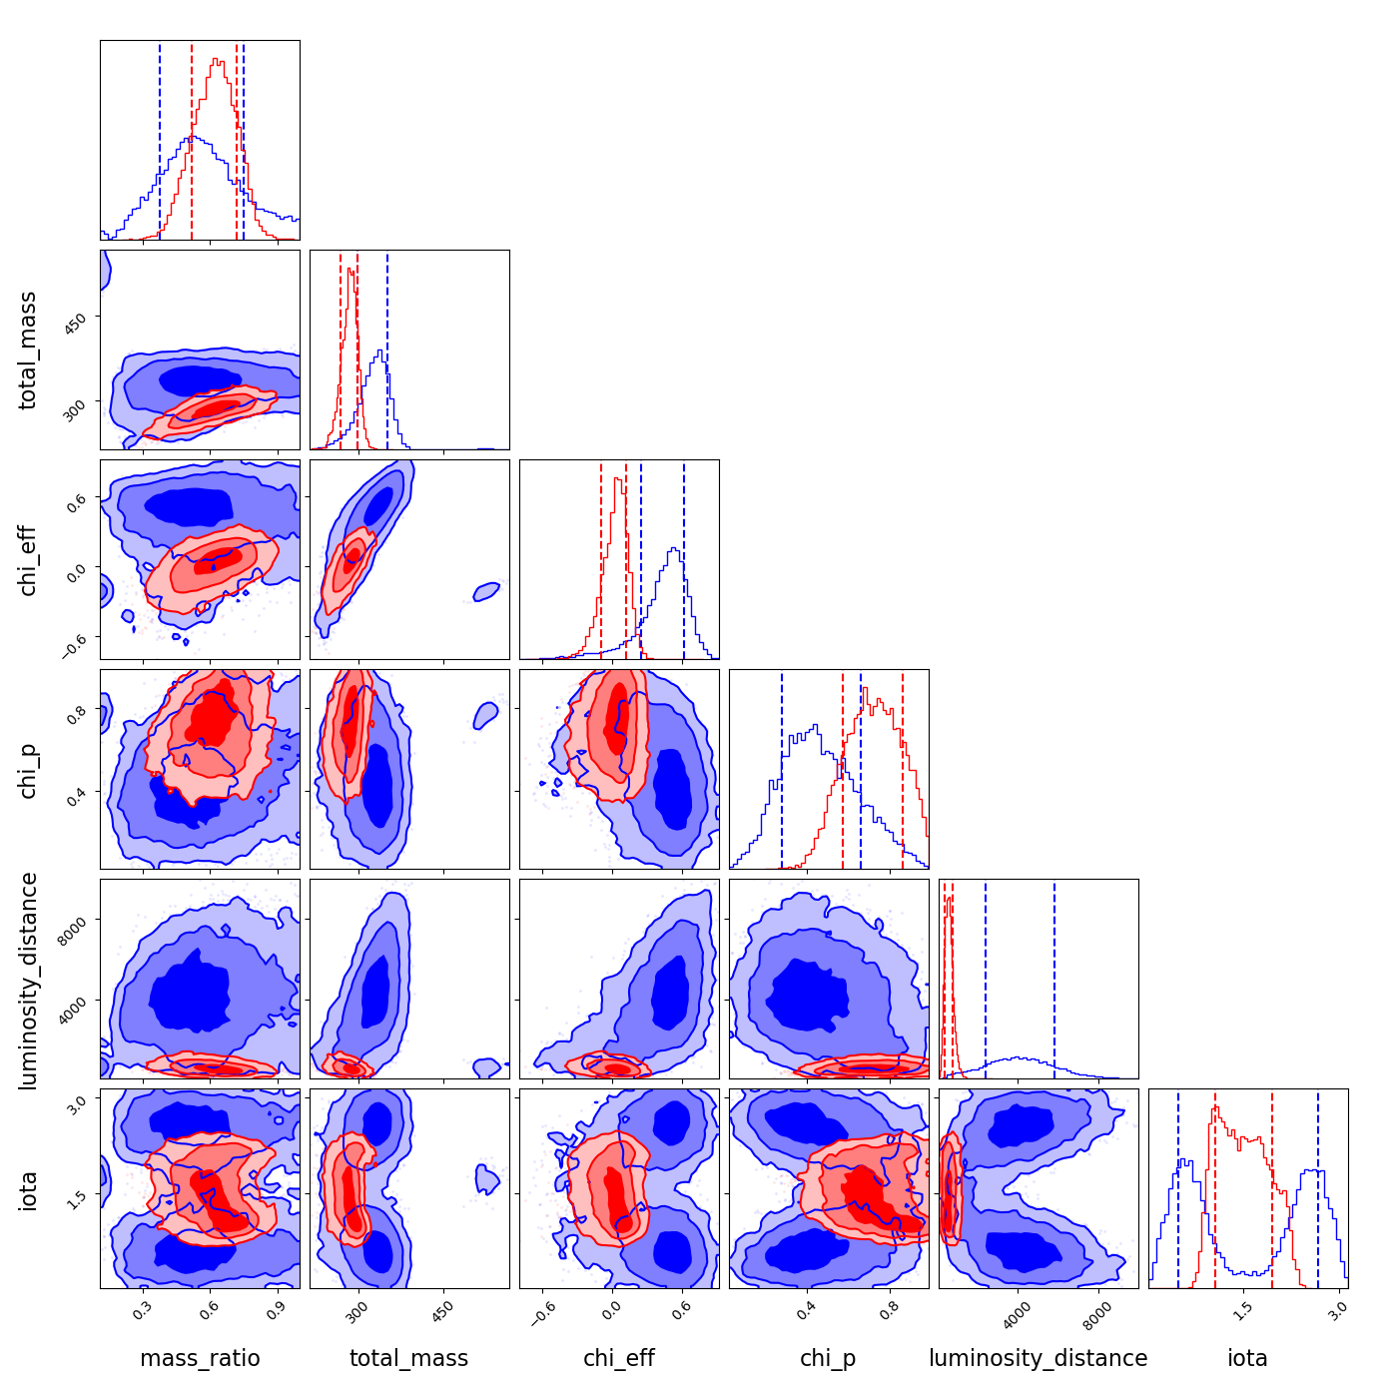
GW230927be (left) and GW231123 (right) posterior comparison for selected parameters.

Slide 10
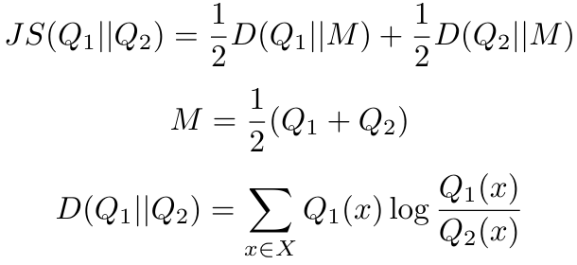
Let’s quantify the differences:
Jensen-Shannon divergence
JS is bounded by [0, 1].
JS=0 iff distributions are identical.
Due to PE seeds, etc. JS~0.05 is typically considered the “significance” threshold.
JS - Jensen-Shannon divergence
Q - distributions
D - Kullback-Leibler divergence
M - mixture distribution (convex combination)
we use log2

Slide 11
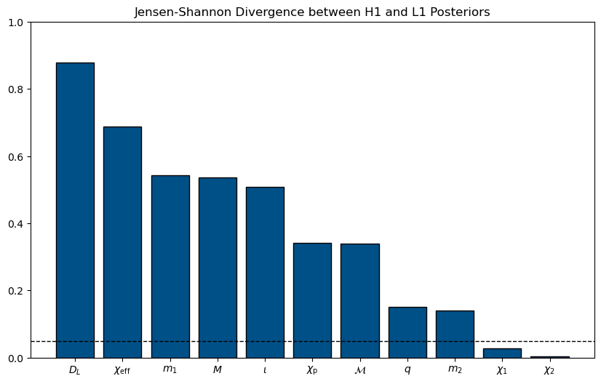
Jensen-Shannon divergences between LIGO Hanford-only run and LIGO Livingston-only run for selected parameters. Approximate “significance threshold” of 0.05 is marked with a dashed line.

Slide 12
What could be the source of these differences?
Available waveform approximants fail to correctly model waveforms in this region of the parameter space.
We know they perform poorly from the GW231123 paper, but we don’t know if this is the sole reason.
Certain Gaussian noise realizations could bias the parameter estimation.
That can be checked by performing injections with Gaussian noise.
Non-Gaussian noise (glitch) coincident with the signal.
We hope this is not the case - this is very challenging to deal with.
We can think of a couple possible explanations.

Slide 13
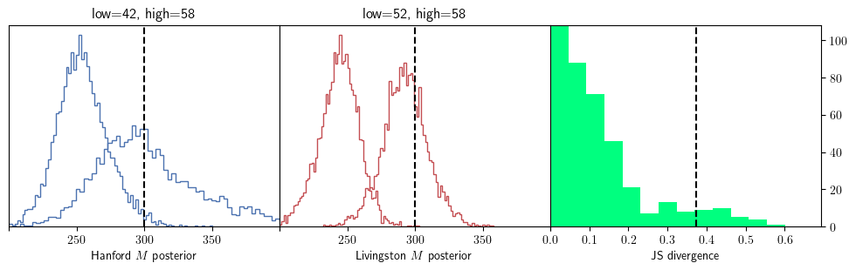
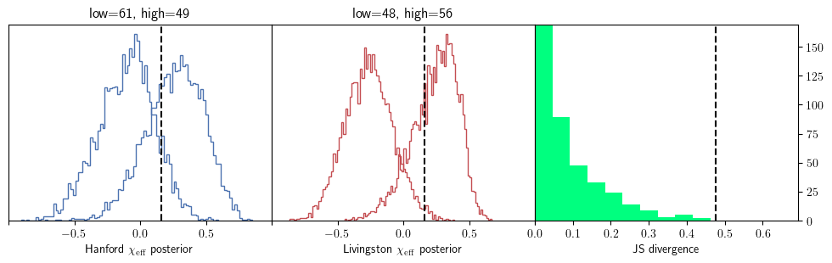
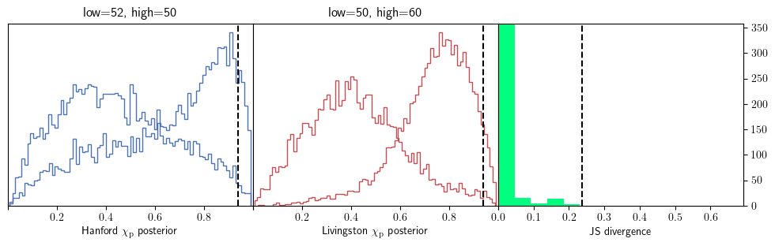
We ran NR injections to check the impact of Gaussian noise
Numerical relativity (NR) is supposed to be the “ground truth” for gravitational waves, free of the accuracy issues waveform approximants face.
Left two histograms are extreme posteriors from H1-only and L1-only PE with injected value marked with black dashed line. Rightmost histograms show distribution of JS divergences of combinations of runs with black dashed line indicating the value for GW231123.
‹#›
Notes:
7% of seeds have JS>= for total mass

Slide 14
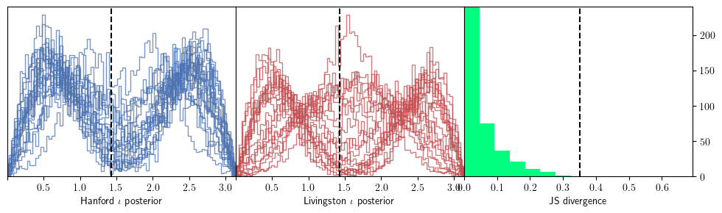
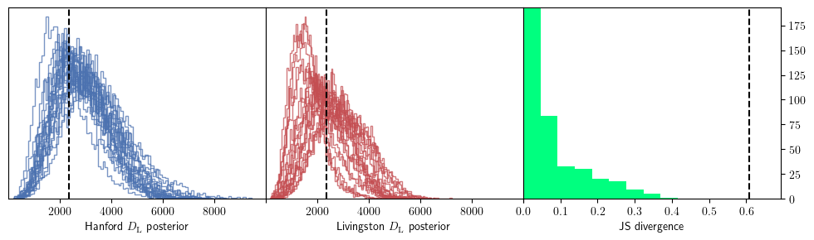
Inclination and distance
Livingston:
edge-on
Hanford: face-on
We see behavior similar to GW231123 for inclination in around ⅓ of the seeds. The differences in luminosity distance are much less pronounced, though.

Slide 15
Conclusion and next steps
We found that Gaussian noise fluctuations can cause differences similar to the ones we see in GW231123’s parameter estimation.
We see that the magnitude of differences is smaller than in GW231123 for some parameters as measured by Jensen-Shannon divergence, but we should take that with a grain of salt - the injected parameters most likely differ noticeably from the event.
The fact that such differences have not emerged for other events suggest that Gaussian noise impacts shorter events more.
Currently, we are running two other Gaussian noise injections that hopefully will corroborate our findings:
another NR waveform, with identical spin magnitudes oriented differently (less precession),
maximum likelihood waveform inferred for GW231123.
The computations are still ongoing.

Slide 16
Acknowledgements
Thank you to:
My mentor Sophie Bini for invaluable guidance and help,
All the other LIGO SURF associates, in particular Lucy Thomas, Simona Miller, Jonah Kanner and Alan Weinstein for help and valuable comments,
All the LIGO SURF students,
National Science Foundation, LIGO Laboratory and Caltech.

Slide 17
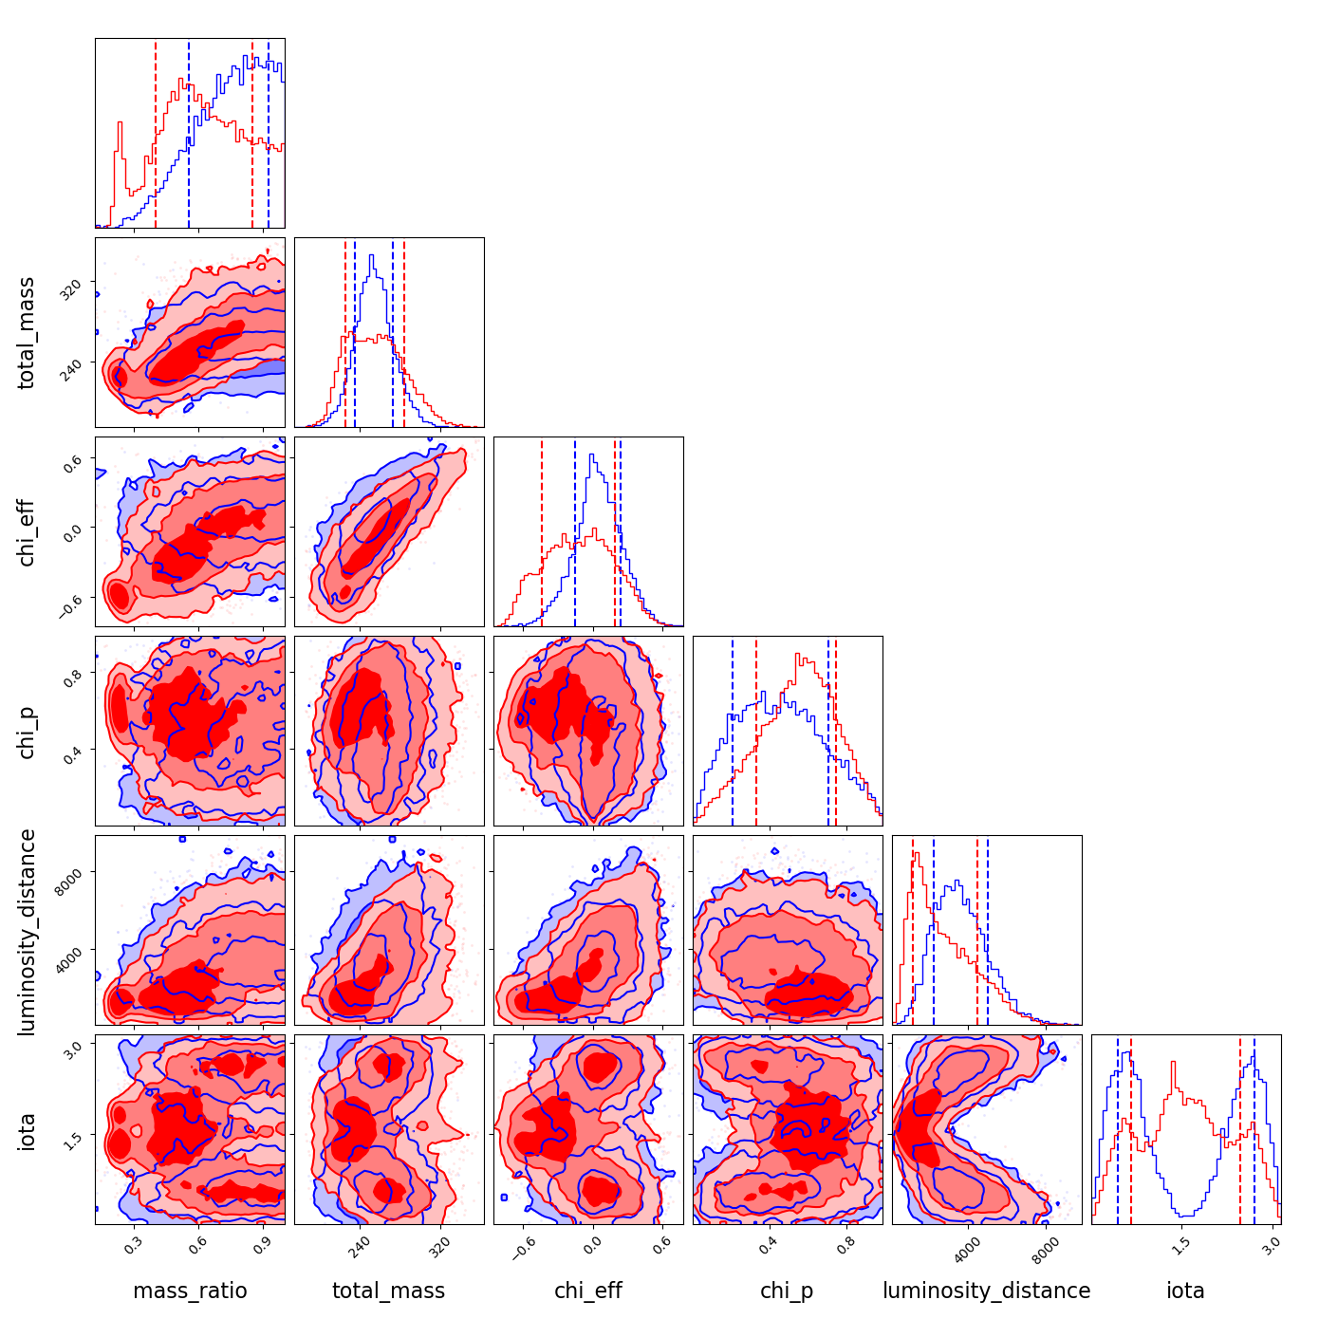
Bonus: GW190521 (left) and GW231123 (right) posterior comparison for selected parameters.

