Slide 1

Imprints of the frequency-domain Source on Black hole ringdown
Aleyna Koro
Mentors: Andrew Laeuger, Colin Weller

Slide 2
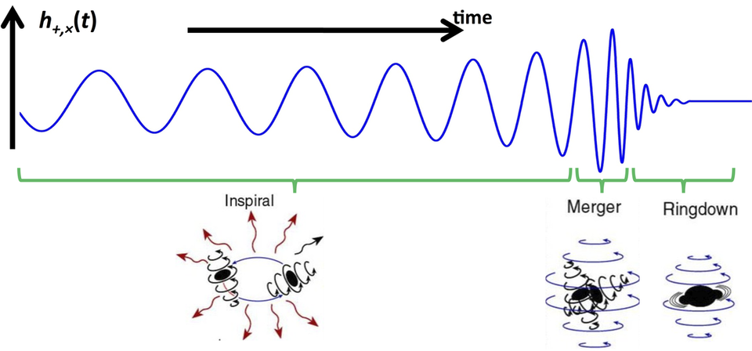


Background
We treat the ringdown as a perturbation to the final black hole which allows us to use perturbation theory.
Ringdown can be described as a sum of Quasinormal modes (QNMs).
$$h_{+,×}\sim \sum_{ℓ,m,n}{A_{ℓmn }e^{−iω_{ℓmn}t}}$$
$$ω_{ℓmn}=ω_{R}+iω_{I}$$
According to the no hair theorem, the QNM frequencies are completely determined by the black hole’s spin and mass.
M. Favata/SXS/K. Thorne
Notes:
This diagram shows the 3 phases of a BH merger.
Inspiral: two BHs orbiting each other. GWs emitted very weak, hard for LIGO to detect.
Merger: When the BHs meet and combine. Short lived but strong GWs
Ringdown: the result of merger is spinning BH which radiates GW as its settling into final phase. We focus on this
Ringdown is made up of a sum of QNMs.
QNMs are the frequencies and modes at which the remnant BH oscillates at. QNMs have a real part and imaginary part. Real: oscillation, Imag: decay
We get the QNMs and their amplitudes from fitting the GW strain, where amp contains pre-merger physics
these QNMs have amplitudes which contains pre-merger physics.
l and m are angular harmonics, and n is the overtone index. *
h plus and cross are the 2 DOFs in the classical GW.
No hair thm states that a BH can be solely described by its mass and spin. According to that thm, we should be able to determine the spin and mass of the BH from the from the ringdown.

Slide 3
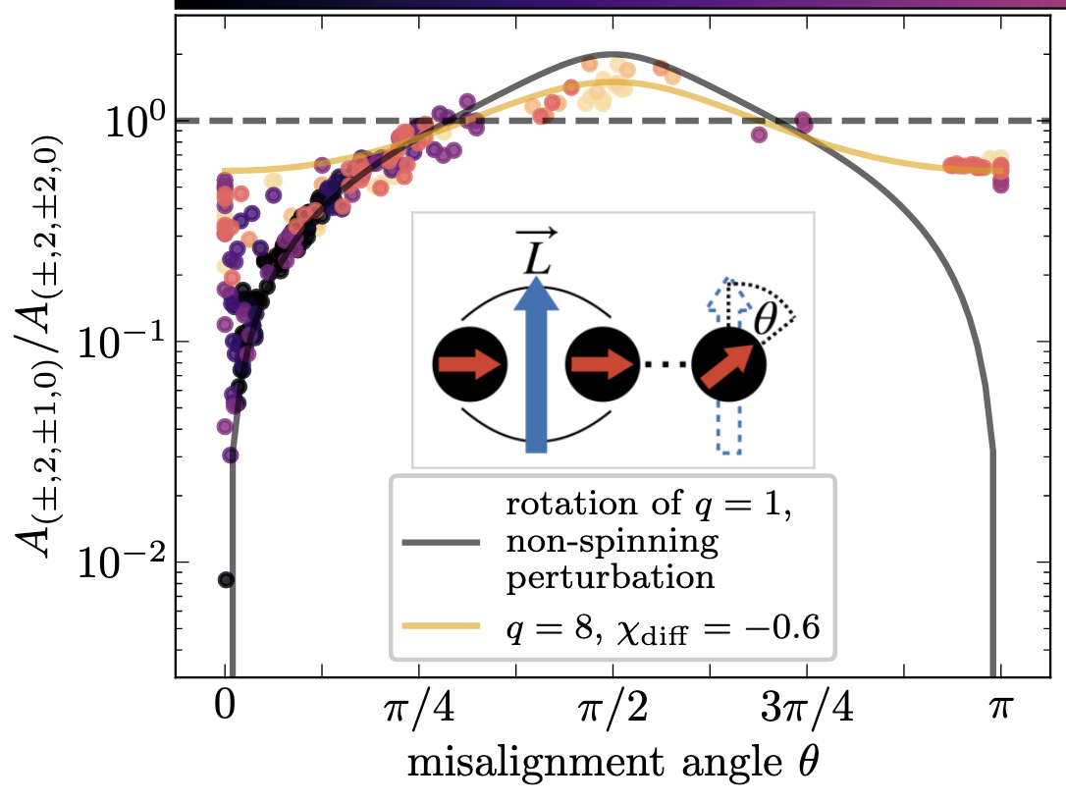
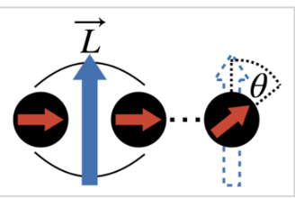

Previous ringdown analysis has used QNM amplitudes to extract properties of a BBH system.
$$h_{+,×}\sim \sum_{ℓ,m,n}{A_{ℓmn }e^{−iω_{ℓmn}t}}$$
Testing general relativity (GR) has also been a focus in these studies.
Hengrui Zhu et al.
What can we infer about pre-merger physics from the ringdown?
Notes:
Previous work on analysis of ringdown has looked at how QNM amplitudes(A) are used to extract properties of a BBH system.
This plot shows that the misalignment between the final BH spin and the orbital angular momentum.
The black curve is the theoretical predication, and the dots are the amplitude ratio measurements from NR simulations. Their agreement signifies that spin misalignment is imprinted on the ringdown.
Use QNMs to test GR: since we can obtain mass and spin from QNMs we can test whether the detected ringdown gives the right mass and spin that aligns with GR
Since we get the whole QNM spectrum from mass and spin, the more overtones we measure, the more tests we can enact on GR.
We can infer about properties about the remnant BH, but what about the pre-merger physics like the source that causes the disturbance to the BH from ringdown?
For this we must build the ringdown.

Slide 4

Teukolsky equation describes how a perturbation to a rotating black hole evolves.
$$\frac{d^{2}ψ}{dr_{∗}^{2}}+\left[ω^{2}−V\left(r\right)\right]ψ=0$$
We solve the radial homogeneous Teukolsky equation and then inverse Fourier transform to get the time domain solution.
Notes:
To obtain the waveforms and therefore study the ringdown we solve the Teukolsky equation which is a wave equation with some potential. The QNMs are solutions to this eqn.
We solve the homogenous Teukolsky equation and then get the time domain solution via inverse Fourier transform.
This figure shows an example of the kind of waveform we obtain.
It is an initial perturbation to the BH at some location.
The decaying sinusoidal looking thing is the ringdown. Here the source is a time domain Green’s function which is a solution to the Teukolsky eqn.

Slide 5
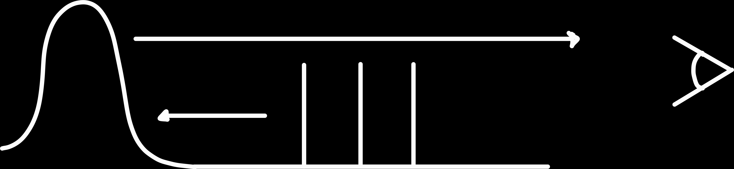
Move initial perturbation location → ringdown shifts by the amount we shift the location.
Observer
BH curvature potential
Source locations
Notes:
Say what axis are and legend!
To make sure the ringdown is what we are seeing, we fix the observer at some location and then move the location of the initial perturbation.
What we should expect is that the ringdown delays by the amount we shift the location.
This is because the ringdown is the GW that travels from the initial perturbation to the BH and backscatters off the BH curvature potential and then reaches the observer.
So, if we move the location the the time for the GW to go from perb to BH will also shift by that amt we move the location.
Basically, say what’s on plot and how we expect ringdown to delay by 20 for src moving from 40 to 60
This is the waveform that we apply the QNM filters to.

Slide 6


QNM filter removes a chosen QNM ($ω_{lmn})$ from the ringdown signal.
$$ℱ_{lmn}=\frac{ω−ω_{ℓmn}}{ω−ω_{ℓmn}^{∗}}$$
Ringdown filters can be used as an alternative approach to testing GR.
WRONG!
Notes:
QNM filters can remove/suppress a chosen QNM from the ringdown. This is done by mirroring the ringdown component at the QNM and thus removing it from the signal while maintaining the power of signal.
This diagram filters out the fundamental mode of a simple function. Since the fundamental mode dominates the end of the ringdown, the rational filter successfully suppresses that part of the waveform.
The bottom plot is when we remove the fundamental and 1st overtone and as u can see it suppresses ringdown even more at earlier time
Third plot is what the filter looks like incorrectly if we were off by 10%: it slight reduces the waveform amplitude but doesn’t fully remove it.
Filters as a way to test GR: By applying filters, we can remove specific modes(like the fundamental since that tends to dominate, 1st overtone…). This exposes overtones that would be hard to measure initially.
Long term would be to rely on the filters since we don’t have to fit for the QNM amplitude in order to remove it
The more frequencies/modes we can measure, the tighter the test of GR becomes — since every mode of the QNM spectrum has to match the same mass and spin of the remnant black hole.
Green func time domain is testing the we have computed the QNMs and that the filters actually remove them. Shows that QNMs are truly composed in ringdown and it gets filtered correctly.

Slide 7


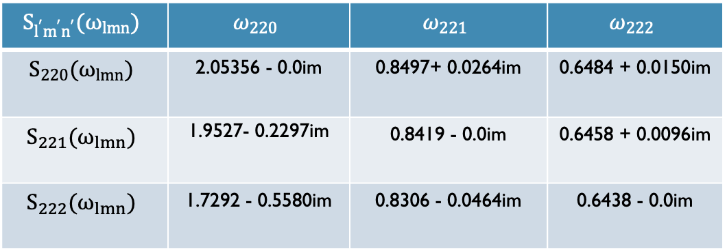

If we drive the source at Re($ω_{ℓmn})$, can we see its imprint emphasized in the ringdown?”
→ It depends
$$\frac{d^{2}ψ}{dr_{∗}^{2}}+\left[ω^{2}−V\left(r\right)\right]ψ=S$$
$$S_{l^{′}m^{′}n^{′}}(ω_{lmn})$$ | $$ω_{220}$$ | $$ω_{221}$$ | $$ω_{222}$$
$$S_{220}(ω_{lmn})$$ | 2.05356 - 0.0im | 0.8497+ 0.0264im | 0.6484 + 0.0150im
$$S_{221}(ω_{lmn})$$ | 1.9527- 0.2297im | 0.8419 - 0.0im | 0.6458 + 0.0096im
$$S_{222}(ω_{lmn})$$ | 1.7292 - 0.5580im | 0.8306 - 0.0464im | 0.6438 - 0.0im
$$A_{ℓmn,ℓ^{′}m^{′},n^{′}}\sim E\left(ω_{ℓmn}\right)S_{l^{′}m^{′}n^{′}}(ω_{ℓmn})$$
QNEF
Source
$$S_{ℓ^{′}m^{′}n^{′}} \sim \frac{1}{1+{(ω−\text{Re}(ω_{ℓ^{′}m^{′}n^{′}}))}^{2}}$$
Notes:
Now we look at the inhomogeneous Teukolsky eqn. The S is a source which could be the environment of the remnant BH like accreting matter or a toy model.
Here we take the source to be the Lorentzian centered at the Real part of the QNM frequency.
Goal is to drive the source at Re(QNM) to try to preferentially excite the QNM.
The plot on the top is the ringdown for these sources peaked at the different QNMs 220,221,222
The bottom plot is when we apply the filter to remove the fundamental mode.
Although we have peaked these sources at different QNMs, they still have the same ringdown. We can explain this by looking at the QNM amplitudes.
A is the QNM amplitude which is approximately the QNM excitation coefficient * the source at the QNM.
The excitation coefficient quantifies how strongly a QNM is excited when BH is perturbed. The Excitation coeff. is independent of the source.
This is table shows the source function peaked at different QNMs and evaluated at different QNMS. As you can see, these values are all very similar to each other no matter where the source is centered.
This explains why the ringdowns look all the same.
We can’t cleanly excite or isolate a single overtone just by centering the source at the real part of the QNM. How about at the full QNM?

Slide 8

$$S_{ℓ^{′}m^{′}n^{′}} \sim \frac{1}{1+{(ω−ω_{ℓ^{′}m^{′}n^{′}})}^{2}}$$
Driving source at the full QNM
Source contamination
Notes:
What if we drive the source at the full QNM?
We see more of this preferential excitement. However, But if we drive the system exactly at the QNM frequency, the resonance means both the source and the black hole’s response are decaying at the same rate.
Mathematically, that double pole introduces an extra factor of t, so the amplitude grows linearly before decaying, which is what we call resonant amplification.
This why blue aligns so well with the red
and because the source and BH both contribute at this frequency, the filter cannot fully remove the 220 mode.

Slide 9

Summary
Constructed QNM filters to analyze ringdown.
Looked at sources peaking at Re($ω_{ℓmn}$) and at the full QNM frequency
Found: no preferential excitation at Re($ω_{ℓmn}$), but possible at full QNM
Next steps: Explore environmental imprints on ringdown with filters.
Notes:
Test GR using filters: by checking that the overtone amplitudes or frequencies matches with what we get from the no hair thm.
want to move beyond toy sources and explore more physical environments like accretion disks or matter clouds, to see whether those environments leave measurable imprints on the ringdown

Slide 10



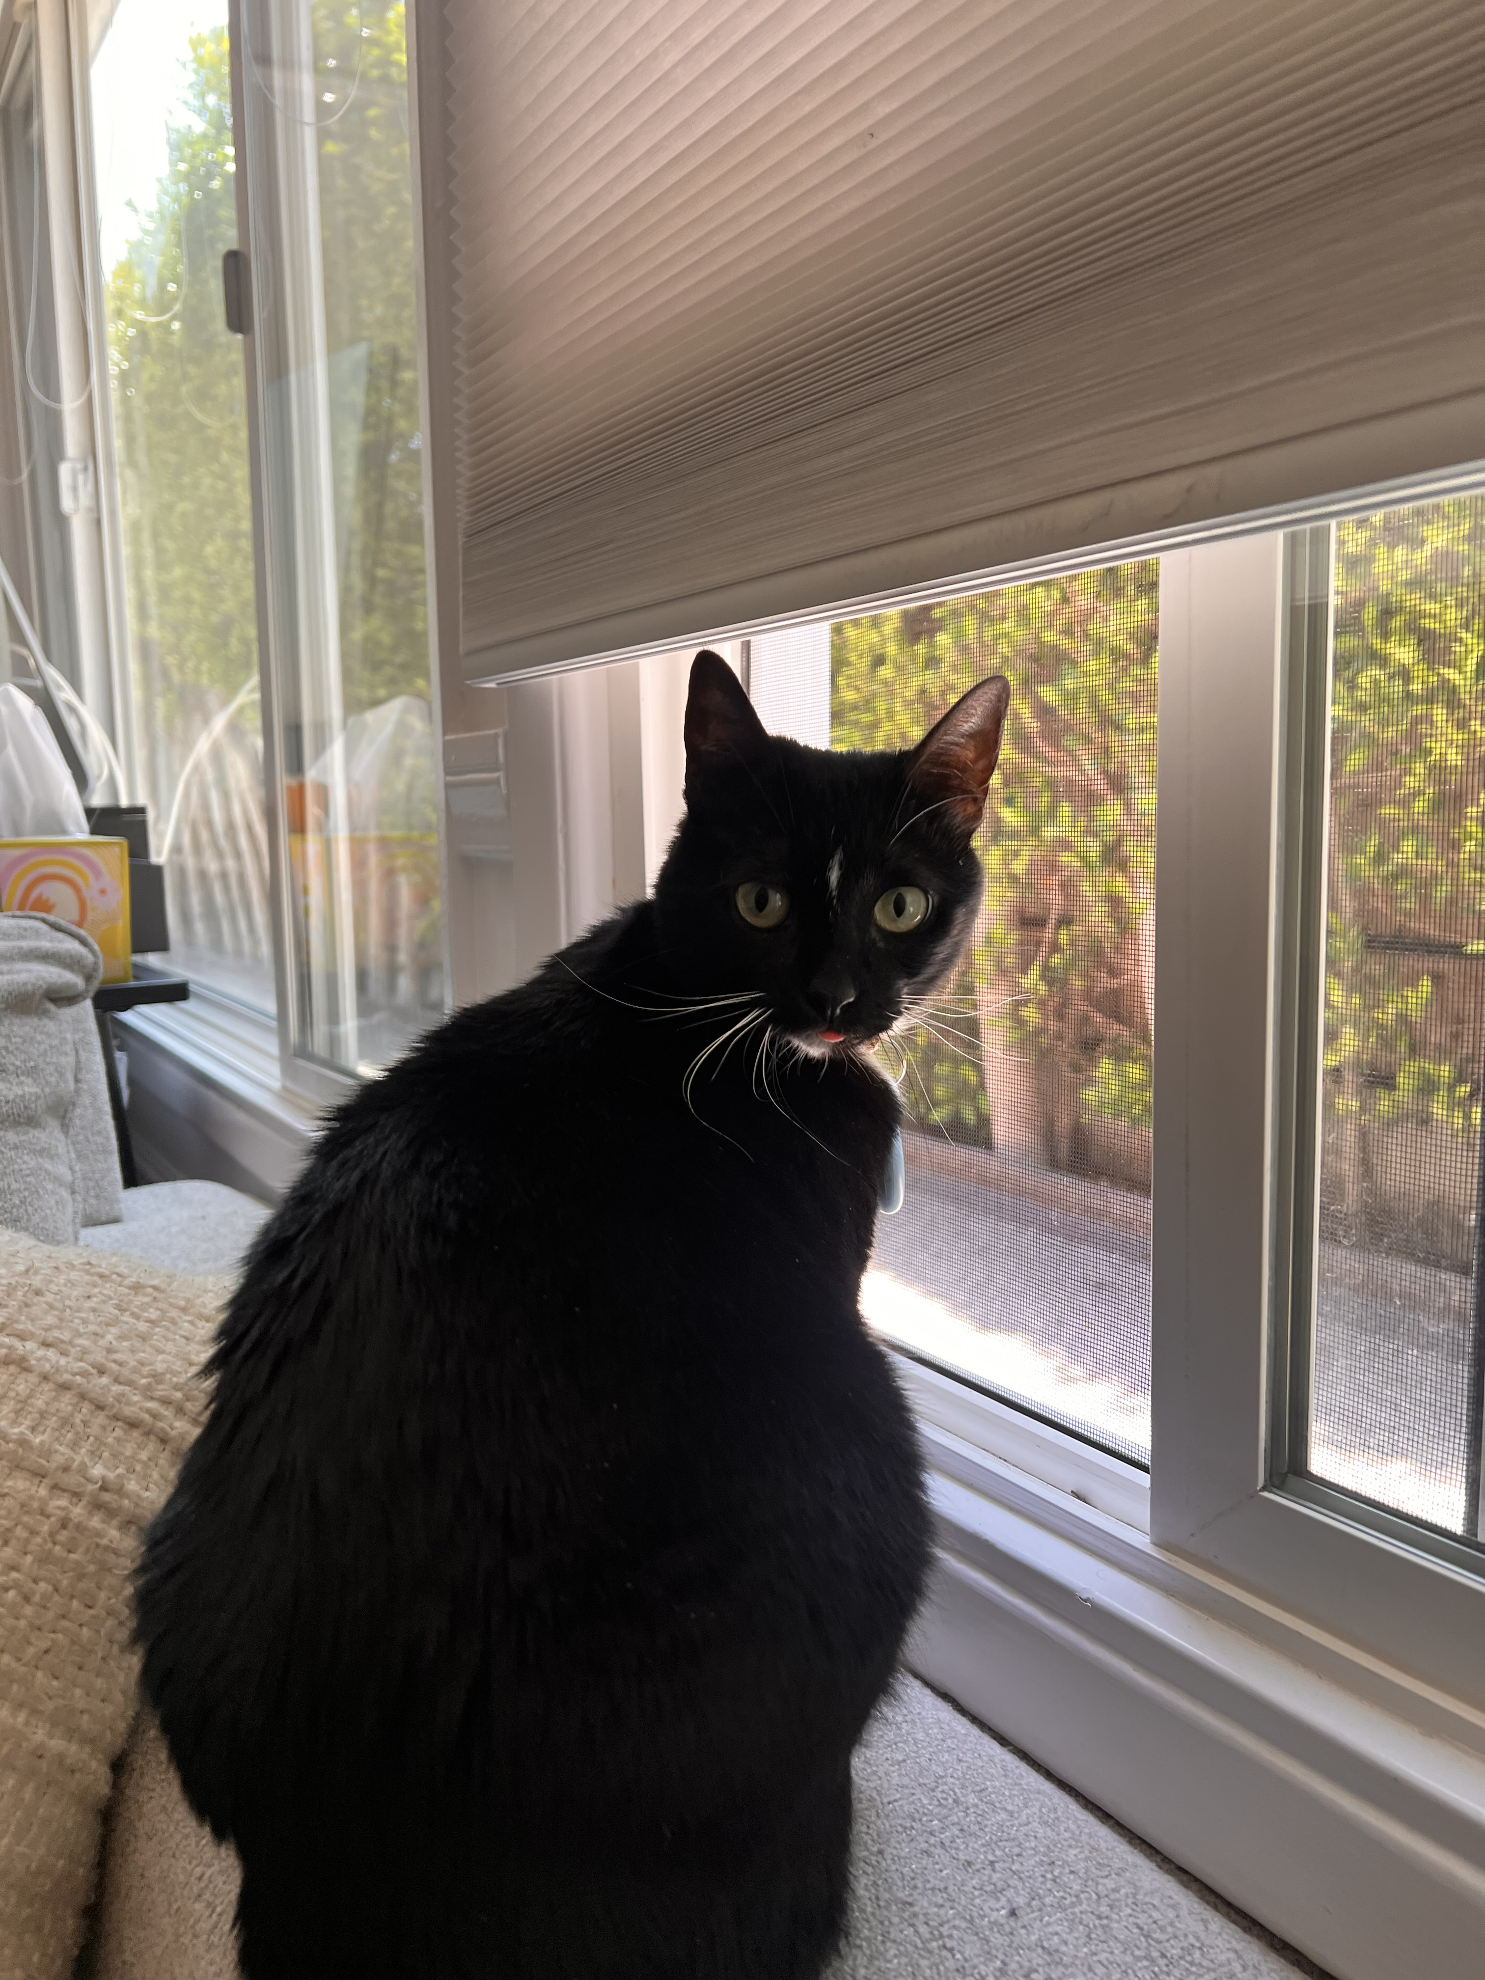
Acknowledgments
I would like to thank my mentors Andrew Laeuger and Colin Weller for their continued support and guidance throughout this project. Would also like to thank my cat Nova! This work was supported by the National Science Foundation Research Experience for Undergraduates (NSF REU) program, the LIGO Summer Undergraduate Research Fellowship program (NSF LIGO),
and Caltech.

Slide 11
