Slide 1





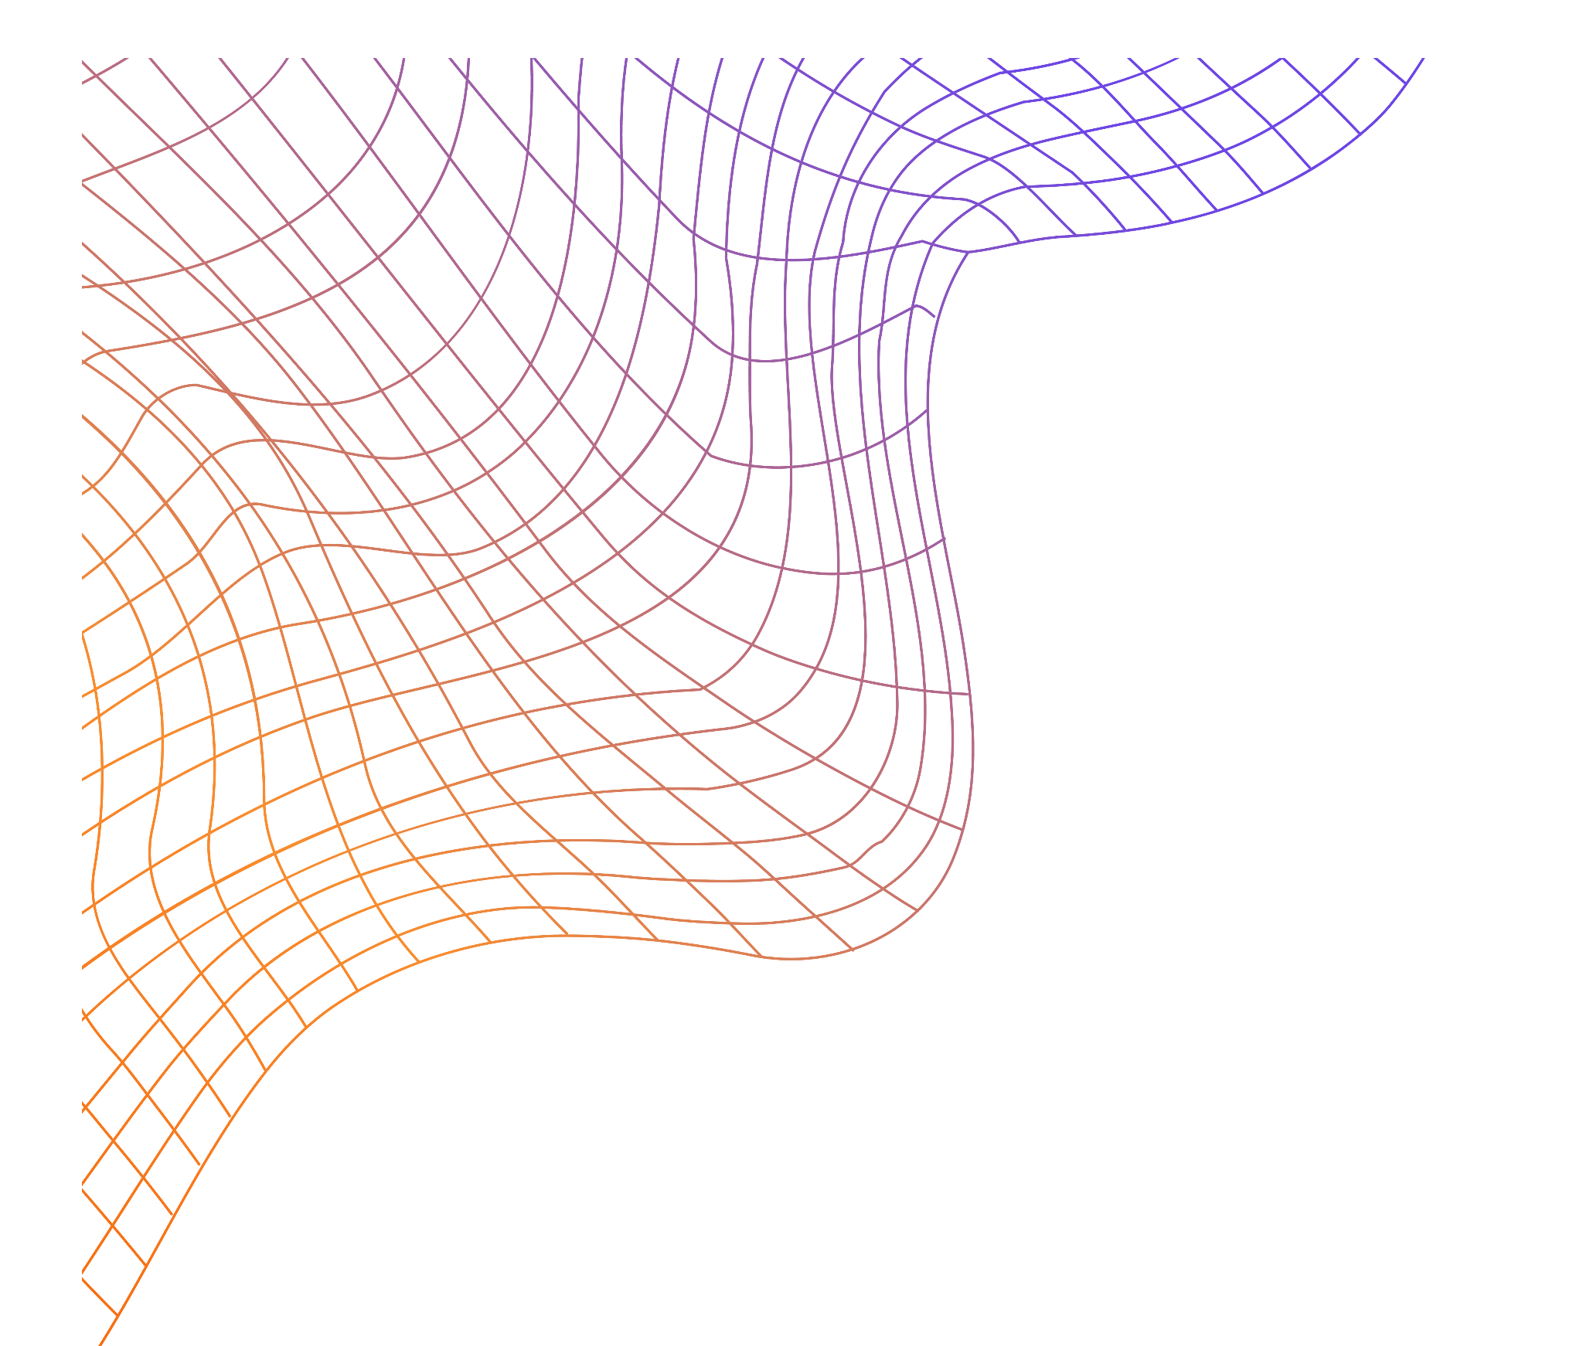


Mapping and Correcting the Surface of the GQuEST End Mirrors
Rafael Volkamer-Pastor
Mentors: Daniel Grass and Lee McCuller

Slide 2
What am I going to talk about?
What is GQuEST/
Scientific Introduction
How to Correct Mirror Deformations
Achievements/
Advancements

Slide 3
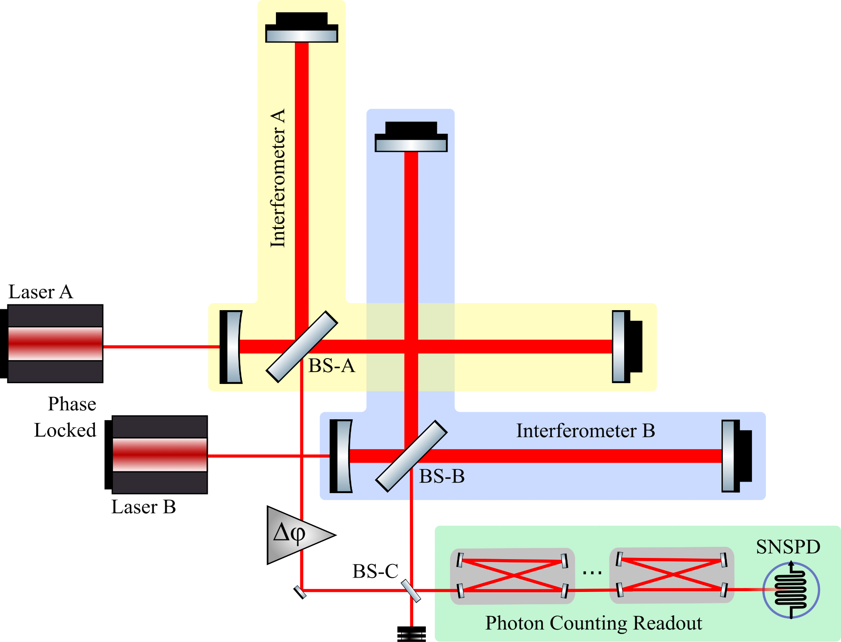
What is GQuEST?
Gravity from the Quantum Entanglement of Space-Time
Erik Verlinde and Kathryn Zurek predict ’geontropic’ fluctuations, stochastic fluctuations of space-time geometry induced by entropy.
GQuEST is a “table top” (7m) Michelson Interferometer designed to detect these quantum gravity fluctuations.
Notes:
Let’s start at the first question I had when starting SURF, which was “What is GQuEST?”
Erik Verlinde and Kathryn Zurek, two theoretical physicists, predict stochastic fluctuations of space-time geometry.
When light propagates through a space with these fluctuations, it is predicted to accumulate a phase difference relative to light traveling without the fluctuations.
GQuEST is a table top interferometer designed to detect these fluctuations.

Slide 4
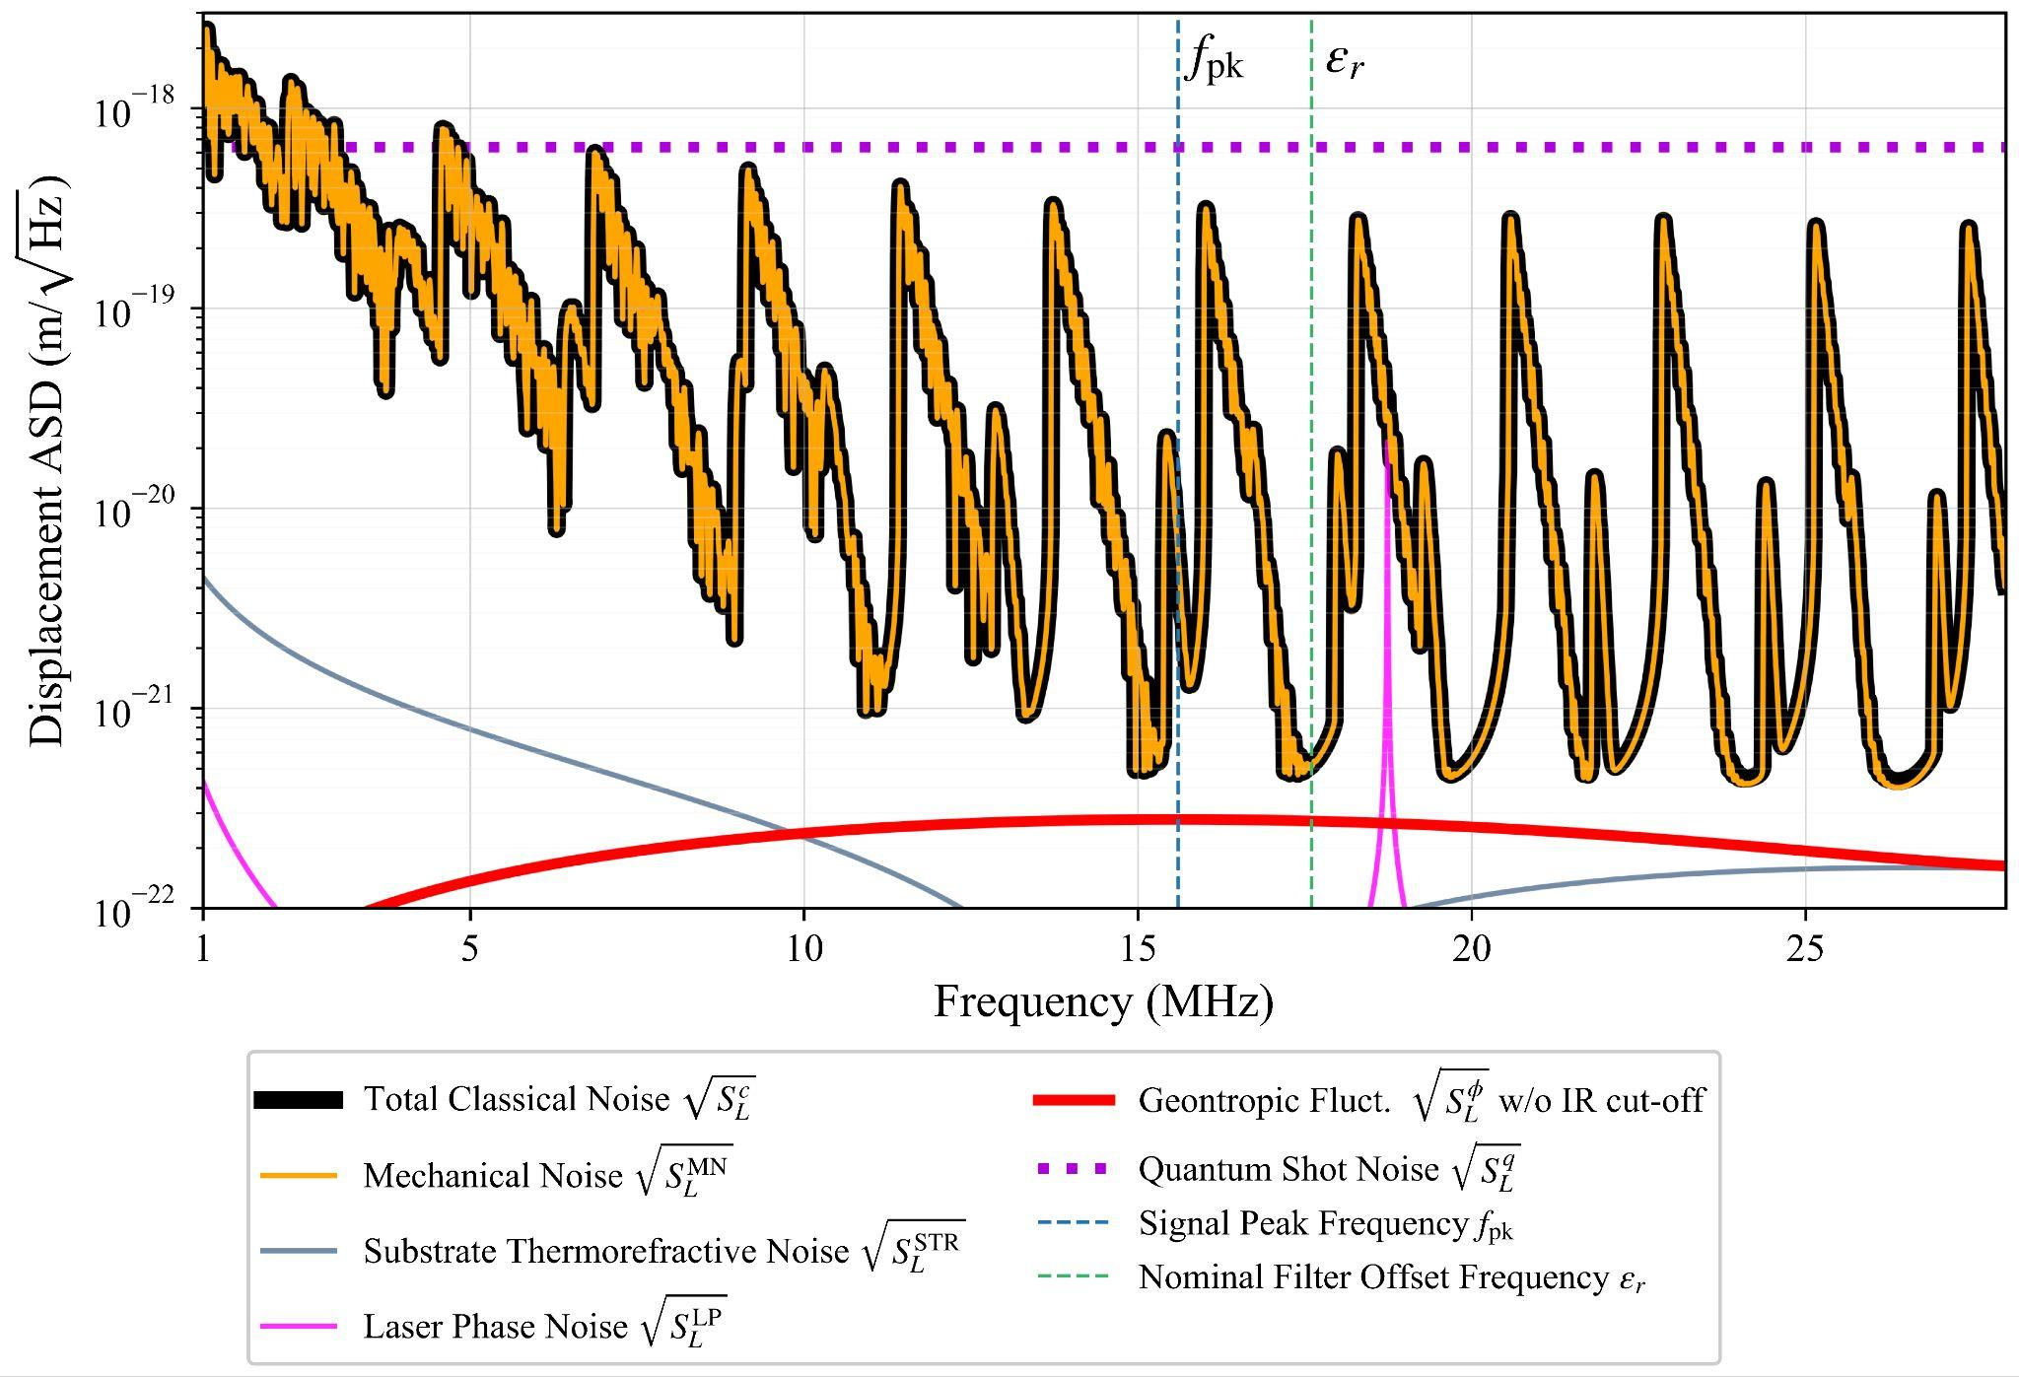
What are the advantages to GQuEST?
GQuEST filters the output light such that only photons carrying the signal are detected (some noise will still pass).
Notes:
Despite being much shorter than LIGO, GQuEST is able to stay competitive with LIGO primarily due to it’s photon counting readout.
The genotropic fluctuations are 7 order of magnitude in power below the quantum shot noise of a high power interferometer with traditional homodyne readout.
However, photon counting is not susceptible to quantum shot noise. This drastically reduces the total noise to 1 order of magnitude above the signal
My project is concerned with these end mirrors

Slide 5
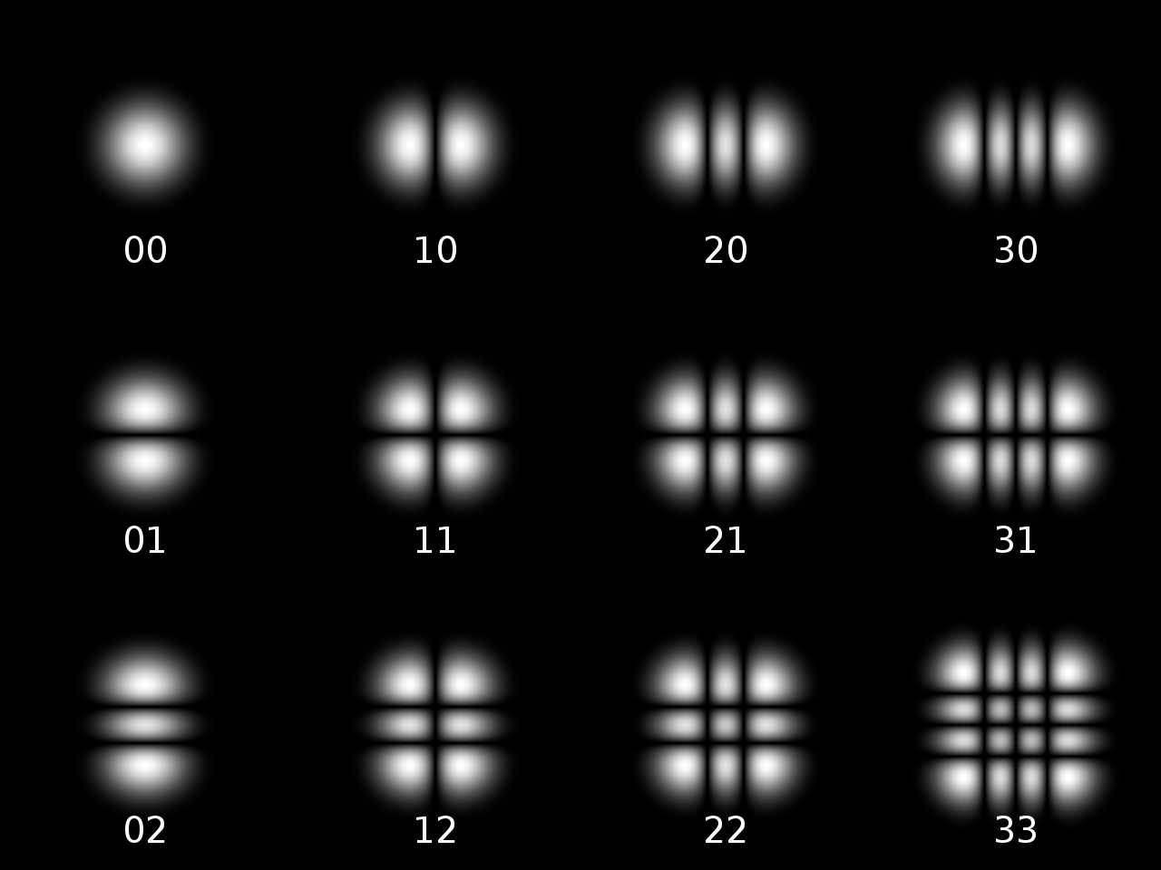
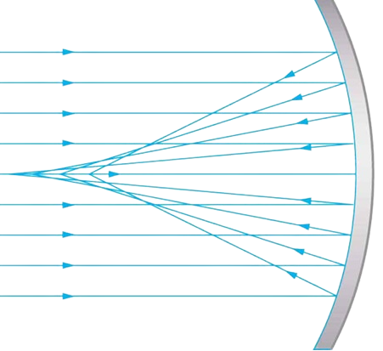
Scientific Introduction
Credit: University of Central Florida
Lenses/Curved Mirrors have a focal length
Inverse of focal length is focusing power (diopters)
Diopters are nice because the more diopters the more aggressive the lens (focal length is the opposite)
Credit: Bob Mellish
The Hermite Gauss basis is an orthogonal basis
You can use it to decompose a coherent paraxial beam
Coherent: Fixed phase relation
Paraxial: Approximately parallel to the optical axis

Slide 6
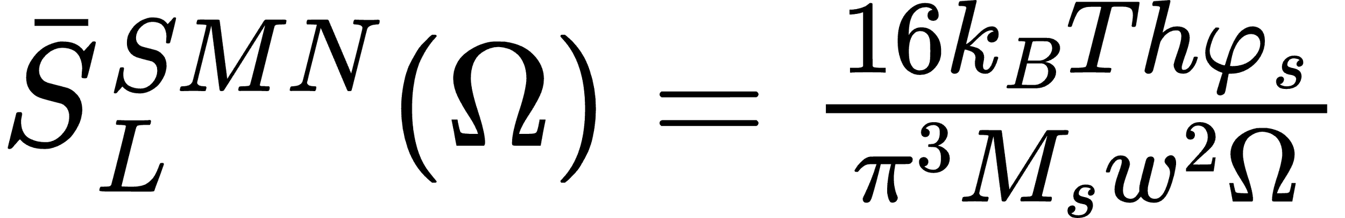
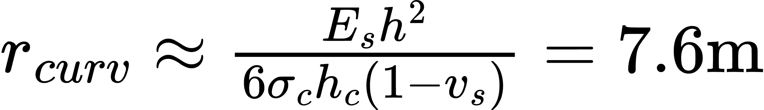
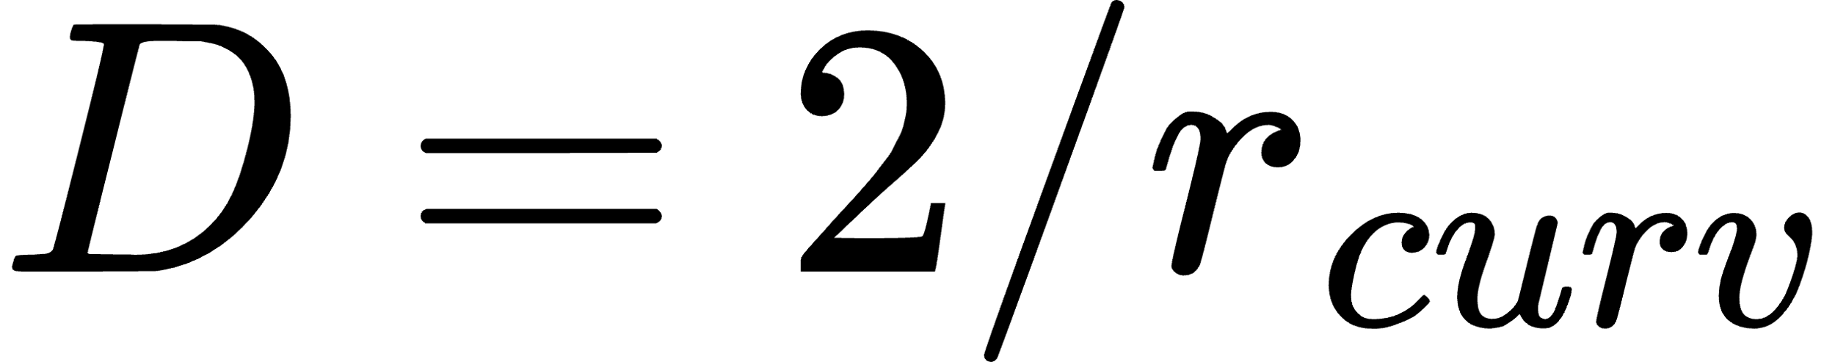
Noise in GQuEST
Because of photon counting, GQuEST is not limited by quantum shot noise but instead limited by classical noise.
We mitigate the noise contribution by reducing the thickness of the end mirrors.
This makes the mirror more pliable, and causes the mirror to bend when getting coated.
The power, in diopters, lensed into higher order modes (HOM) is approximately,
Noise contribution from substrate
(mirror thickness - h)
Unintentional curvature of mirror
GOAL: Reduce quadratic deformations without inducing higher order deformations or surface roughness. Have a loss less than 50ppm.
Flat Substrate
Reflective Coating
Curved Mirror
Notes:
*Mention curvature is not intentional
Substrates vs coating

Slide 7
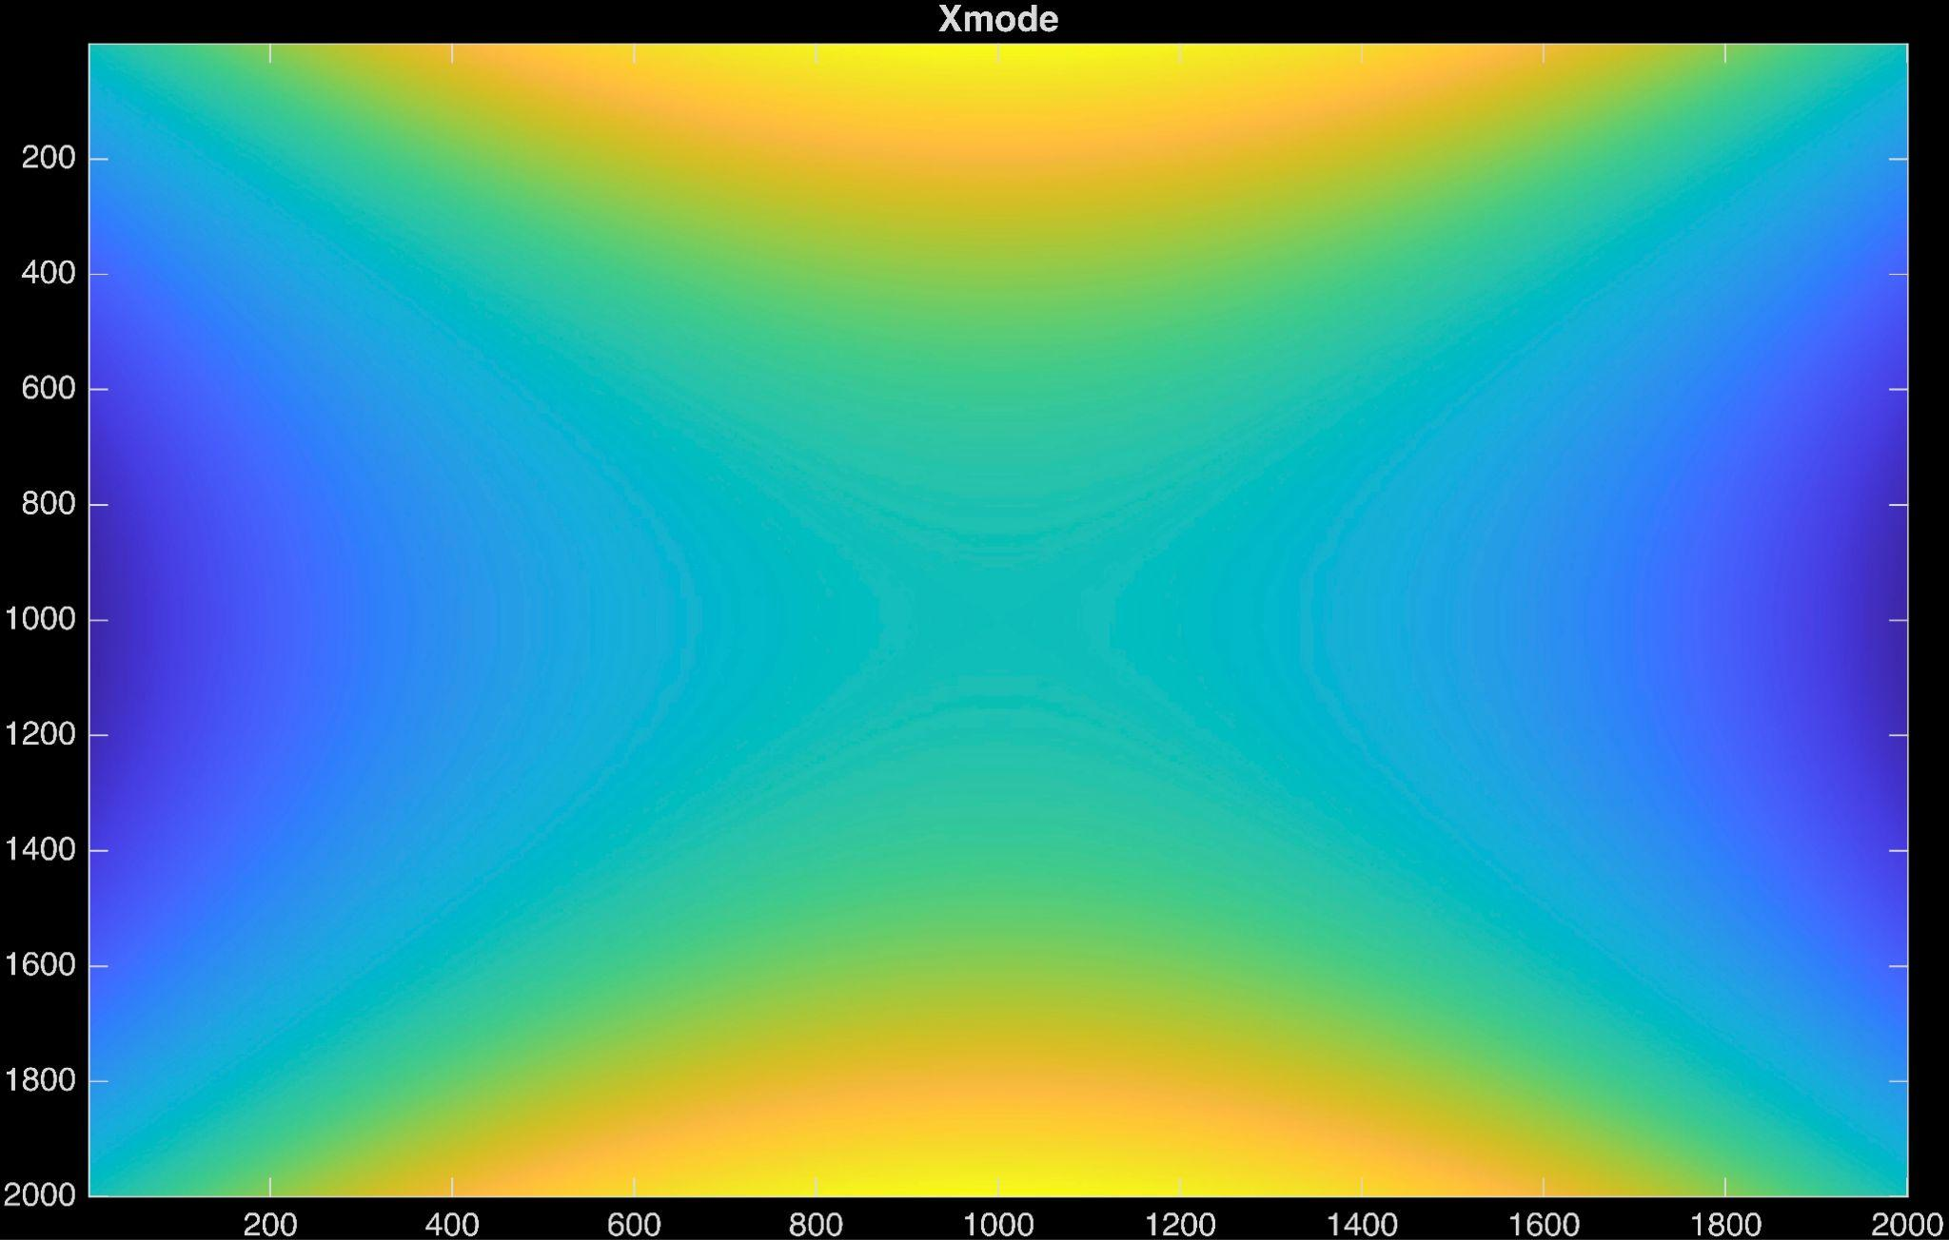
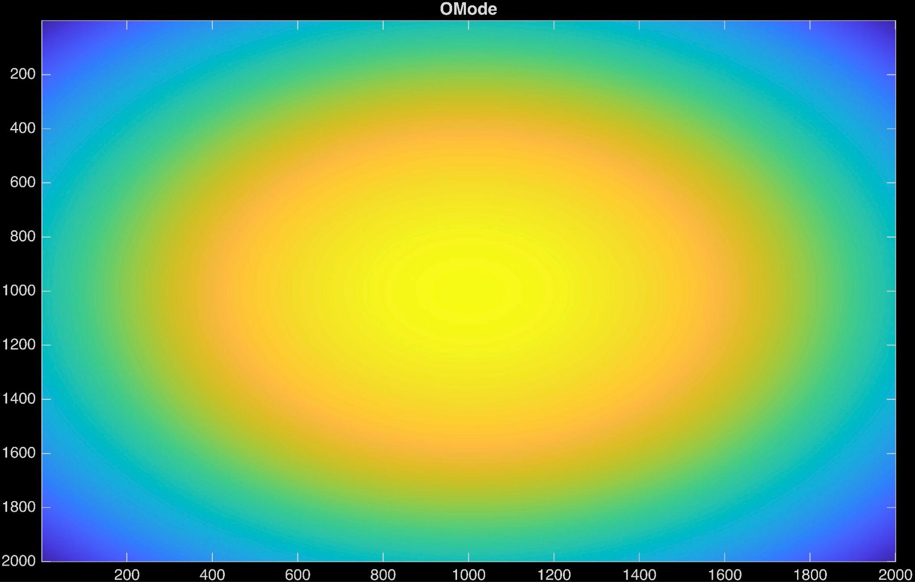
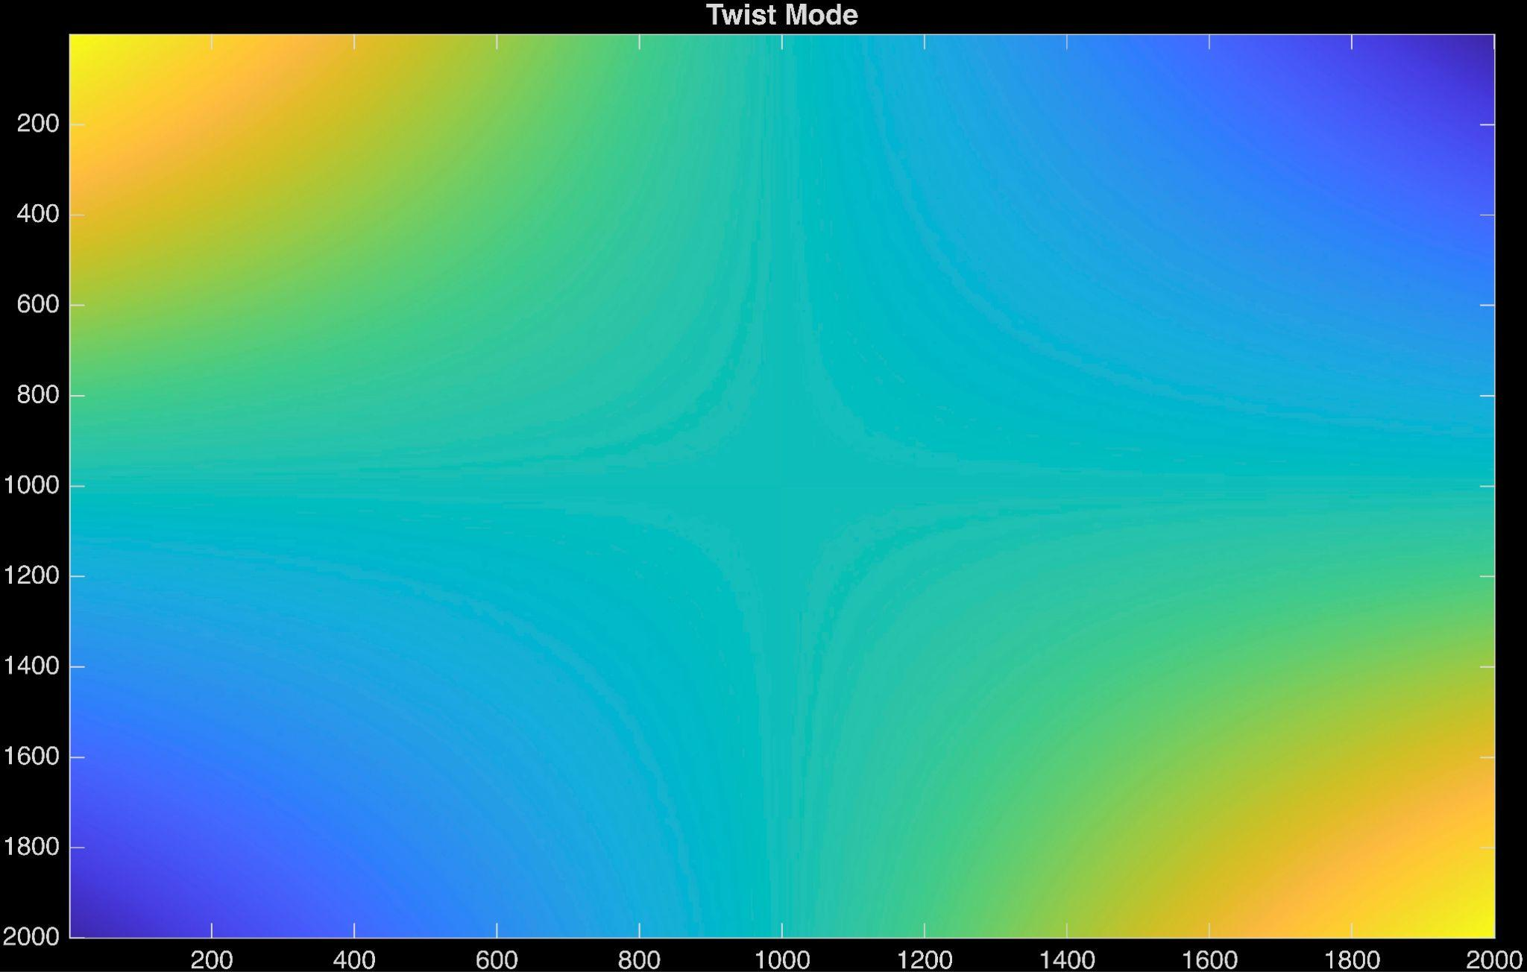
HOMs and their Production
There are three main mirror deformations that we are concerned about. These are quadratic deformations. Linear and constant deformations can be corrected by a kinematic mount.
XMode
OMode
+Mode
Leads to coupling into the HG_02 and HG_20
Leads to coupling into the HG_02 and HG_20
Leads to coupling into the HG_11
Notes:
A quick introduction to the types of mirror deformations we care about.
After position, tip and tilt
There is the Xmode, Omode, Plus Mode…
As I said before the majority of the light is expected to bump into the HG02 and HG20 modes
We expect that if we have good control over these deformation with our mirror mount that we should be able to really mitigate the optical power loss

Slide 8
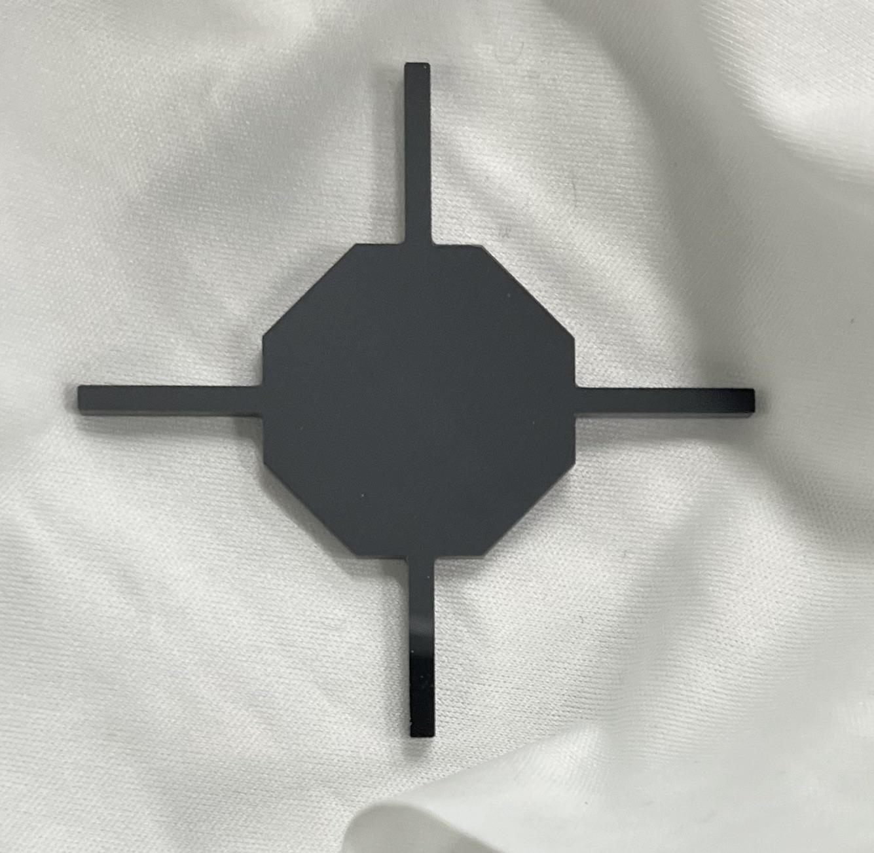
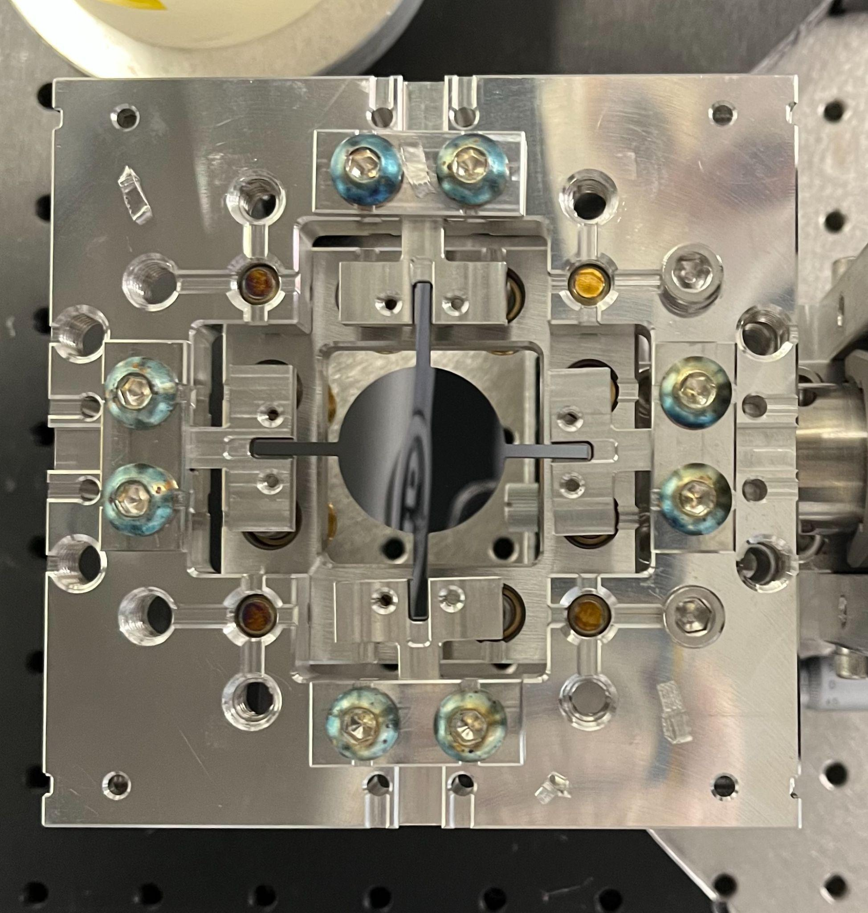
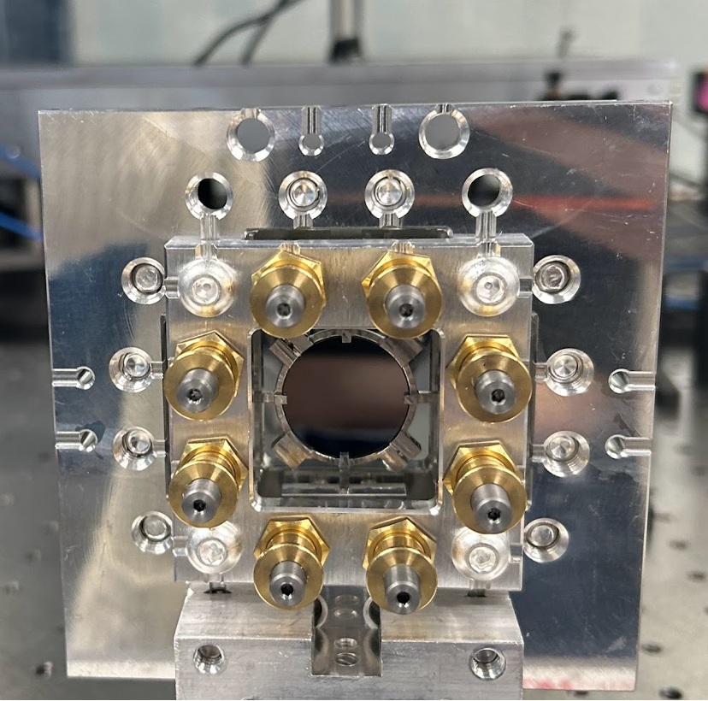
Adjustable Mirror Mount
Adjustment Screws
Clamping Ts
.35cm
NanoCam Imaging Area
2.5cm
Notes:
Apply an anti-reflective coating to the back side of the mirror
Utilizing matching pairs
Using the adjustable mirror mount to correct for the curvature
Explain how adjustment mount works
Go from .26 diopters to 3e-4 diopters

Slide 9
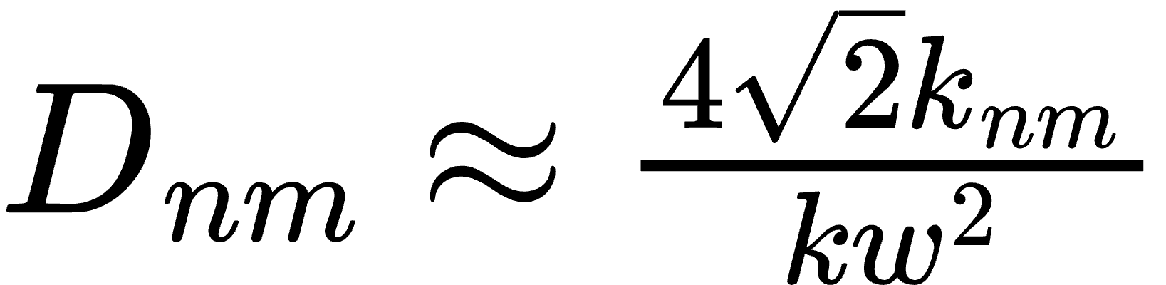
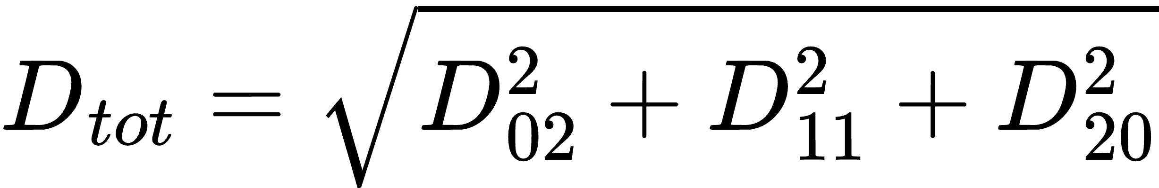
Calculate Coupling to HOMs and Lensing Power
Calculating the coupling coefficient, we assume incoming HG₀₀
Lensing Power in Diopters (n+m=2)
Notes:
We only care about these bending modes if we know how power we lose.
We can calculate this using the coupling coefficients to the HOMs.
This tells us how much of the incoming beam couples to each HOM.
I have a some code in MATLAB which reads the NanoCam data and calculates these overlap integrals
Beam coming in is in 00

Slide 10
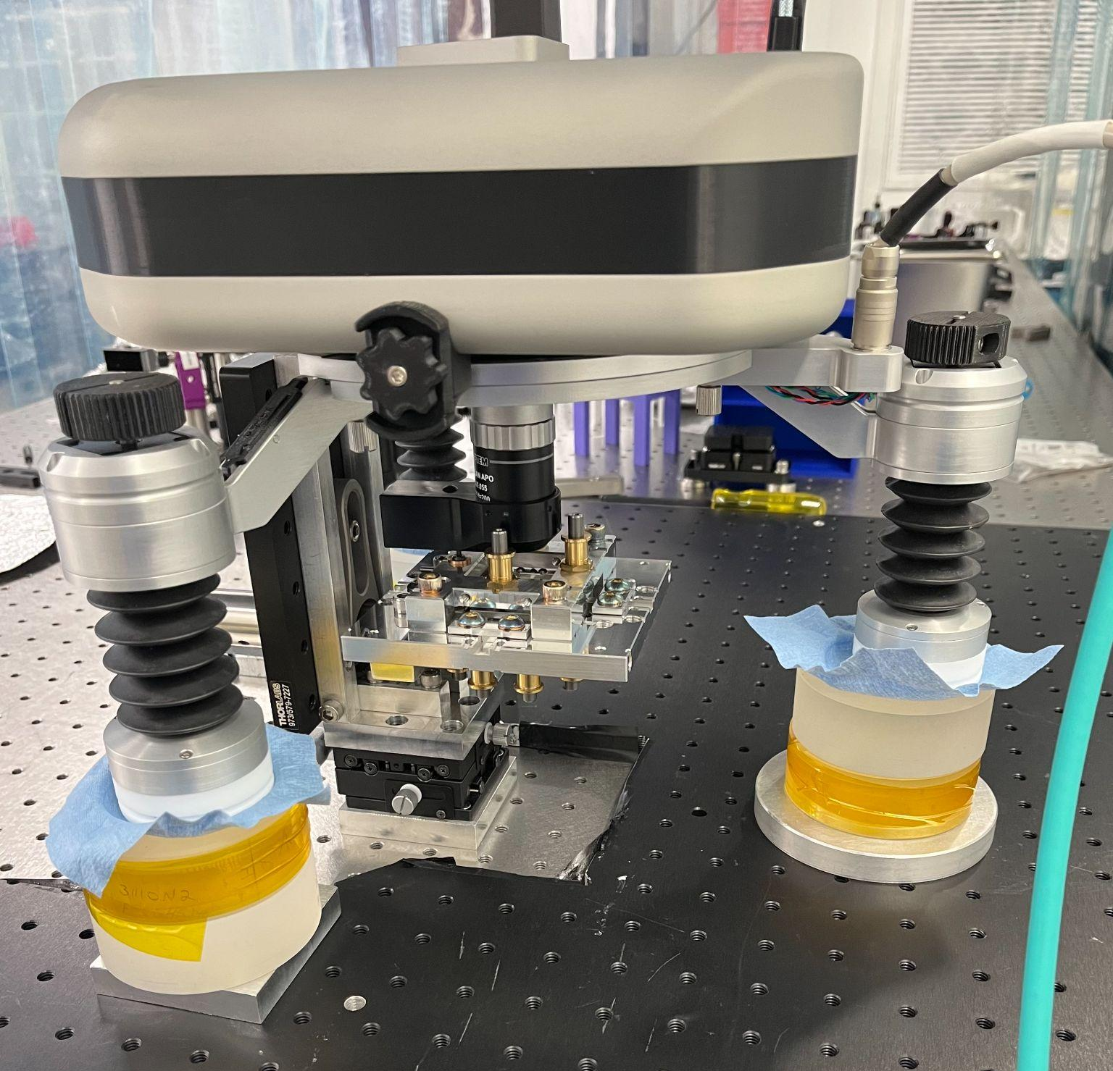
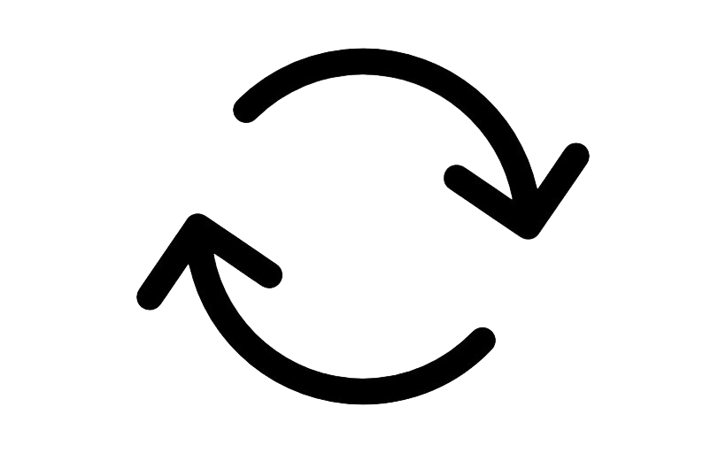
Start
Take an image of the mirror with the optical profiler
Calculate coupling coefficients to HOMs and lensing power
x30
Adjust mirror surface with mirror mount
Is the mirror flat enough?
You’re done
No
Yes

Slide 11
Limited Field of View with the NanoCam
There is a major limitation with the NanoCam, with the current set of objectives we are only able to capture a 3.5mm by 4mm area. The 2σ power radius of the laser on the mirror is expected to be around 3mm which means the area the NanoCam images does not fully encompass the laser beam.
Issues with cropped domain
We are missing power
Hermite Polynomials are not orthogonal
Astigmatism with NanoCam
Solutions
Use a least squares fit to approximate a larger mirror area, accounting for residuals
Convert from a clipped HG basis to the full HG basis using a matrix*
Developed a method to calculate the astigmatism without using a reference flat*
.35cm
2.5cm
*cut for time, more info in appendix

Slide 12
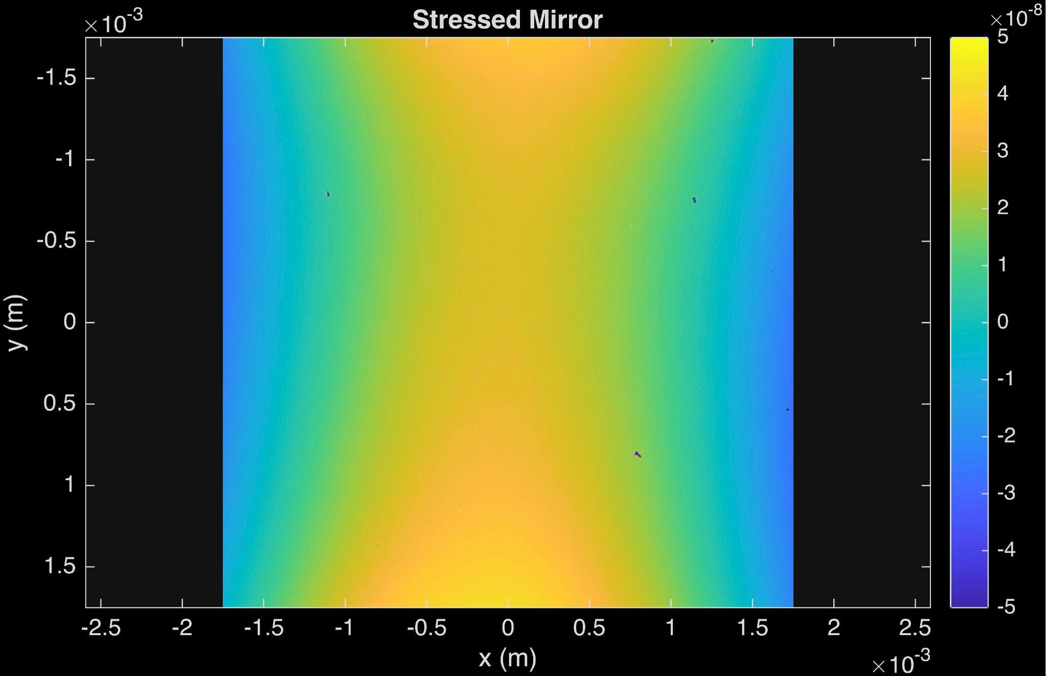
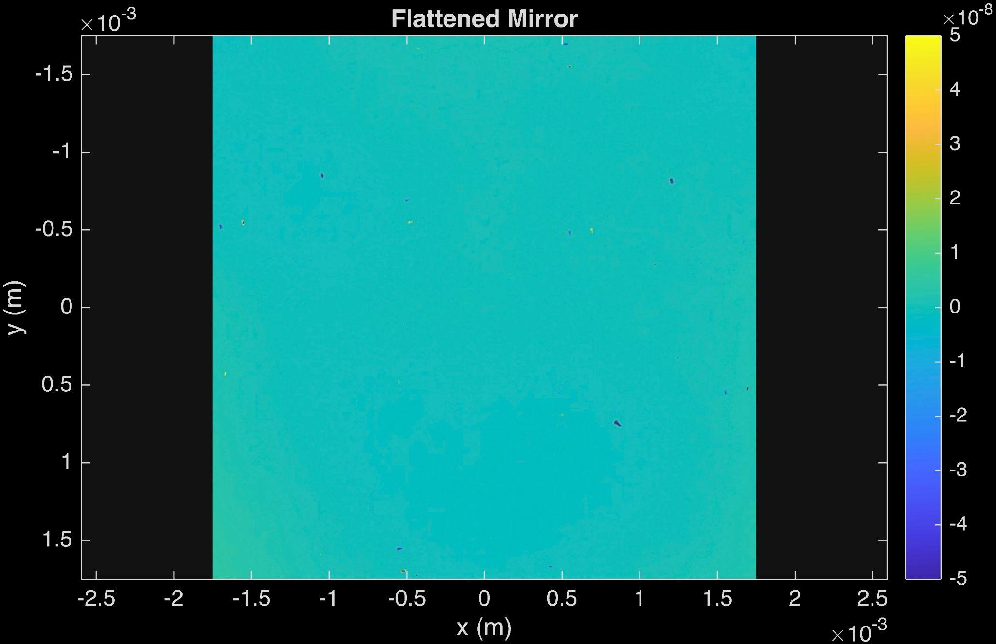
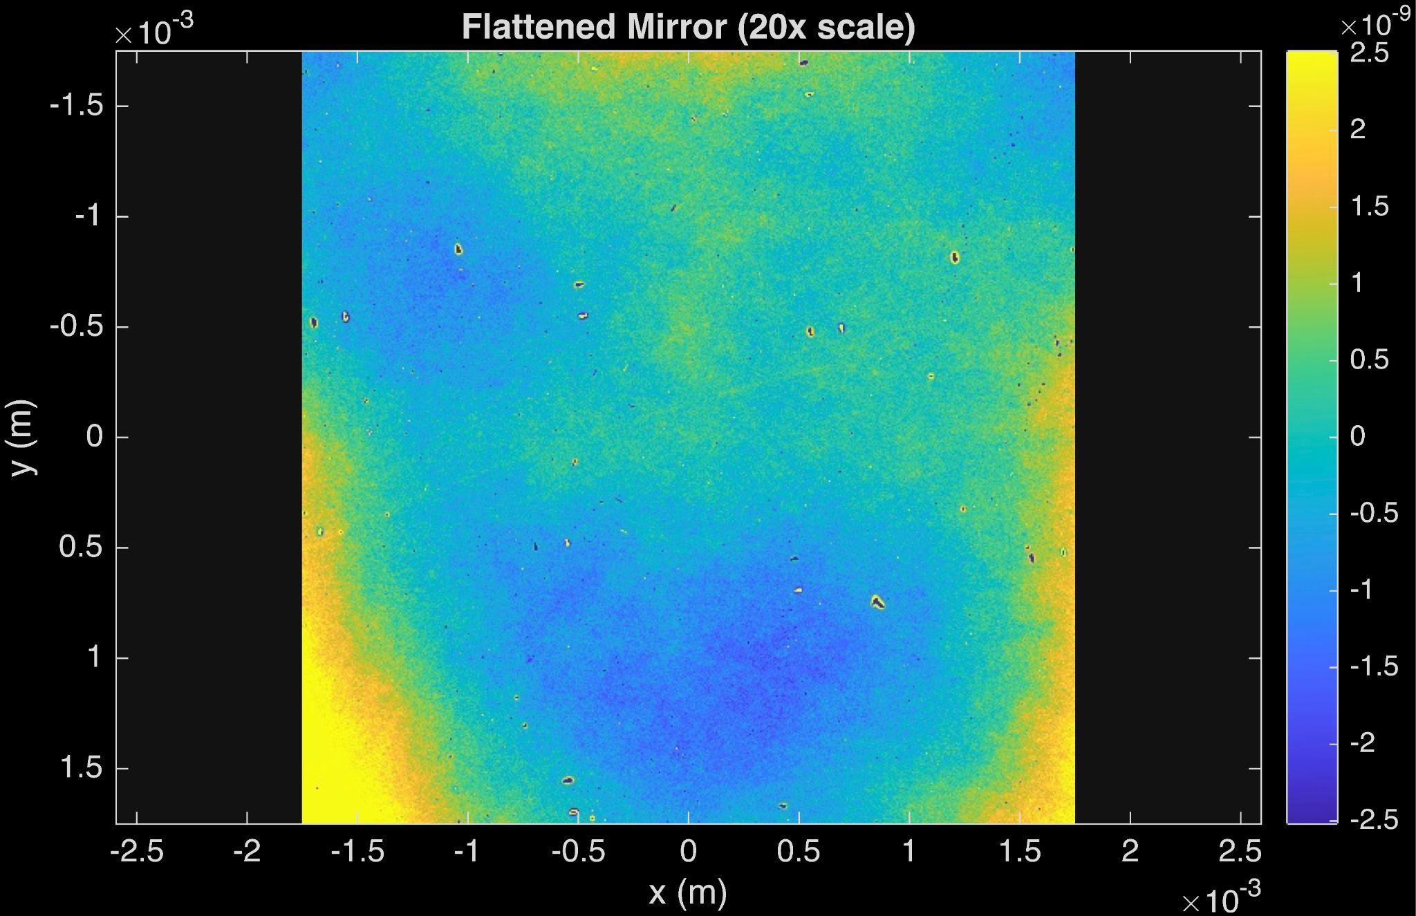
Flattening the Octagonal Spoked Mirror
 | Clamped Mirror | After Flattening
rms in m | 2.23⨉10⁻⁸ | 9.53⨉10⁻¹⁰
weighted rms in m | 1.90⨉10⁻⁸ | 8.30⨉10⁻¹⁰
diopters | 0.058023 | 0.0012017
power scattered from residuals | 38.5ppm | 24.8ppm
total loss | 185,453ppm | 1005ppm
*below NanoCam astigmatism

Slide 13
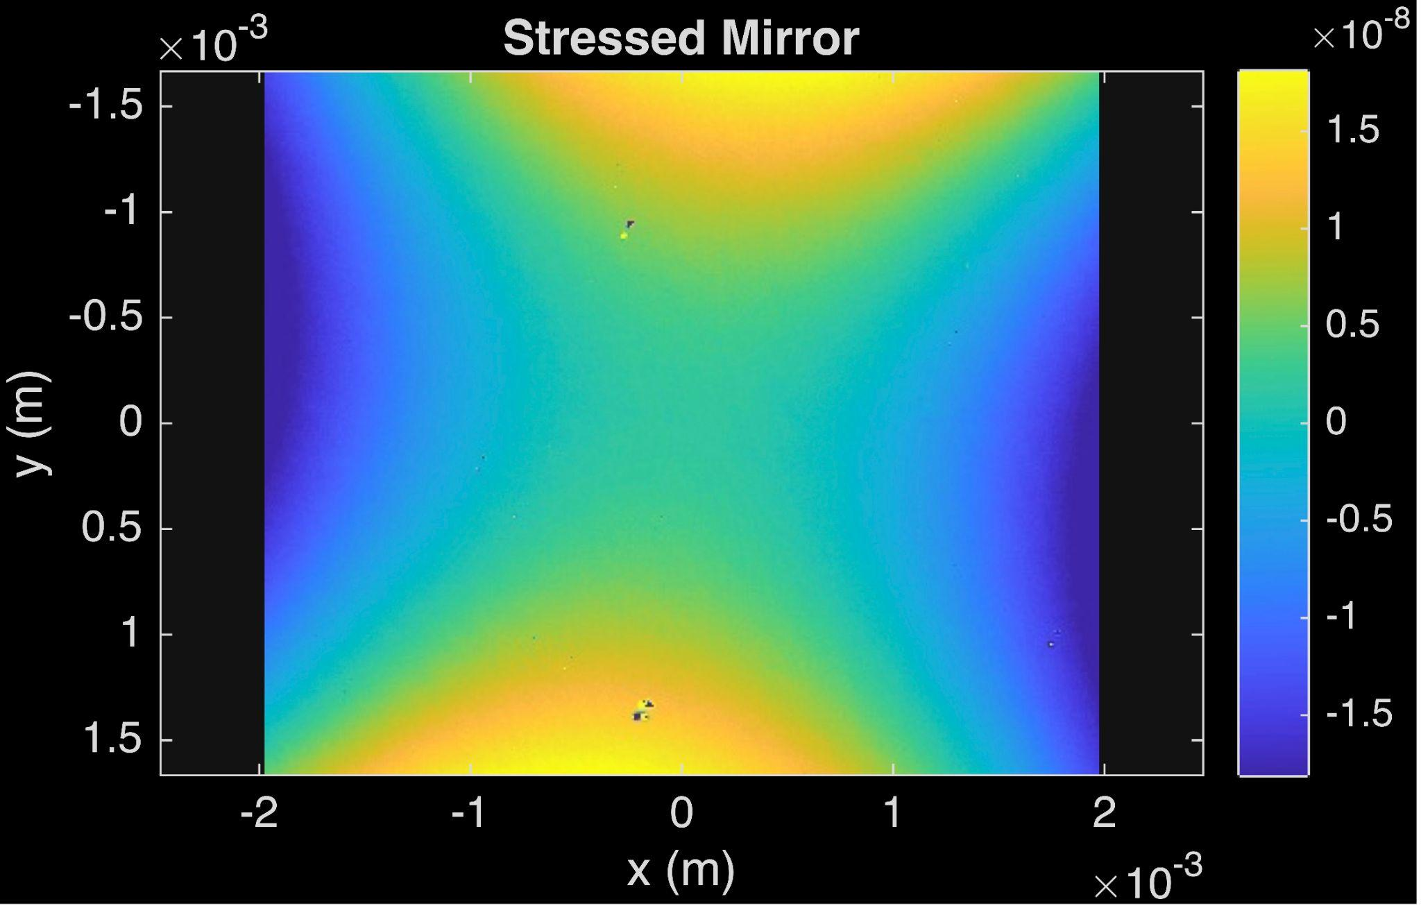
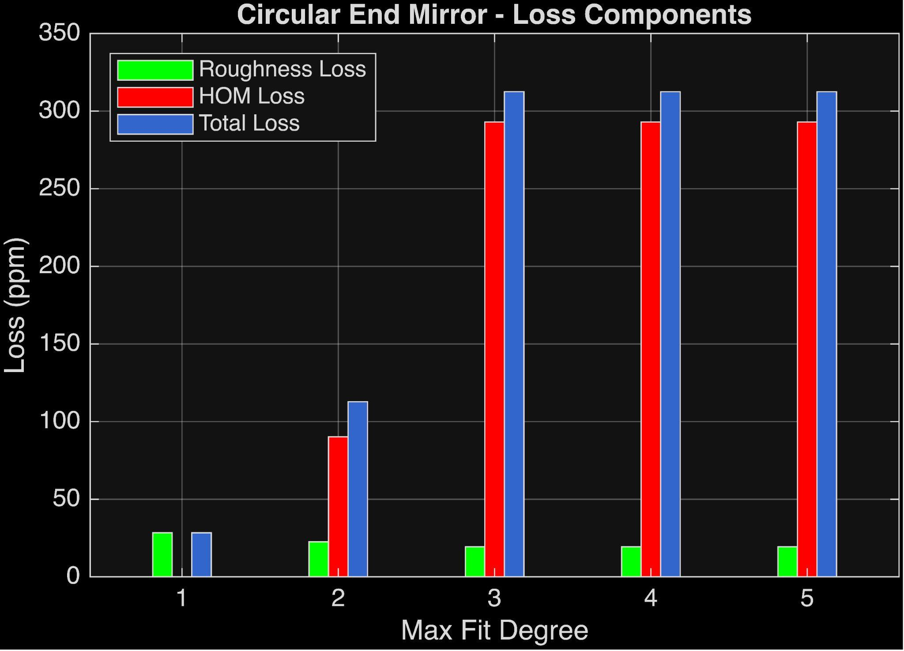
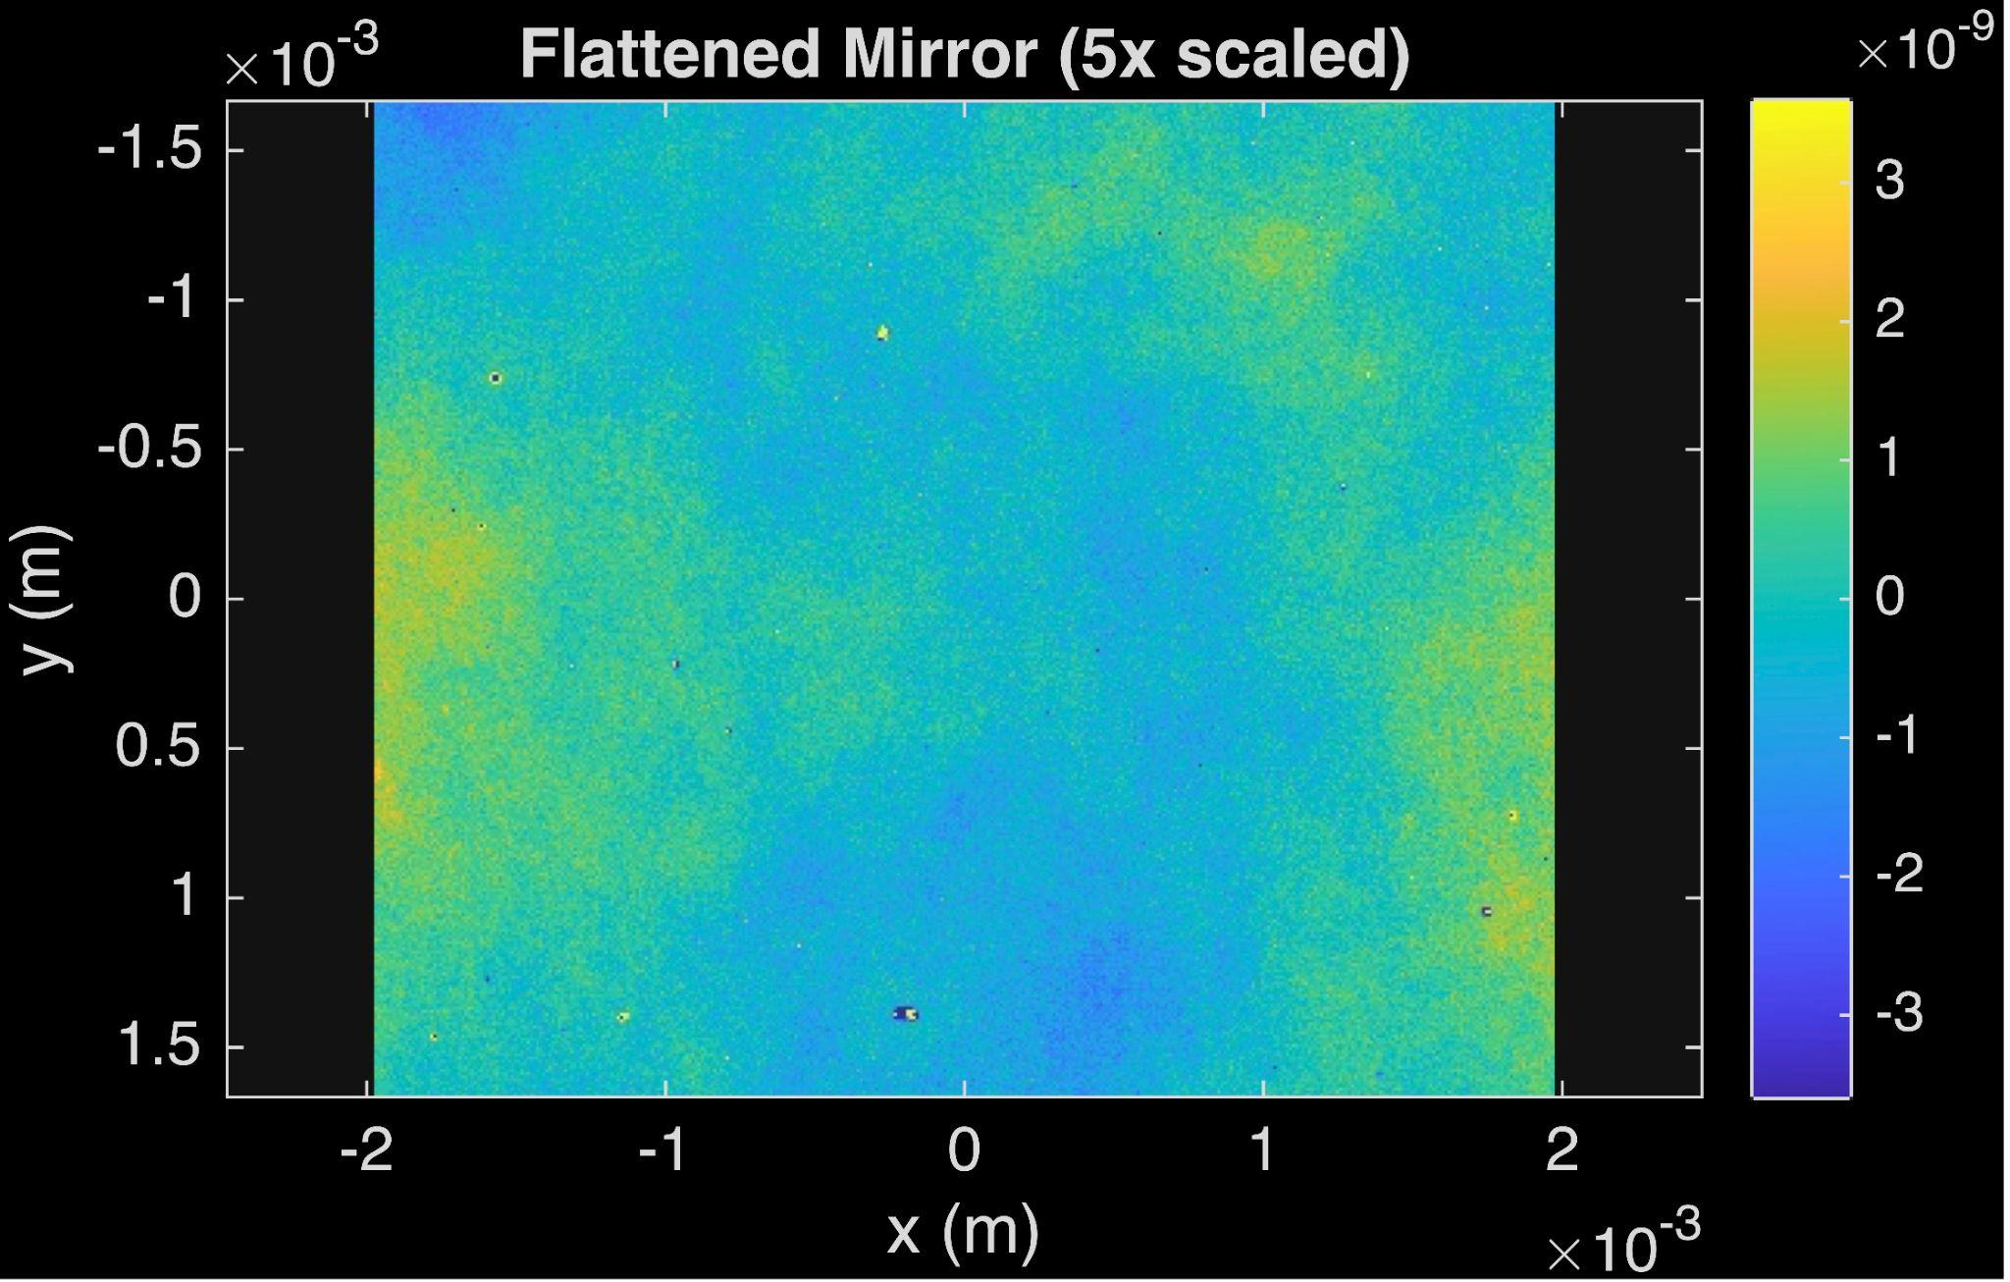
Flattening the Circular Spoked Mirror
 | Clamped Mirror | After Flattening
rms in m | 9.07⨉10⁻⁹ | 7.58⨉10⁻¹⁰
weighted rms in m | 7.73⨉10⁻⁹ | 6.57⨉10⁻¹⁰
diopters | 0.03014 | 0.00051475
power scattered from residuals | 235ppm | 19ppm
total loss | 43,461ppm | 312ppm

Slide 14
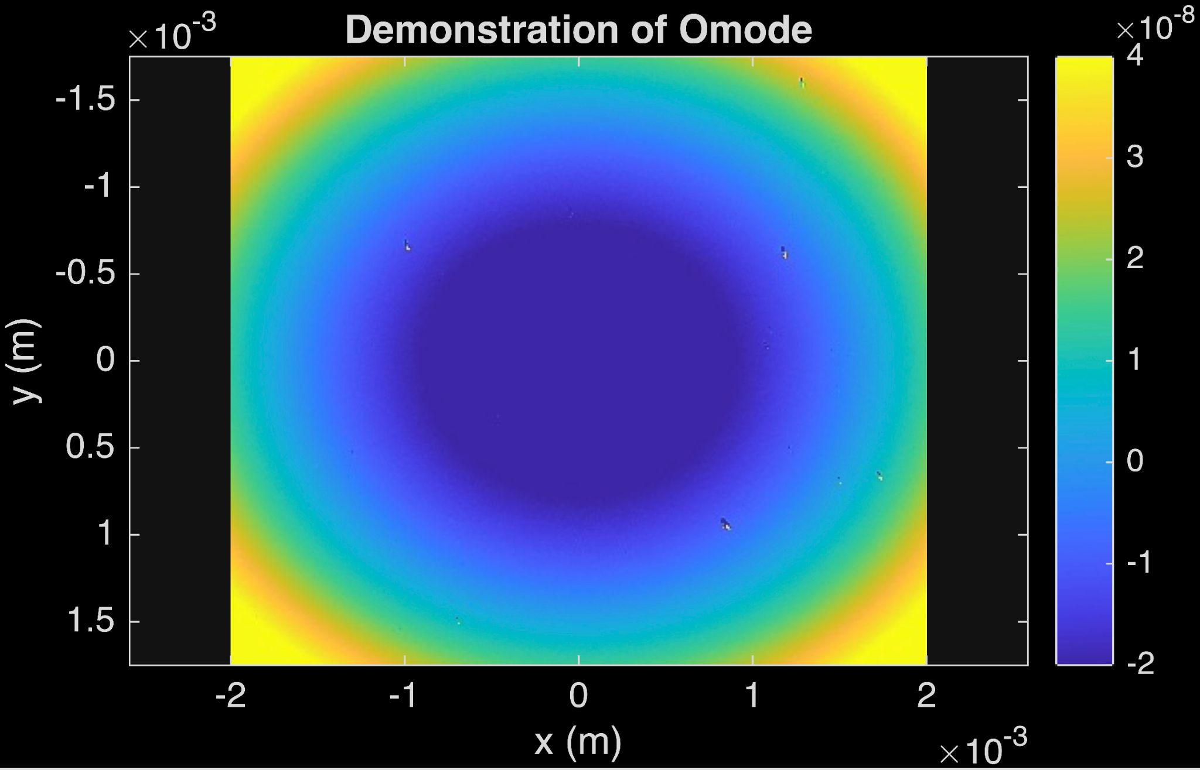
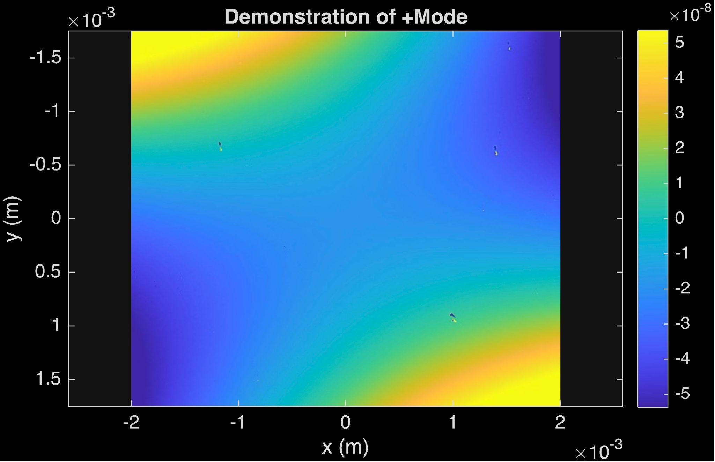
Creating Omode and +Mode
 | OMode | +Mode
diopters | 0.056 | 0.061
power coupled above n+m=2 | 0.0131 | 0.0455
weighted rms of the mirror surface | 1.82⨉10⁻⁸ meters | 2.91⨉10⁻⁸ meters
weighted rms of residuals of quadratic fit | 7.59⨉10⁻¹⁰ meters | 1.05⨉10⁻⁹ meters
*a third of what PSAMS at LIGO can do

Slide 15
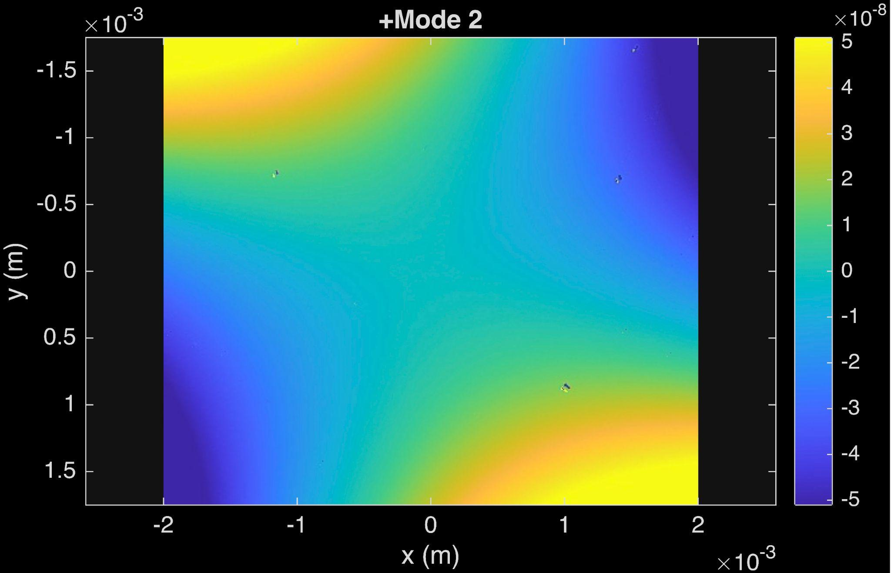
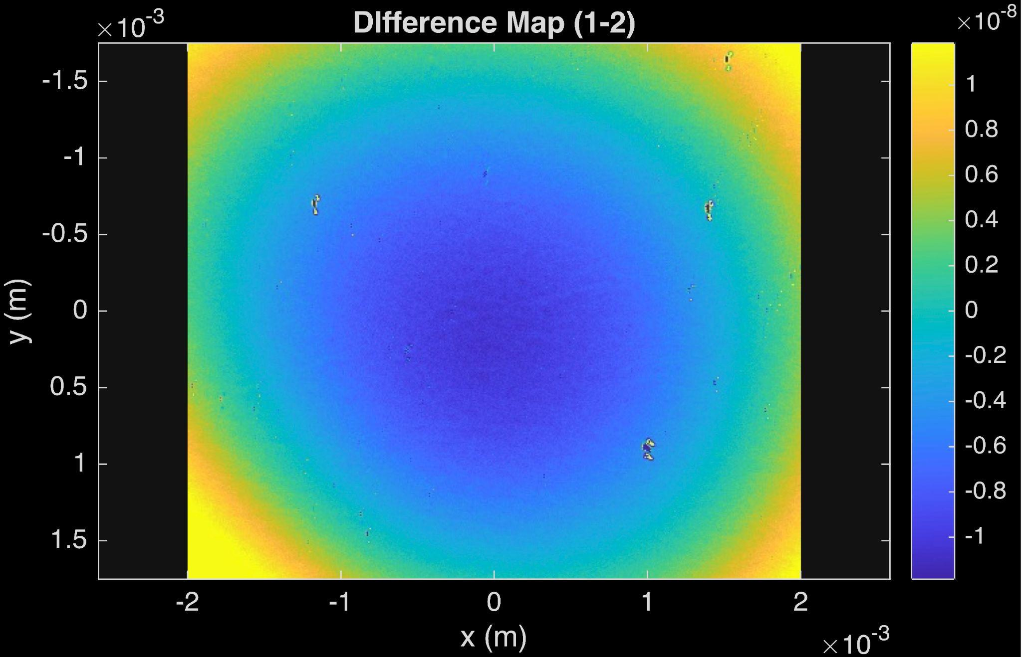
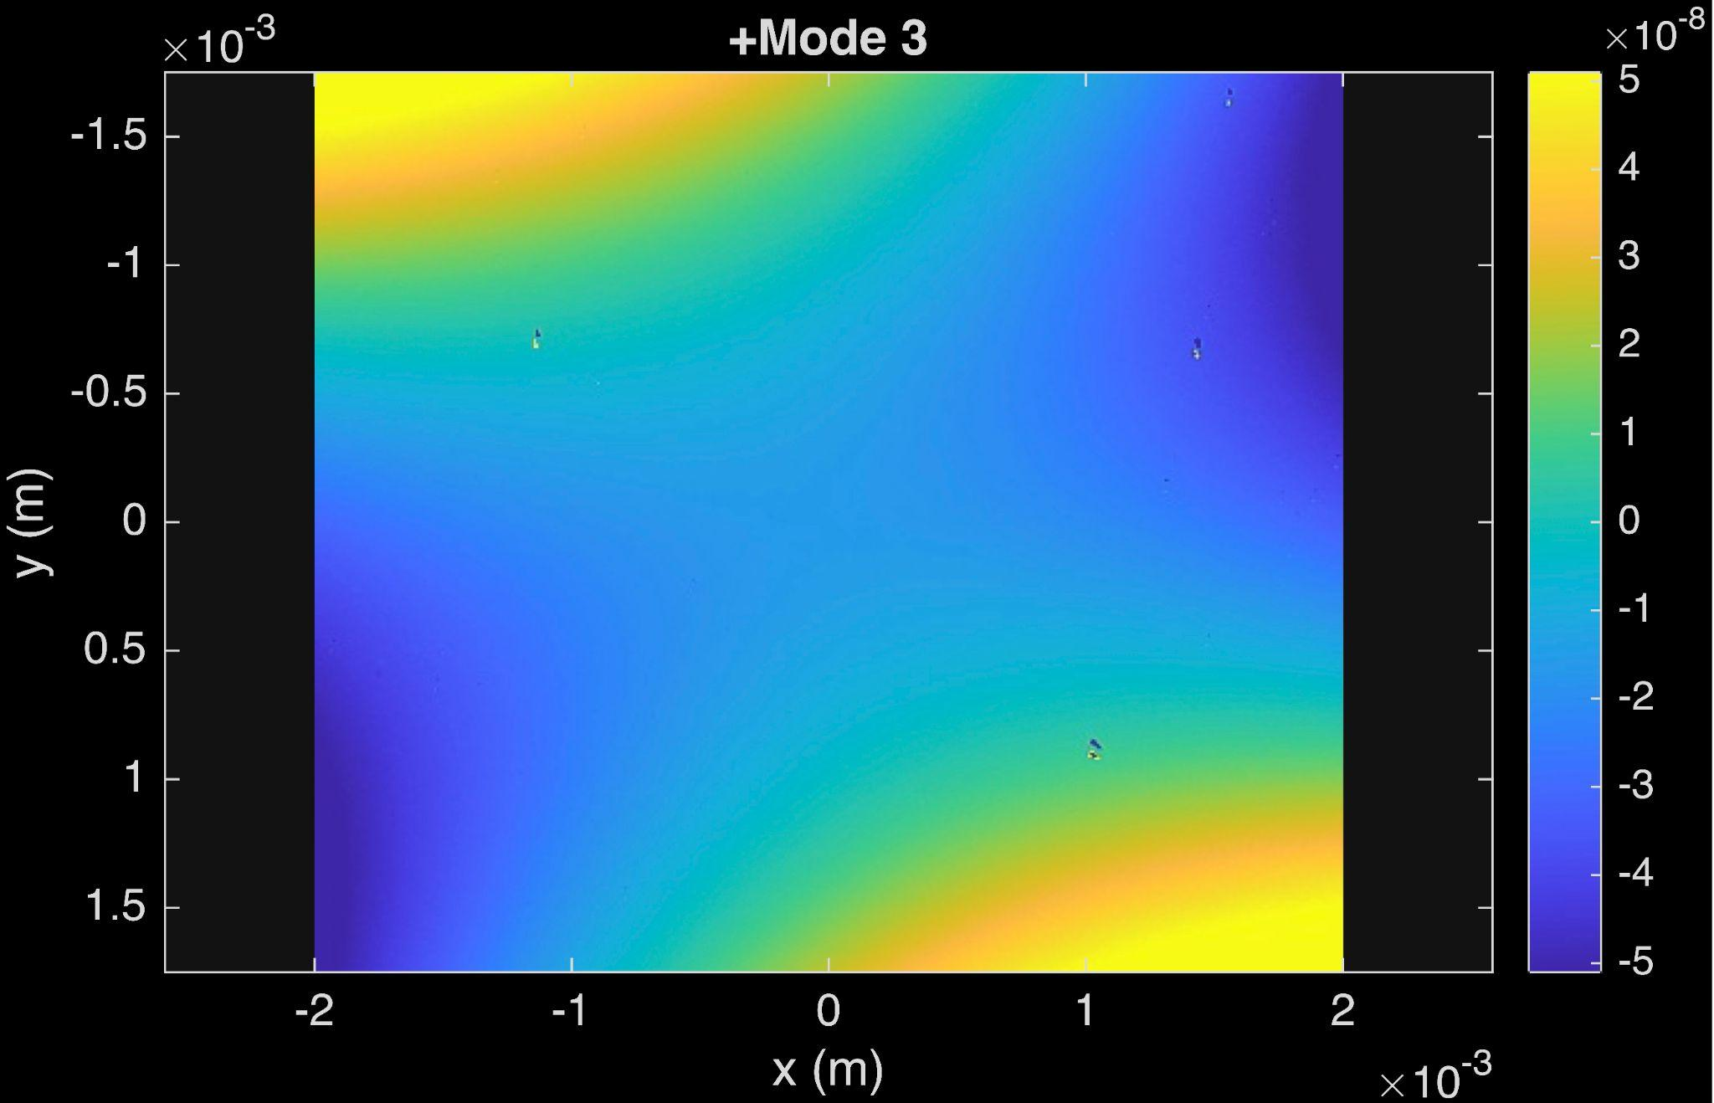
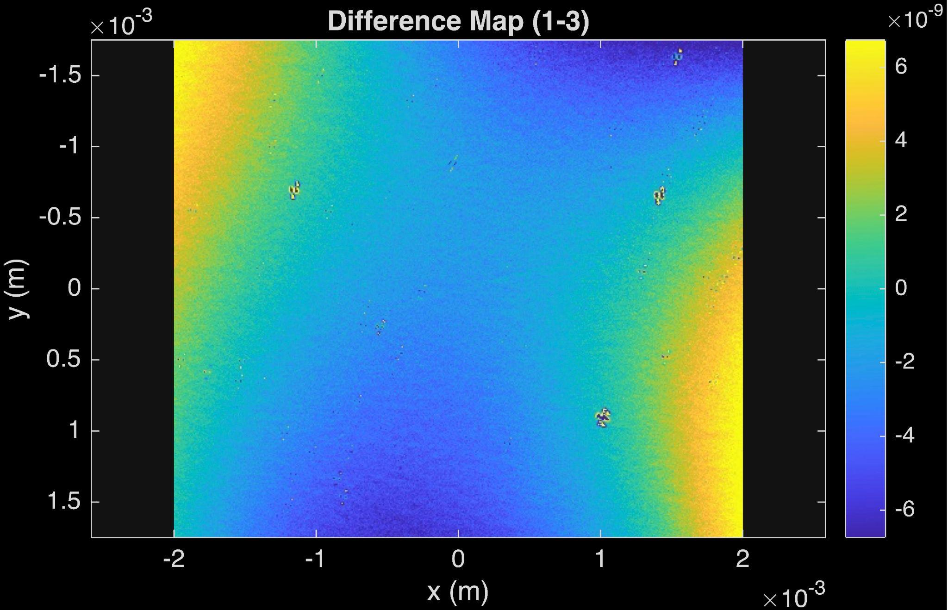
Repeatability
Scaled 5x
 | Mean
Total lensing power (diopters) | (6.33±0.05)⨉10⁻²
Lensing 20 (diopters) | (2.39±0.5)⨉10⁻²
Lensing 11 (diopters) | (4.46±0.3)⨉10⁻²
Lensing 02 (diopters) | (3.74±0.5)⨉10⁻²
Scaled 10x

Slide 16
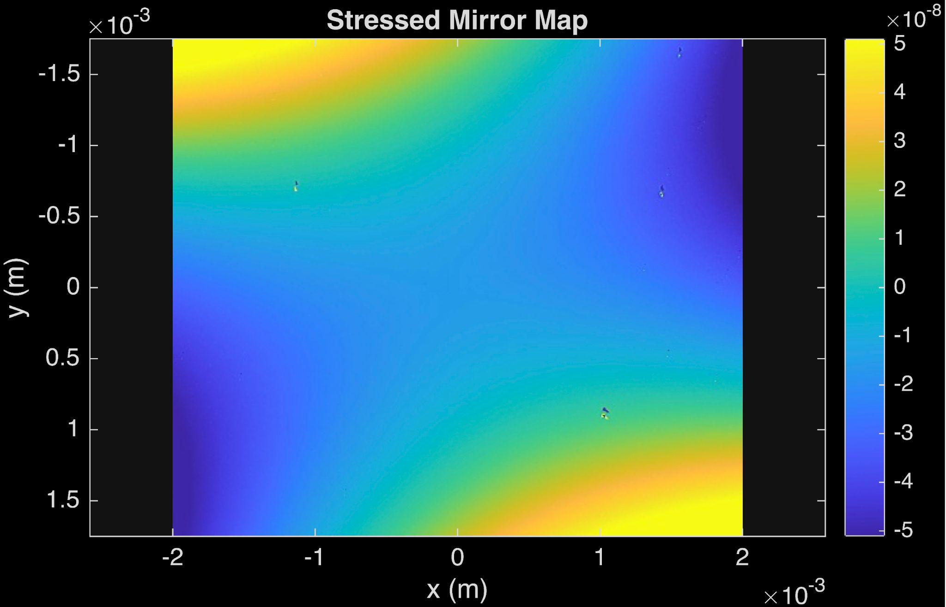
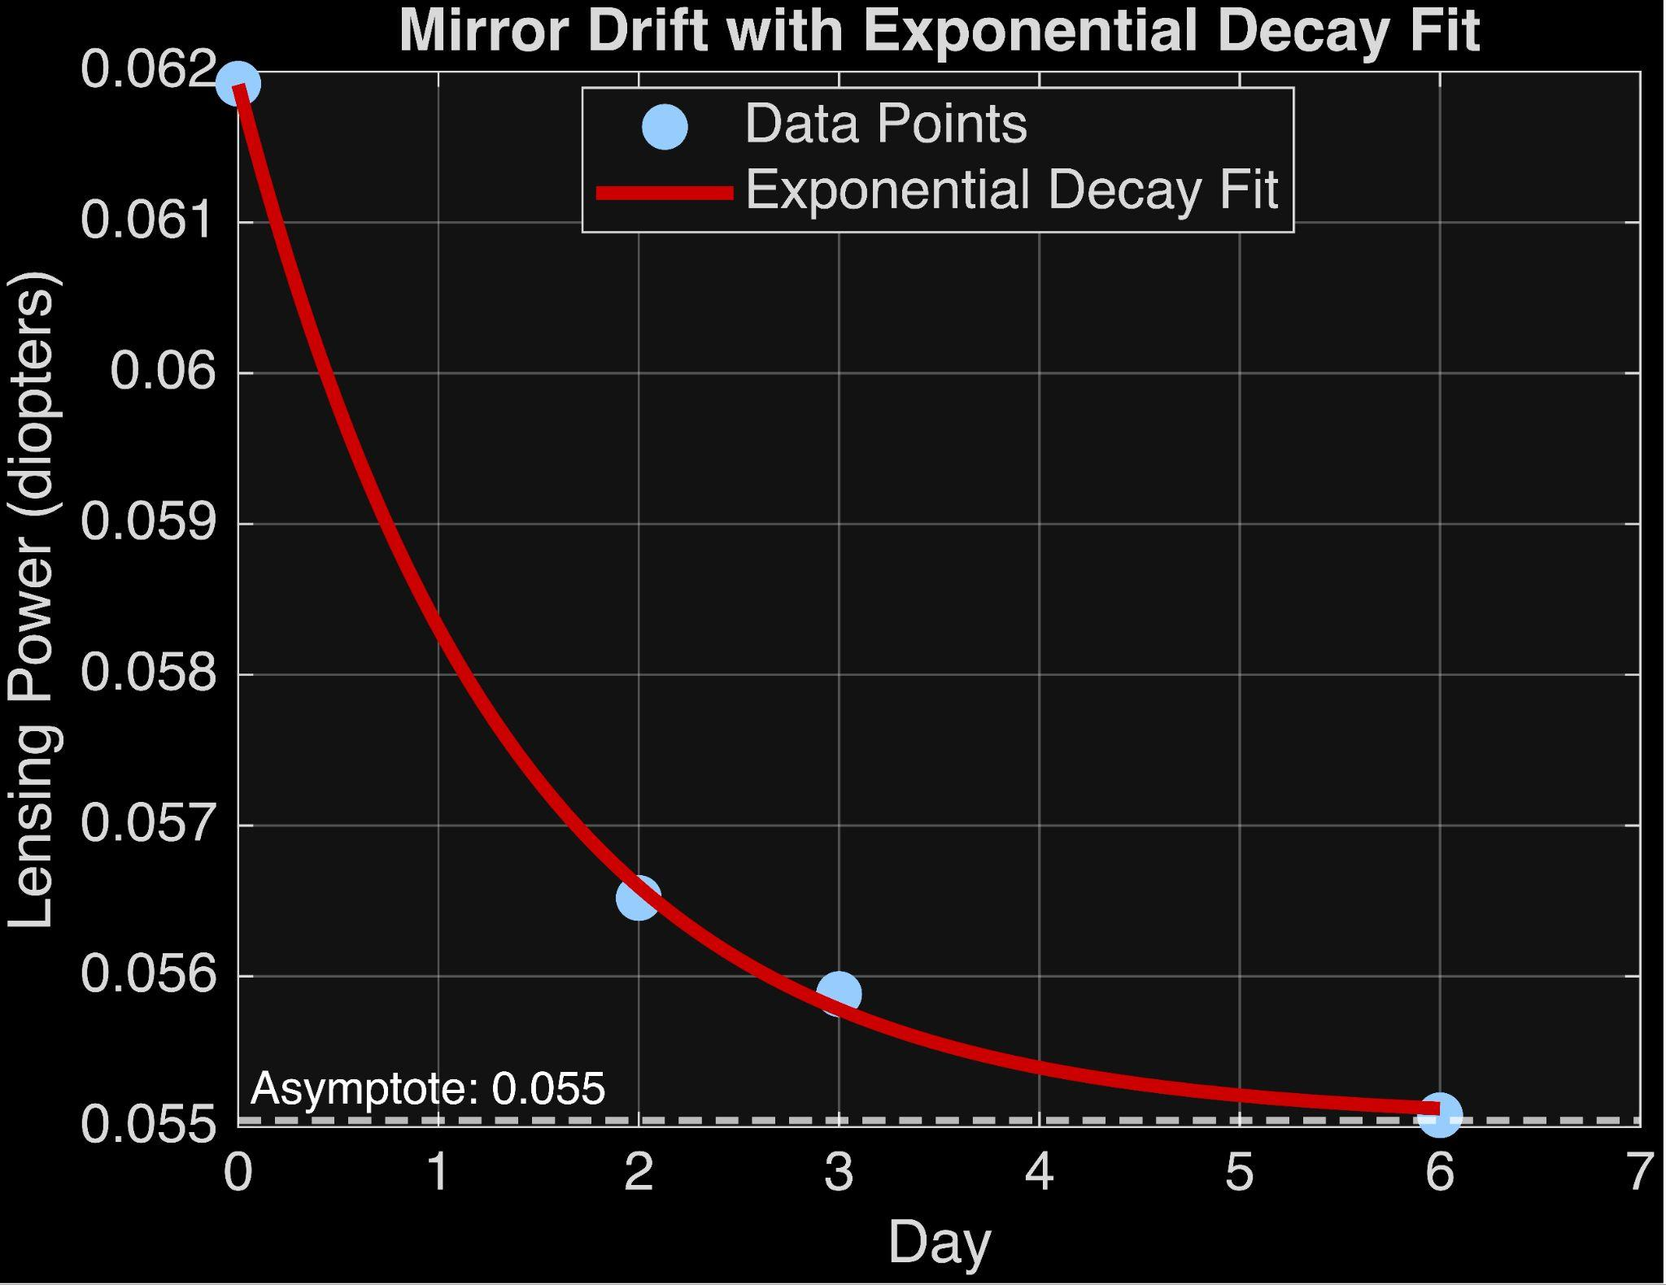
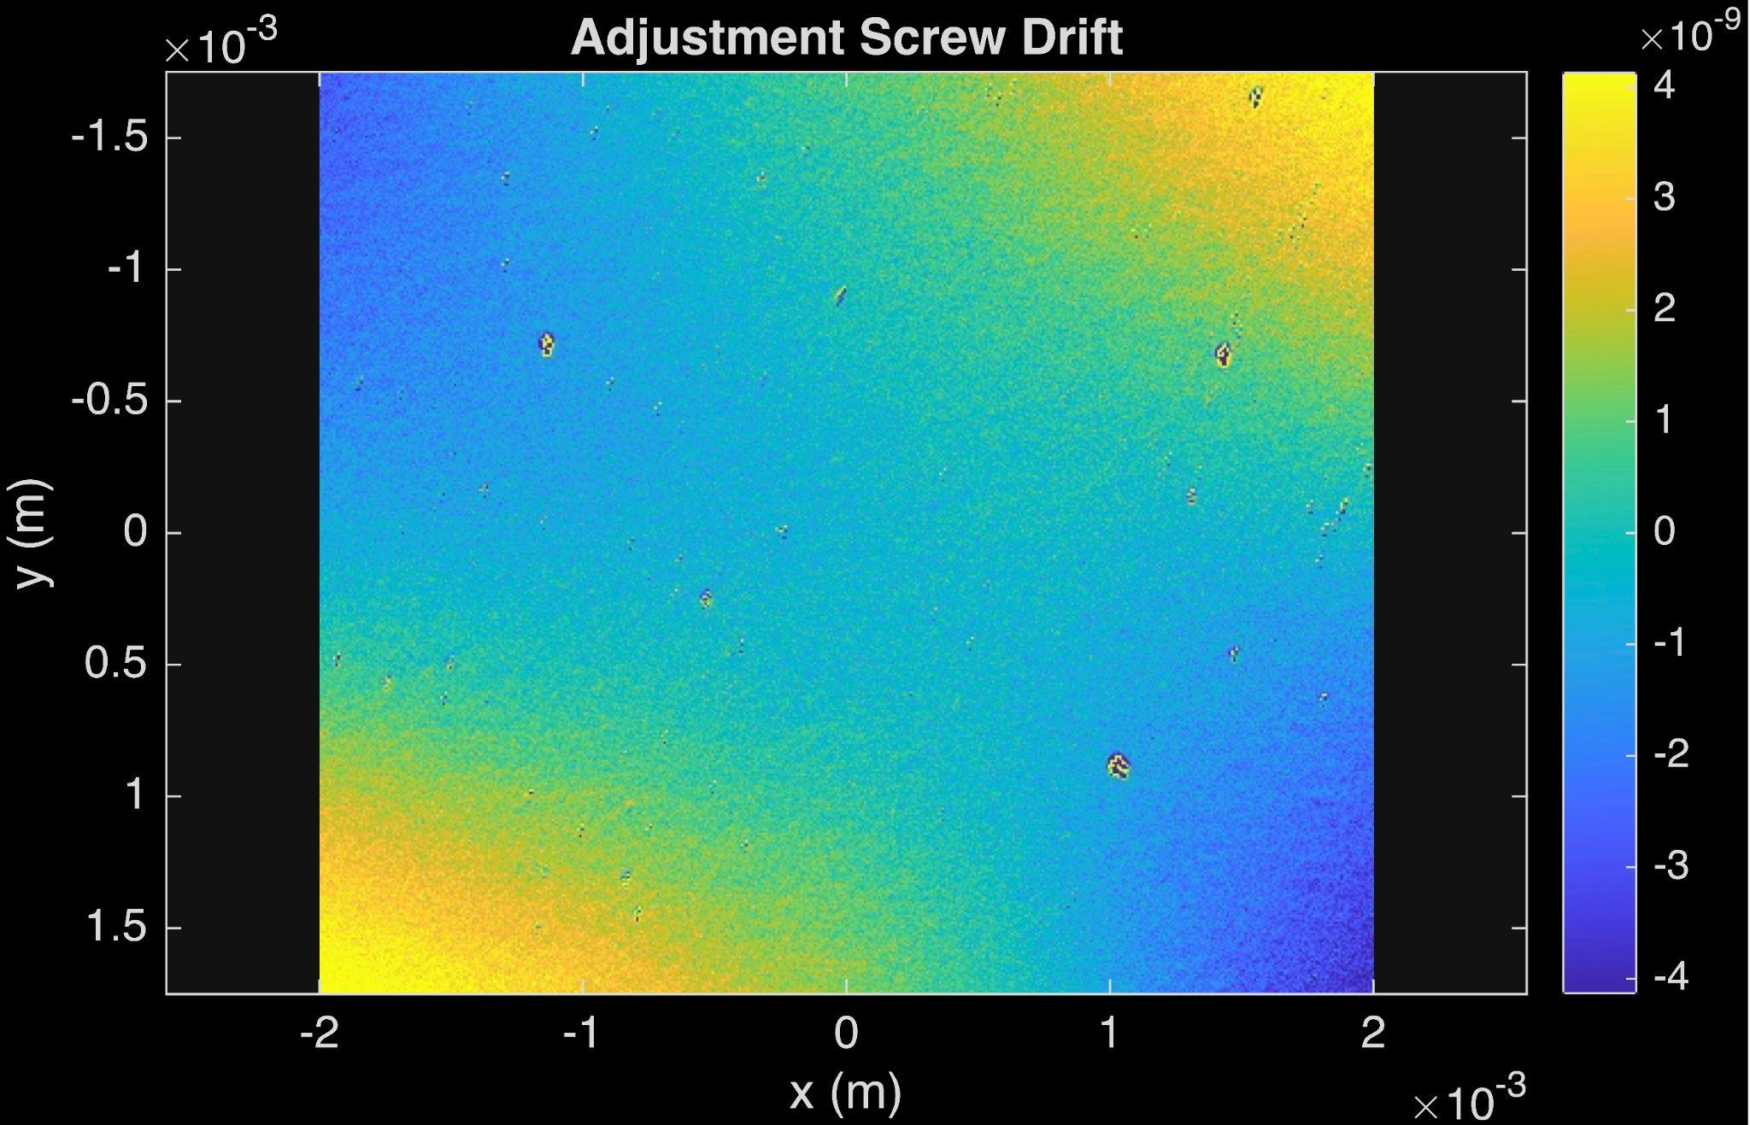
Mirror Drift Over Time
Scaled 10x
Roughly a 10% decrease in focusing power in the first three days and then significant leveling.

Slide 17
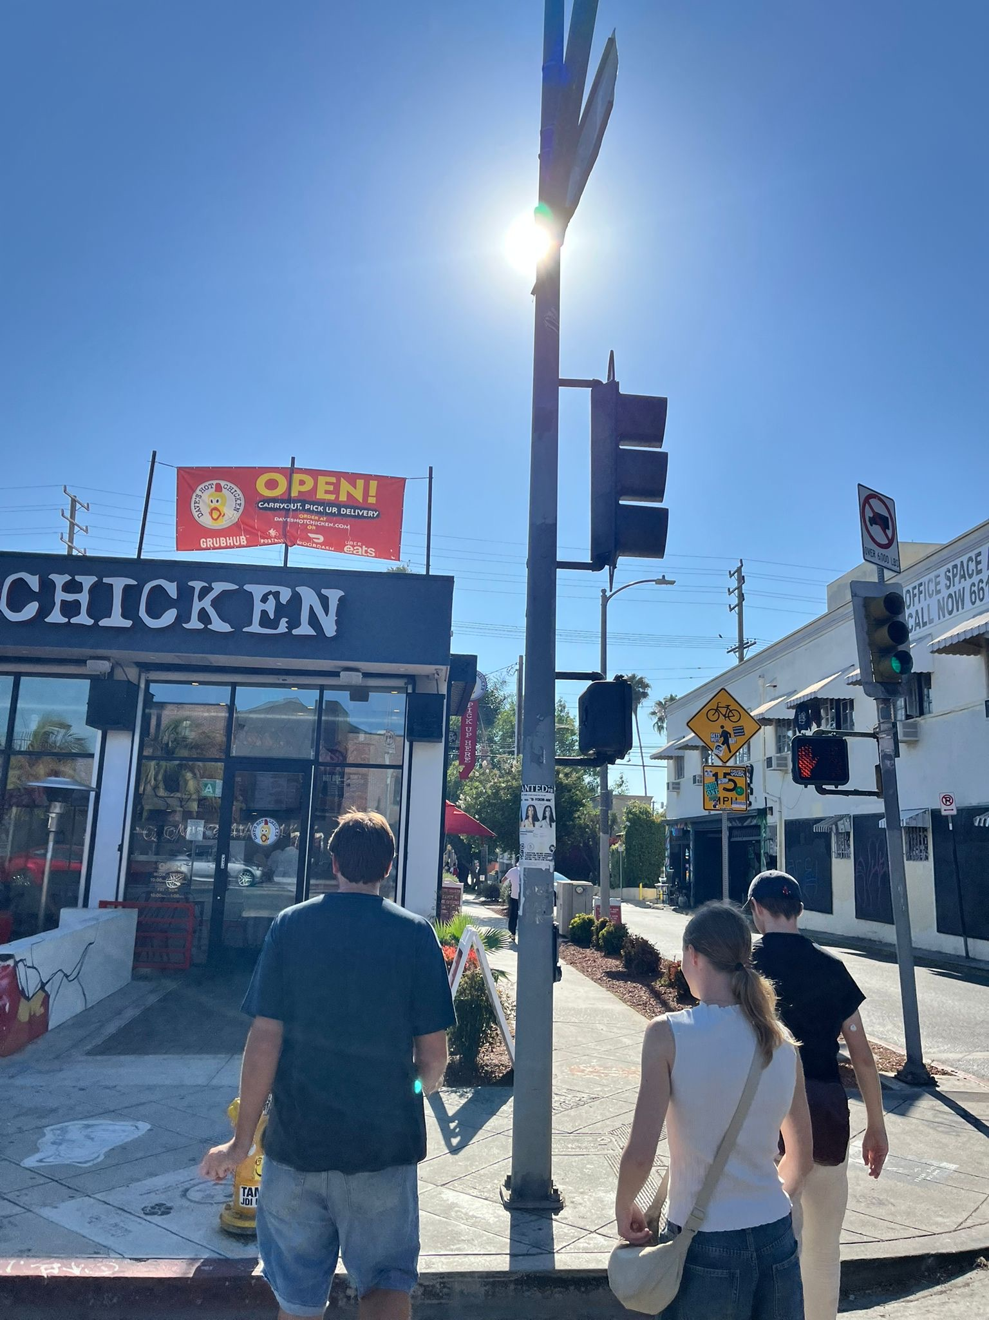
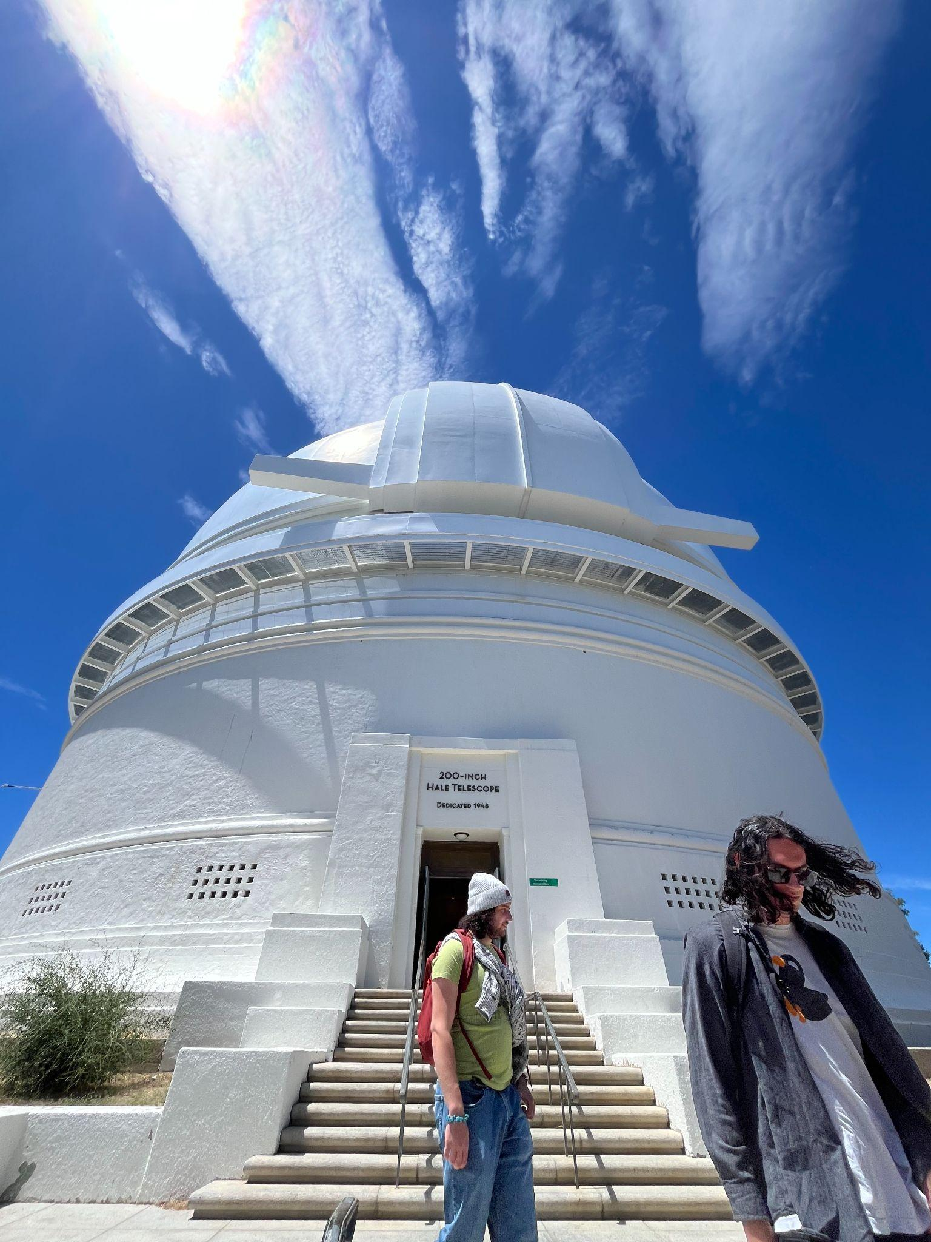
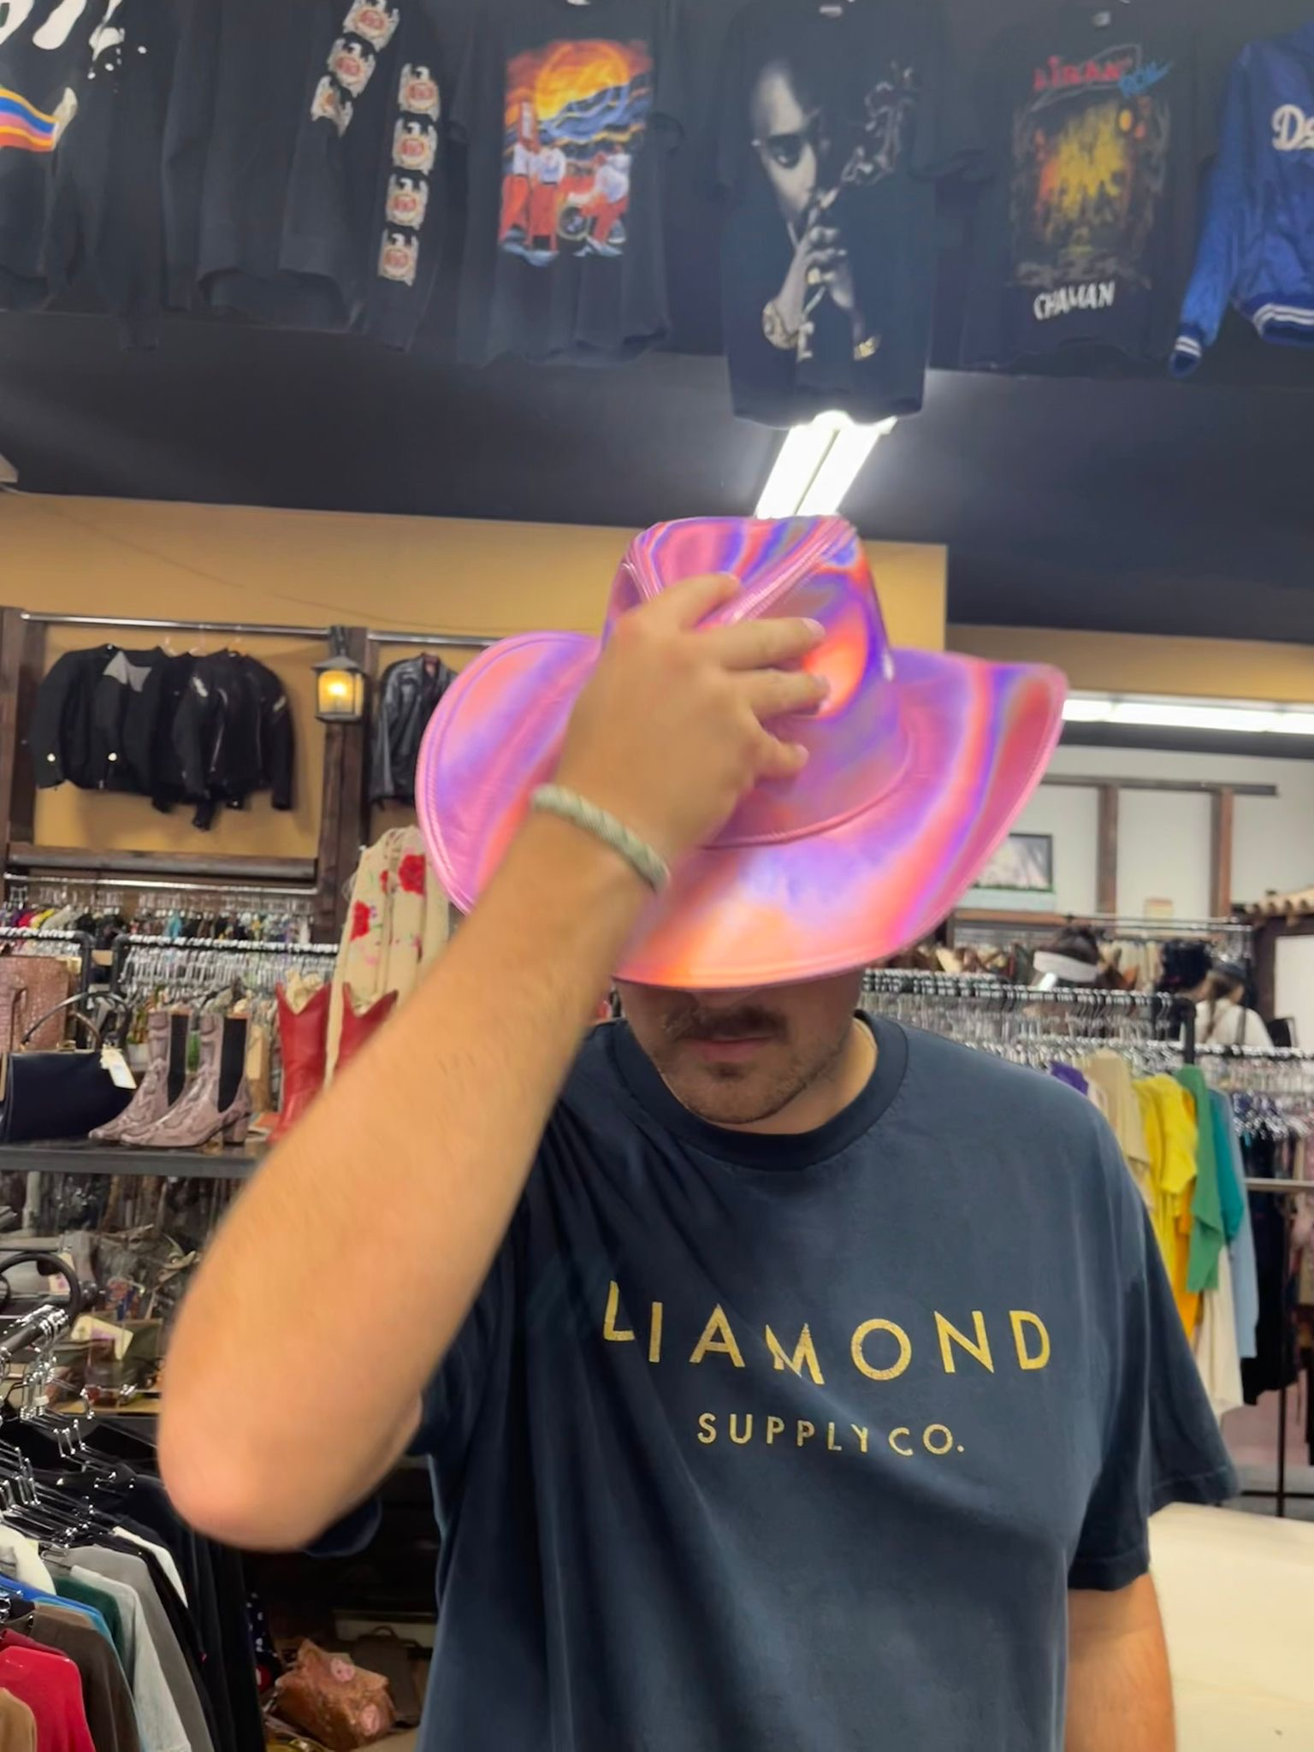
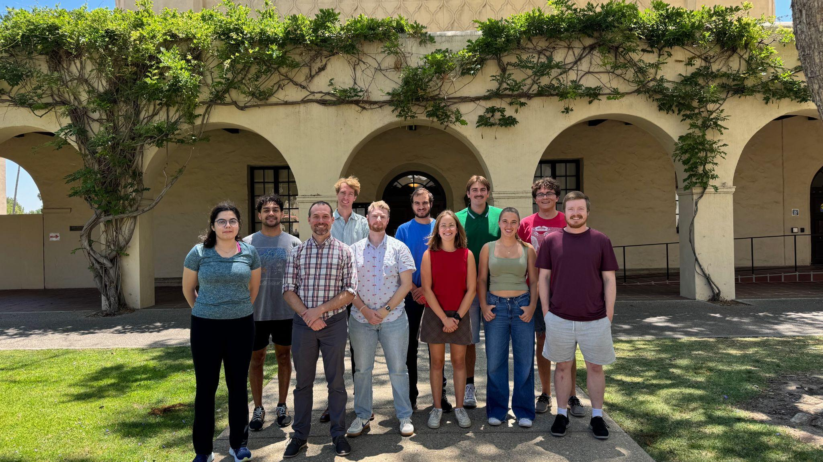
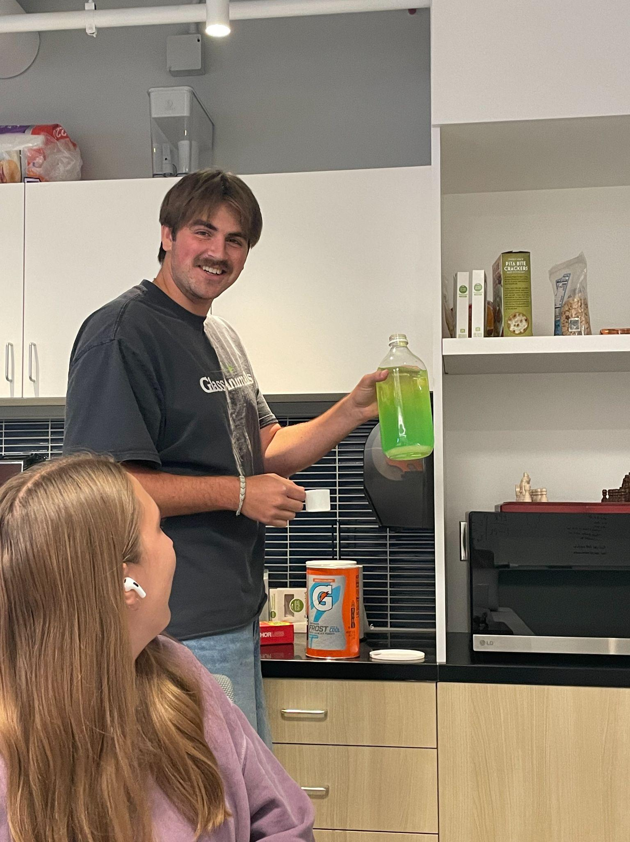
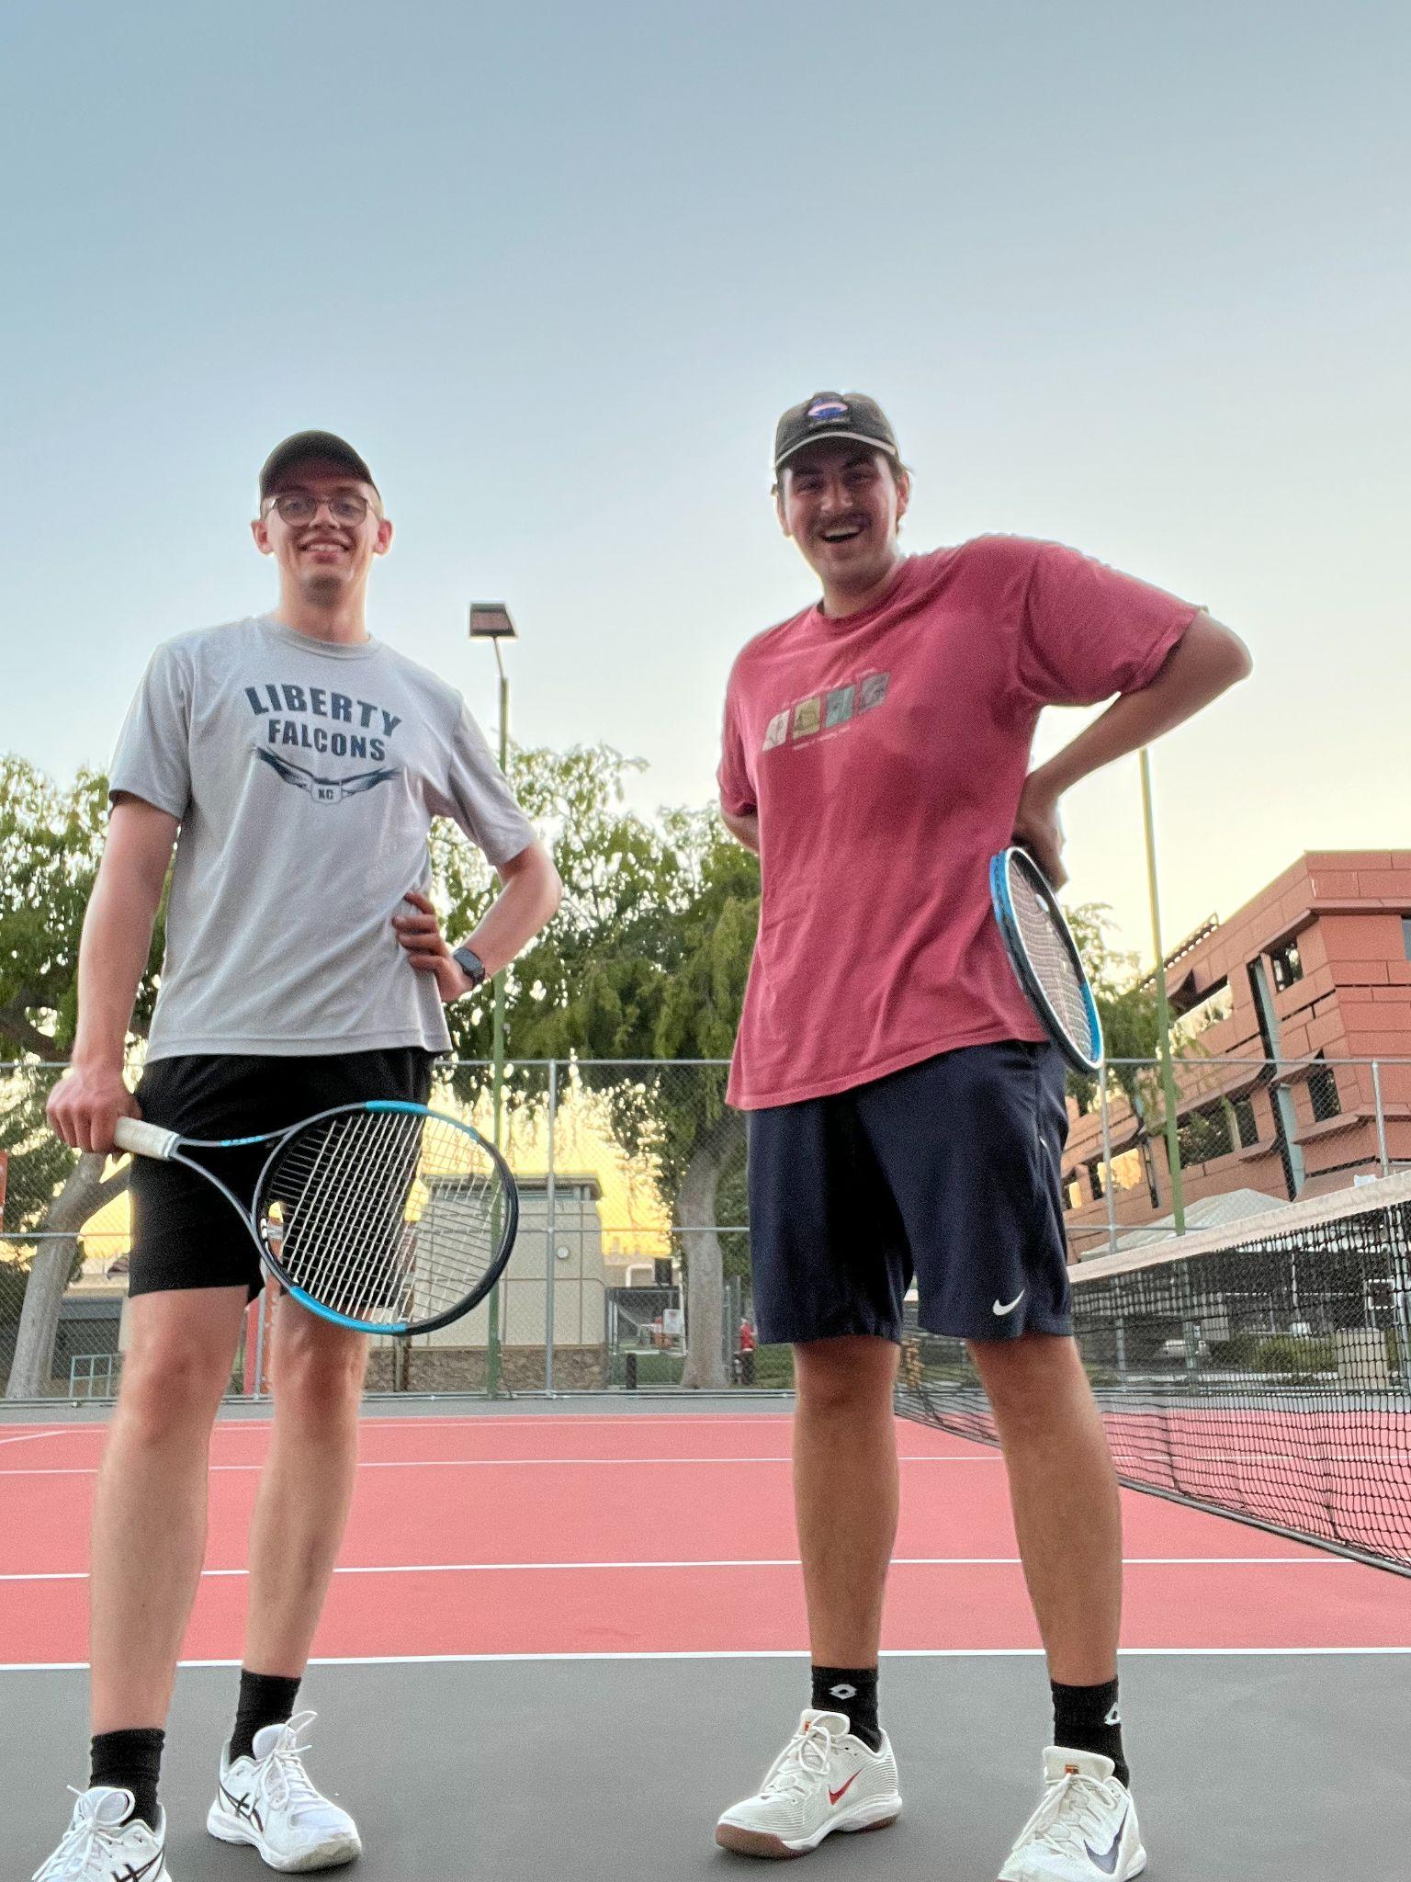
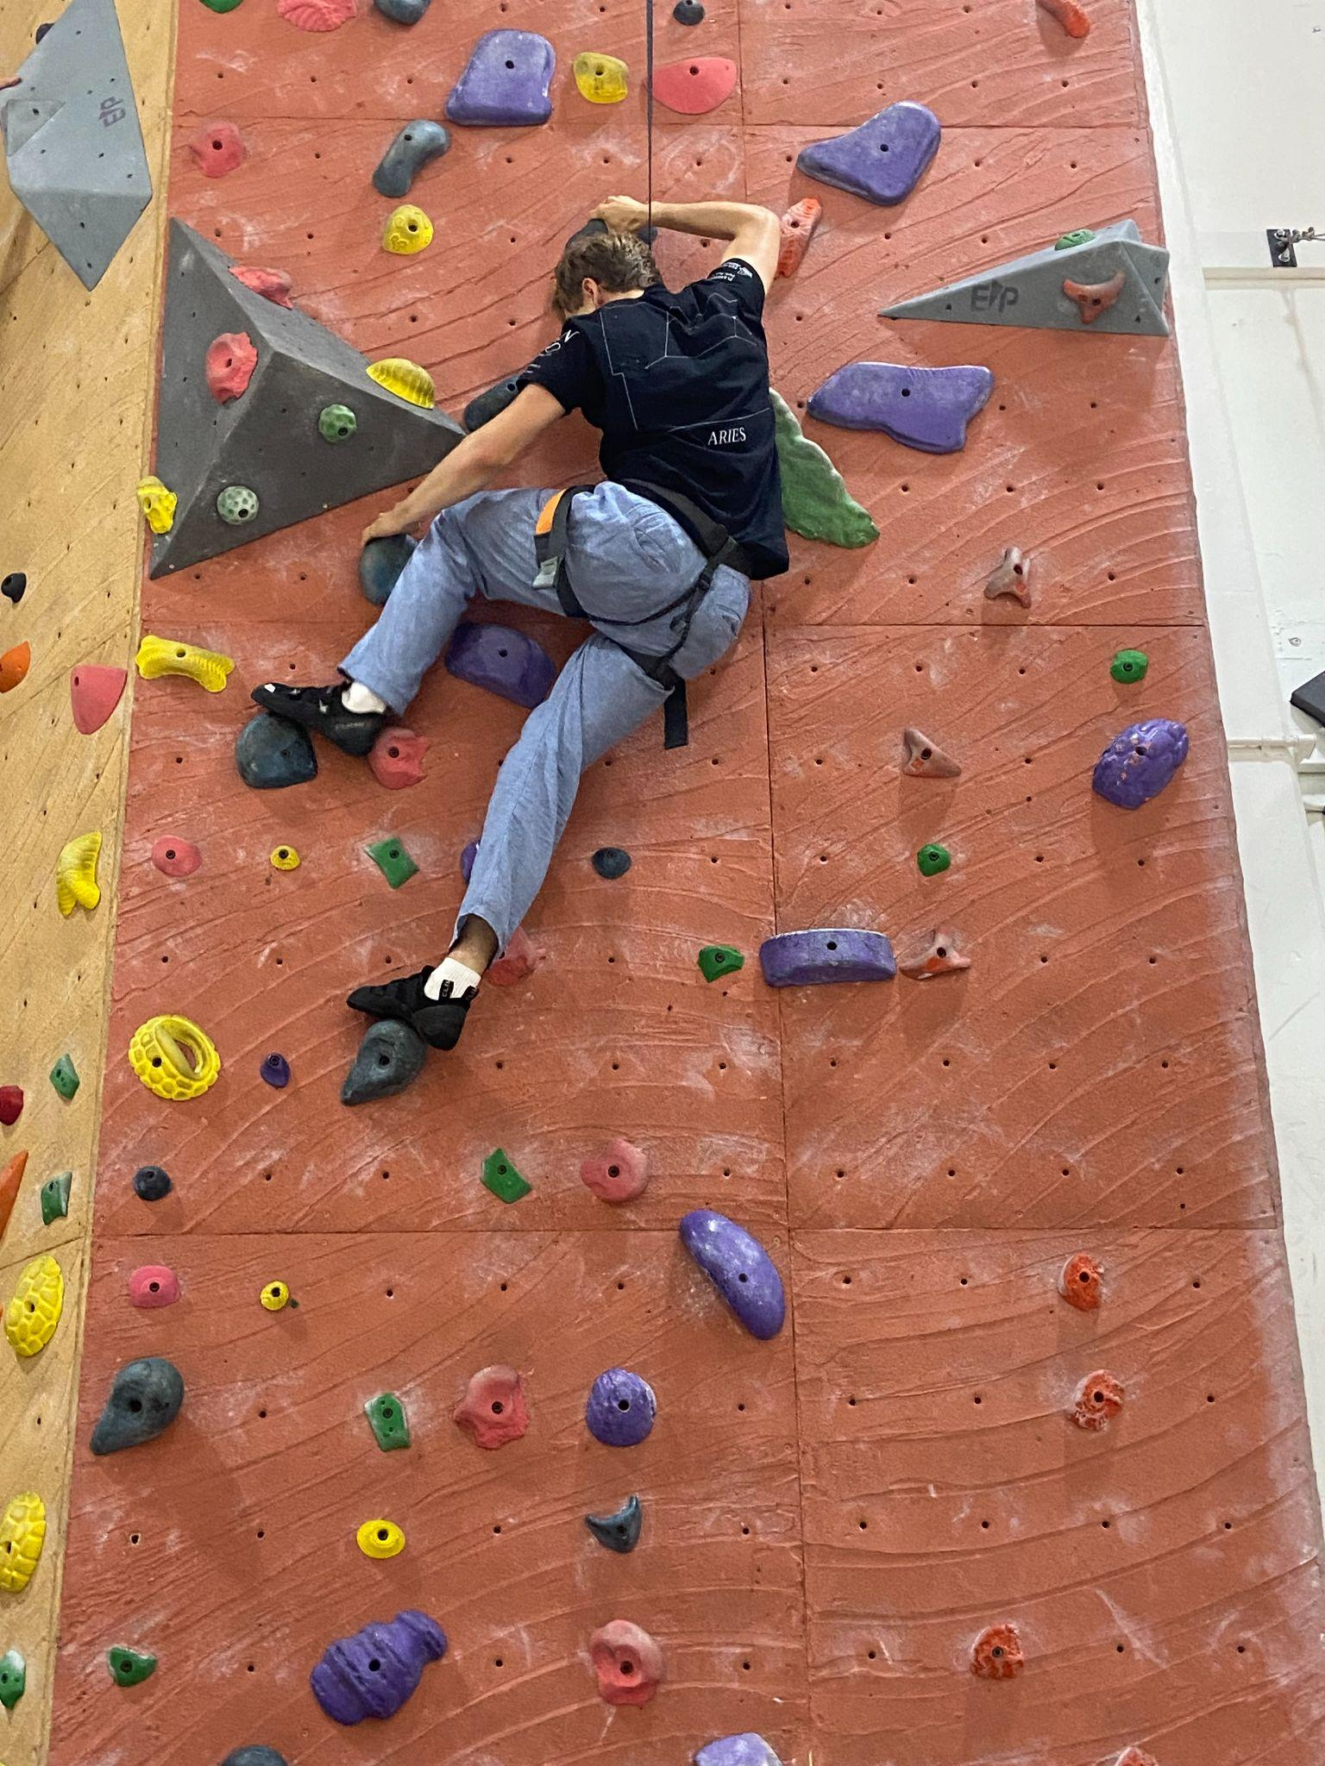
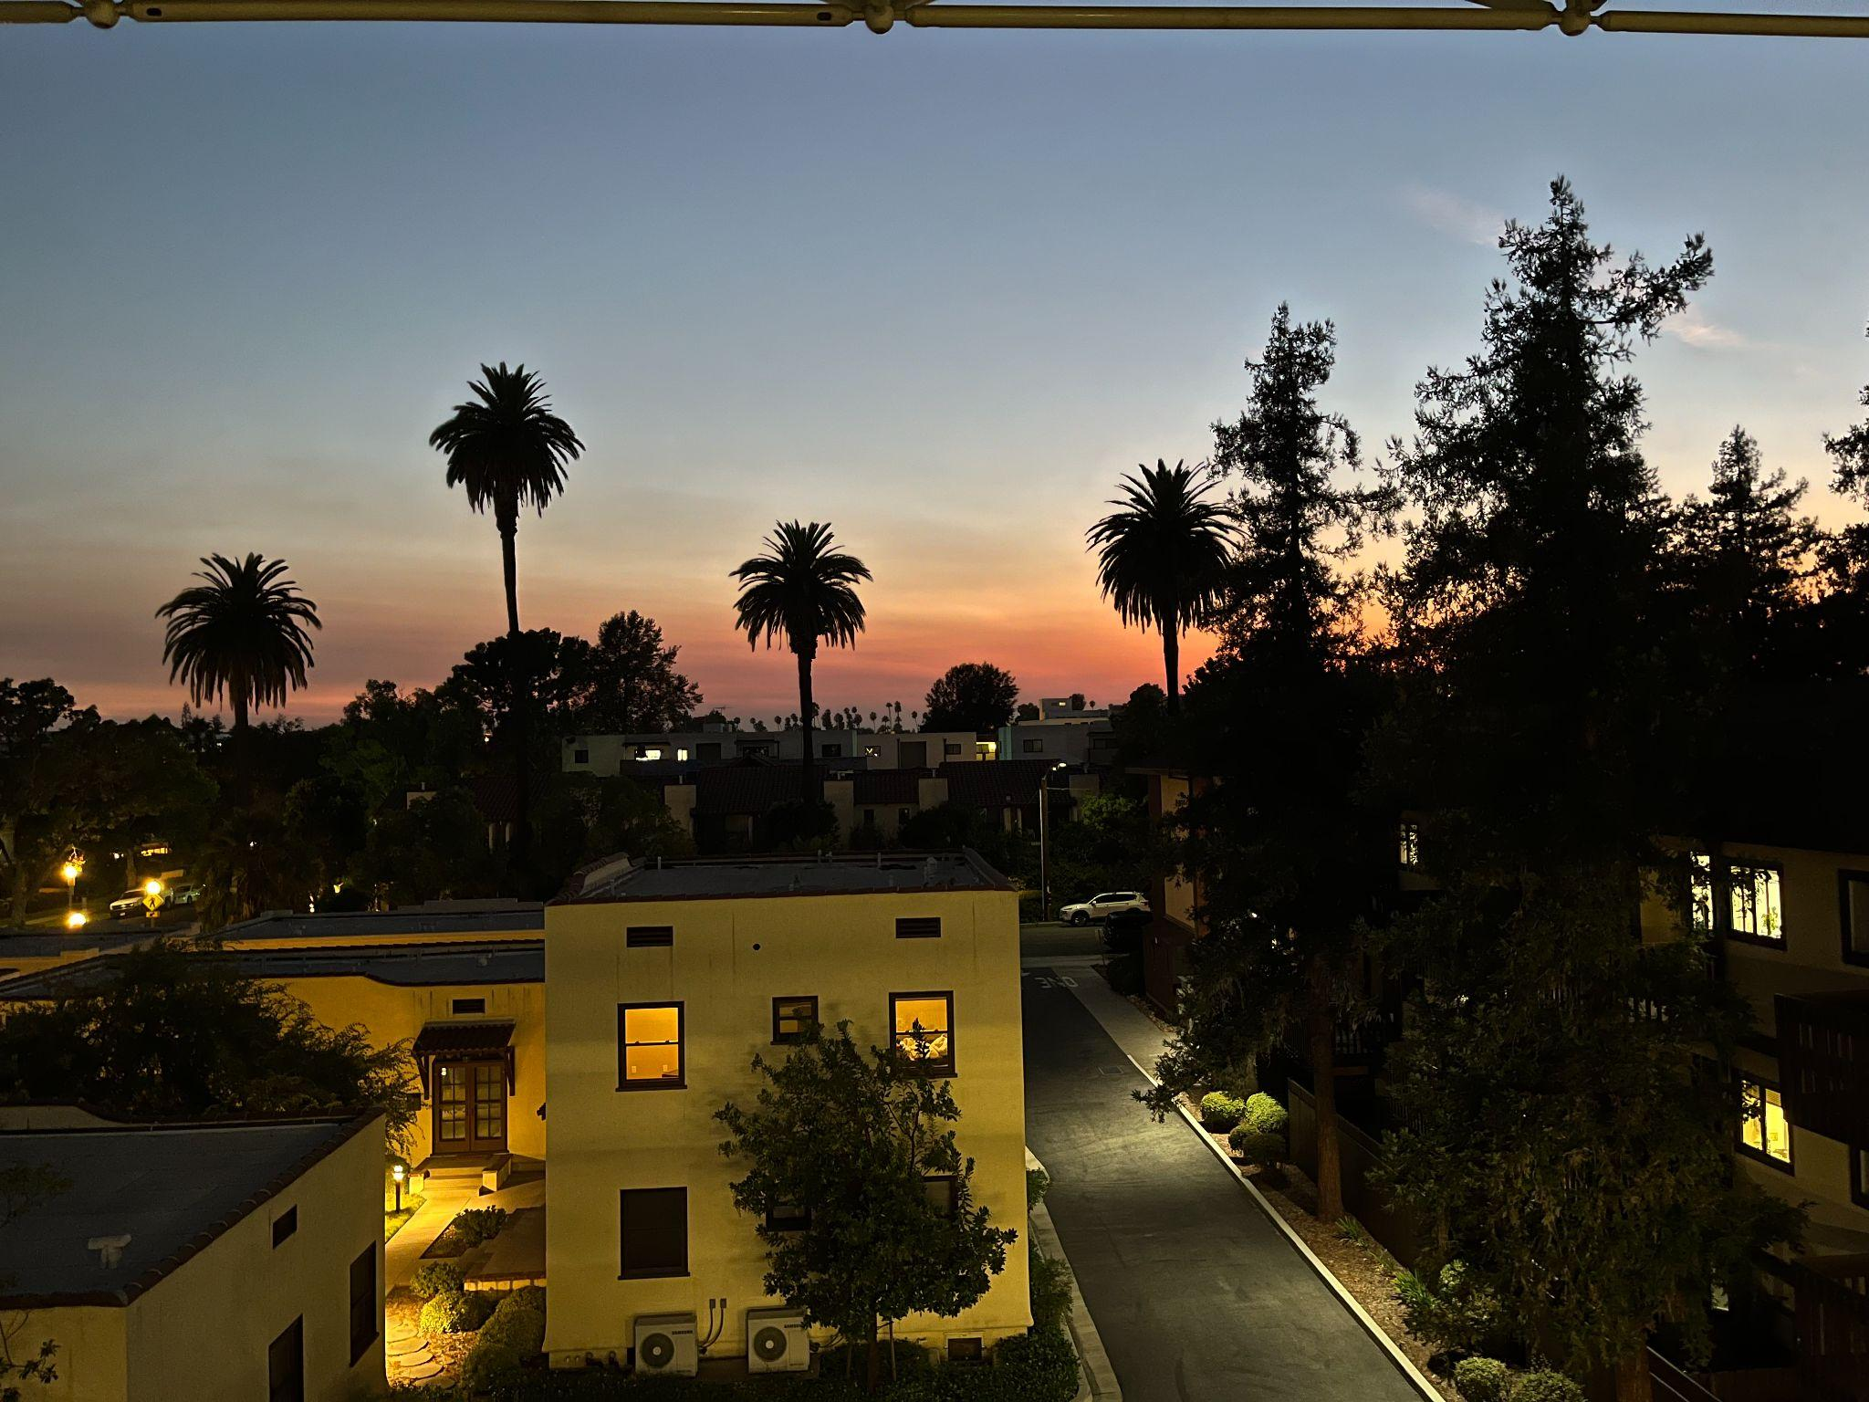

Slide 18
Questions?
Thank you to Caltech, LIGO, NSF, Fermilab, the Department of Energy, and the Heising-Simons Foundation for making this opportunity possible. And a special thanks to Garilynn Billingsley for her advice and letting us use her 4D NanoCam (optical profiler).

Slide 19
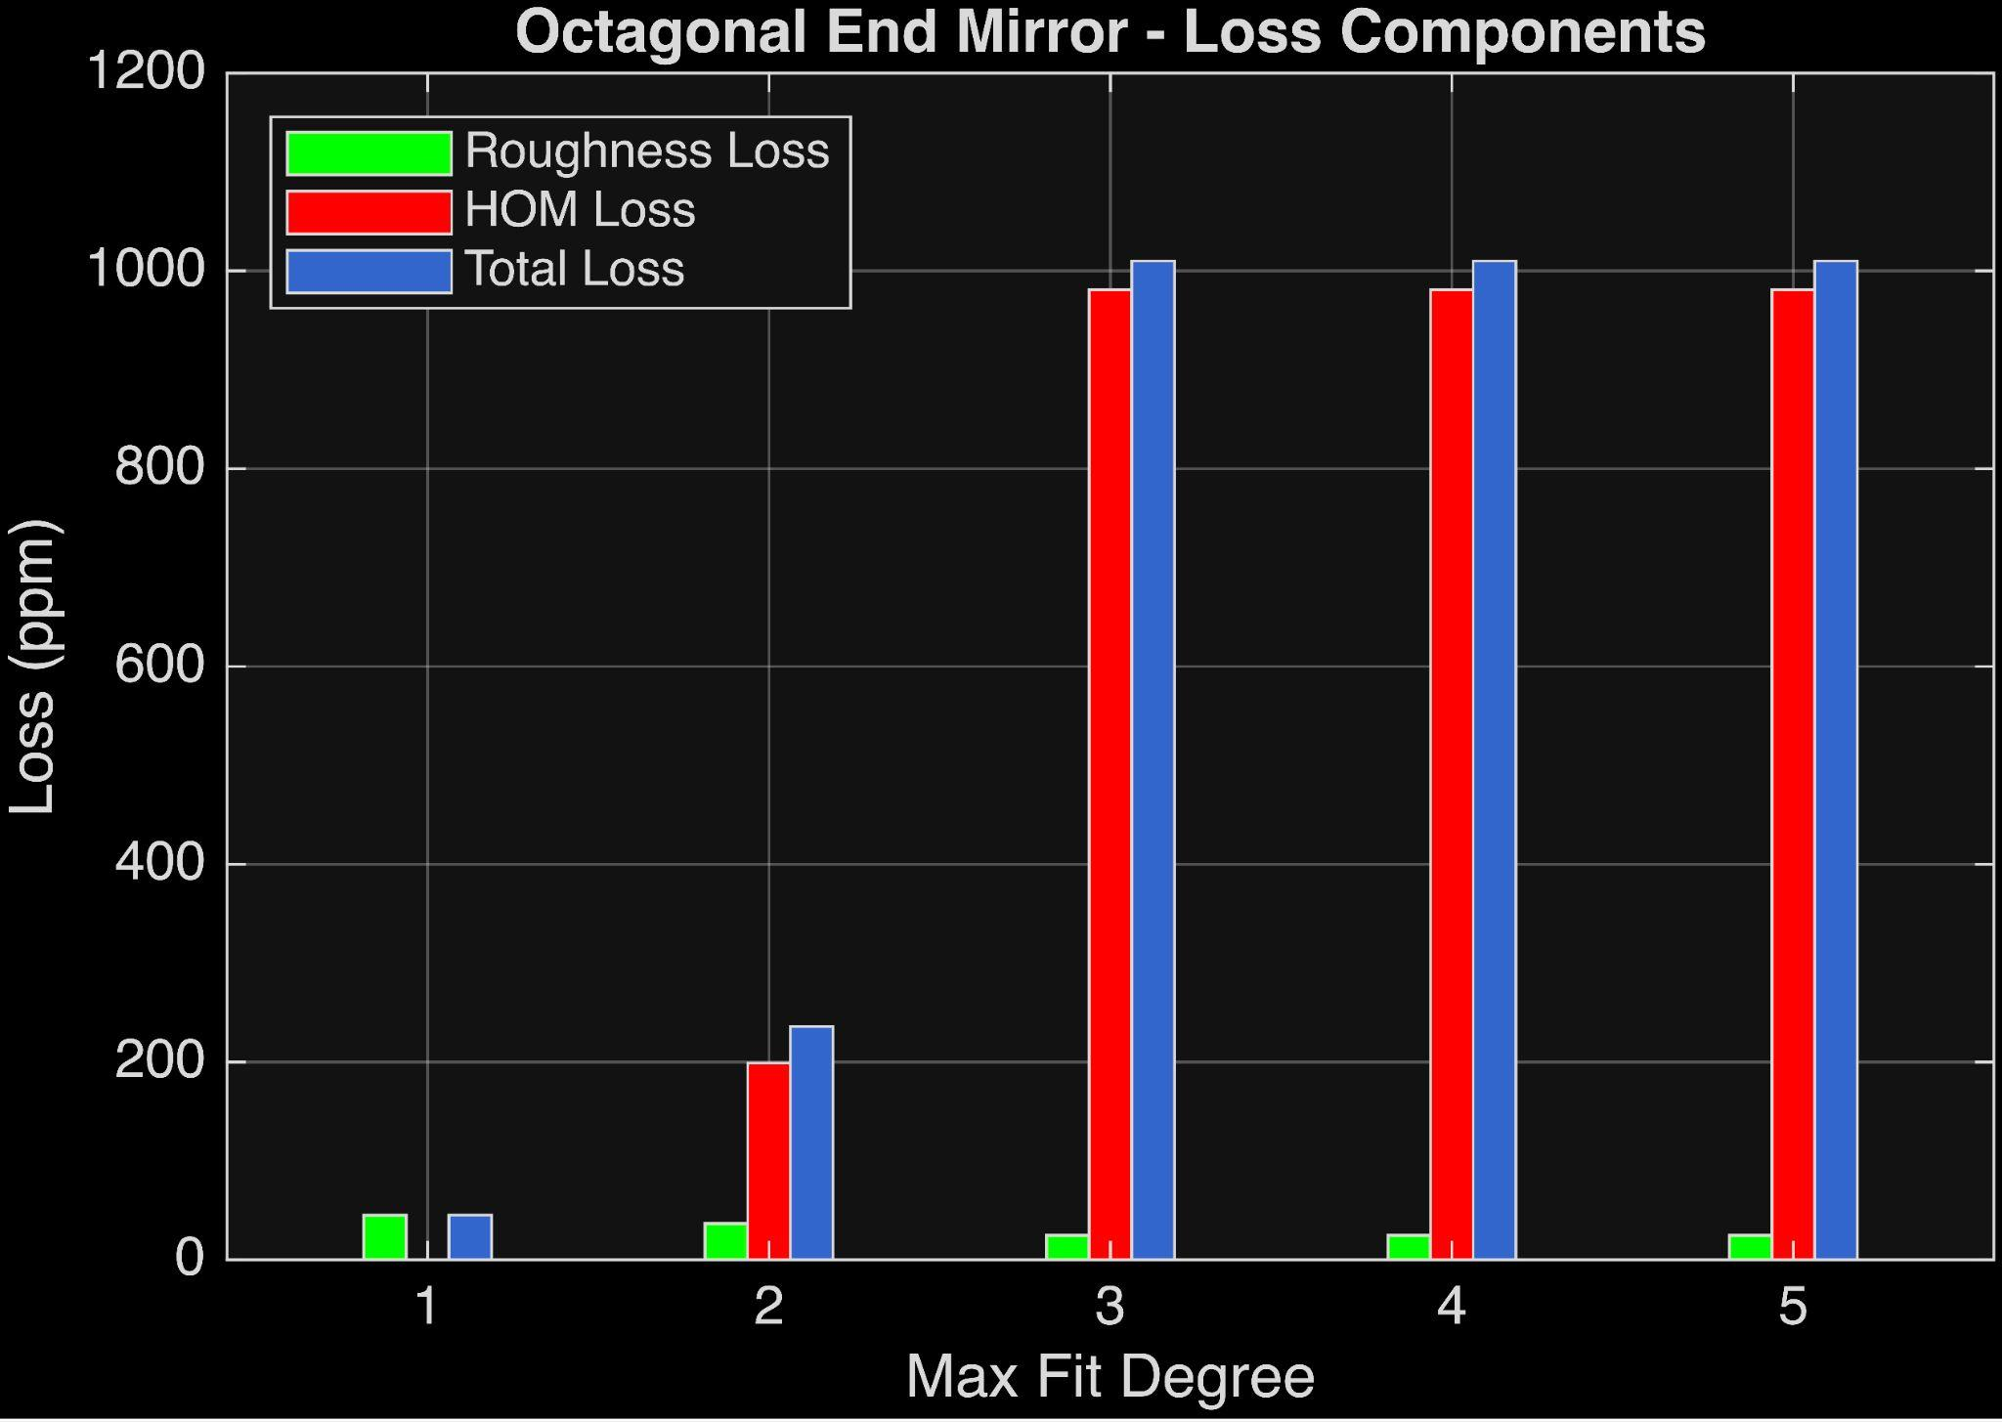
Loss Analysis at Different Fitting

Slide 20
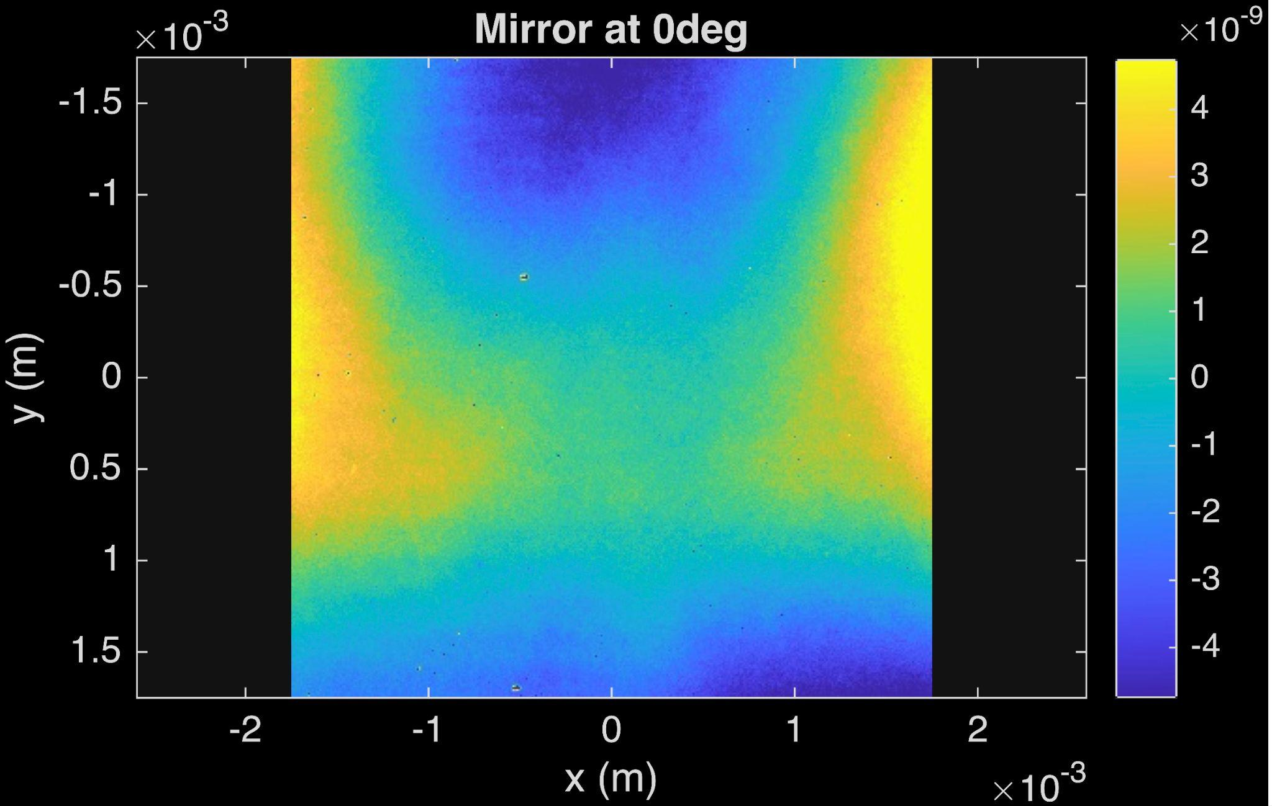
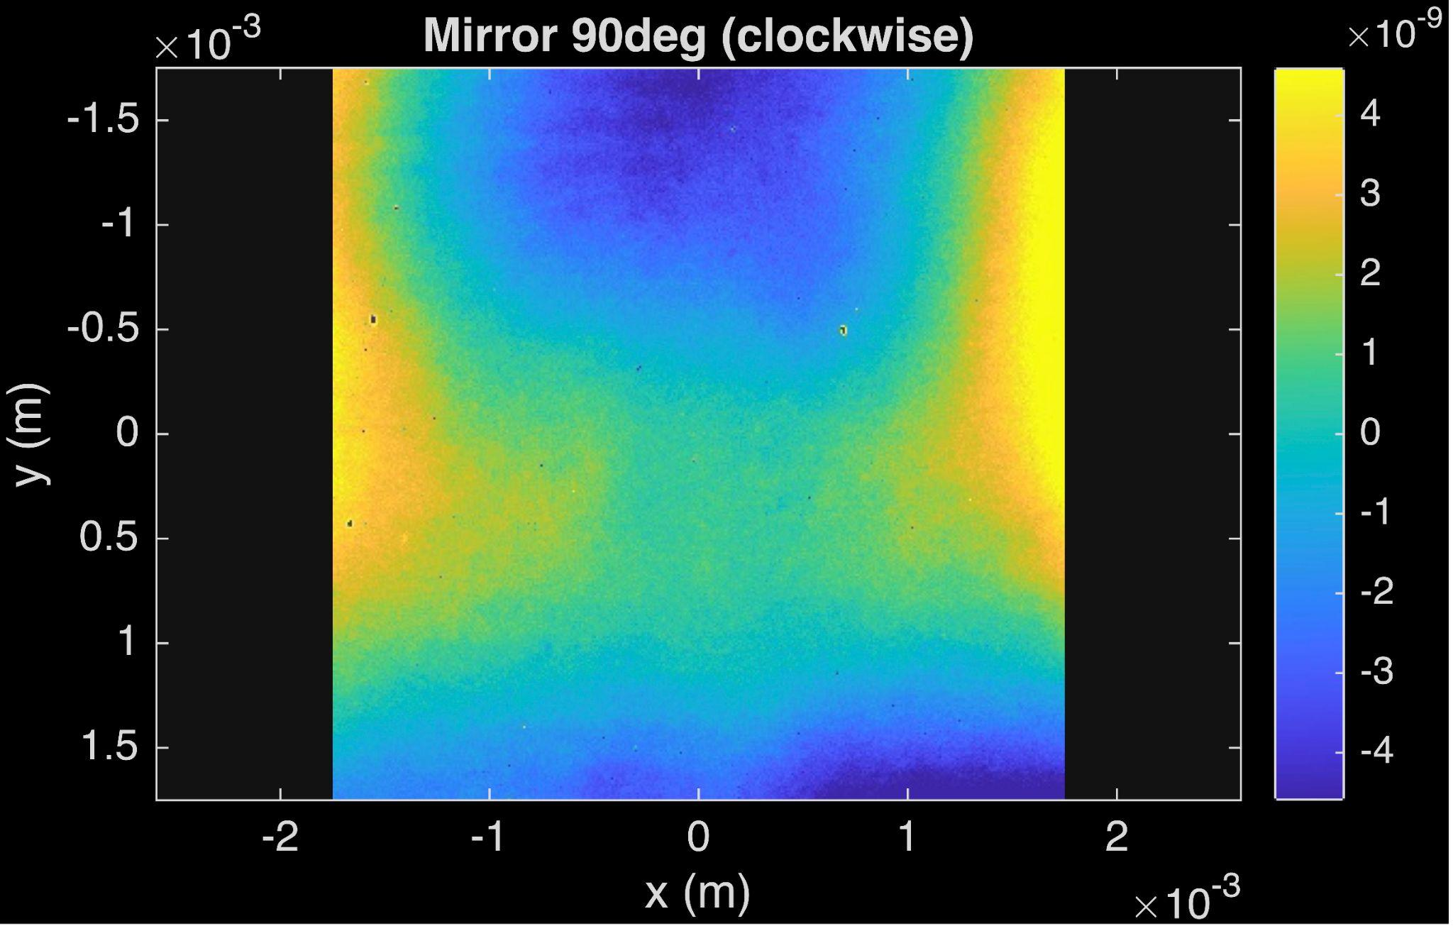
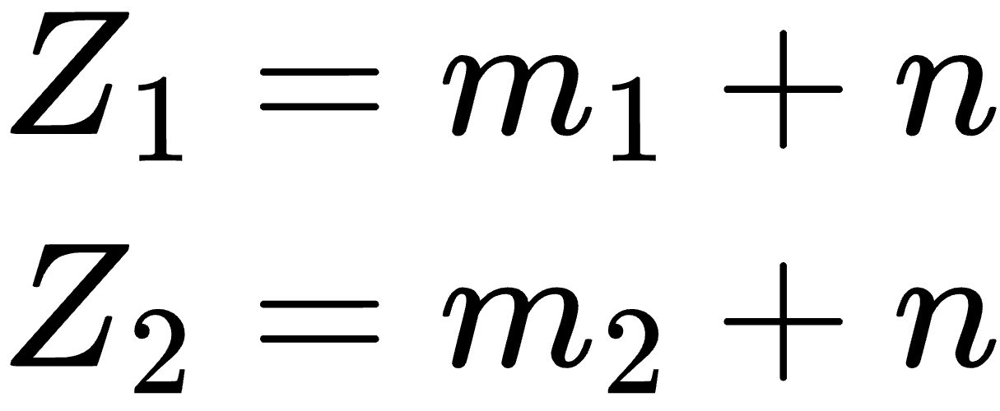
NanoCam Astigmatism 1

Slide 21
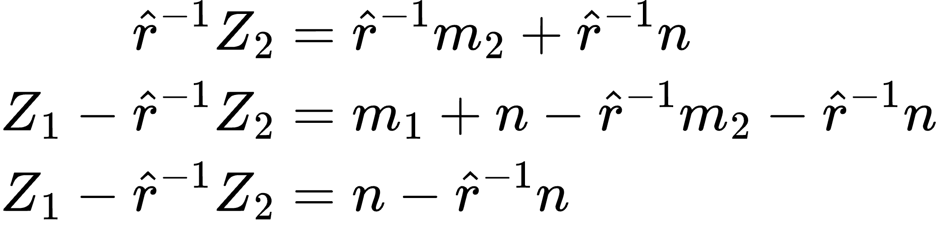
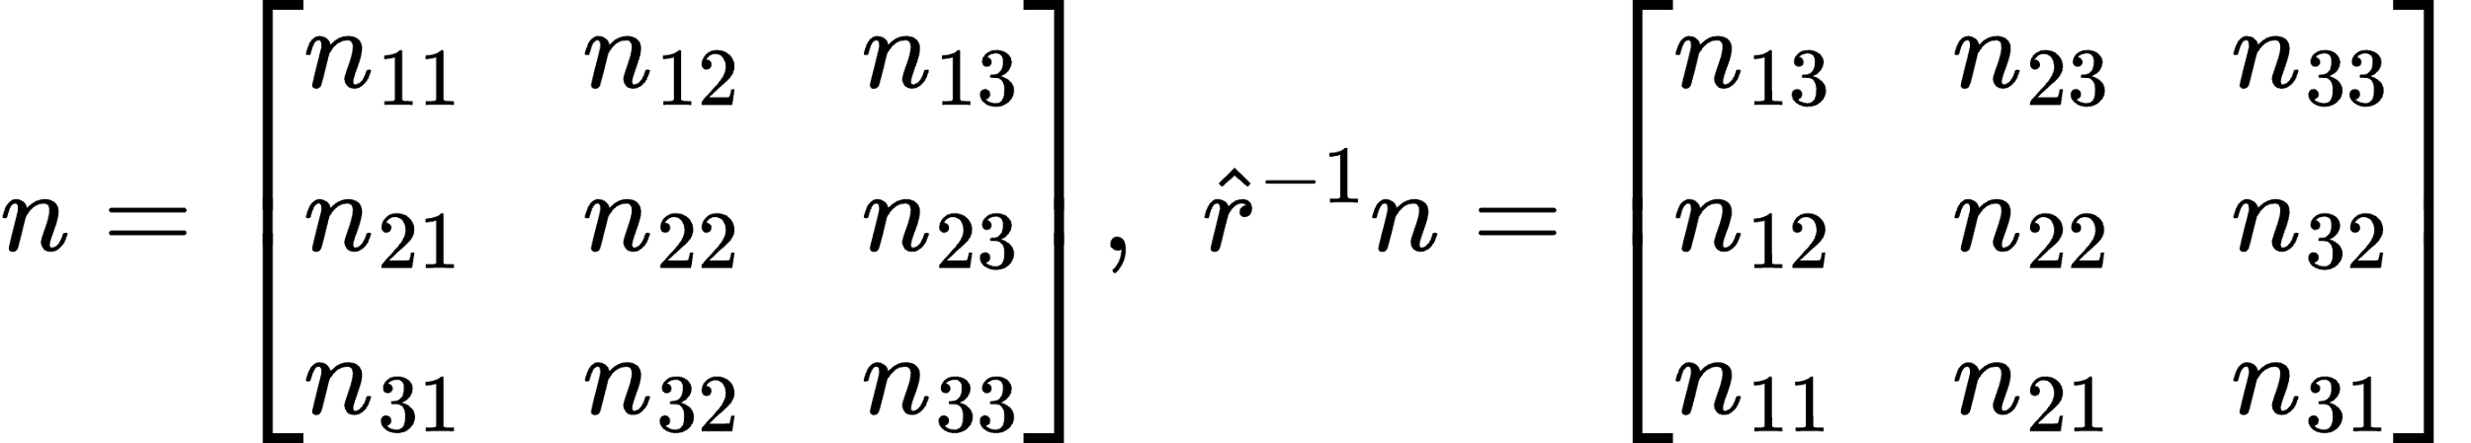
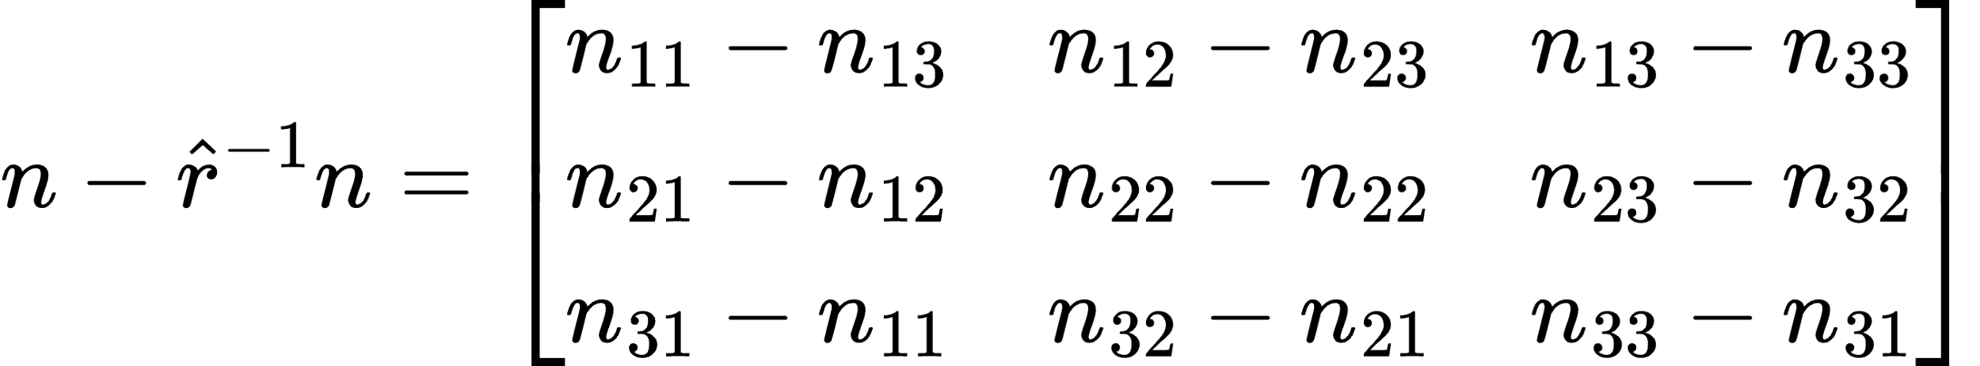
NanoCam Astigmatism 2

Slide 22
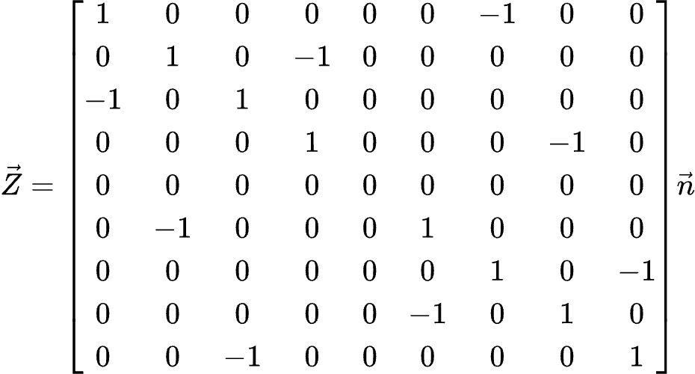
NanoCam Astigmatism 3

Slide 23
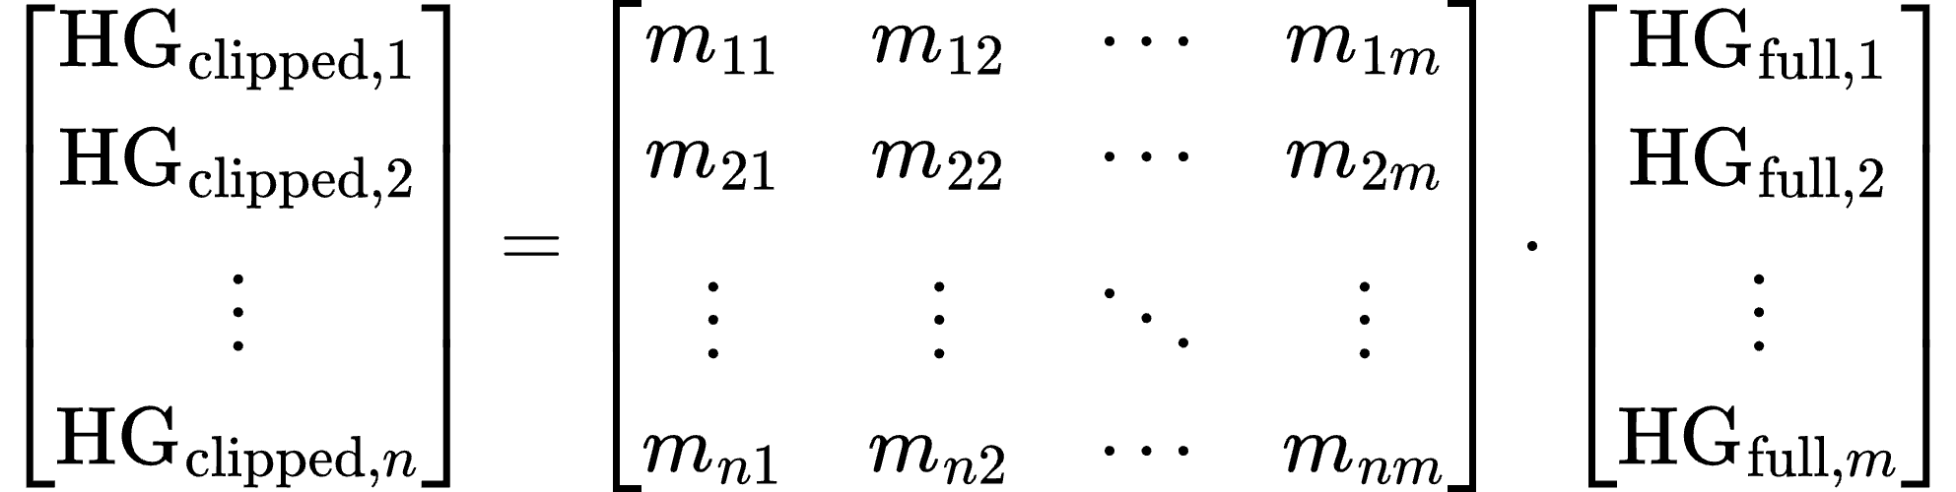

The Matrix Approach 1
The current approach to work around the limited domain of the NanoCam is to work in two
Hermite Gauss bases: HG clipped basis and the HG full basis.
Notes:
The first basis is the clipped HG basis, which will be the coupling coefficients on the NanoCam domain.
The second basis is the full HG basis, which will be the coupling coefficients on an infinite domain.
HG full is what we actually care about

Slide 24


The Matrix Approach 1

Slide 25


Stitching Images Together
Circular Spoked Mirror
Octagonal Spoked Mirror

Slide 26
What NanoCam looks like

