Slide 1

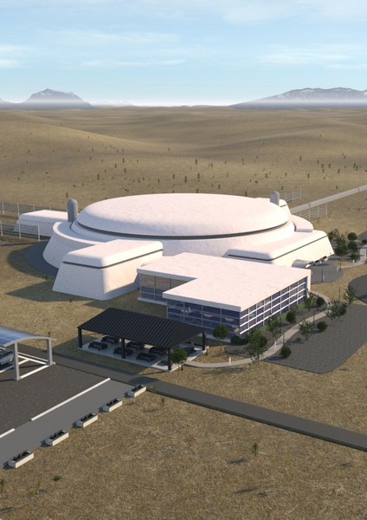


Remote Site Evaluation for
Cosmic Explorer
Tooba Ansar Amherst College
Mentors: Robert Schofield & Michael Landry

Slide 2
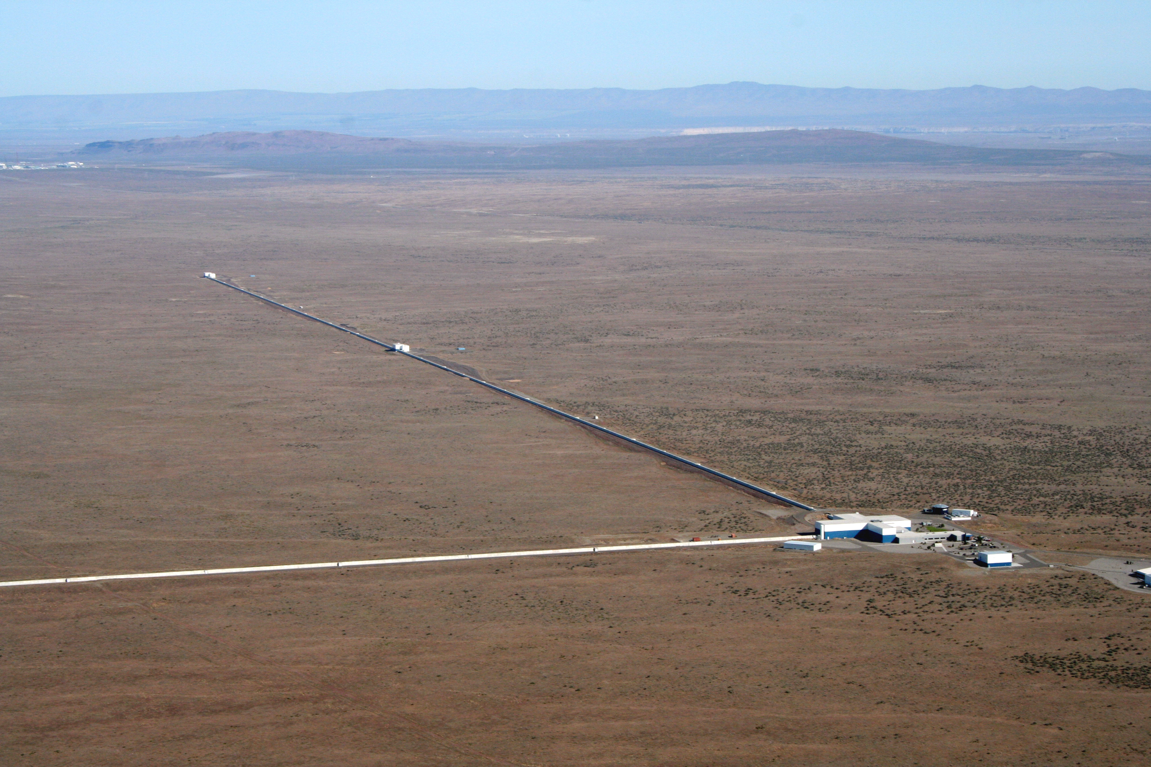
What if LIGO were 10 times longer?
You’d get Cosmic Explorer…
Proposed third-generation gravitational-wave observatory
40 km and 20 km arms in the US
10x as sensitive as A+ Advanced LIGO

Slide 3
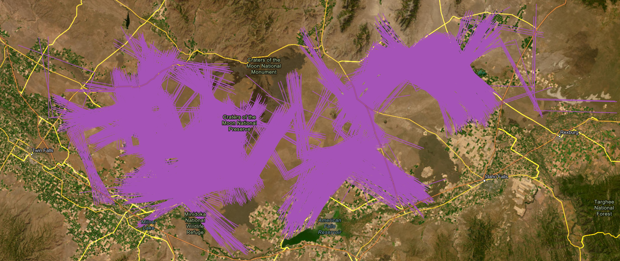
Several hundred sites identified using topological data!
Idaho

Slide 4
Remote evaluation saves resources/time
We look for:
40 km of land clearance
Anthropogenic sources of noise
  Vehicles
  Rail lines
  Roads
  Powerlines

Slide 5
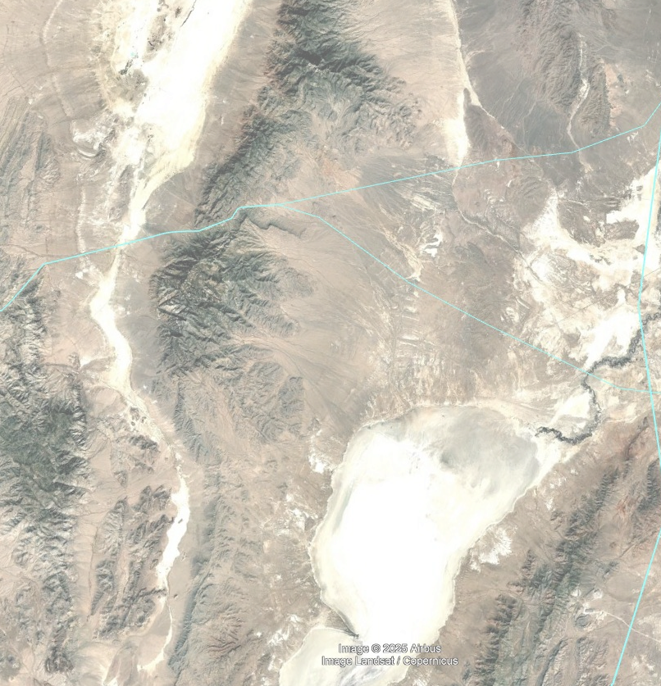
Visual Evaluation of Sites
Fictional, not to scale
Used Google Earth Pro to survey 7 potential sites
Cars, roads, rail tracks, and power lines
Buildings
Painstaking and prone to error
Need something scalable and efficient

Slide 6
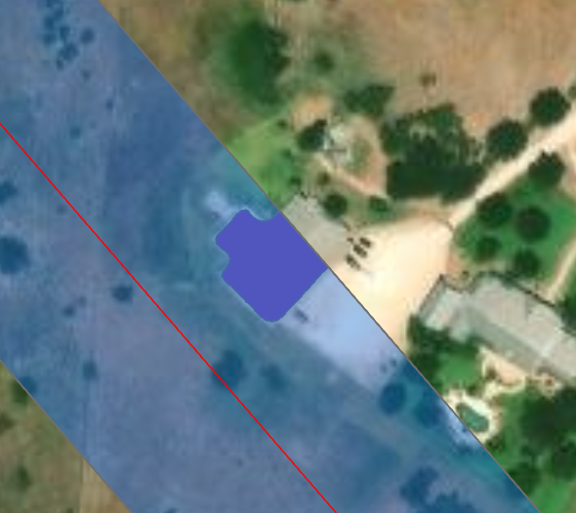
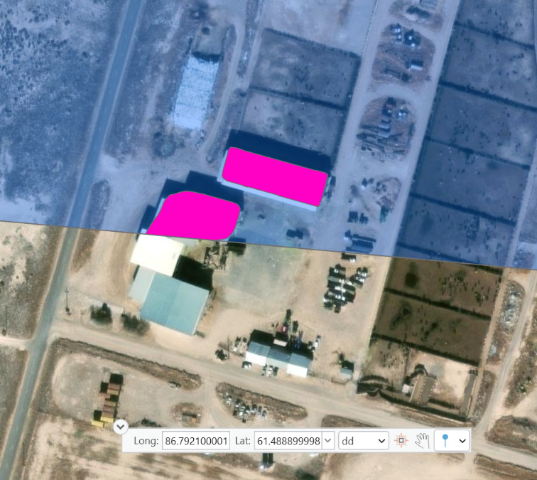
Finding a GIS solution
Challenges with training our own deep learning model
Computing power
Input resolution
Accuracy
Pretrained ArcGIS models

Slide 7
Switching gears again…

Slide 8
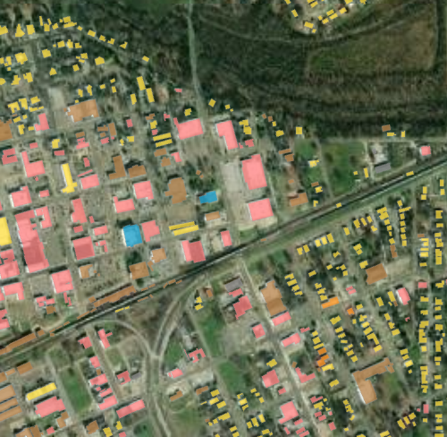
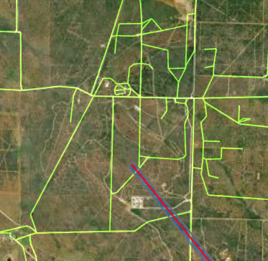

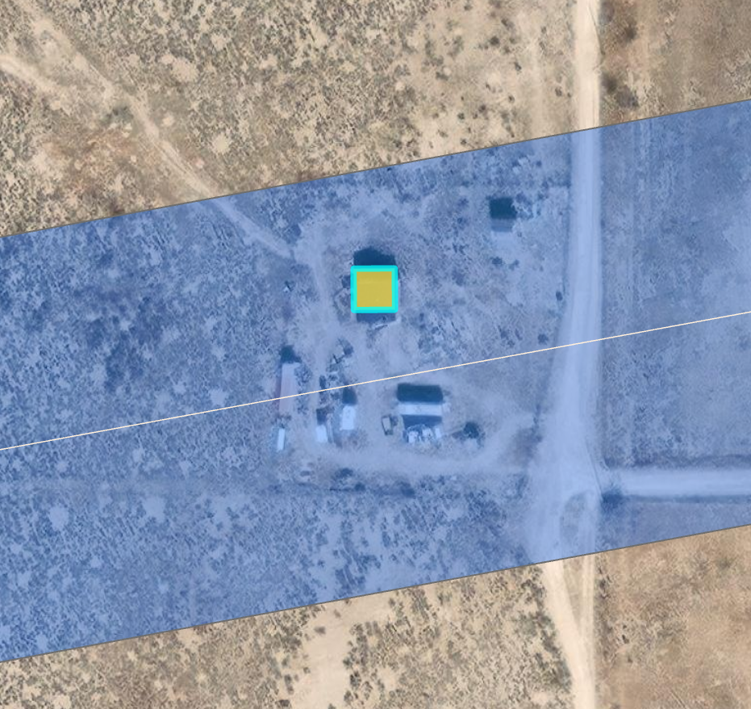
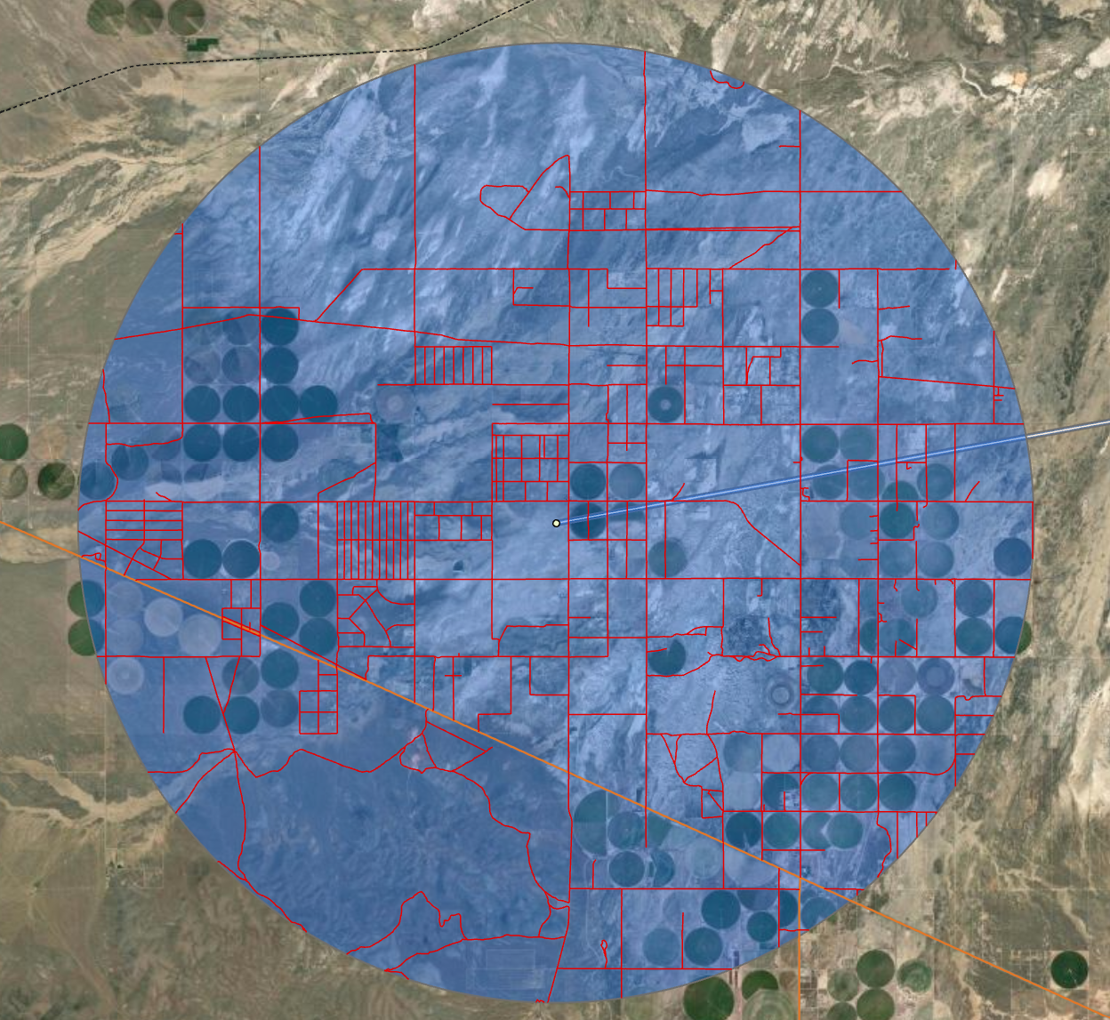
Buildings
Transportation
Spatial Filtering
Publicly available vector datasets

Slide 9
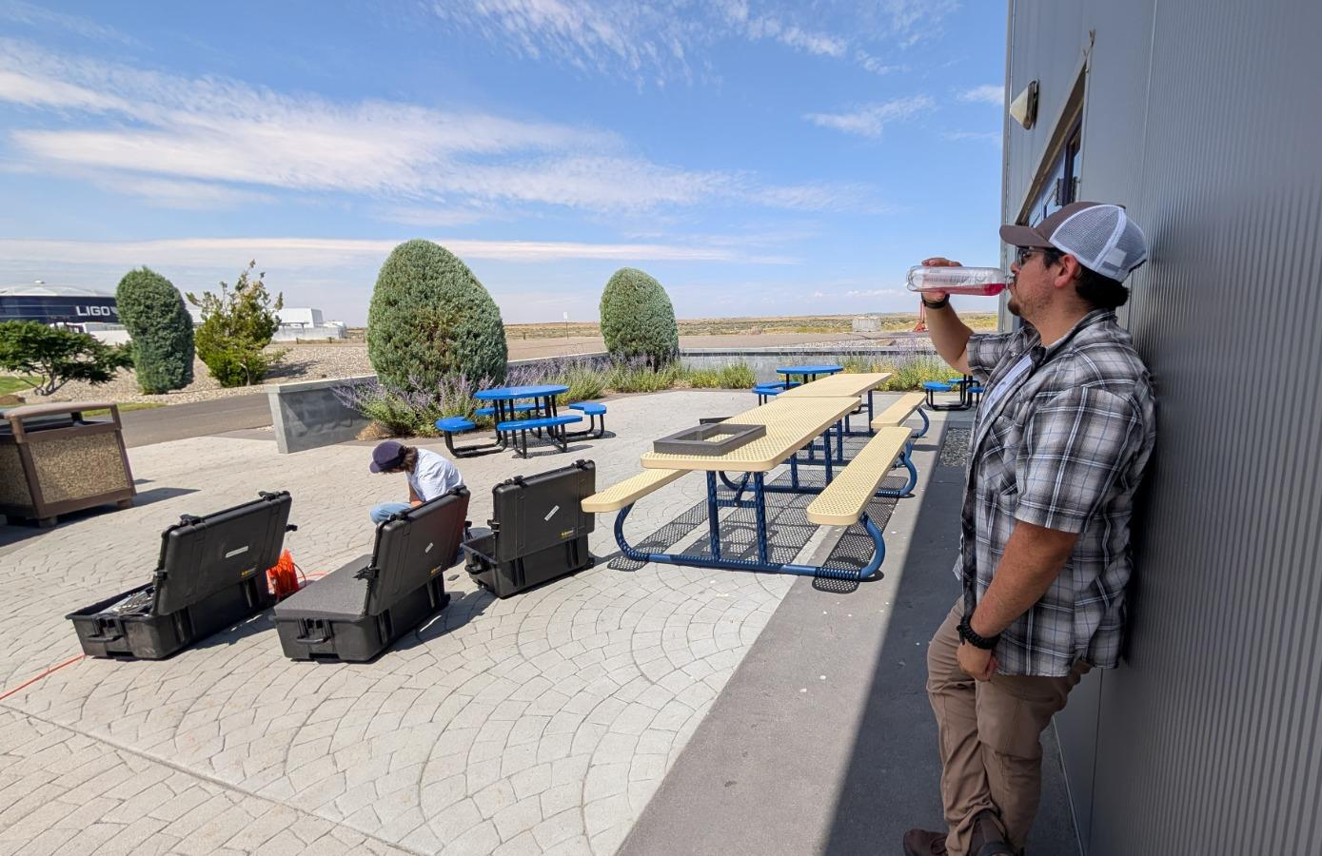
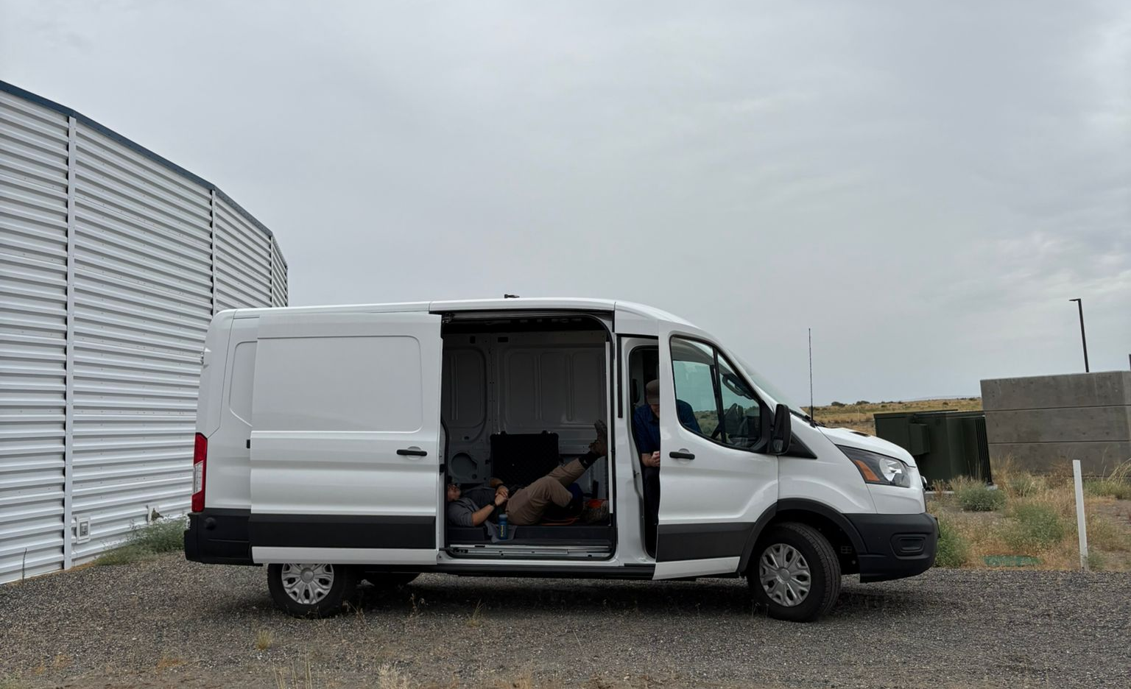
We are collaborators…
Exhibit A
Exhibit B

Slide 10

We are collaborators…
GitHub repository
The problem
  Cost for a large collaboration
  Web-based sharing
  Large-scale, automated workflows
The solution → API for ArcGIS in Python
  Libraries for scripting and automation of spatial analysis
  Sharing within and between organizations
  Accessible

Slide 11
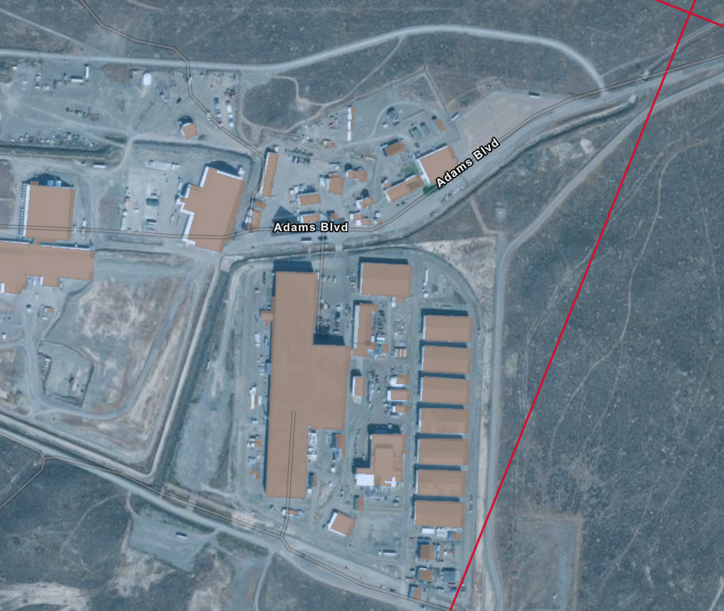
API Framework
KMLs of clusters with several thousand sites
Buildings vector dataset
Building identification, counts, and coordinates to csv

Slide 12
Building identification, counts, and coordinates to csv
New KMLs of sites with no buildings
Transportation vector dataset
Mapping kilometers of transportation lines to csv

Slide 13
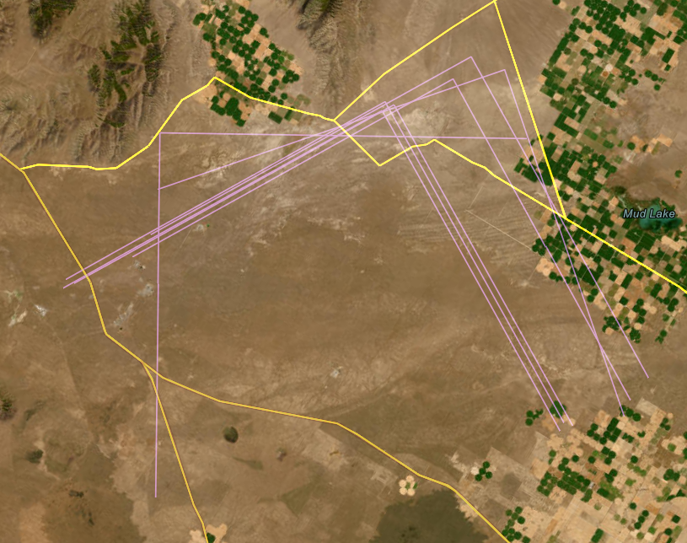
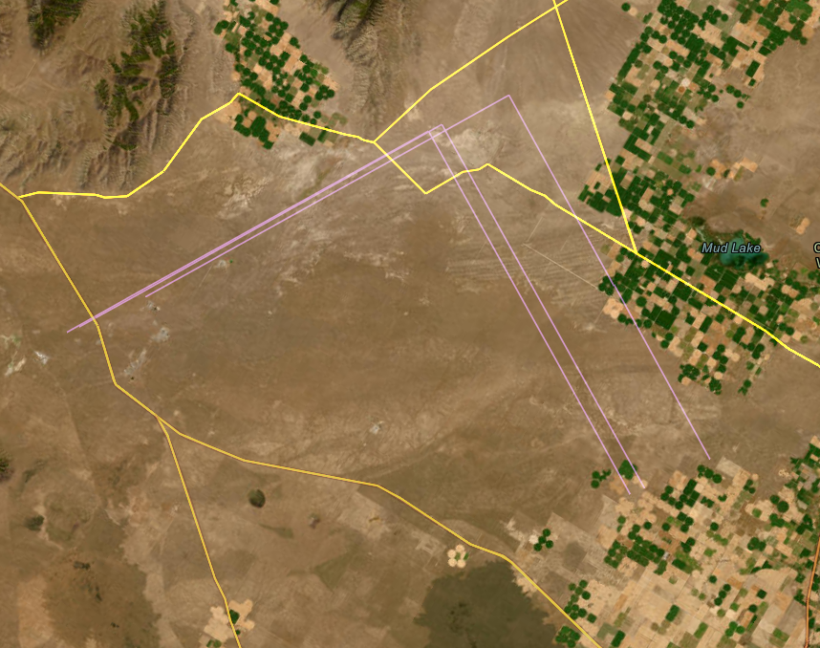
Filtered KMLs
7 sites
3 sites
Idaho
Idaho
All sites in a cluster
Filtered to those with no buildings

Slide 14
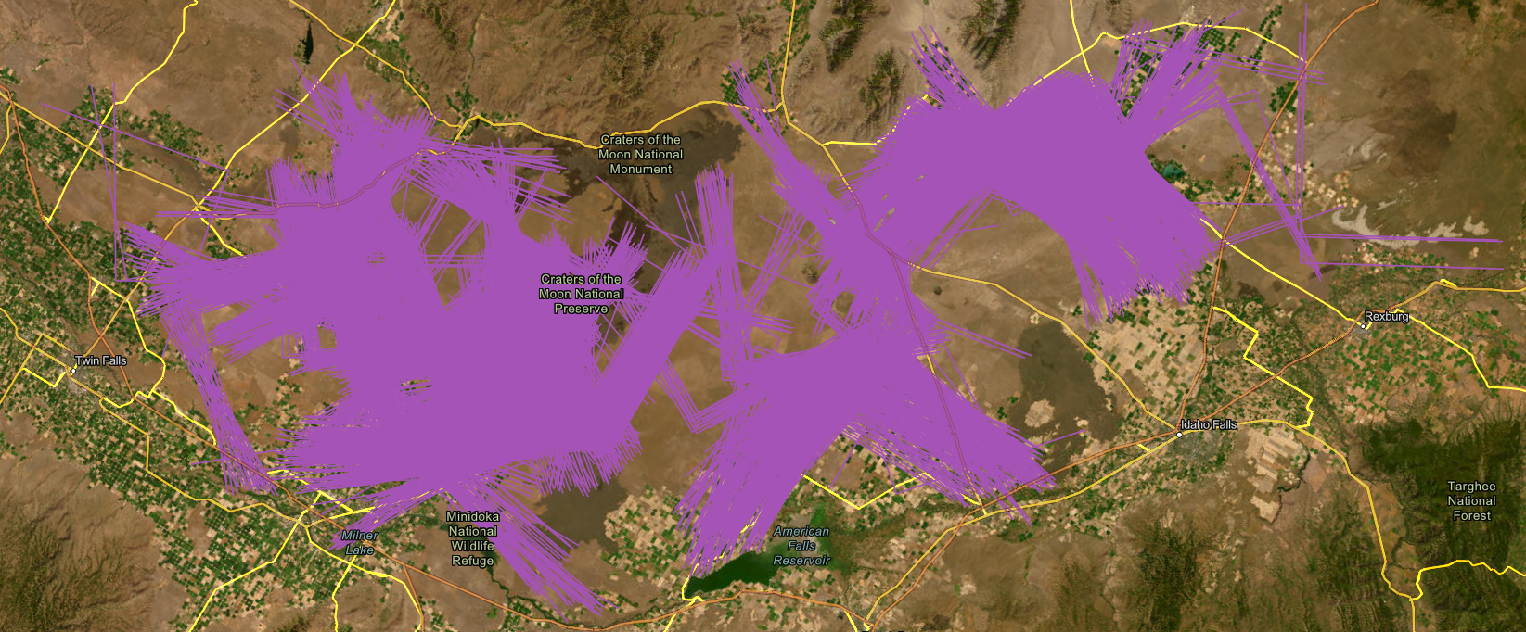
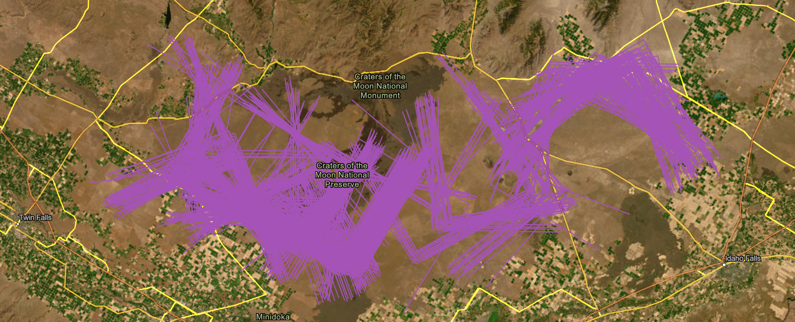
2183 sites
Idaho
598 sites
Idaho

Slide 15
Where do we go from here?
The API is the first filter in the narrowing down of sites
Cluster → sites with no buildings → new KML → km of roads near stations
Faster and accurate than visual inspection, reducing time for initial site assessment
This framework can be adapted for automation of further stages
  Measuring distances between stations and sources of noise
  Mapping power lines
Notes:
Looking at the bigger picture, once we’re through with the remote evaluation, we will begin on site testing using the kits that the SURFs from last year made and I’ve worked on for a bit. Then, there’ll be some politics that will result in the selection of a site, once a site is selected, construction will begin in the early 2030s, and CE is projected to make its first detection halfway through the next decade.
Cosmic Explorer can detect stellar-mass black hole mergers from when the universe was less than 500 million years old. Understanding how the universe made the first black holes, and how these first black holes grew, is one of the most important unsolved problems in astrophysics. Cosmic Explorer will detect gravitational waves from binary black holes and neutron stars out to the edge of the visible universe. Evidence for first stars by detecting black hole mergers in their wake.

Slide 16
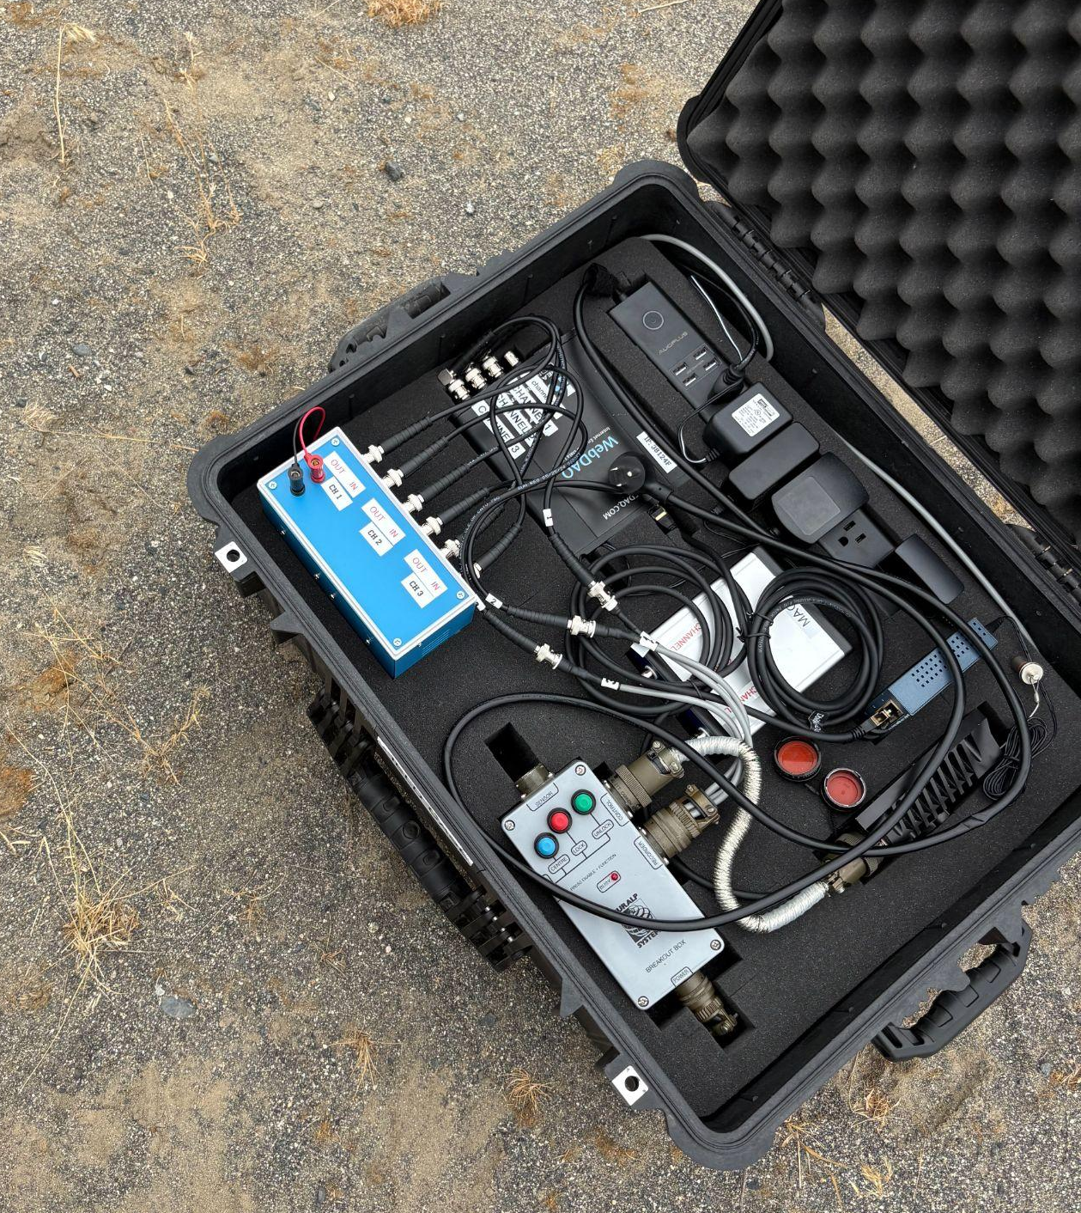
Bigger picture!
On-site testing with seismometer and magnetometer kits
  Tested them this summer
  Improved instruction manual
  Measurements in Idaho on identified sites
Site evaluation
Development
Design
Construction
Operation
2020
2025
2030
mid-2030s
Notes:
Looking at the bigger picture, once we’re through with the remote evaluation, we will begin on site testing using the kits that the SURFs from last year made and I’ve worked on for a bit. Then, there’ll be some politics that will result in the selection of a site, once a site is selected, construction will begin in the early 2030s, and CE is projected to make its first detection halfway through the next decade.
Cosmic Explorer can detect stellar-mass black hole mergers from when the universe was less than 500 million years old. Understanding how the universe made the first black holes, and how these first black holes grew, is one of the most important unsolved problems in astrophysics. Cosmic Explorer will detect gravitational waves from binary black holes and neutron stars out to the edge of the visible universe. Evidence for first stars by detecting black hole mergers in their wake.

