Slide 1
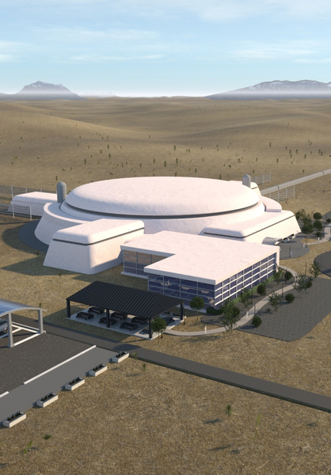


Remote Site Evaluation for
Cosmic Explorer
Tooba Ansar
Mentors: Robert Schofield & Michael Landry

Slide 2
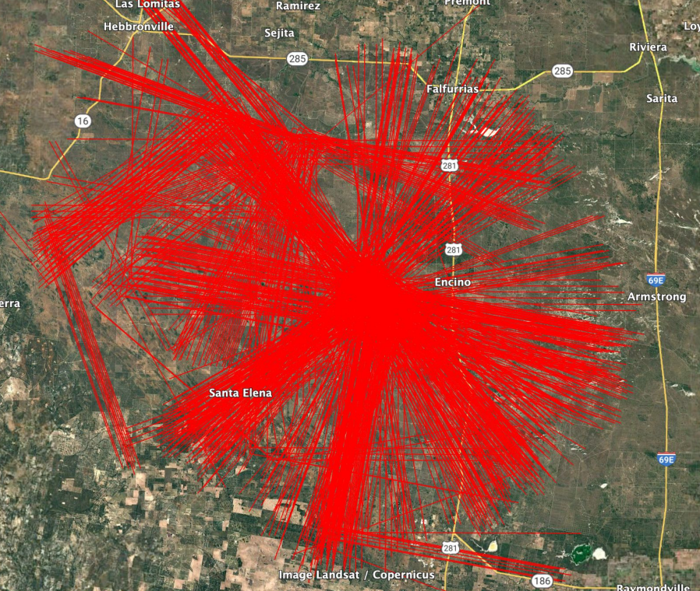
Cosmic Explorer
Several hundred sites identified using topological data!
Proposed third-generation GW observatory
40 km and 20 km arms
10x as sensitive as A+ Advanced LIGO
Ambient seismic, acoustic, electromagnetic, and environmental noise limit sensitivity
Remote evaluation saves resources/time
40 km of land clearance
Anthropogenic sources of noise

Slide 3
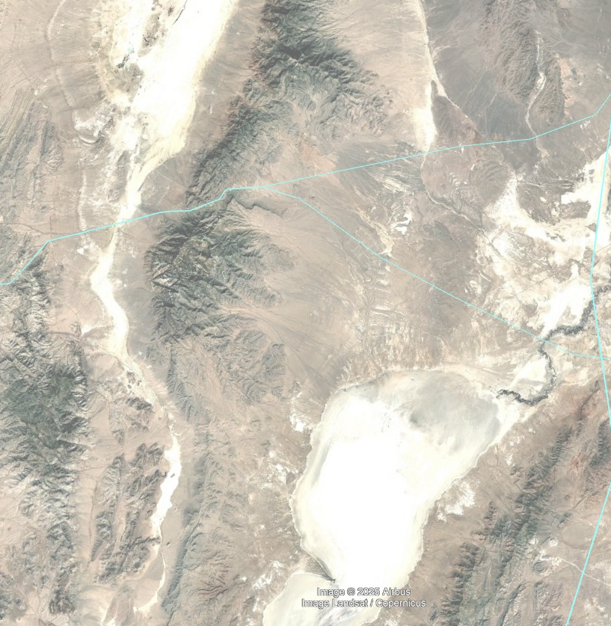
Visual Evaluation of Sites
Fictional, not to scale
Used Google Earth Pro to survey 7 potential sites
Cars, roads, rail tracks, and power lines
Buildings
Painstaking and prone to error
Need something scalable and efficient

Slide 4
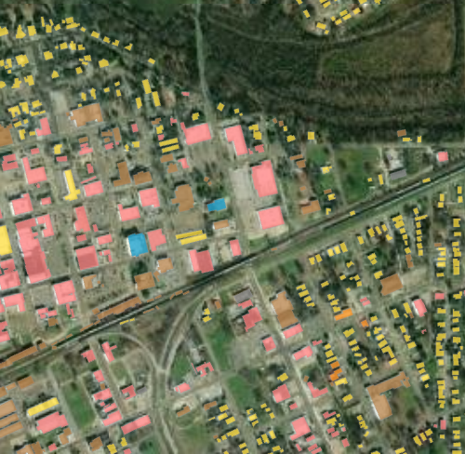
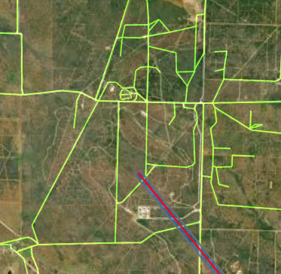
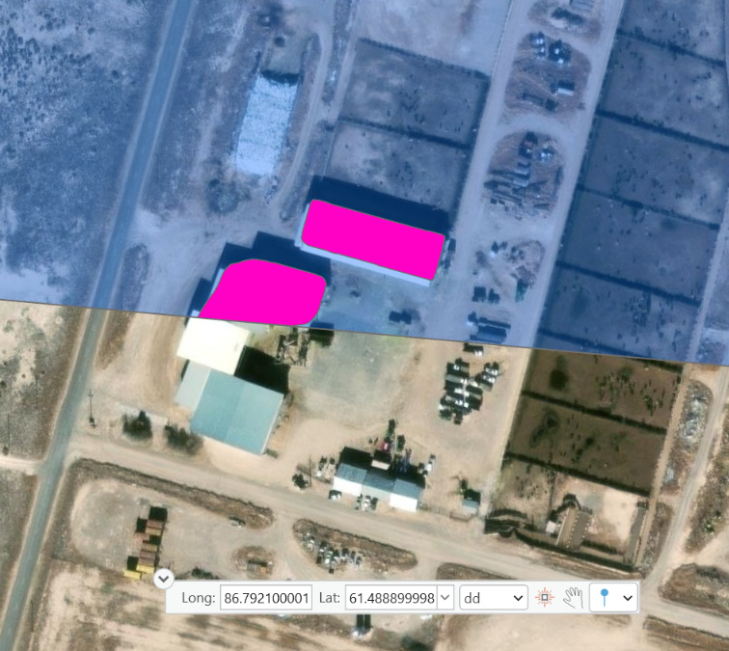
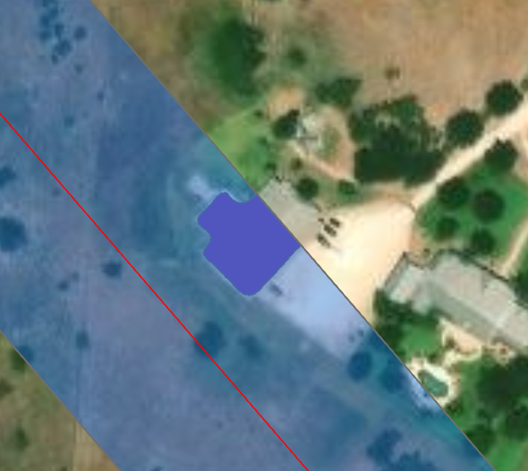
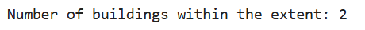
Finding a GIS solution
Considered training our own DL model
Buildings
Roads (including gravel)
Pretrained ArcGIS models
Computing power
Input resolution
Accuracy
Publicly available vector datasets
Success!

Slide 5
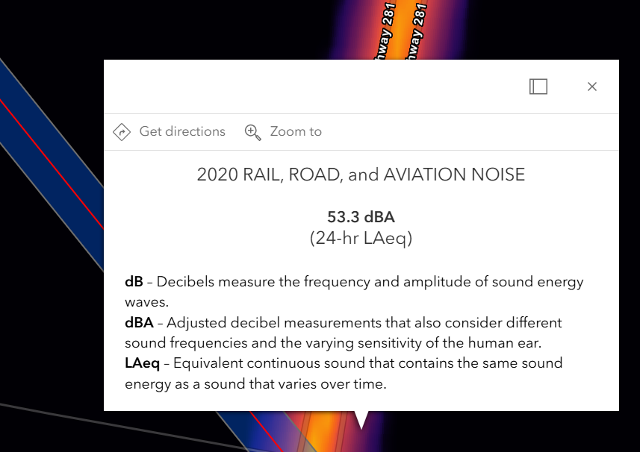
Looking ahead…
Vehicle detection
  Raster data on noise levels
  Trucks vs. smaller vehicles
  Computing power
Mapping total km of roads around CE station
  A programming problem
Rails on each rail road
  Trainspotters (dubious)
Robust wind data
  Contacting NOAA

