Slide 1




Cavity Enhanced Sum Frequency Generation
Amarnath
Mentors: Francisco Salces Carcoba, Rana Adhikari

Slide 2
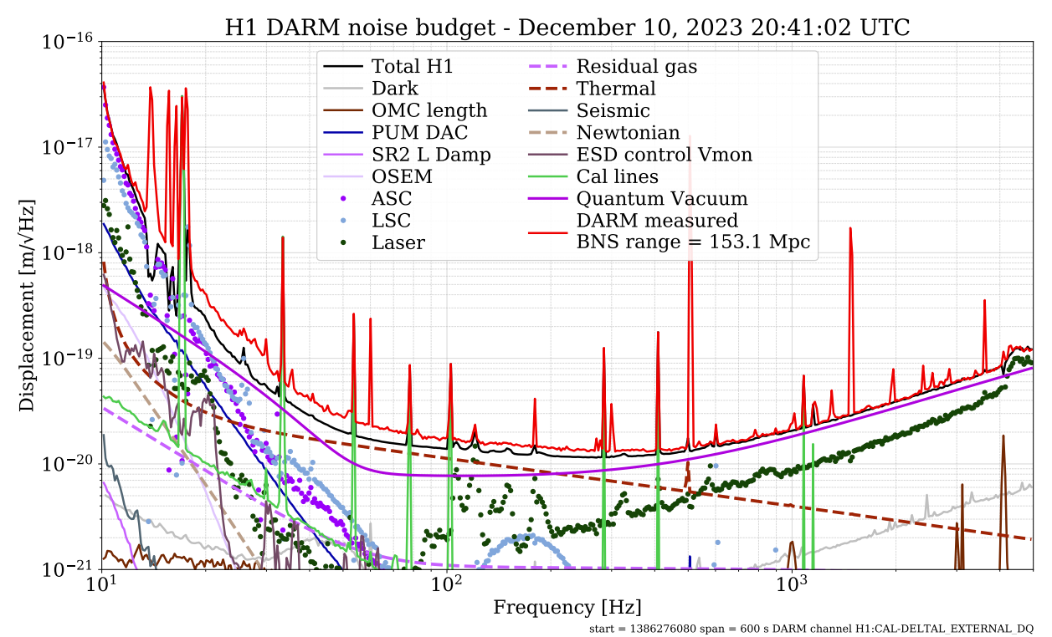
Introduction
Sensitivity of LIGO
Thermal Noise

Slide 3
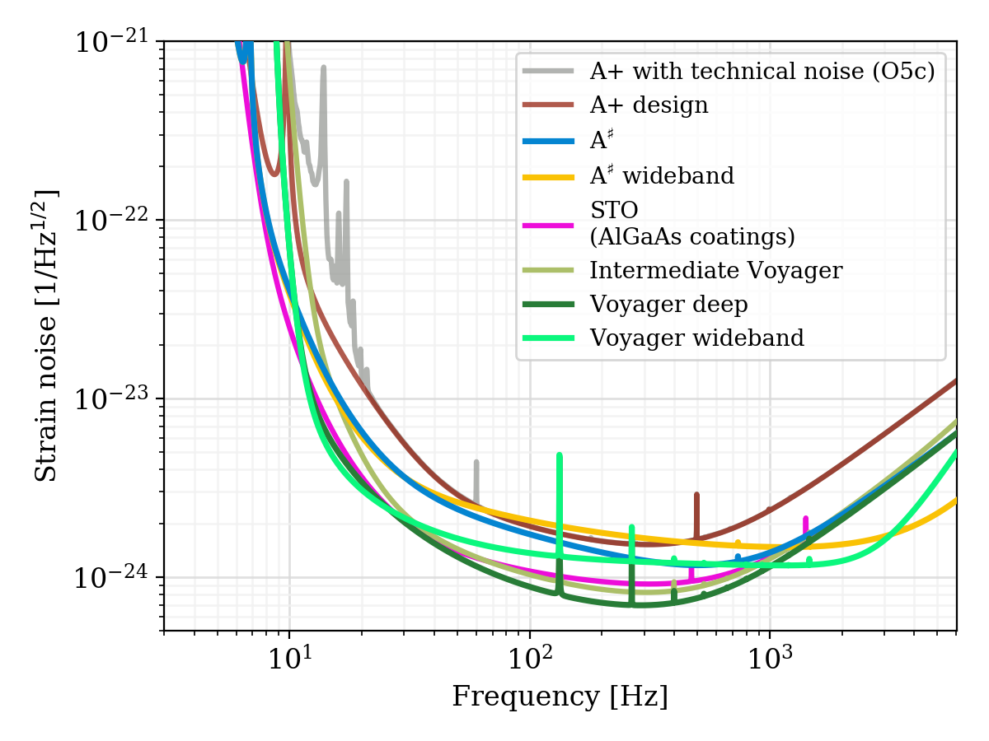
Future LIGO Upgrades
LIGO Voyager Upgrade
Fused Silica
Crystalline Silicon
1064 nm
2 Micron
Cryogenic cooling

Slide 4
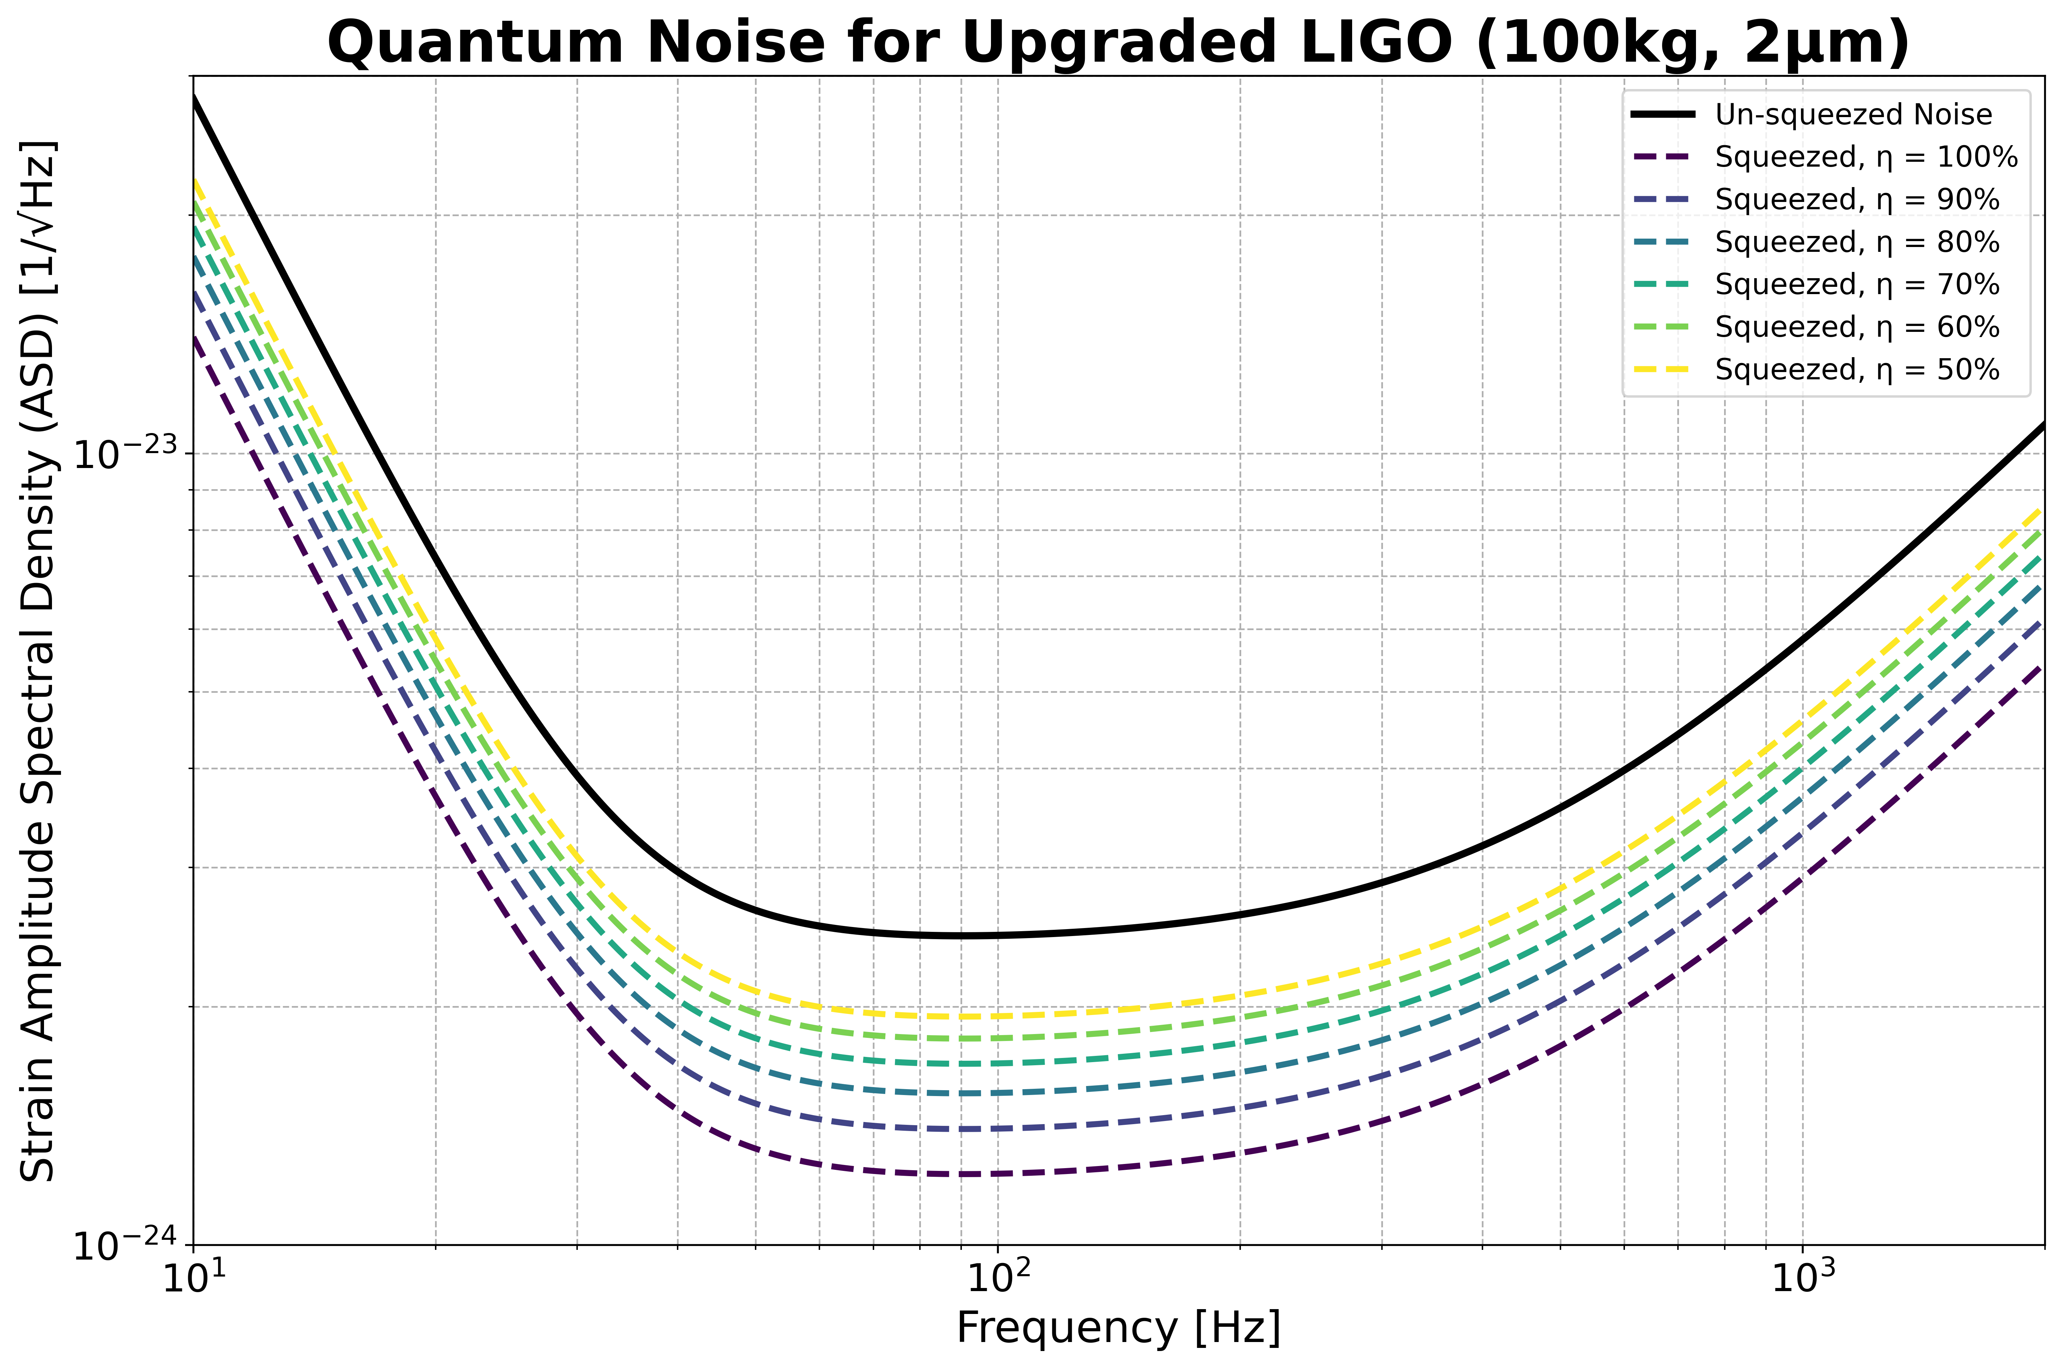
Motivation
Low Quantum Efficiency of Photo detectors at 2 micron
Indirect Detection of 2 um.
Using Sum Frequency Generation

Slide 5

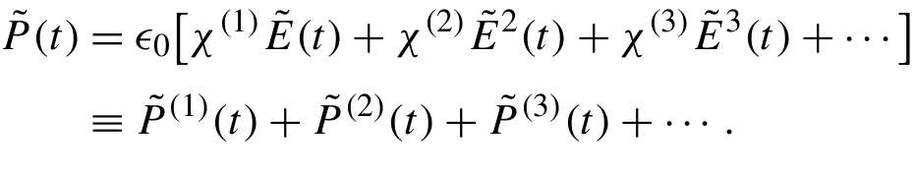
Sum Frequency Generation
In conventional Optics: Polarization depends linearly on Electric field.
Non-linear materials: Higher order dependence are considerable.
Second Harmonic Generation.
Difference frequency Generation.
Sum frequency generation.

Slide 6
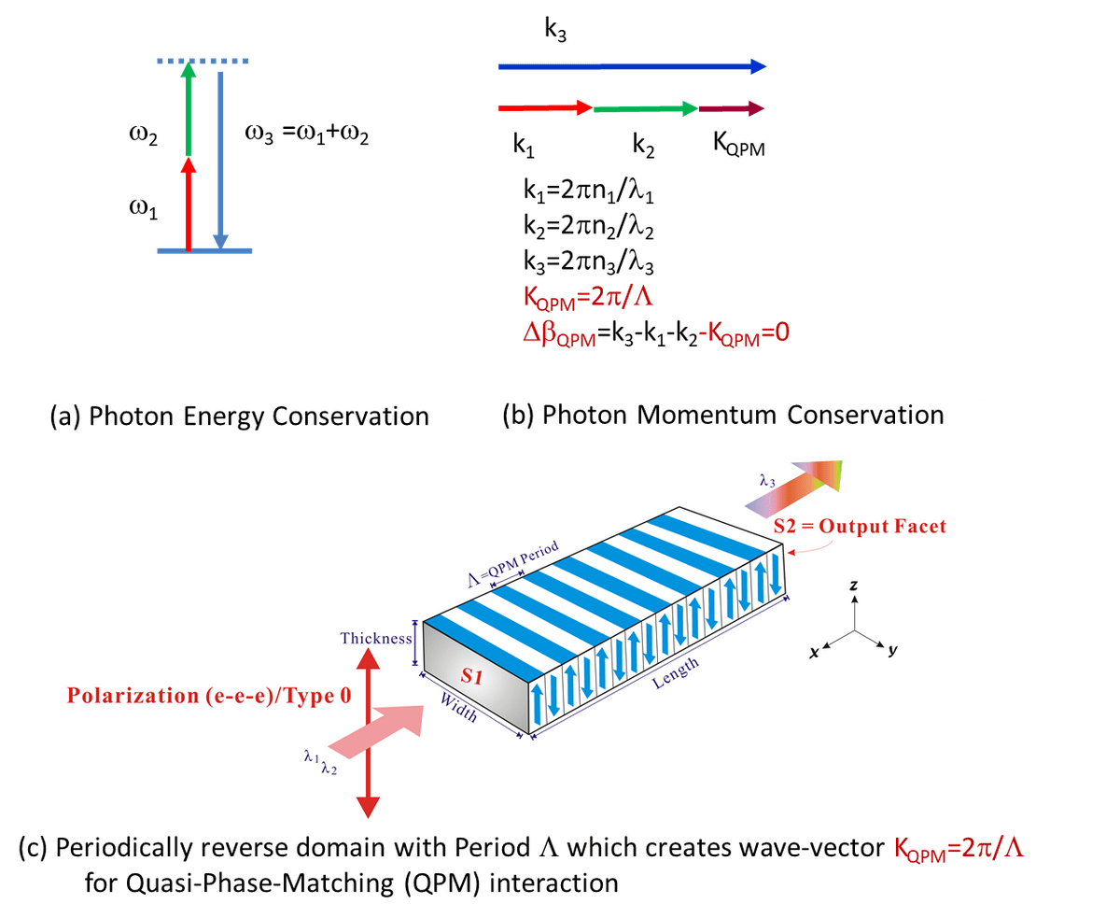
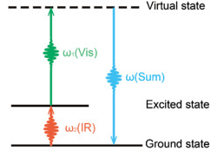

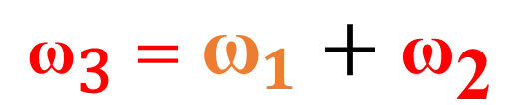

Sum Frequency Generation
$${\text{ω}}_{1}$$
$${\text{ω}}_{\text{3}}={\text{ω}}_{1}+{\text{ω}}_{\text{2}}$$
$${\text{ω}}_{\text{2}}$$
Periodically Poled Lithium Niobate

Slide 7
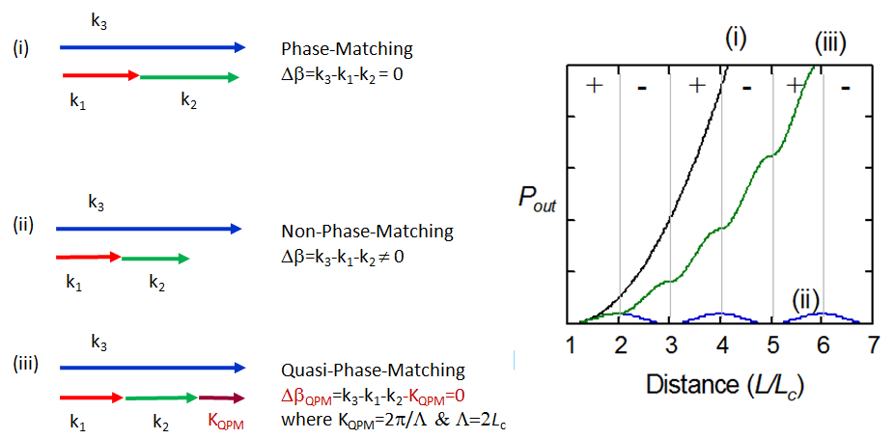

Sum Frequency Generation
Power output
Periodic poling
Flip in the sign of
After every coherence length
The distance over which the accumulated phase difference of mixing waves reaches π is the "coherence length" L_{c}

Slide 8
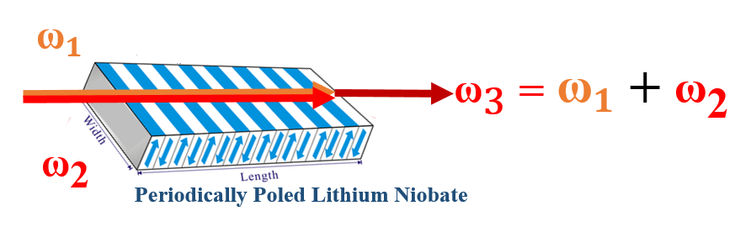
Recap
Low Quantum Efficiency of Photo detectors at 2 micron
Indirect Detection of 2 um.
Setting up Sum Frequency Generation.

Slide 9


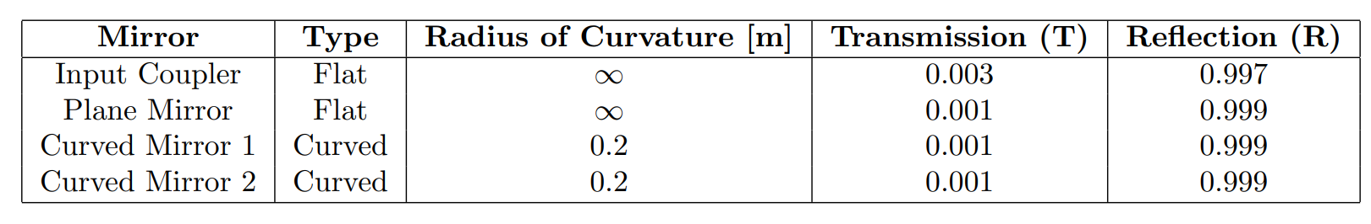
Bowtie Cavity Setup
Transmission Photo detector
Reflection Photo detector
Plane Mirror
Input coupler
Plane Mirror
1064 nm LASER
Pump
Infrared Camera
700 nm Up conversion
2 Micron LASER
20 mm × 10 mm × 0.5mm
Periodically poled
Lithium Niobate
Curved Mirror 1
Signal
Curved Mirror 2

Slide 10
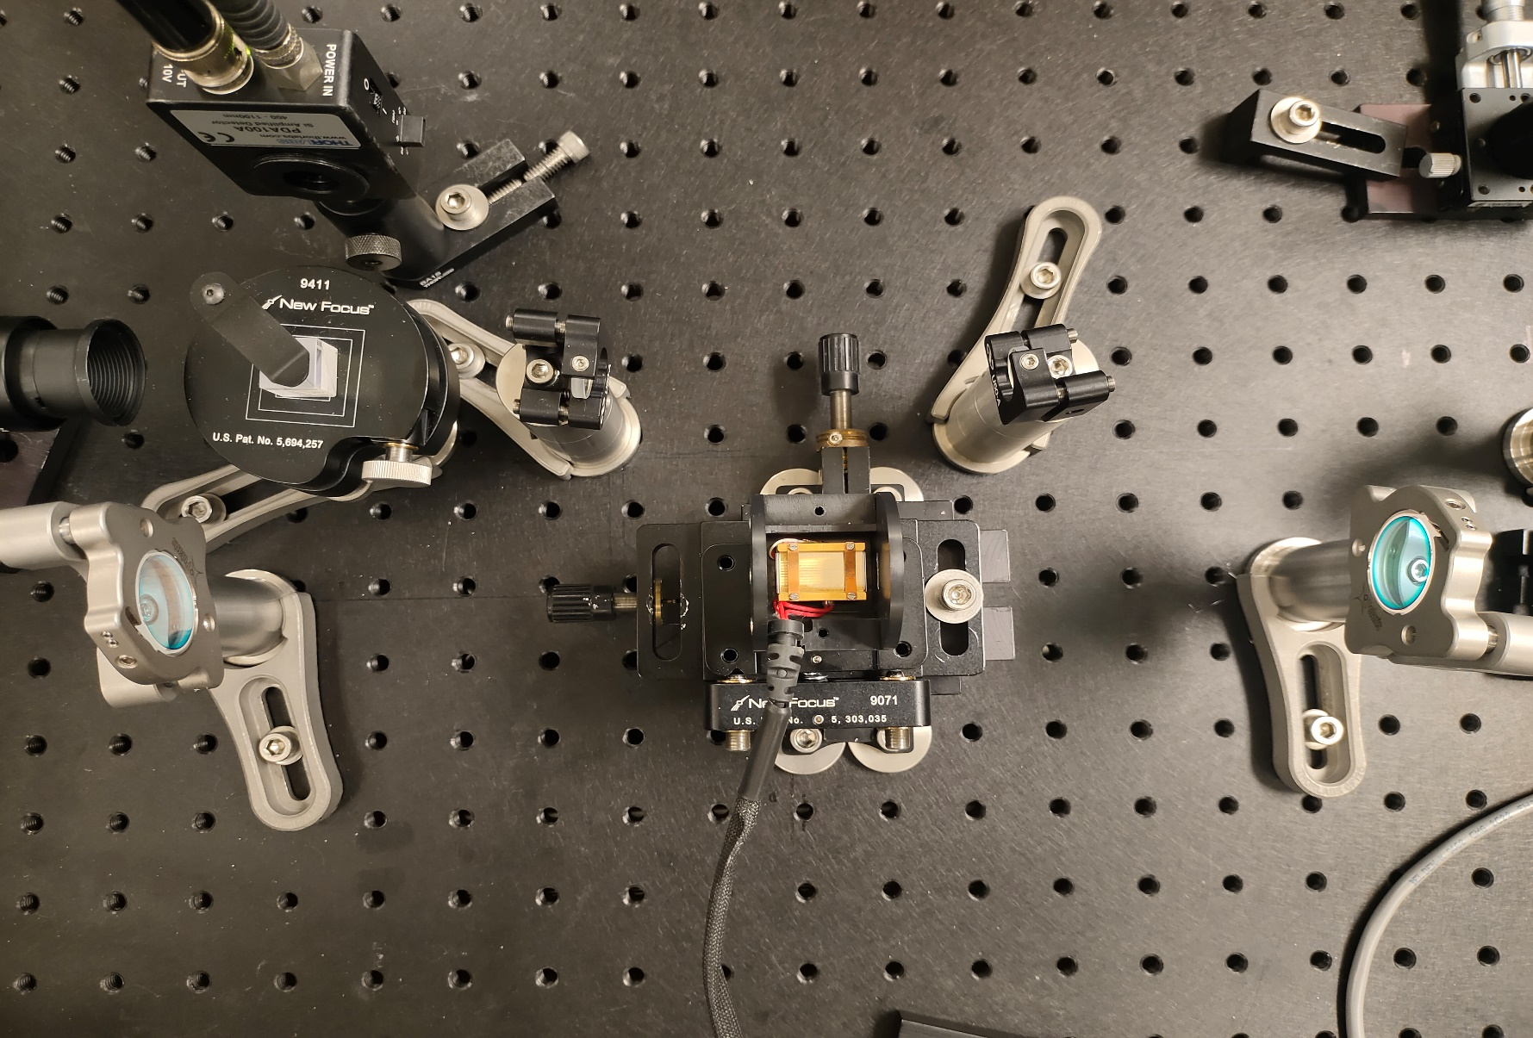
Bowtie Cavity Setup
Transmission Photo detector
Plane Mirror
Plane Mirror
Input coupler
Infrared Camera
Curved Mirror 1
Curved Mirror 2
Periodically poled
Lithium Niobate

Slide 11
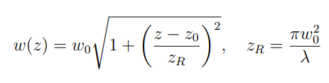

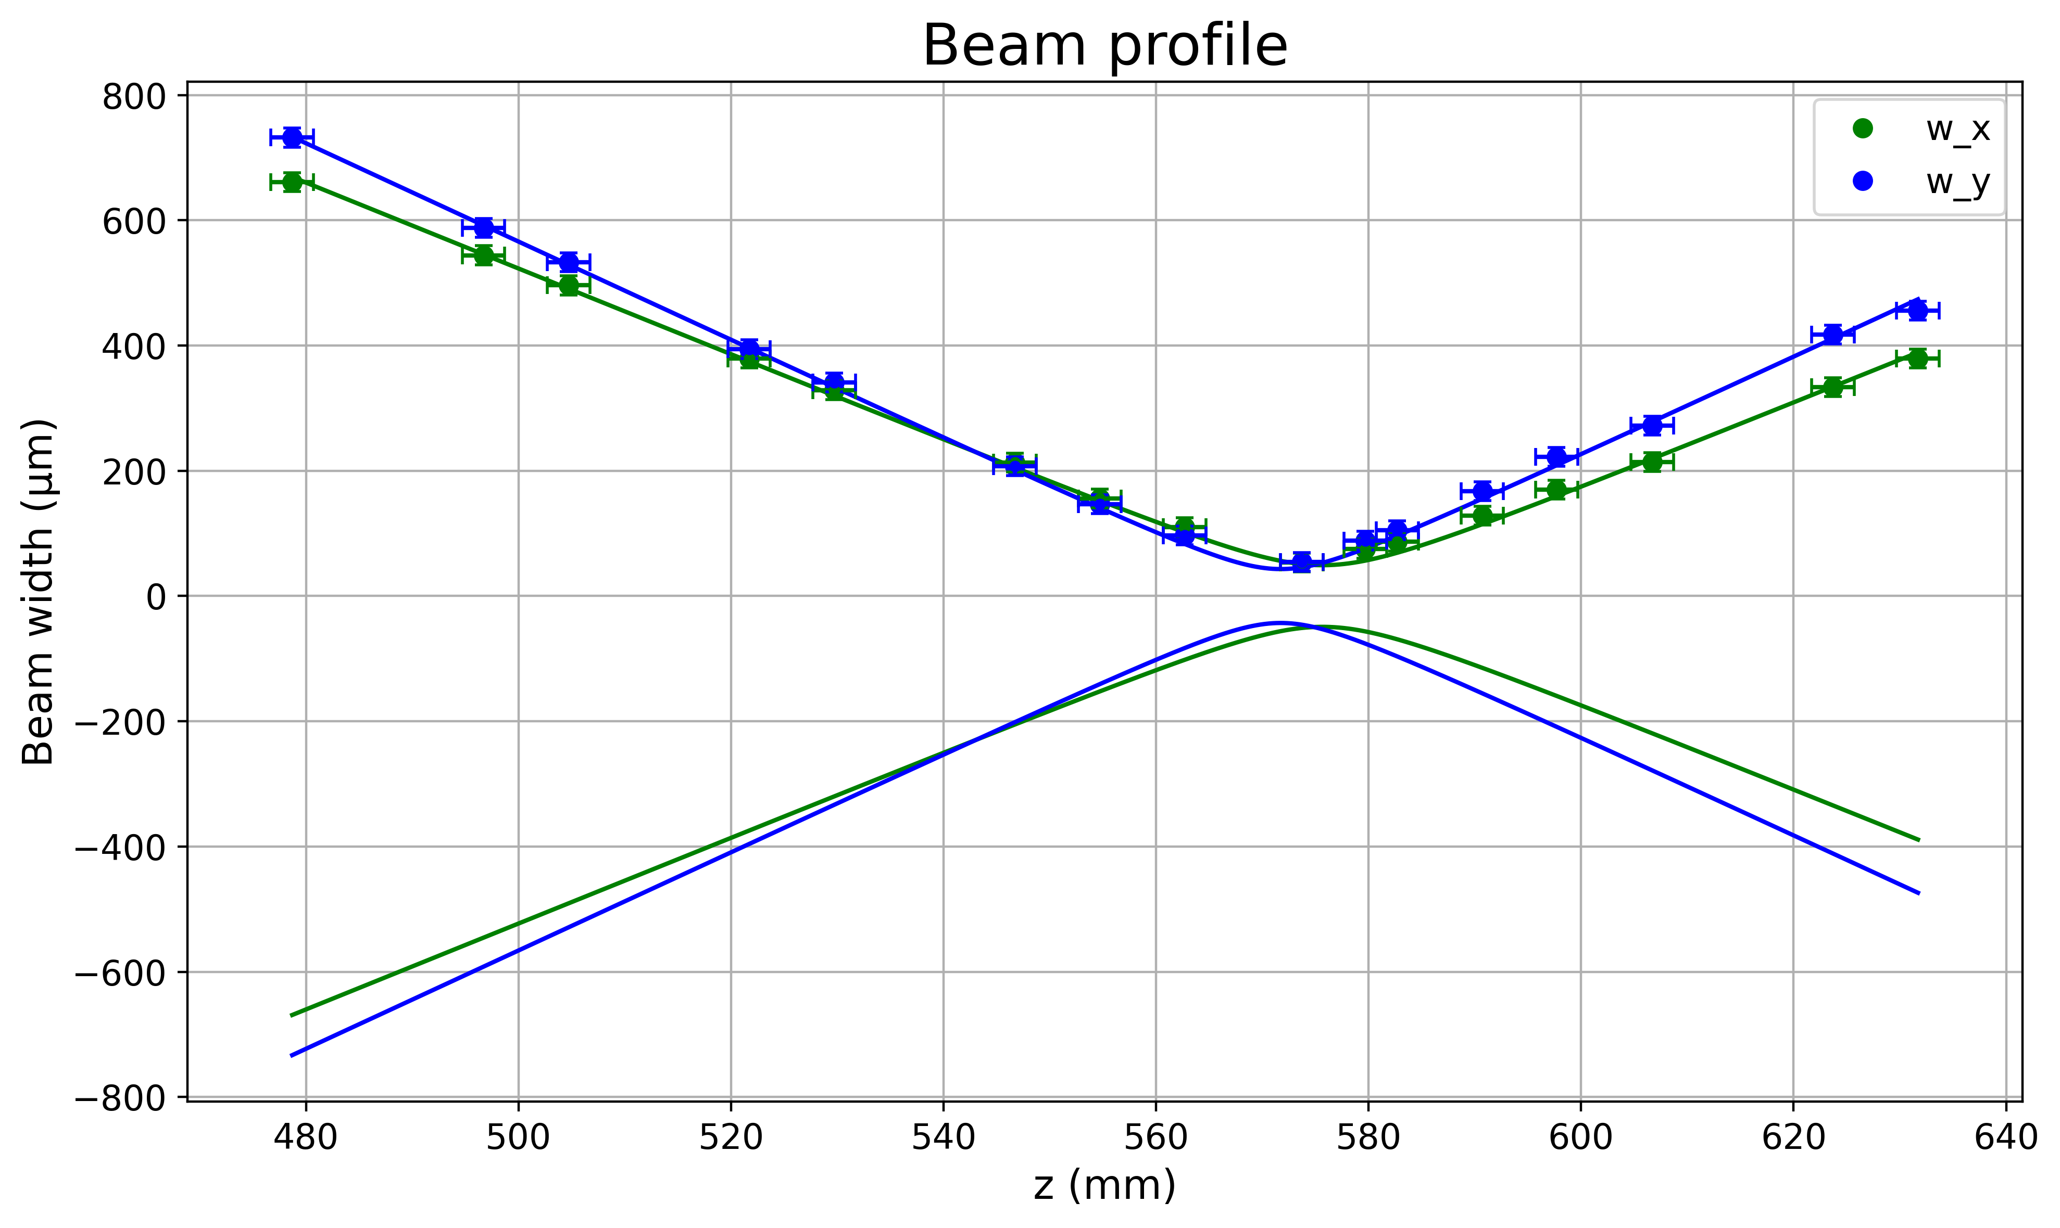

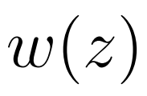




Gaussian beam propagation
Beam complex “q” parameters
Measuring the Beam Profile
Fitting the data and obtaining q parameters.
2*Waist

Slide 12

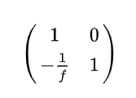


Gaussian beam propagation
ABCD Matrices
Matrices to model propagation
Paraxial assumption
Thin lenses assumption
Free space
Thin lens

Slide 13
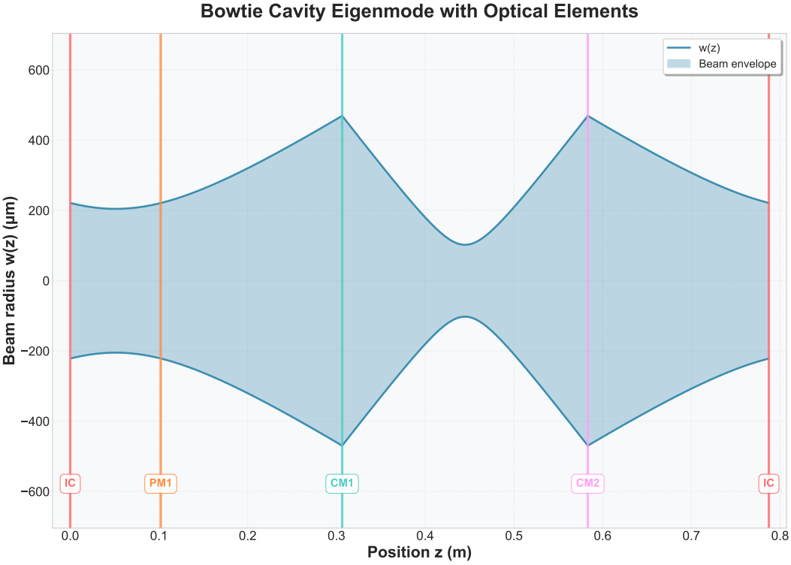

Cavity Eigen mode
Pump-resonant (1064 nm)
Cavity Eigen mode Calculation
Gaussian beam propagation
~200 Microns
Input coupler
Plane mirror
Curved Mirror 1
Curved Mirror 2
Input coupler

Slide 14
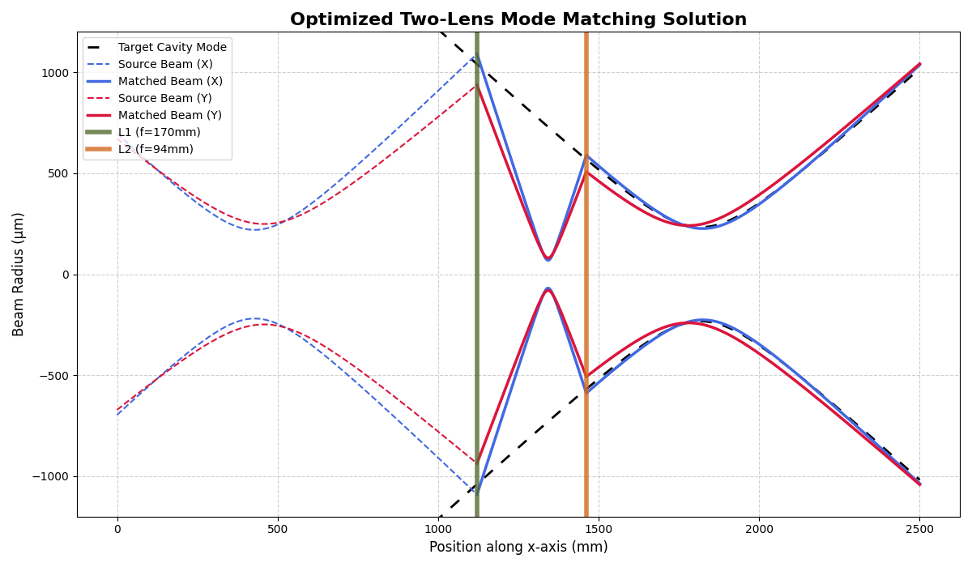
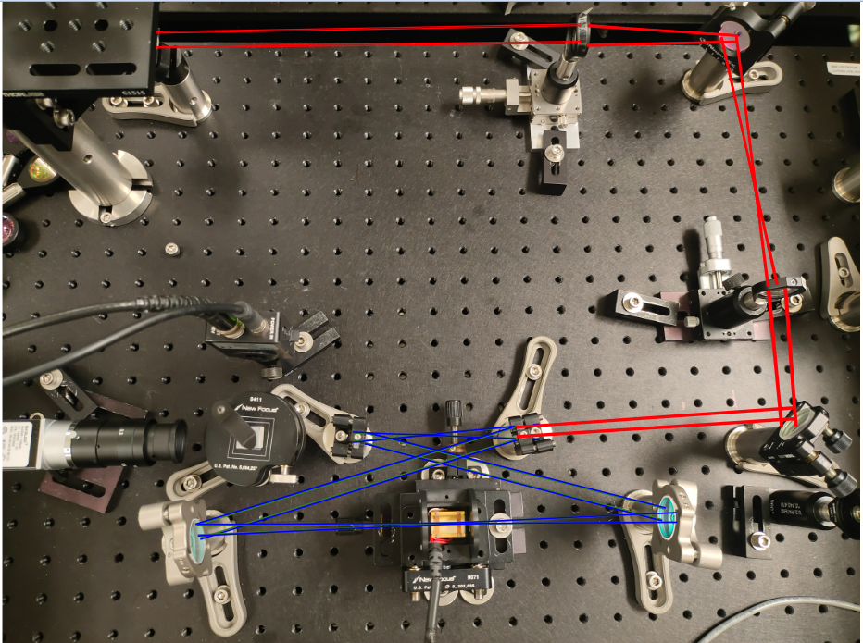
Mode matching
To summarize:

Slide 15
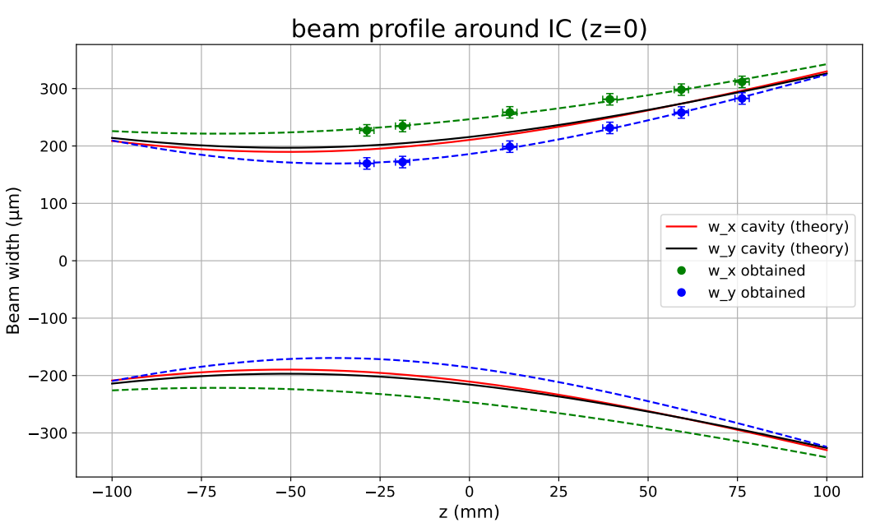
Mode matching
Beam Profile around Input Coupler of Cavity

Slide 16
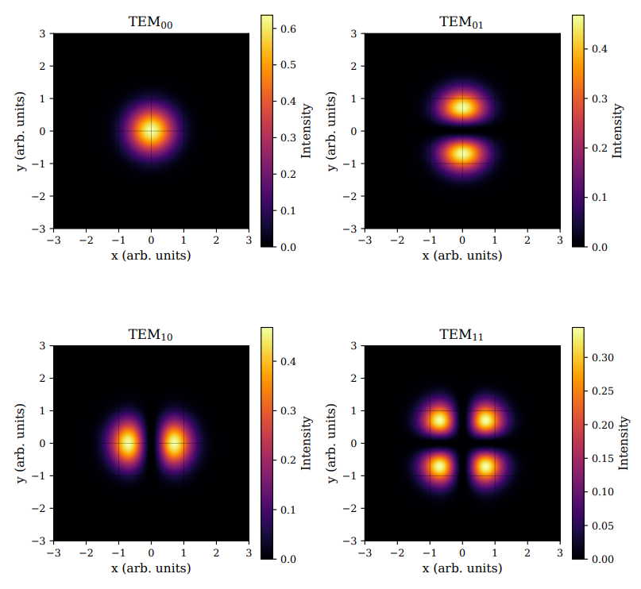
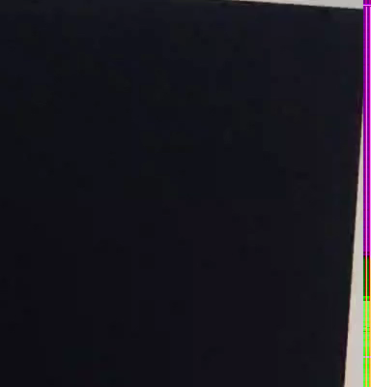
Cavity flashing
Higher order modes of light
Cavity flashing
Transmission Signal

Slide 17
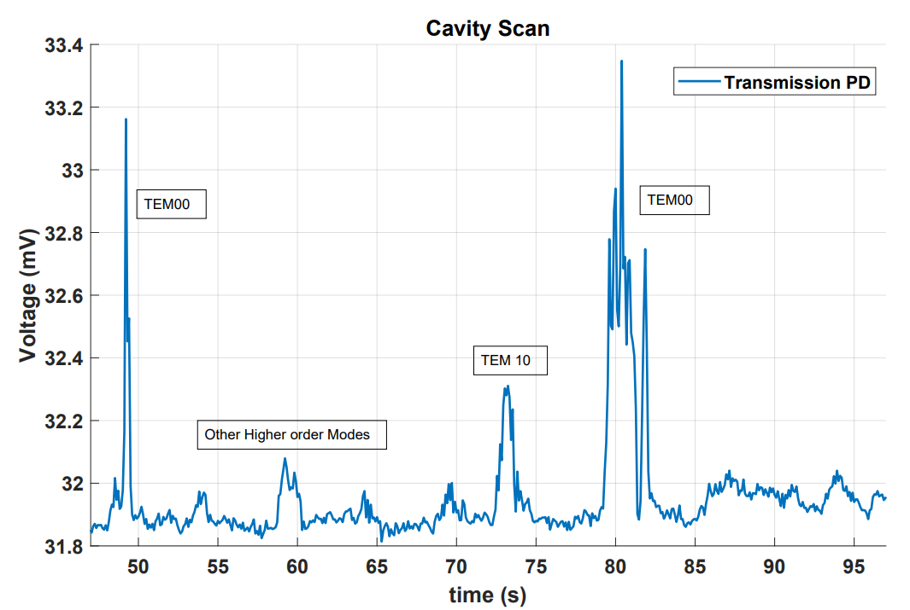
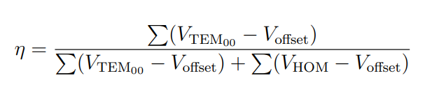
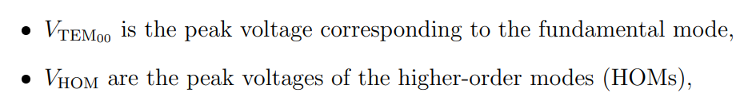
Measurements for the Bowtie Cavity
Cavity flashing
Transmission Signal
Measuring mode matching efficiency ~60%

Slide 18
Future plans:
Characterizing the Cavity.
Pound-Drever-Hall Locking the cavity
Two mode squeezing from the bowtie cavity ?

Slide 19
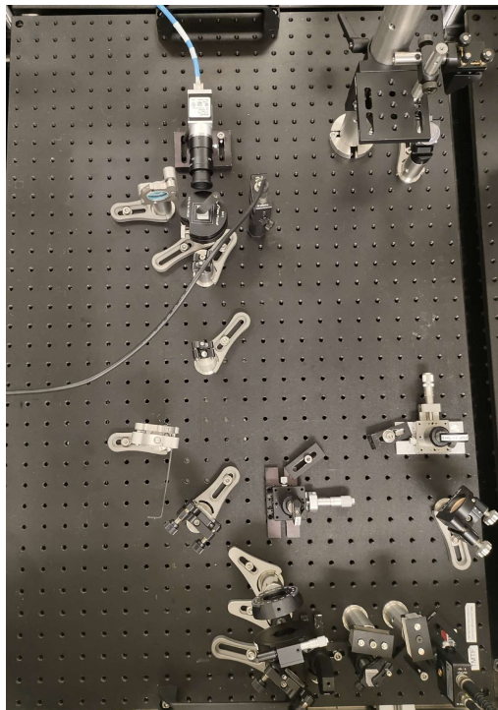
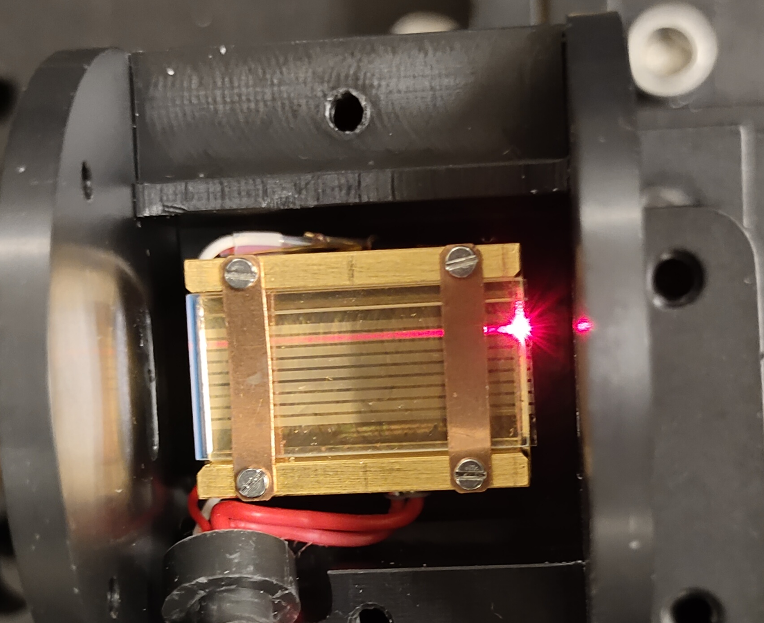
Few pics

Slide 20

Acknowledgements and Sources
Mentors: Paco, Rana Adhikari
All the 40 meter and west bridge folks
Wenxuan Jia et al. ,Squeezing the quantum noise of a gravitational-wave detector below the standard quantum limit.Science385,1318-1321(2024).
Ma, Y., Miao, H., Pang, B. et al. Proposal for gravitational-wave detection beyond the standard quantum limit through EPR entanglement. Nature Phys 13, 776–780 (2017).
https://science.jpl.nasa.gov/documents/1375/3_Thomas_Lucy_4-1-2025.pdf
https://www.hcphotonics.com/ppln-guide-overview
LIGO-G2501500-v1

