Slide 1

Cosmic Explorer
Beamtube Experiment (CE-BEX):
Beam Tube Principal Cost Drivers
Beamtube Workshop #3 (29-Sep – 2-Oct 2025)
Caltech
Dennis Coyne
28-Sep-2025 v1
Artist: Eddie Anaya (Cal State Fullerton)
LIGO-G2502099-v2

Slide 2
Scope
Includes:
  Beam Tube
  Beam Tube Supports
  design, materials, stiffening provisions, pump ports, supports, manufacturing, cleaning, transportation, and leak testing
Does not include:
  Baffles
  Slab (foundation)
  BT enclosure
  BT insulation
  BT vacuum bake
  Vacuum equipment (gate valves, pumps, controls, gauges, etc.)
  Overall management oversight, cost of money, etc.

Slide 3
Caveats & Sources
Caveats
  Based on 1994 cost data from CBI for the LIGO Beam Tube
  While this data is "ancient", it may still provide relative measures of cost
  In addition, this estimate (captured in a Mathematica notebook, LIGO-T2400377) may provide the template for updating to current cost information
  Proper escalation would require different escalation factors for the various elements of the estimate – this has not been done
Sources
  LIGO-C1900321, “Final Design Review Data Package, Beam Tube Module: CDRL 09, DRD 04, Draft Detailed Design prepared by the contractor, CB&I
  C-type documents in the LIGO DCC are generally restricted to LIGO Lab personnel, but can be made available to LSC and perhaps the public (TBD)
  Document LIGO-T2400377 also compares the CB&I estimate to the LIGO cost book

Slide 4
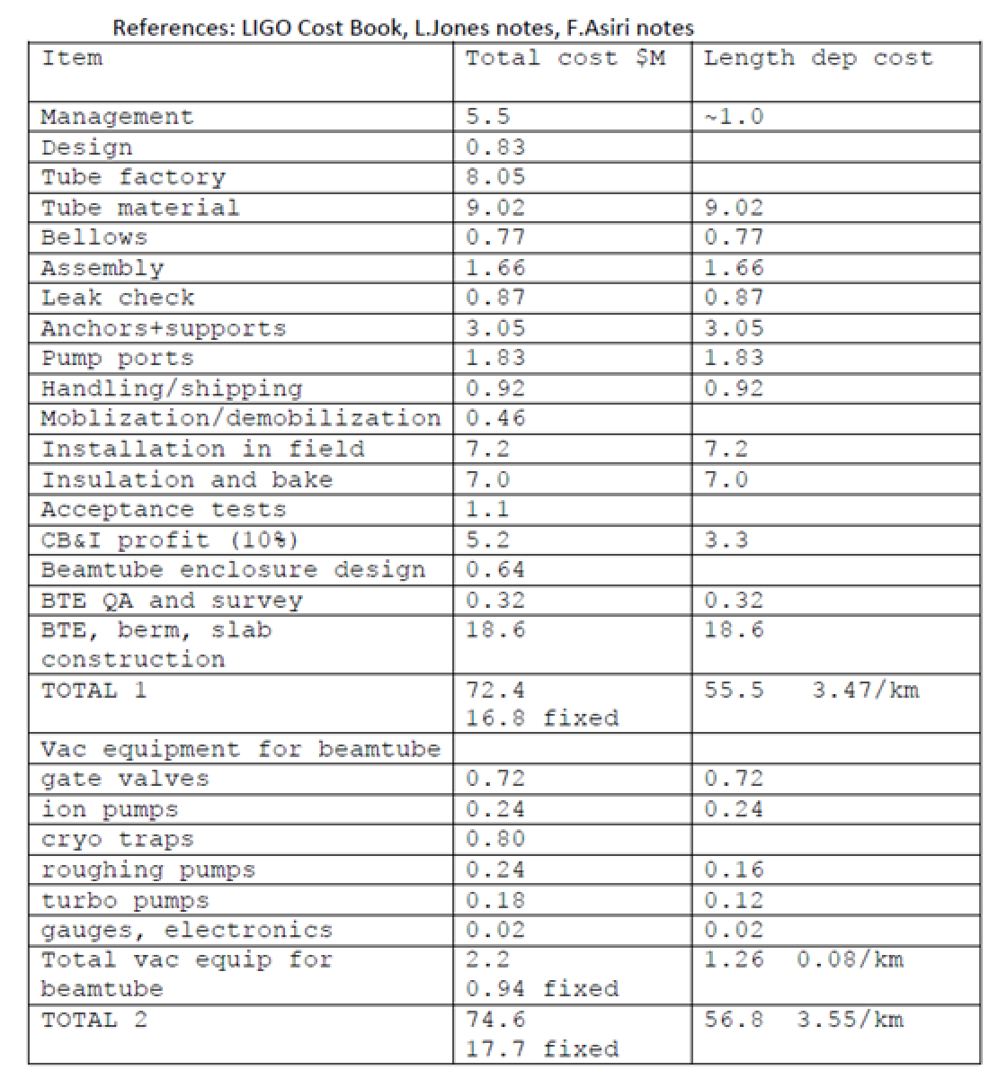
LIGO BT Costs
Cost table compiled by Rai Weiss for a 2020 proposal to the NSF for CE seed funding for vacuum research
Separation of Fixed and "Per km" costs
Projection for a 40km interferometer in 2028 USD using an inflation rate of 0.023/year (factor of 2.166) – total cost for 80km = $635M

Slide 5
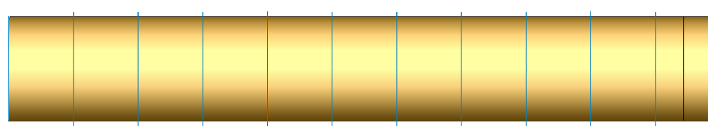
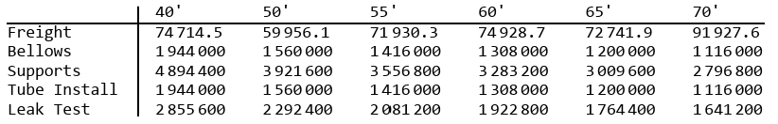
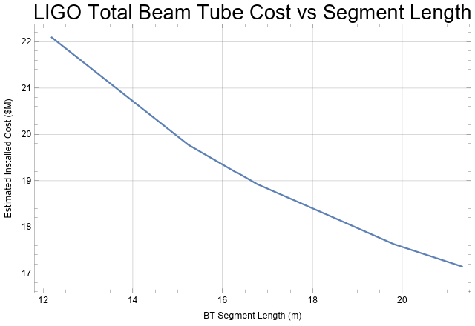
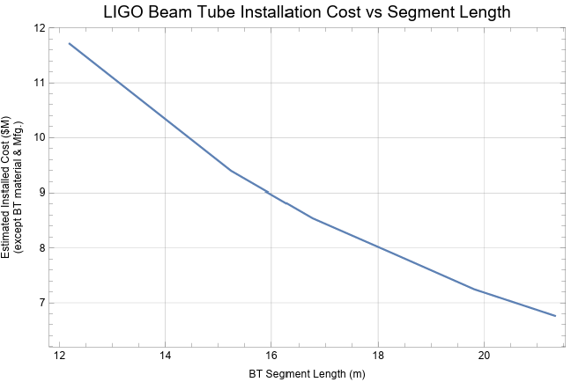
Tube Segment Length Impact on Cost
(2 sites, 16 km, 1994 USD)
LIGO FIXED STIFFENER SPACING (758 mm)
Costs independent of tube segment length:
  Coil mfg (average of 5 steel producers)
  Spiral Welding manufacture
  Stiffener costs (mfg and installation)
Total Costs vs segment length:
SEGMENT LENGTH
Install Costs dependent of tube segment length:
  Short transport case (Portland, OR to Hanford, WA)
LIGO Segment Length (19805 mm)
LIGO Segment Length (19805 mm)

Slide 6
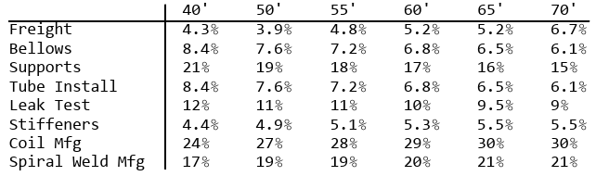
Tube Segment Length Impact on Cost
(2 sites, 16 km, 1994 USD)
Total Costs dependent of tube segment length:
  Long transport case (Portland, OR to Livingston, LA)
Segment Lengths > ~20 m not considered because Freight costs rose dramatically
Total Cost ($M)

Slide 7
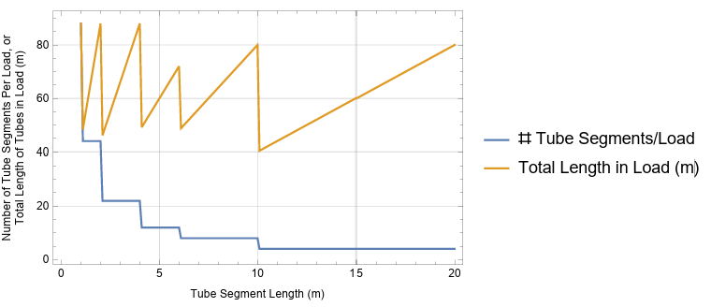
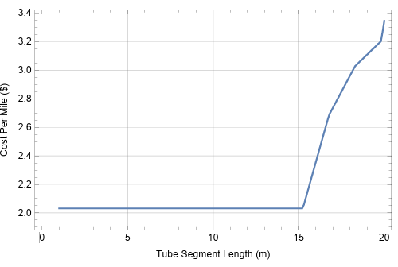
CE Cost (1994 USD) with LIGO Beamtube for varying tube segment length
Freight
  Heavy hauling (8.6x13.6x53 ft, <80,000 lb)
  Packing density used to determine the number of transport loads:
    > 4m long tubes, 2 rows x 2 levels)
    ≤ 4m long tubes, stand up in 2 rows x 11
LIGO FIXED STIFFENER SPACING (758 mm)
SEGMENT LENGTH

Slide 8
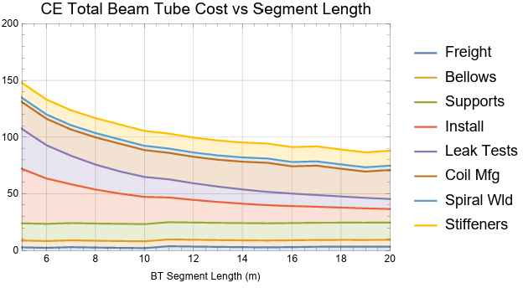
CE Cost (80 km, 1994 USD) with LIGO Beamtube for varying tube segment length (concluded)
Bellows (EJ)
  In principle the EJ could be designed to handle the displacement of multiple BT segments, or optimized for shorter BT segments
  I’ve estimated the number of EJs on the assumption that each EJ handles 40 m of tube
Supports: Assumed 1 fixed & 1 guided support per EJ
Pump Ports: Simply scaled by (CE Length)/(LIGO Length)
Coil Mfg Costs (avg. of 5): coil material (304L), transport to/from bake facility, bake, transport to/from finishing mill, outgas test, level, slit, transport to tube mfg, less cost of 10% scrap steel
Spiral Mill Costs (avg. of 3):
  not quoted as a function of segment length
  shorter segments would cost more due to the need
  to make more transverse cuts
Stiffeners: material, fabrication, welding costs

Slide 9
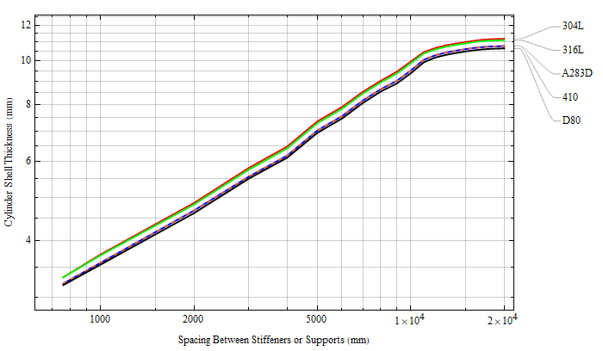
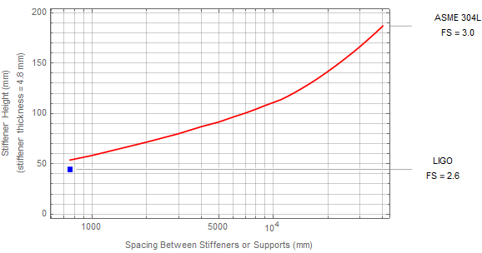
CE Cost (80 km, 1994 USD) with LIGO Beamtube for varying tube stiffener spacing
VARIABLE STIFFENER SPACING
Cylinder thickness and stiffener height (MOI) increases as stiffener spacing increases per ASME 2023.BPVC.VIII, Division 1
Costs independent of stiffener spacing: Tube segment freight, Bellows, Supports, Leak Tests, Pump ports, Tube installation
Assuming cylinder is formed by spiral welding
(thick-walled is more likely slip rolled?)
Assuming each 304L coil weight remains the same
Stiffener
  Material costs scaled by stiffener weight
  Welding cost assumed constant per stiffener
SEGMENT LENGTH = 20 m
Asymptotes to Unstiffened, Thick-Walled Cylinder
? Stiffener Moment of Inertia should decrease as the spacing asymptotes to thick-walled, unstiffened cylinder thickness
Required Cylinder Shell Thickness vs External Ring Stiffener Spacing
LIGO

Slide 10
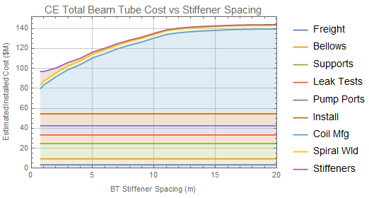
CE Cost (80 km, 1994 USD) with LIGO Beamtube for varying tube stiffener spacing (concluded)
The CB&I (LIGO) design seems optimal for a 304L ring-stiffened cylinder
Corrugation fabrication cost (currently unknown) is offset by ~34% of baseline total
  Stiffener cost of ~13.6%
  Bellows cost of ~6.2%
  Shell thickness reduction from 3.23 mm (LIGO) to 2.78 mm (CEBEX RFI) represents a cost of ~13.9%
LIGO Stiffener Spacing (758 mm)

