Slide 1
Weld design to join chambers – mechanical tolerances Dust contamination Manufacturing and welding options
Roxane Misler roxane.misler@cern.ch
Gilles Favre

Slide 2
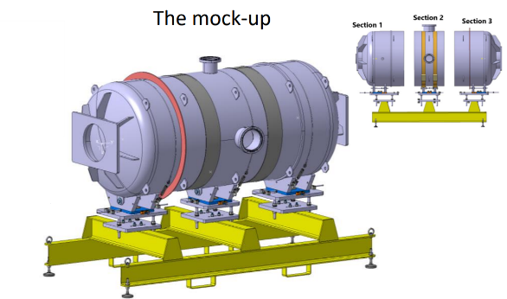
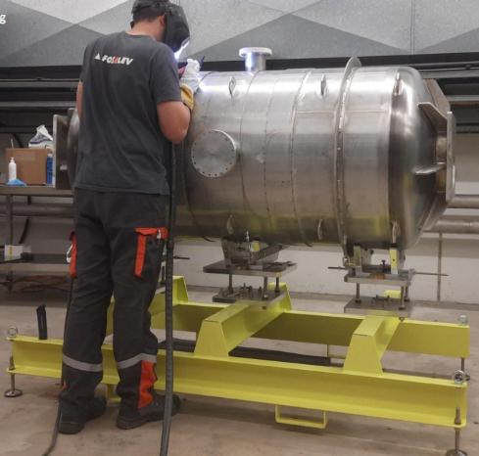
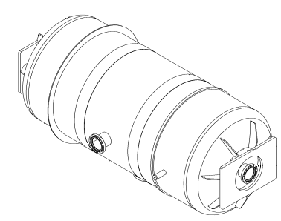
Weld design to join chambers – 1rst step mock-up
Ø 850 mm
2 m length
4 mm thickness
3 parts
2 open sleeves
Test the forming process of material 441,
Evaluate the geometry of the component at a reduced scale,
Monitor dust contamination during assembly + welding processes,
4 mm open sleeve by manual fillet welds.
Detection of virtual leak, and vacuum test
R.Misler
roxane.misler@cern.ch
Notes:
The mock-up component was developed to test the forming process of material 441, evaluate the geometry of the component at a reduced scale, and monitor dust contamination during assembly.
The welding of the three parts was carried out to test a specific assembly method using a 4 mm open sleeve by manual fillet welds. To meet the project’s cleanliness requirements (ISO 6 during assembly operations), dust contamination was assessed throughout both the assembly and welding processes, which were performed under a mobile cleanroom. Detection of virtual leak, bakeout to accelerate water vapor outgassing for vacuum test.

Slide 3
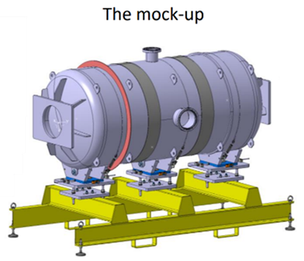
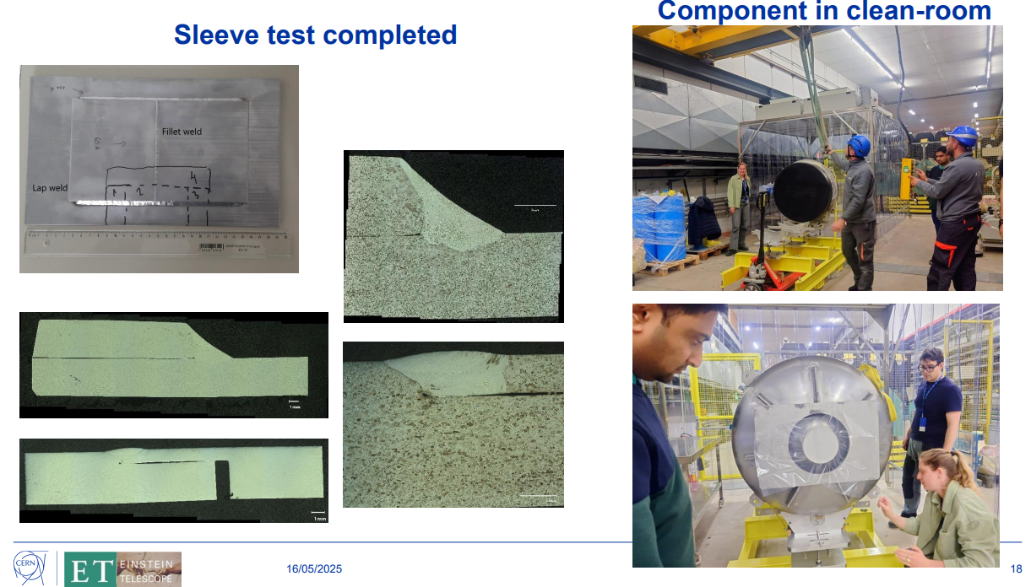
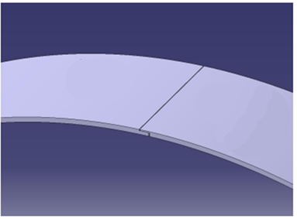
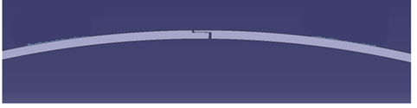
Weld design to join chambers – 1rst step mock-up
Metallography qualification of open sleeve
4 mm open sleeve by manual fillet welds
R.Misler
roxane.misler@cern.ch
Notes:
The mock-up component was developed to test the forming process of material 441, evaluate the geometry of the component at a reduced scale, and monitor dust contamination during assembly.
The welding of the three parts was carried out to test a specific assembly method using a 4 mm open sleeve by manual fillet welds. To meet the project’s cleanliness requirements (ISO 6 during assembly operations), dust contamination was assessed throughout both the assembly and welding processes, which were performed under a mobile cleanroom. Detection of virtual leak, bakeout to accelerate water vapor outgassing for vacuum test.

Slide 4
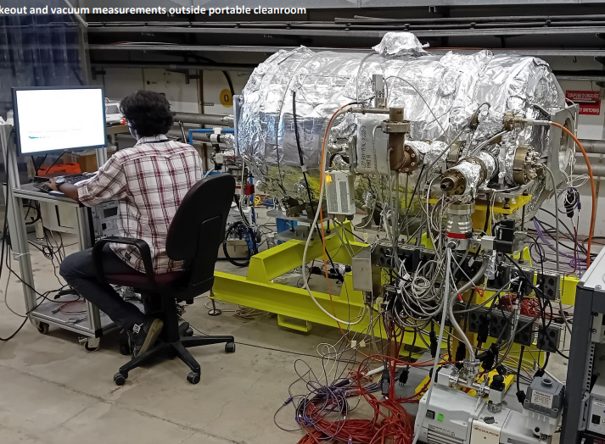
Weld design to join chambers – 1rst step mock-up
4 mm open sleeve by manual fillet welds : TIG (141M) with 317L filler
Detection of virtual leak, and vacuum test.
→ Successful result
R.Misler
roxane.misler@cern.ch
Notes:
The mock-up component was developed to test the forming process of material 441, evaluate the geometry of the component at a reduced scale, and monitor dust contamination during assembly.
The welding of the three parts was carried out to test a specific assembly method using a 4 mm open sleeve by manual fillet welds. To meet the project’s cleanliness requirements (ISO 6 during assembly operations), dust contamination was assessed throughout both the assembly and welding processes, which were performed under a mobile cleanroom. Detection of virtual leak, bakeout to accelerate water vapor outgassing for vacuum test.

Slide 5
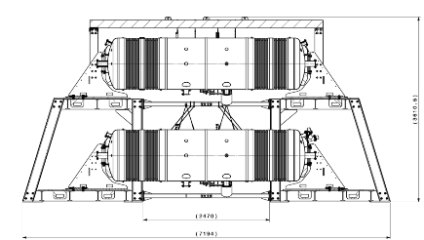
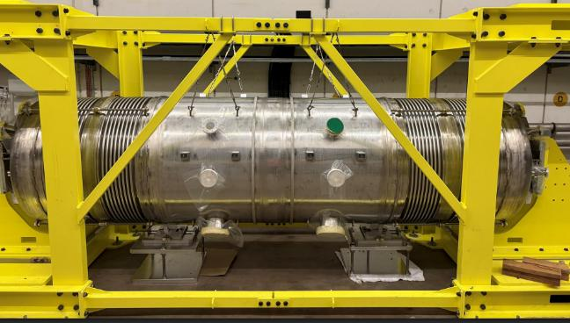
Weld design to join chambers – 2nd background
Background component :
End-cap (EC): resists mechanical stresses during pumping
Bellow (BL): absorbs stresses and compensates thermal expansion
Pumping module (PM): ensures UHV is achieved.
Test and validate the mechanical strength of the complete assembly,
ensure leak-tightness,
Closed sleeve with 2 mm thickness by manual fillet welds,
detection of virtual leaks and allowing for bakeout procedures.
EC
BL
PM
PM
BL
EC
Ø 1008 mm
4,2 m length
4 mm thickness
2 parts
1 close sleeve
R.Misler
roxane.misler@cern.ch
Notes:
The background component is made up of three parts on each side: the end-cap (EC), the bellow (BL), and the pumping module (PM). The EC resists mechanical stresses during pumping, the BL absorbs these stresses and compensates for thermal expansion, and the PM ensures UHV is achieved.
This sub-assembly is used to test and validate the mechanical strength of the complete assembly and to ensure leak-tightness. The welding assembly method uses a closed sleeve with 2 mm thickness by manual fillet welds, enabling the detection of virtual leaks and allowing for bakeout procedures. Once the background component has been fully validated, it will be cut into two sections and assembled on either side of the pilot sector.

Slide 6
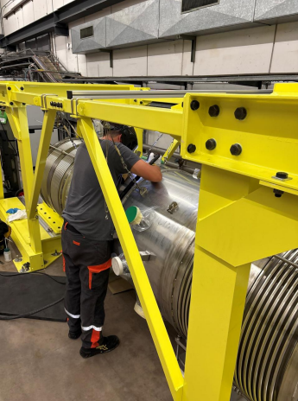
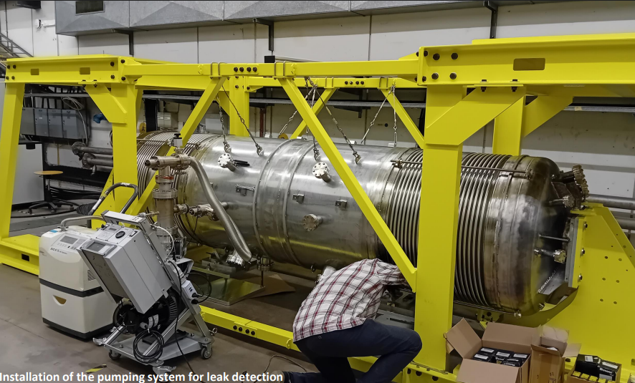
Weld design to join chambers – 2nd background
Metallography qualification of close sleeve
Fitting the close sleeve with the roundness components
4 mm close sleeve by manual fillet welds : TIG (141M) with 317L filler .
Detection of virtual leak, and vacuum test.
→ Successful result : Better for close sleeve
R.Misler
roxane.misler@cern.ch
Notes:
The background component is made up of three parts on each side: the end-cap (EC), the bellow (BL), and the pumping module (PM). The EC resists mechanical stresses during pumping, the BL absorbs these stresses and compensates for thermal expansion, and the PM ensures UHV is achieved.
This sub-assembly is used to test and validate the mechanical strength of the complete assembly and to ensure leak-tightness. The welding assembly method uses a closed sleeve with 2 mm thickness by manual fillet welds, enabling the detection of virtual leaks and allowing for bakeout procedures. Once the background component has been fully validated, it will be cut into two sections and assembled on either side of the pilot sector.

Slide 7
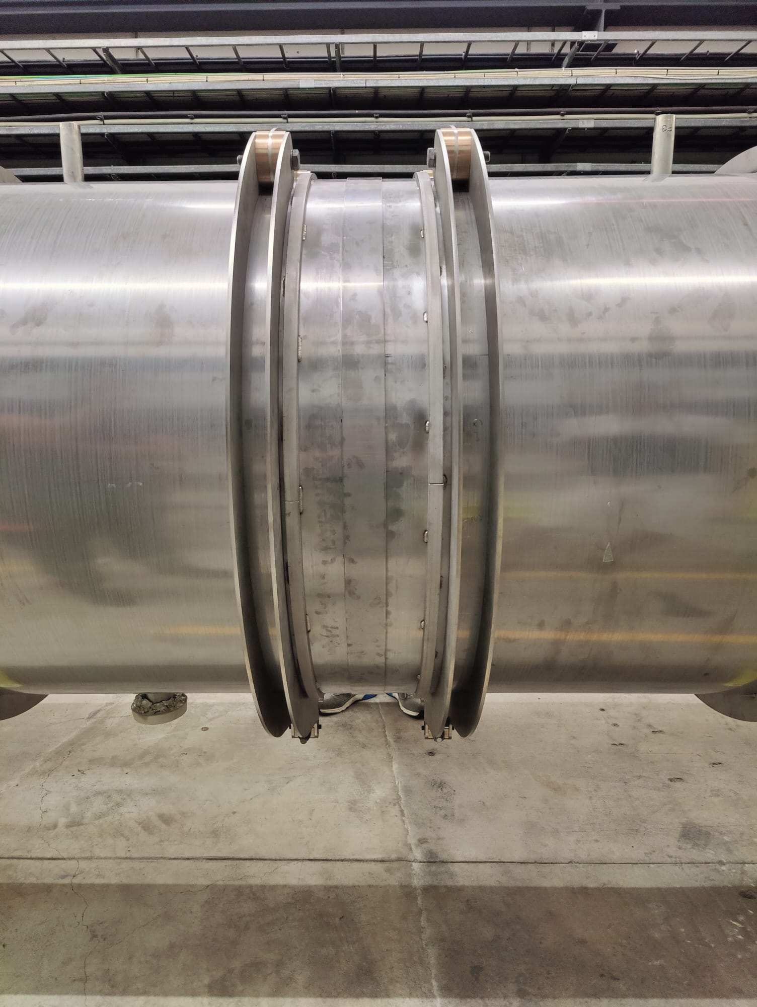
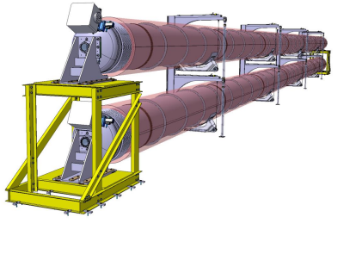
Weld design to join chambers – 3rd step Pilot sector
Sleeve
Ø 1008 mm
40 m length
4 mm thickness
8 parts / line
7 sleeves / line
Chamber
Chamber
currently in progress,
closed sleeve, 2 mm thickness with a 1 mm gap, joined by manual fillet welds.
Roundness tool for chambers extremities
R.Misler roxane.misler@cern.ch
Notes:
The pilot sector is the most representative configuration of the final E.T. project assembly.
Its purpose is to demonstrate assembly feasibility, identify elements requiring correction or modification, and document best practices for manufacturing and testing for the final E.T. system.
A first assembly line is currently in progress using a method similar to the one applied to the background component: closed sleeve, 2 mm thickness with a 1 mm gap, joined by manual fillet welds. The assembly consists of twice three 6-meter tubes, joined end-to-end.
Each tube was individually tested (leak test) prior to final assembly to verify manufacturing tightness.
The pilot sector is the most representative configuration of the final E.T. project assembly. Its purpose is to demonstrate assembly feasibility, identify elements requiring correction or modification, and document best practices for manufacturing and testing for the final E.T. system.

Slide 8
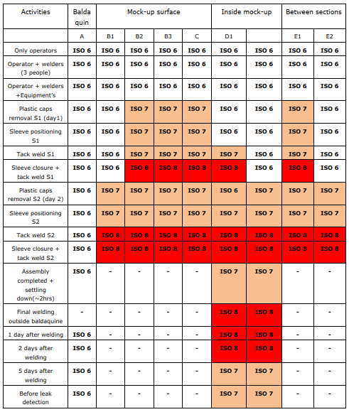
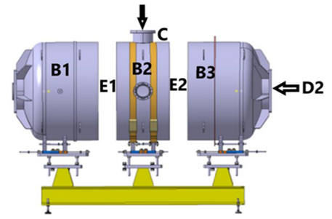
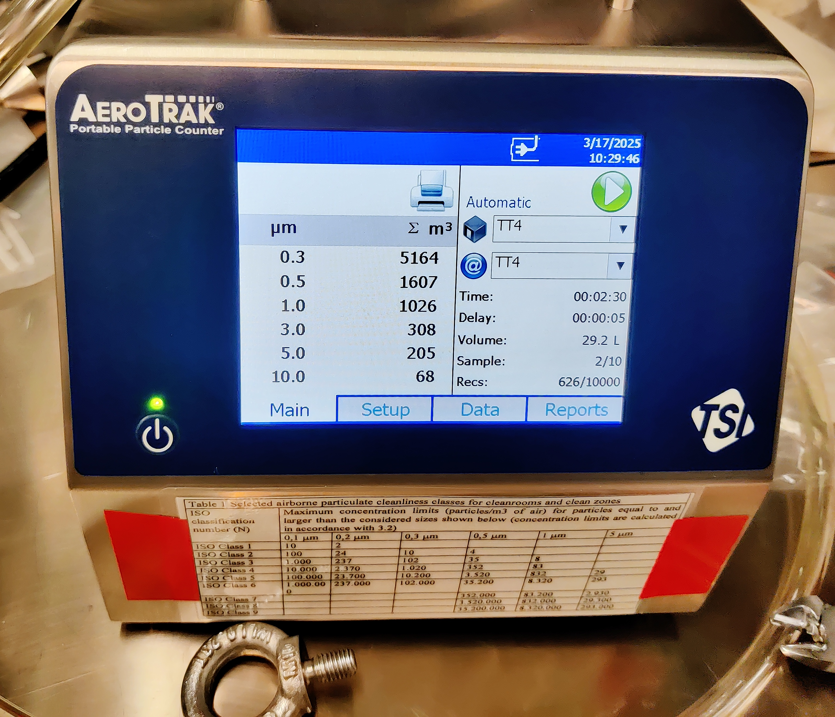
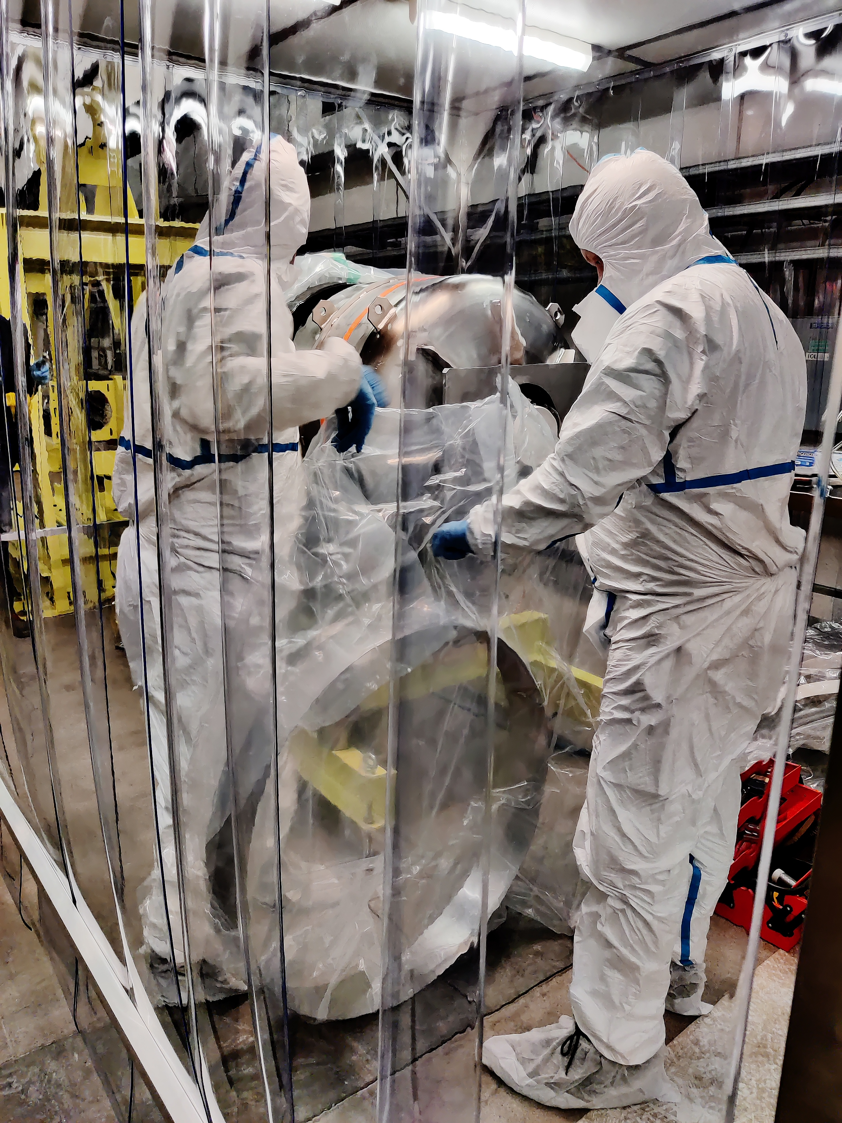
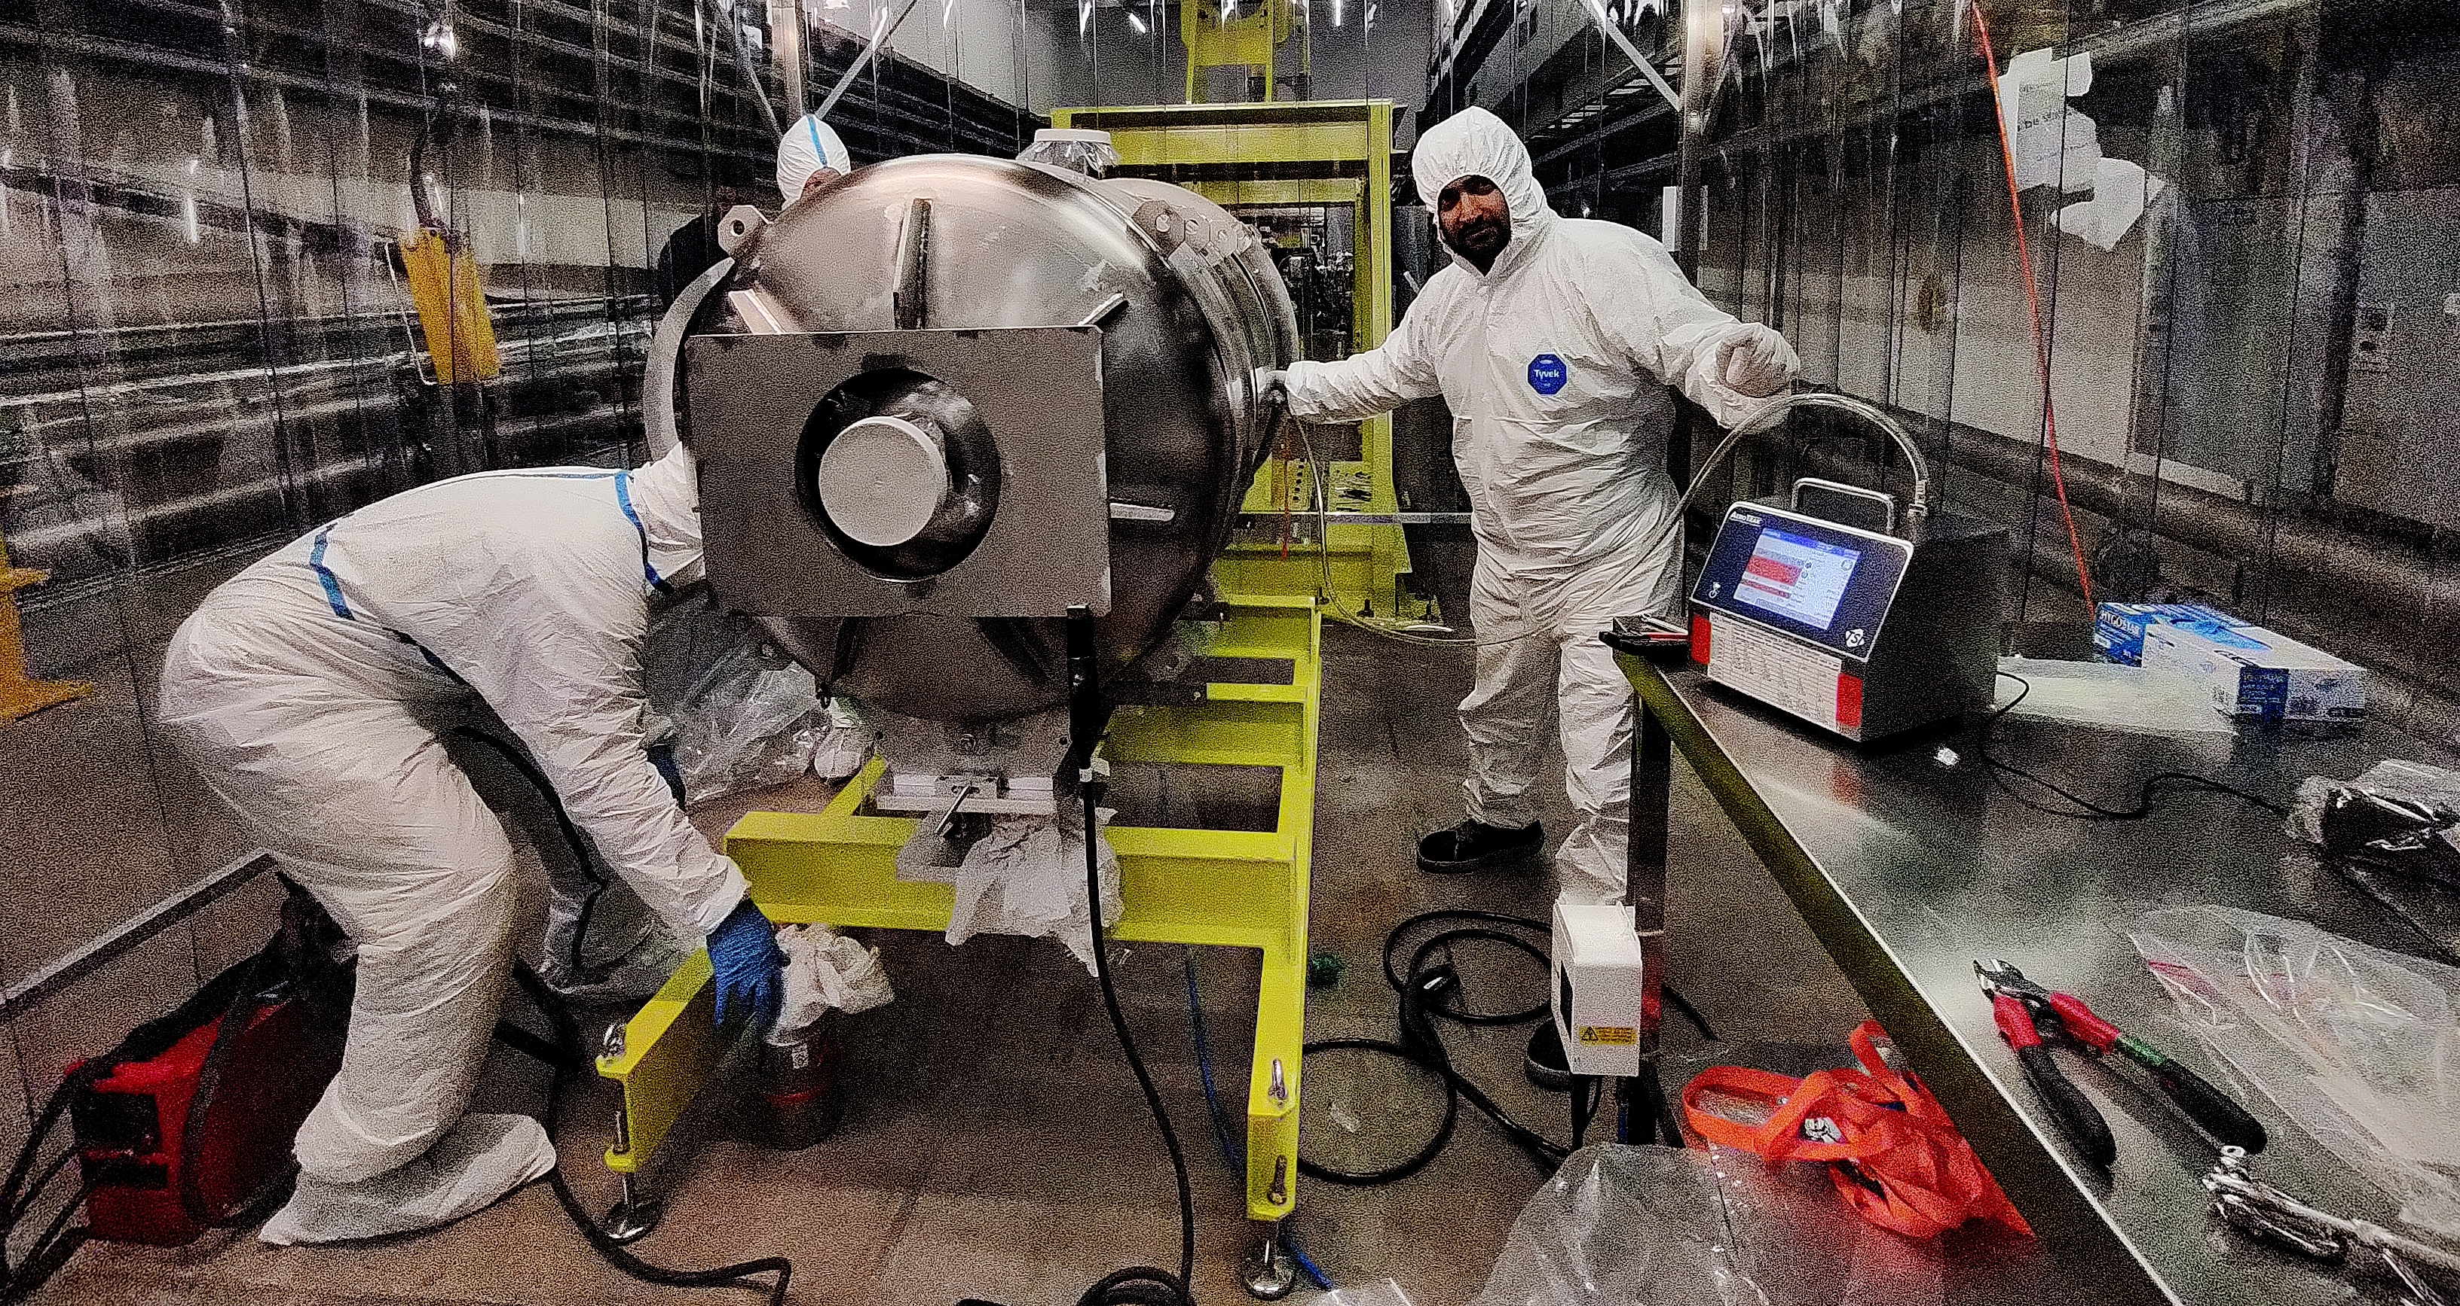
Dust monitoring during mock-up assembly
D1
D2
R.Misler roxane.misler@cern.ch

Slide 9
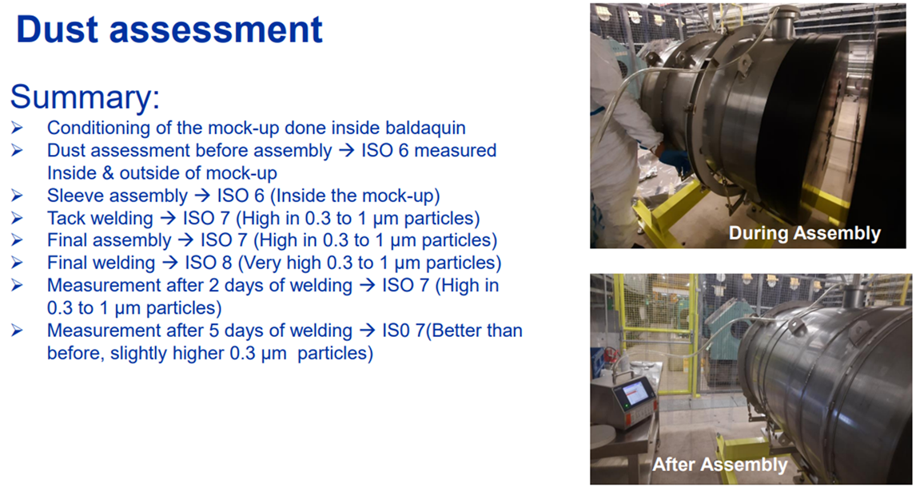
Dust monitoring during mock-up assembly
R.Misler roxane.misler@cern.ch

