Slide 1
Welding techniques
purchasing of the orbital welding machine
purchasing of the orbital welding machine
Roxane Misler roxane.misler@cern.ch
Gilles Favre

Slide 2
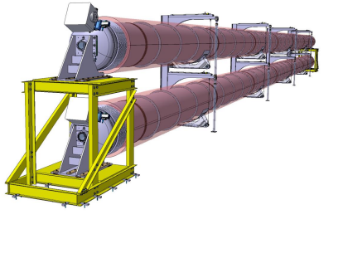
Welding techniques
Information to consider :
Roundness of the parts to be joined
Type of assembly
Butt weld / Fillet weld / Lip weld
Choice of process
Automatic process
Manual process
Welding to then be able to cut for future repairs
Accessibility
R.Misler roxane.misler@cern.ch

Slide 3
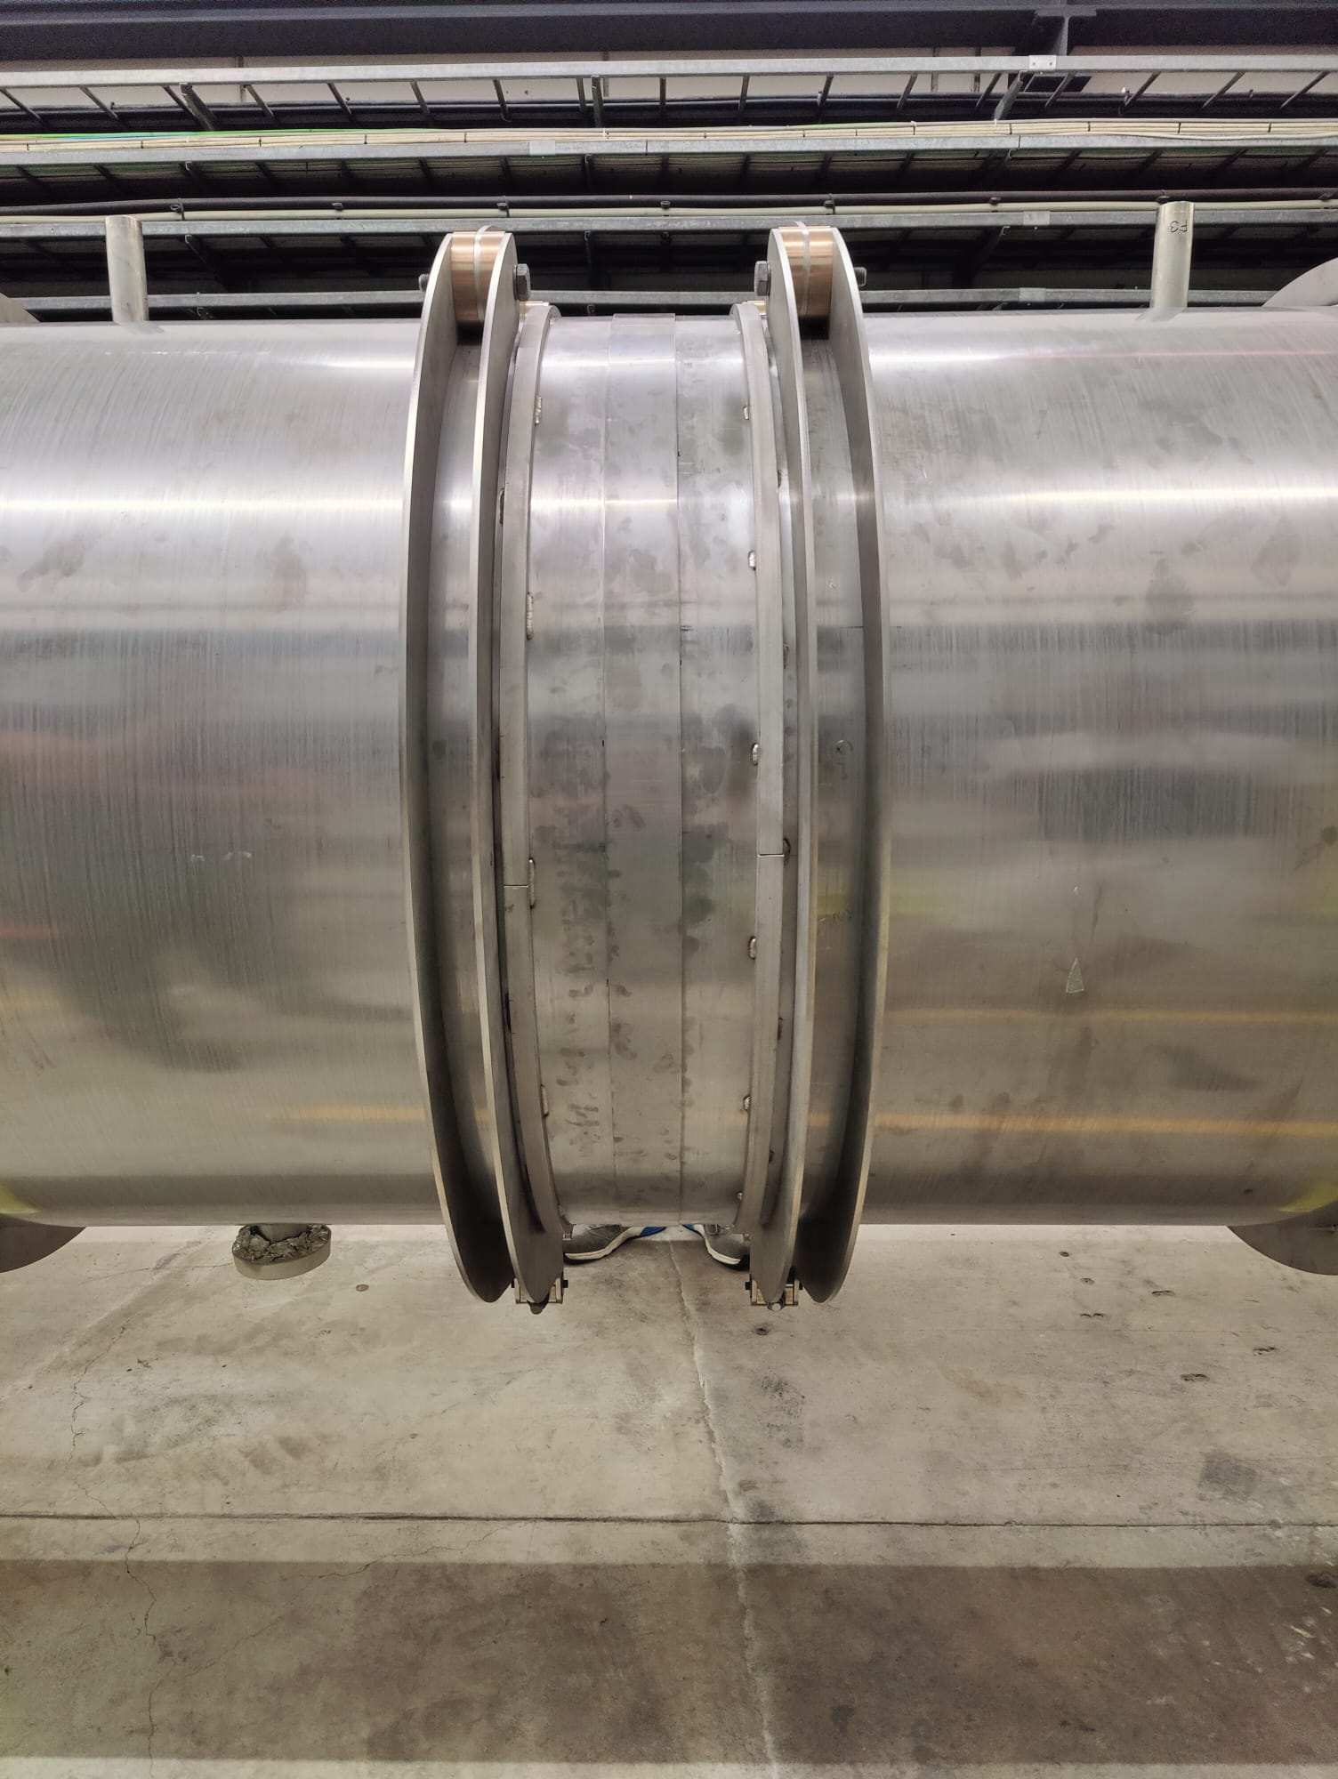
Welding techniques
First line will be weld manually at CERN :
Modular roundness tool positioned at the end of each tubes
Close sleeve in 4mm thickness with 1mm gap
Manual fillet welding
TIG process with filler material 317L
Possibility to cut the sleeve while limiting internal dust contamination of the tube
R.Misler roxane.misler@cern.ch

Slide 4
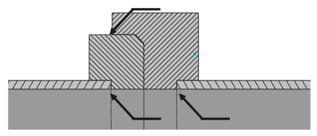
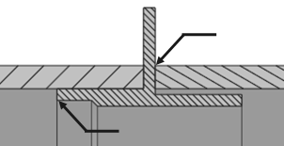
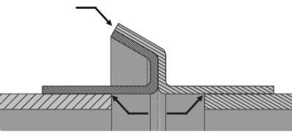
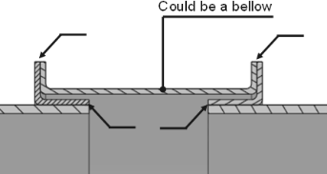
Welding techniques
Other joint assembly discuss
FLANGE
CENTERING RING-LIKE
INCLINED LIP
DOUBLE COLLAR
R.Misler roxane.misler@cern.ch

Slide 5
Welding techniques
Other joint assembly discuss
Second line discussion:
No machining for tubes ends
Tolerant to extremities roundness
Collars could be made by spinning metal
Cut and welding out of tube direct view
Central part can be replaced by a below
DOUBLE COLLAR
R.Misler roxane.misler@cern.ch

Slide 6
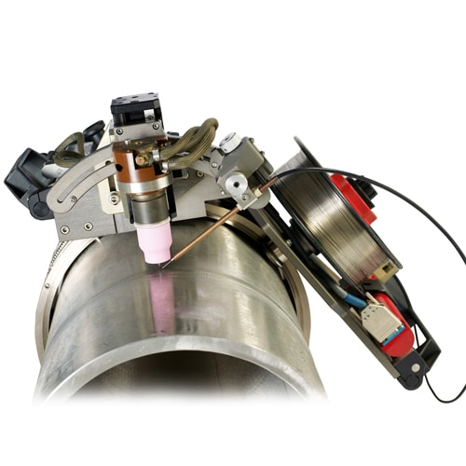
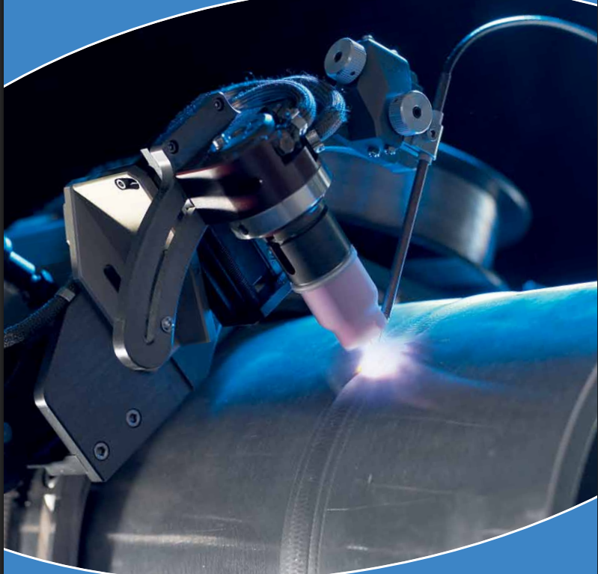
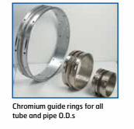
Welding techniques
Information for 2nd line :
An orbital TIG welding machine (Polycar 60) is available at CERN and can be easily borrowed. → Estimated cost saving: 40,000 CHF
The track associated with the available machine has a diameter of 650 mm
Discussion for 2nd line :
With the current 650 mm track:
Tilting the welding head at 45° to perform a fillet weld on a sleeve is not possible.
The double collar/lip weld assembly proposed (manufacturing option)
is not feasible for a 650 mm diameter.
If purchasing a larger track (>1008 mm diameter) – Estimated cost: 15,000 CHF
Tilting the welding head at 45° for a fillet weld on a sleeve is still not possible.
Possibility to test double collar/ lip weld configuration (currently in production) in vertical welding position.
This would require:
Fabrication of two flanges (viroles) at 1008 mm diameter,
Assembly of the new lip weld configuration onto the flanges,
Vertical testing using the orbital TIG welding machine.
The >1008 mm track is custom-made, lead time approx. 3 months.
R.Misler roxane.misler@cern.ch

Slide 8
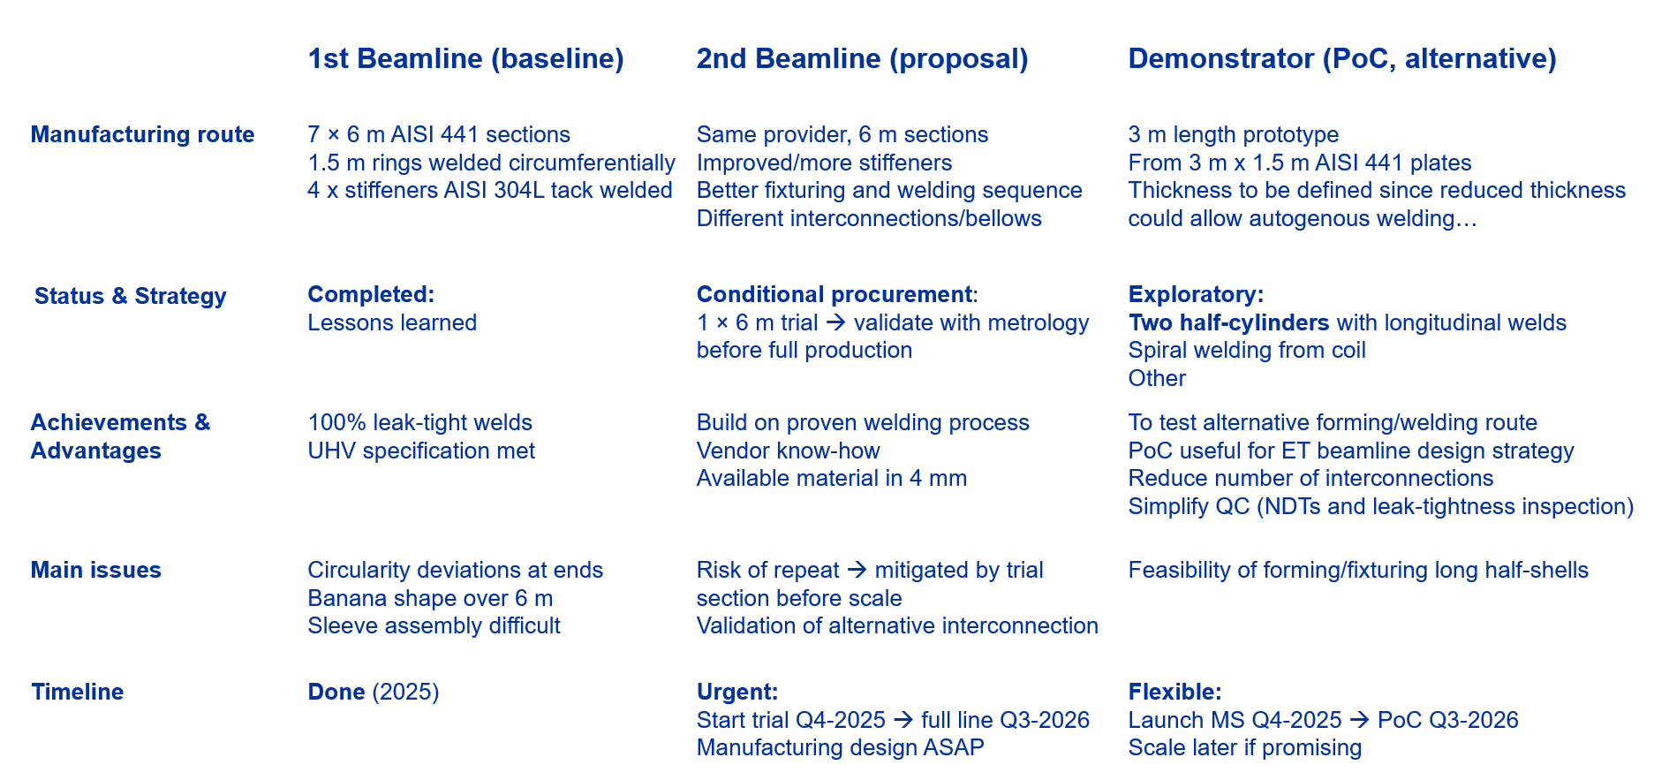
Welding techniques
R.Misler roxane.misler@cern.ch

Slide 9
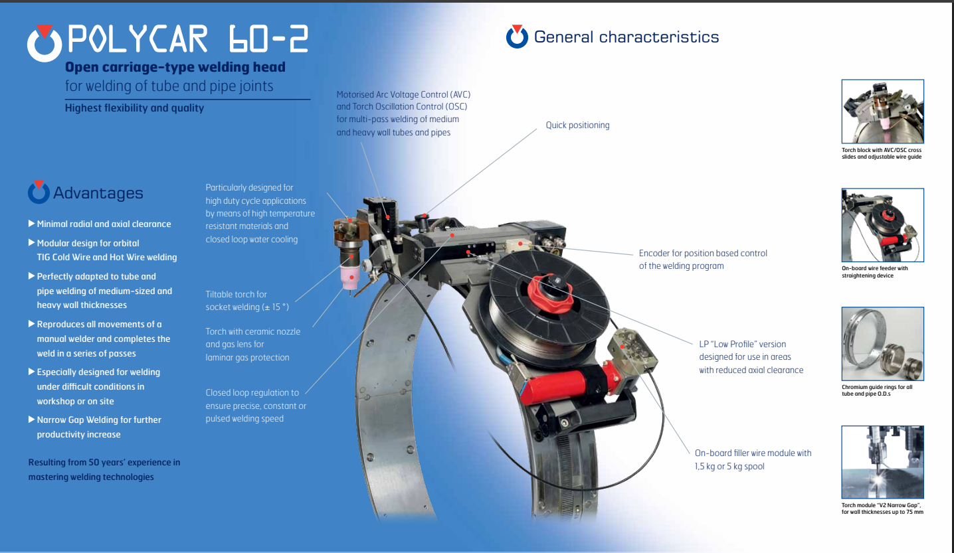
Welding techniques
R.Misler roxane.misler@cern.ch

