Slide 1
Thermal insulation for GWDs beam pipe vacuum systems
Carlo Scarcia, Karl Owens
BWT3, 2025/10/01

Slide 2
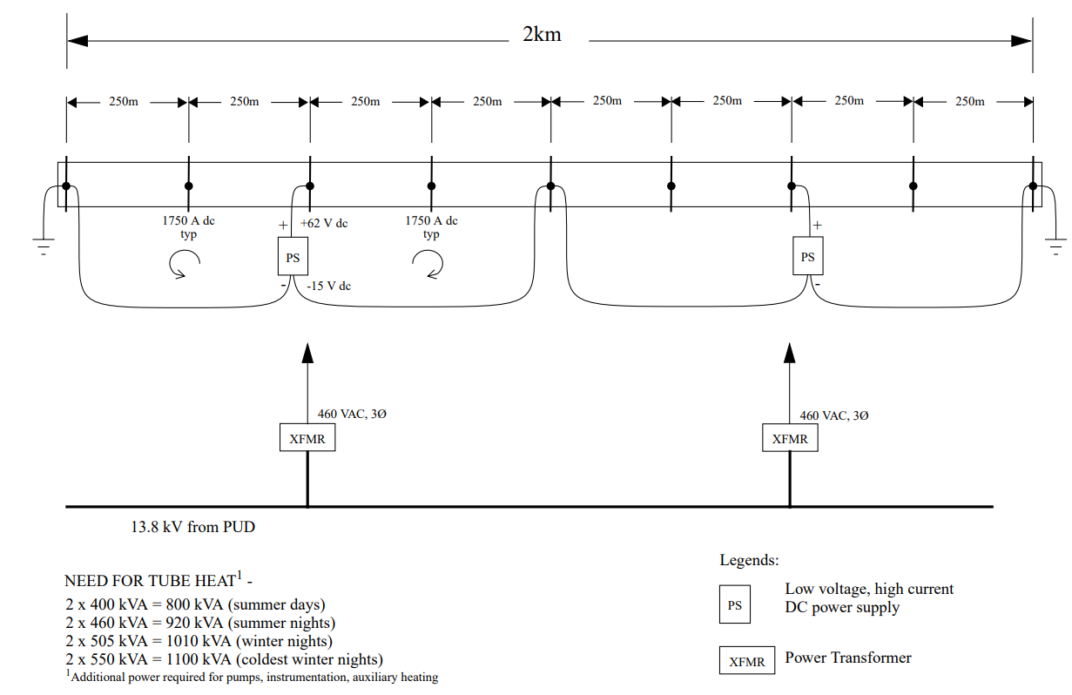
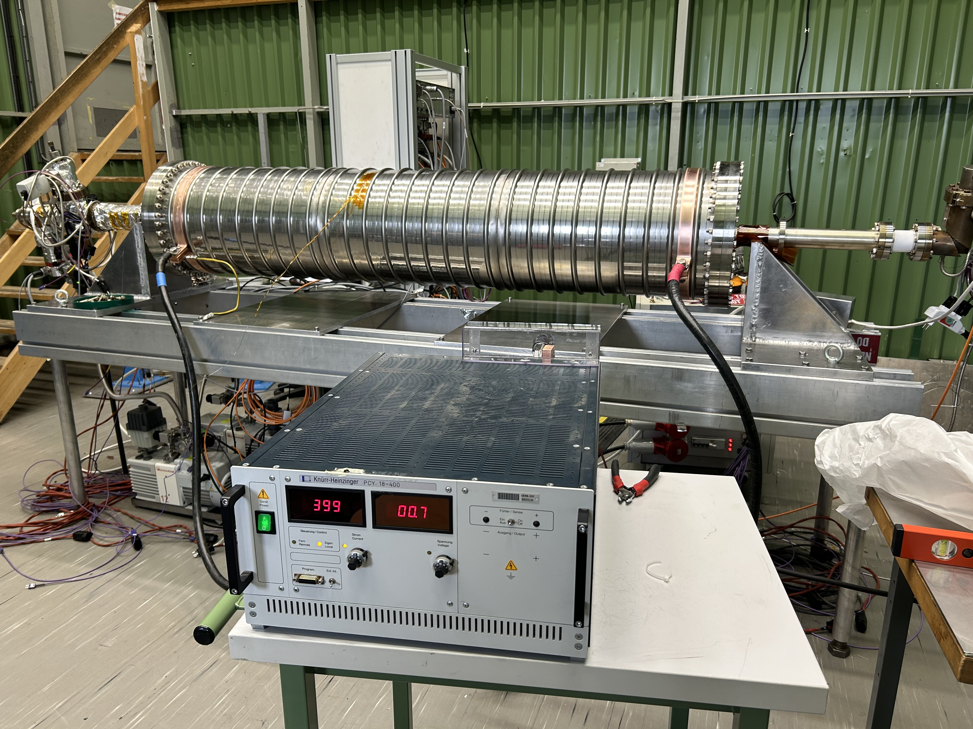
The bakeout of GWD beam pipes
To efficiently bakeout the GWDs beam pipes, we can re-use direct joule effect (beam pipe = conductor).
LIGO bakeout
electrical heating power
(LIGO-G970071-00-P)
Electrical test of a power supply on an
ET corrugated prototype
(400 A max)

Slide 3
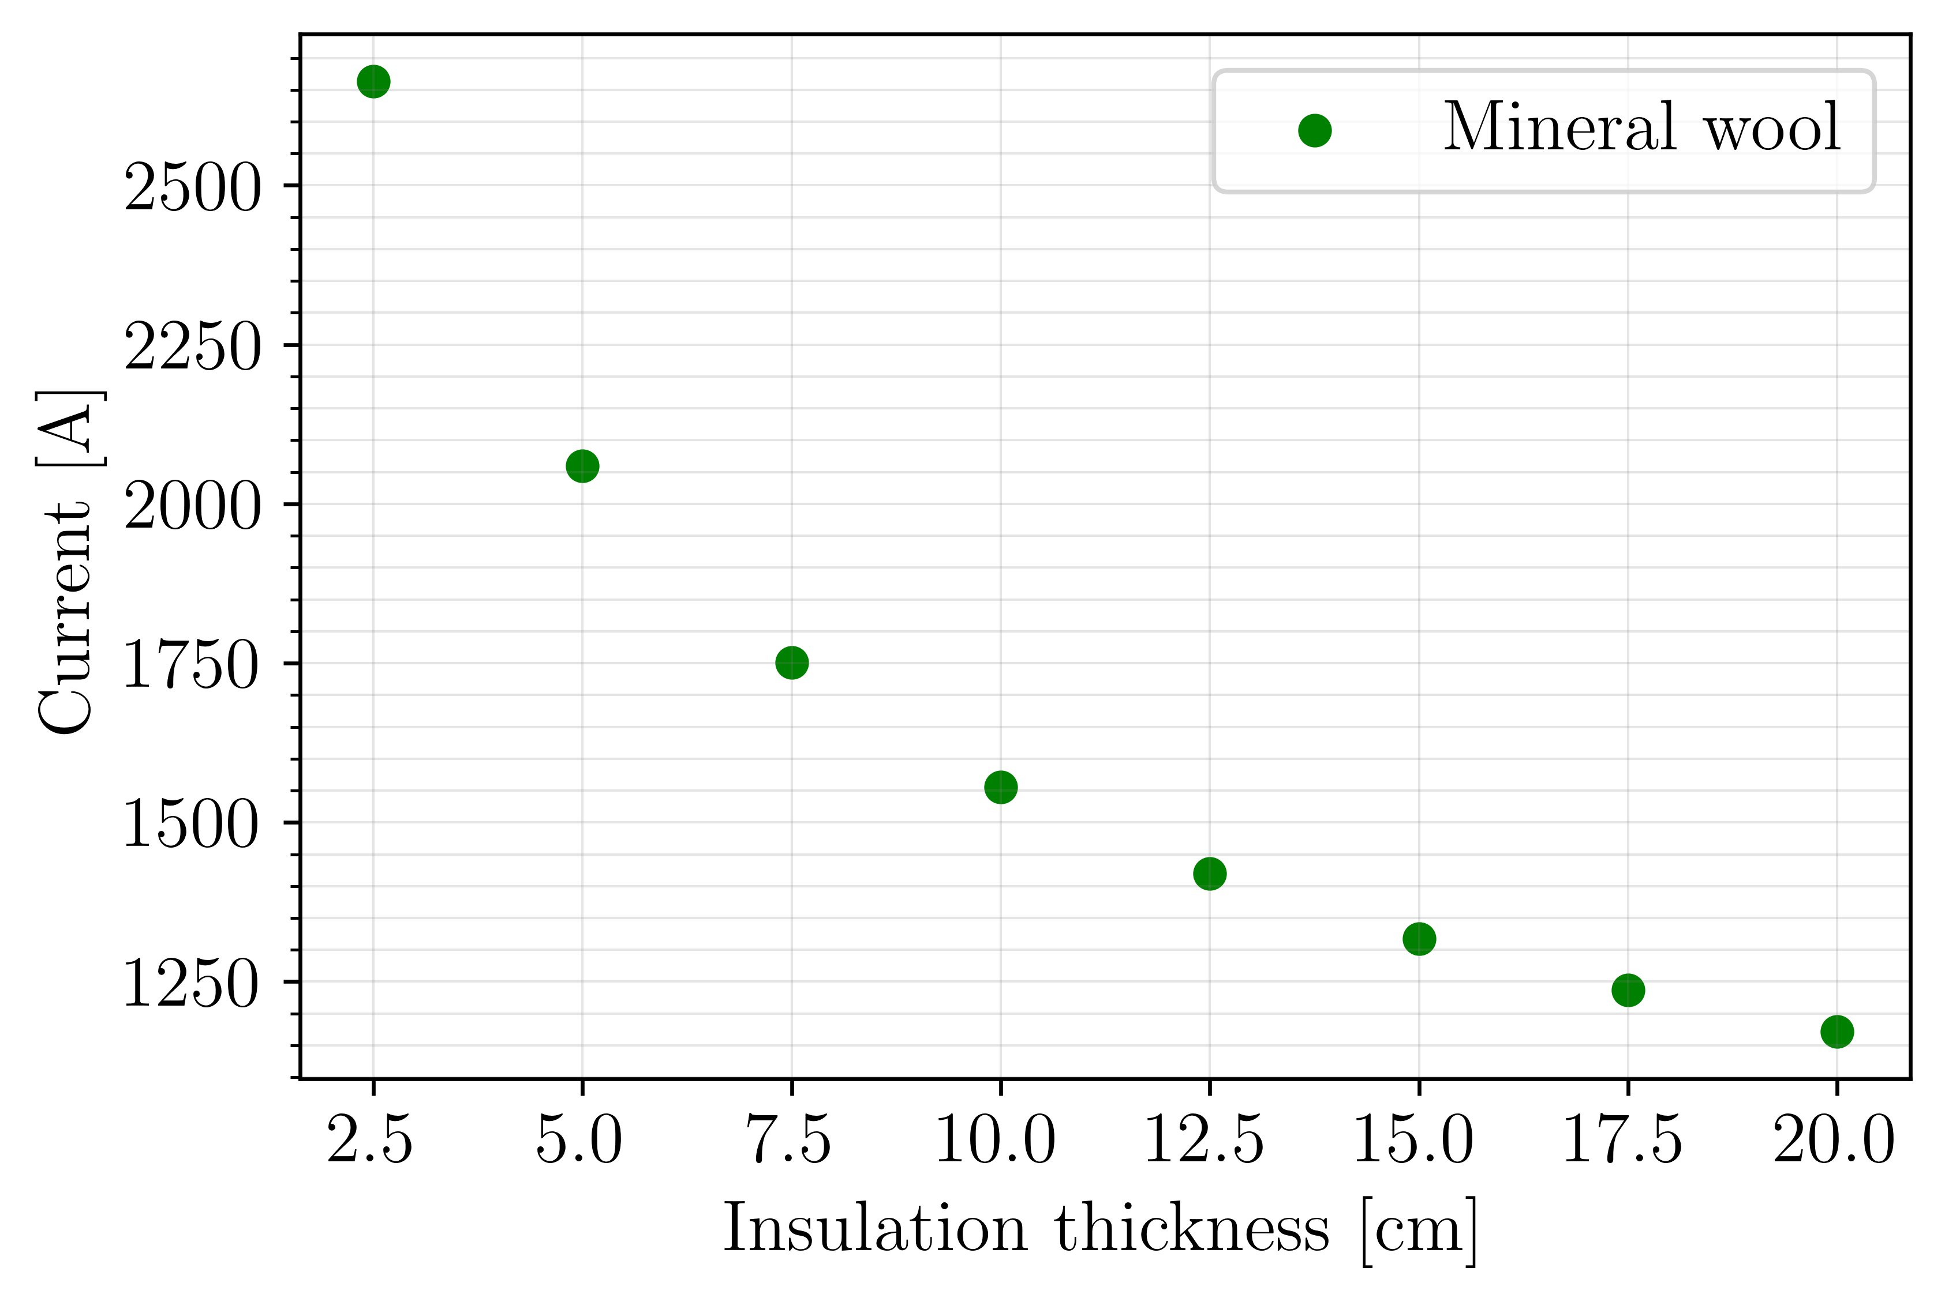
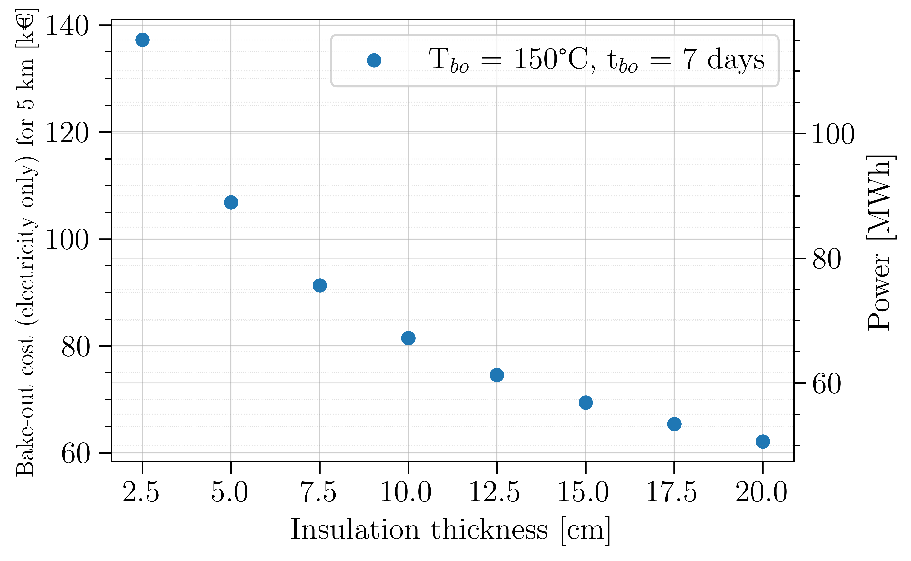
Why do we need insulation?
Limiting heat losses = limiting needed current = lower costs
The system is foreseen to be baked one, maximum two times over 50 years of operation (150°C max).
K_{mineral wool} : 3.65E-7 ΔT²+1.44E-4*ΔT+4.89E-2 W m⁻¹ K⁻¹, ΔT: 130°C (150°C-20°C). Convection coefficient (h): 5 W m⁻² K⁻¹ (calm air, no forced ventilation)

Slide 4
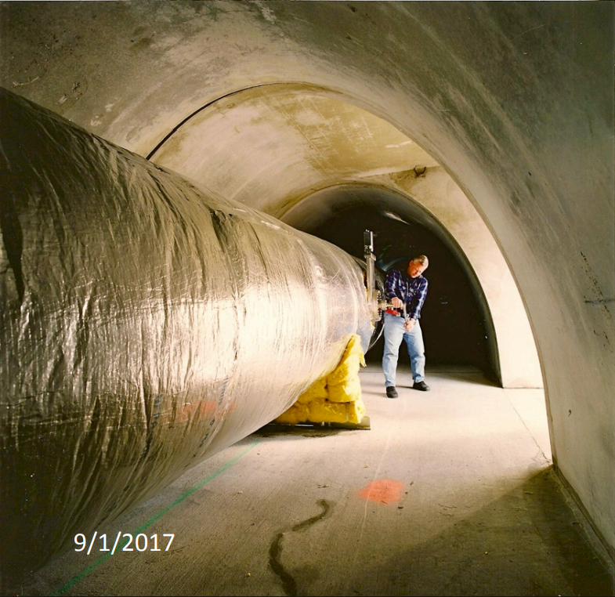
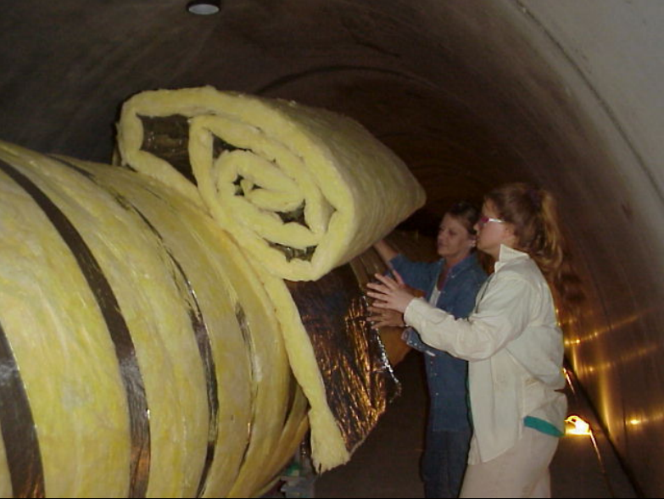
The problem of LIGO and VIRGO approach
Insulation: 15 cm mineral wool (double layer of 7.5 cm) permanently installed.
For ET
Surface to be covered: ~380.000 m² (120 km)
Cost of insulation (mineral wool 10 - 15 cm): ~48 – 60 €/m²
Total insulation cost [€]: ~ 18 - 23 M €
Other concerns:
Depreciation cost if permanently installed?
Storage?
Sustainability?
Cleanliness and dust generation?
Safety (smoke, fire generation, installation, etc.)?
Images courtesy of M. Zucker and R. Weiss

Slide 5
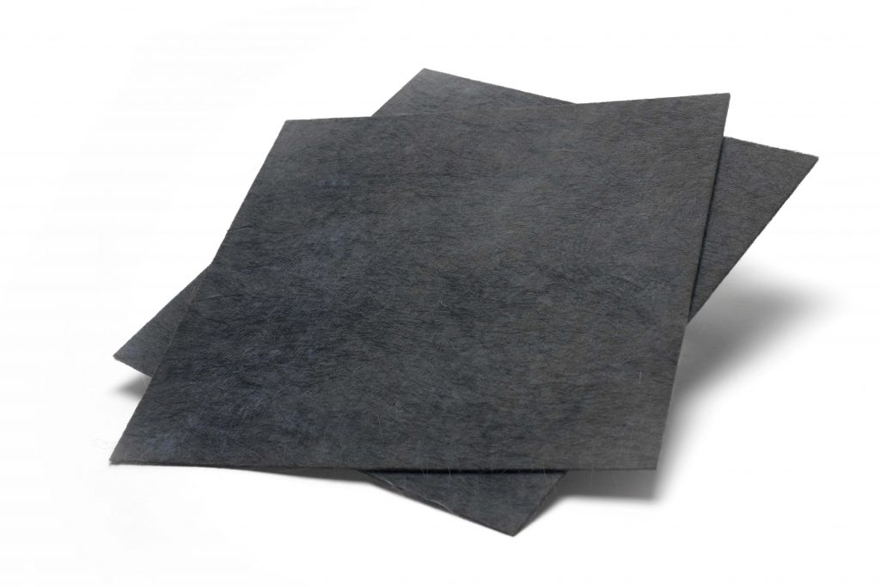
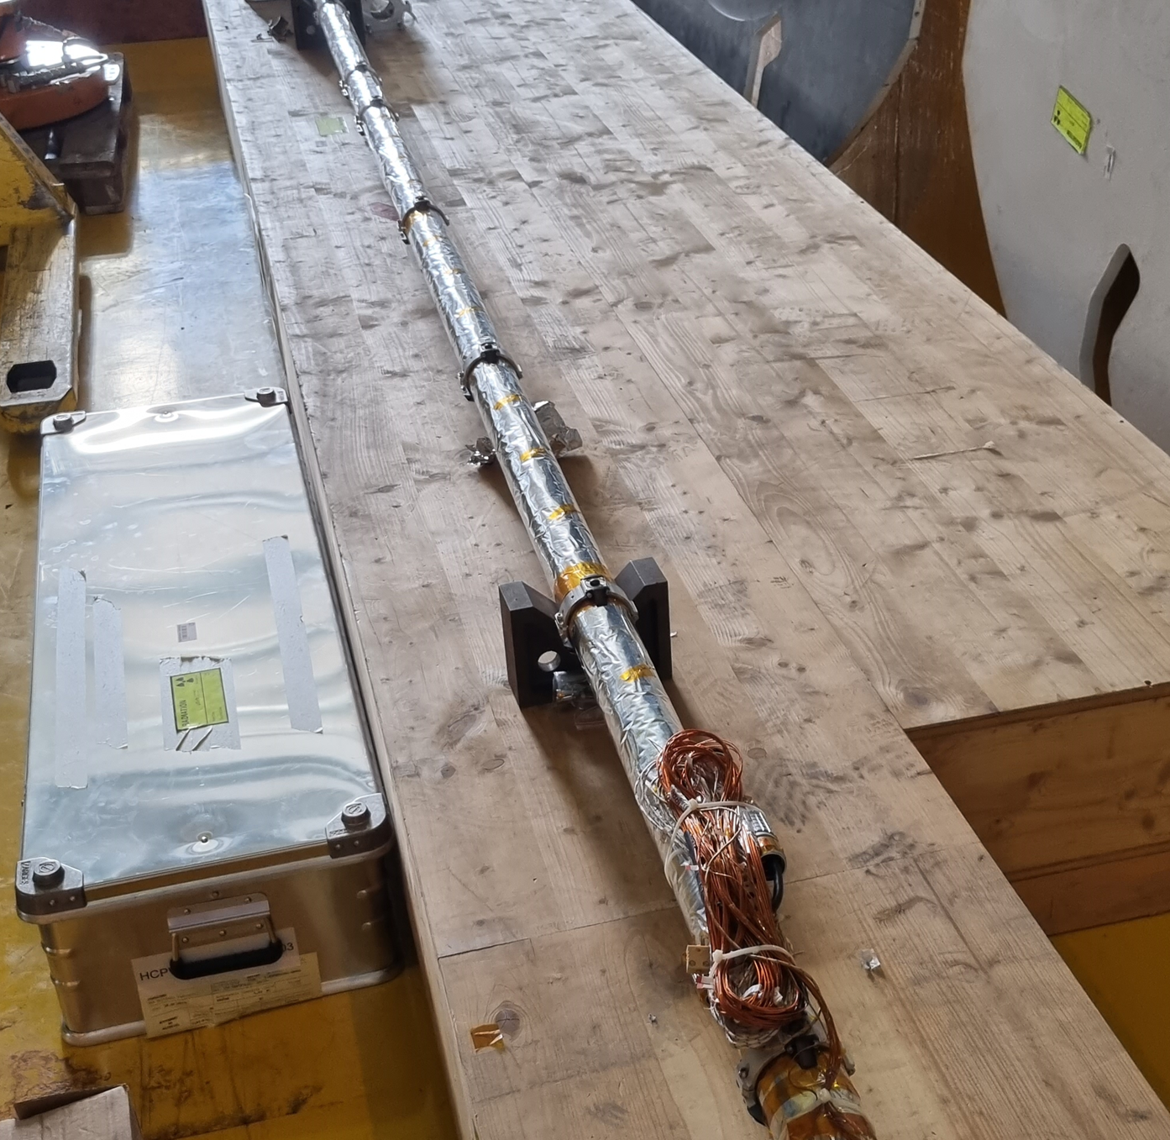
Some alternative materials to mineral fibers
Aerogel
Thermal Conductivity (λ) Range: 0.015-0.025 W m⁻¹K⁻¹
Pros
Extremely low thermal conductivity
Thin
Lightweight
Hydrophobic
Flexible
Cons
Expensive
Brittle
Powdery debris
Irritant and possibility of respiratory problems

Slide 6
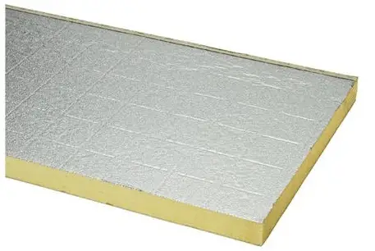
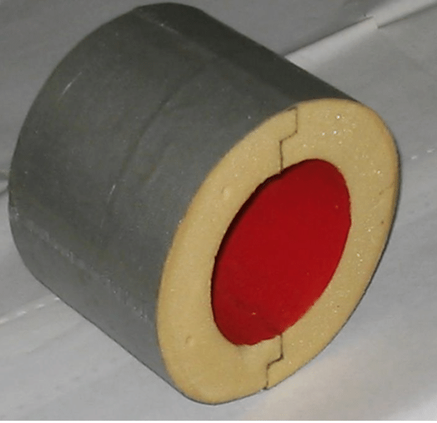
Some alternative materials to mineral fibers
Polyurethanic foam
Thermal Conductivity (λ) Range: 0.02-0.03 W m⁻¹K⁻¹
Pros
Very low thermal conductivity
Available in various thicknesses
Highly durable
Lightweight
Cons
Sometimes more expensive than fibre-based materials
Off-gassing
Lower operating temperature

Slide 7
Development of a new thermal insulation for ET
No explicit requirement from the project (ET). Project developed by CERN and PIEP (PT)
 | Target value | Maximum value
Insulation thickness [cm] | 10
Form | Reusable shells
Maximum operating temperature [°C] | 400 | 300
Thermal conductivity k [W m⁻¹ K⁻¹] (at 20°C) | < 0.04 | < 0.05
Thermal conductivity k [W m⁻¹ K⁻¹] (at 150°C) | < 0.05 | < 0.06
Reaction to fire (EN 13501-1) | Euroclass A1 | Euroclass A2
Smoke production (EN 13501-1) | S1 | S1
Droplets generation (EN 13501-1) | D0 | D0
Water vapour resistance factor | <1 | Not specified
Mechanical properties yet to be determined

Slide 8
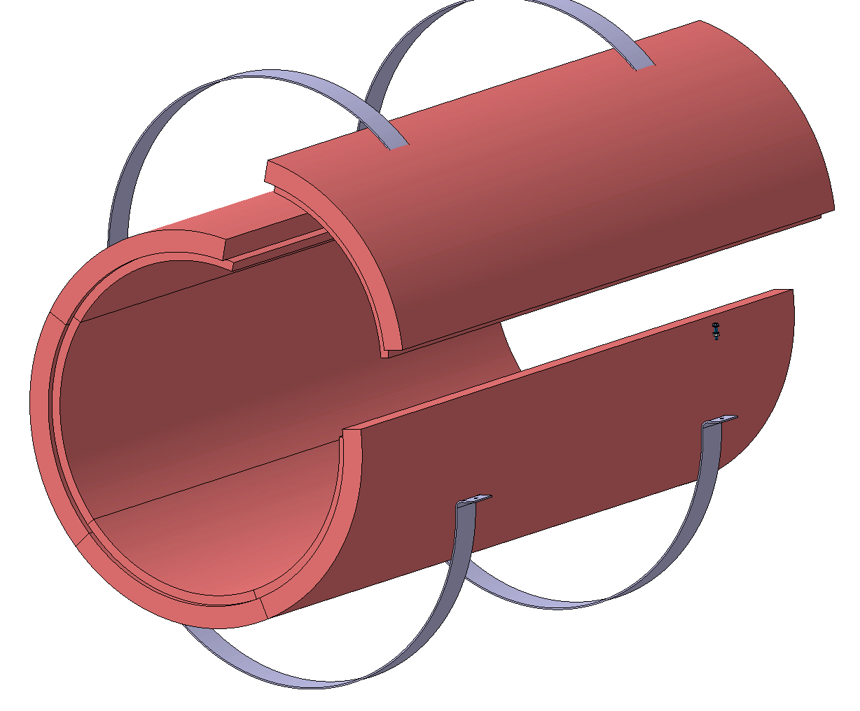
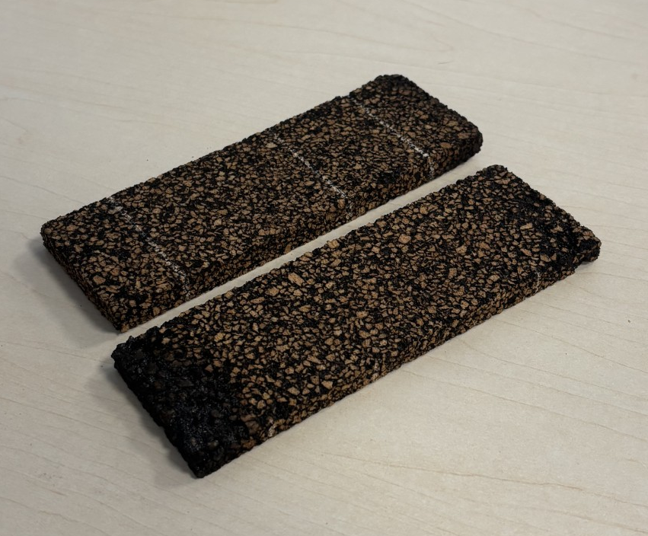
Development of a new thermal insulation for ET
Objective of the project: development of sustainable, cheap and inflamable insulation for Einstein Telescope based on:
Cork + Bio-phenolyc foam
Fire retardant modified PIR
The material will be castable and made in shells.
Installation in ET-PS foreseen for Q3 2026

Slide 10
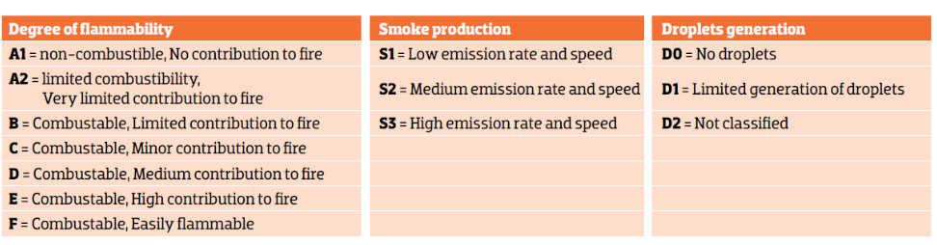
Source: KNAUF insulation

