Slide 1

Optimized Corrugated Tube Design
Cosmic Explorer Beamtube Experiment (CEBEX)
Beamtube Workshop #3 (29 Sep – 2 Oct 2025)
Caltech
30 Sep 2025 v1
Alberto Franco-Ordovas
Artist: Eddie Anaya (Cal State Fullerton)
LIGO-G2502143-v1

Slide 2
Scope
Corrugated design: Why?
Convolution geometry: Parameters & Selection
FEA Model:
Geometry & Python Script
BC’s + Set Up
Results
Parametric runs
Design Explorer (DX)
Results + Response Surfaces
Optimization
2

Slide 3
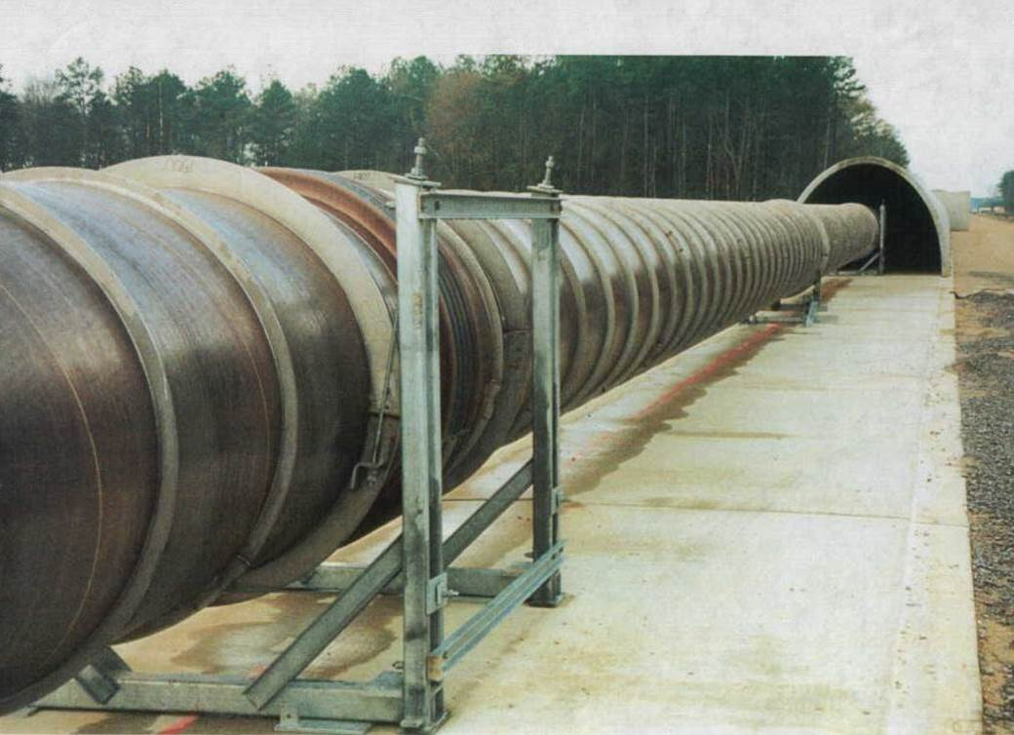
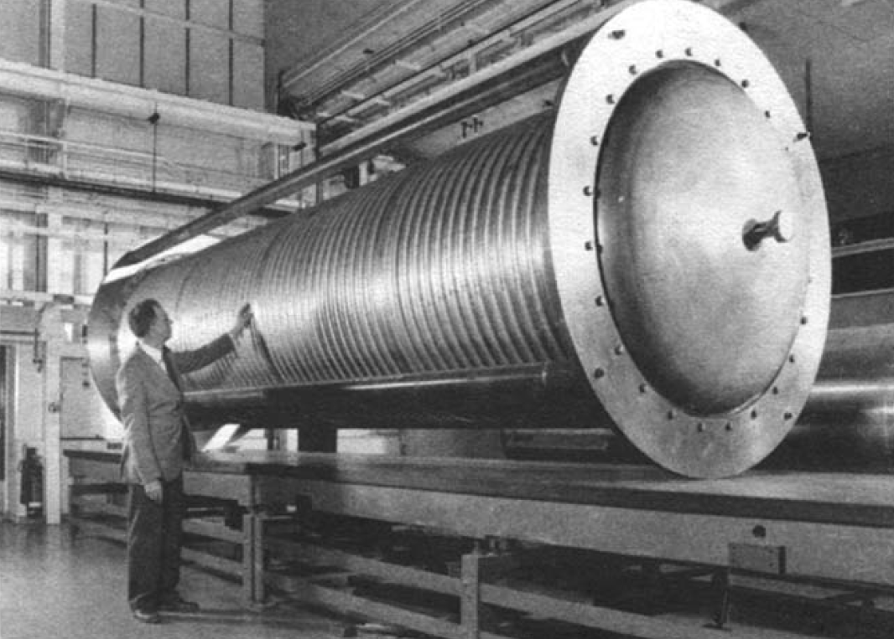
Corrugated Tube: WHY!?
Original LIGO:
3.2 [mm] wall thickness x 20 [m] x 1.2 [m]
Stiffener rings (welded)
Expansion joints (40 [m])
Corrugations could help with:
Improving buckling response (NO stiffener rings)
Absorbing thermal expansion (NO/Less exp. Joints)
Thinner wall
90’s vs 2020’s: better computational & manufacturing processes to help exploring
VS
3

Slide 4
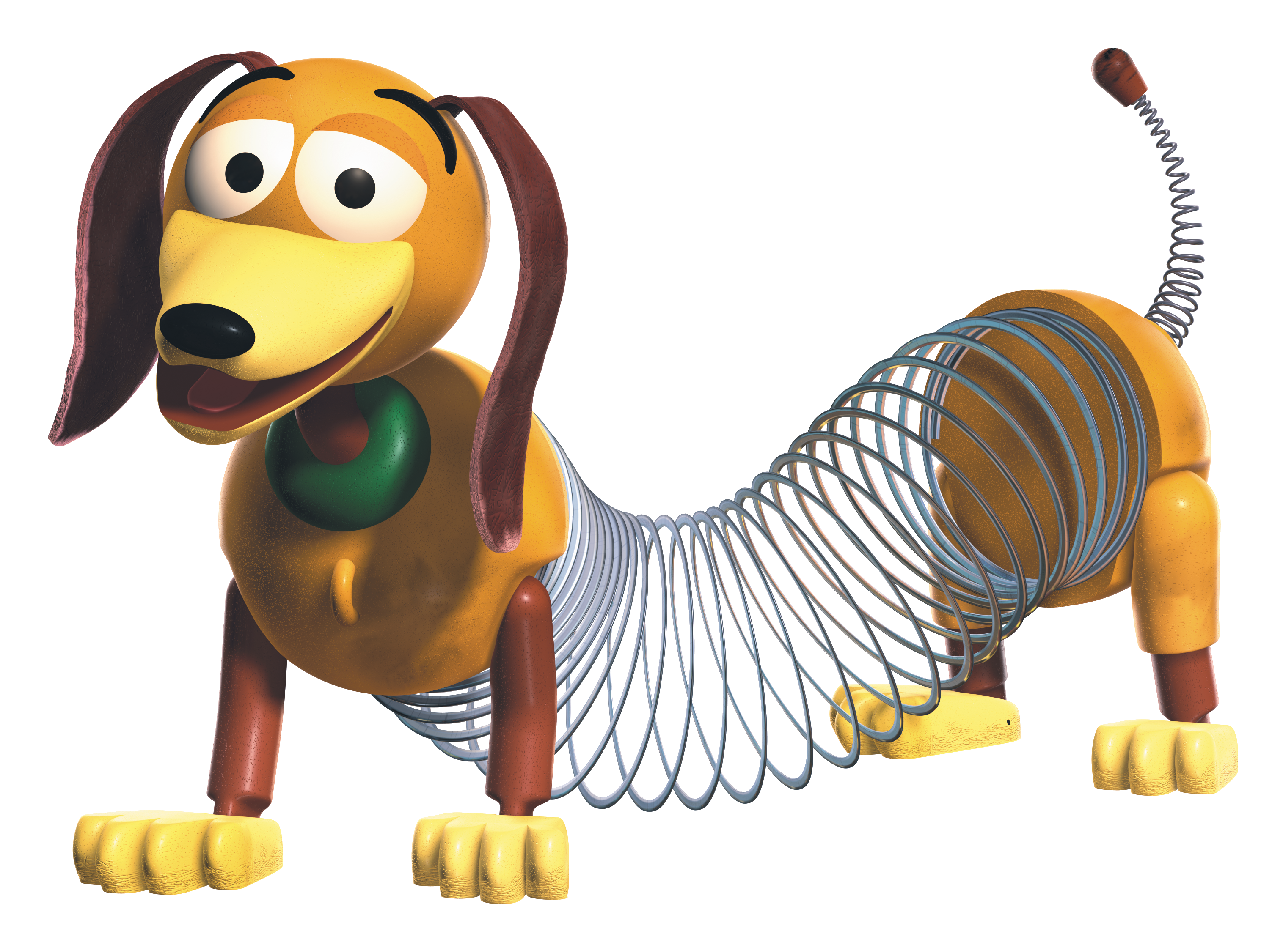
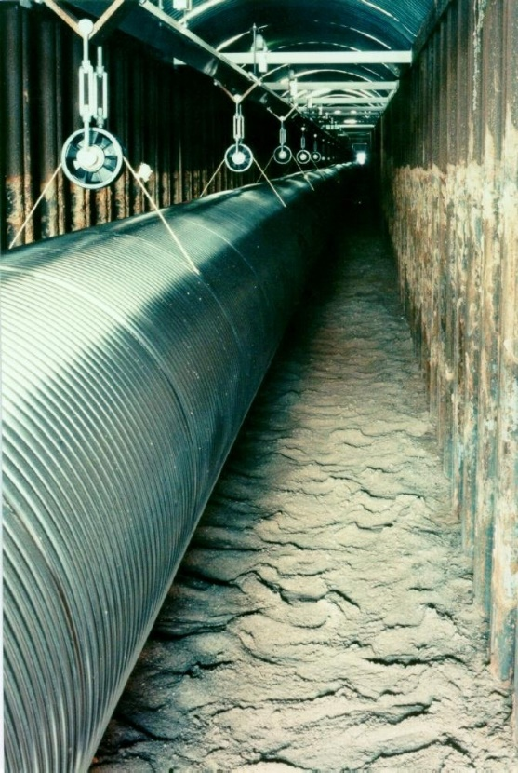
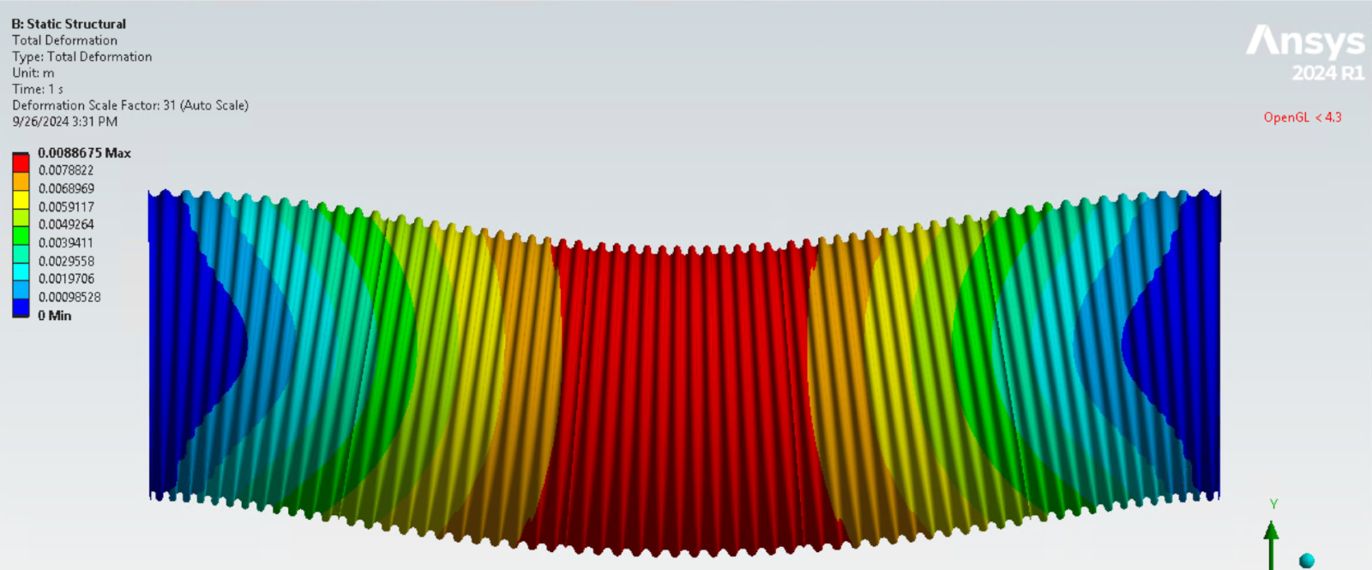
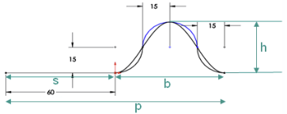
Previous Corrugated Tubes
GEO 600: Hung from the ceiling → For 40kms?!?!
Supports are also to be taken into account
Continued corrugation: too slinky if supports are not placed close enough
Trade-off: singular convolution modules: Flat span + Corrugation
GEO 600
4

Slide 5

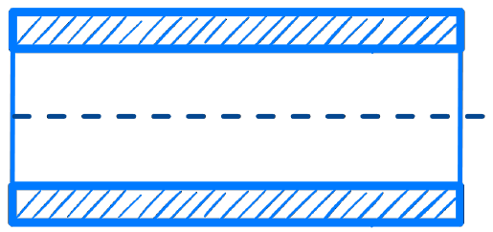

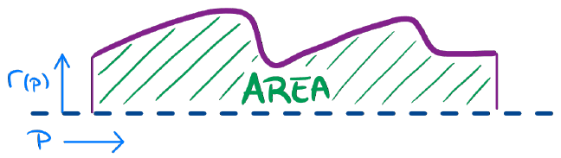
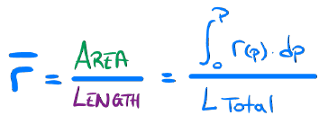
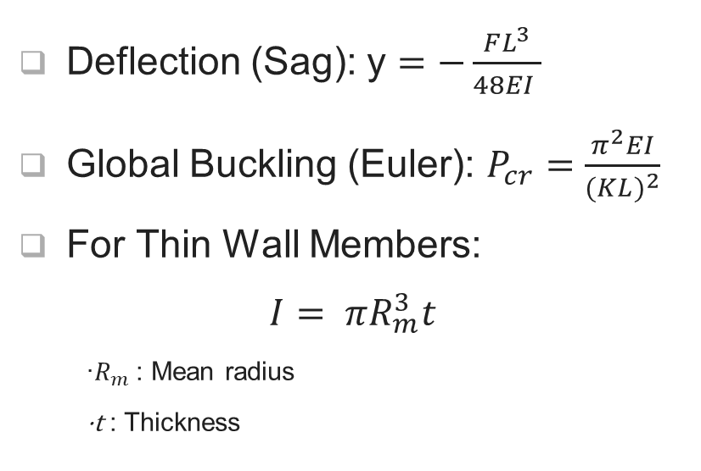
Convolution Geometry: Shape?
Deflection (Sag): y $=−\frac{FL^{3}}{48EI }$
Global Buckling (Euler): $P_{cr}=\frac{π^{2}EI}{{(KL)}^{2}}$
For Thin Wall Members:
$$I= πR_{m}^{3}t$$
·$R_{m}$: Mean radius
·t : Thickness

Slide 6
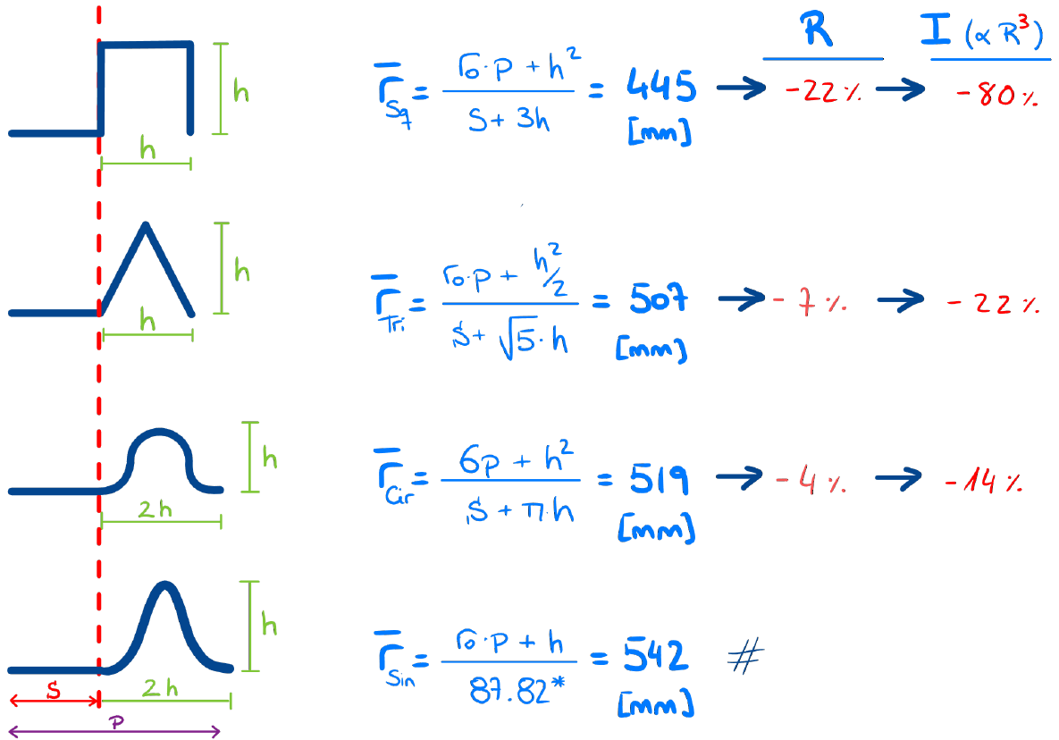
Convolution Geometry: Sinusoidal
Numerical values for:
h = 30 [mm]
P = 120 [mm]
The sinusoidal corrugation provides a better performance

Slide 7
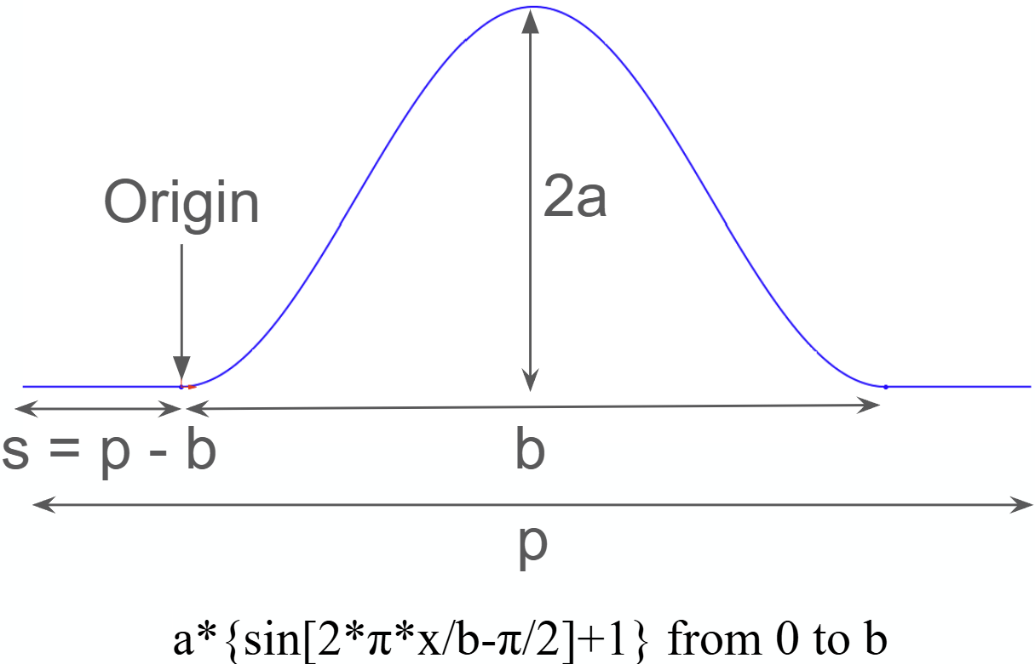
Convolution Geometry
Sinusoidal Corrugation Parameters:
Amplitude: a
Period: b
Pitch: p
Beamtube Parameters:
Thickness: t
Length: L (*)
4 Parameters: How to find an “optimal” space? Through Parameter Correlation!
FEA Model
Design Points
Input/Output Param
Response Surface
Optimization

Slide 8
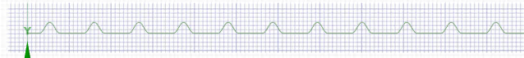
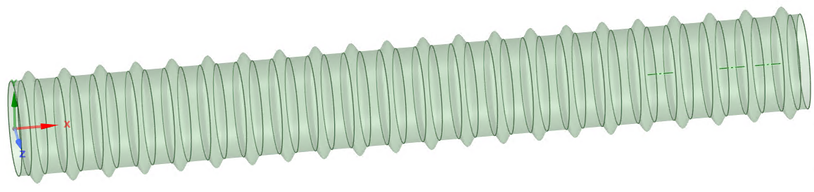
FEA Model: Geometry Definition
Initial geometry: 2D Sketch
Final geometry: 3D Shell
A Python Script is needed to generate the geometry from scratch every run
Otherwise, the input parameters (a, b, p) cannot be modified once the 2D sketch has been revolved and became a 3D Shell body.

Slide 9
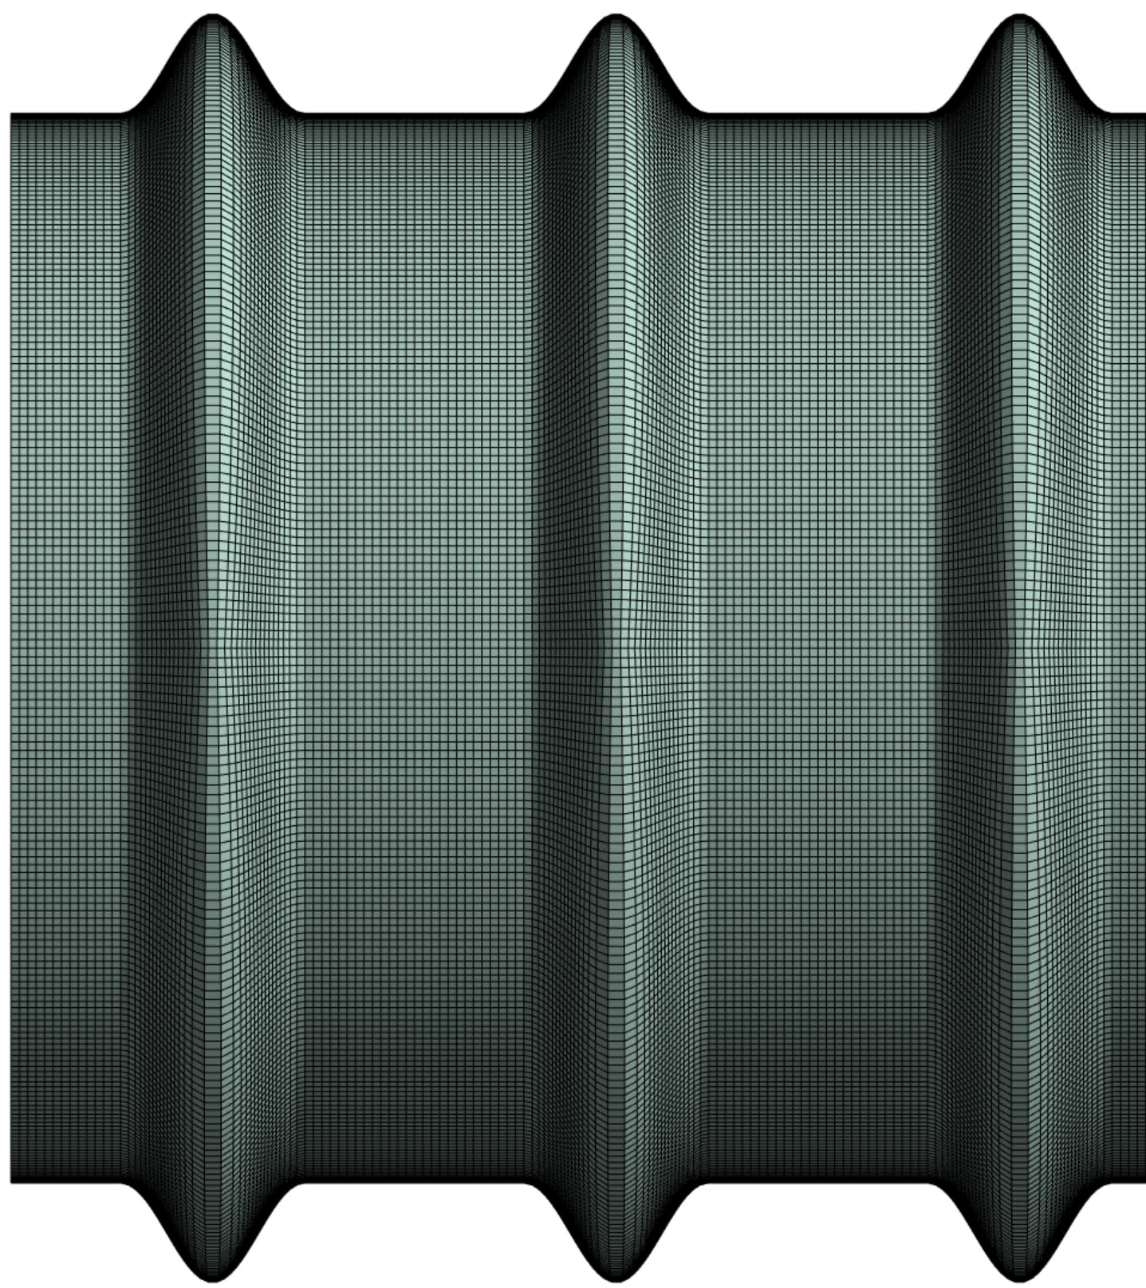
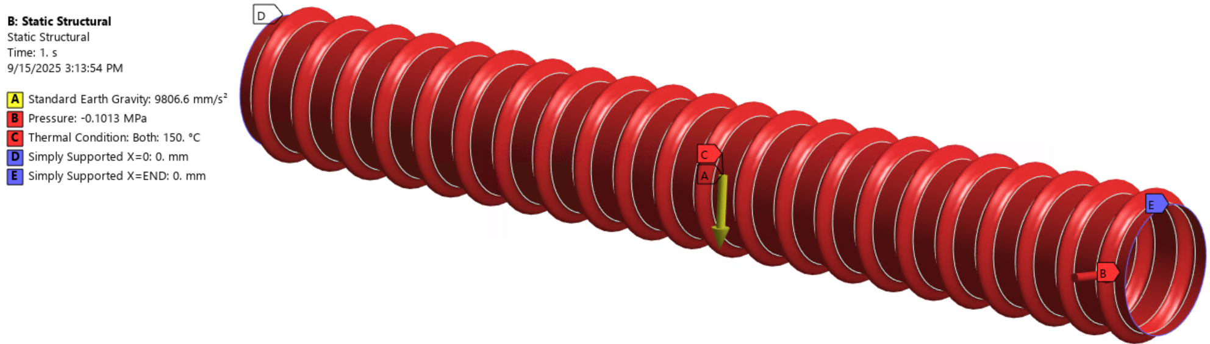
FEA Model: BC’s & Configuration
Boundary conditions implemented:
Gravity + Bakeout (@ 150ºC) + Inner Vacuum
All through “Named Selections”: automatization
Mesh defined: 10x10 [mm]
9

Slide 10
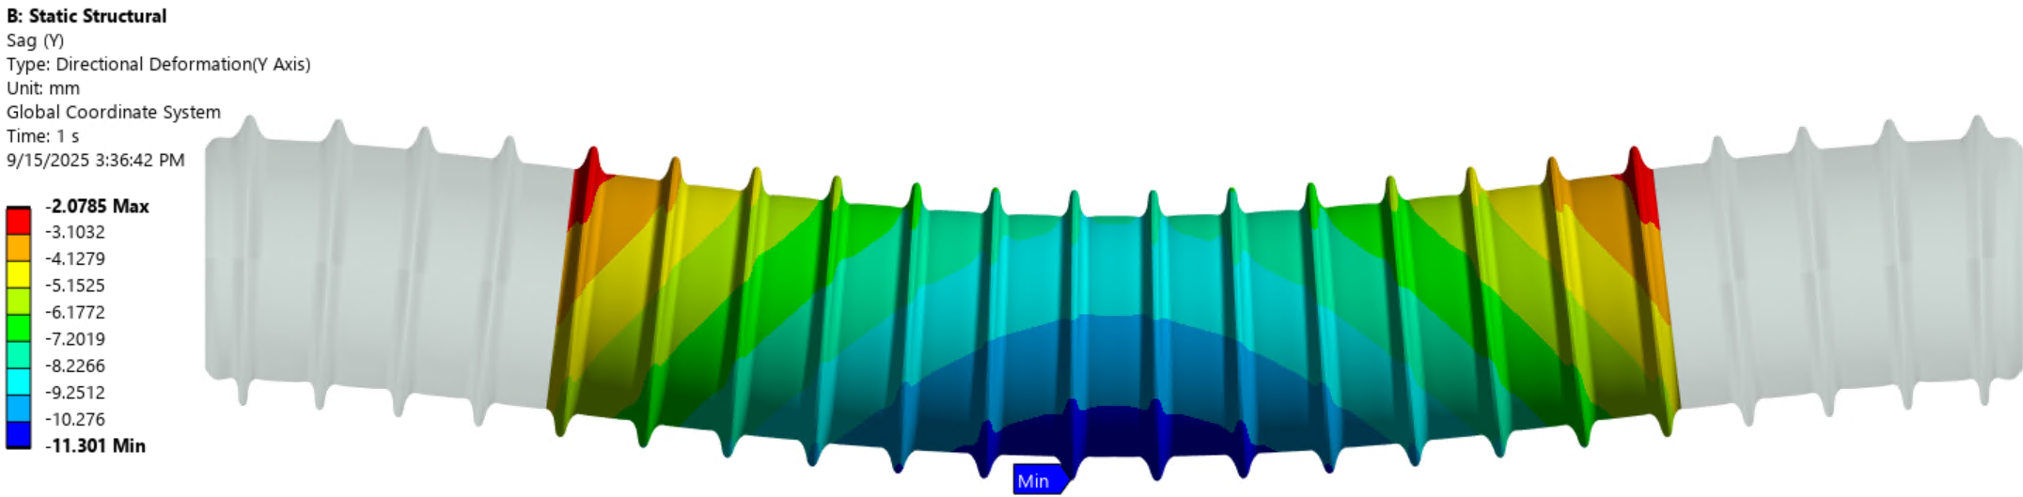
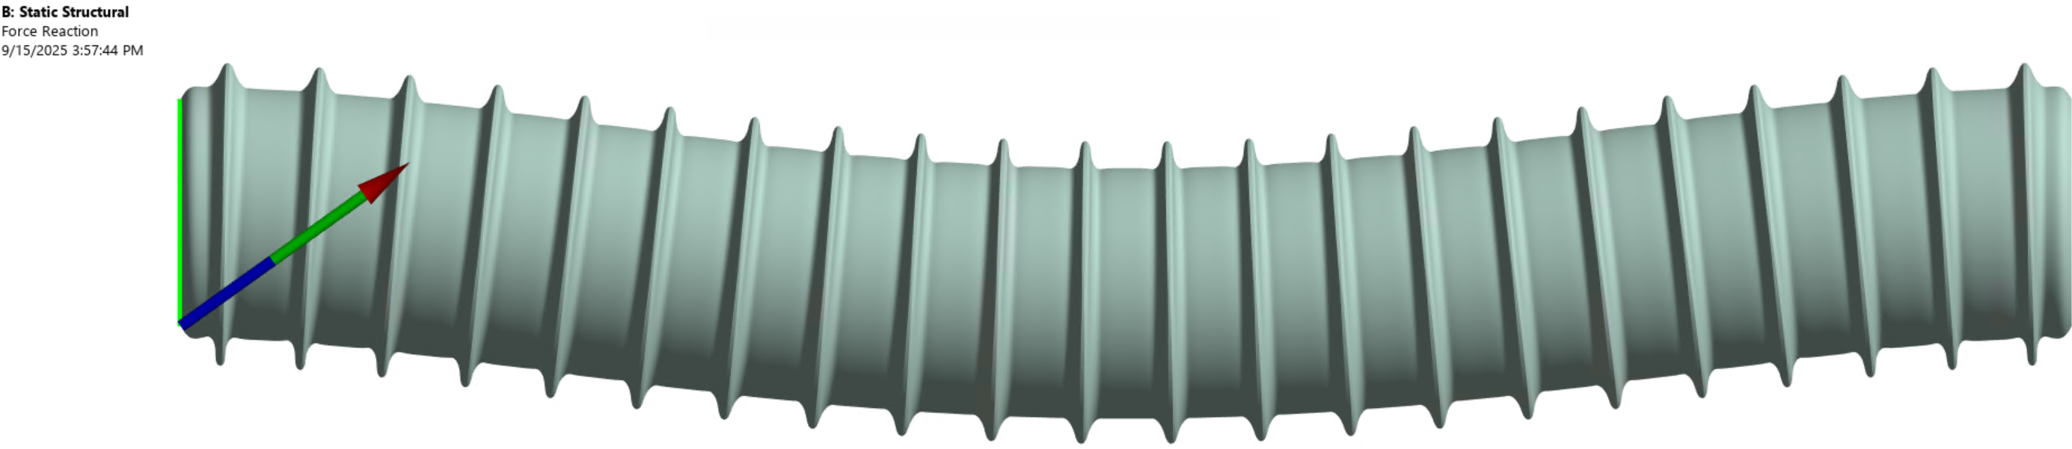
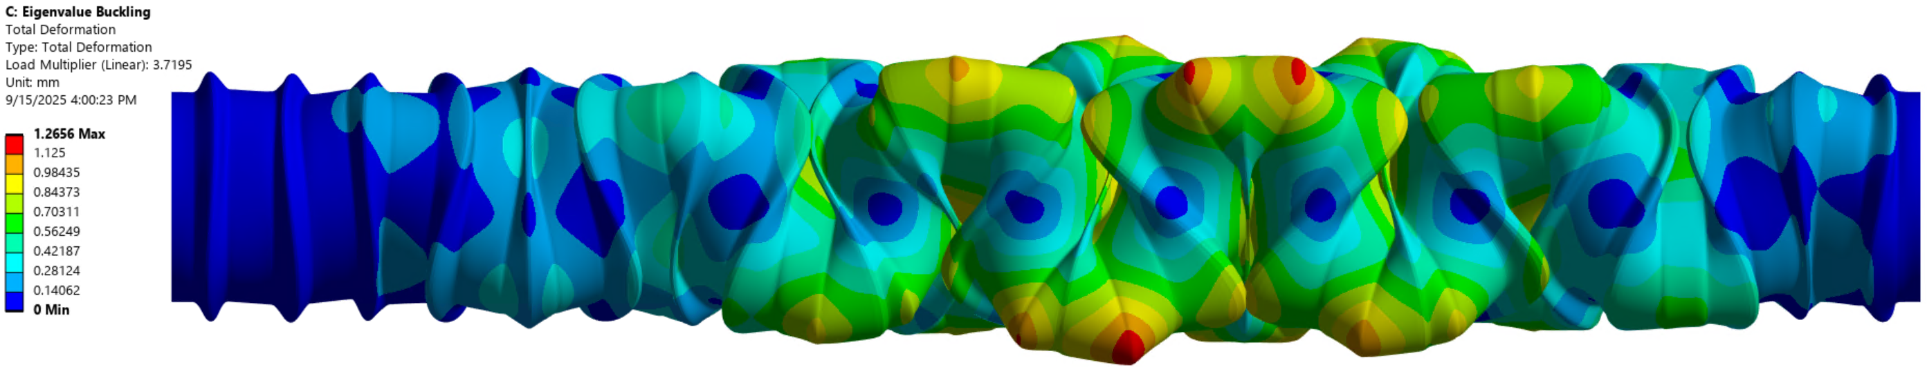
FEA Model: Results to observe
The following results were set as Output Parameters
Sag: Deflection at the beamtube center
Reaction Forces: X & Y axis at Supports
Buckling Factor: Global buckling
10

Slide 11
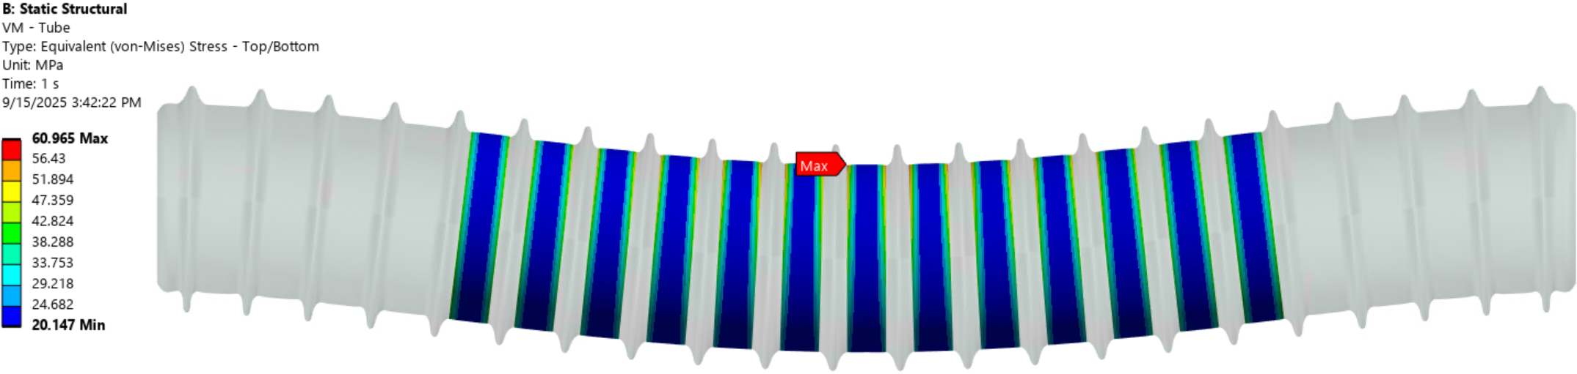
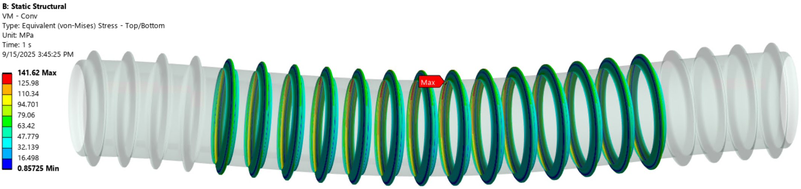
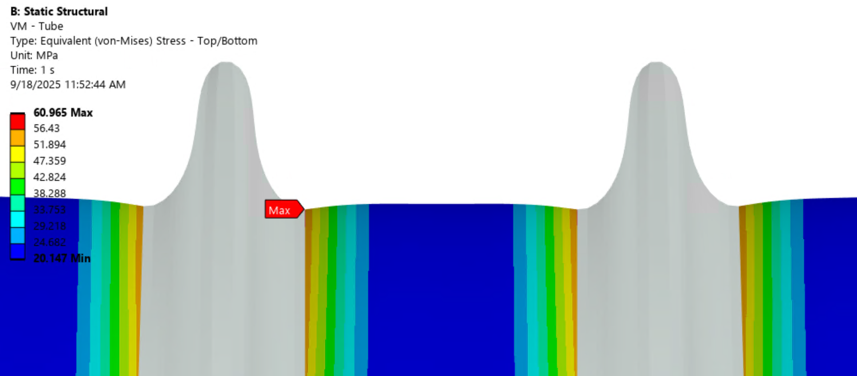
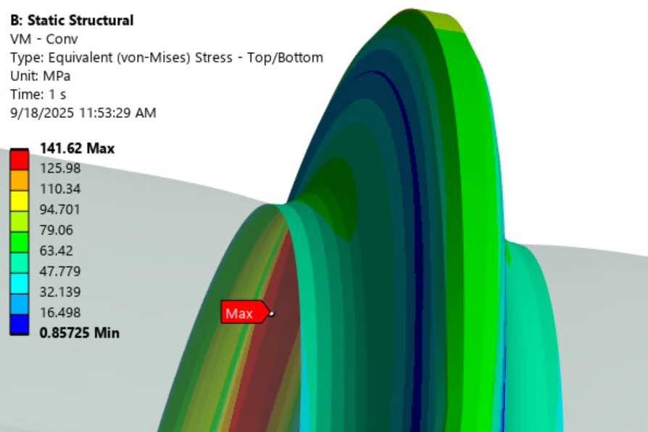
FEA Model: Results to observe
The following results were set as Output Parameters
Von-Mises: Max Stress at flats & convolutions, for a better understanding
11

Slide 12
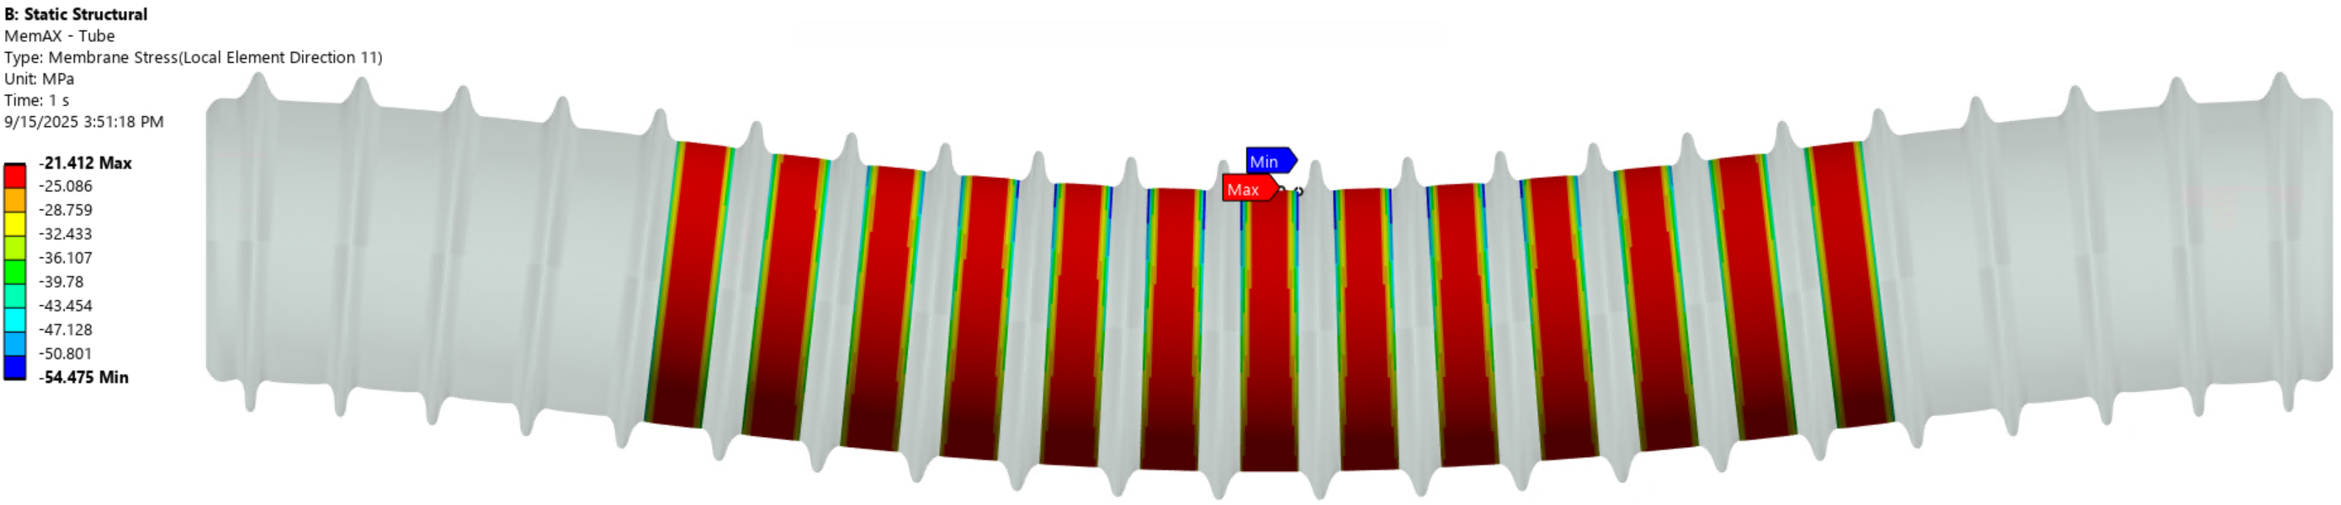
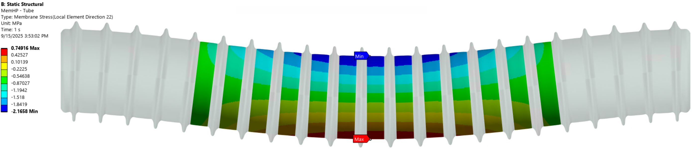
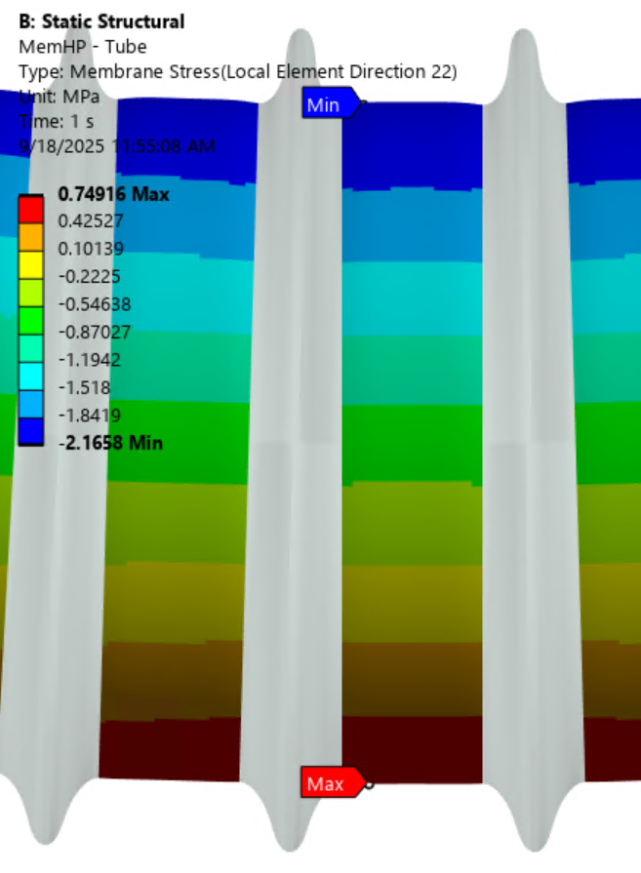
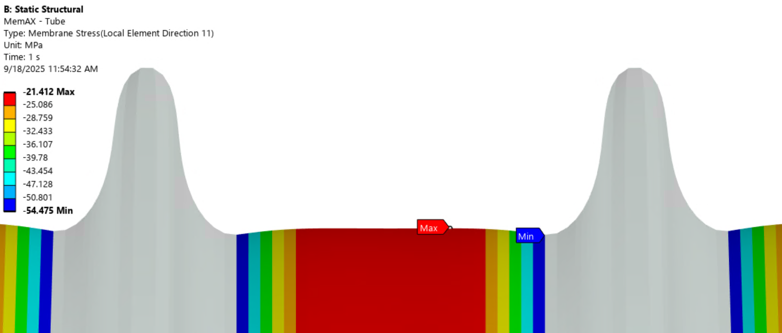
FEA Model: Results to observe
The following results were set as Output Parameters
Membrane: Max/Min at flats for Axial (left) and Hoop (right)
12

Slide 13
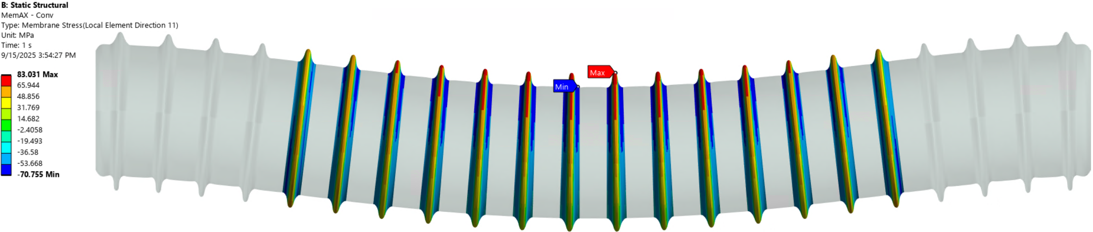
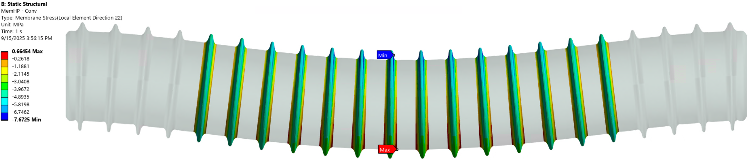
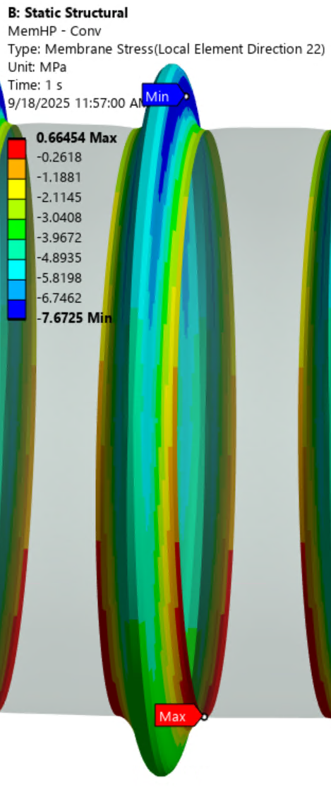
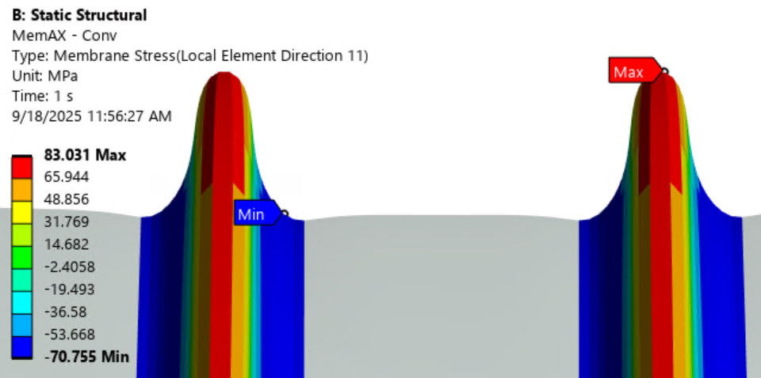
FEA Model: Results to observe
The following results were set as Output Parameters
Membrane: Max/Min at corrugations for Axial (left) and Hoop (right)
13

Slide 14
FEA Model: Results to observe
The following results were set as Output Parameters
To wrap-up: 14 output parameters total
RESULT | PARAMETERS | LOCATION
Sag (Y) | Min | Mid beamtube
Force Reaction | X, Y | Ends
Buckling Factor | Load Multiplier | Global
Von Mises – Tube | Max | Central flat: boundary w conv
Von Mises – Convolution | Max | Central conv: peak, inner face
Tube – Membrane Axial | Min, Max | Central flat
Tube – Membrane Hoop | Min, Max | Central flat
Conv – Membrane Axial | Min, Max | Central conv: peak & valley
Conv – Membrane Hoop | Min, Max | Central conv: valleys
14

Slide 15
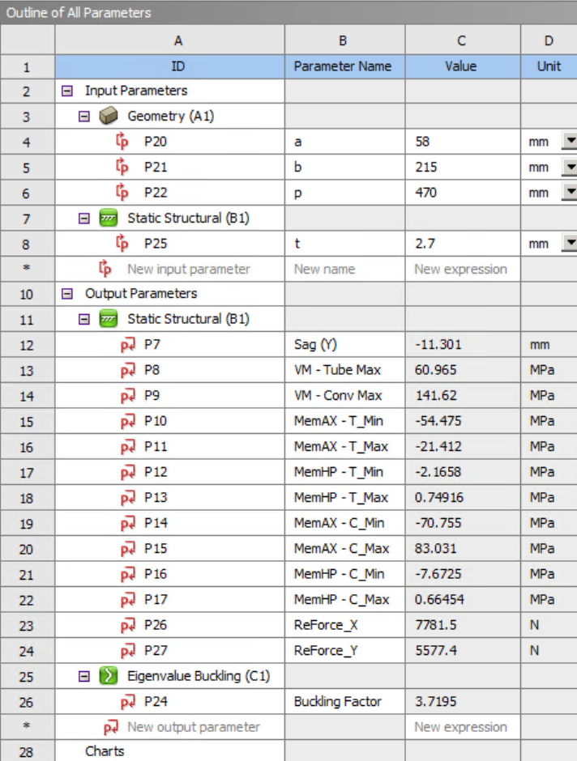
Parametric Runs: Creating a data pointcloud
Parameters Set: all parameters displayed
Need to define range of study for input Par
a: 40 to 80 [mm], b: 120 to 240 [mm], p: 300 to 700 [mm]
t: 2 to 3.5 [mm]
Need to define Design of Experiment Method
Central Composite Design: Face centered
This settles the way DX will select the Design Points to calculate so they properly cover the design space.
Once all the DPs are done: Meta Model
Surface type: Kriging, variable.
This defines the algorithm used to study the correlation among DPs to create response surfaces (prediction)

Slide 16
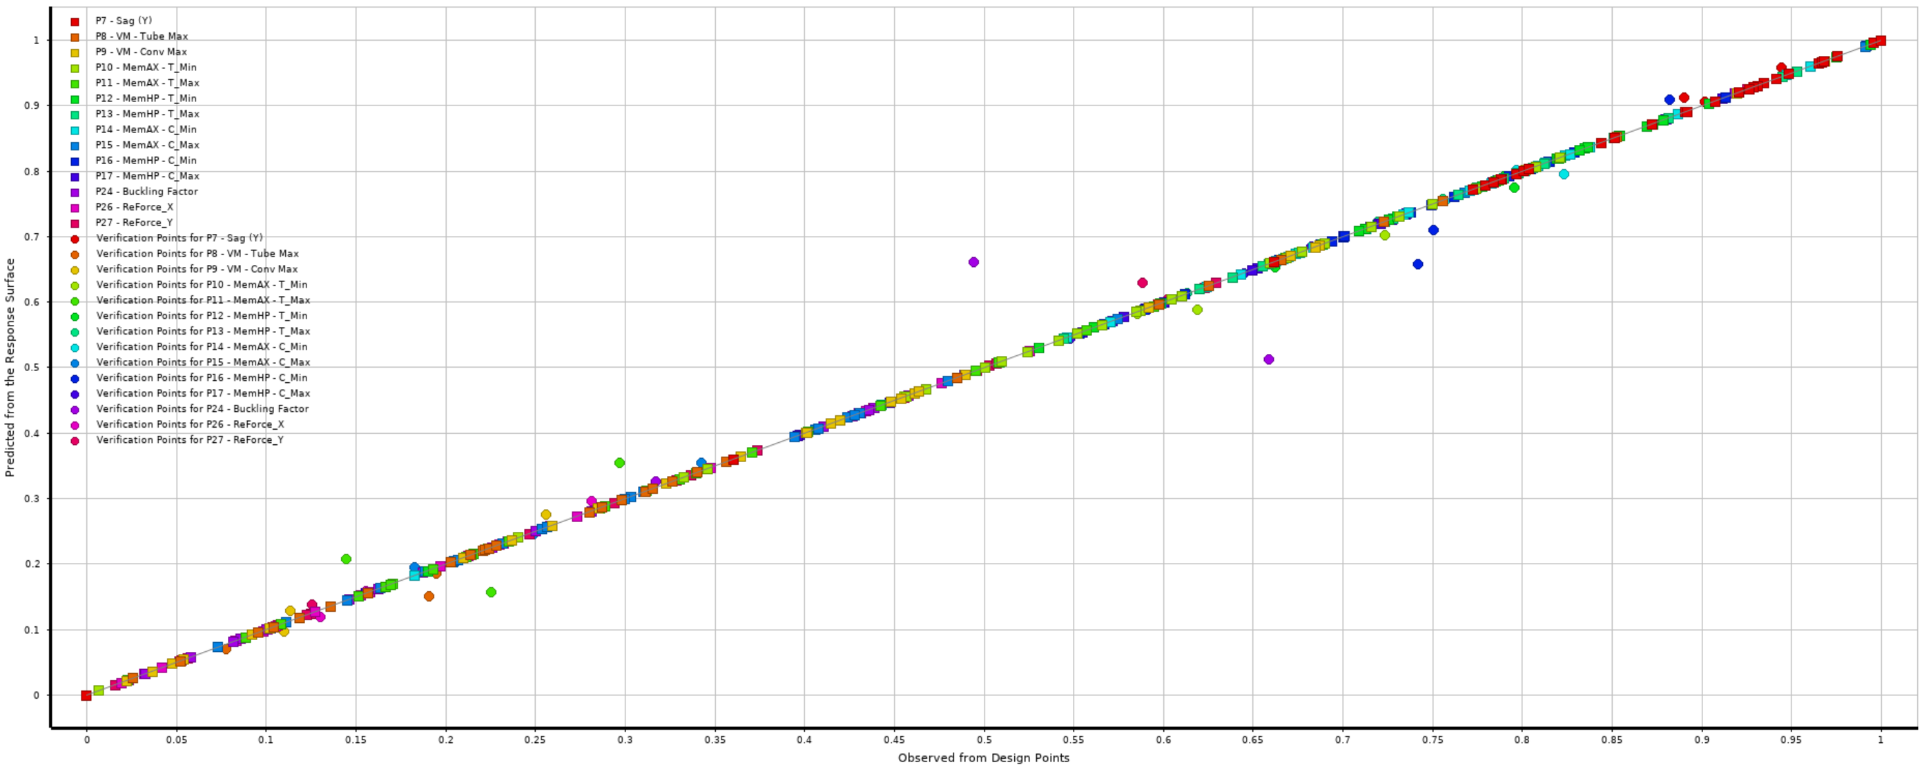
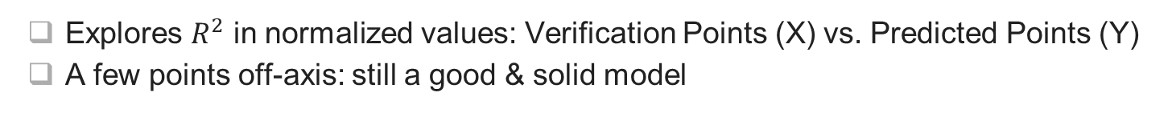
Design Explorer (DX) Results
Goodness of Fit
Explores $R^{2}$ in normalized values: Verification Points (X) vs. Predicted Points (Y)
A few points off-axis: still a good & solid model

Slide 17
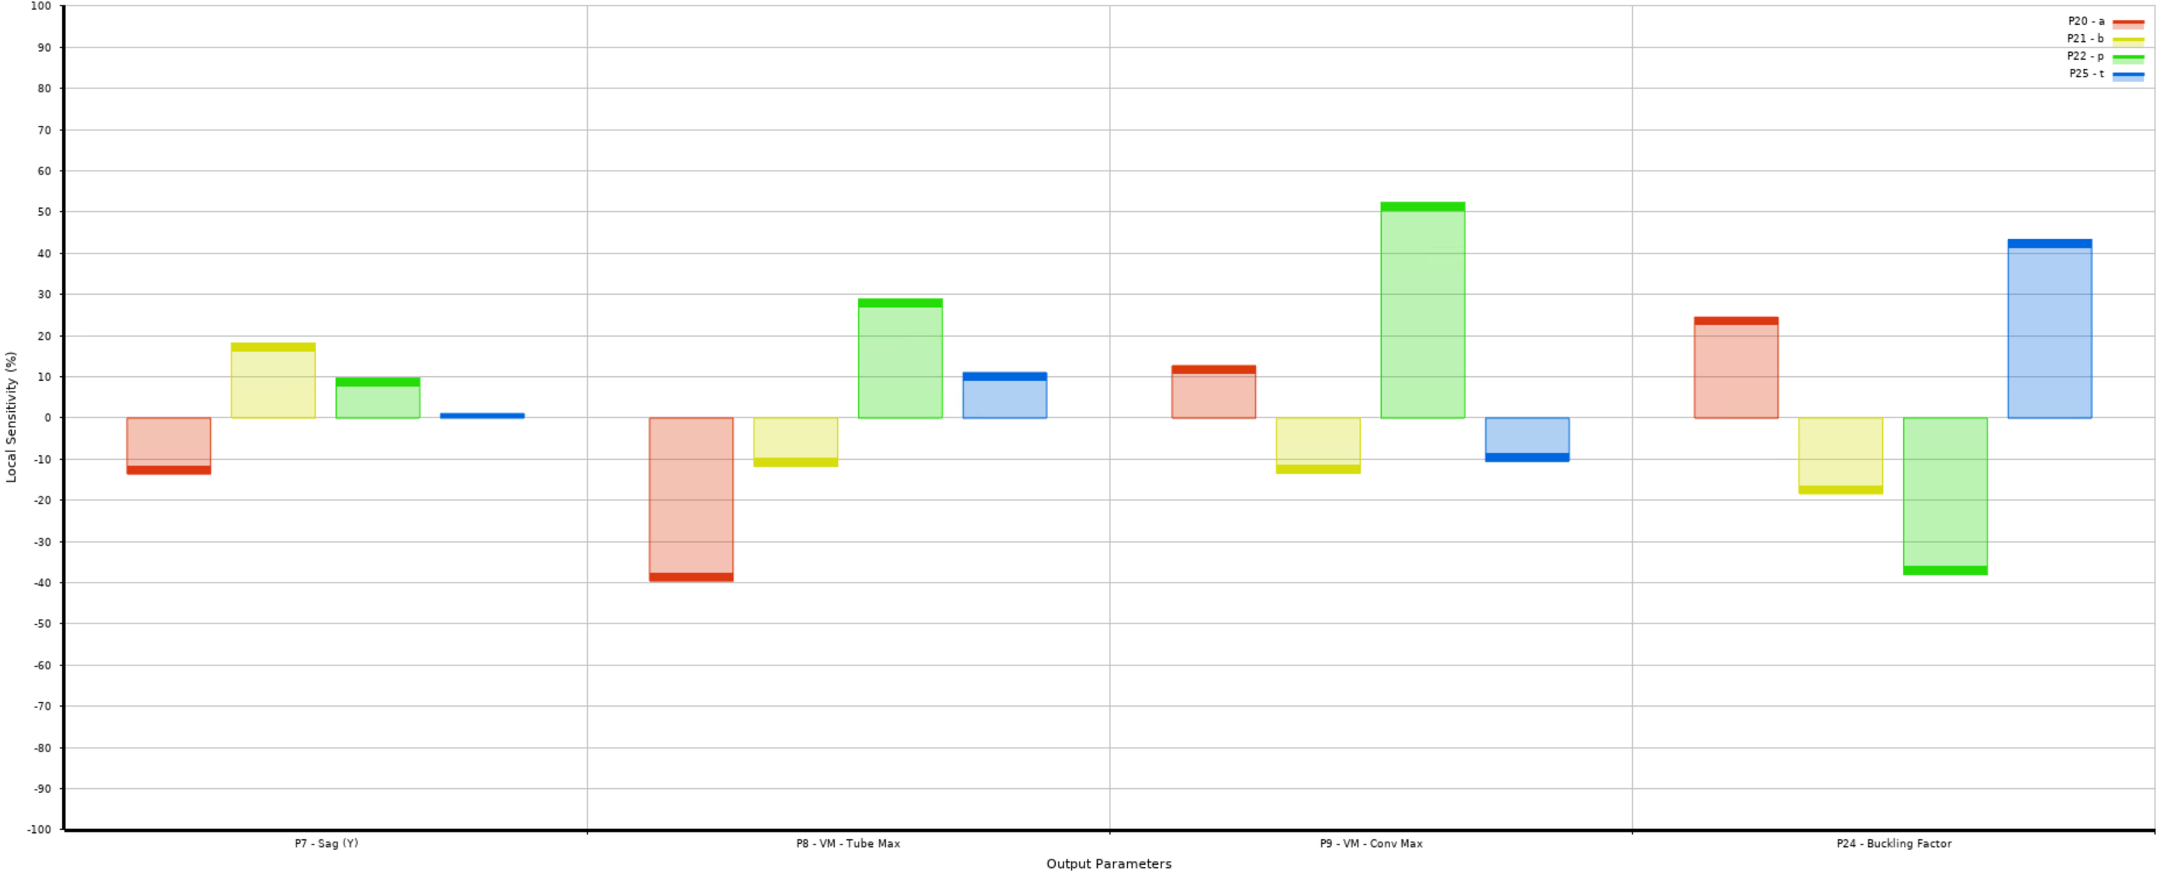
Design Explorer (DX) Results
Local Sensitivity
Measures input parameters impact on output parameters
Key: a (red), b (yellow), p (green), t (blue)
Sag
Von-Mises: Tube MAX
Von-Mises: Conv. MAX
Buckling Factor

Slide 18
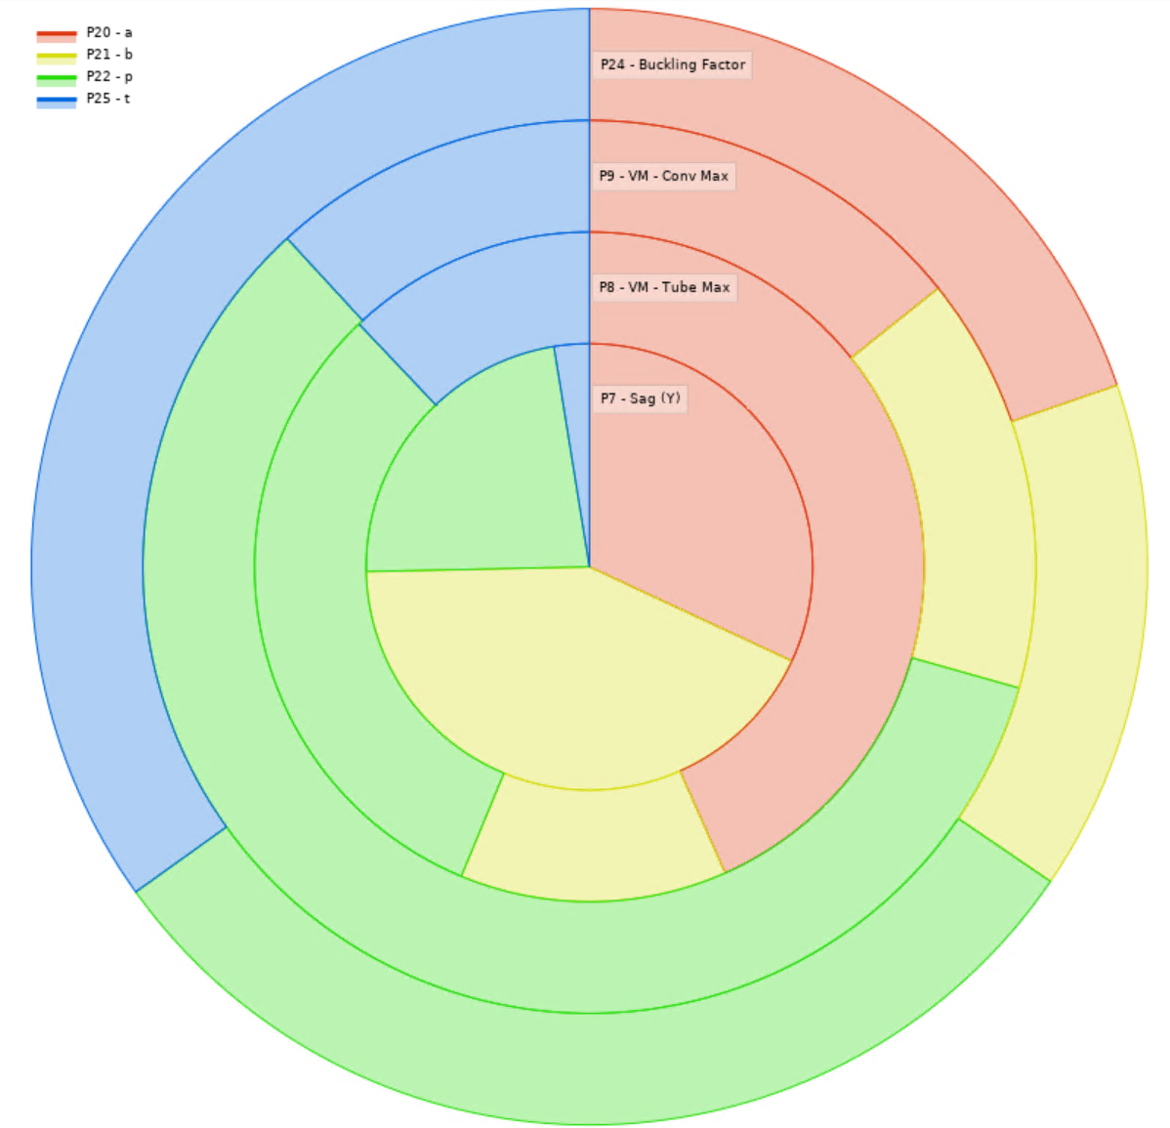
Design Explorer (DX) Results
Local Sensitivity
Measures input parameters impact on output parameters
Key: a (red), b (yellow), p (green), t (blue)
Sag
Von-Mises: Tube MAX
Von-Mises: Conv. MAX
Buckling Factor

Slide 19
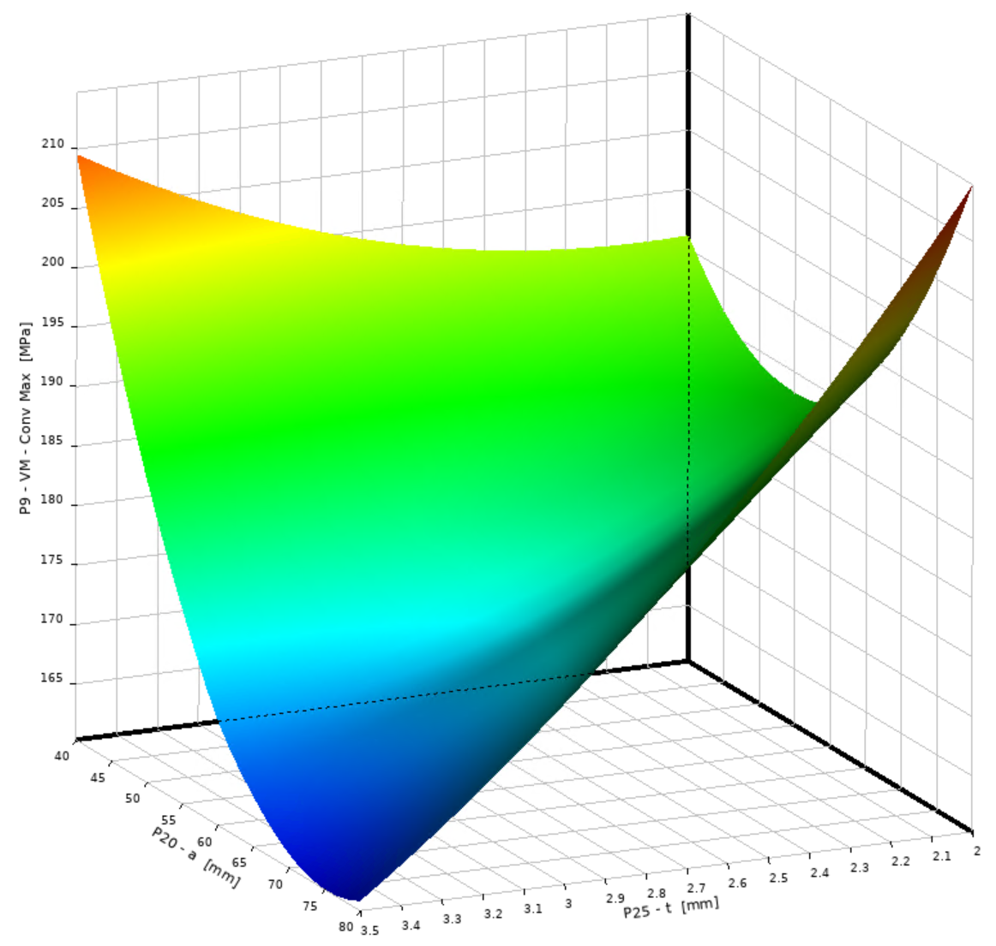
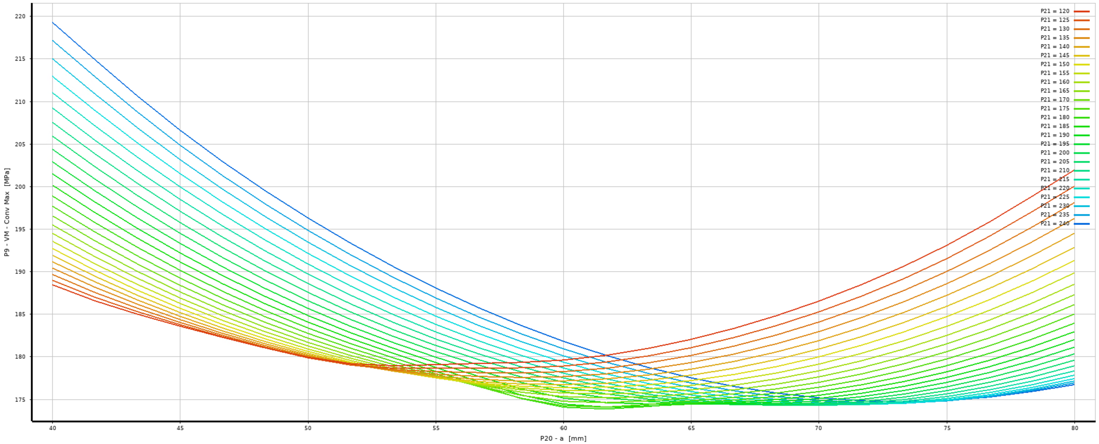
Design Explorer (DX) Results
Response Surfaces – 2D & 3D
Visual display to understand the behavior of the input/output parameters
Allows 2 input (x, y) vs. 1 output (z)
Rest of inputs: modifiable values
Also, 2D graphs w isolines

Slide 20
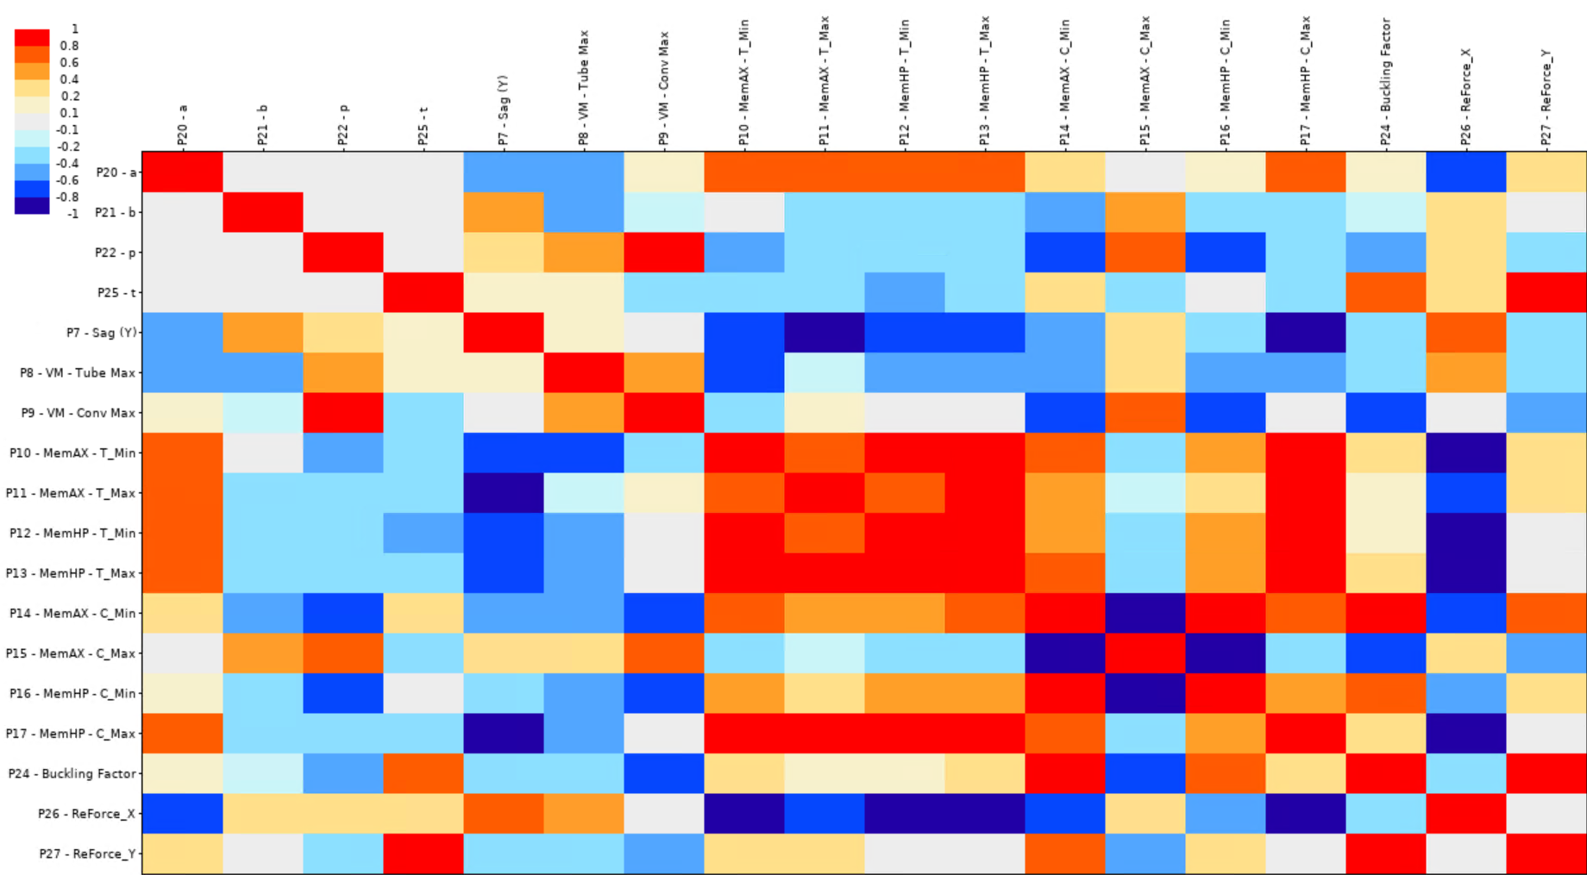
Design Explorer (DX) Results
Correlation Matrix
Interaction between ALL parameters (output/output included! → Trade-offs)

Slide 21
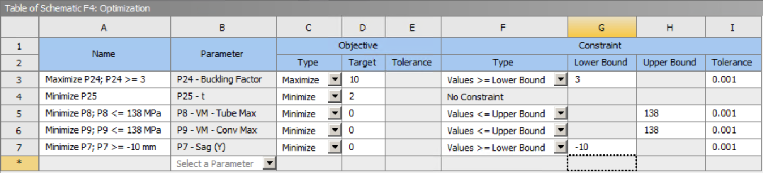
DX Optimization Tool
Design Points & Verification Points calculated + Results checked: OK!
DX will cross the Design Space and come with a set of Candidate Points
Set the target values for the desired parameters:
Maximize Buckling Factor, consider values only > 3: Rule of thumb for ASME cod.
Minimize t: set target of 2 [mm] as it is the lowest value for t
Von-Mises < 138 [Mpa]
Minimize Sag, consider values only < 10 [mm]

Slide 22
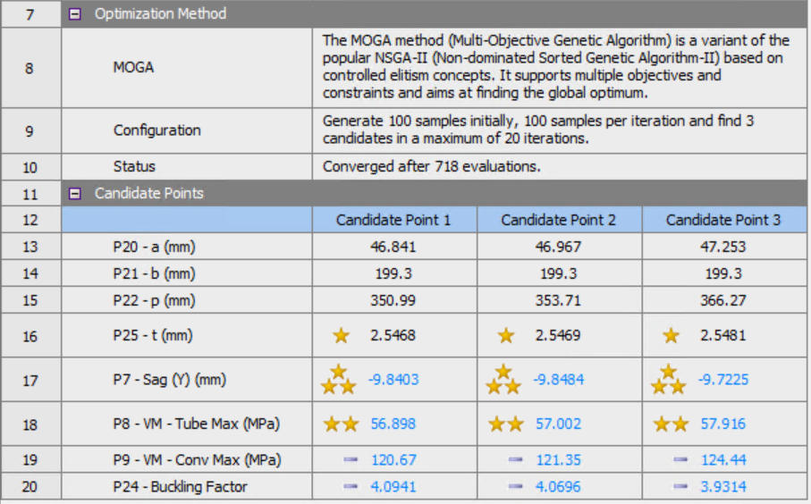
DX Optimization Tool
3 candidate points are chosen: Verification can be requested as part of the process
In this case, all 3 pivot around the same Design Space area (very close values)
Verification Point:
Sag: -9.87 [mm]
VM Tube: 56.92 [MPa]
VM Conv: 120.8 [MPa]
Buckling: 4.4

Slide 23
Corrugated Summary
On paper: a reasonable solution for a corrugated tube is possible
Most likely through ASME Method B: elastoplastic qualification
4 or 5 parameters are still manageable to get a good parametric model, suitable for optimization
Final definition of values depends on engineering & tolerancing
t = 2.5468 [mm] is not a suitable value for manufacturing…
Post-processing needed after optimization
Manufacturability of the corrugated beamtube to be studied by vendors as per RFI launched last month.

