Slide 1
Induction Bakeout EXperiment (IBEX) at LIGO Caltech
Melina Fuentes-Garcia, Albert Lazzarini, Jon Feicht
2 Oct 2025
DCC: LIGO-G2502145

Slide 2
Outline
Motivation
Overview
Implementation
Preliminary Results
Modeling
Prospects for the Future: Scaling to Cosmic Explorer (CE)
LIGO-G2502145

Slide 3
Motivation (1/2)
Induction Heating Experiment
Mild steel is an attractive option for CE because it has a much lower (<100x) H₂ outgassing rate due to its manufacturing process and its much lower cost because it's use in the pipeline industry.
Mild steel pipe resistivity too low for practical I²R heating. Alternate method needed.
Magnetic and eddy current losses of mild steel make it ideal for induction heating. Works best with highly permeable materials but can be used with austenitic stainless steel (SST).
Simulate zone heating scenario using isotherm models. See tech note LIGO-T2400167.
Multiple zone bake appears to work just as well as baking the entire system, back diffusion does not seem to effectively repopulate adsorption sites if pumping is adequate.
Perform experiment on system, with length-diameter (l/d) ratio ~ 60x, of pipe steel.
A zone bakeout appears to be effective as an entire-tube bakeout if performed correctly
LIGO-G2502145
Notes:
Very efficiency heating method, no insulation required.
LIGO has l/d ratio of 4000

Slide 4
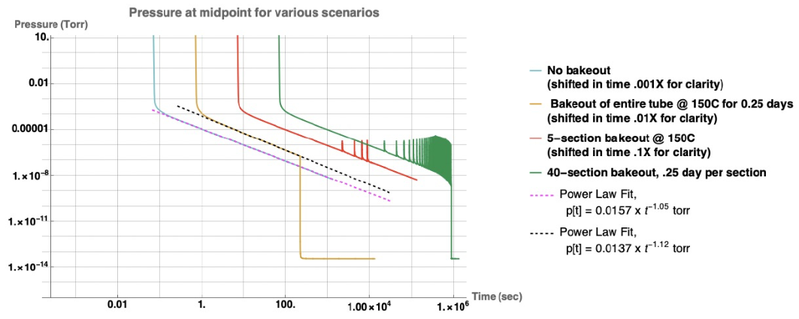
Motivation (2/2)
Sectional (sequential) bakeout experiment
Modeling suggests that a zonal bakeout can achieve acceptable residual water outgassing rate
Isotherm models showing the water pressure in various bakeout scenarios.
LIGO-G2502145
Notes:
Isotherm models of various water bakeout scenarios. From left, 1. (blue curve) shows room temperature pumpdown behavior as typical 1/t rate. 2. (yellow curve) is a conventional bake at 150 C then cooled. 3. (red curve) is a partial bake of only a few sections, essentially the same as room temperature behavior. 4. (green curve) shows a sequential bake of all sections, then cooled, final pressure identical to conventional bake.
R. Weiss https://dcc.ligo.org/LIGO-T080330 saw similar behavior when reanalyzing the beamtube water pressure. We will use the RF heating system to simulate this effect.

Slide 5
Overview
Induction Heating Experiment
Goal: Determine if a “zone bakeout” described by isotherm modeling can be applied to a mild steel vacuum system.
100mm ID x 6m long (l/d=60) mild steel beamtube (5.7mm thick), composed of ten spool pieces (API 5L) with DN100CF flanges (A572).
Each spool piece could fit into Sun Steel furnace if magnetite coating desired.
Mild steel zero-length reducers (better CTE match @ DN40CF flange).
Cleaned and processed at Caltech. LIGO class-A vacuum bake showed no hydrocarbons (HCs) in residual gas analyzer (RGA) scan.
Cleaned with mild acidic cleaner (Citrajet)
Main tube made of mild (pipe) steel that will be baked with induction heater.
End sections with pumping and instrumentation (all SST parts) baked with fiberglass heat trace.
RF system (generator, transformer, optical pyrometer, chiller) procured, tested at vendor site, and integrated at Caltech. Working as intended!
Vendor (Inductronix/CEIA USA) designed the induction coil, utilizing Comsol finite element analysis (FEA) models to meet our requirement (RT to 250°C in < 1min). Multiple coil designs considered and final selection was a clamshell coil.
Translation rail system designed and assembled at CIT. Traveling heater!
Isotherm model p_{H2O}(t) for zone bake.
LIGO-G2502145
Notes:
Mild steel DN100 to DN40 Zero-length end flanges to reduce CTE mismatch to 304 flanges (17.3 vs 11 x10⁻⁶ m/m-C).
Two spool pieces were sent to vendor for testing, Jon visited too, vendor site in Ohio.
Vendor COMSOL FEA with thermal profiles to estimate power needed to reach 250C internal temperature in < 1min. Pictures available.
Cleaning procedure linked in next slide.

Slide 6
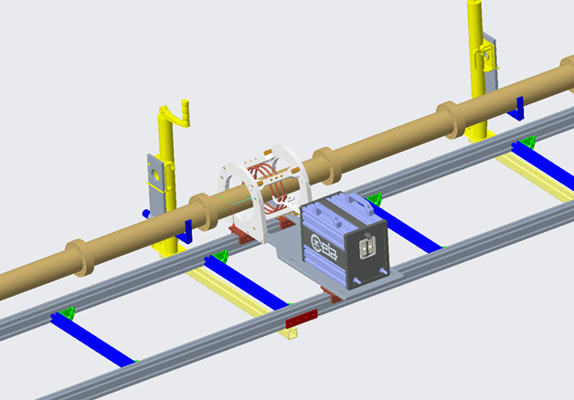
Implementation
Induction Heating System
25 kW x 40 kHz RF generator. Output power adjustable.
Impedance matching network coil-auto tuning
IR feedback w/ emissivity for temp control
Thermocouple reference for setting emissivity
Mild steel pipe and CFFs. 100mm ID x 6m length
Efficient RF coupling; magnetic
RT to bake temp (150-250°C) in ~5 seconds
Symmetrical pumping and gauging system
Two each 300 L/s TMPs, cold cathode gauges, Prisma RGA only at one end currently
Linear bearing track with variable speed gearmotor
Average bake duration ~30 minutes end to end
CFF flanges have been unreliable > 150°C (CTE mismatch w/ Cu gasket)
Considered sourcing Helicoflex spring seals
Seals reliable when power capped at 30% max output
Model of the setup of the induction bakeout experiment (IBEX), showcasing the translation track, induction heater head, clamshell coil, mild steel beamtube sections, and supports.
LIGO-G2502145

Slide 7
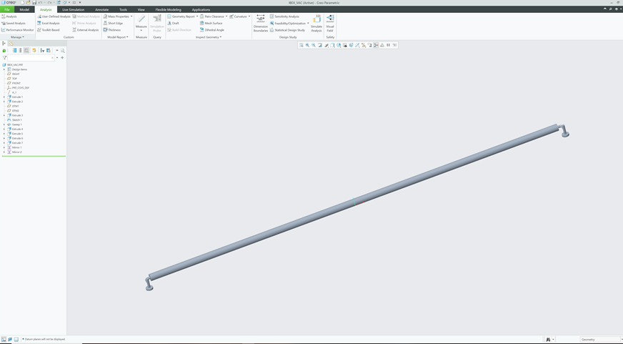
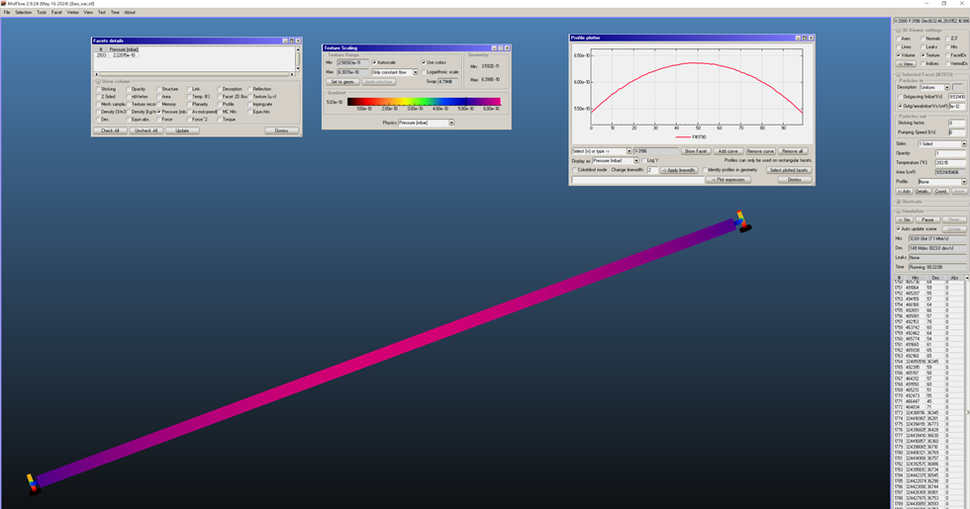
Modeling (1/3)
Computer-Aided Design (CAD) and Molflow+
CREO/ProE solid model of vacuum volume
Create Molflow model from imported .stl file
Use Molflow to calculate outgassing rate H₂, H₂O using partial pressure at RGA. Adjust molecular speed and effective pump speed.
Calibrate RGA with Penning gauge.
Simple linear calibration, assume same ionization efficiency (1) for all ions.
E-multiplier needed- too low pressure for Faraday. Errors due to ion productions. Prisma does not count ions.
Tube pressure 5.3e-10 mbar after 30 min bake and ambient pumping.
Pressure rises to ~e-4 mbar when heating.
Pump speed at tube ends < 50 l/s (est.) throttled by conductance of plumbing.
CAD and Molflow+ model of the mild steel vacuum chamber.
LIGO-G2502145
Notes:
Test-particle Monte-Carlo simulators for ultra-high-vacuum and synchrotron radiation, developed at CERN

Slide 8
Modeling (2/3)
Modeling a high-temp bake → vent → low-temp bake
Using the updated Dubinin-Radushkevich (D-R) model originally implemented by Rai Weiss in the late 1990s for the initial LIGO bakeout, we can:
Model a high-temp (150°C) bake followed by low-temp (80°C) rebake after a vent to atmosphere
Visualize how the D-R isotherm model predicts the H₂O site occupancy changes during bake, vent and rebake
After a high-temp bake the lowest binding energy sites are depleted
A subsequent vent starts to slowly repopulate the weakest bound sites, hardly affecting the population at high energies left after the high-temp bake
A low-temp bake afterwards seems adequate to deplete the weaker bound sites
LIGO-G2502145

Slide 9
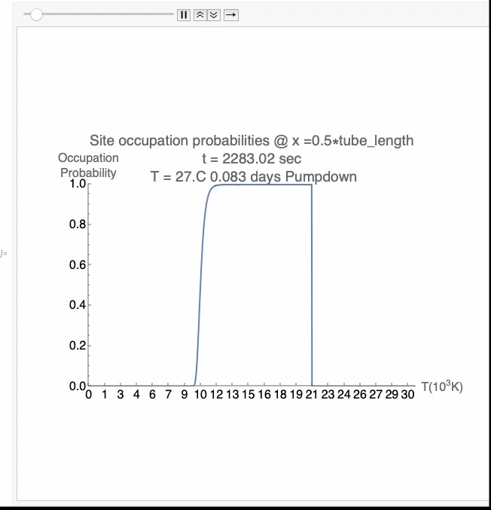
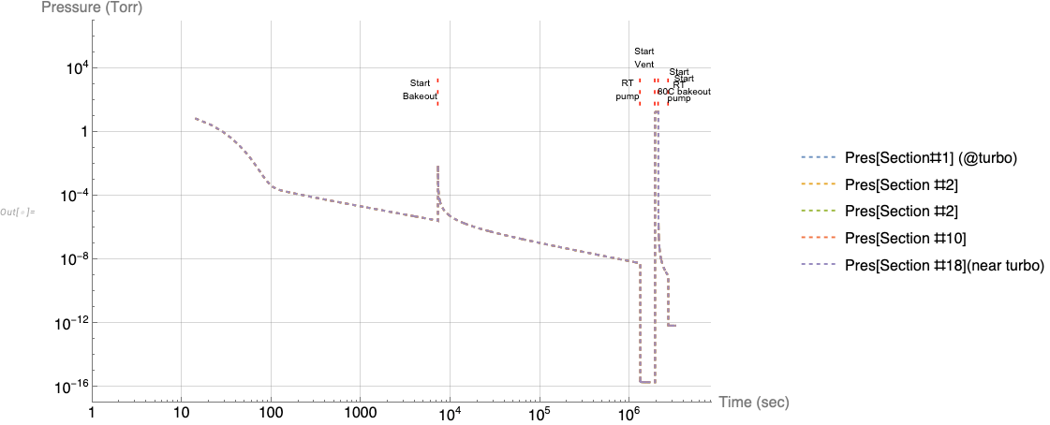
Modeling (3/3)
Modeling a high T bake → vent → low T bake
Figures: (Left) Isotherm model of high temp bake followed by vent and low temp bake. (Right) Video showing the occupation probabilities at various sites energies. *Link to ~8 min animation: https://wm1693.box.com/s/6aj8f6vptn7wo5u2blsx12n5vxevfgs2
LIGO-G2502145
Notes:
Link to ~8 min animation: https://wm1693.box.com/s/6aj8f6vptn7wo5u2blsx12n5vxevfgs2
2 hr R.T. pumpdown
15 day 150°C bakeout
7 day R.T. pump
2 day vent
7 day 80°C rebake
7 day R.T. pump

Slide 10
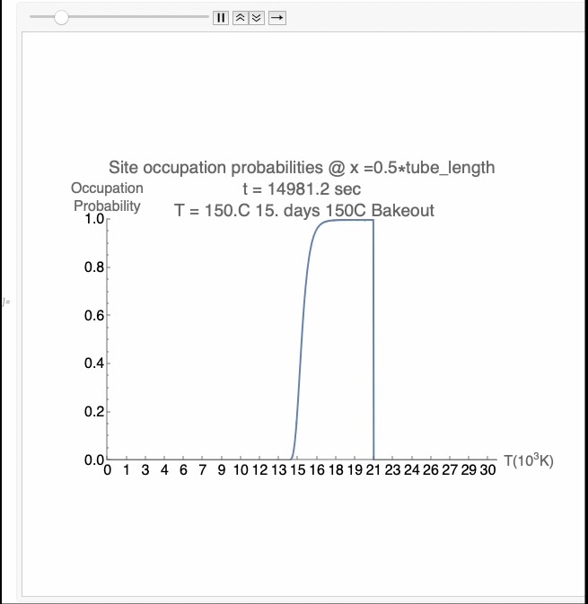
Modeling (3/3)
Modeling a high T bake → vent → low T bake
Figures: (Left) Isotherm model of high temp bake followed by vent and low temp bake. (Right) Video showing the occupation probabilities at various sites energies. *Link to ~8 min animation: https://wm1693.box.com/s/6aj8f6vptn7wo5u2blsx12n5vxevfgs2
LIGO-G2502145
Notes:
Link to ~8 min animation: https://wm1693.box.com/s/6aj8f6vptn7wo5u2blsx12n5vxevfgs2
2 hr R.T. pumpdown
15 day 150°C bakeout
7 day R.T. pump
2 day vent
7 day 80°C rebake
7 day R.T. pump

Slide 11
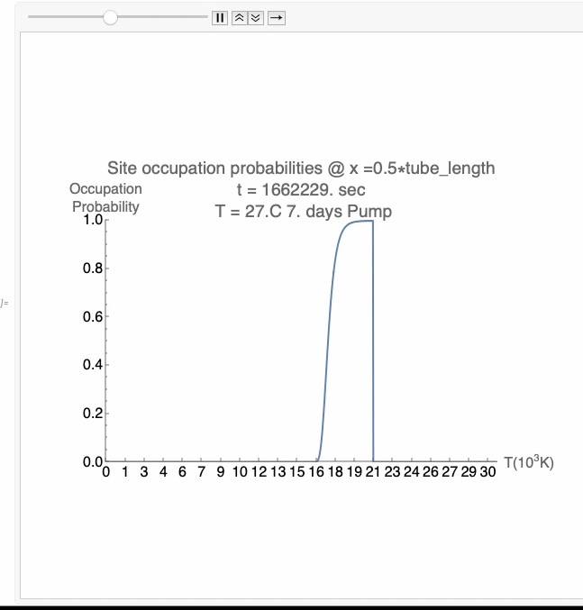
Modeling (3/3)
Modeling a high T bake → vent → low T bake
Figures: (Left) Isotherm model of high temp bake followed by vent and low temp bake. (Right) Video showing the occupation probabilities at various sites energies. *Link to ~8 min animation: https://wm1693.box.com/s/6aj8f6vptn7wo5u2blsx12n5vxevfgs2
LIGO-G2502145
Notes:
Link to ~8 min animation: https://wm1693.box.com/s/6aj8f6vptn7wo5u2blsx12n5vxevfgs2
2 hr R.T. pumpdown
15 day 150°C bakeout
7 day R.T. pump
2 day vent
7 day 80°C rebake
7 day R.T. pump

Slide 12
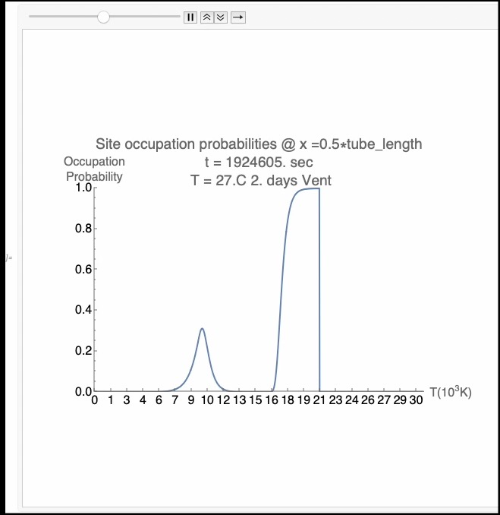
Modeling (3/3)
Modeling a high T bake → vent → low T bake
Figures: (Left) Isotherm model of high temp bake followed by vent and low temp bake. (Right) Video showing the occupation probabilities at various sites energies. *Link to ~8 min animation: https://wm1693.box.com/s/6aj8f6vptn7wo5u2blsx12n5vxevfgs2
LIGO-G2502145
Notes:
Link to ~8 min animation: https://wm1693.box.com/s/6aj8f6vptn7wo5u2blsx12n5vxevfgs2
2 hr R.T. pumpdown
15 day 150°C bakeout
7 day R.T. pump
2 day vent
7 day 80°C rebake
7 day R.T. pump

Slide 13
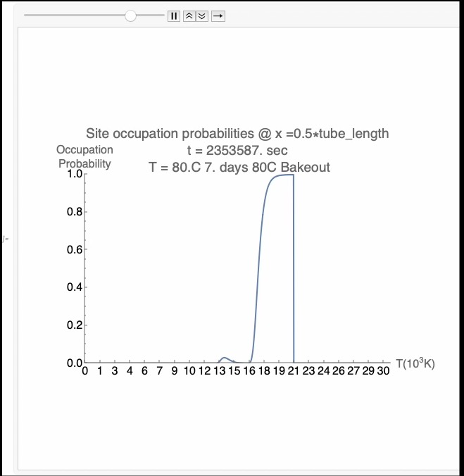
Modeling (3/3)
Modeling a high T bake → vent → low T bake
Figures: (Left) Isotherm model of high temp bake followed by vent and low temp bake. (Right) Video showing the occupation probabilities at various sites energies. *Link to ~8 min animation: https://wm1693.box.com/s/6aj8f6vptn7wo5u2blsx12n5vxevfgs2
LIGO-G2502145
Notes:
Link to ~8 min animation: https://wm1693.box.com/s/6aj8f6vptn7wo5u2blsx12n5vxevfgs2
2 hr R.T. pumpdown
15 day 150°C bakeout
7 day R.T. pump
2 day vent
7 day 80°C rebake
7 day R.T. pump

Slide 14
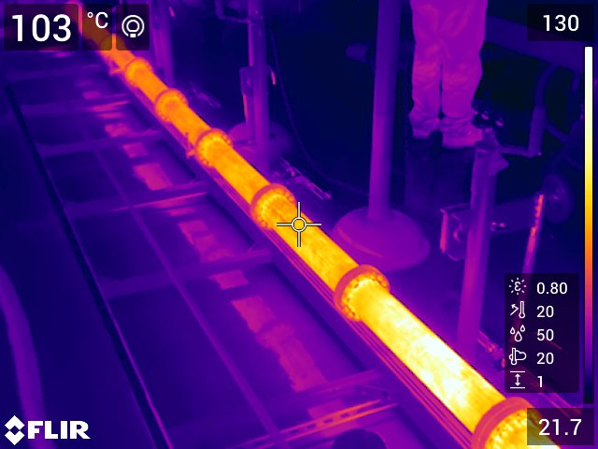
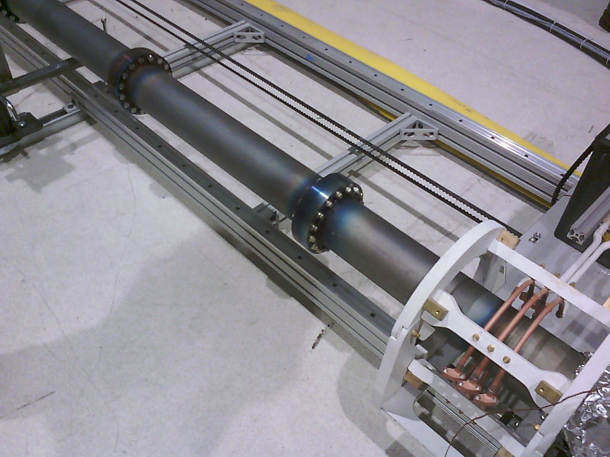
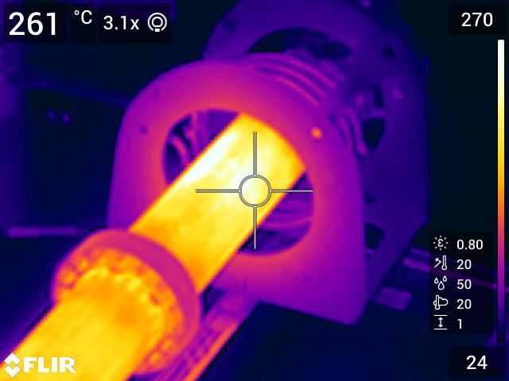
Preliminary Results (1/3)
Lessons learned from preliminary bakeouts
Bakes performed at 150°C to 250°C, with pressures reaching e-9 and e-10 mbar range after cooldown.
Speed ~2 mm/sec across entire length of tube
Speed can be adjusted
RGA scans show mainly water; very low hydrogen
High temp bakes sprung leaks due to SST hardware on mild steel conflat flanges
Swapped all with high strength steel hardware
Surface emissivity changed after bakeouts
Welded studs onto tube for thermocouple connection to calibrate pyrometer emissivity
Automated translation to be integrated that features a rotary encoder for precise positioning and additional safety measures
(Bottom Left & Top Right) Images taken with an IR camera during various bakeouts. (Middle) Surface color visibly changed after bakeouts.
LIGO-G2502145

Slide 15
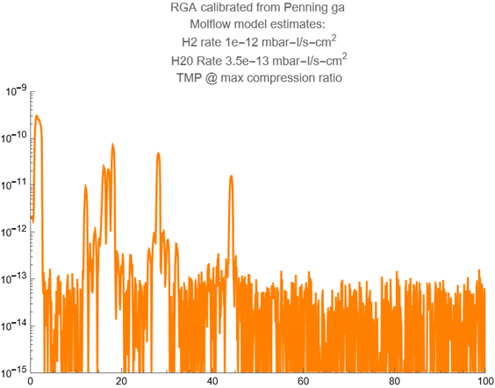
Preliminary Results (2/3)
Outgassing rates from RGA + Cold Cathode
Induction baking is very efficient, zone outgassing effective.
Depleted water sites do not seem to be refilled.
Tube vented to atmosphere, baked 30 min end-to-end 150°C when cool 6.7e-10 mbar.
Alloy steel typical low H₂ diffusion, includes outgassing of RGA shell, misc. 304 SST components.
1e-12 H₂ mbar-L/s-cm²
3.5e-13 H₂O mbar-L/s-cm²
RGA scan used to calculate outgassing rates from 150°C bake on July 24th, 2025. x-axis is amu, and y-axis is ion current.
LIGO-G2502145

Slide 16
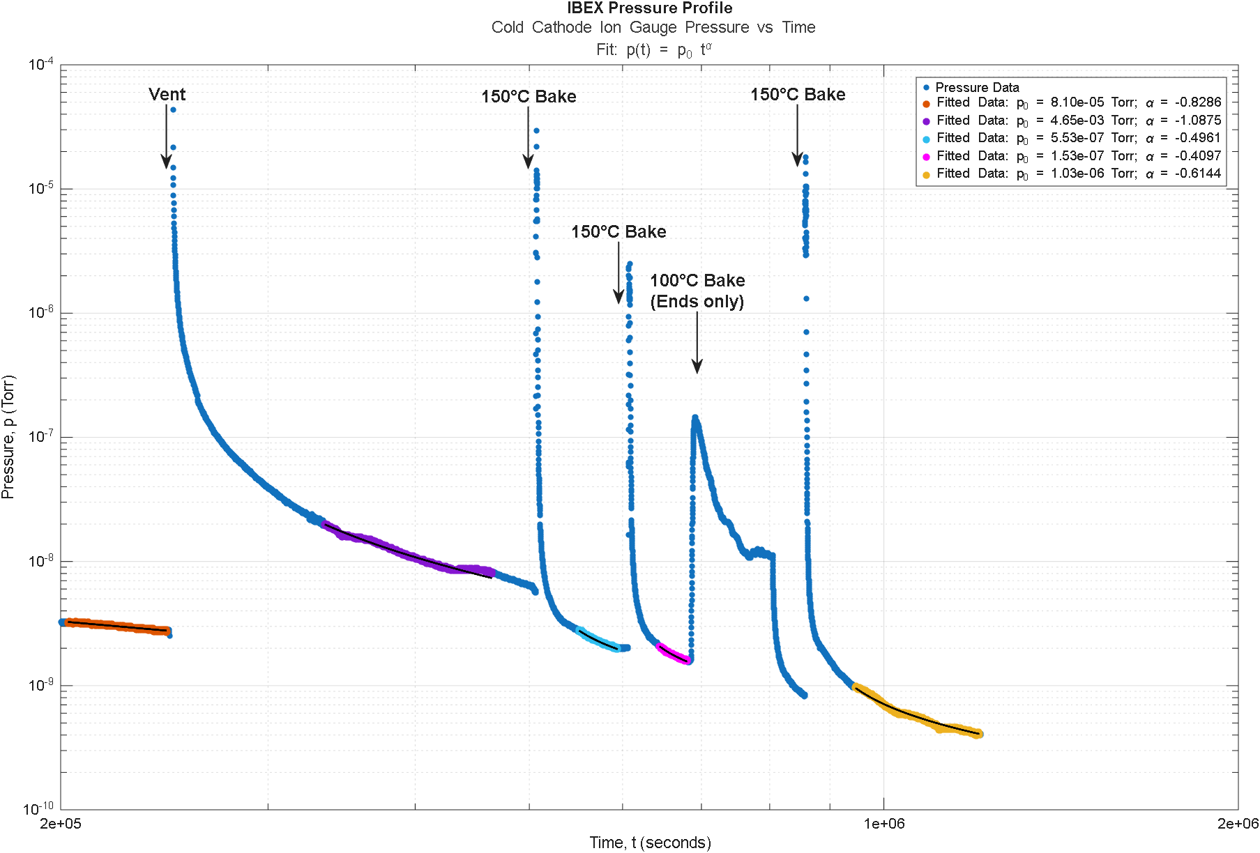
Preliminary Results (3/3)
Pressure profiles
Since capping the maximum power output to 30%, bakes set to 150°C have not sprung any leaks
Pressure profiles from the pumpdown following: (orange) an unplanned vent, (purple) planned vent, (cyan, magenta, yellow) 150°C bakes.
LIGO-G2502145

Slide 17
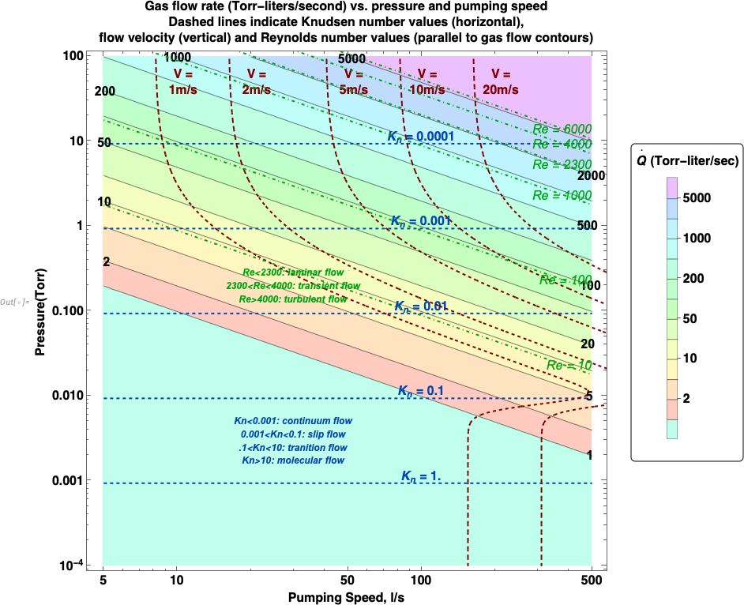
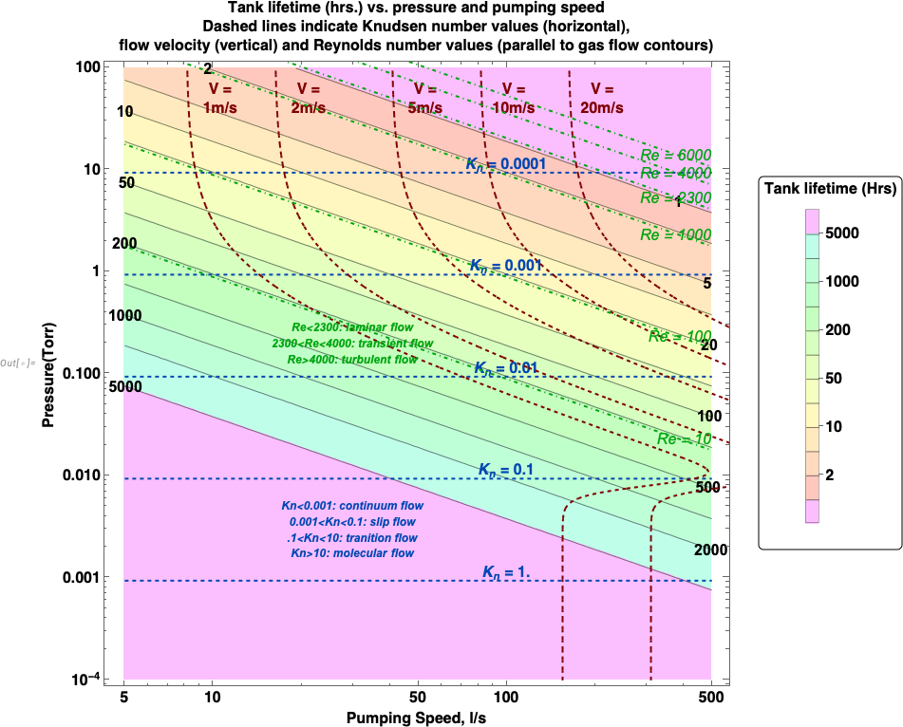
Prospects for the Future: Scaling to CE (1/2)
Planning for a bake with circulating dry gas (N₂)
First back-of-the-envelope parametric study to identify {pressure, pumping speed, V_{N2}} values to use
Developing a more realistic Navier-Stokes model (steady-state, compressible flow) in Mathematica
LIGO-G2502145
Figures: (Left) (Right)

Slide 18
Prospects for the Future: Scaling to CE (2/2)
If Cosmic Explorer elects a mild steel beam tube, an ohmic heating bakeout approach is not feasible due to lower resistivity of the steel.
The use of a moving inductive heater is an attractive option.
Need to address how to move the heater carriage past supports.
Will need to make sure pumping speed is adequate to remove the outgassed water.
The use of a circulating dry gas may prove essential to keeping sections clean.
LIGO-G2502145

Slide 19
Thanks!
Thank you for your attention!
LIGO-G2502145

Slide 20
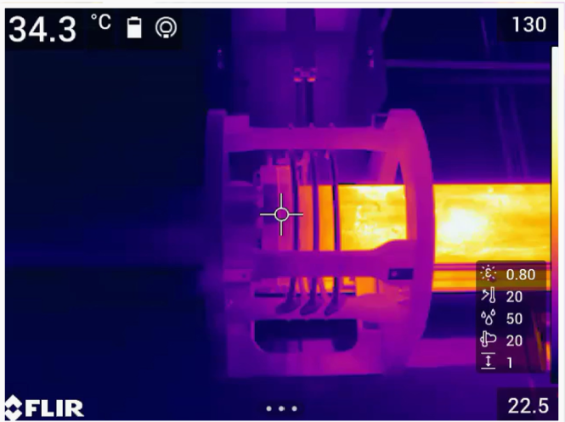
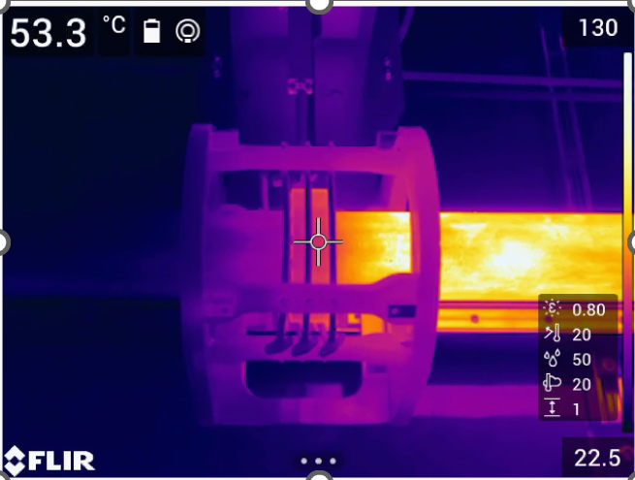
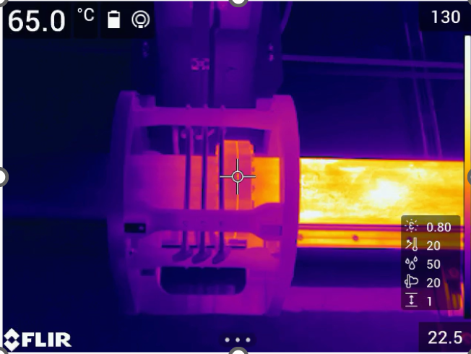
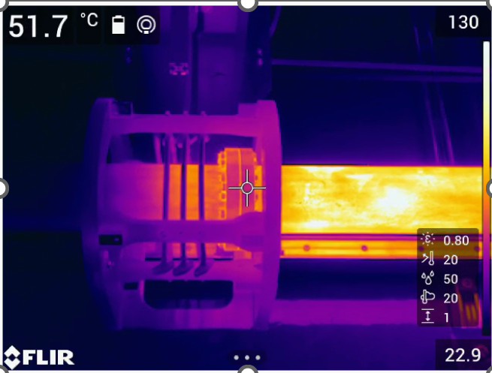
Thanks!
Thank you for your attention!
LIGO-G2502145

Slide 21
Additional Slides
For additional details and pictures/videos

Slide 22
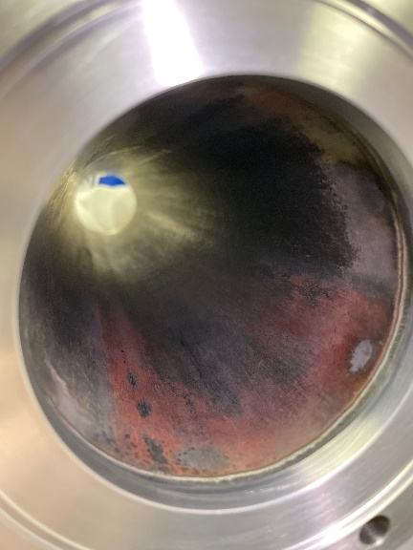
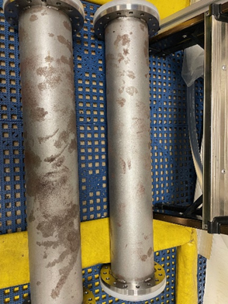
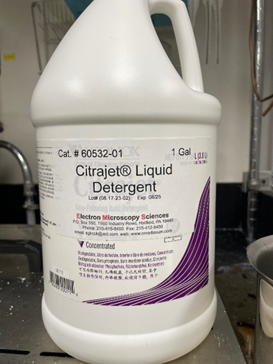
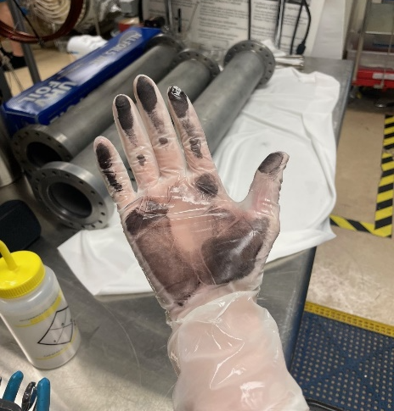
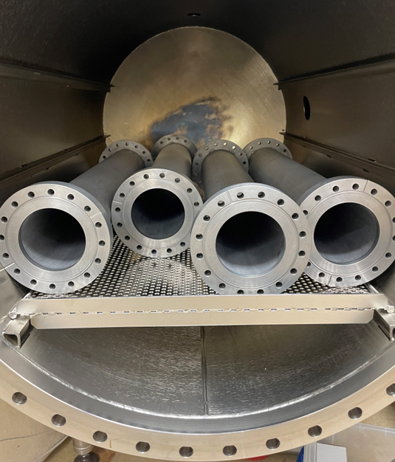
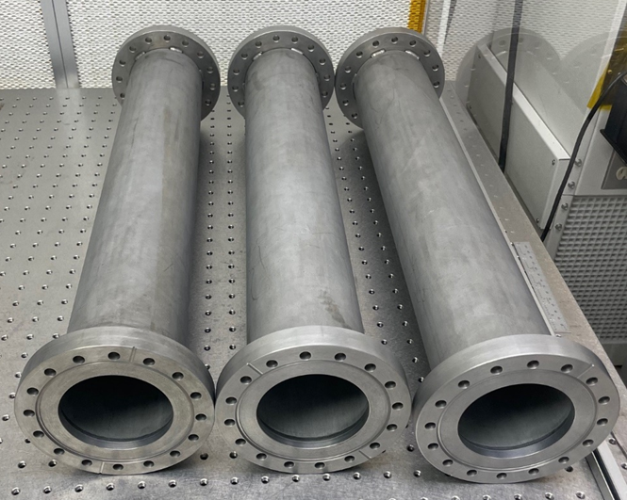
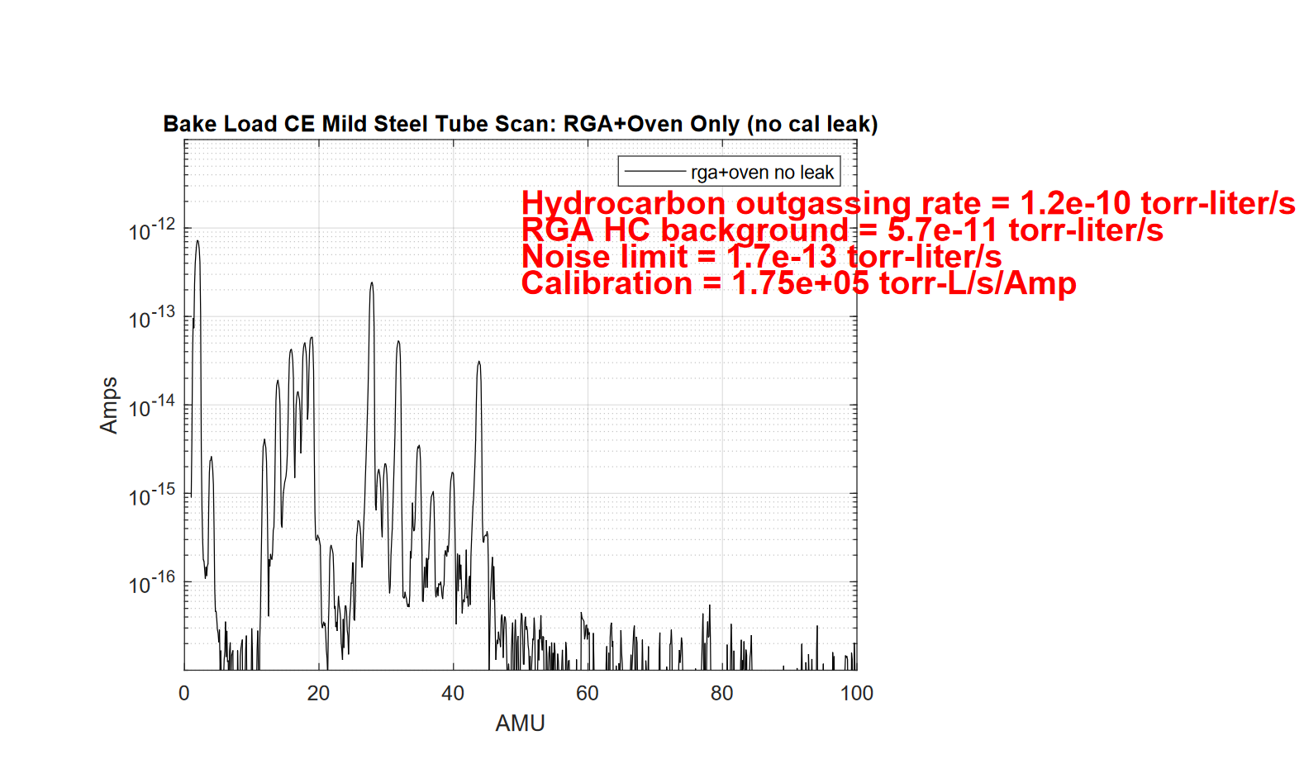
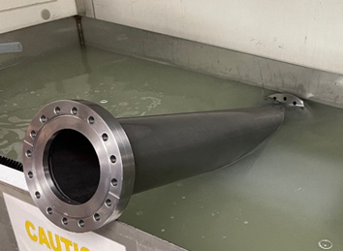
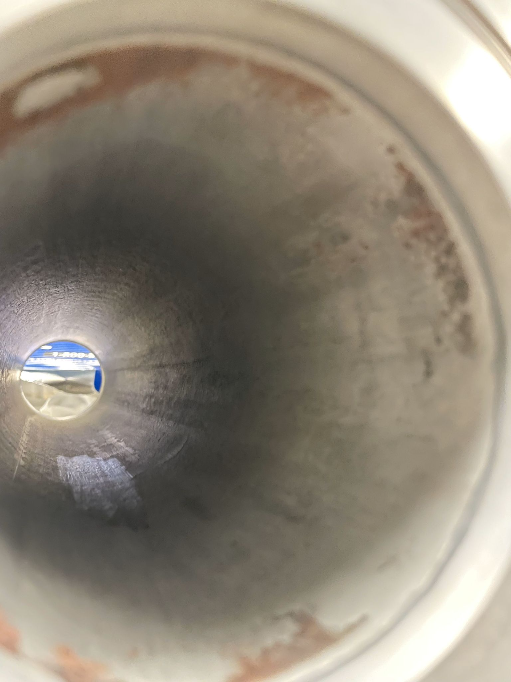
Implementation (1/4)
Clean and Bake at Caltech
Mild acidic cleaner (Citrajet) used to clean pipes. Several rounds using 2%-1% concentration with hot DI water. Removes rust, mechanical scrubbing helps.
Images of mild steel pipe sections before, during, and after cleaning process. *Full cleaning procedure can be found at LIGO-E2400350.
LIGO-G2502145
Notes:
From left to right: Steel pipe nipples have red and black rust, fingerprints, etc. Exterior surfaces bead-blasted, interior mill-finish
Pipe interior shows rust due to rainwater (outdoor storage of pipe stock)
Citrajet citric acid detergent
Deionized water + 2% Citrajet bath. 50 C bath temperature + mechanical scrubbing. 3X bath changes
Black rust. Citric acid metal salt
Drying on laminar-flow bench. Tubes show mild etching as expected. Next step is UHV bake
API 5L pipe steel nipple bakeout 200 C
Bake meets LIGO hydrocarbon requirements. Note that the entire tube has been baked/sampled including skip-welded crevice where tube inserts into DN100 non-rot CFF counterbore, obvious poor vacuum practice but unavoidable. DN100 flanges are alloy steel. Samples will also be prepared for metallurgical analysis (Henkel).

Slide 23
Implementation (2/4)
RF System
25kW, nominal 40kHz LC inductive resonant system. Large range of power adjustment.
Insulated gate bipolar transistor (IGBT) frequency-agile drive. Can run pulse width modulation (PWM) or off-resonance to control output power.
Auto-tune with switchable inductance. Capacitors in work head match impedance of coil and radio frequency (RF) cable.
4m umbilical cable from RF source to coil.
Prime power 400 Volt 3-phase (transformer from 480 Volt panel).
Control feedback system via optical pyrometer, can also use 2-wire thermocouple (TC). Emissivity calibration. Optional redundant and/or survey pyrometer.
Human machine interface (HMI) for user control, can mirror to PC for monitoring, remote programming, data logging and management. All parameters and run details captured by HMI and stored as .csv files. HMI operation includes remote e-stop and deadman switch.
Clamshell copper coil to snap around tube (over obstacles/stands). 3-turn solenoid coil used in initial testing at vendor applications lab.
Chiller for water-cooling the power electronics and coil also included.
LIGO-G2502145
Notes:
insulated gate bipolar transistor
Tube RT to 250°C < 1 min, but wide power adjustment.
Visited vendor on 6-17-24. Applications lab. Tested heating tube sections; 6” flange stack and 4” pipe.
CIT facilities has requirements for 480V panel, from which transformer was installed onto.
Coil voltage/coupling to different diameters. Coil voltage 50V higher in 4” pipe section, so not an issue. Coupling to SST end flanges good, magnetic tube and steel flanges excellent coupling. No arcs or overheating issues with bolts.
Optical pyrometer provides feedback for RF power control. Single color pyrometer with emissivity correction. Follows heating head and measures pipe temperature inside coil zone. Focal length 500mm, 12.5 spot. Red LED aiming light, emissivity correction set at 0.8.

Slide 24
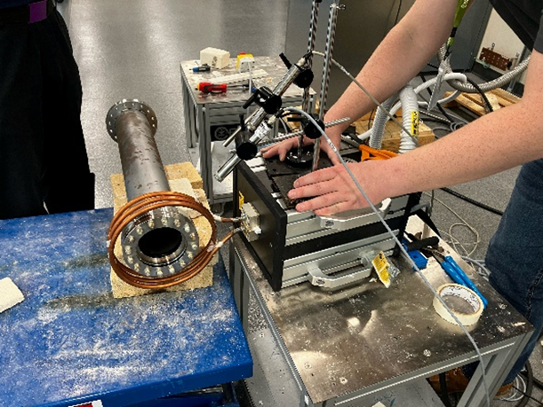
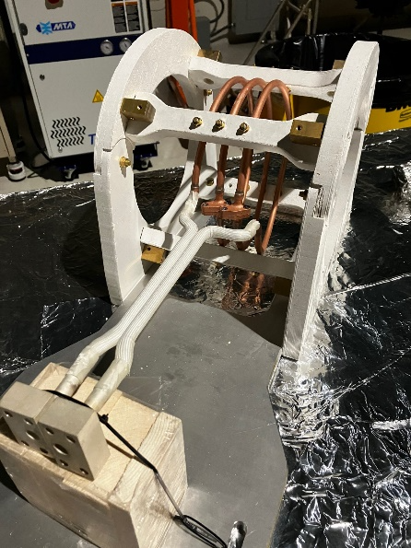
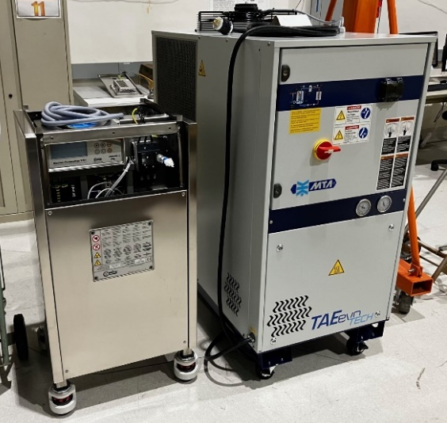
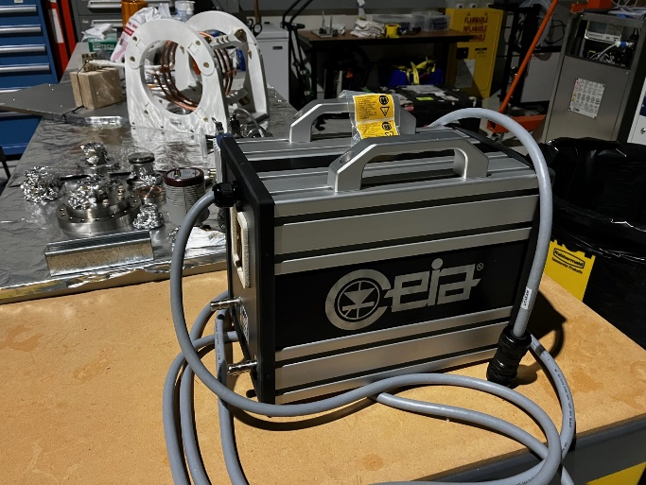
Implementation (3/4)
Induction Heating Equipment
Images of the RF system used for the induction heating.(Left Top) Initial testing at vendor lab, using prototype 3-turn coil. (Left Bottom) Induction heater head, with umbilical cord. (Middle) Clamshell coil used in final assembly. (Right) RF generator and chiller.
LIGO-G2502145
Notes:
Translation system
Heating tests at vendor, optical feedback
RF coil system
Pipe 1/10 (6 meters total) – not included in slide
25 kW RF source and cooler
Coil matching network

Slide 25
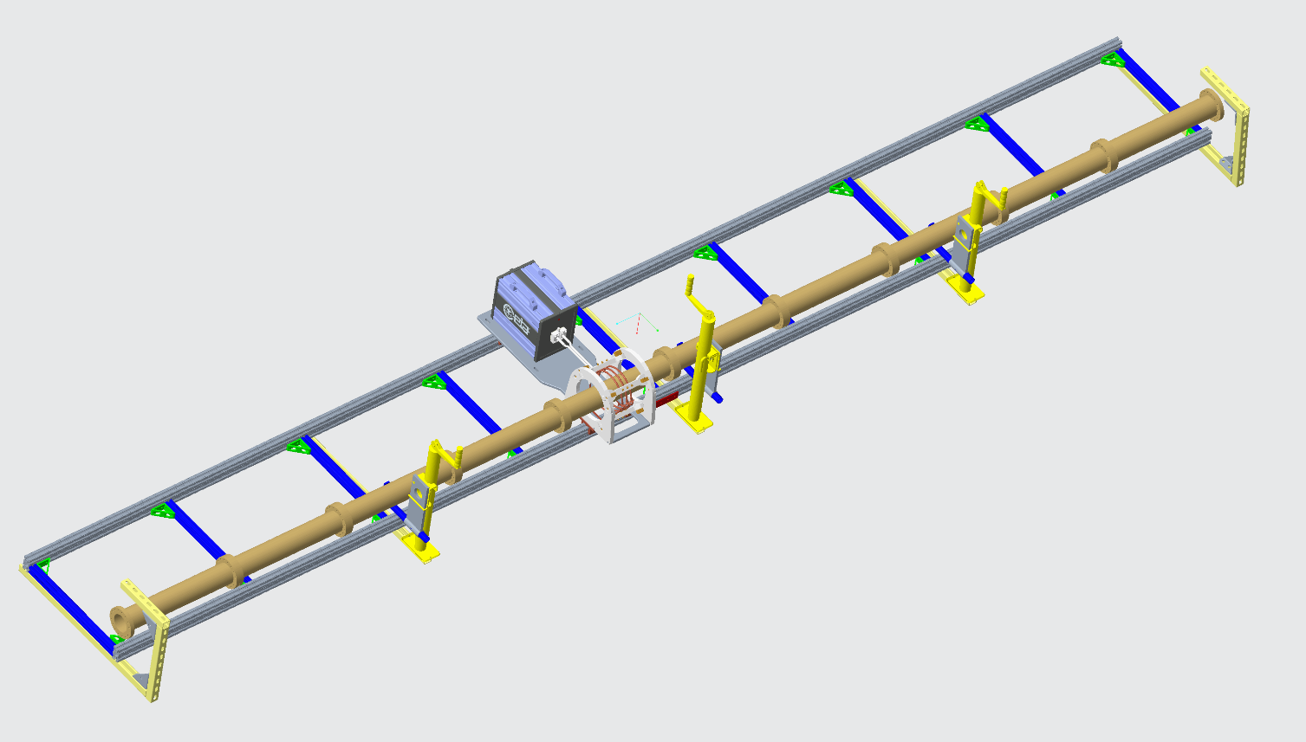
Implementation (4/4)
Translation Track Assembled
RF induction coil heats tube to 150-250°C in 20cm zone increments with translation rail system, where speed can be varied and direction switched.
(Left) Model and (Right) assembly of translation track, displaying heater head with coil attached. Optical pyrometer (control feedback to RF generator) installed directly above heater head.
LIGO-G2502145
Notes:
Track/rail system has been assembled. RF induction coil will heat tube with programmed motion ~ 200-250°C in a 20 cm zone. Speed can be varied. Optical pyrometer feedback to RF generator for temperature control.
Turbopump and gauging at both ends. Albert to model with DR isotherm.

Slide 26
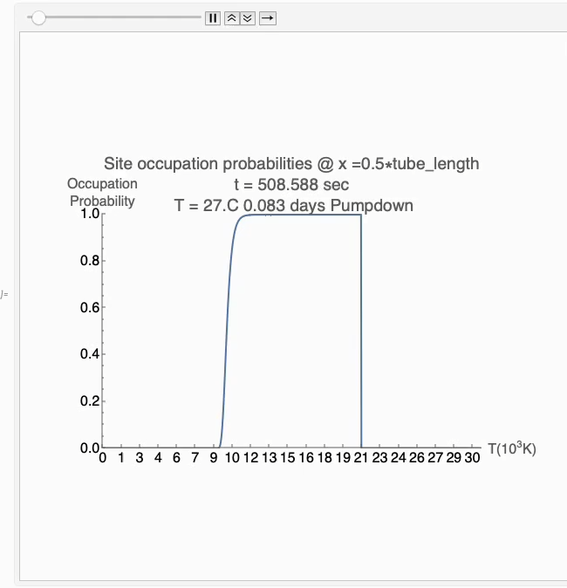
Modeling (3/3)
Modeling a high-temp bake → vent → low-temp bake
(Left) Isotherm model of high temp bake followed by vent and low temp bake. (Right) Video showing the occupation probabilities at various sites energies. *Link to ~8 min animation: https://wm1693.box.com/s/6aj8f6vptn7wo5u2blsx12n5vxevfgs2
LIGO-G2502145
Notes:
Link to ~8 min animation: https://wm1693.box.com/s/6aj8f6vptn7wo5u2blsx12n5vxevfgs2
2 hr R.T. pumpdown
15 day 150°C bakeout
7 day R.T. pump
2 day vent
7 day 80°C rebake
7 day R.T. pump

Slide 27
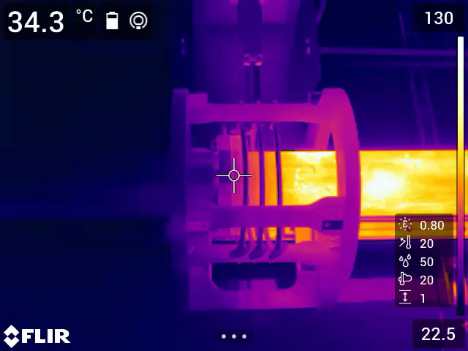
Thanks!
Thank you for your attention!
LIGO-G2502145

