Slide 1
Design Drivers for Scattered Light Baffles
CE/ET Beamtube Workshop III, LHO 2025-10-01
Antonios Kontos, Bard College

Slide 2
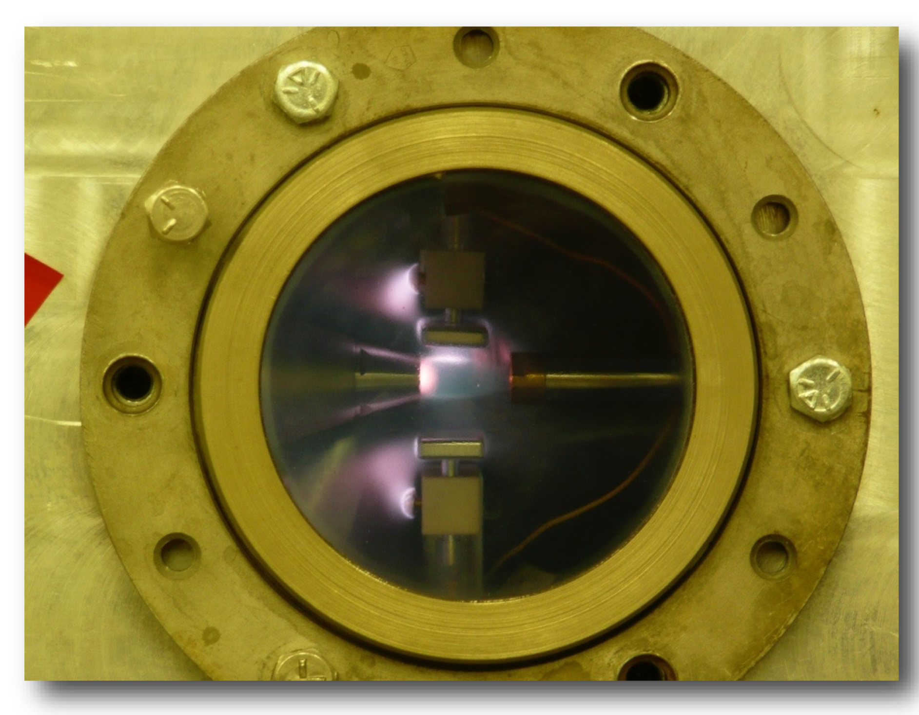
Gas target
Beam
Gas Flow
Notes:
Arrows for the jet

Slide 3
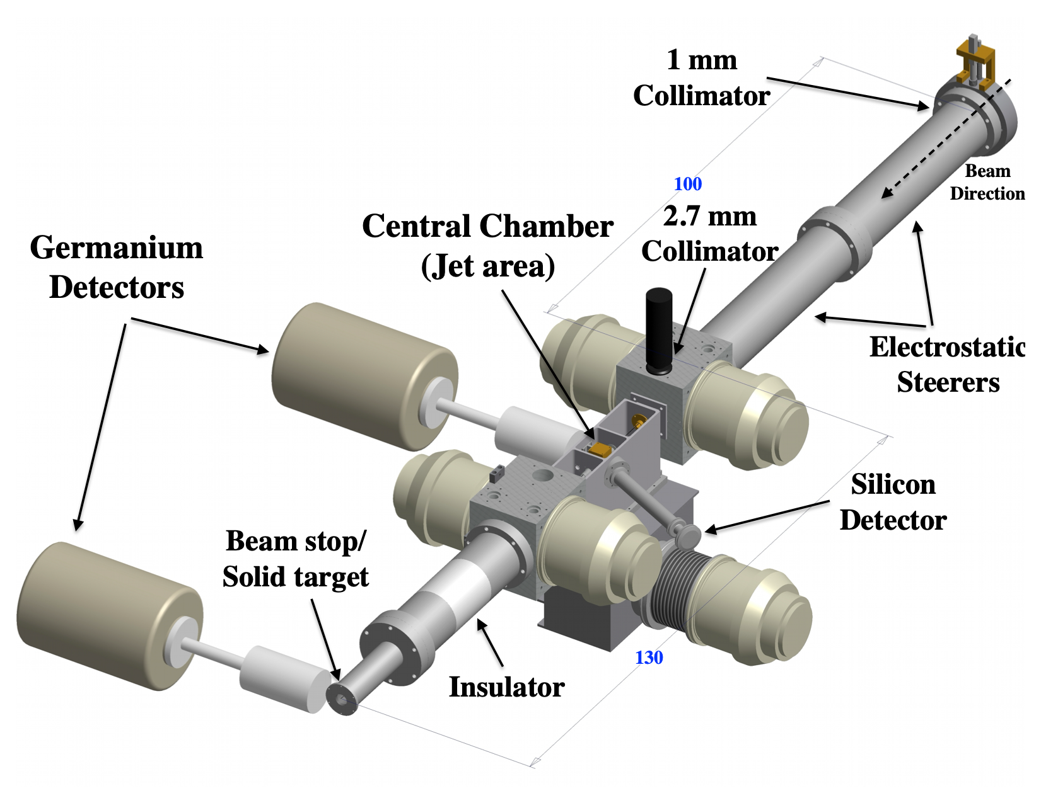
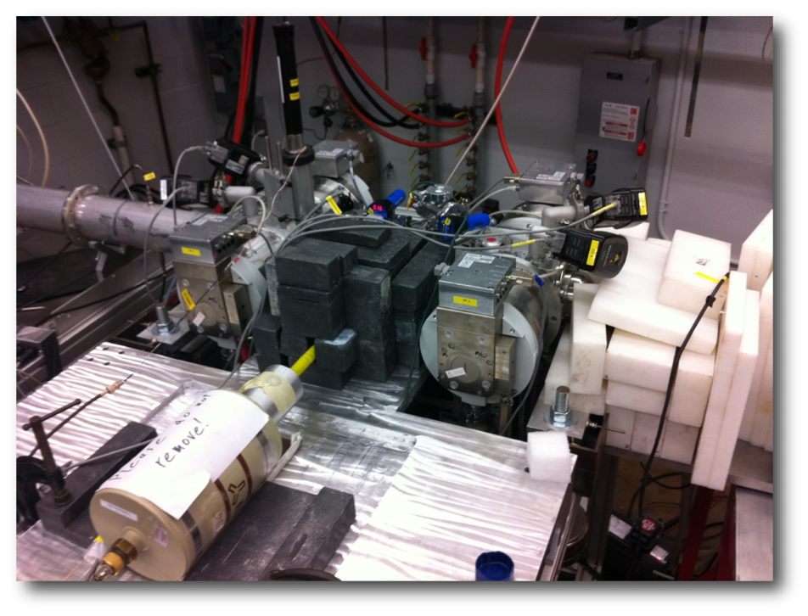
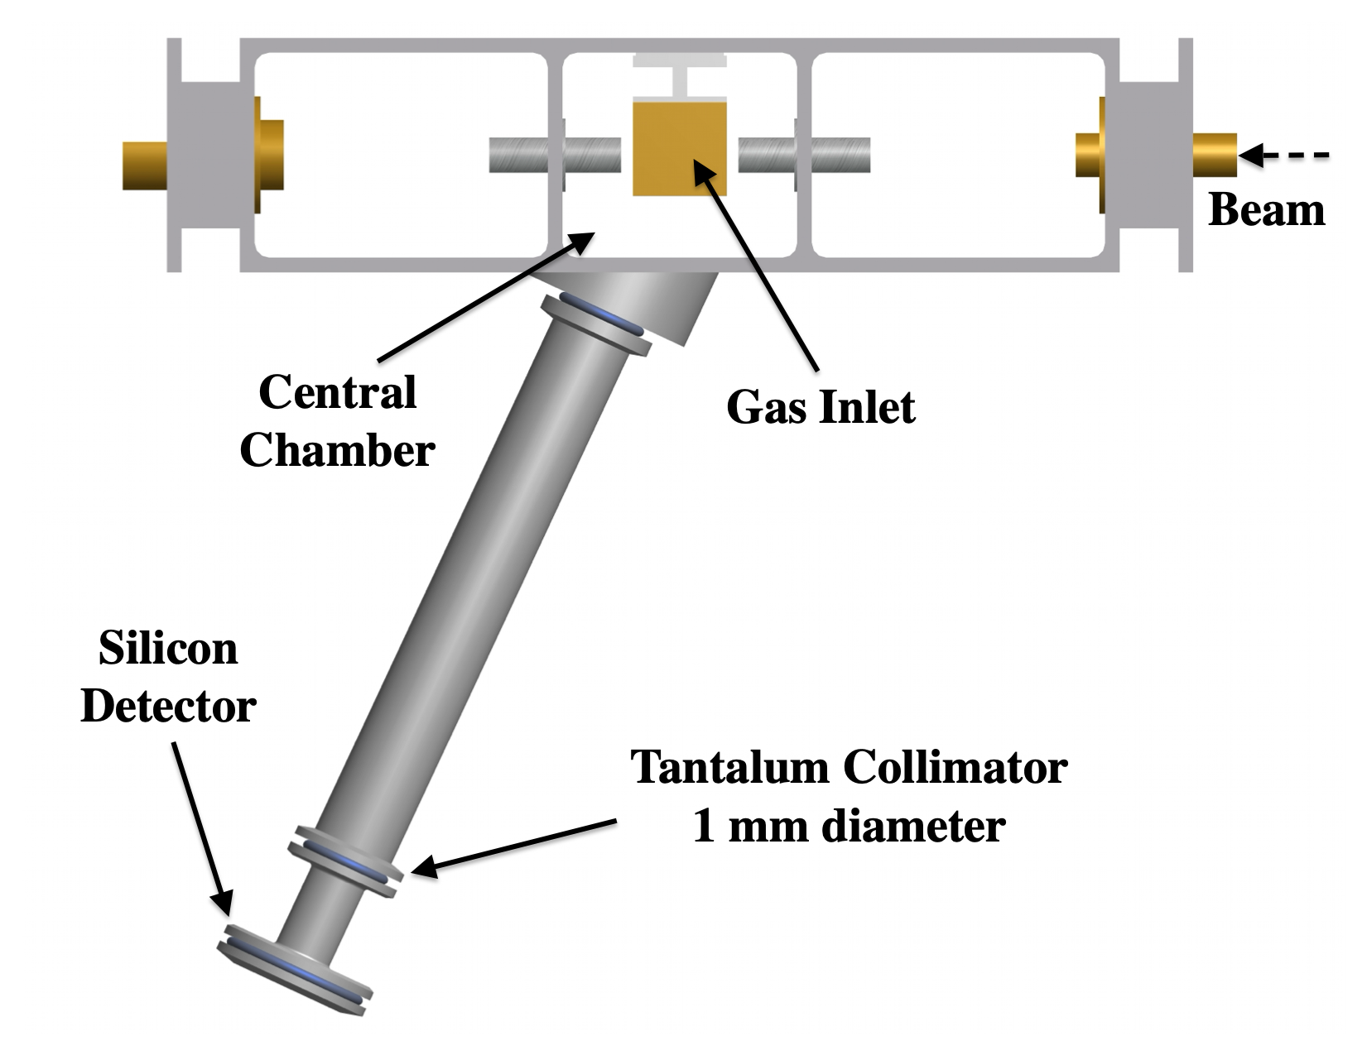
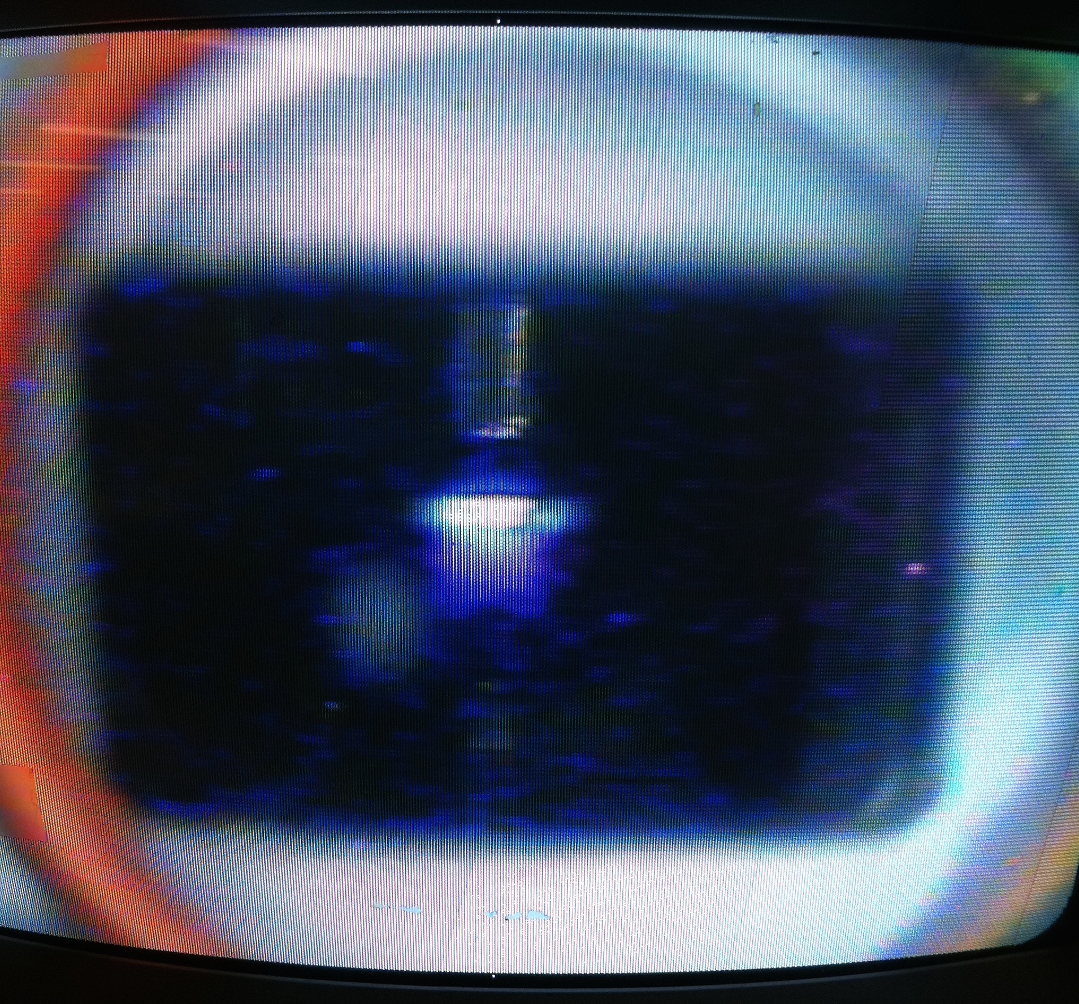
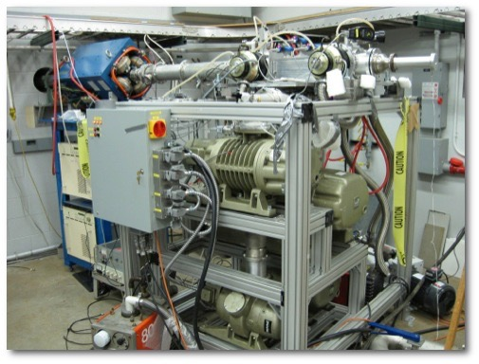
How to measure the ³He(α,γ)⁷Be cross section!
HIPPO gas-jet target @ Notre Dame

Slide 4
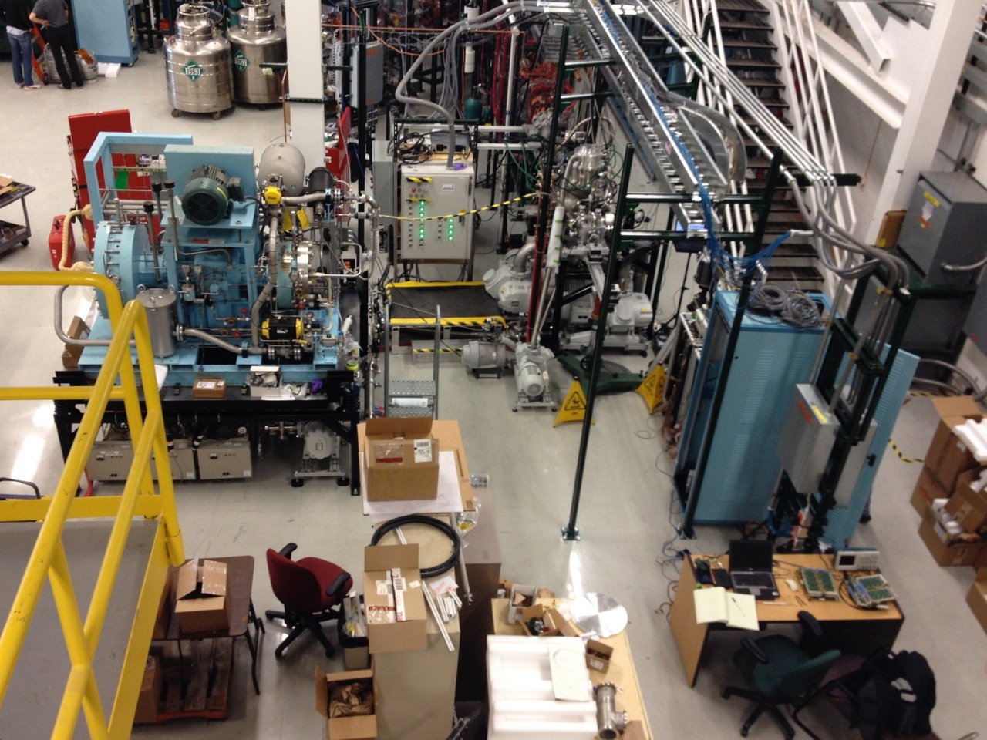
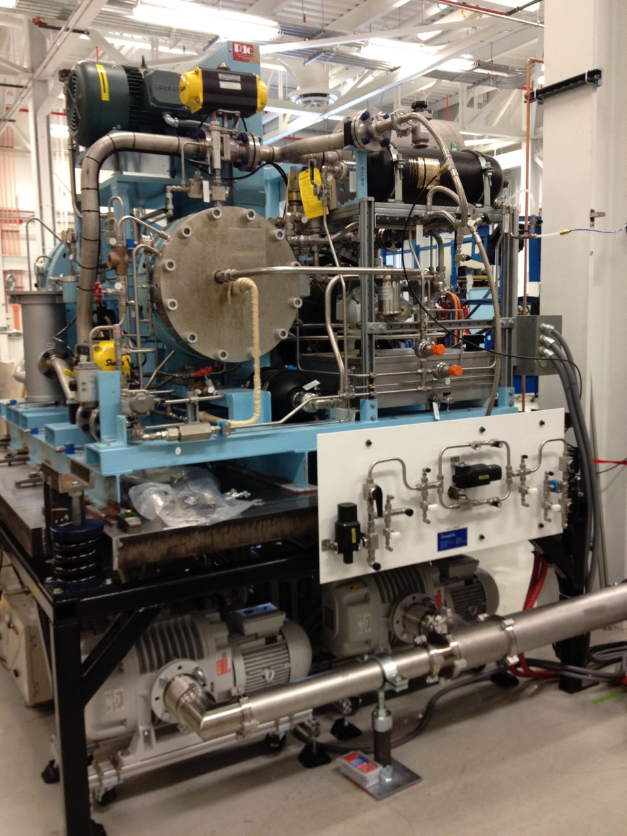
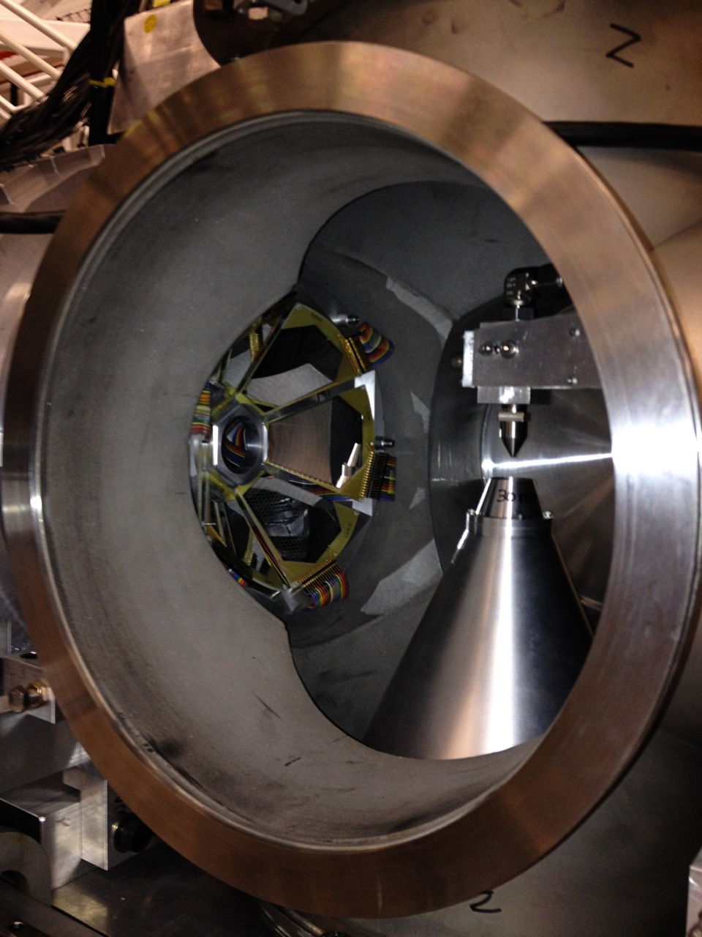
Gas Targets
JENSA, MSU
HIPPO, Notre Dame

Slide 5
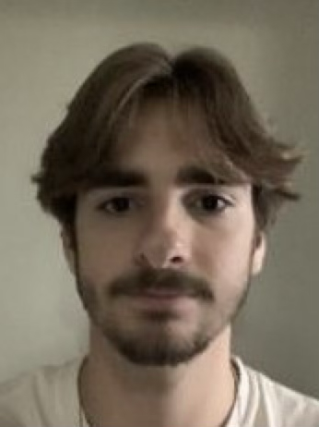
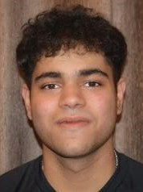
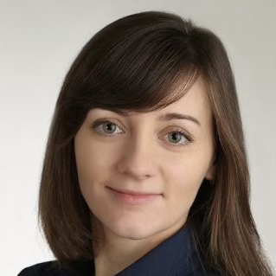

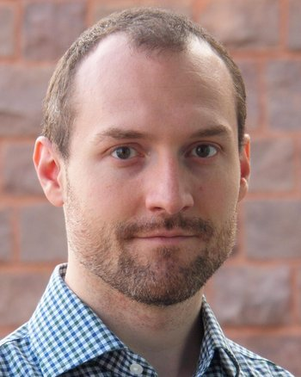


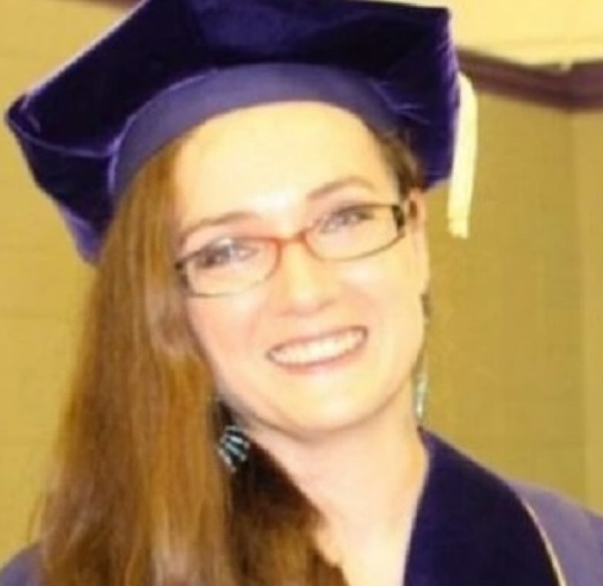
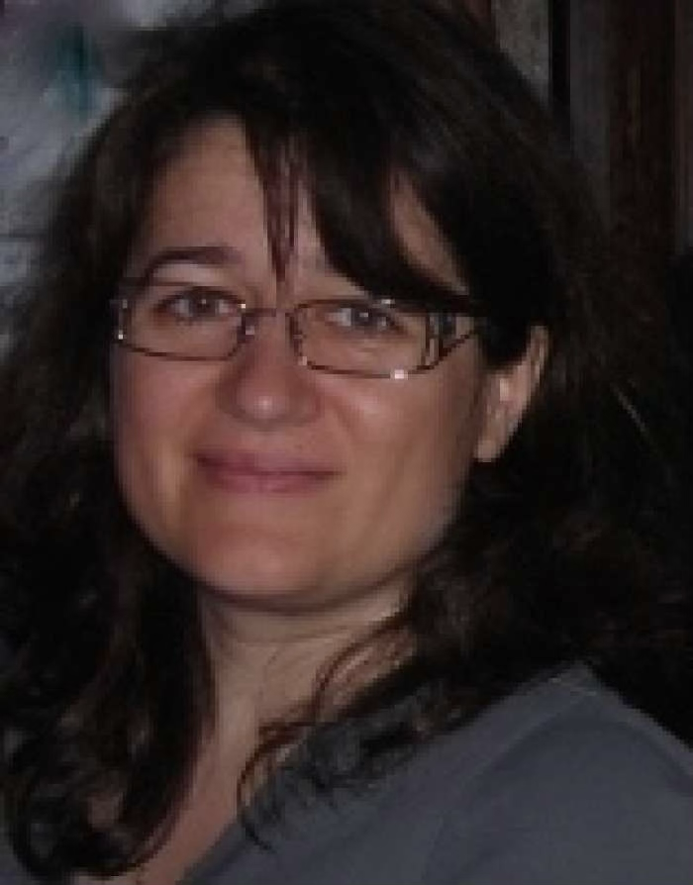

CE Stray Light Group
Alena Ananyeva Engineer @Caltech
Alena Ananyeva Engineer @Caltech
Antonios Kontos Professor @Bard
Lee McCuller Professor @Caltech
Kincade Avery Undergrad @Bard
Antonios Kontos Professor @Bard
Syed Ibtesham Undergrad @Bard
Baffle Material Measurements
Project Management
Alena Ananyeva Engineer @Caltech
Antonios Kontos Professor @Bard
Marc Andres-Carcasona Research Scientist @MIT
Anamaria Effler Scientist @LLO
Adrian Helmling-Cornell Postdoc @Bard (Incoming)
Rodica Martin Professor @Montclair
Stray Light Modeling
Non-beamtube Stray Light
Hiro Yamamoto (Caltech-Retired)
Antonios Kontos Professor @Bard

Slide 6
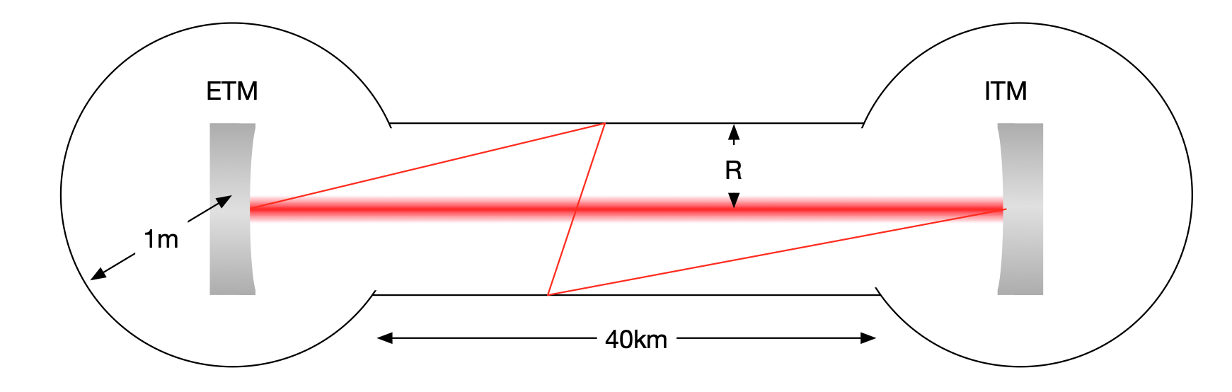
What are we focused on first?
Beamtube Baffles to prevent scattered light from reaching the beamtube and then back to our optics

Slide 7
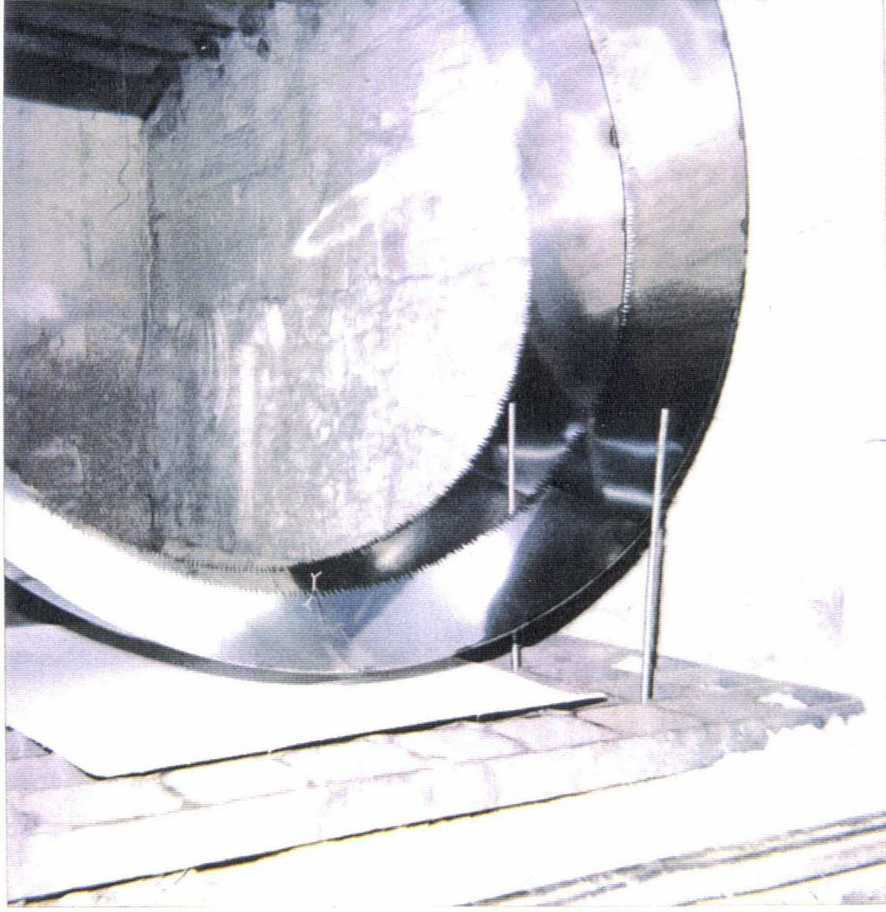
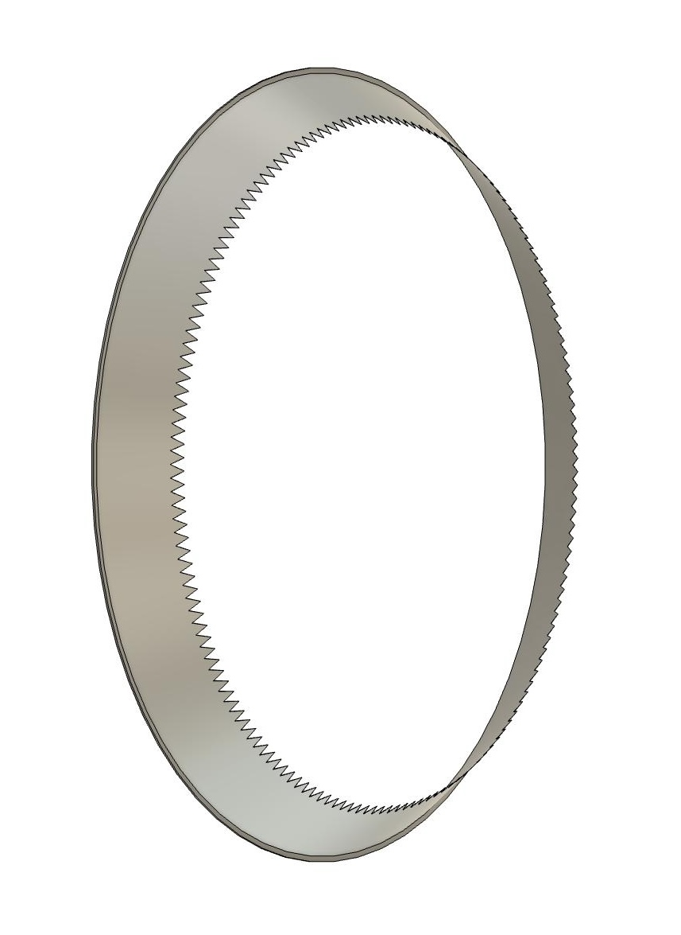
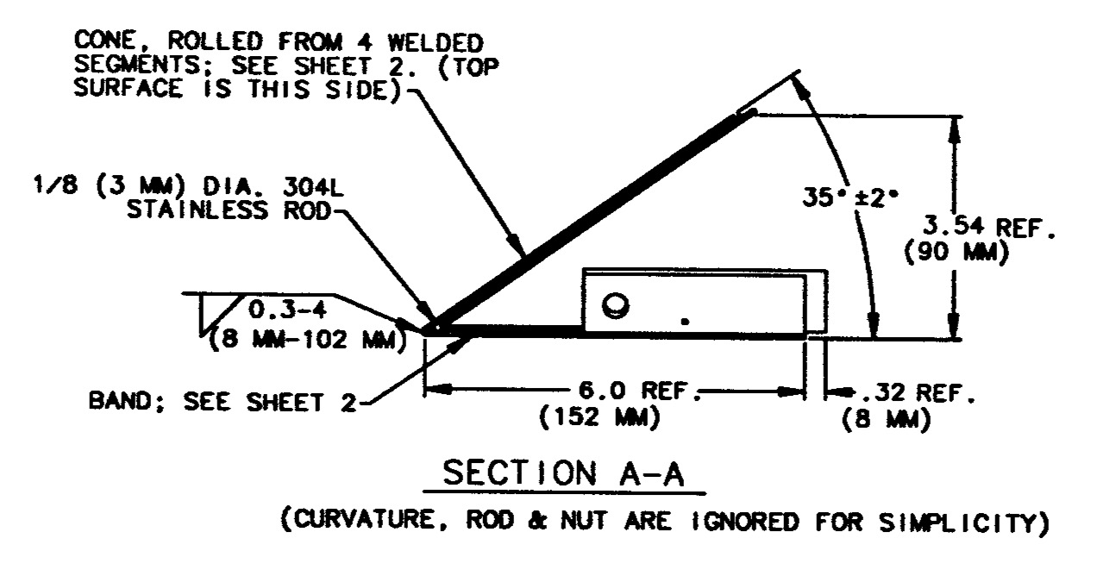
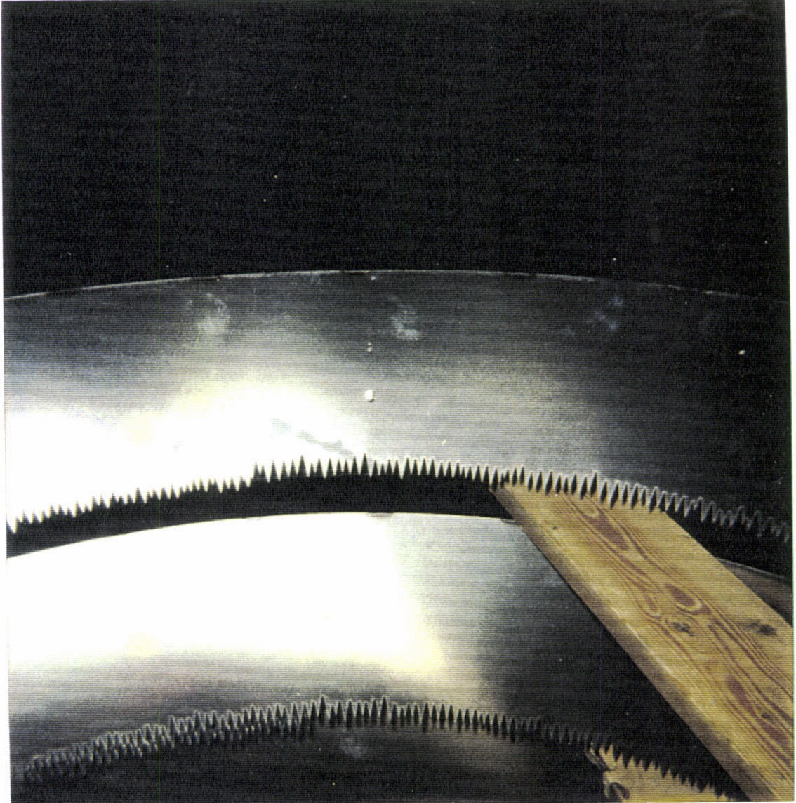
What are we focused on first?
Beamtube Baffles to prevent scattered light from reaching the beamtube and then back to our optics
Baffle
$${35}^{∘}$$
Beamtube wall
(BRDF)
$${55}^{∘}$$
$${35}^{∘}$$
backscatter
Near Side
Far Side
incoming
$${55}^{∘}$$

Slide 8
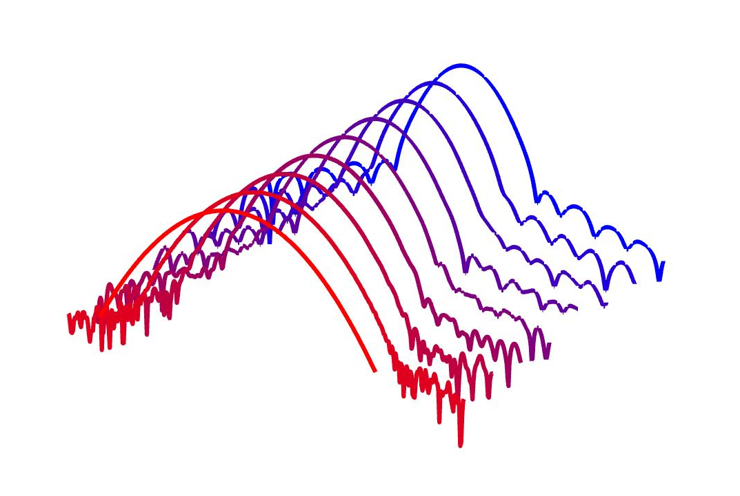
A bit more “detail”
There is really no way to shield the beamtube fully
Some field always makes it to the tube due to diffraction
Next
Previous
Field on
tube
Wave Optics
Beam

Slide 9
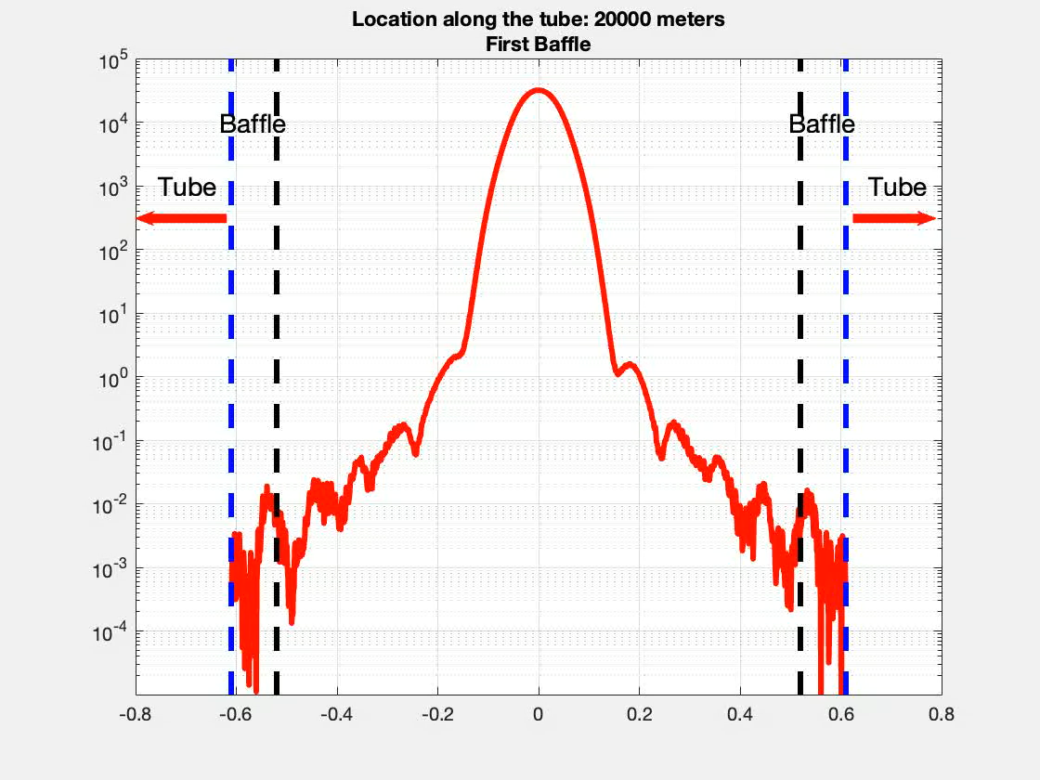
Light Propagation through the tube

Slide 10
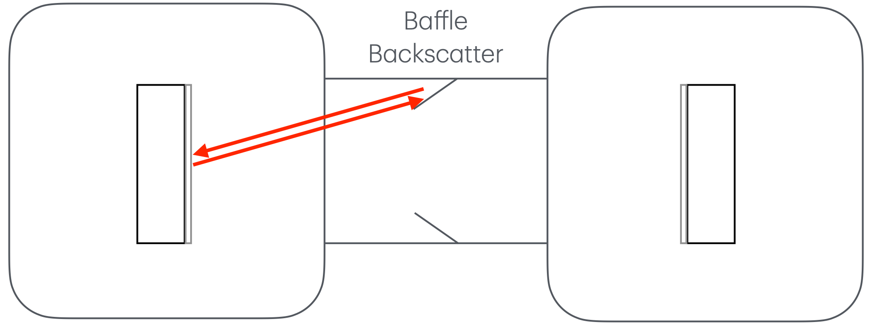
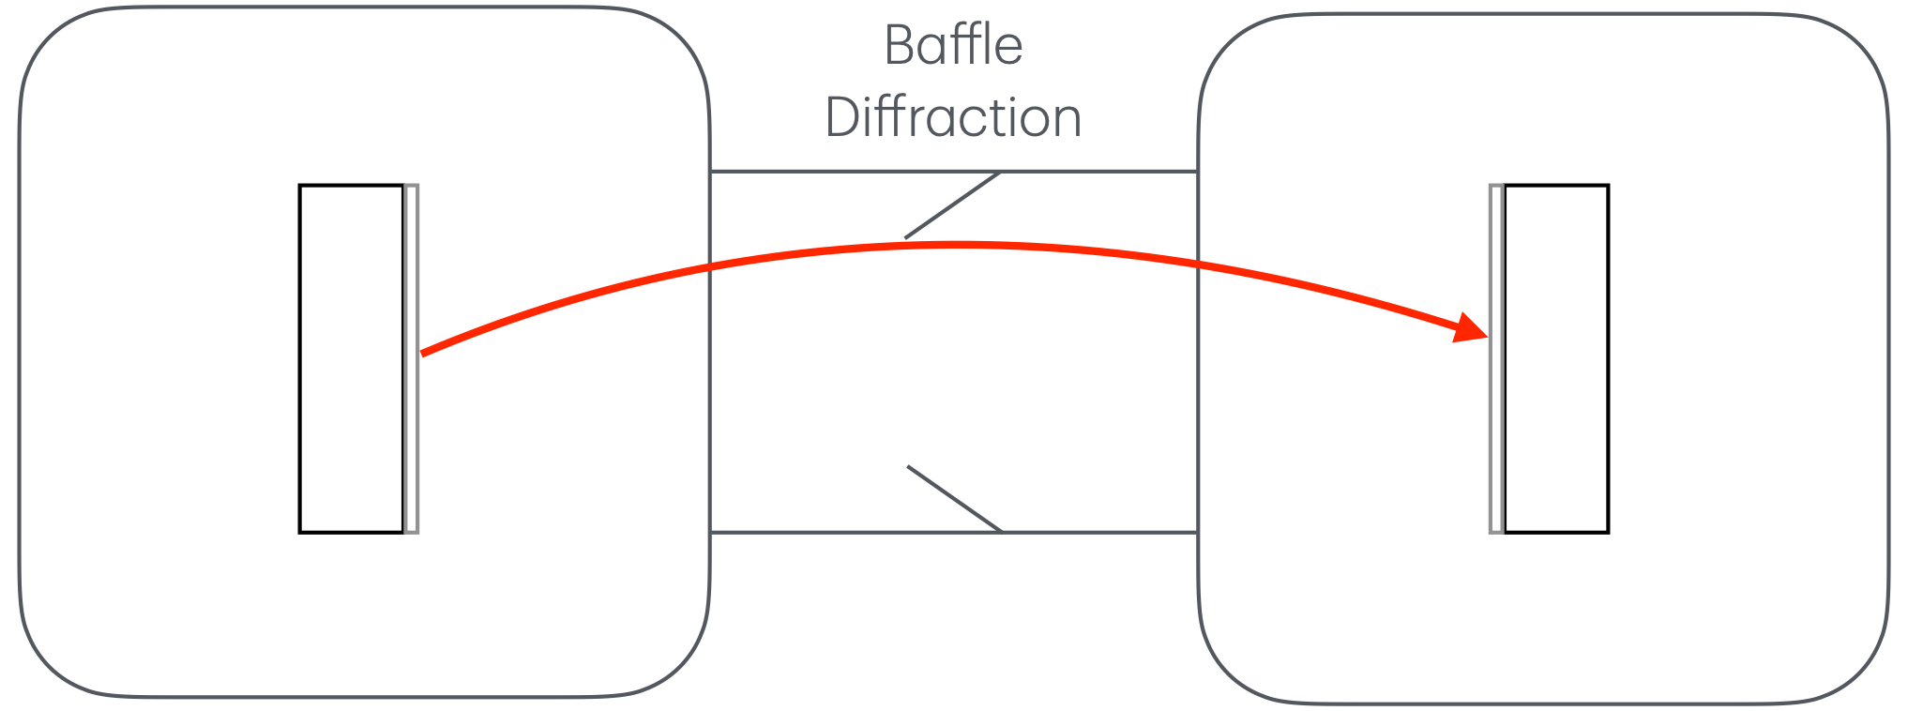
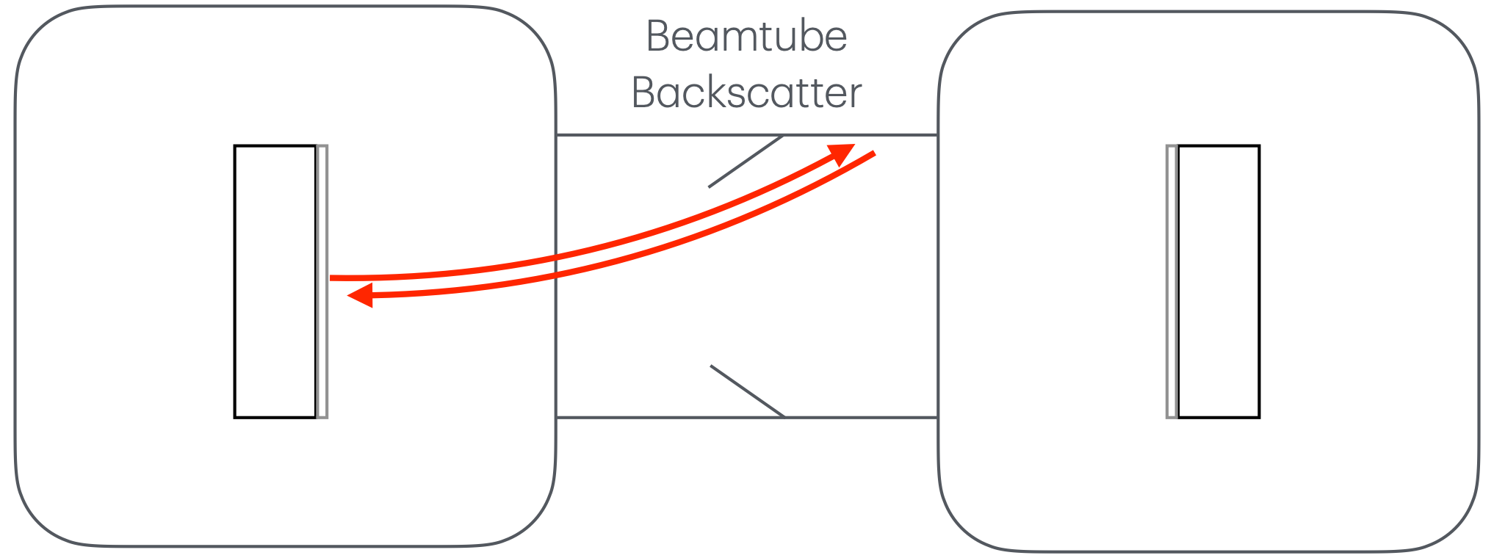
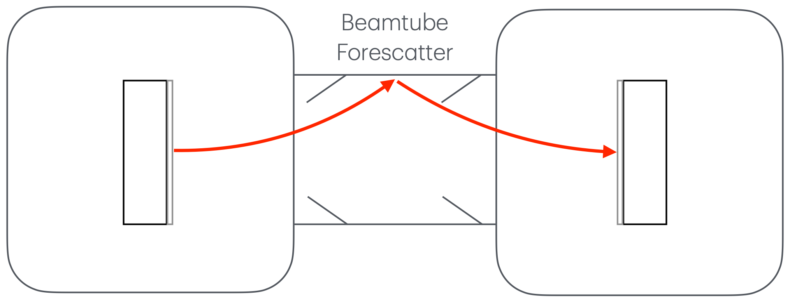
What are we focused on first?
Types of noise we model
Baffle Backscatter
Baffle Diffraction
Beamtube Forescatter
Beamtube Backscatter

Slide 11
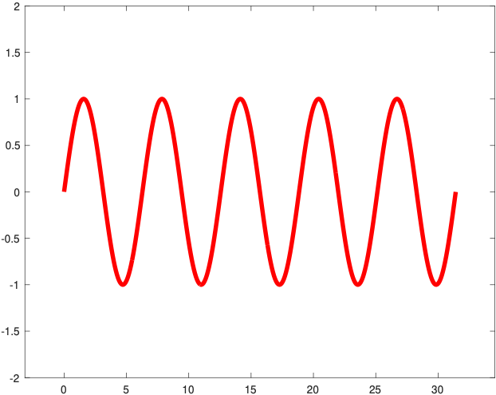
A bit more “detail”
Baffle Backscatter
Stray Beam Recombines
Main Beam

Slide 12
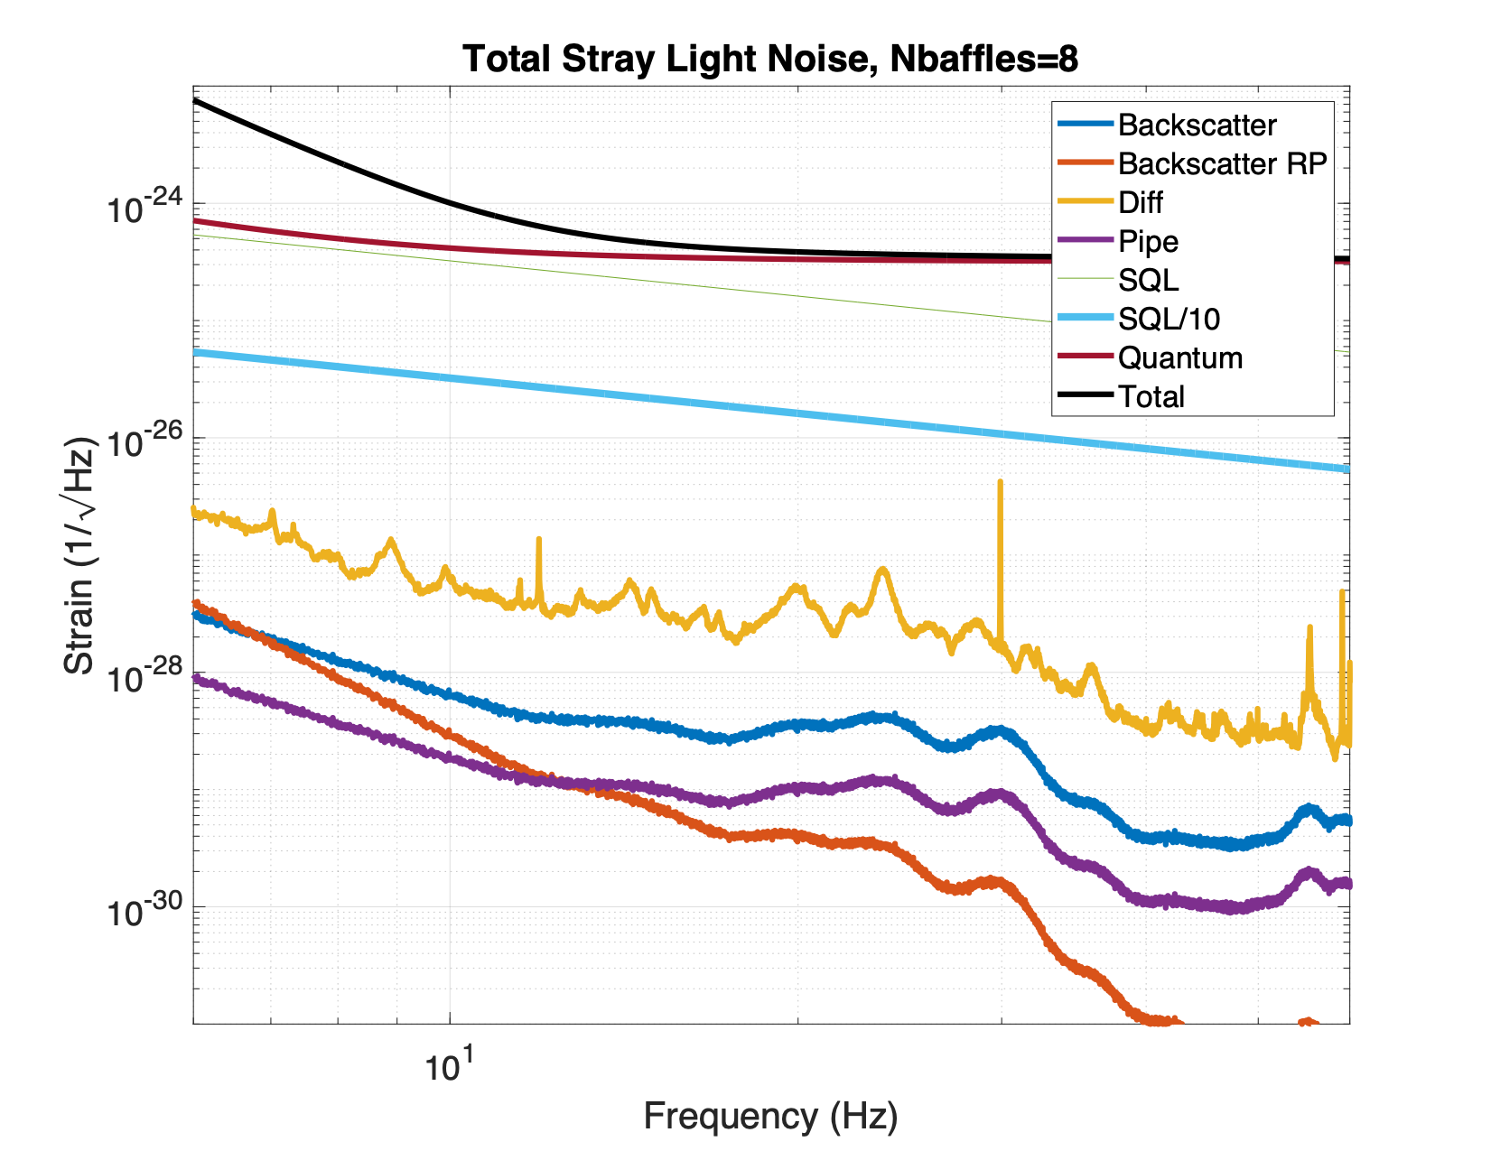
We make Noise Estimations Like So
As long as our model tells us we are away from the sensitivity of CE, we are good.

Slide 13
Relevant Parameters for Stray Light
Beamtube wall material, radius, and shape
Baffle locations, material, mounting, and shape
Vacuum System Design
Coupling of seismic activity to the tube and baffle
Seismic Activity at LOW AND HIGH frequencies
Beamtube alignment tolerance and other non-ideal considerations

Slide 14
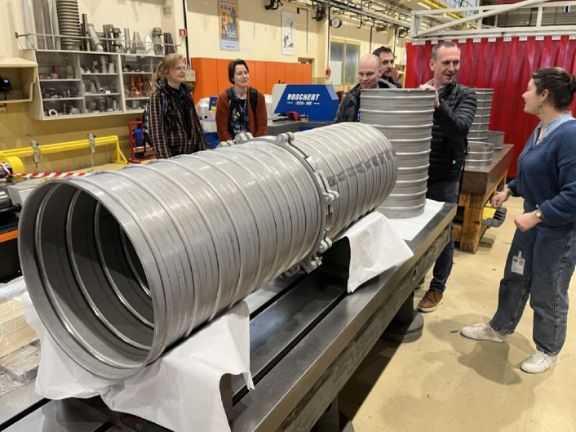
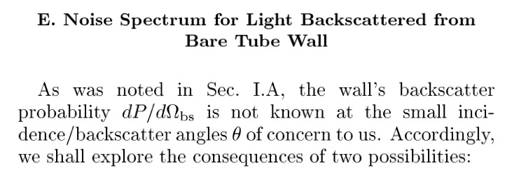
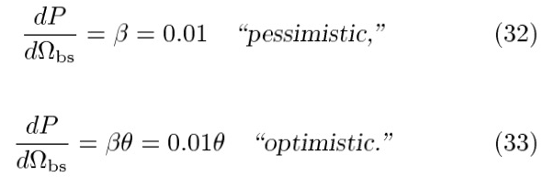
Relevant Parameters for Stray Light
Beamtube wall material, radius, and shape
Wall Type $→$ forward and back scatter $→$ baffle shielding requirement
Wall Radius $→$ Baffle height/inner radius $→$ Number of baffles
…
Side note: There are no measurements at the low/high angles required for our models

Slide 15
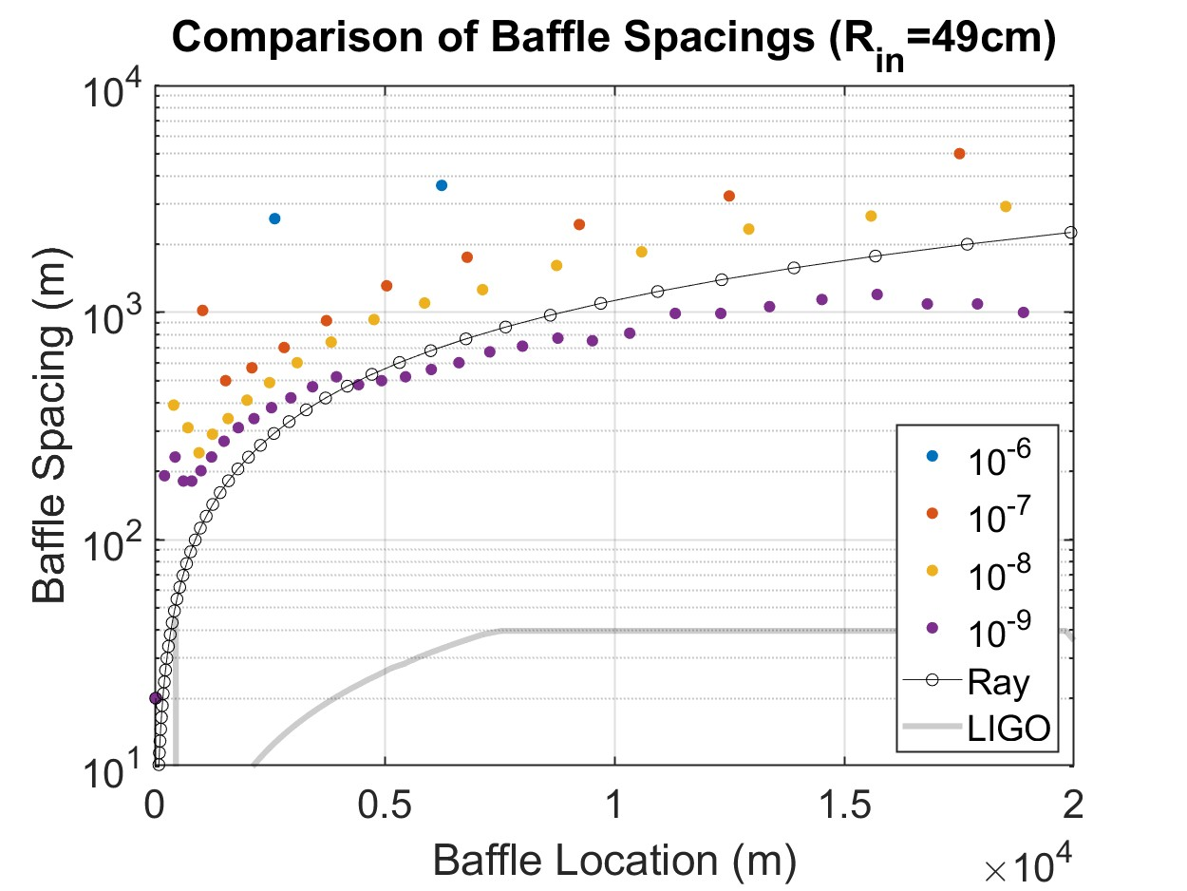
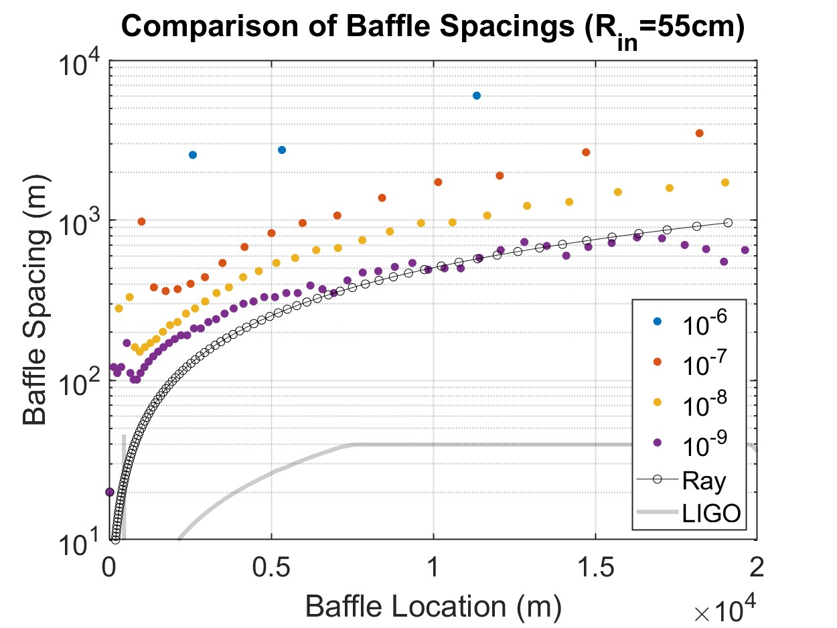
Relevant Parameters for Stray Light
Baffle locations, material, mounting, and shape
Assuming we pick one type of baffle.
Locations depends on inner radius.
Locations depend on allowable power on beam tube.
Geometrical vs Wave approach.

Slide 16
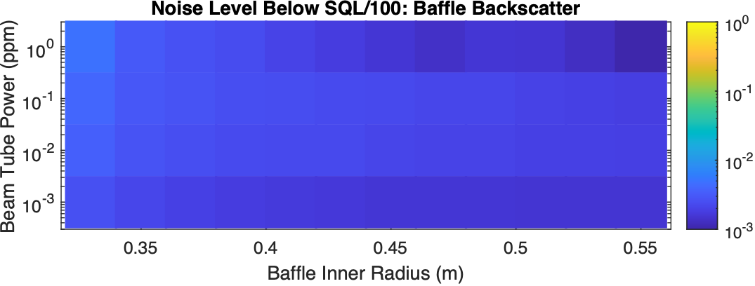
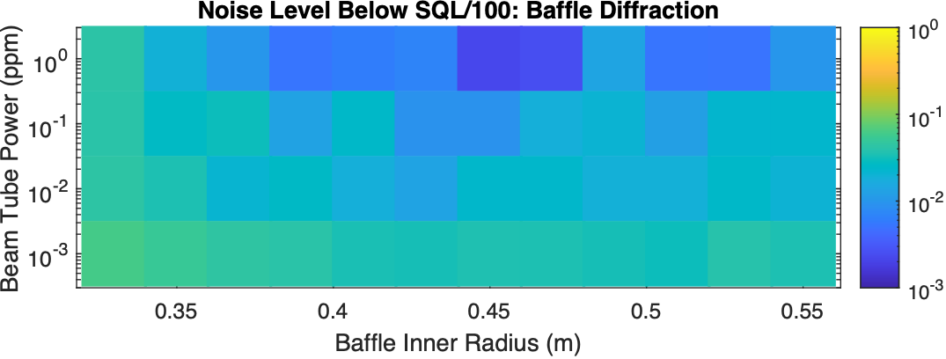
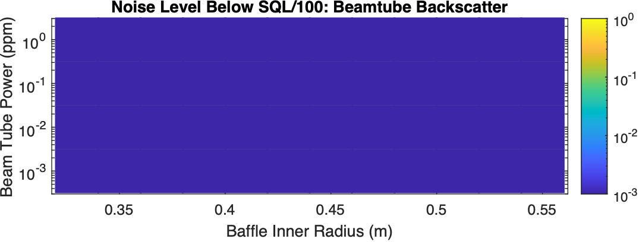
Distributed Power Configuration
Baffle locations, material, mounting, and shape
Main takeaway is that too many baffles only increase diffraction noise…
Baffle Backscatter Noise is less dependent on beamtube coverage and their radius

Slide 17
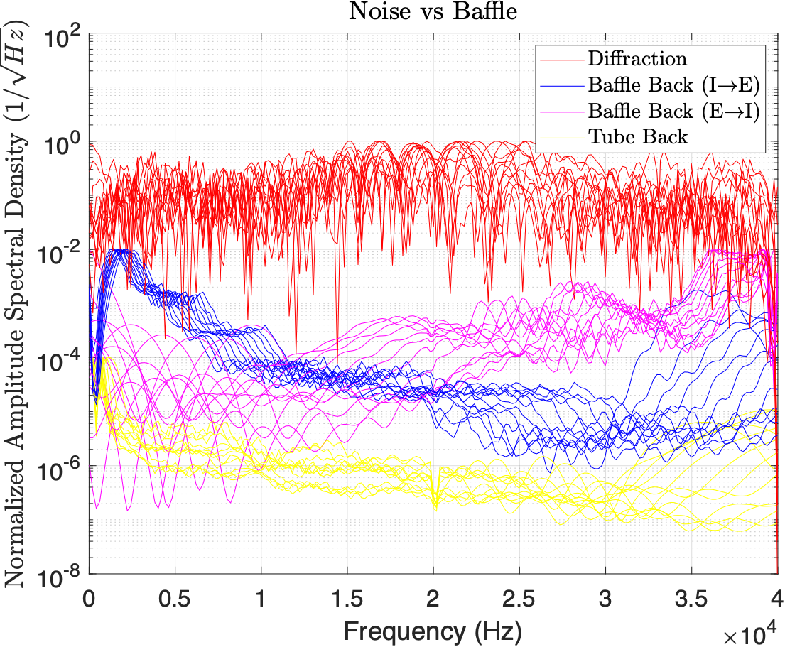
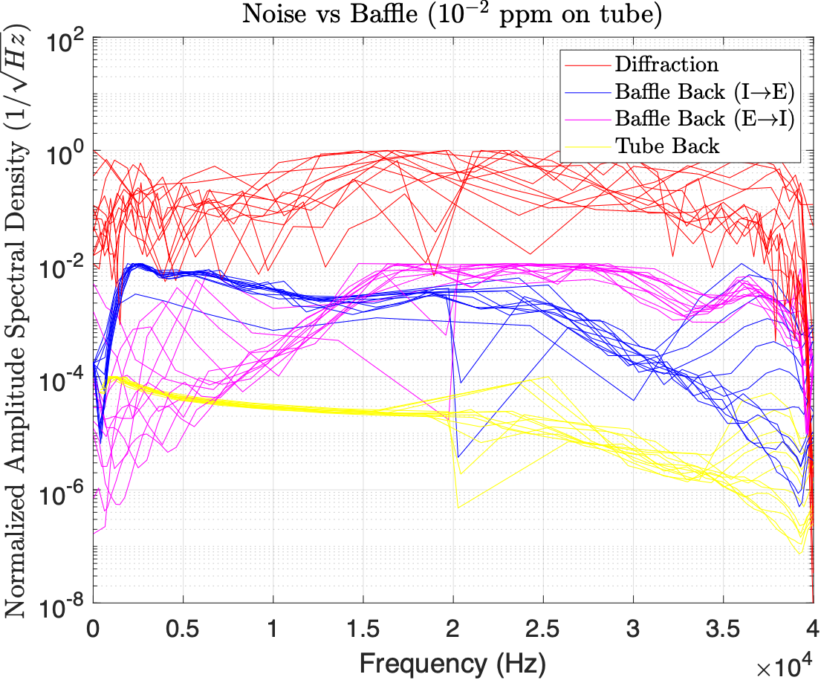
Noise vs Baffle
Main takeaways
Main takeaways is independent of the case studied.
Diffraction noise peaks in the middle section, but dependence on location is relatively weak.
Backscatter noise peaks close to the test mass, but when considering both test masses, backscatter becomes weakly dependent on location.

Slide 18
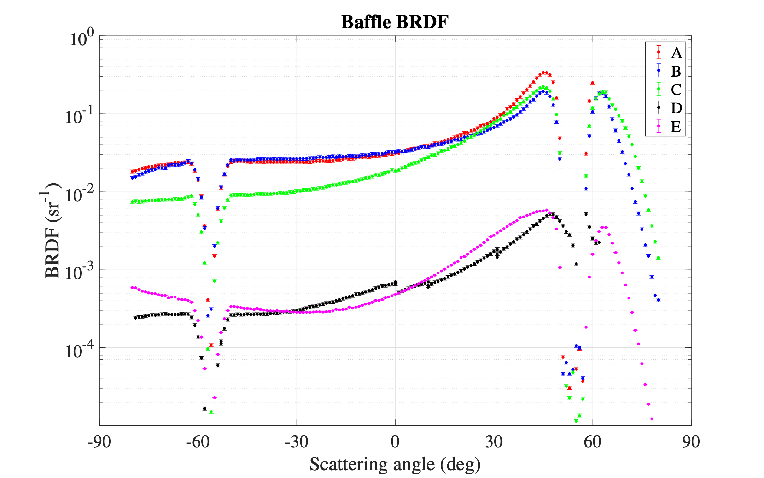
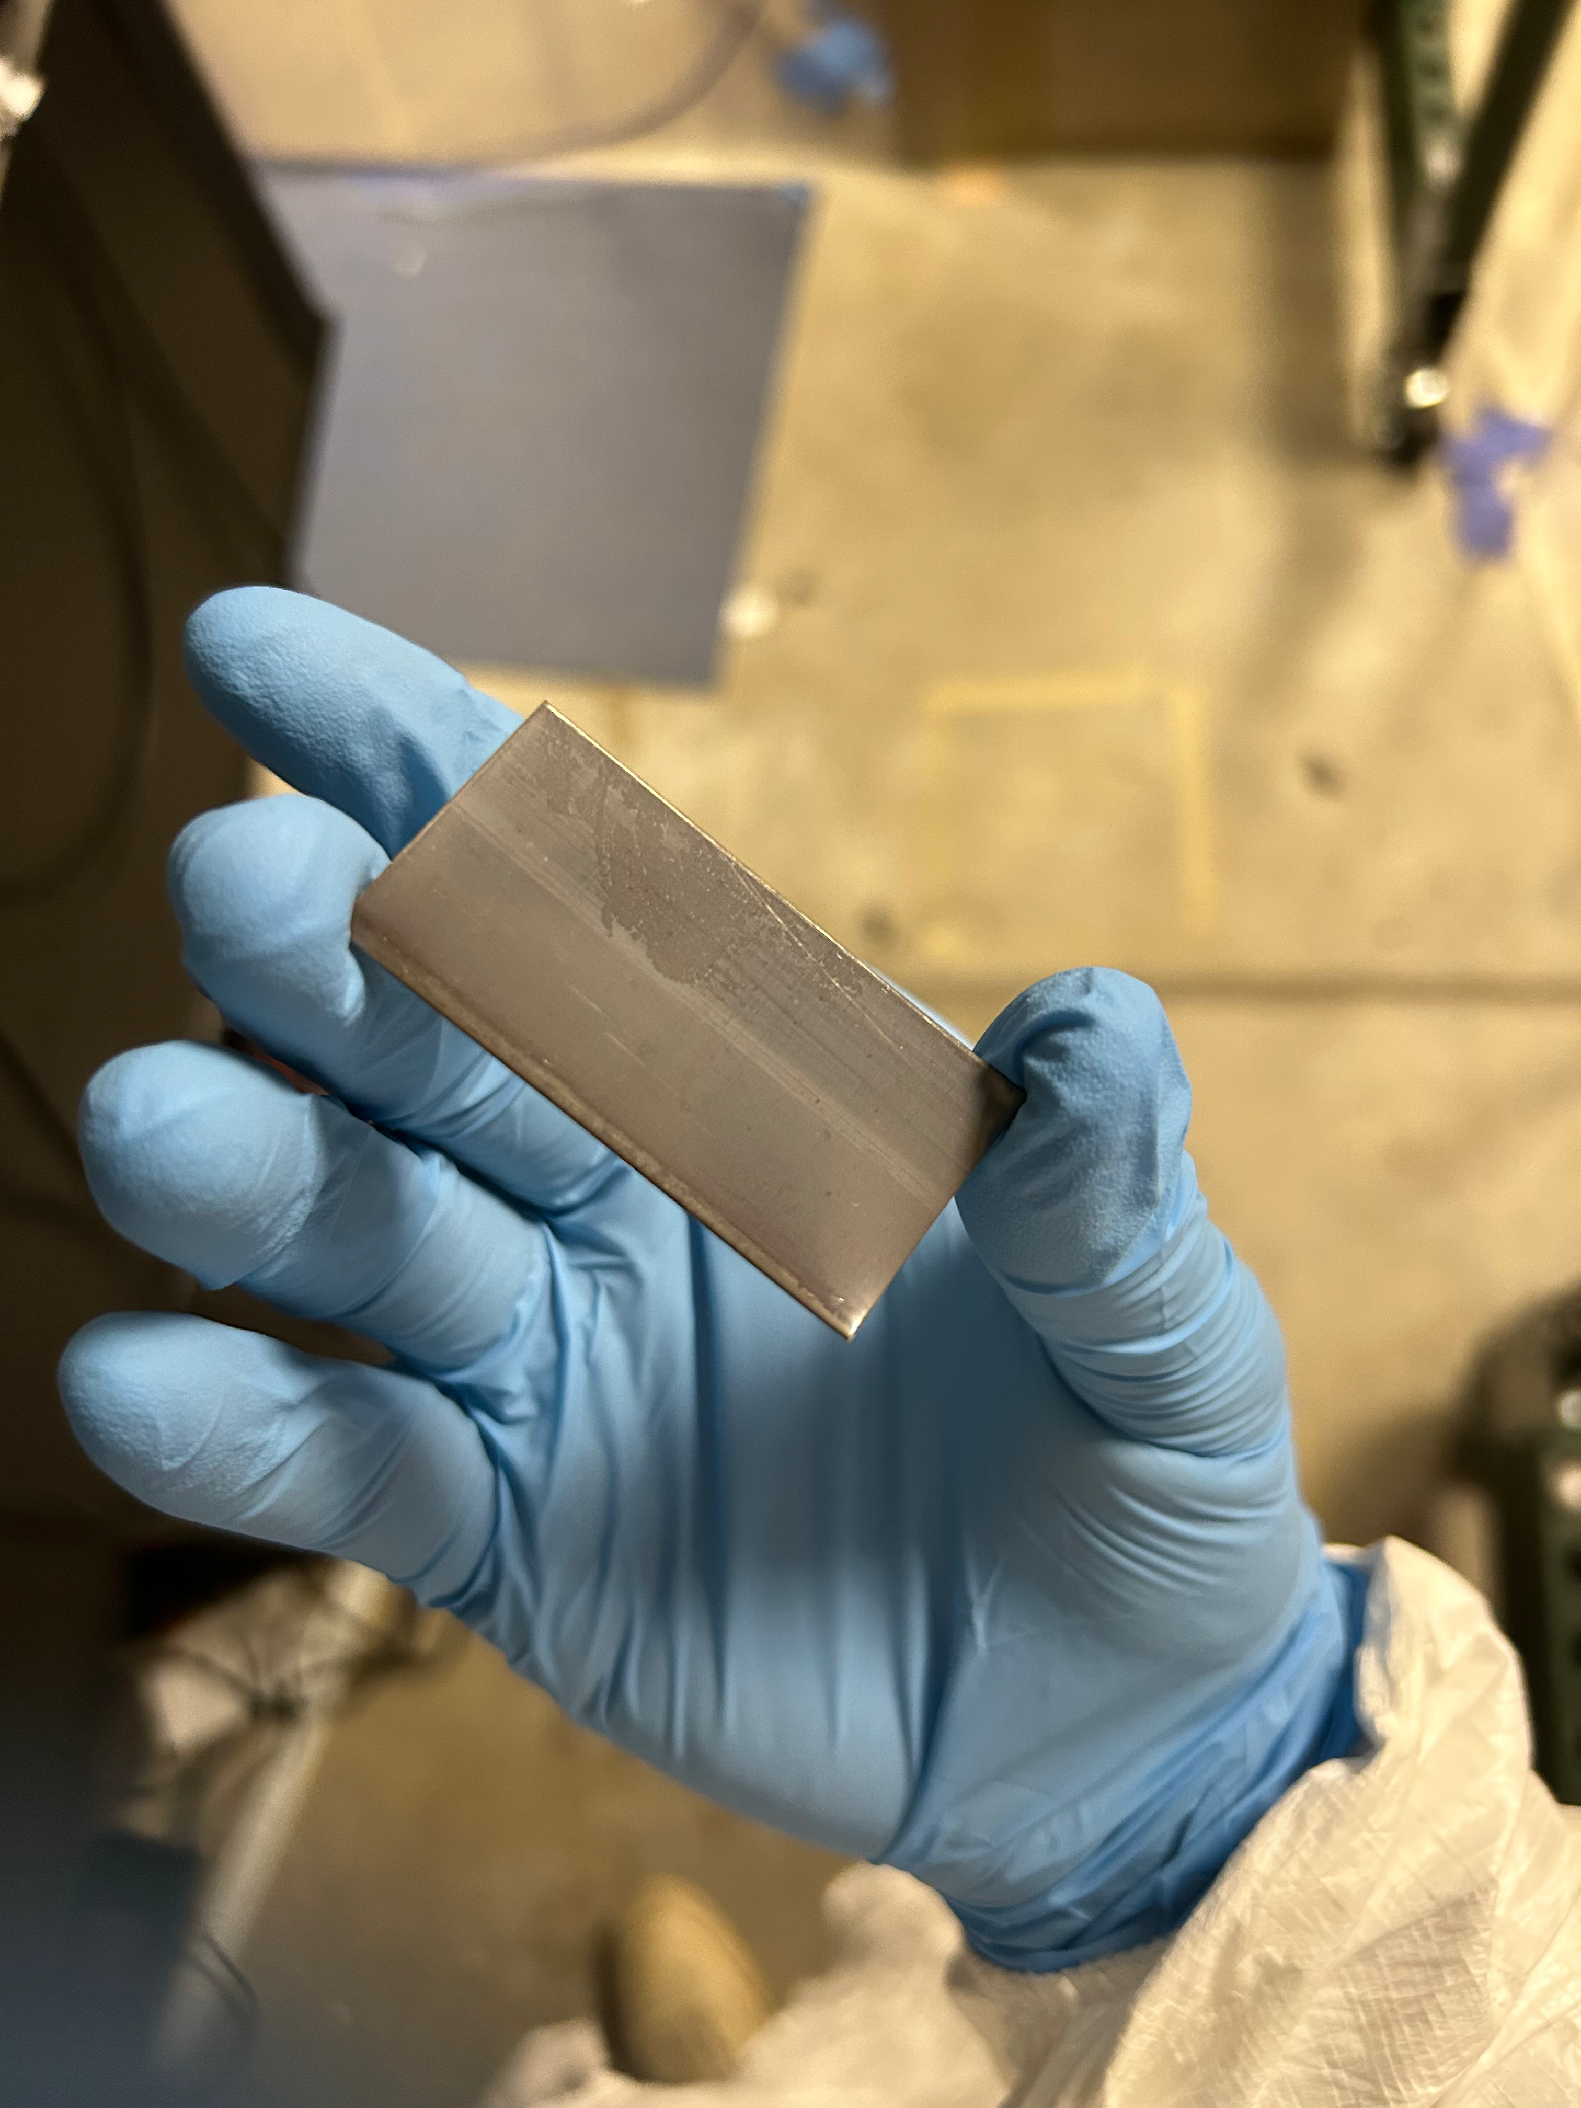
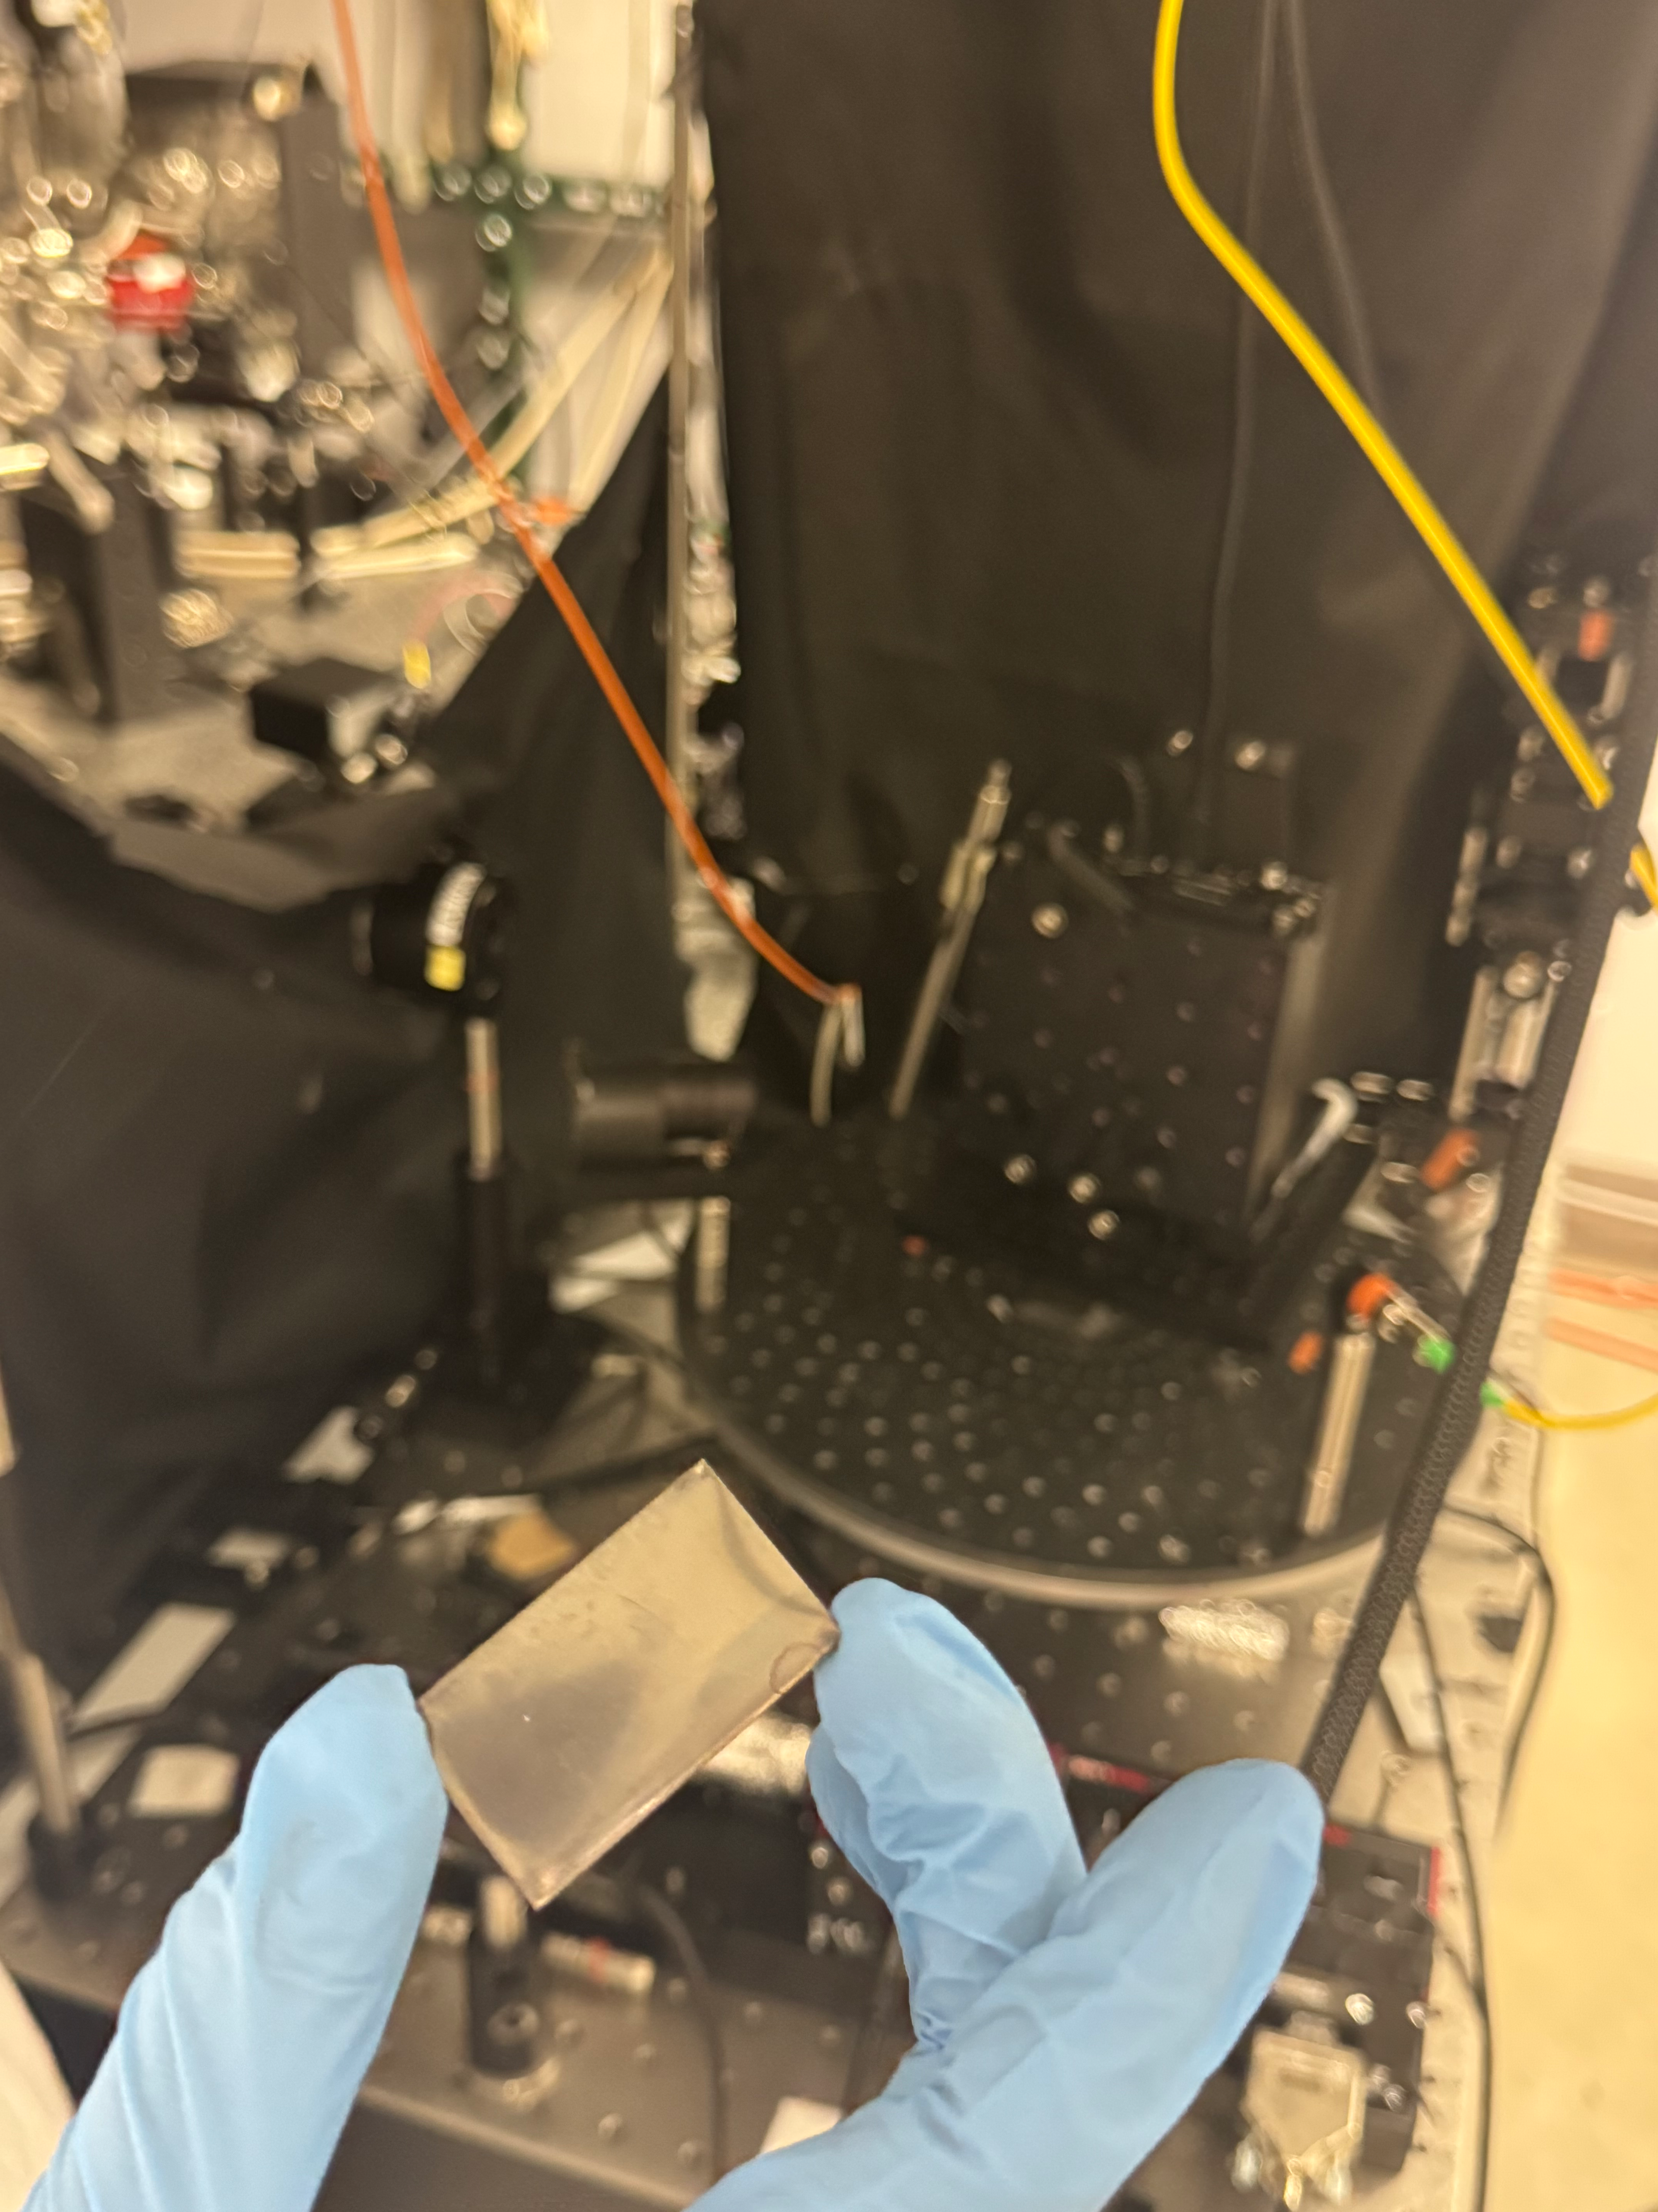
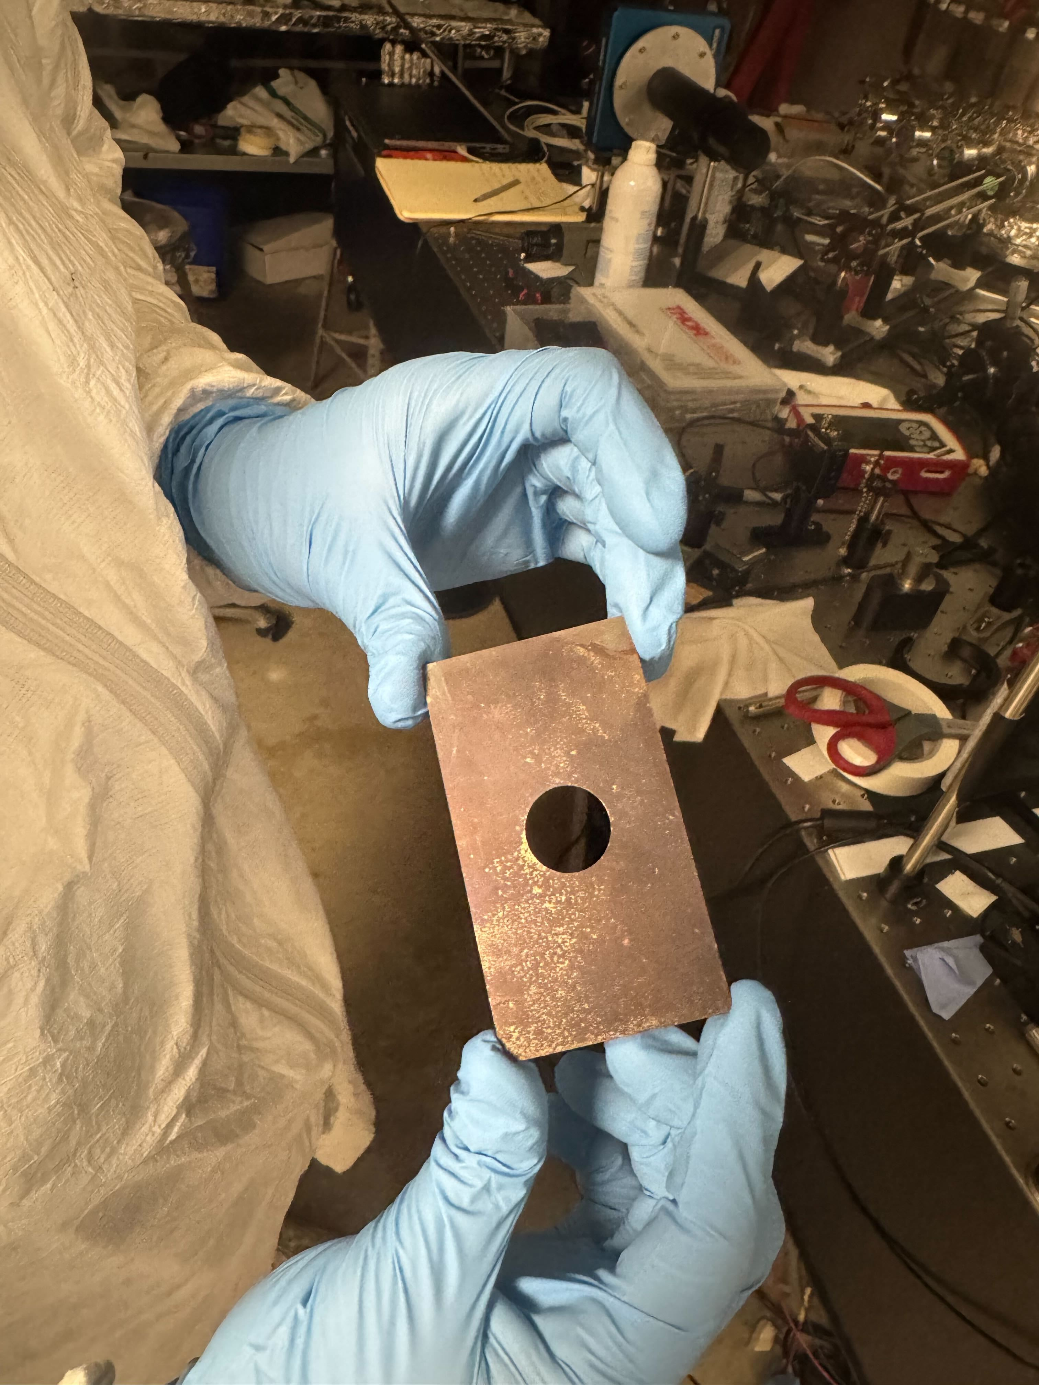
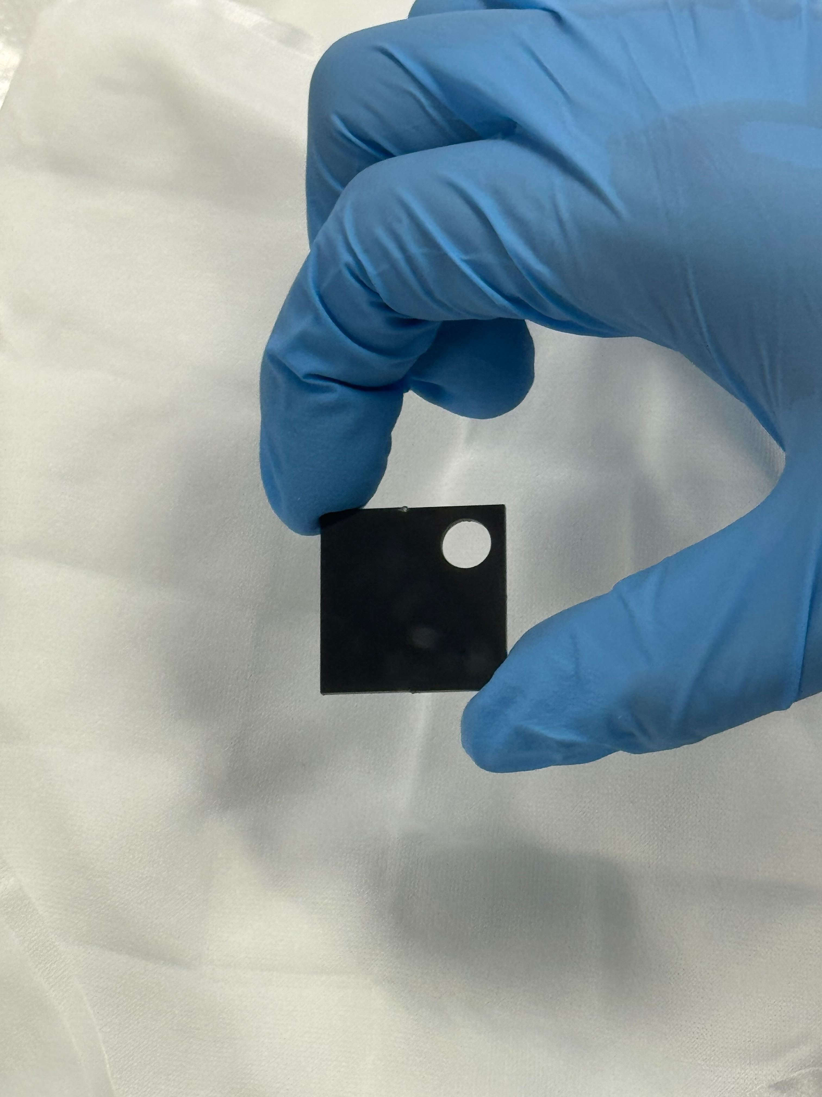
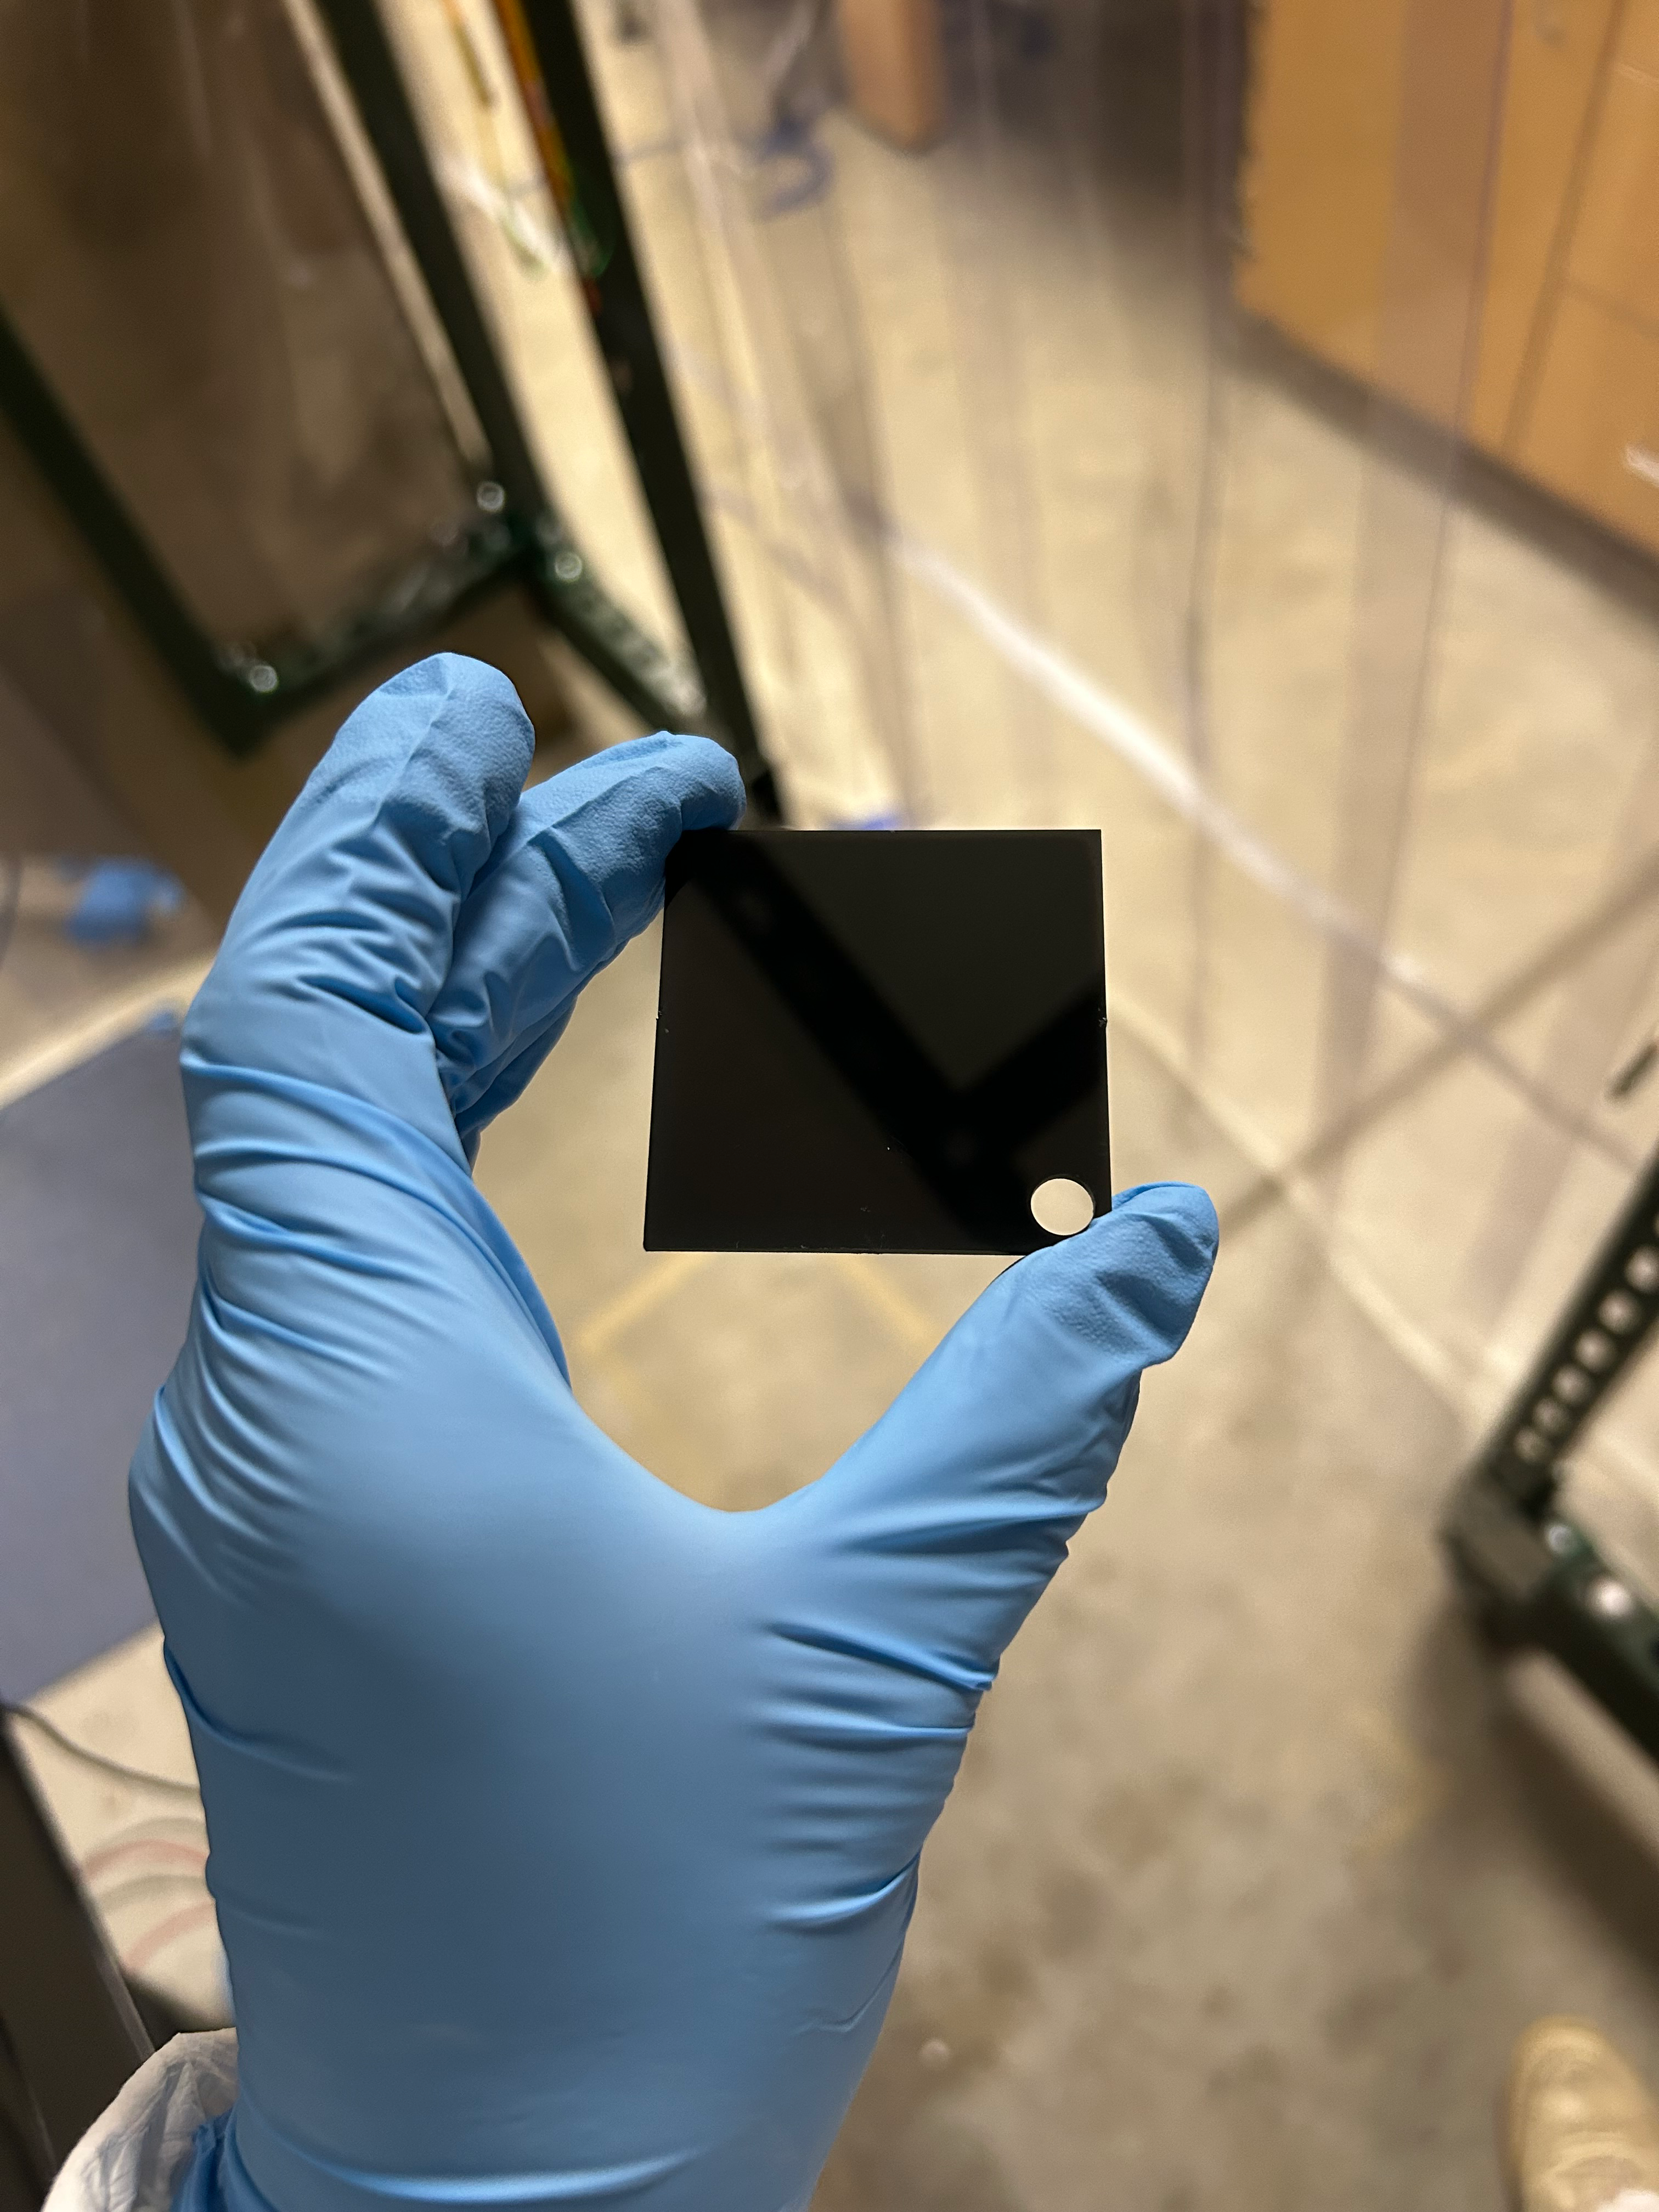
Backscatter from Various Materials
Baffle locations, material, mounting, and shape
SSTL (polished)
A
SSTL (polished)
B
D
E
We are interested in these values
SSTL (oxidized)
DLC (super#8)
DLC (super#8)
C

Slide 19
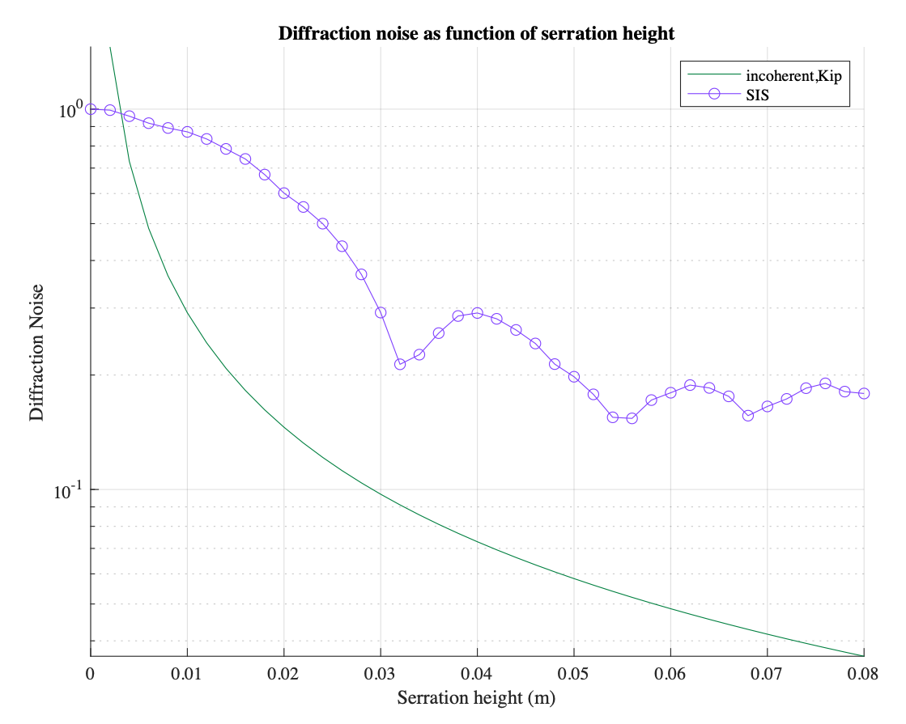
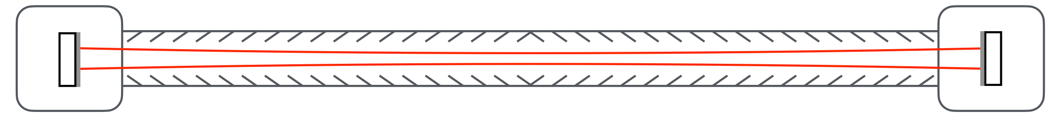
Serration for Good
Baffle locations, material, mounting, and shape

Slide 20
Relevant Parameters for Stray Light
Beamtube wall material, radius, and shape
Baffle locations, material, mounting, and shape
Vacuum System Design
Coupling of seismic activity to the tube and baffle
Seismic Activity at LOW AND HIGH frequencies
Beamtube alignment tolerance and other non-ideal considerations

Slide 21
Relevant Parameters for Stray Light
Vacuum System Design
Nearly all calculations point to a 100-200m minimum separation between baffles.
If cryo-pumps are placed every 200-250m, and each of them requires some baffling, then it’s possible it is all we need.
~100-200m min spacing

Slide 22
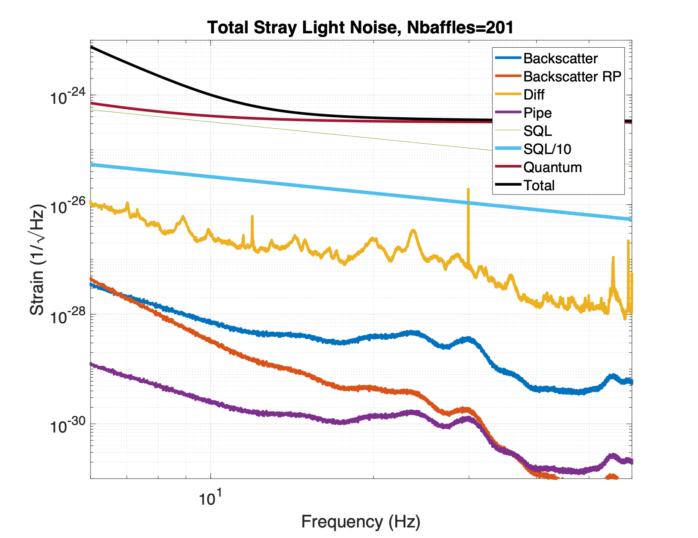
Standard Simple Configuration
Vacuum System Design
Constant 200m baffle spacing

Slide 23
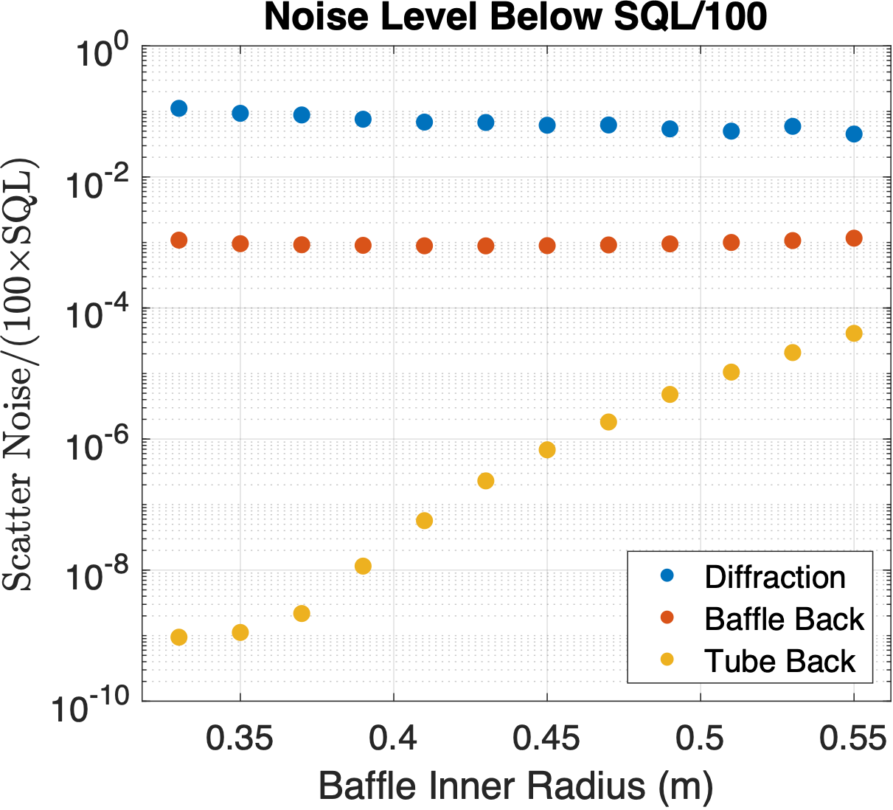
Standard Simple Configuration
Vacuum System Design
Noise vs Baffle Inner Radius
Very low angle tube backscatter a relative unknown

Slide 24
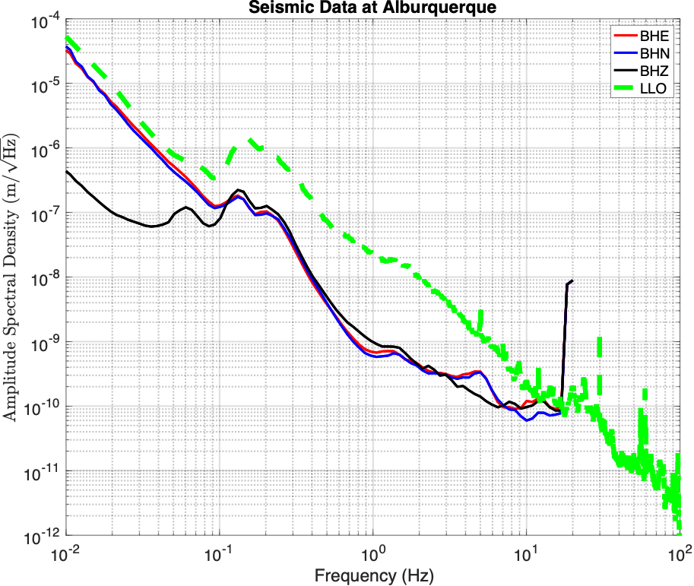
Relevant Parameters for Stray Light
Coupling of seismic activity to the tube and baffle
We care both for the low frequencies and the high frequencies, due to fringe wrapping
We assume that the ground motion transfer directly to the baffle
Mounting will determine resonances and damping
Ground
Tube
Baffle

Slide 25
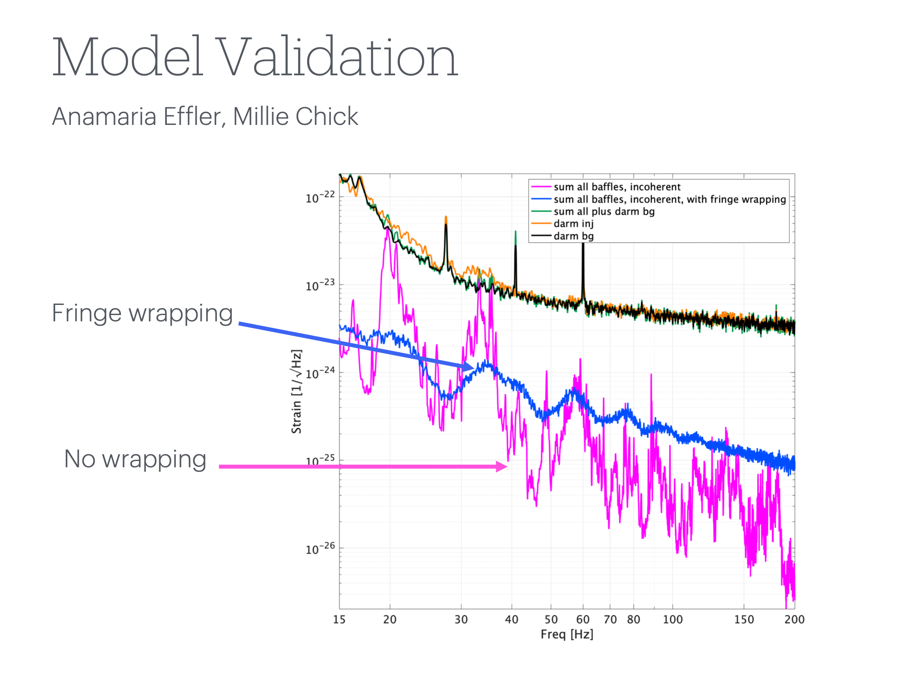
IS A FACTOR OF 10 SAFETY MARGIN ENOUGH?

Slide 26
Key Takeaways
More baffles, more diffraction noise.
Baffle Backscatter noise doesn’t change much with config.
Noise per baffle is “evenly” distributed across the tube.
Beamtube scatter is a relative unknown.
Noise estimates are generally favorable, but need to increase modeling confidence.
Beamtube Diameter at ~122cm is ok from the Stray Light point of view

Slide 27
Thank you!

Slide 28

Modeling Development
Fringe wrapping is an important effect that is relatively easy to model for backscatter.
Fringe wrapping on diffraction is less straightforward and not explored.
Diffraction noise from low frequency beam motion.

Slide 29
Mirror Figure
Baffle Isolation Requirement
Mirror Thermal
Other Products
SLC
Vacuum Chamber Constraints
Tube Size Constraints
Tube Material
Beam Splitter AOI constraint
Seismic Activity
Optic Wedge Requirements

Slide 30


Placing Beamtube Baffles
Baffle Locations: Going beyond ray optics
Traditional approach to the placement of baffles is to use ray optics and try to shadow the entire beam tube.
Another approach is to use SIS to calculate the wave propagation and calculate the power on the beam tube between baffles, and try to keep it below a given threshold
Ray Optics
Marc Andres-Carcasona Phys. Rev. D 108, 102001

Slide 31



Slide 32

Distributed Power Configuration
0.01ppm/section
1ppm/section

Slide 33
Baffling strategy for other systems (LIGO as a guide)

Slide 34

SLC NSF Award — 3-Year Timeline
Major Goals
3R document
Report on Stray Light Noise Analysis for CE.
Evaluation of Impact of Test Mass surface roughness to the overall Stray Light Noise.
Baffles Conceptual Design for the 40 km beamtubes.
Trade Study on Baffles Materials and Coatings with main focus on beamtube baffles.
General requirements document - Stray Light Mitigation Strategy for core and auxiliary optics..
Modeling tools development
Modeling of beam tube stray light
Modeling validation
Baffle material measurements
Ray trace modeling of other components
Stray Light 3R doc
Finalize Conceptual Design
Exploration of non-ideal effects
Support of other systems
Baffle material measurements
Ray trace modeling of other components
Stray Light 3R doc
Finalize Conceptual Design
Support of other systems
Non-beamtube related strategies
2 μm
Stray Light 3R doc
Year 1
Year 2
Year 3

Slide 35
Forescatter from Various Materials
Would be great if we had some low angle measurements for forward and backscatter (<1deg)
Interested in these values
A
B
D
C
E

