Slide 1
Leak detection of the ET Pilot Sector beam tubes
Purnalingam Revathi, Jan Hansen

Slide 2
ET Pilot Sector leak detection strategy
Tube element flow [DN1000 – 6 m] (AISI 441)
1
Pre-cleaning
2
Welding of fittings
3
Leak detection
4
Dust – controlled cleaning
5
Storage
~ 1 week/tube element
1
Preparation
2
Pumpdown and leak detector calibration
3
System calibration
4
Leak testing
5
Disassembly of the tooling and pumps
6
Results and report
Tube end surface preparation
Assembly of leak detection tooling and tooling and pumps
Using the internal calibrated (He-4) leak
Using an external calibrated (He-4) leak
He-4 injection into external pockets on the welds

Slide 3
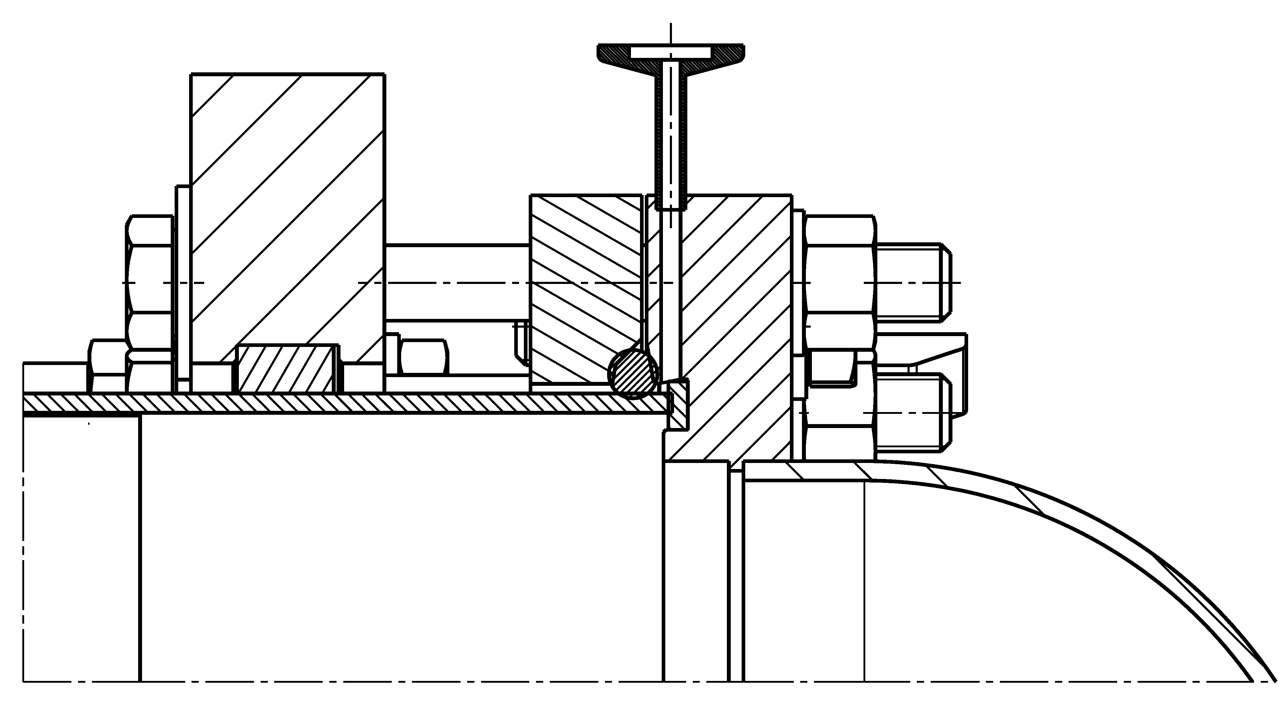
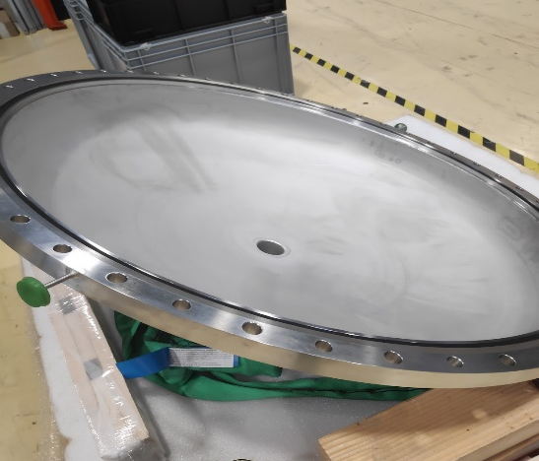
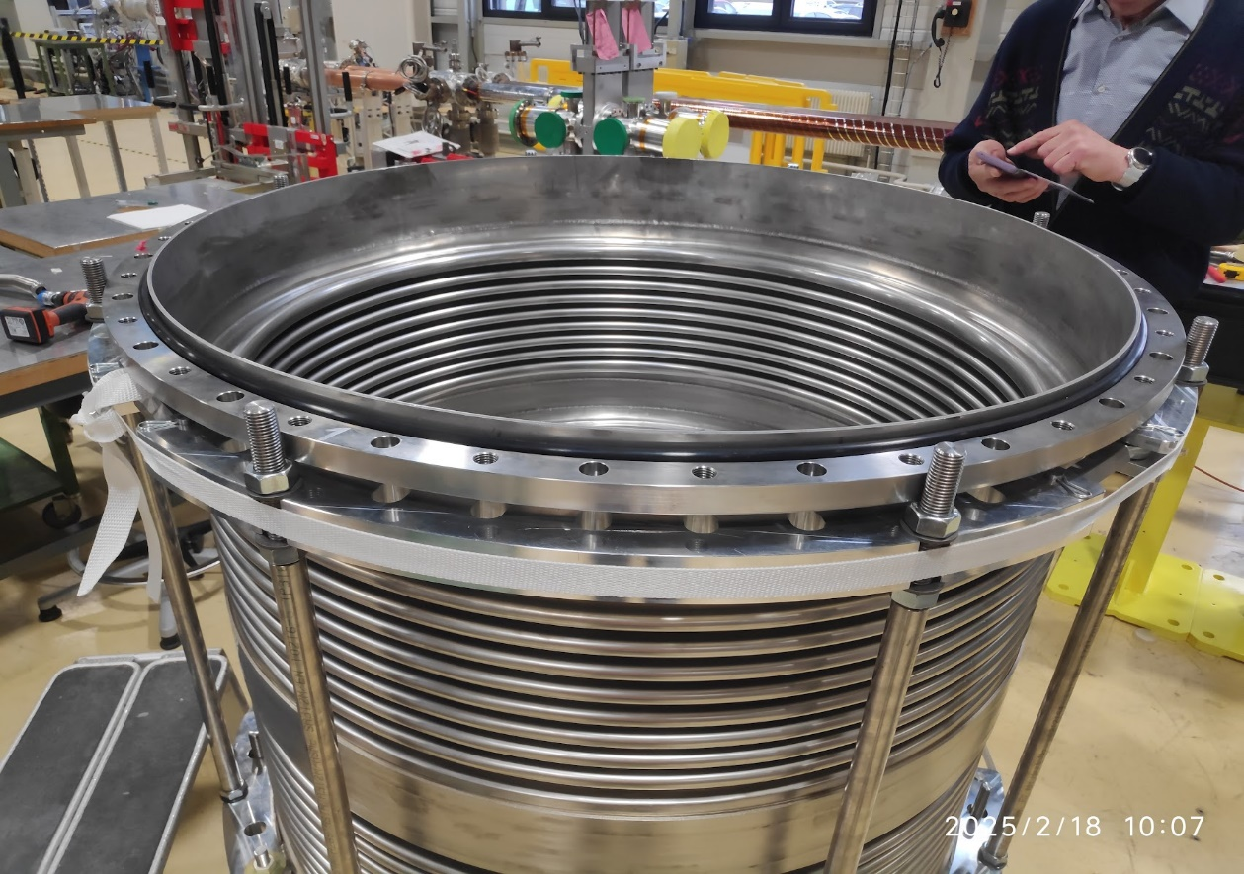
Leak detection of tube elements: Tooling
Flat NBR seal
NBR
O - ring
Test of the leak detection tooling on the ET pilot sector bellows

Slide 4
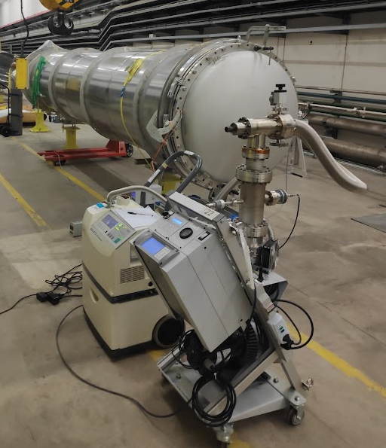
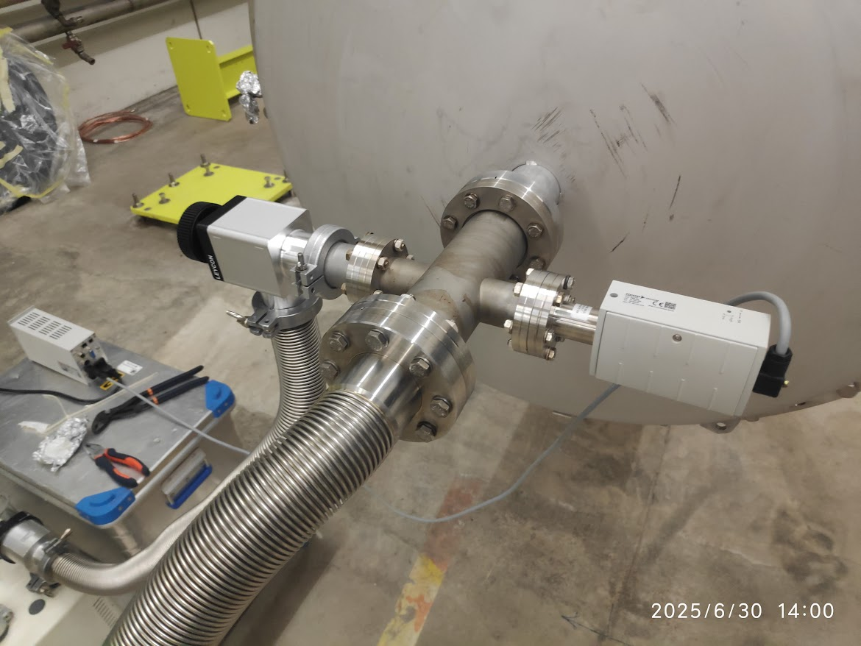
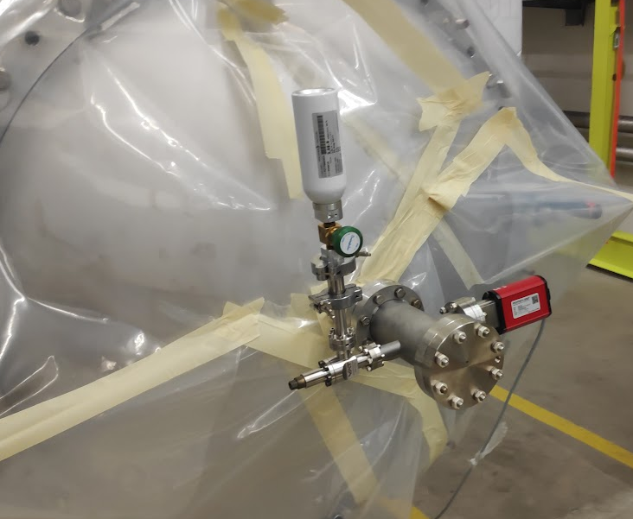
Leak detection of tube elements: Assembly
full range pressure gauge
full range pressure gauge
Connection to the root pump
Connection to the turbomolecular pumping group and the leak detector
Calibrated leak
Details of the calibration end
Details of the pumping end

Slide 5
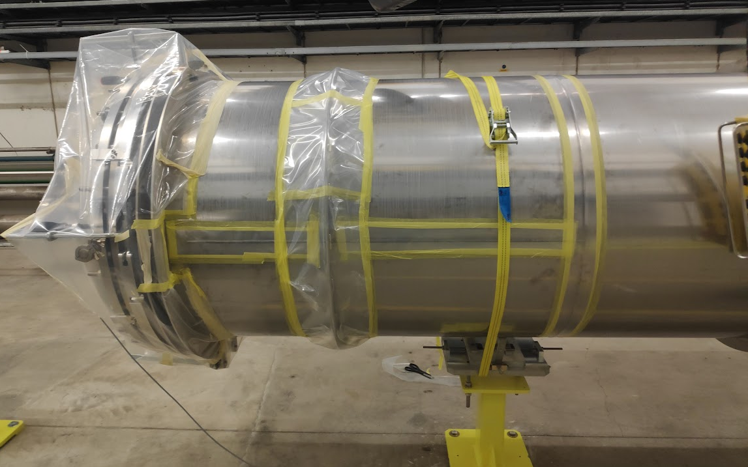
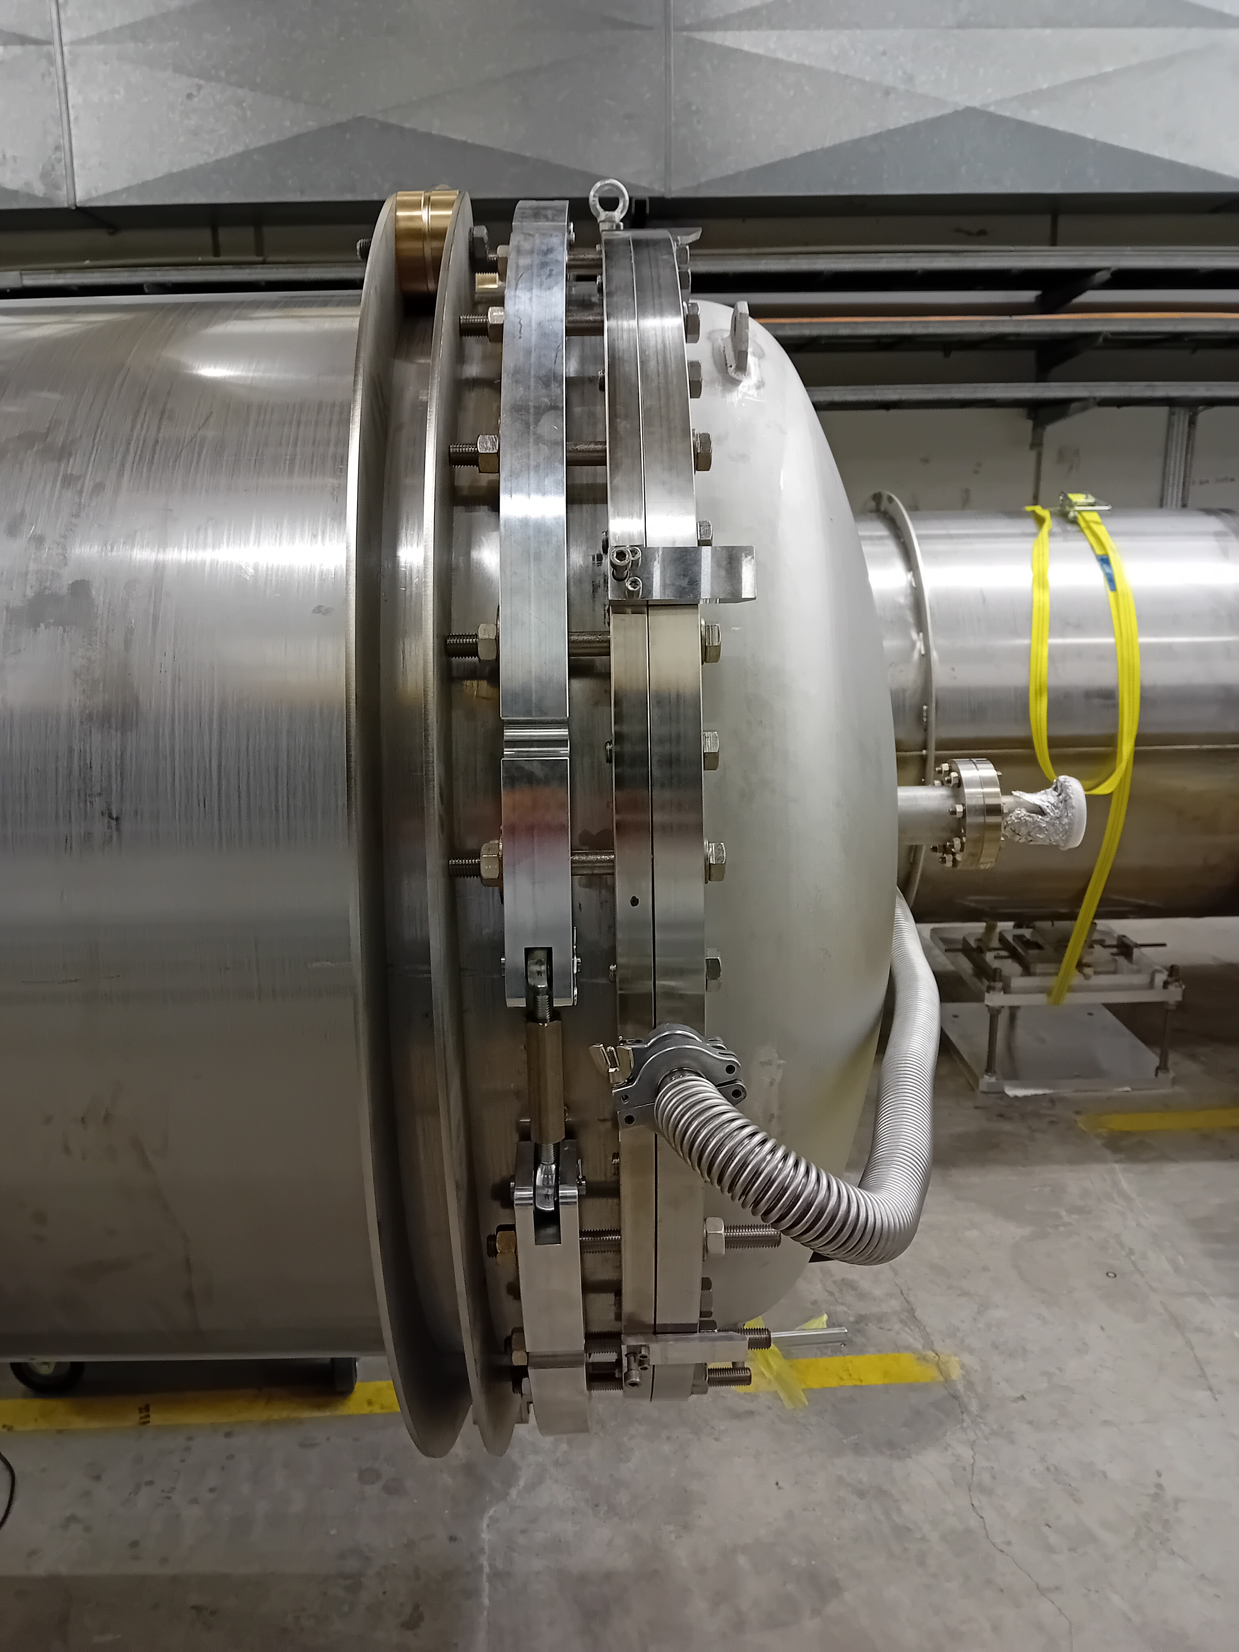
Leak detection of tube elements: Leak testing
Plastic cover pockets over the welds for helium injection
Plastic cover to protect the NBR O-rings
*Double gasket (flat seal + o-ring) with differential pumping
100% external leak detection of the welds:
Testing of all 11 welds ( 3 circumferential welds, 4 stiffener welds, 4 longitudinal welds) for all 7 tubes = 77 welds in total
*If required when the first seal is not leak tight

Slide 6
Strategy for leak detection for Einstein Telescope
Purnalingam Revathi
Excerpts from Slides of Paul Cruikshank’s presentation from Beampipes for Gravitational Wave Telescopes 2023 [1]
[1] Beampipes for Gravitational Wave Telescopes 2023 (27-29 March 2023): Overview · Indico

Slide 7
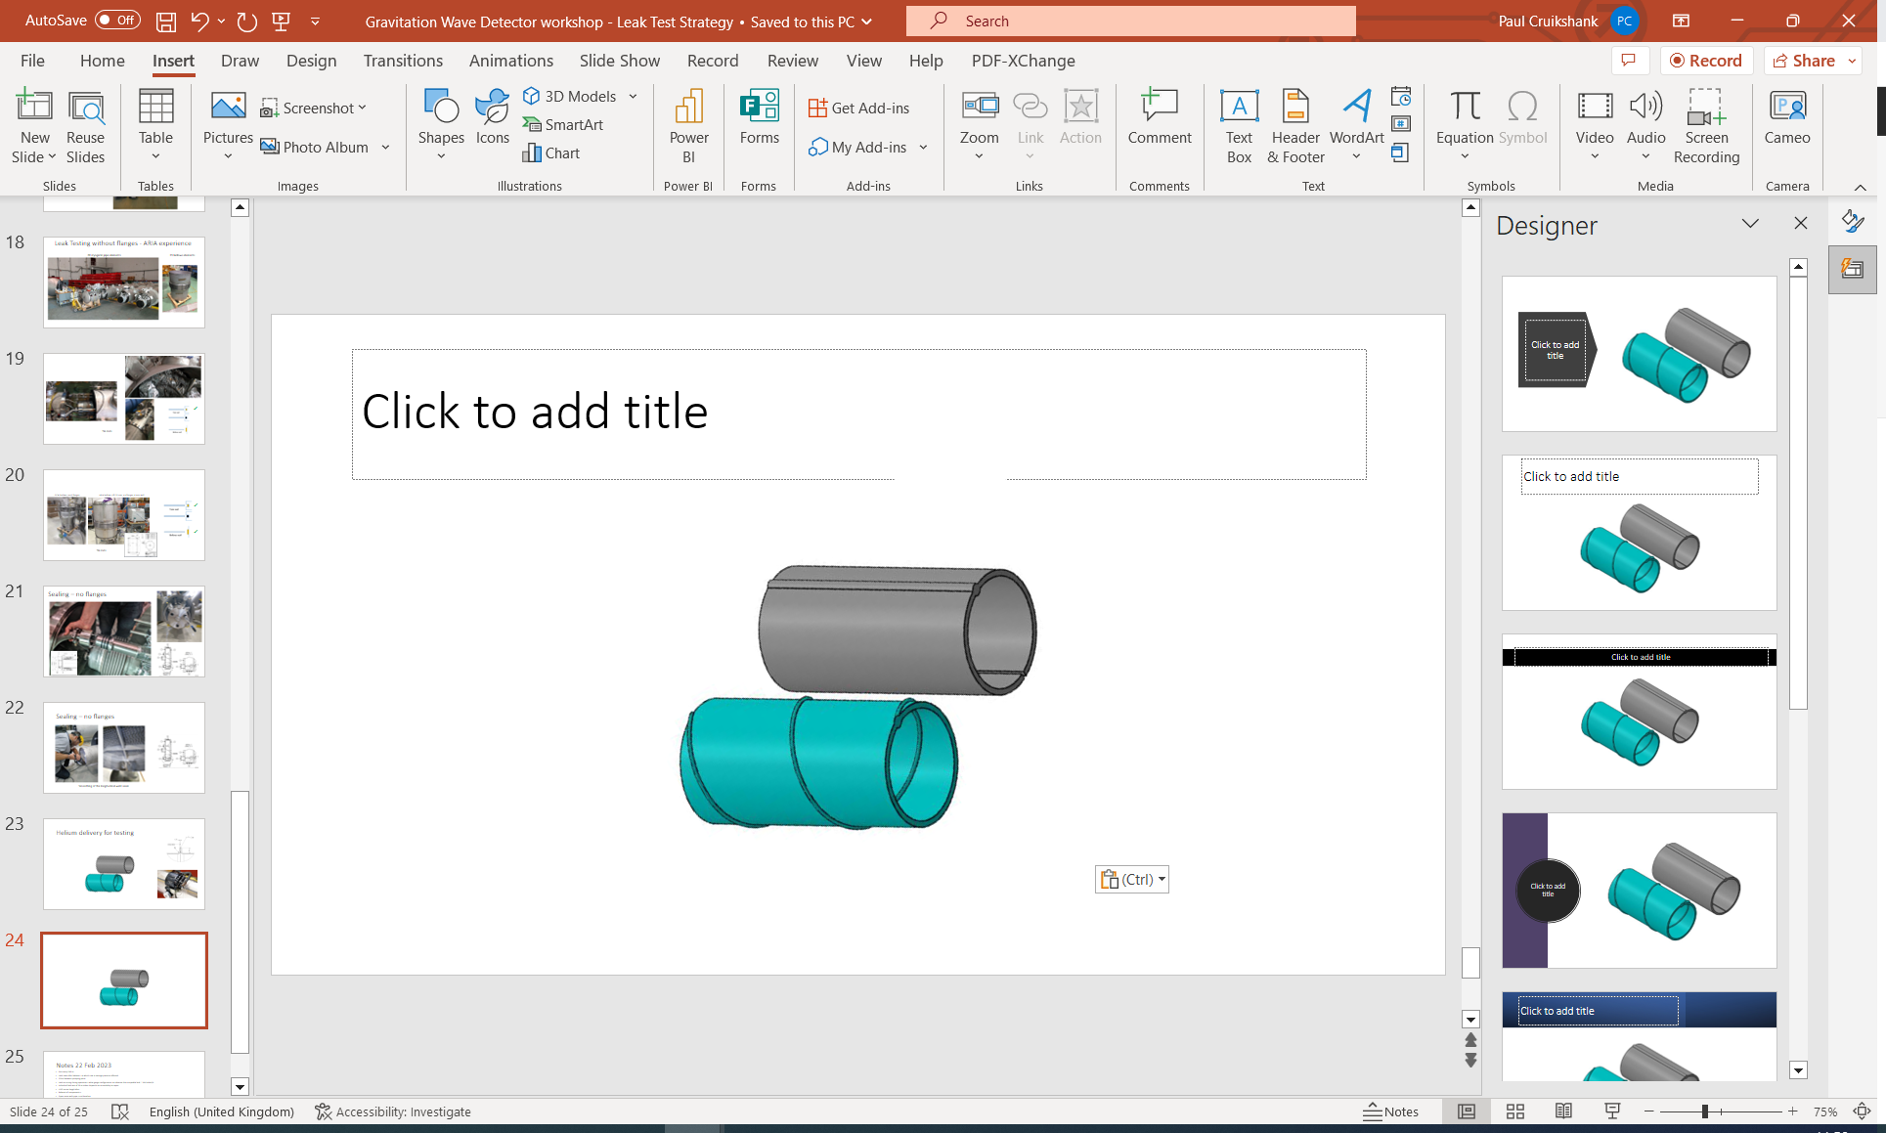
Leak Testing: What could leak ?
Ex-situ (components)
  15m Pipe
    longitudinal weld (spiral or straight)
    circumferential welds (if any)
    material through-wall defects (porosity, inclusions, damage, weld arc errors, ..)
  1 m Pumping Module
    welds, material defects, flange NC,…
In-situ ( x00 m Pipe Strings)
  Pipe to Pipe circumferential welds
  Degradation of validated components (transport, corrosion, etc)
In-situ (5 km Vacuum Sector)
  Pipe to Pumping Module circumferential welds
  Vacuum Instrumentation CF flange connections
Components:
under vacuum tests, external helium
Slides from Paul Cruikshank’s presentation from Beampipes for Gravitational Wave Telescopes 2023 [1]
[1] Beampipes for Gravitational Wave Telescopes 2023 (27-29 March 2023): Overview · Indico
Pipe Strings: Pipe to Pipe
(under vacuum tests, external helium)
Vacuum Sector: Pipe String to Pipe String

Slide 8
Leak detection Strategy for Einstein Telescope
Leak Test Strategy | Fixed Costs (std tests) | Variable Costs (leaks)
‘Max’ Testing Strategy (classic, preventive approach) | Ex-situ: 100 % Component leak test ($$$), In-situ: 100 % Subsector leak test($$), In-situ: Vacuum Sector leak test ($), | NC localisation, repairs & retest ($) NC localisation, repairs & retest ($) NC localisation, repairs & retest ($)
‘Mid’ Testing Strategy | In-situ: 100 % Subsector leak test($$), In-situ: Vacuum Sector leak test ($), | NC localisation, repairs & retest ($$) NC localisation, repairs & retest ($)
‘Min’ Strategy (corrective approach) | In-situ: Vacuum Sector test ($) | NC localisation, repairs & retest ($$$)
Slides from Paul Cruikshank’s presentation from Beampipes for Gravitational Wave Telescopes 2023 [1]
[1] Beampipes for Gravitational Wave Telescopes 2023 (27-29 March 2023): Overview · Indico
Component: pipe elements and pumping modules; Subsector: pipe elements welded between two pumping modules (“pipe strings”);
Sector: pipe elements/pumping modules welded between two sector valves
Assuming 2-year period, 400 working days, and going for ‘Max’ testing strategy.
Vacuum System Item | Qty | Leak tests (Factory) | Leak tests (On-site)
Arm Pipe (15 m unit length, Ø 1.0 m) | 8000 | 20/day | —
Arm Pumping Module (1 m unit / 500 m) | 240 | ~1/day | —
Arm Pipe String (500 m lengths) | 240 | — | ~1/day
Arm Vacuum Sector (5000 m lengths) | 24 | — | ~1/month

Slide 9
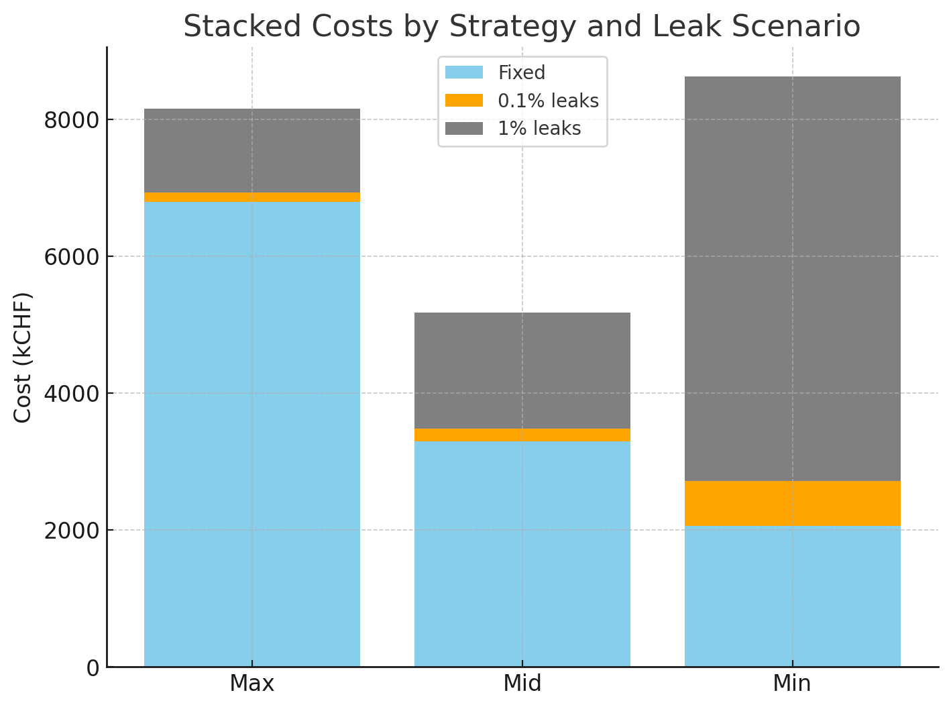
Leak detection Strategy: Cost estimate
Max Strategy:
Low risk
Early warning of leak issues
Dominated by component testing costs
Min Strategy:
High risk (high confidence)
Dependent on low leak occurrence
Potential minimum cost
Mid Strategy
Medium risk
Higher leak occurrence can be tolerated w.r.t cost.
Can review strategy dependent on field results.
Slides from Paul Cruikshank’s presentation from Beampipes for Gravitational Wave Telescopes 2023 [1]
[1] Beampipes for Gravitational Wave Telescopes 2023 (27-29 March 2023): Overview · Indico
1 CHF = 1 Euro = 1 USD

Slide 10
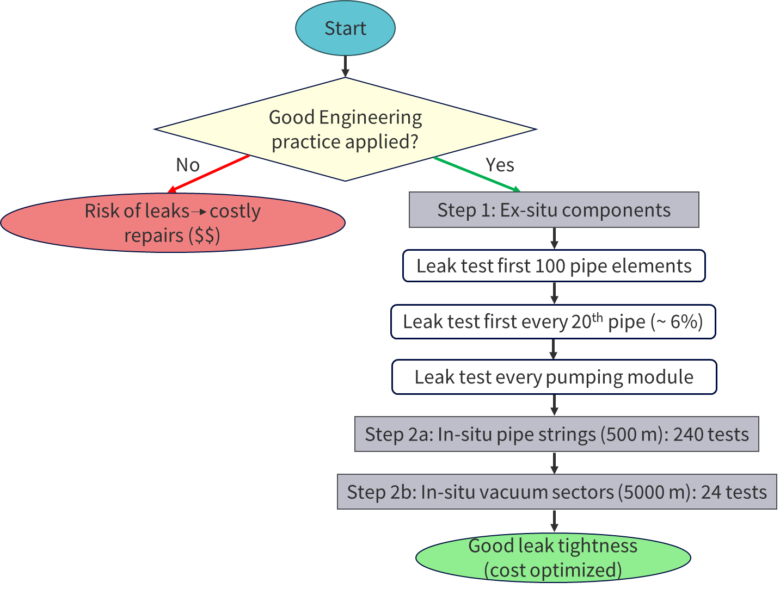
Leak detection Strategy for Einstein Telescope: Conclusions
Adopting “Mid Strategy” with sampled testing of pipe elements ex-situ would be a way to go forward.
Good engineering practice:
Design, manufacture, assembly, commissioning, QC.
Vacuum engineer must be involved in all steps.
Solutions exist to close vacuum vessels without flanges.
Different leak testing strategies can be considered – each has its merits and drawbacks with respect to duration, cost, risk, etc.

Slide 11
Thank you for your attention!

Slide 12
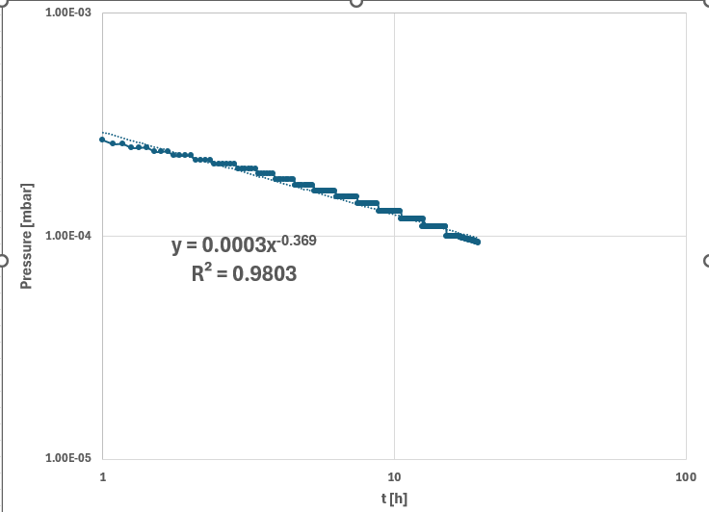
Leak detection of tube elements: Pumpdown
The pumpdown was slower with a time exponent of -0.369 possibly because of the NBR gasket
Confirmed by a separate pumpdown of an NBR gasket

Slide 13
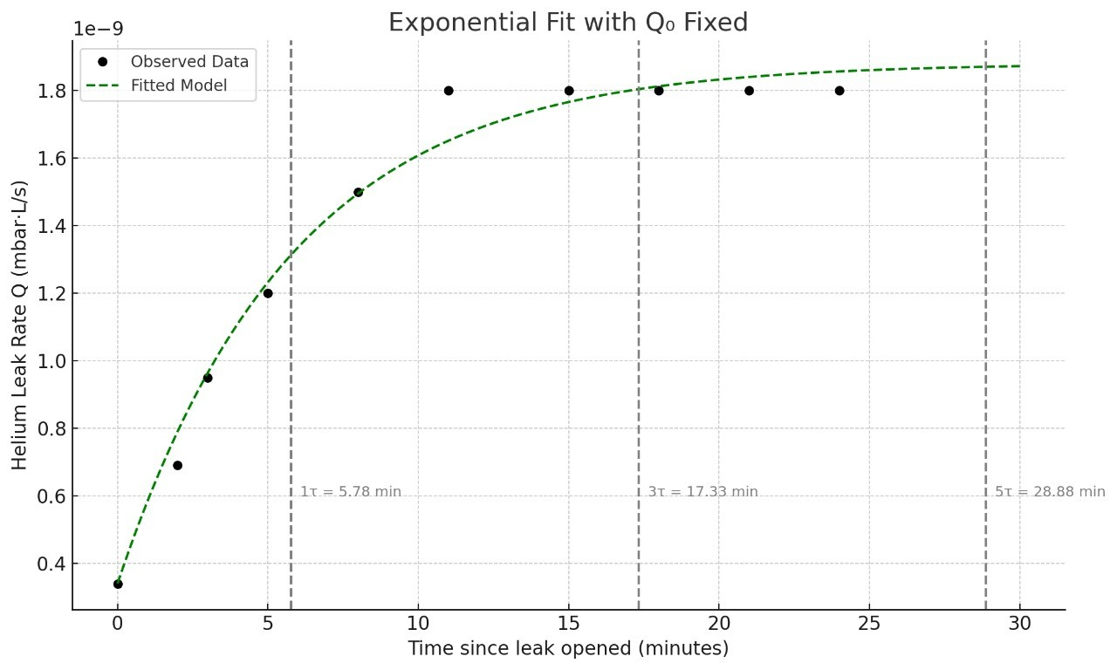
Leak detection of tube elements: System calibration
The system calibration was done using a calibrated leak (Helium-4) on the end opposite to the pumping end.
This provides us the time constant (τ) of the system and the time to wait (t > 3τ) after helium injection during the leak test.

