Slide 1

Cosmic Explorer
Beamtube Experiment (CE-BEX):
Beam Tube Design Update
Joint CE & ET Beam Tube Meeting (10-Dec-2025)
Caltech
Dennis Coyne
Jon Feicht
Alberto Franco
Anna Iudintseva
8-Dec-2025 v3
Artist: Eddie Anaya (Cal State Fullerton)
LIGO-G2502595-v3

Slide 2
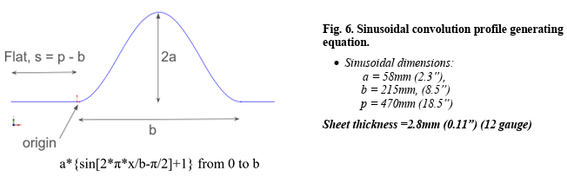
No Manufacturing Interest in
“Optimized” Cylindrical Corrugated Tube
Sent out Request For Information (RFI, LIGO-L2500049) to ~20 companies
  staggered, deep, sinusoidal corrugations
Too different from standard manufacturing practice?
→ Apparently no interest or expression of capabilities to fabricate
Exploring some alternatives:
  Explore thick-walled, unstiffened, carbon steel “oil” pipe alternative
  Explore commercially available corrugated pipe

Slide 3
Readily Available “Oil” Pipe
Contingency Plan for an “Oil Pipe”
  API-60x steel, 24” OD x 3/8” thick (schedule 20) x 100 m (609.6 mm x 9.5 mm thick)
  Beamtube l/d ratio ~ 1/150 is perfect for 1-d diffusion model
  Available either linear weld seam or spiral welded
Proposed plan (LIGO-E2500307):
  Carbon steel tube heads
  CTE matched 304SS Conflat flanges
  Steel Bellows
  Heat tracing for bakeout
  Cast Perlite for insulation
  Distributed Temperature Sensing (DTS) using fiber optics

Slide 4
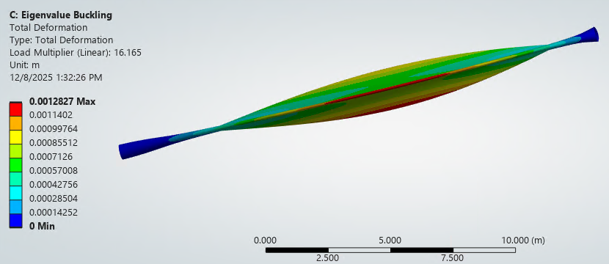
“Oil Pipe” appears to be Structurally Adequate
API specified steels are not allowed in the ASME BPVC
FEA results
  based on similar material (A283D)
  Coupled to a bellows at the end of a 20 m tube
  8 mm sag over 20 m
  indicates adequate strength and buckling safety factor (~16x)

Slide 5
Commercially Available Corrugated Steel Pipe (CSP)
References:
  Corrugated Steel Pipe (CSP) Manual, National Corrugated Steel Pipe Assoc., cr 2018
  ASTM specification A760M, "Standard Specification for Corrugated Steel Pipe, Metallic-Coated for Sewers and Drains“
"Most shop-manufactured CSP is produced on a machine that forms helical corrugations; in such case, the seam may be either a continuous helical lock seam or a continuously helical welded seam …"
"In contrast with CSP, structural plate pipe is always fabricated with annular corrugations and field bolted longitudinal and circumferential seams."
Consequently, for CEBEX, our interest is only in helical corrugated CSP
(not structural plate pipe)
… Helical Corrugation Redux

Slide 6
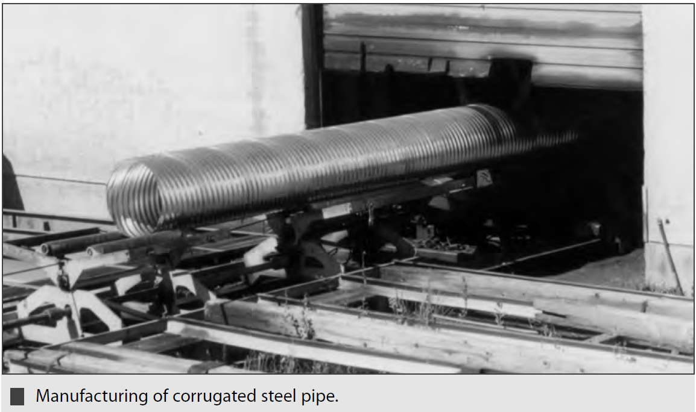
Reasons to Pursue Helically Corrugated and Welded Pipe
Pro
  Standard commercial CSP product
  No high plastic deformation crossing the weld HAZ
    May be the cause of unacceptable UHV leak failure rates (see LIGO-E2400425)
  Eliminates the need for bellows and stiffeners
Con
  Requires alternating chirality sections of pipe/tube (i.e. LH, RH, LH, …) to compensate for the length-to-torsion coupling
  However …
    CE can afford two rolling machines with opposite handiness
    CEBEX can be constructed to allow one end to rotate when performing the bake-out
      Challenge becomes the design of this support and the transition to the CSP

Slide 7
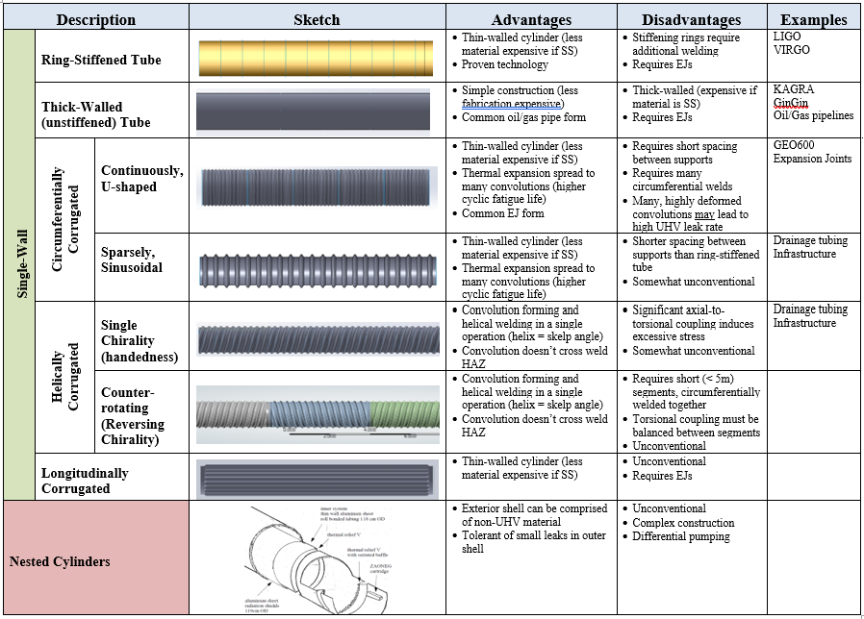


Beamtube
Taxonomy
CURRENT FOCUS

Slide 8
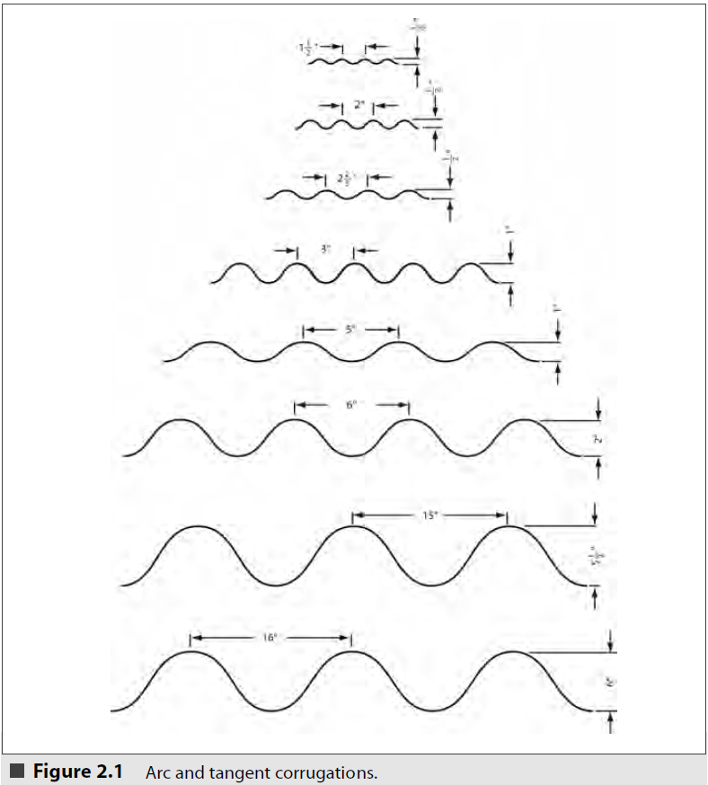
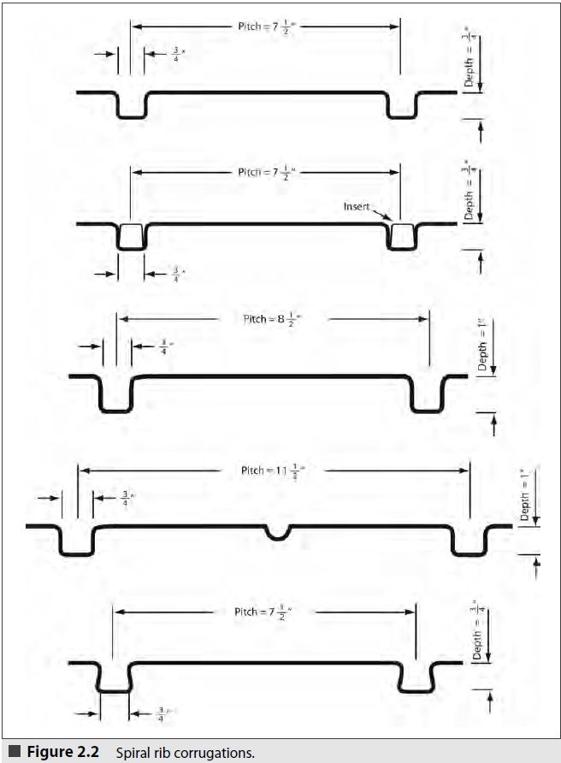
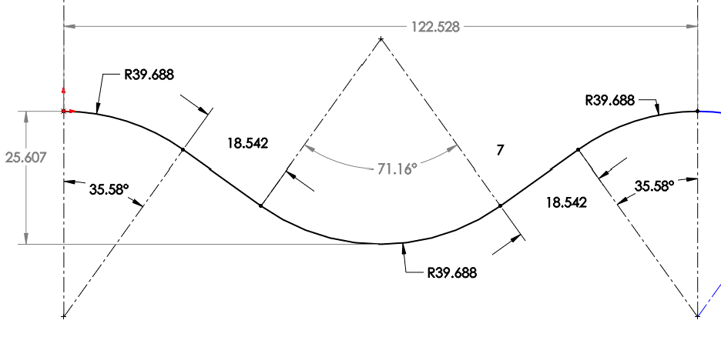
Standard Corrugation Profiles
Arc & Tangent
  Not very different from sinusoidal profile
  Corrugations are continuous (no flat sections to easily interface to baffles
  Only 3 profiles appropriate for large diameter CSP
Ribbed
  Sharp corners will induce high stresses
(dimensions in mm)
5” pitch x 1” height x .0598” thick

Slide 9
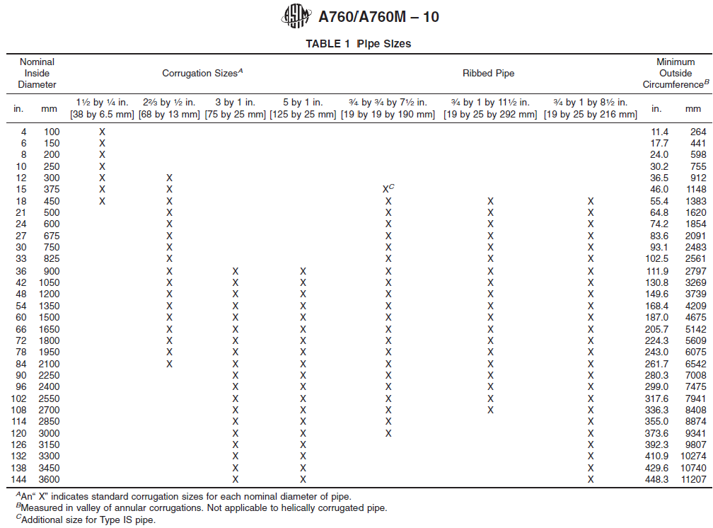
Standard CSP
CLOSEST TO LIGO BEAM TUBE DIAMETER (1244 mm)

Slide 10
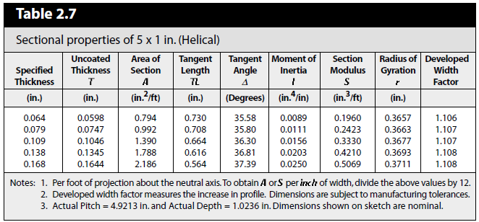
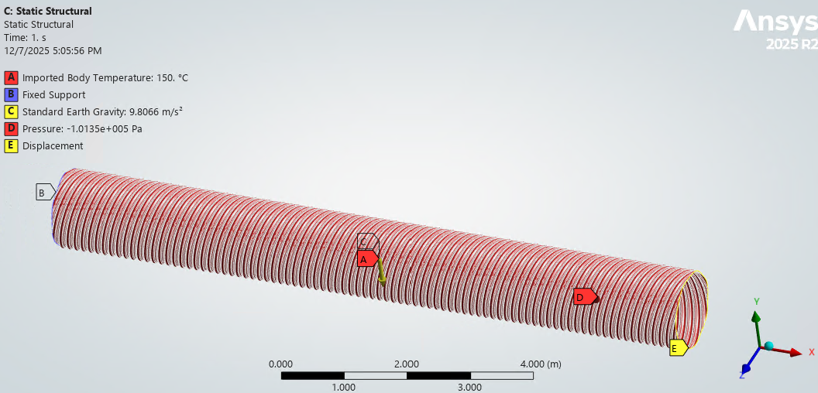
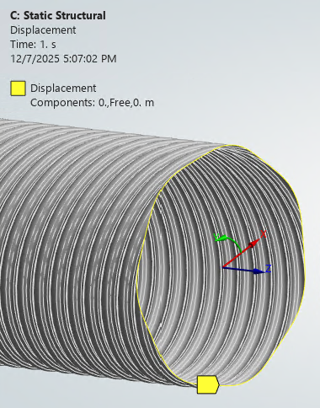
Preliminary FEA Results
No info yet on skelp edge prep (e.g. flat portion) for helical welding
No info on re-rolling/forming ends for circumferential welds
FEA Caveats:
  Arc & Tangent profile is defined at the helix angle, not perpendicular to the skelp (helix angle is ~11 deg)
  Mesh is coarse and with poor mesh quality (element distortion or skew) distortion
  Single profile, corresponding to t = 1.52 mm (0.0598”), used for all thicknesses

Slide 11
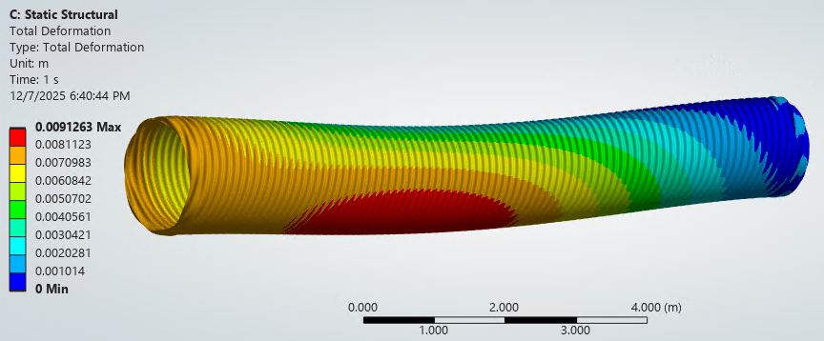
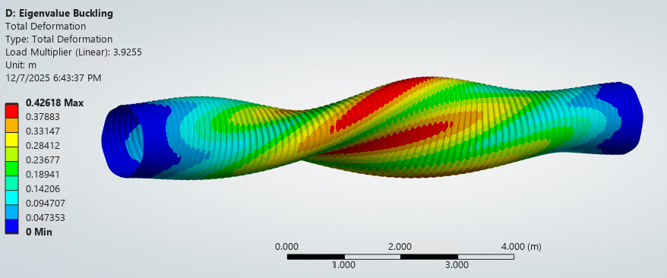
Preliminary FEA Results
Profile | Thickness mm (in) | Sag (mm) | Buckling Factor | Axial Spring (kN/m)
127 x 25 | 1.52 (.0598) | 16.8 | 1.02
 | 1.90 (.0747) | 14.4 | 1.54
 | 2.66 (.1046) | 11.1 | 2.72
 | 3.42 (.1345) | 9.1 | 3.92 | 4,033
 | 4.18 (.1644) | 8.0 | 5.04
76 x 25 | 3.42 (.1345) | 9.1 | 3.96 | 4,128
PROMISING
PROMISING
10 m length of Arc & Tangent profile
LIGO Bellows for a 20 m long pipe:
  1,401 kN/m design maximum
  845 kN/m ± 10% as-built

Slide 12
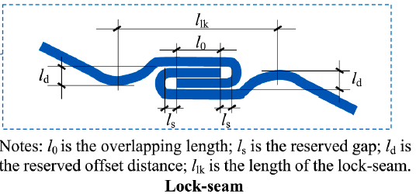
Helical Lock-Seam vs Continuously Welded Seam
ASTM A760M allows for either helical lock-seam or helical continuous weld
Industry prefers the lock seam
for buried applications
  Lock-seam allows for easier, leak-resistant assembly,
  especially for large diameters, offering flexibility
  Lock-seam also provides greater structural integrity,
  better stress distribution (reducing crack risk)
  whereas continuous welds, while strong,
  can create potential leak points,
  require precise alignment, and are harder to manage on heavy gauges
Iff CSP manufacturers don’t have (or don’t want to add) a weld head to the CSP mill, then
  Consider a weld processing step subsequent to the CSP forming mill
  Fixed weld head coupled to a custom helically guided tube rotator/translator
WELD

Slide 13
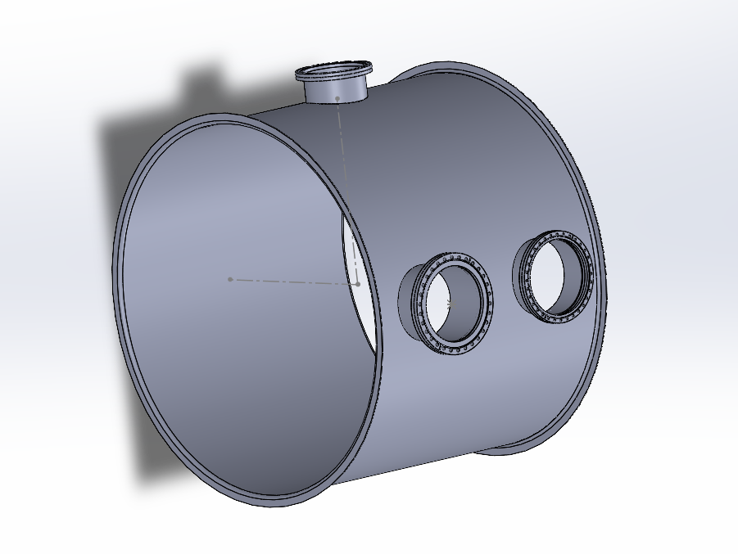
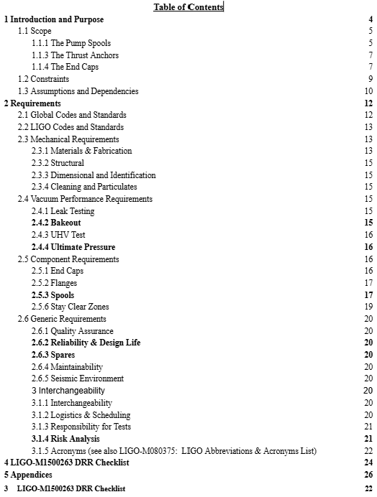
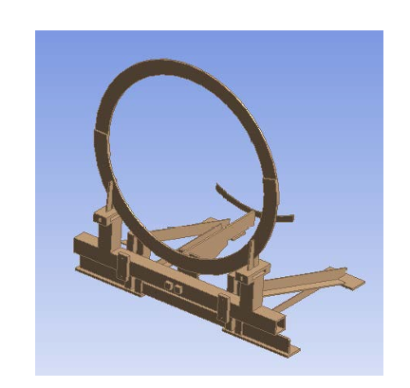
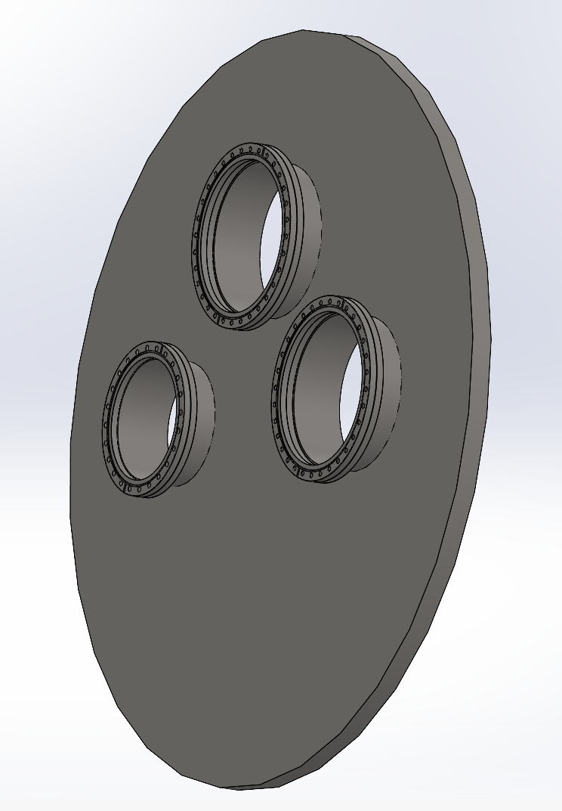
Draft Requirements Document:
Pump Spools, Beamtube Supports, Thrust Anchors, and End Caps (LIGO-E2500329)
Design & Fabrication requirements for all components of the CEBEX structural system, including:
  Quantities and types of port configurations
  Dimensions
  Vacuum performance

