Slide 1
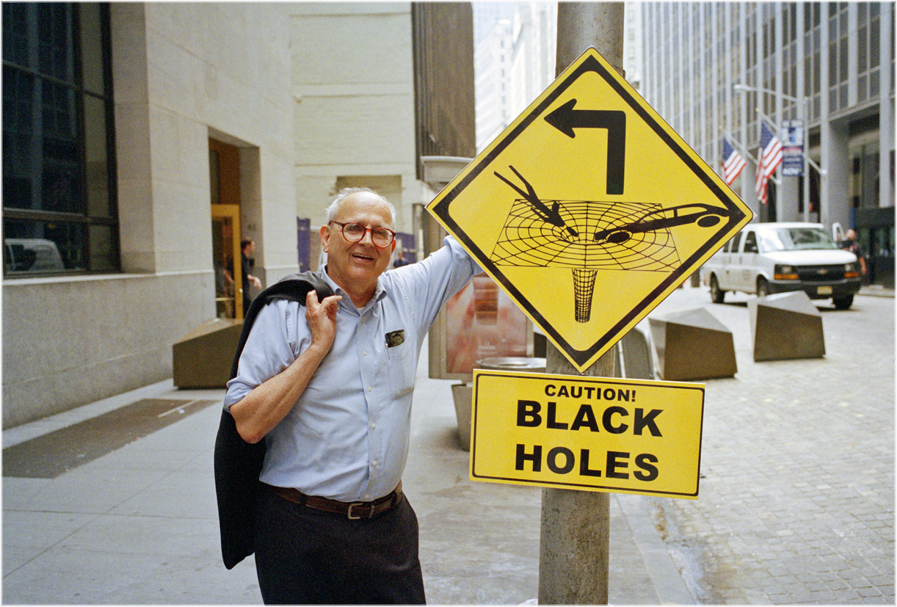
The Origins of Rai’s legacy
Rai Weiss Symposium, February 27, 2026
Peter Fritschel, MIT
Photo: Matt Weber
Some material from AIP Oral History (w/ D Zierler)

Slide 2
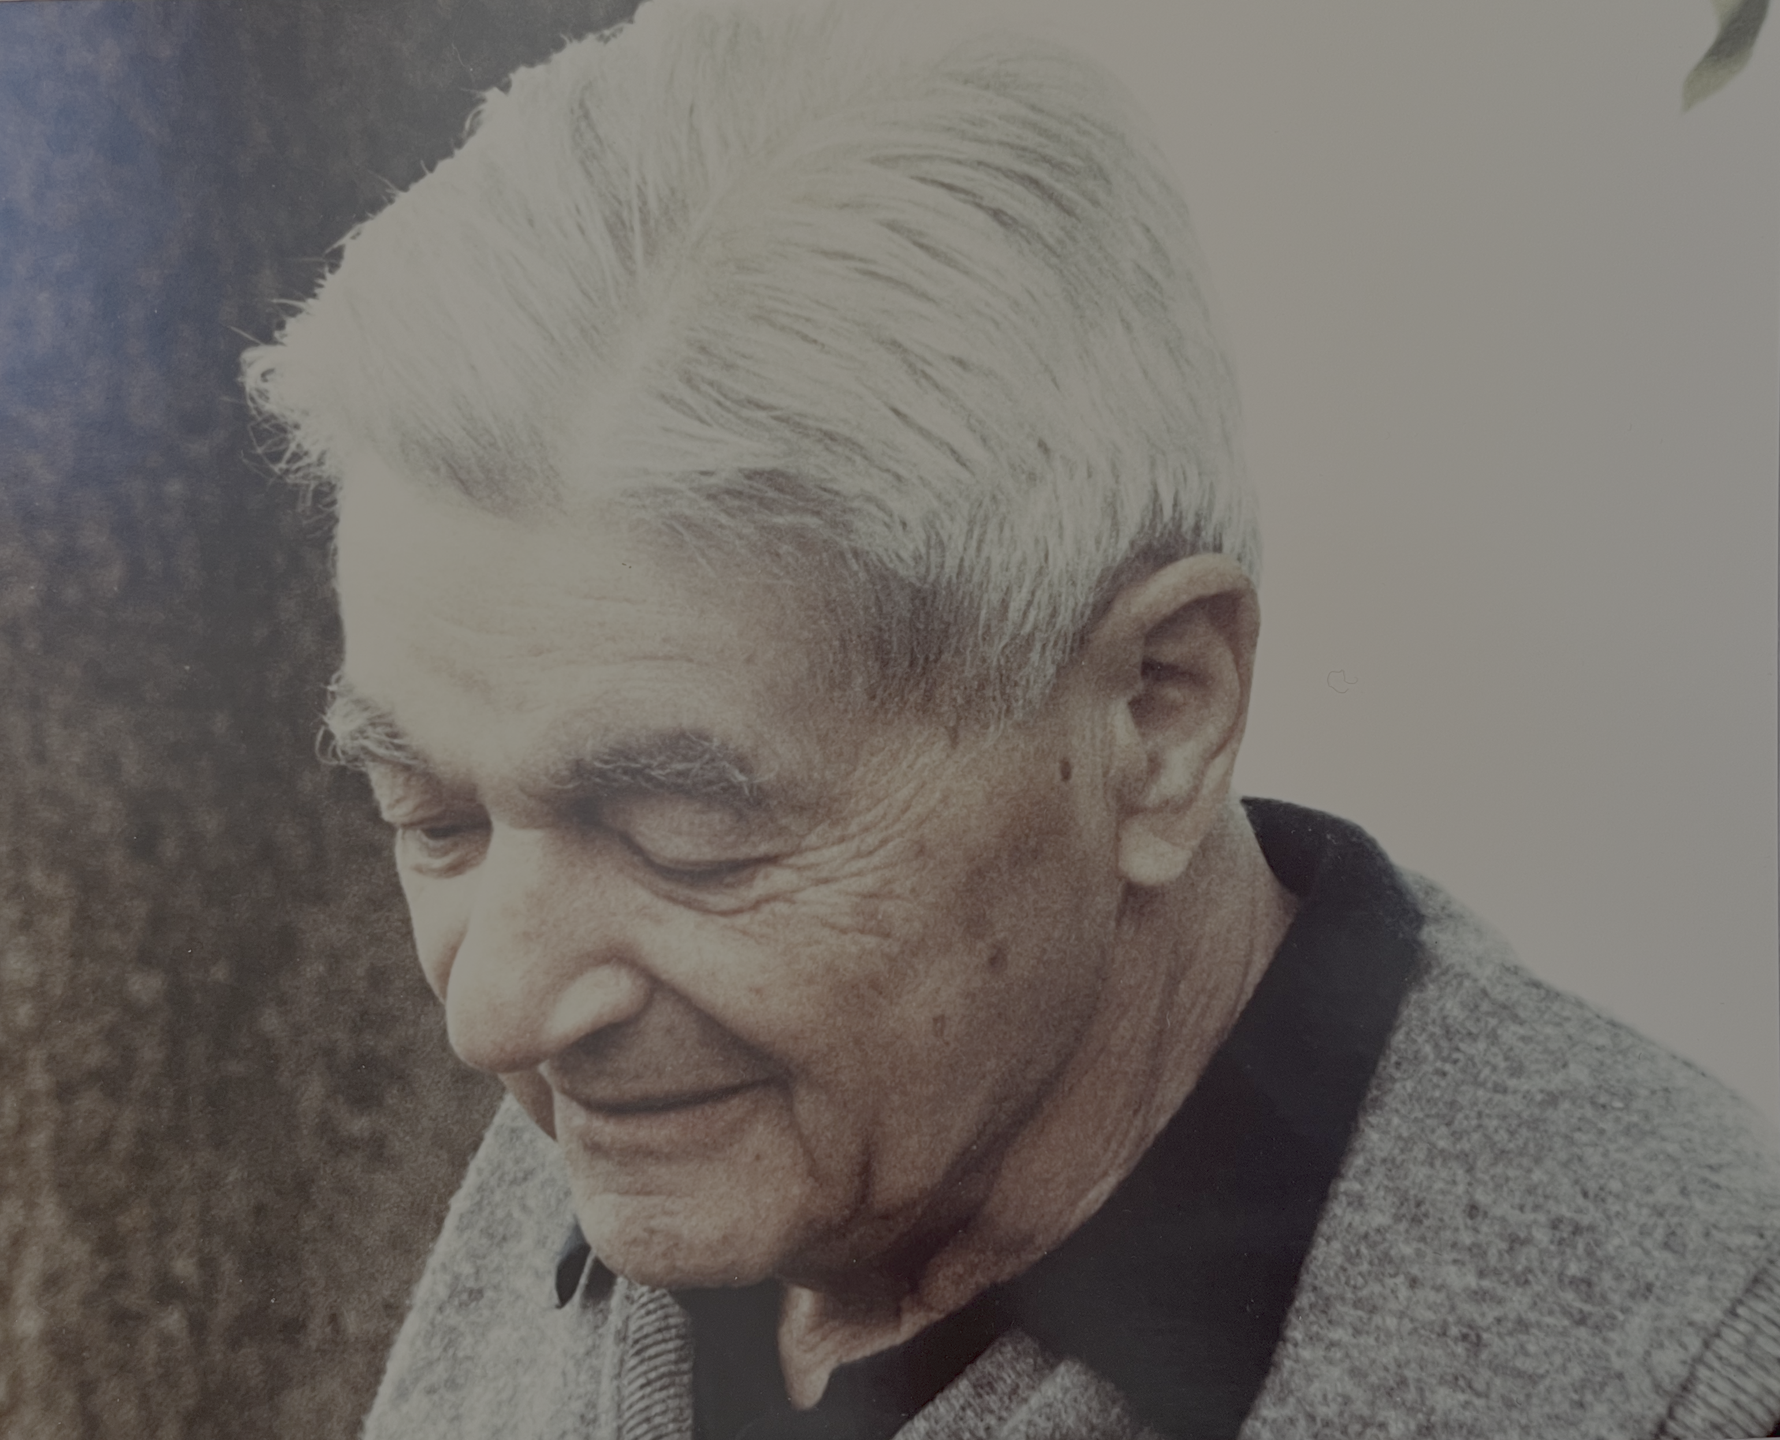
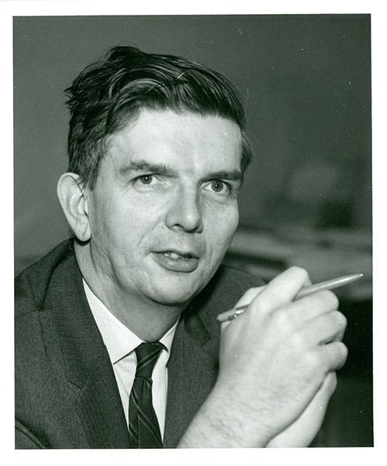
Rai’s intellectual fathers
MIT: Jerrold Zacharias
Princeton: Bob Dicke
Rai’s graduate advisor at MIT and longtime mentor
Rai’s postdoc advisor at Princeton, 1962-1965

Slide 3
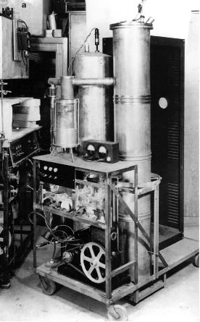
Zacharias lab at MIT
Atomic clocks: attempted to build an atomic fountain clock with the goal of measuring gravitational redshift on Earth
Experiment failed: no slow atoms
Rai built an ionizer to convert neutral atoms/molecules to a collimated ion beam
50 yrs later, Rai built an ionizer for LIGO
Hand-built field emission array
First cesium clock
Experiment to test the Finlay-Freundlich (‘tired light’) hypothesis on gamma rays using the Mossbauer effect (null result)
Time for a “boring” Ph.D. thesis (1962):
Stark effect and hyperfine structure of hydrogen fluoride

Slide 4
2 years in the Dicke group at Princeton
Built a quartz gravimeter to look for excitations of a 20m period, spherically symmetric mode of the Earth, as might be produced by scalar gravitational field radiation (Brans-Dicke theory of gravity)
Experiment ‘failed’ in that temperature and tilt fluctuations prevent it from measuring actual vertical earth noise
Device used a ‘null-seeking servo’, a technique that Rai attributes to Dicke, and the basis for LIGO’s operation
Rai’s 2 years at Princeton had a profound impact on his scientific development
Dicke group was involved in: gravitational equivalence principle measurement; gravitational red-shift of the sun; precise measurement of g; oblateness of the sun …
He learned from Dicke how to design an experiment to get to its fundamental limits

Slide 5
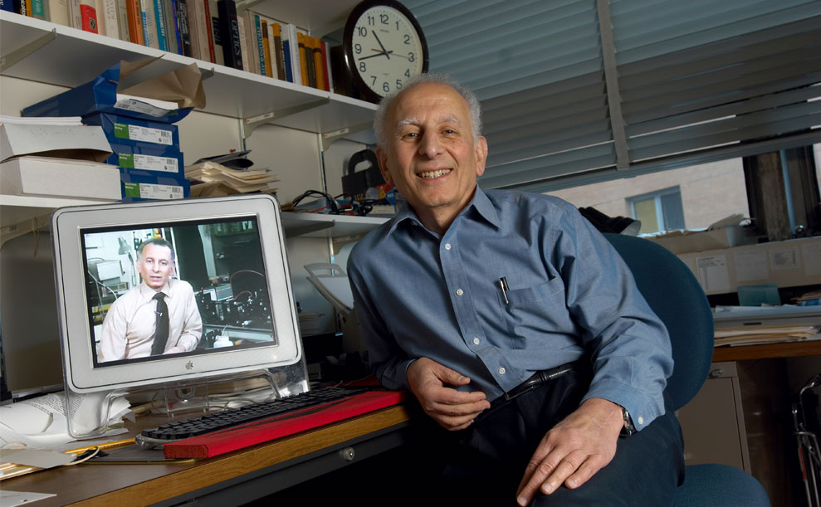
Back to MIT as assistant professor: 1965
Started the Gravitation and Cosmology research group and began a long-range program to see if Newton’s constant G changes with time
Absolute gravimeters (around the earth) referenced to the Stark effect in a molecular beam
Monitor earth’s shape with km-scale laser strain meters
Began with frequency stabilization of an Argon laser
Another measurement of the Freundlich red-shift hypothesis, now with a laser interferometer
Phase sensitivity at 10 kHz limited by shot noise, at ~10⁻⁸ of a fringe (2-3 orders of magnitude from what LIGO would need)
Blum & Weiss, Phys Rev 155 , 1412 (1967)

Slide 6
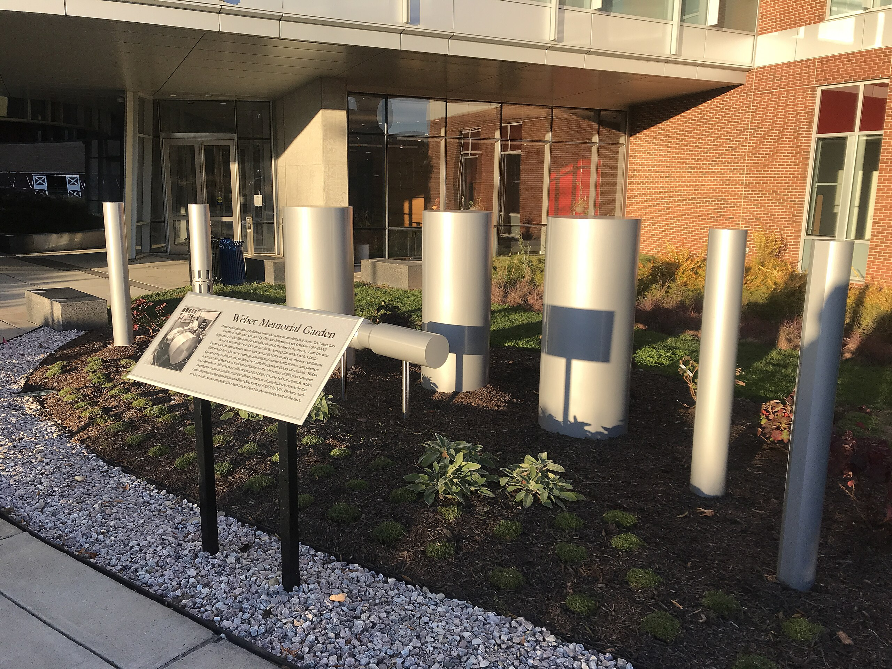
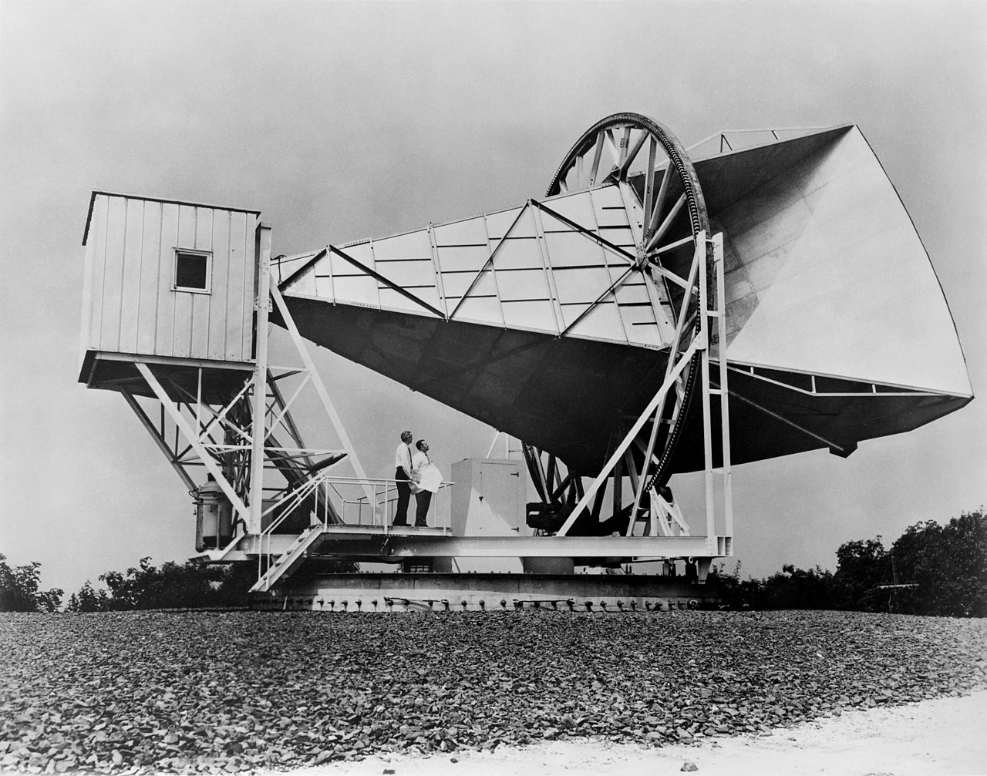
A transformative assignment
Weber memorial garden at U Maryland
In 1966 Rai was asked to teach a graduate course in general relativity
The students had heard about Joe Weber’s bar detectors for gravitational waves, and asked how they worked
Instead, Rai presented them with the gedanken experiment of using a laser and a good clock to measure the light travel time to and from an inertial mass
Given as a problem to solve, which they did, but of course there was no clock that was good enough
The course moved on to cosmology …
Penzias & Wilson had discovered the microwave background in 1964, interpreted by Dicke to be of cosmic origin
Had not yet been shown to be thermal or isotropic
Holmdel horn antenna

Slide 7
Tenure pressure leads to CMB foray
Rai wasn’t publishing much, and the gravity experiments weren’t going to give timely results
Bernard Burke suggested he pursue the microwave background, which he did, involving grad student Dirk Muehlner, who had experience w/ far infrared
Balloon-borne radiometer
Balloon launch from NCAR, Palestine, Texas
Between 1967 and 1982, Rai’s group flew around 20 balloon flights, first to measure the spectrum, then the isotropy of the cosmic microwave background
From PRD, 7 , 326 (1973)

Slide 8
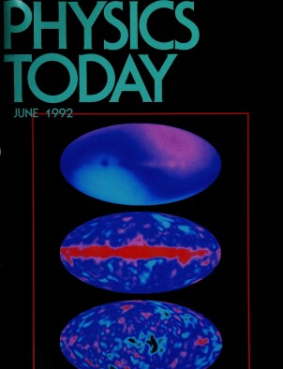
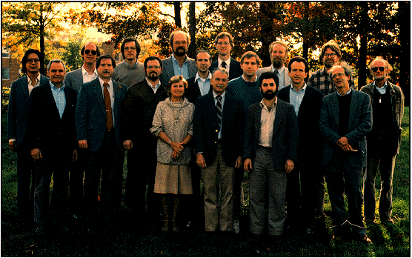
CMB research into the 1980s → 90s
Rai hands over the MIT balloon work to Stephen Meyer
Rai joins John Mather on COBE (Cosmic Background Explorer), and becomes chair of the COBE science working group

Slide 9
Returning to gravitational waves
Weber announced in 1969 that he had detected gravitational waves
By 1971, other bar groups were seeing nothing
Rai returns to his gedanken experiment, but now makes it differential
Spent the summer of 1971 analyzing the Michelson interferometer scheme and calculating the noises that would affect it, later ‘publishing’ it in:

Slide 10
*
22 pages of text and equations; 1 figure:
Noises analyzed in the report
Amplitude noise in laser output power
Laser phase noise or frequency instability
Mechanical thermal noise in the antenna
Radiation-pressure noise from the laser light
Seismic noise
Thermal gradient noise
Cosmic ray noise
Gravitational gradient noise
Electric field and magnetic field noise
* Part A. was a 35 page report on two balloon flights in 1971

Slide 11
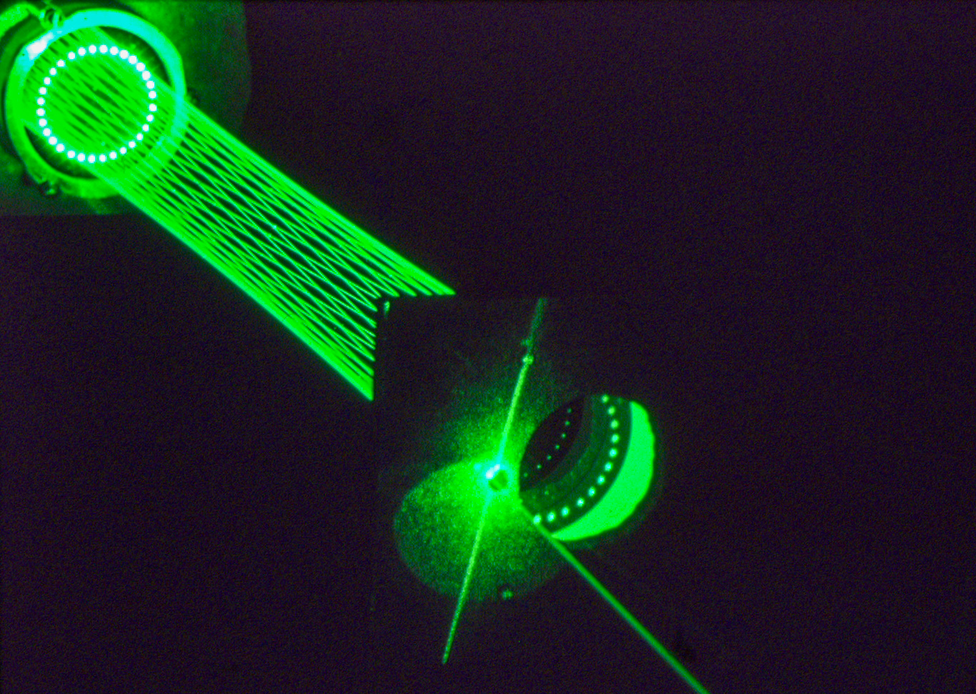
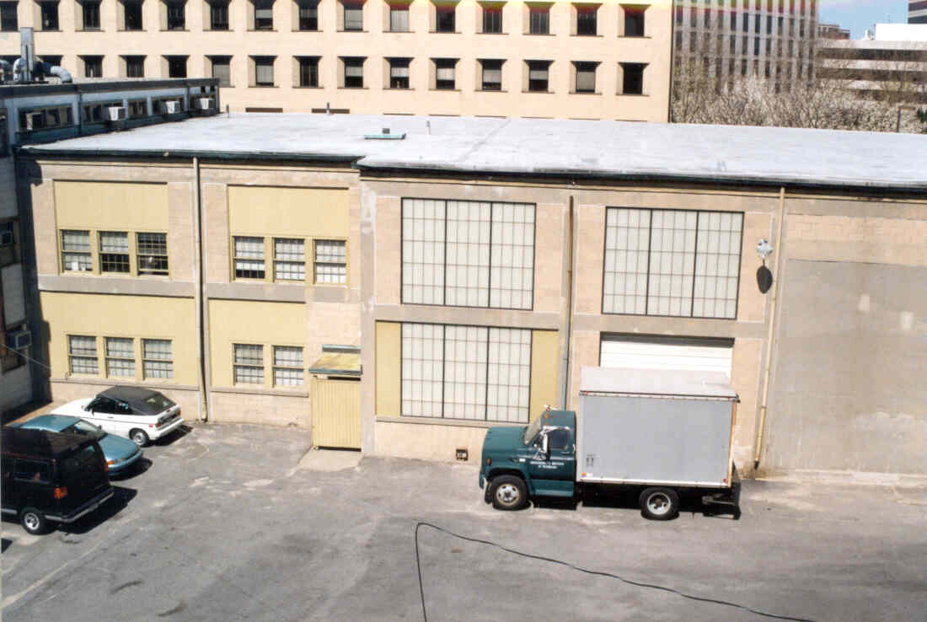
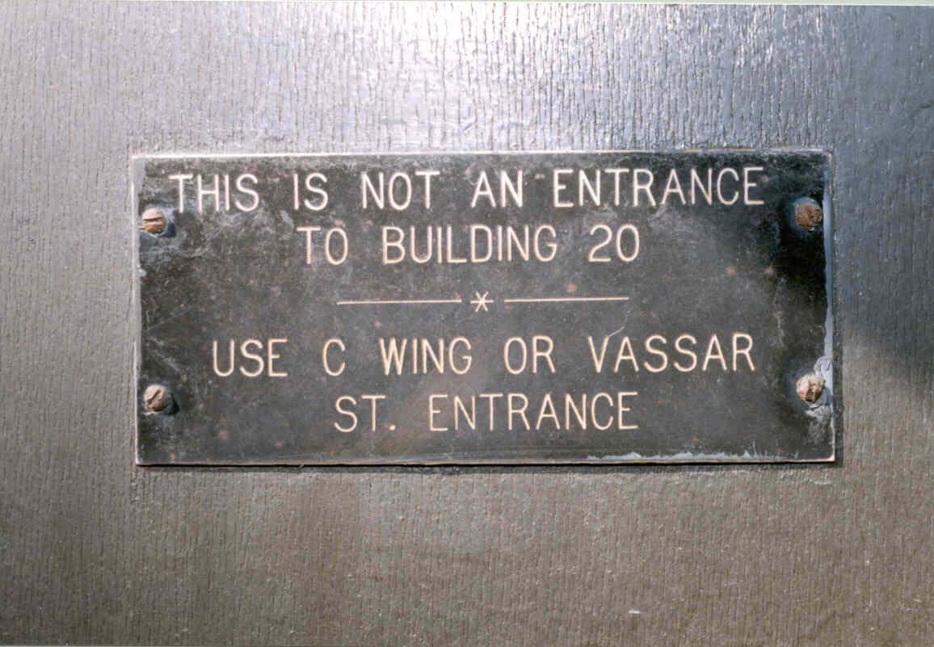
MIT 1.5 m prototype interferometer
Delay line prototype, built and
operated from mid-1970s-80s
Building 20 – F wing

Slide 12
Milestones on the path to LIGO
Rai meets Kip Thorne at a committee meeting, in Wash, DC, in 1975
This interaction catalyzes the formation of the Caltech GW group
Steps to a multi-kilometer interferometer design
1983: aka ‘Blue book’
1984: Joint MIT & Caltech proposal to NSF

Slide 13
1989 Construction Proposal

Slide 14
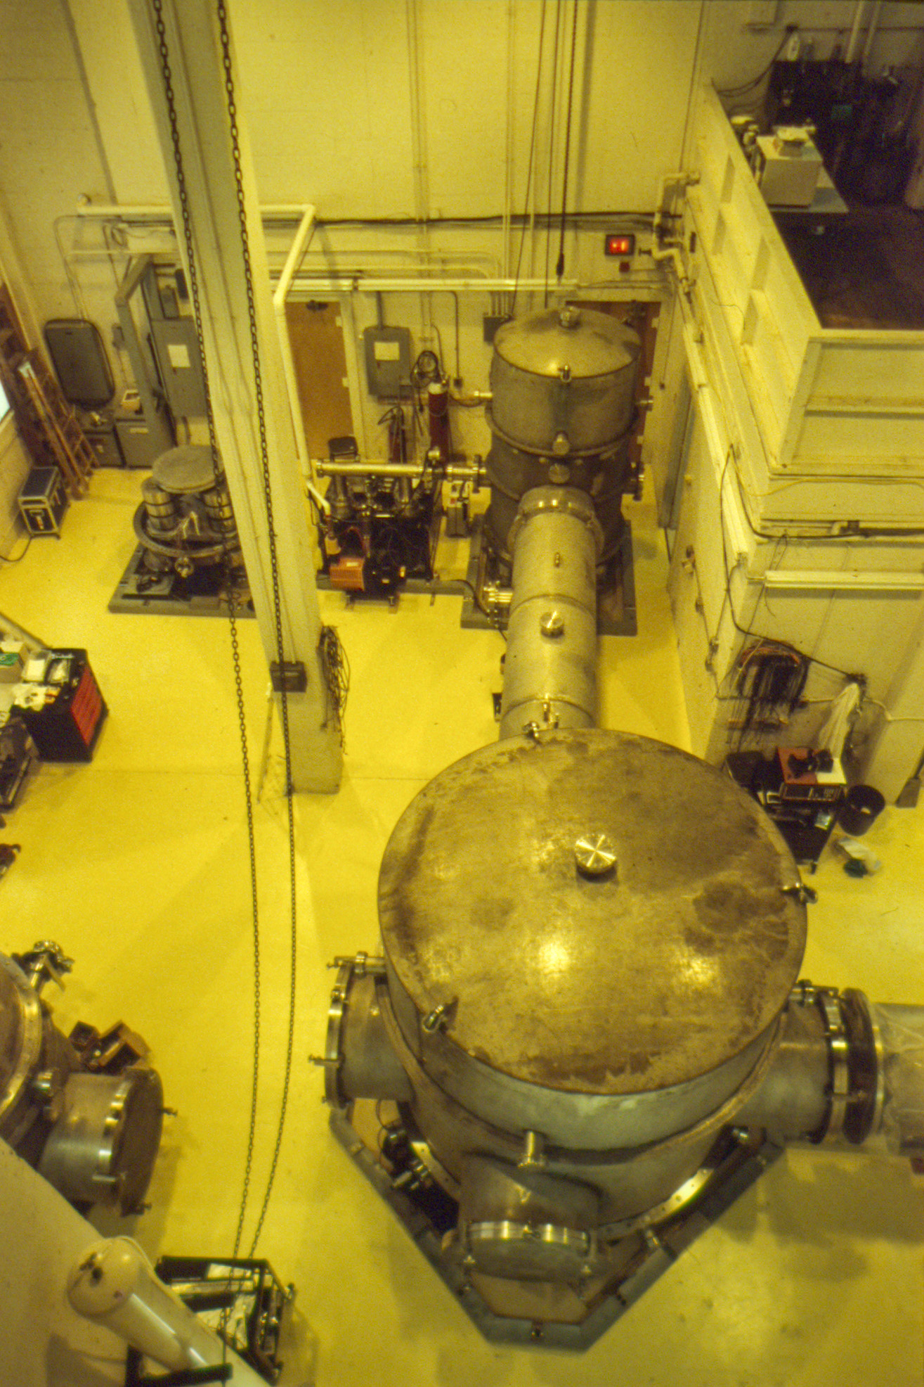
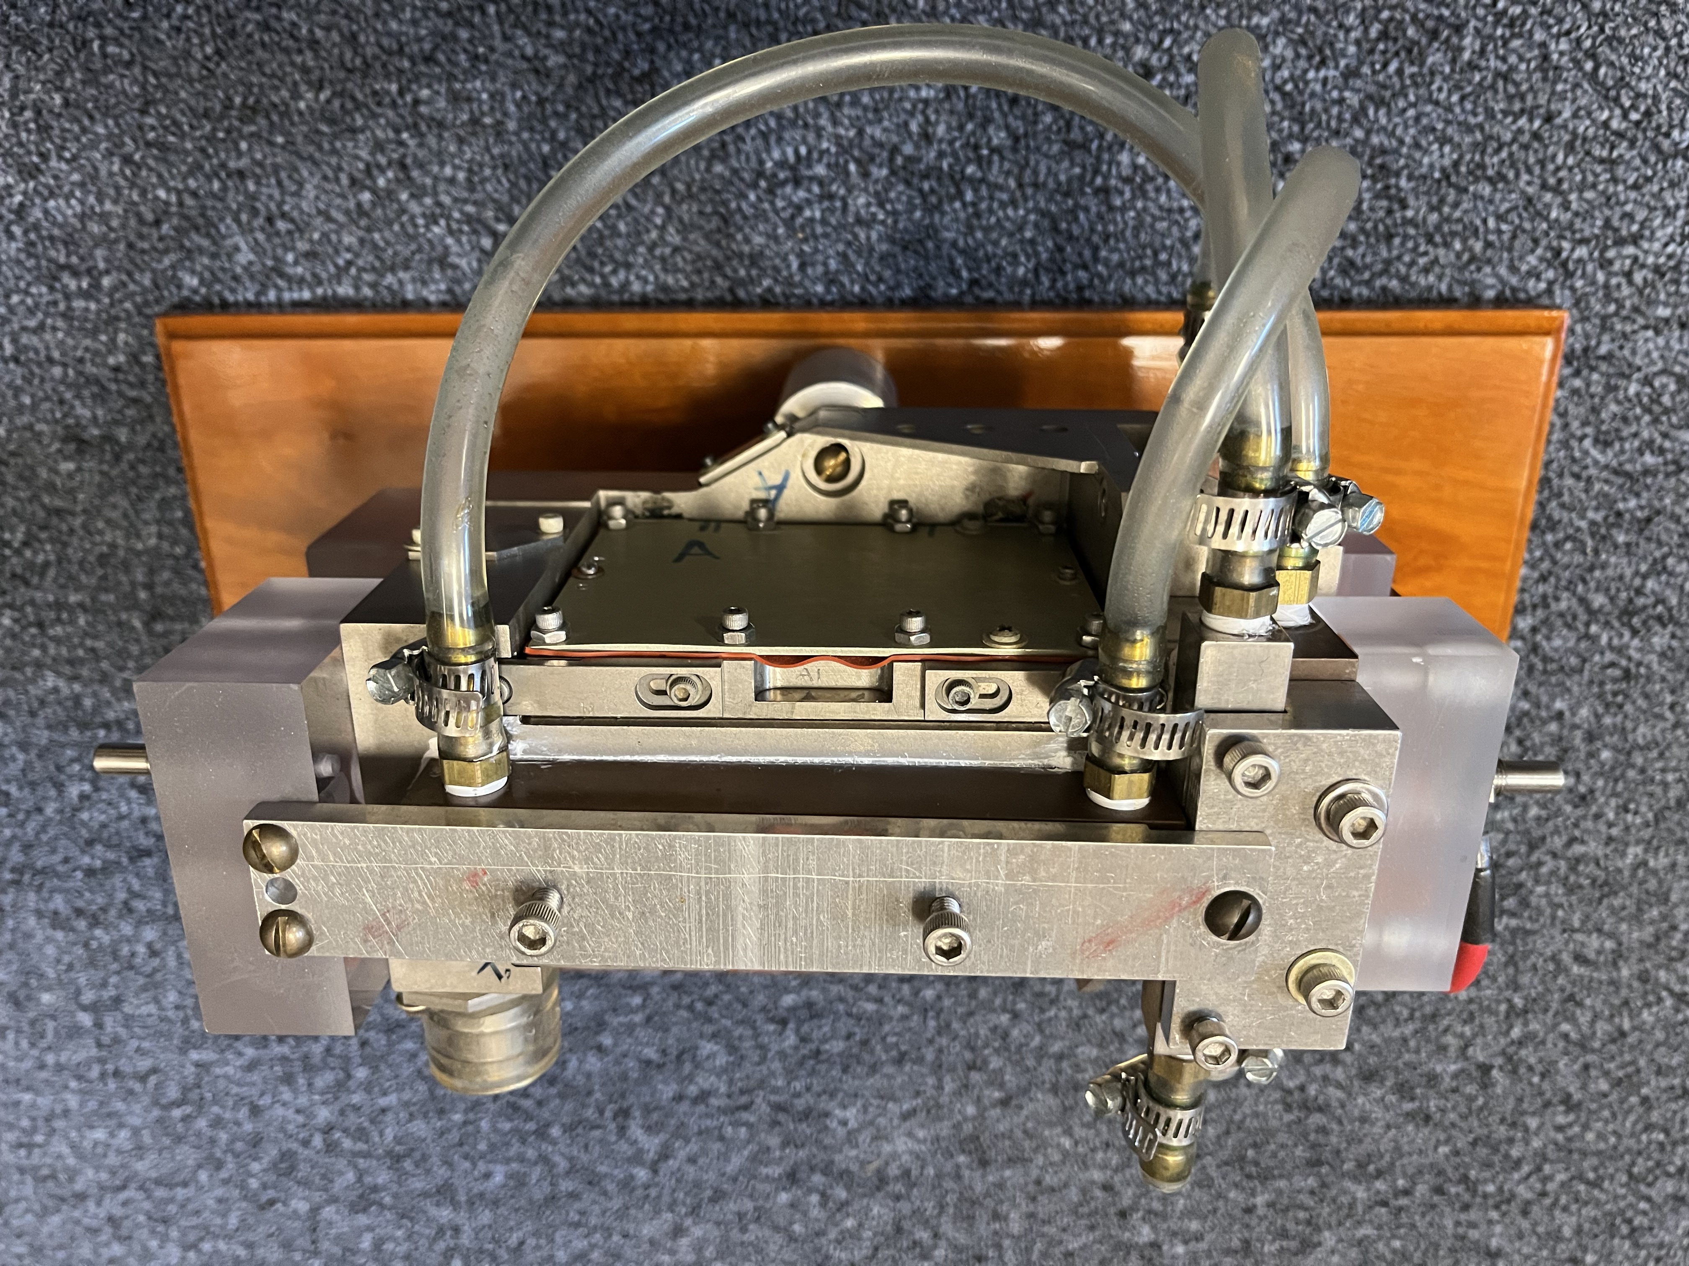
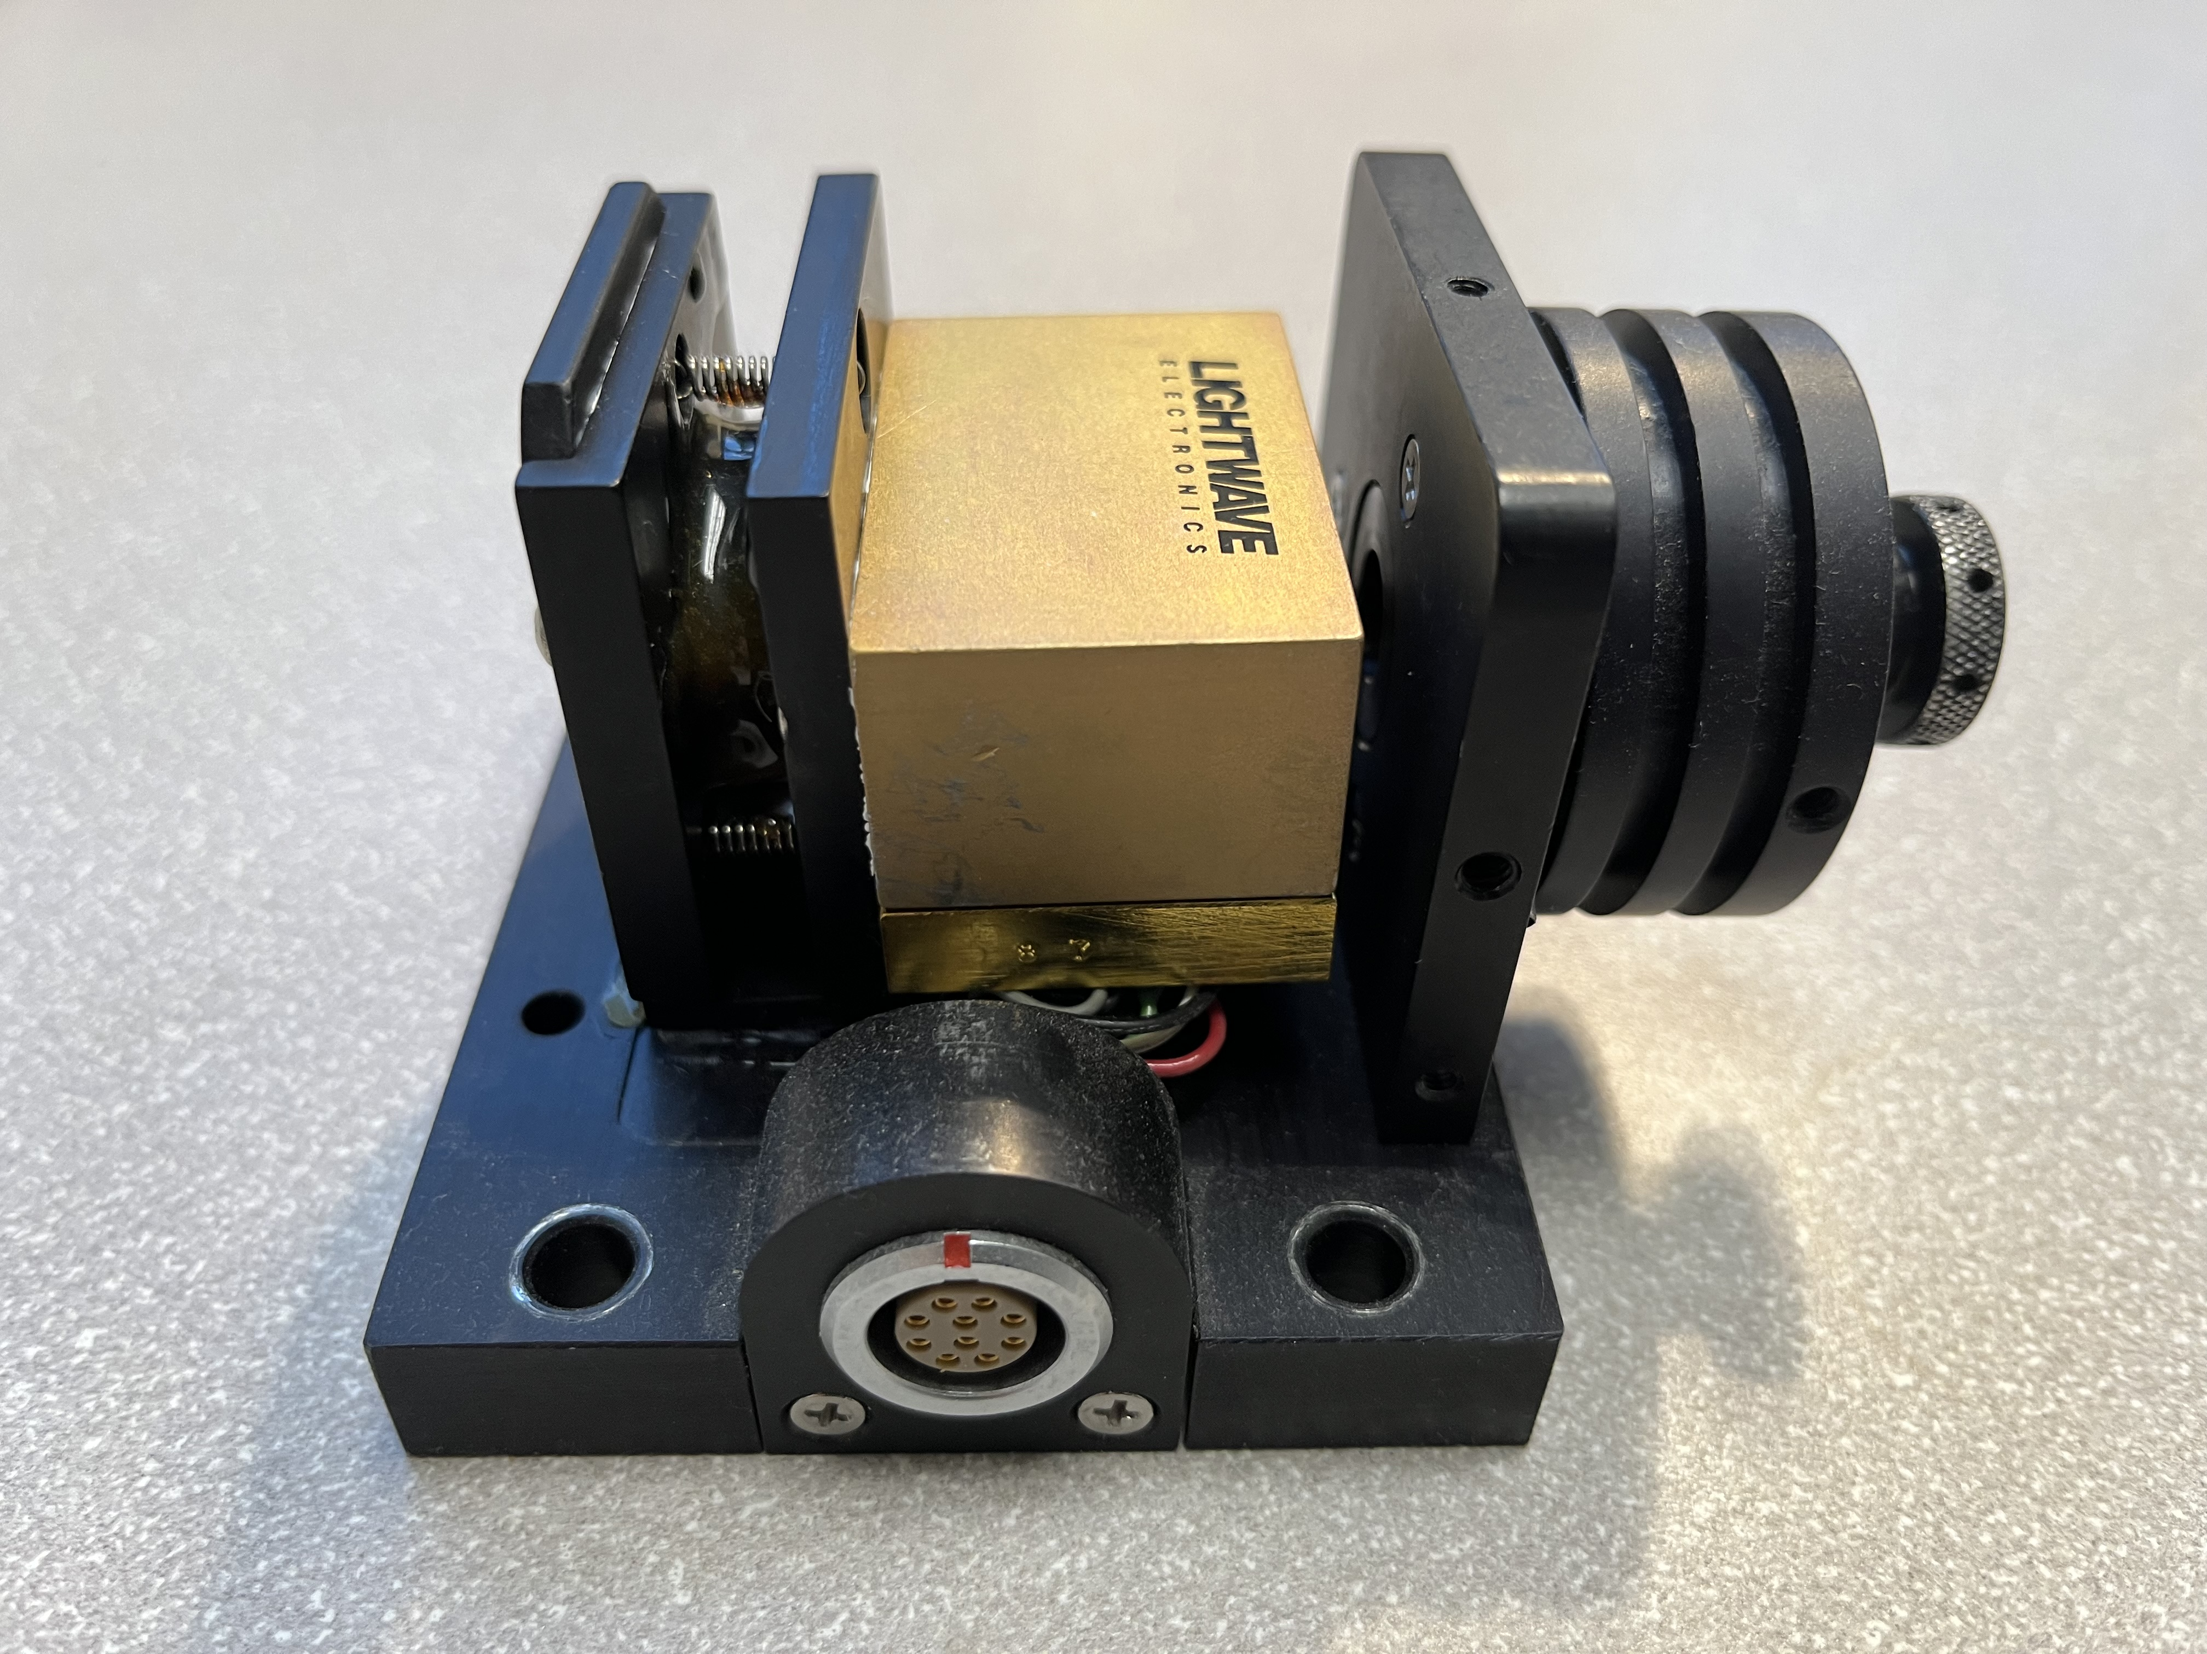
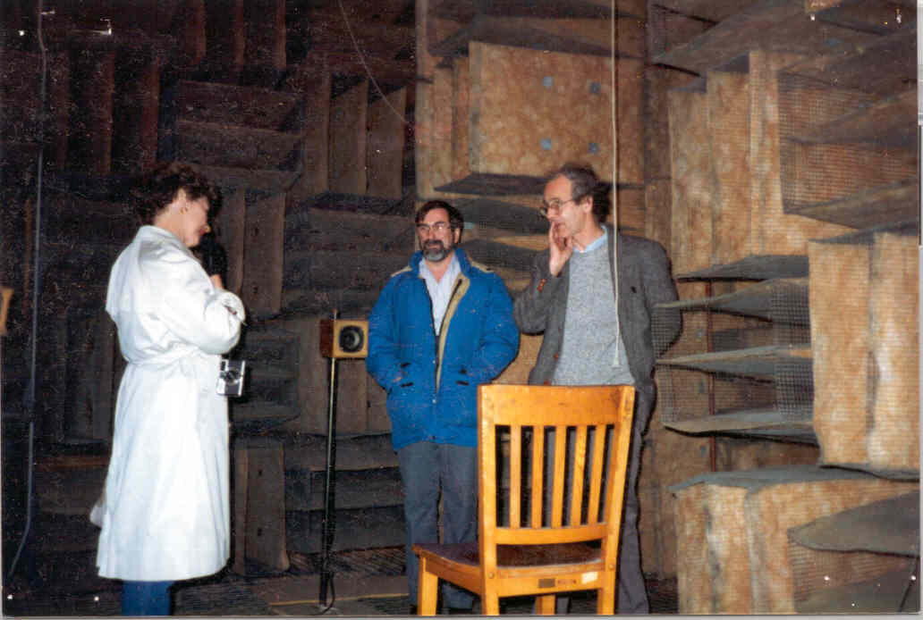
My work with Rai
Mid/late 1980s: planned a new, 5 m prototype, with a new vacuum system, in the 20F high-bay
Lots of ambitions to improve over the 1.5 m, including shifting from the Ar+ laser @514 nm, to a Nd:YAG laser @1.06 um.
Worked on building our own Nd:YAG laser for a couple of years
Arc-lamp pumped slab
laser head, donated by GE
One the first Lightwave NPRO lasers (née MISER), 5 mW!
First measurement of the NPRO frequency noise spectrum, in the 20F anechoic chamber

Slide 15
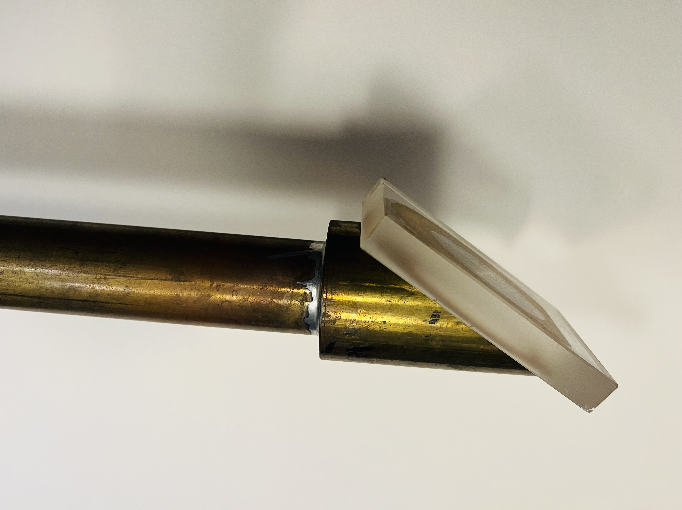
Then Nd:YAG development for LIGO was terminated …
Rai found a NASA program that might support work on absolute frequency stabilization of a Nd:YAG laser, but the proposal due date was not far away
We found a transition in the CO₂ molecule whose tabulated frequency looked promising
Spent an intense couple of weeks building the apparatus and making measurements
Proposal submitted just in time … but not funded
The group suffered with noisy Ar+ lasers for another five years
… in 1995 changed course and adopted the Nd:YAG laser, confirming Rai’s foresight 10 years earlier

Slide 16
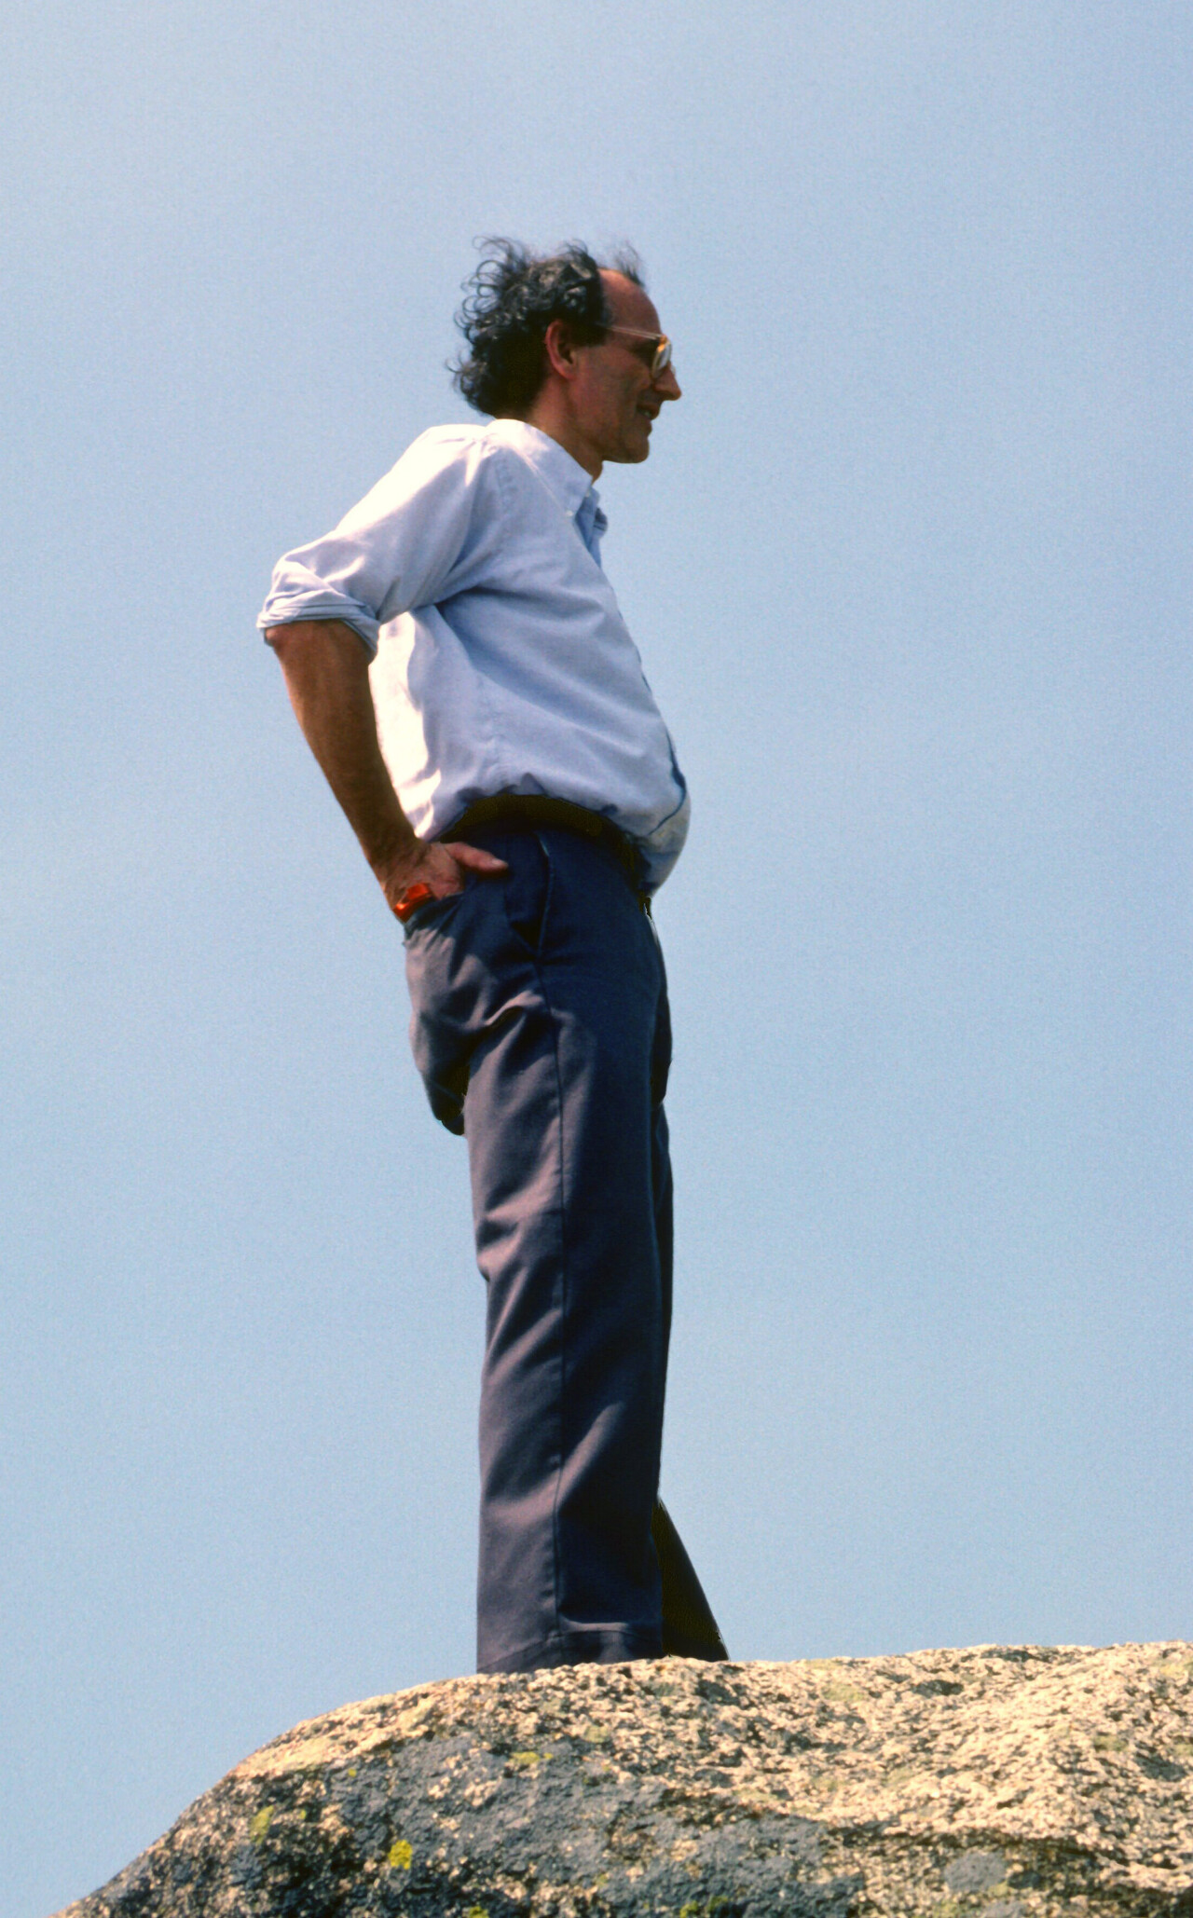
Thank you, Rai

