Slide 1
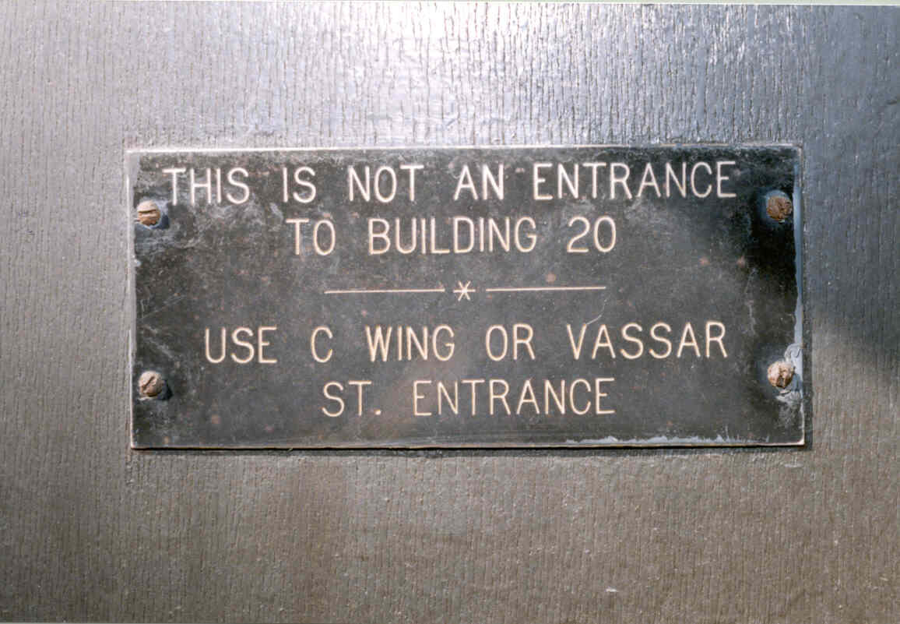
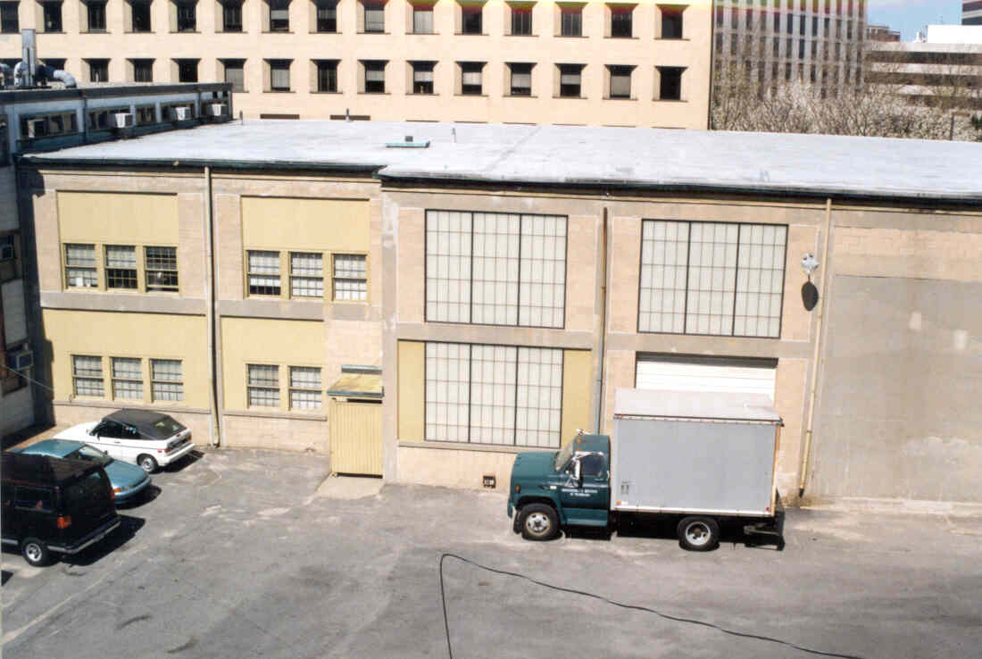
QCD Axions as Dark Matter are Within Experimental Reach!
Building 20 F-wing
From Steve Meyer
Notes:
Connections

Slide 2
Why Rai would like it.
“Maybe the most important experiment in fundamental physics coming up is the search for axions.”
Frank Wilczek (2020)
“Why Axions Could be the Next Big Discovery in Physics”
Ben Safdi (2025)
QCD axions could solve the strong CP problem and be the dark matter.
Notes:
0.5 min 1 min at end
Frank’s quote is from Quantum Magazine, 2020
Ben’s is from a talk title at a Simons/Moore/Templeton/Sloan meeting.

Slide 3
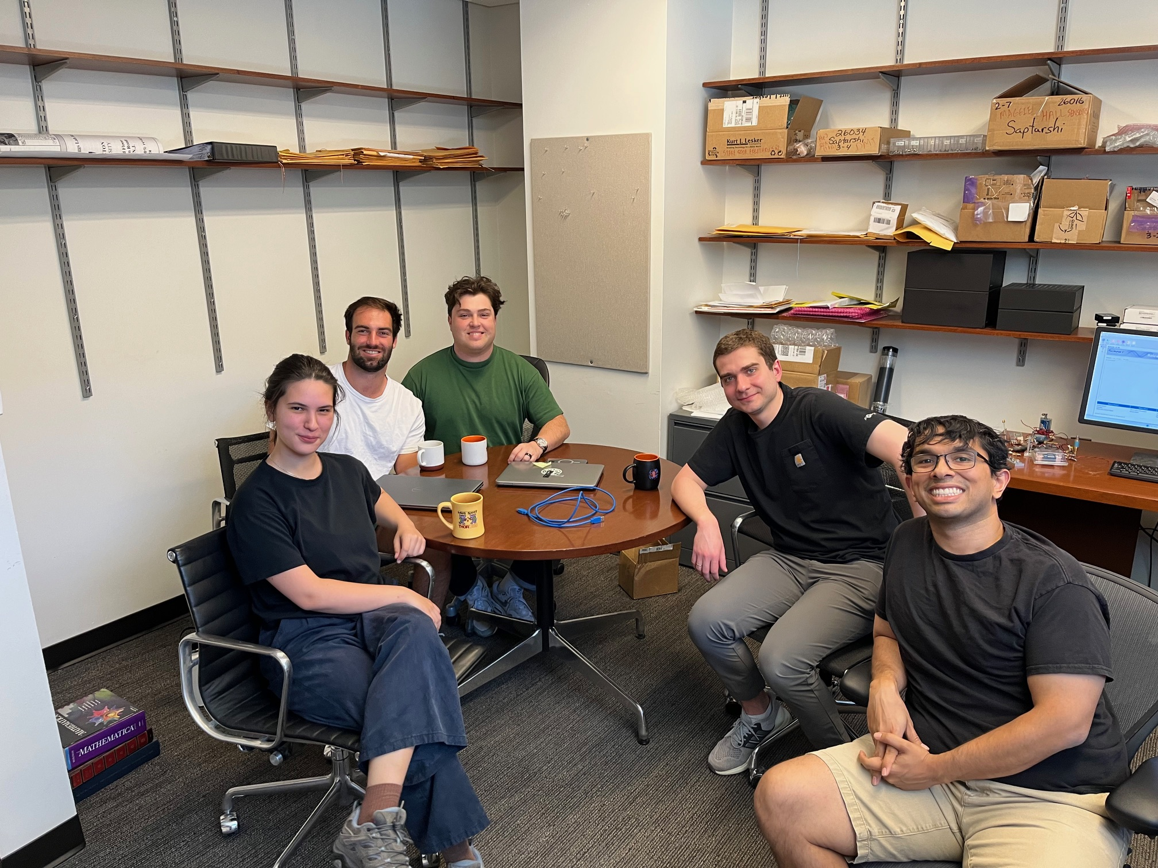
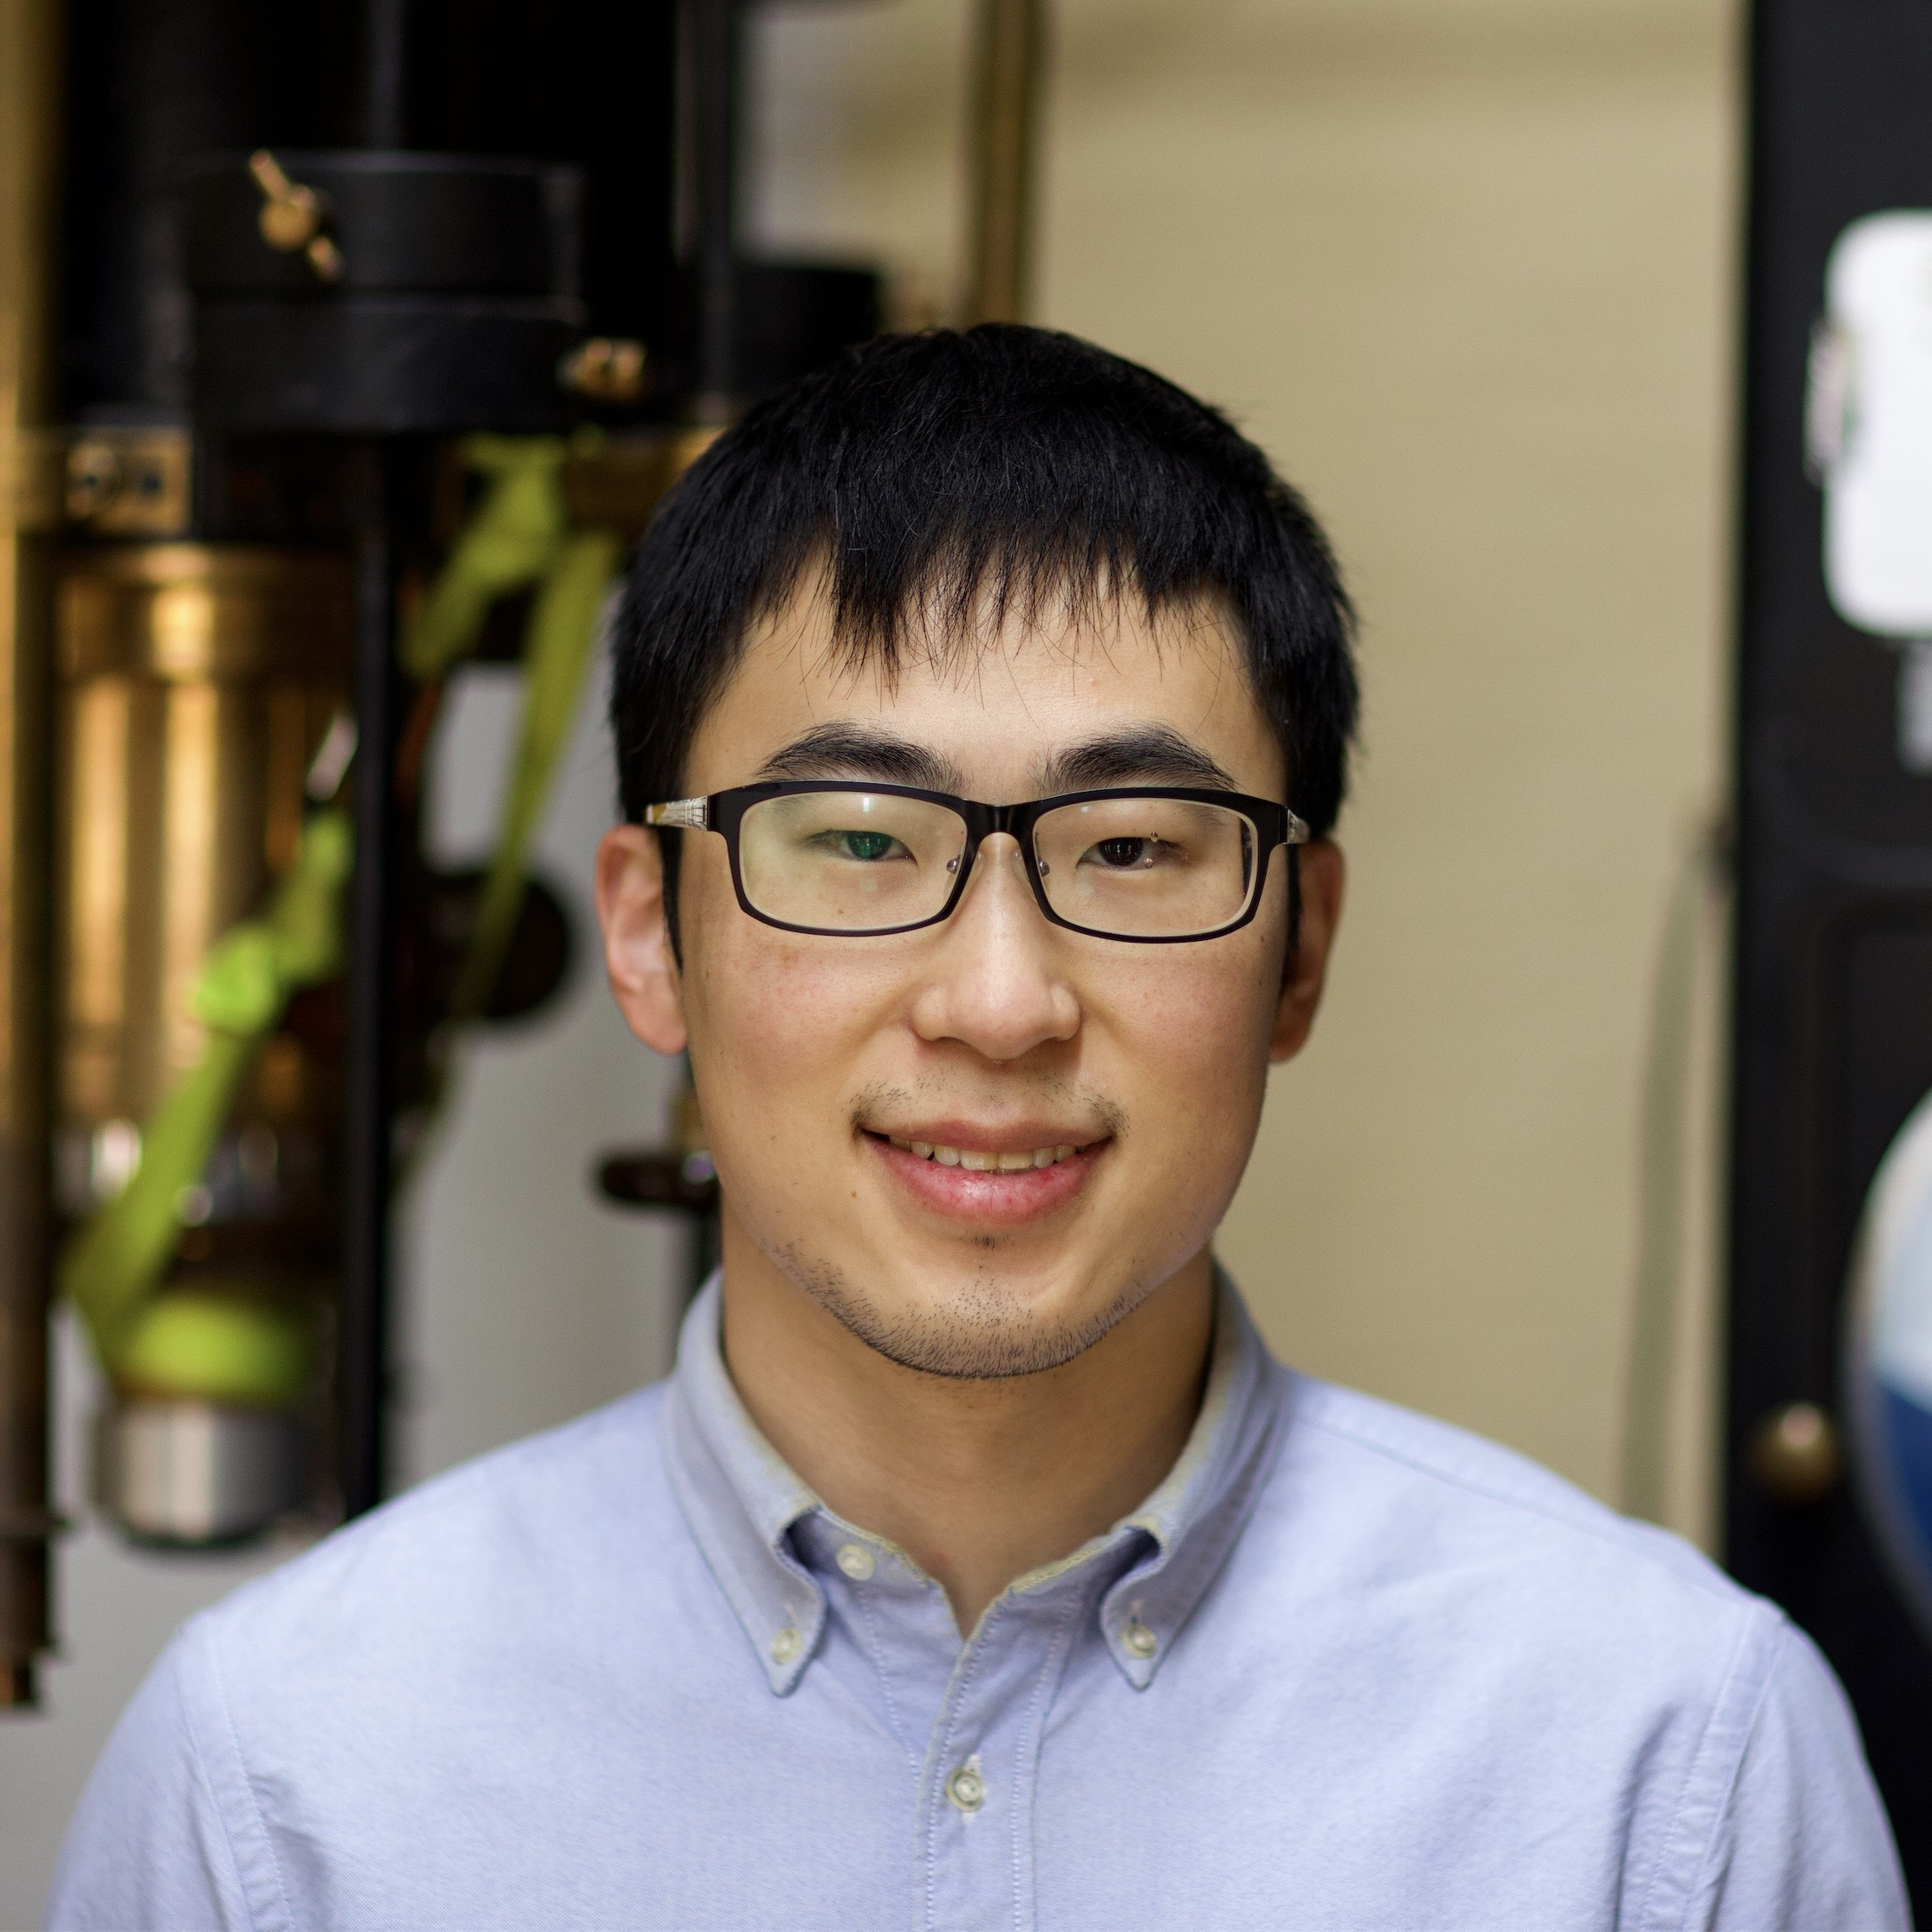



PXS
Joe
Frank
Nate
Roman
Joelle
Saptarshi
Princeton Axion Search (PXS) Team Members
Princeton: Joelle-Marie Begin, Saptarshi Chaudhuri, Frank Fu, Roman Kolevatov,
Nate Otto, Lyman Page, Joe Wiedemann.
DOE PPPL: Jon Dye, Yuhu Zhai
Caltech/JPL: Peter Day, Farzad Faramarzi, Jonas Zmuidzinas
Notes:
Highlight Saptarshi.

Slide 4
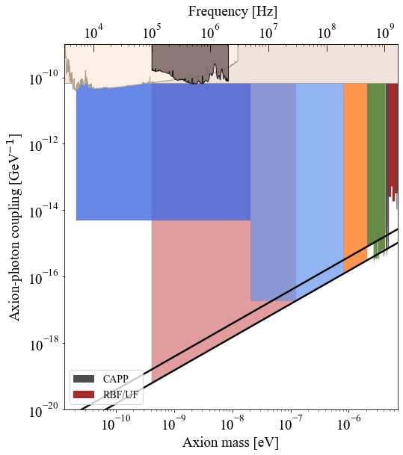
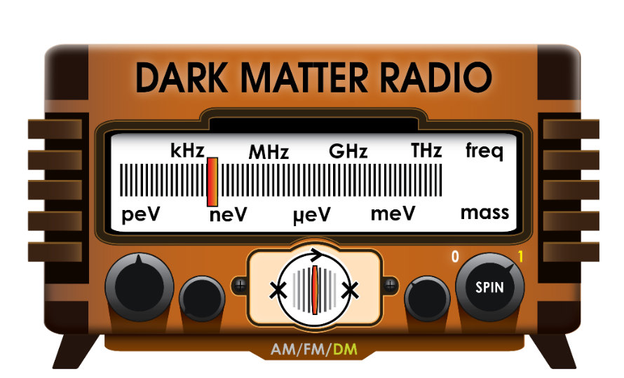
The Princeton aXion Search (PXS)
ABRA-
CADABRA
SHAFT
CAST
Target:
Mass range:
0.8 to 2 μeV
Frequency range:
200-500 MHz
DMRadio-50L
ADMX
CAPP
DMRadio-m³
DMRadio-GUT
DFSZ
PXS
Lots of communication with
1
Alpha: 4-20x10⁻⁵ eV
Notes:
Energy scale at 2 ueV is 3 e12 GeV
Dine-Fishler-Srednicki-Zhitnitsky
Kim-Shifman-Vainshtein-Zakahrov

Slide 5
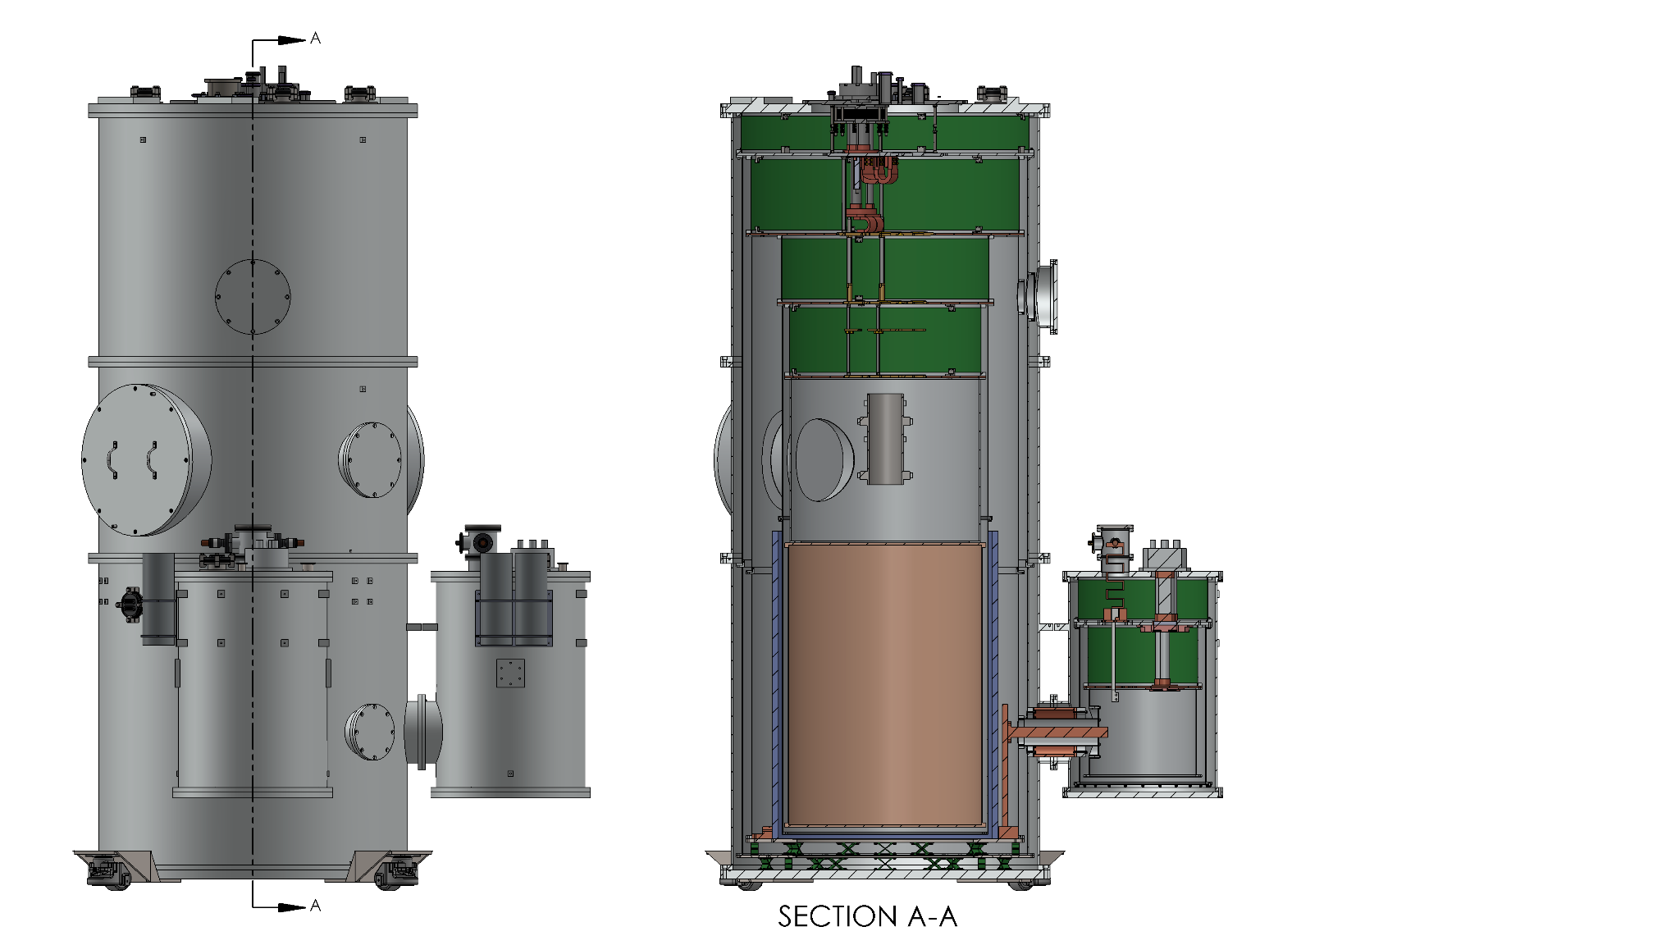
1.2 m
Dilution refrigerator
40mK copper plated aluminum cavity
40mK TWPA readout in low field area (bucking coil and passive shielding)
4K conduction cooled magnet
2.8 m
Magnet current leads and pulse tube cryocooler
Many components already exist.
Notes:
Bucking coil

Slide 6






With greatly appreciated support from
The Tabletop Experiments in Fundamental Physics program
DOE HEP Quantised
NASA APRA at JPL
New Ideas in Natural Sciences

Slide 7
THANK YOU

Slide 8
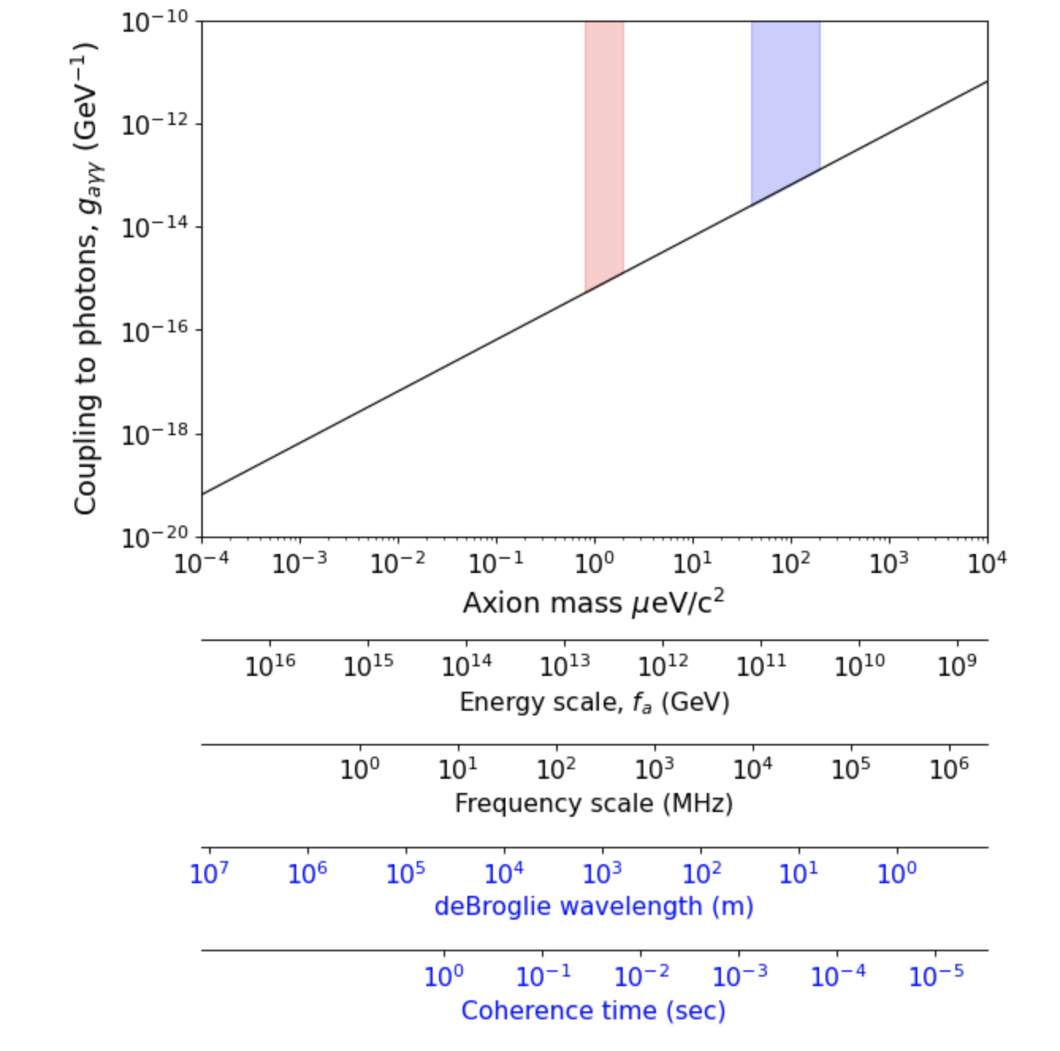
QCD
Axions
PXS
Alpha
DFSZ
GUT
scale
LHC 1.4x10⁴ GeV
Assume DM v/c=10⁻³
Notes:
Two new recently funded
Note the Blue vs Black
Note that model comes from particle physics by forcing the axion to have the same form as a pion, another pseudo scalar.
Axions would be a fundamental pseudo scalar.
To me there seems an extra 2pi in the coherence time
Dine-Fishler-Srednicki-Zhitnitsky
Kim-Shifman-Vainshtein-Zakahrov
Compton wavelength 1000x smaller

Slide 9
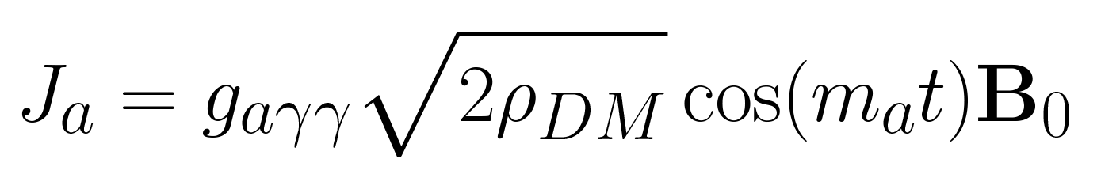
The Idea, conceptually
From Kahn, Safdi, and Thaler, “Broadband and Resonant Approaches to Axion Dark Matter Searches” PRL 117, 1801 (2016).
“ABRACADABRA”
Toroidal DC Magnetic field
The axion couples to a toroidal DC magnetic field to produce a toroidal AC current:
J_{a}
Sikivie 1983
AC current produces an AC field at the center of the coil that can be measured with a SQUID or pick-up coil
We will use a resonant cavity instead.
Kahn et al. geometry, also briefly considered by Thomas and Cabrera (Axion 2010 conference)
Notes:
Local density of dark matter is 0.3 GeV/cm^3. Dark matter velocity 10^{-3}. Proton 0.938 GeV. To get to a real current density multiply by sqrt(hbar*c) and divide by mu_0. I get for g=10^{-12}GeV^{-1} and 1 Tesla J_a=8.7e-{-12} A/m^2.

Slide 10
For PXS (and others)
Field probe
DC magnetic field
AC axion current
E
TM010 mode
B
Solenoid
Cavity
Notes:
Go over the pieces!

