Slide 1
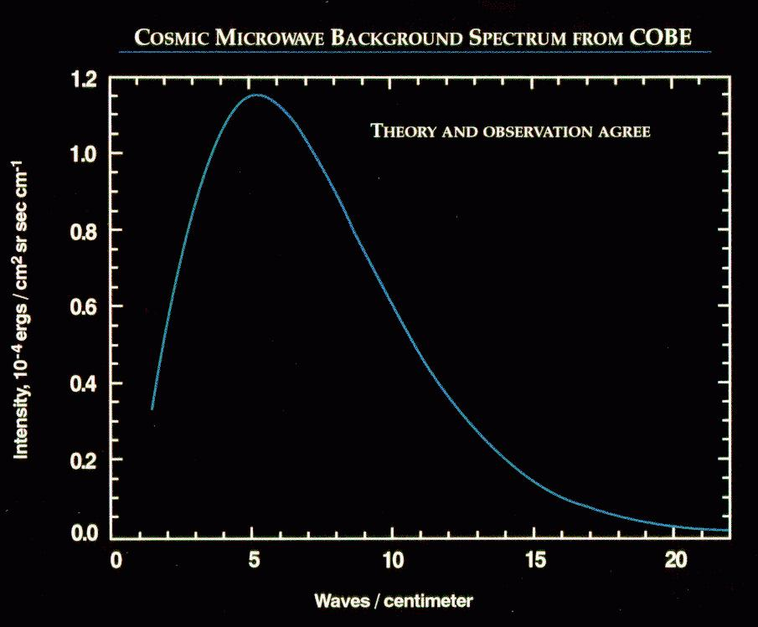
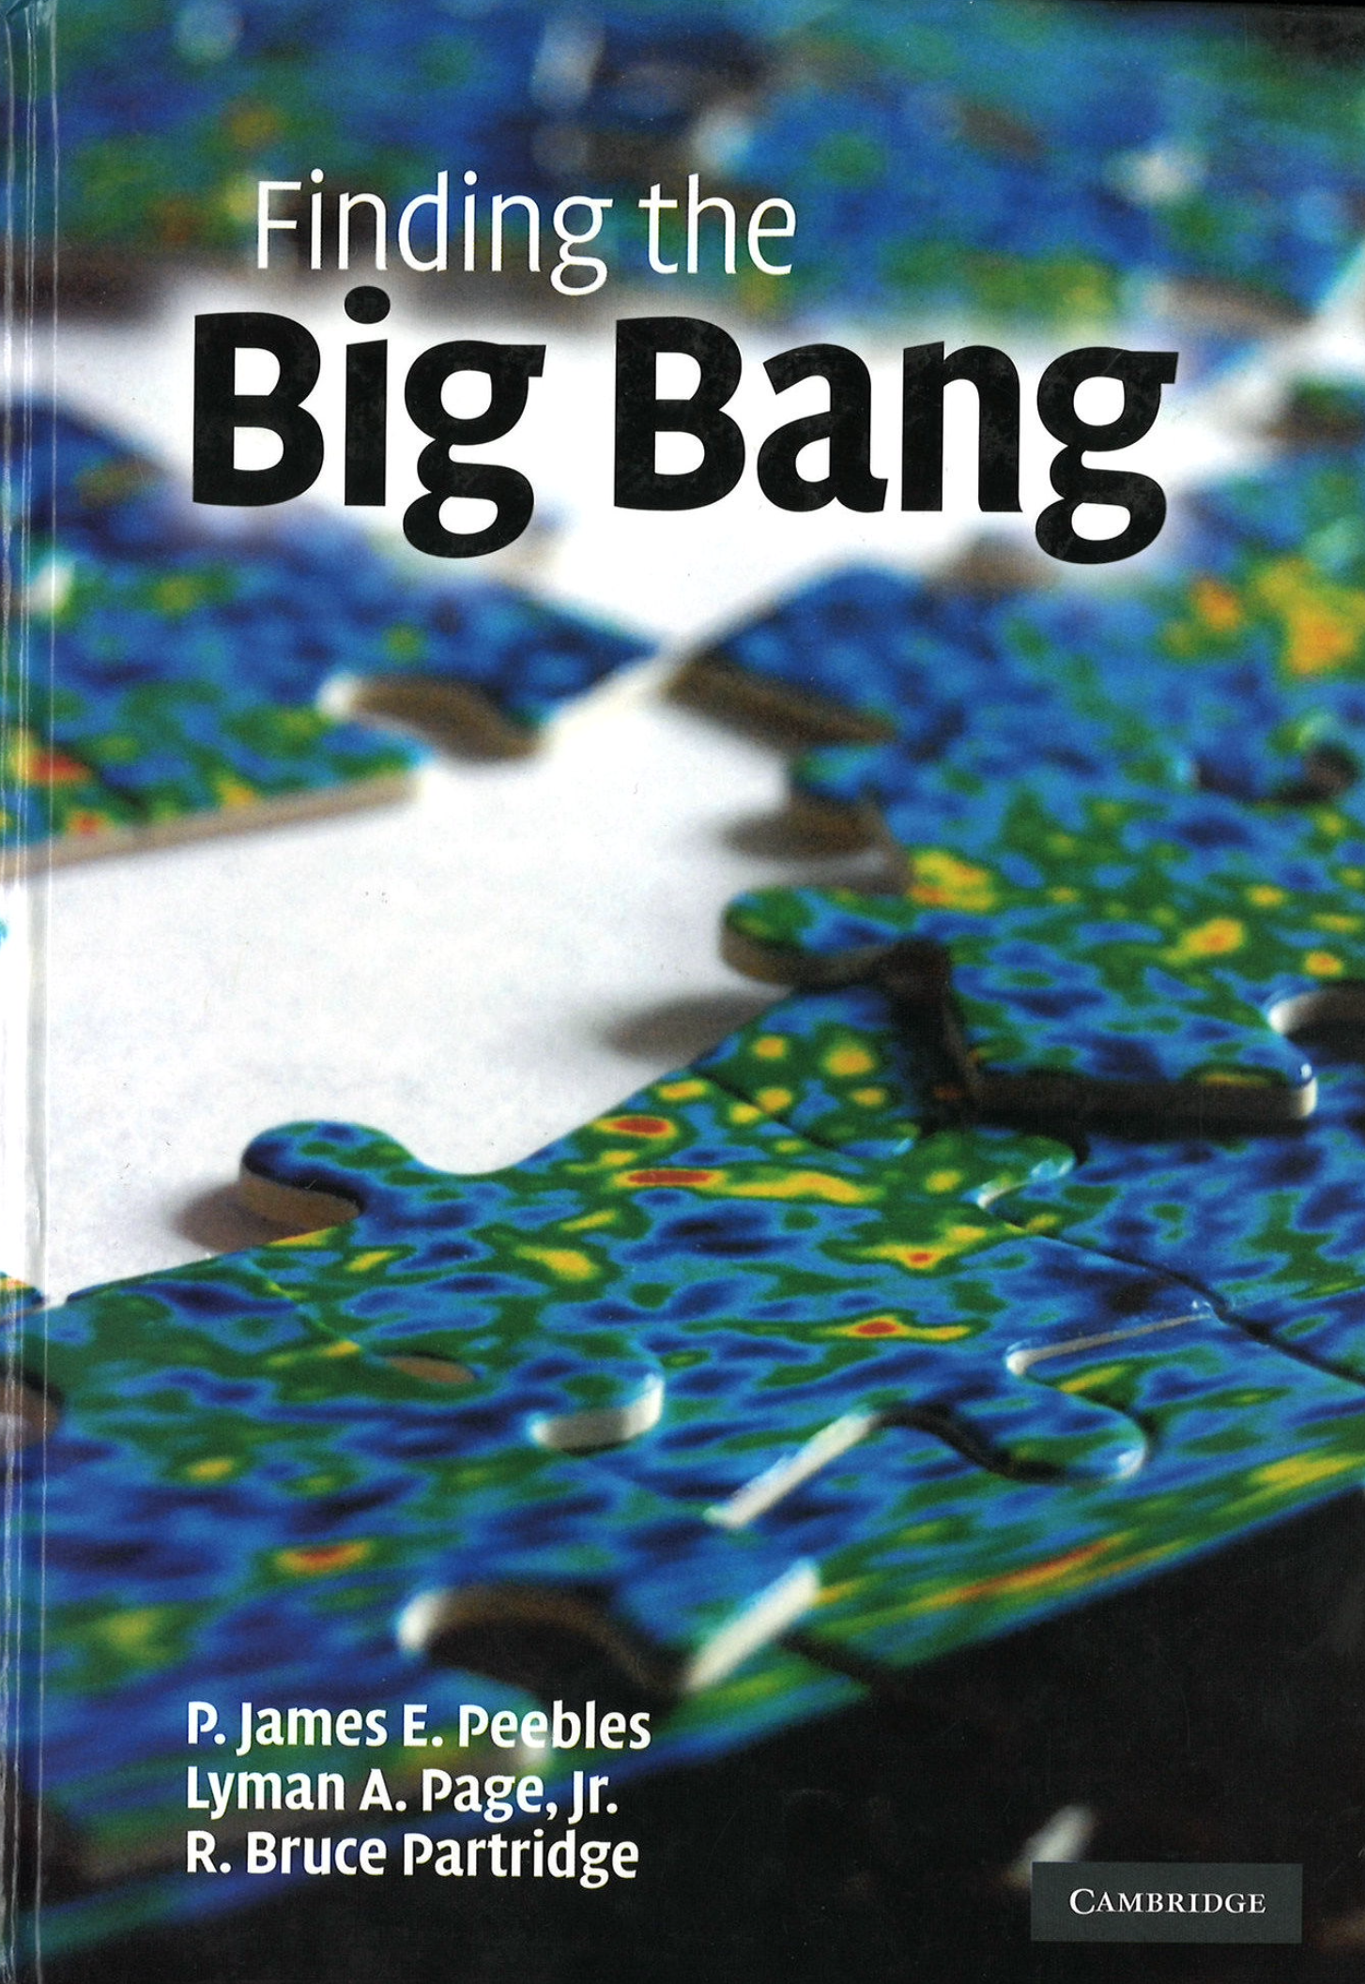
Rai and the CMB
λ=2 mm
COBE/FIRAS spectrum

Slide 2
Rai’s two plus decades on the CMB
1964 RW returned to MIT from Princeton to start a faculty position. Works on measuring G to a part in 10¹⁰.
1967 Bernie Burke suggests that Rai try to measure CMB near the peak ~ 2 mm.
1969 First flight
1970 Dirk Muehlner PhD
1974 Mather, Thaddeus, Weiss, Muehlner, Wilkinson, Hauser, & Binsack met in NYC to discuss what would become COBE.
1975 Rai gets an NSF award for 53K to work on “Interferometric Broad Band Gravitational Antenna”
1976 David Owens PhD
1980 Pat Downey PhD
1980 Steve Meyer joins group as PD
1982 LP starts hanging out in lab, joins in 1983
1983 Andrew Jeffries PhD (SZ) & Mark Halpern PhD, Ed Cheng arrives as PD
1986 Steve Meyer starts as Asst Prof. with LP as first student.
1987 Dave Cottingham arrives as PD
1989 COBE launch. FIRAS: 1990, DMR 1992
2006 Task Force on CMB research: “Weiss report” on the future of the CMB
Peter Saulson

Slide 3
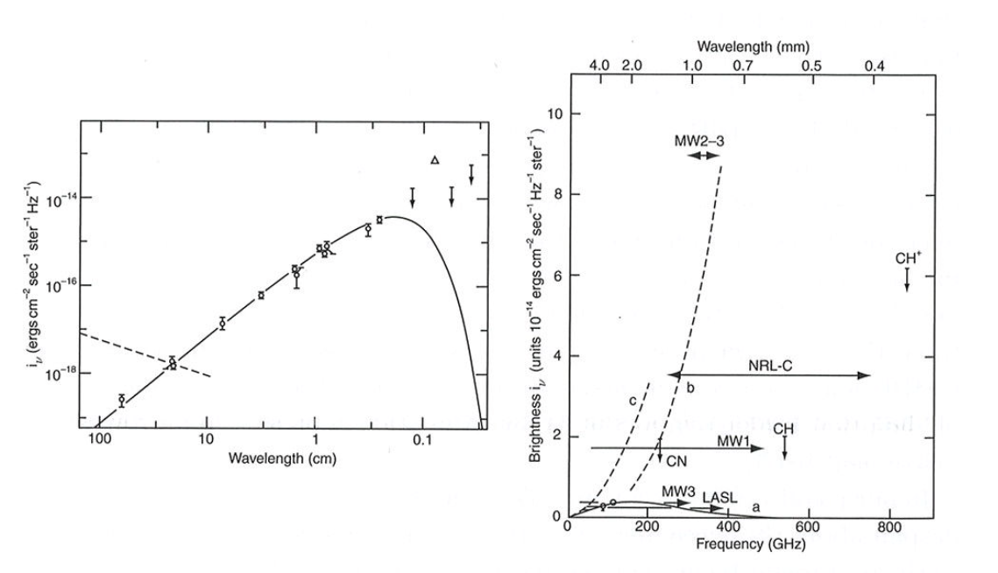
Status of the temperature spectrum measurements in 1970 (from Peebles).
2 mm
3K Blackbody
Note the number of measurements with an excess “above the peak” at 2 mm emission. Was there a “turn over” as expected from a Planck blackbody?
Why was this important to know?
Notes:
The excess above the peak was around for a long time. There were the early rocket experiments.
Then Woody-Richards
Then Peterson
Then Matsumoto et al.
Finally solved with COBE/FIRAS and COBRA in relatively rapid succession in ??

Slide 4
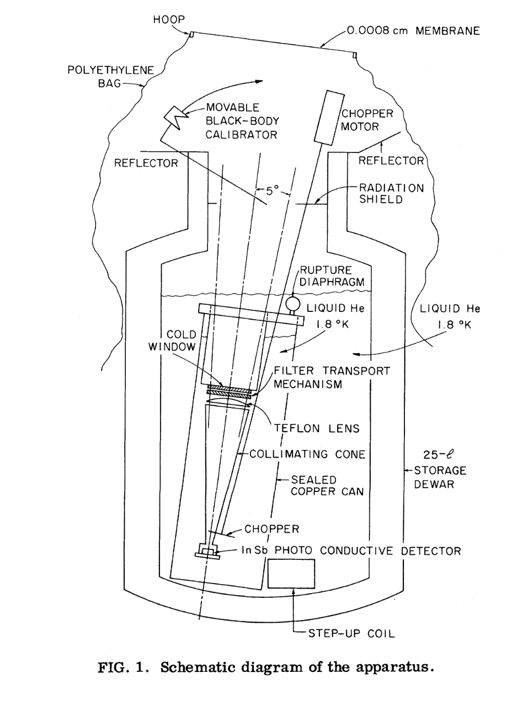
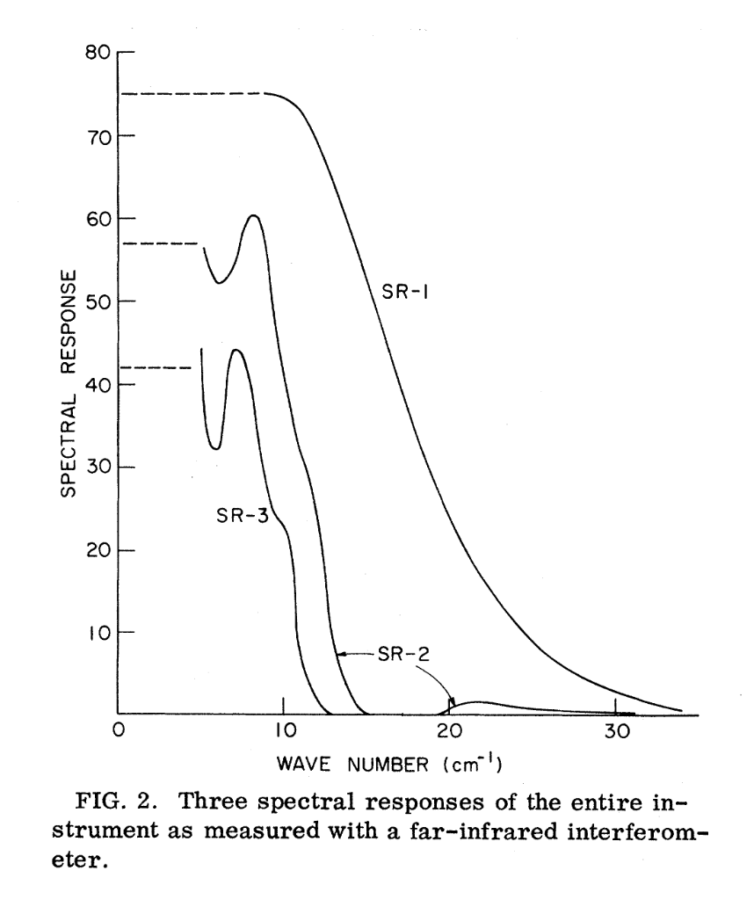
The Instrument
Muehlner & Weiss PRL 1970
Reported, preliminarily, an excess over a BB
Notes:
Flow from a balloon.
Version 1
On the next flight, the let down reel failed.
Then Woody-Richards
Then Peterson
Then Matsumoto et al.
Finally solved with COBE/FIRAS and COBRA in relatively rapid succession in ??

Slide 5
Muehlner-Weiss
Muehlner-Weiss 1970 PRL. Emission at f > peak not BB, they saw an excess, but not as large as others had reported: “spectrum of the isotropic background radiation may not be thermal.”
Second flight. Let down reel failure. Package free fell. Hit the ground at 250 mph.
Rebuilt payload but without IR emitting rim that led to initial excess. Redesigned let-down reel etc. Dick Benford joined. Made 5 additional flights in two years.
Muelhner-Weiss 1973 PRD. Many improvements and checks, added two passbands. After three more flights: “The results are consistent with a 2.7K thermal radiation background.” But, there was uncertain atmospheric emission above ~300 GHz (<0.91 cm). Two more flights to nail down the atmosphere and corrections.

Slide 6
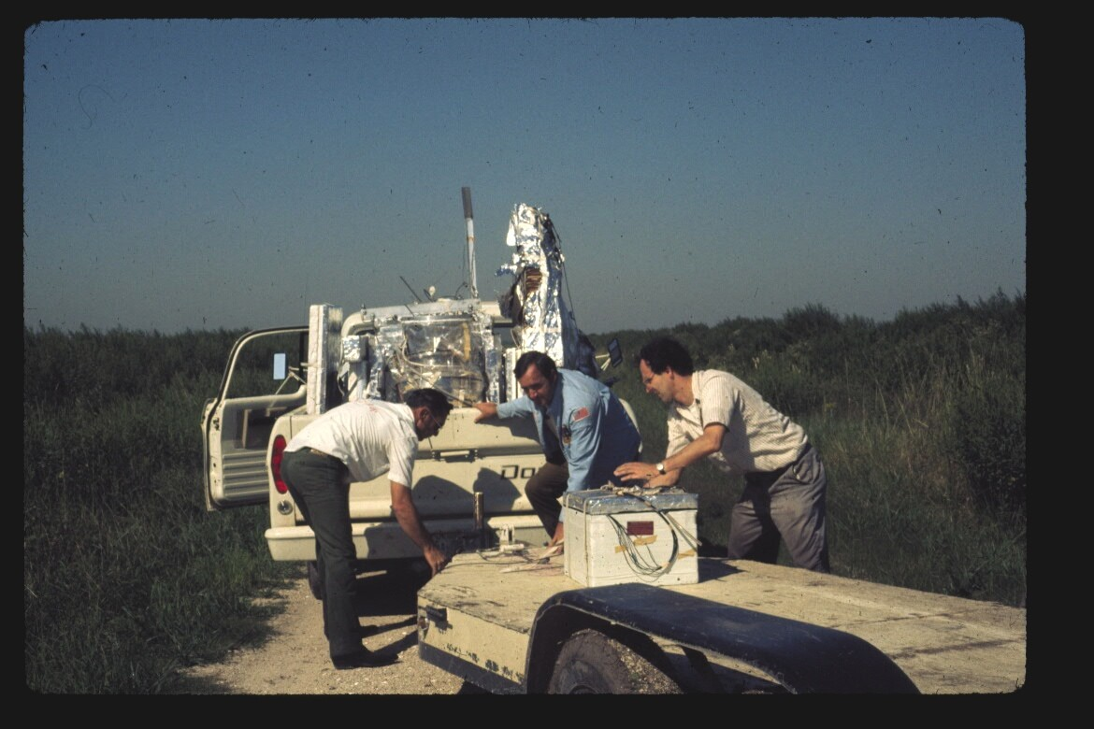
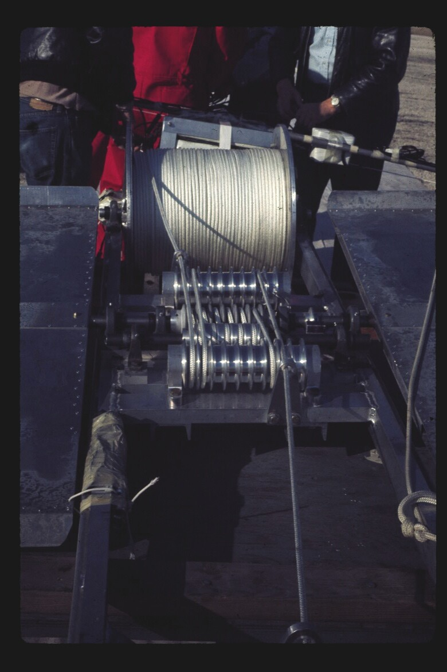
Payload recovery crew, with Rai, from the 1971 balloon flight with Dirk Muehlner and Dick Benford.
From Steve Meyer

Slide 7
“The results of these flights (Muehlner and Weiss 1973a) were published in PRD rather than PRL. This was a significant mistake…. PRL offers rapid response but not much space, and we were not experienced enough to write our results in a convincing and short manner. To us they were clear enough. The results of the initial flights were wrong: there is no excess near the peak… the second set of measurements showed the curve turning down at higher frequencies.
….atmospheric modeling was needed..that took more flights.”
From FTBB

Slide 8
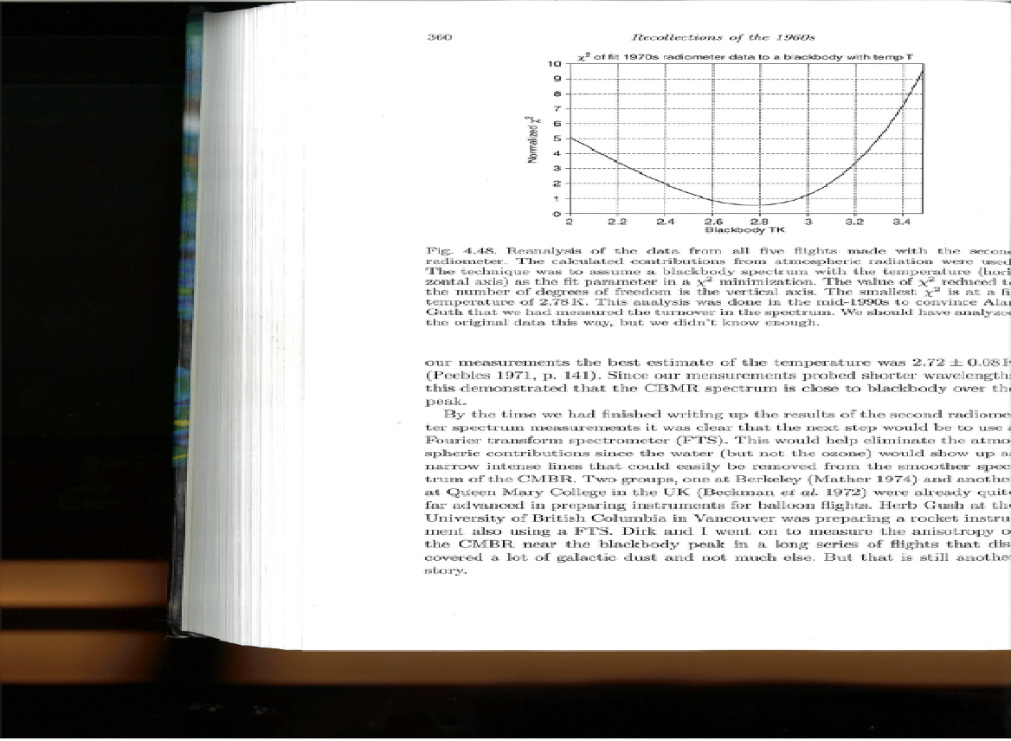
Follow-up, prompted by a question from Alan Guth.
The best way to do the analysis did not occur to MW until later.
Analysis of 5 flights
Notes:
Guth question in 1996 or so.

Slide 9
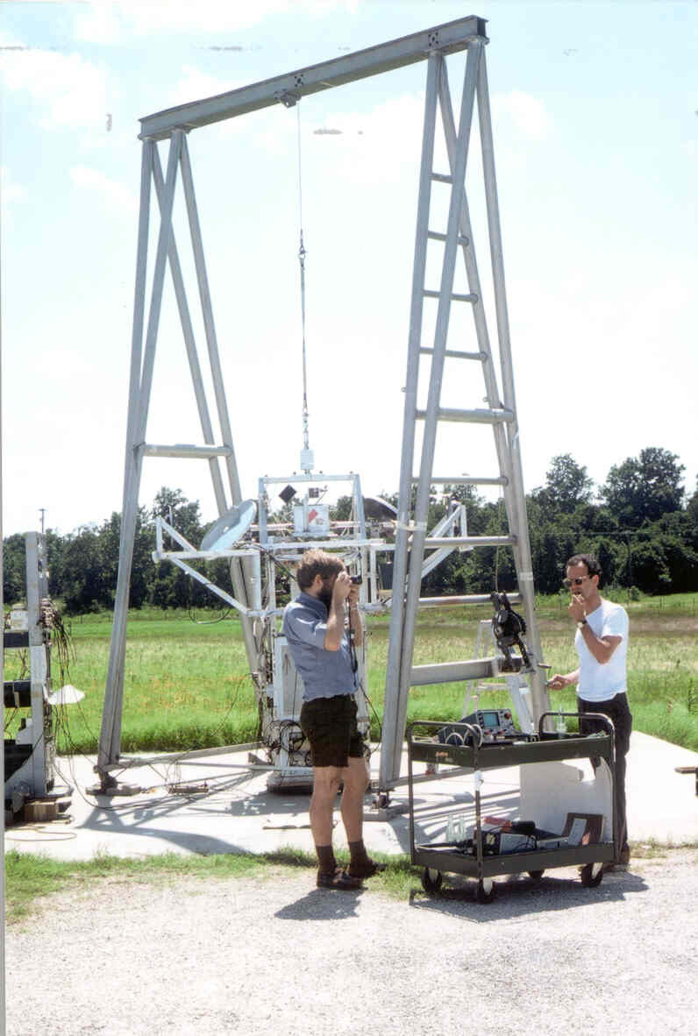
Two flights, 1975 and 1976
Owens, Muehlner, Weiss
Ap J, 1979
A large beam sky survey at mm
and sub-mm wavelengths made from balloon altitudes.
Muehlner
Rai
From Steve Meyer

Slide 10
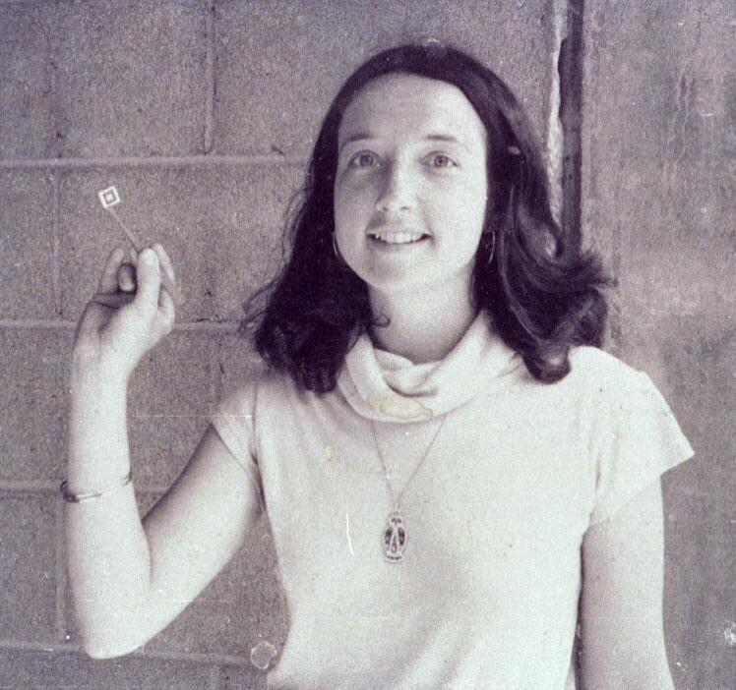
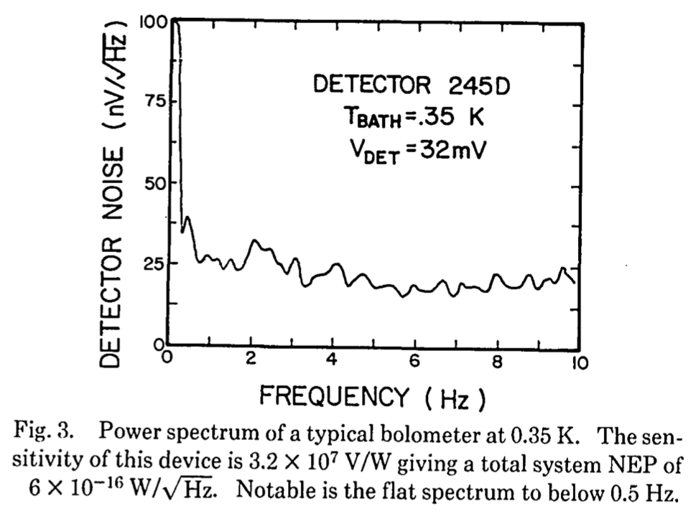
The first monolithic silicon bolometer.
Downey et al. Applied Optics, 1984
Pat Downey
From Steve Meyer
NEP 6x10⁻¹⁶ W/rtHz, 0.5 cm² sr
Notes:
Current SO are xx

Slide 11
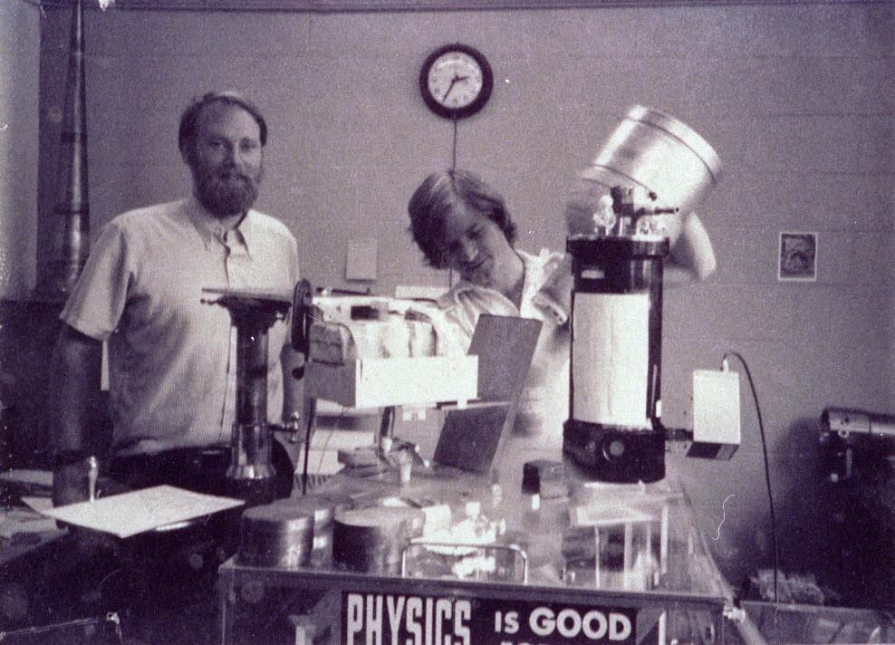
Ned Wright and David Shoemaker next to a FIRAS test FTS.
From Steve Meyer

Slide 12
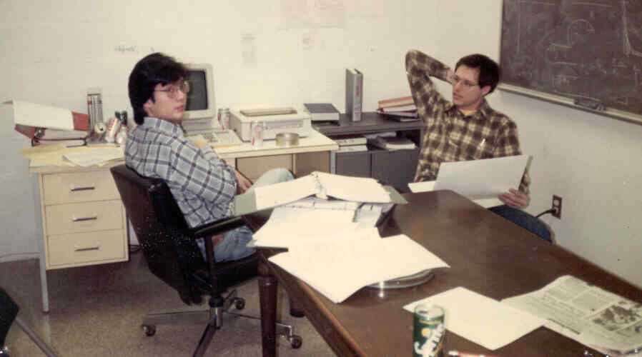
Ed Cheng and Steve Meyer
From Steve Meyer

Slide 13
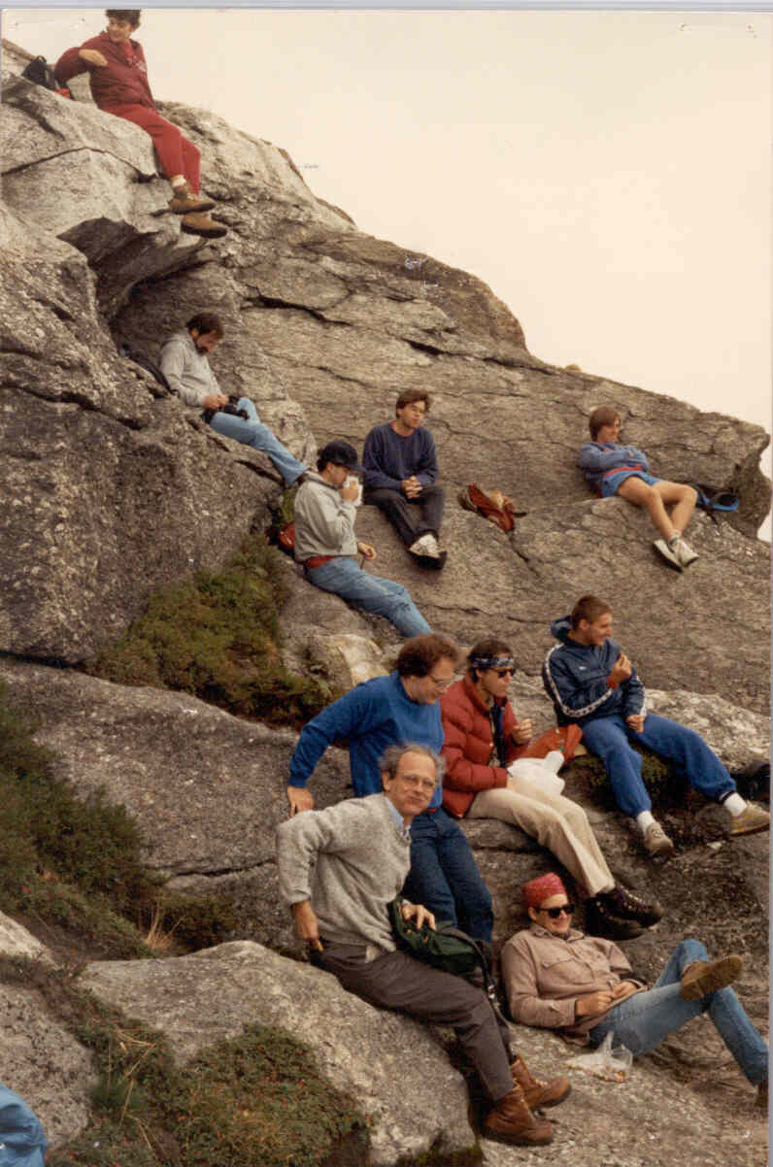
?, D. Benford, Nergis?, Peter, Nelson
RW Dave Cottingham, LP, Steve, Boris G.
From Steve Meyer

Slide 14
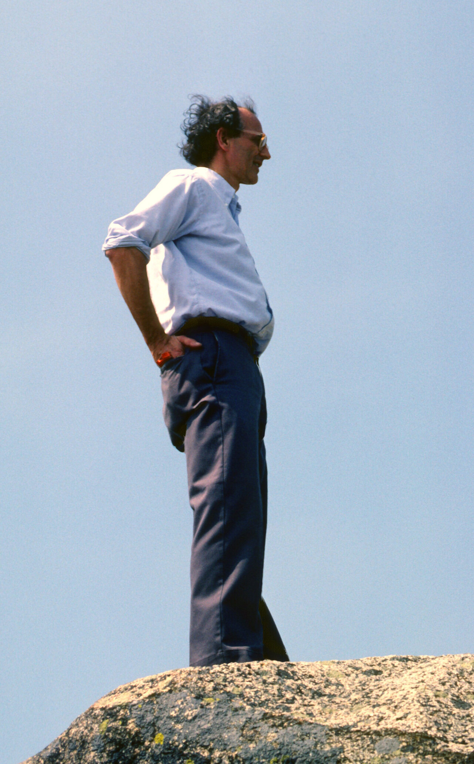
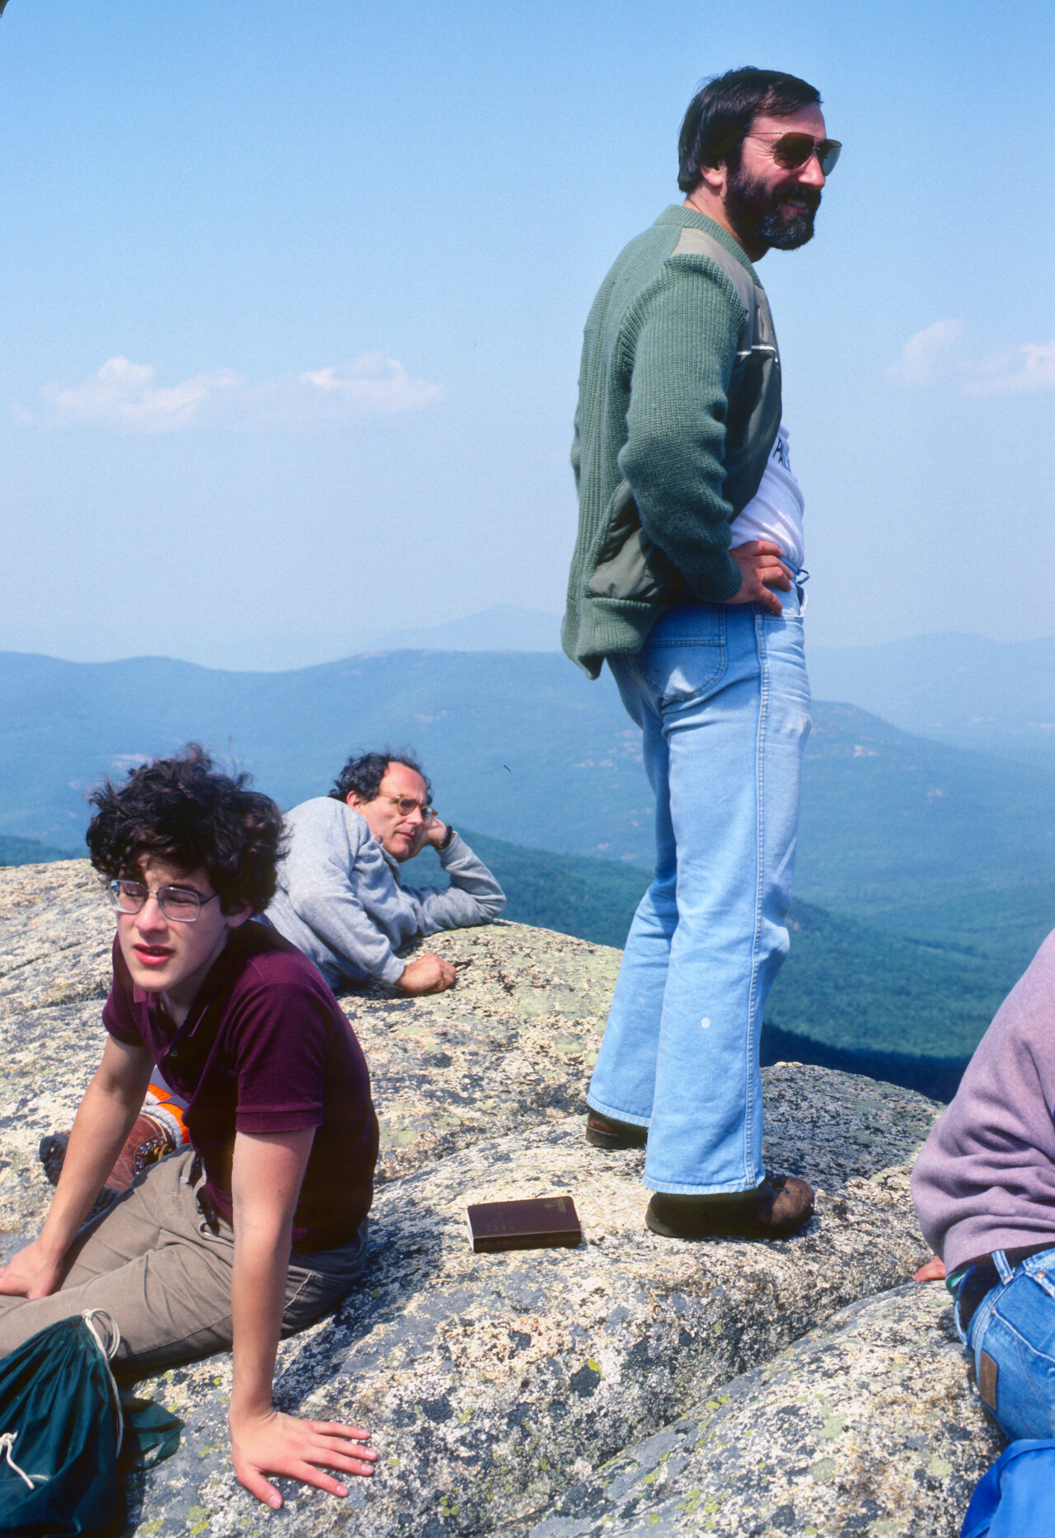
From Steve Meyer

Slide 15
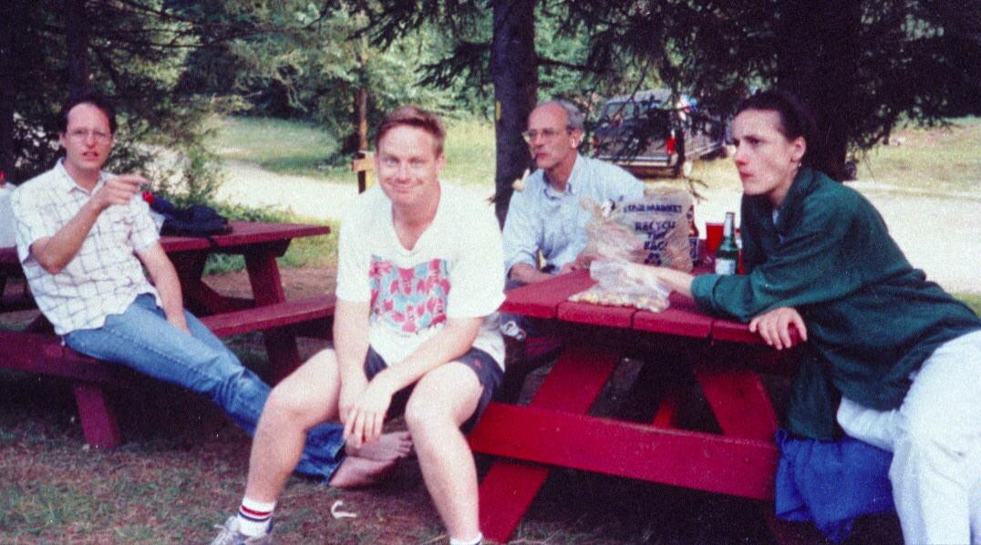
Steve, Bill Barnes, RW, Virginie Landre
From Steve Meyer

Slide 16
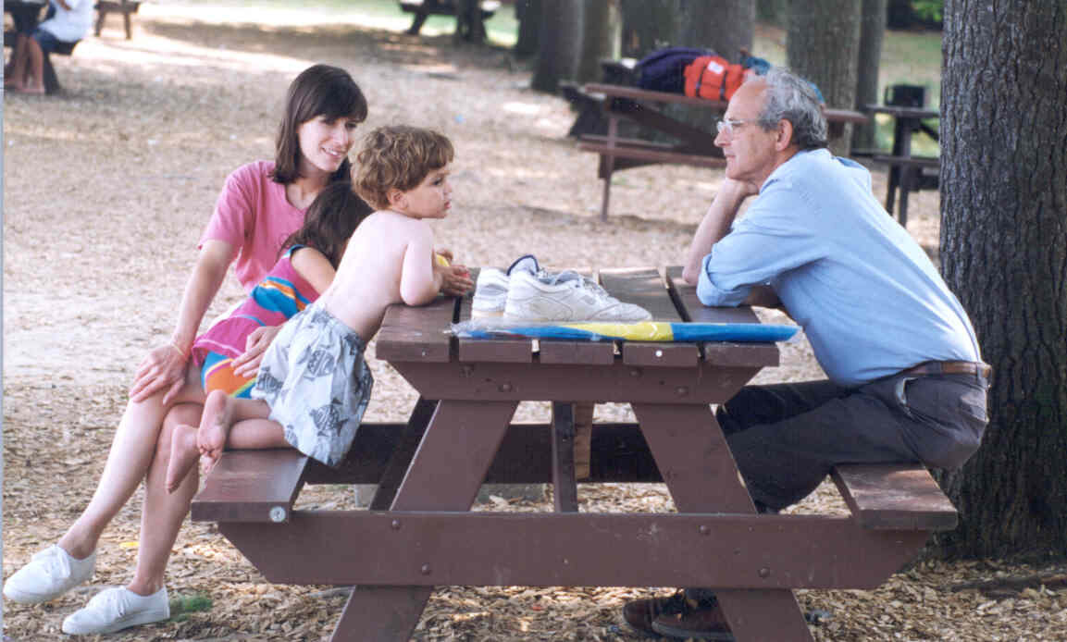
Mrs. Burka, Sam Fritschel, and Rai
From Steve Meyer

Slide 17
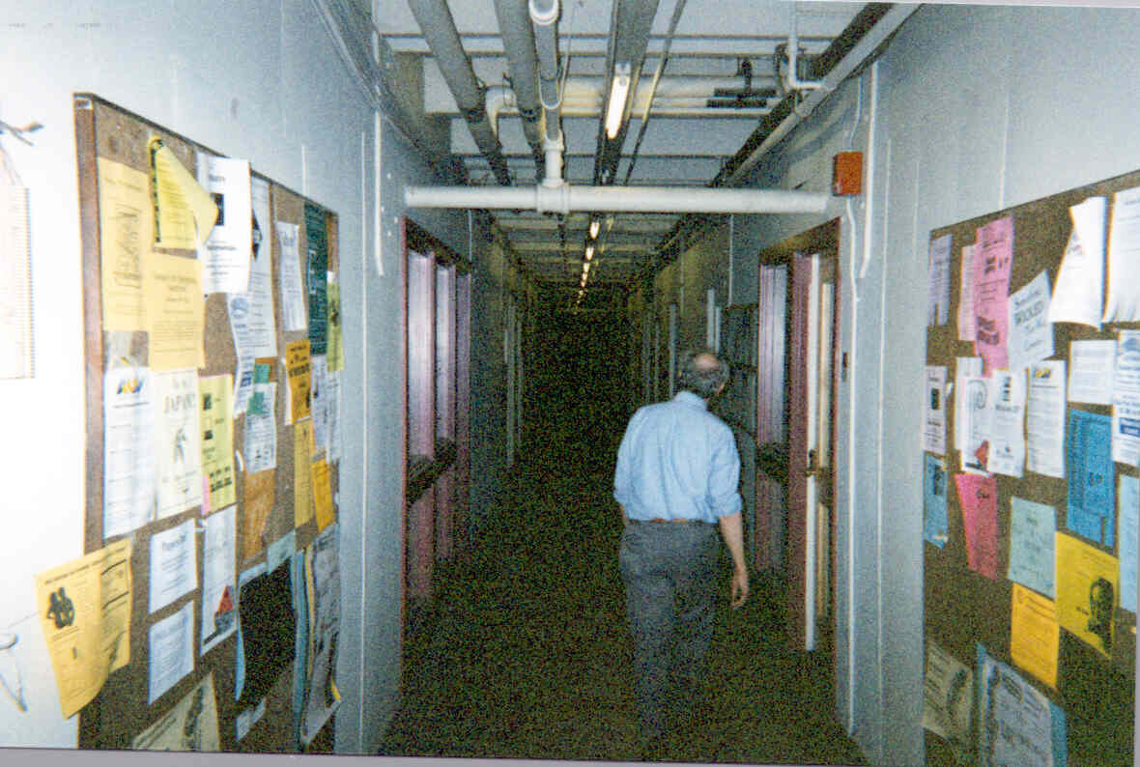
From Steve Meyer

Slide 18
John Mather

Slide 19
Physics in 1970
Lockin amplifier was Berkeley electronic shop design, with vacuum tubes, twin-tee fixed filters, and nuvistor preamps
Fast Fourier transform just invented
No HP calculators yet
Advanced lab computer: PDP-11 programmed by paper tape
Made IR detectors with a wire saw, CP-4 acid etch, indium solder, and tiny wires, with tweezers

Slide 20
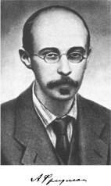
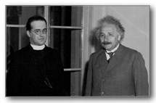
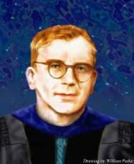
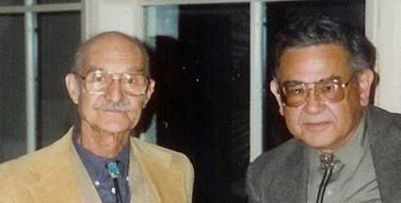
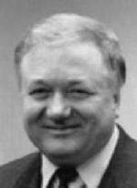
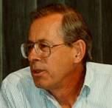
The Power of Thought
Alexander Friedman
Georges Lemaître & Albert Einstein
George Gamow
Robert Herman & Ralph Alpher
Rashid Sunyaev
Jim Peebles

Slide 21
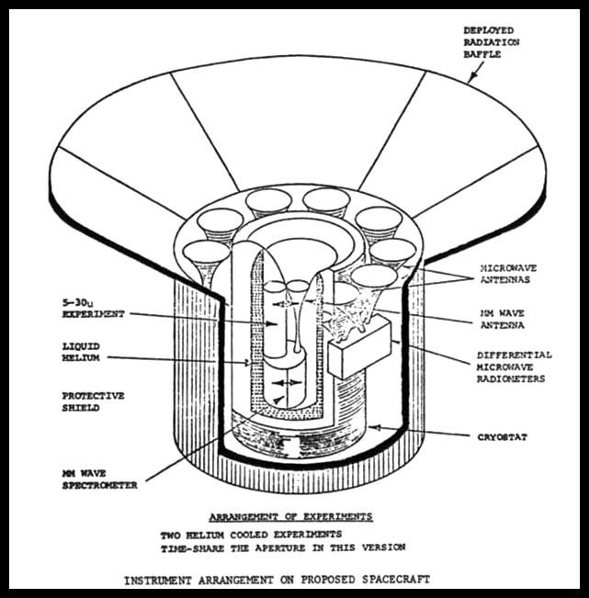
1974

Slide 22
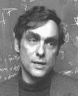
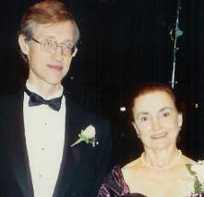
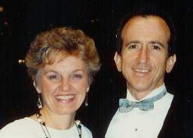
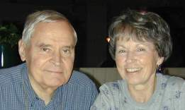
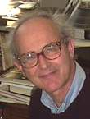
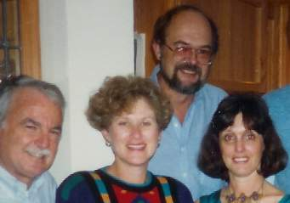
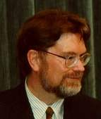
Starting COBE
Mike & Deanna Hauser
Dave & Eunice Wilkinson
John & Jane Mather
Pat Thaddeus
George Smoot
Sam & Margie Gulkis, Mike & Sandie Janssen
Rai & Becky Weiss

Slide 23
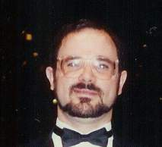
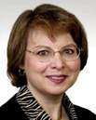
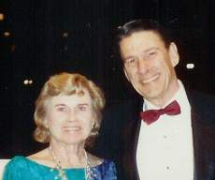
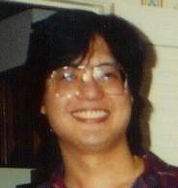
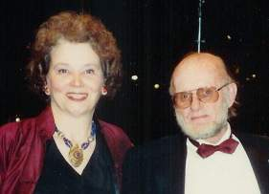

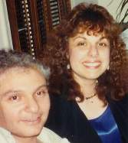
COBE Science Team
Chuck & Renee Bennett
Nancy & Al Boggess
Ed & Tammy Cheng
Eli & Florence Dwek
Tom & Ann Kelsall
Philip & Georganne Lubin

Slide 24
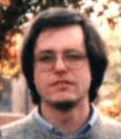
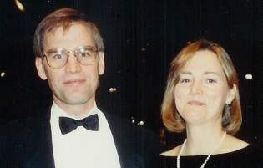
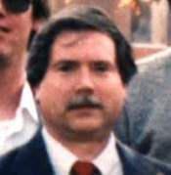
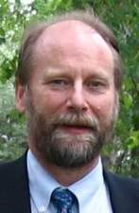
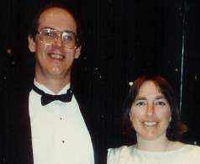
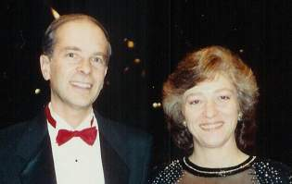
COBE Science Team
Harvey & Sarah Moseley
Tom & Jeanne Murdock
Steve & Sharon Meyer
Rick & Gwen Shafer
Bob & Beverly Silverberg
Ned & Pat Wright

Slide 25
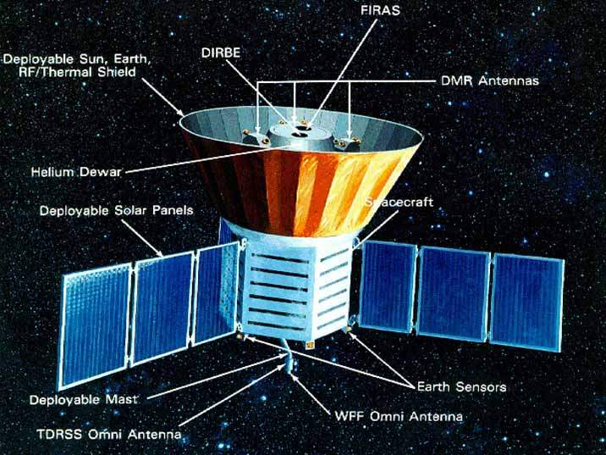
COBE Satellite, 1989-1994

Slide 26
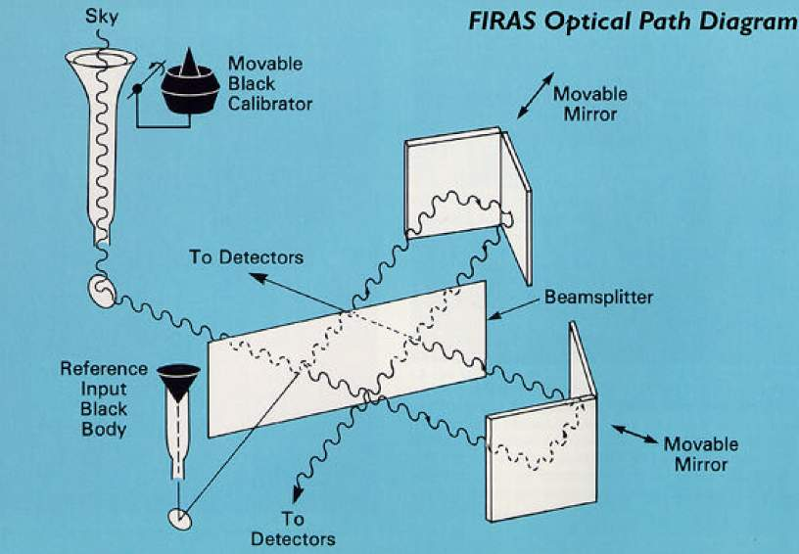
Far Infrared Absolute Spectrophotometer
John Mather, PI
Rick Shafer, DPI
Bob Maichle, IE
Mike Roberto, ISE
Michelson Interferometer (Nobel 1907)

Slide 27
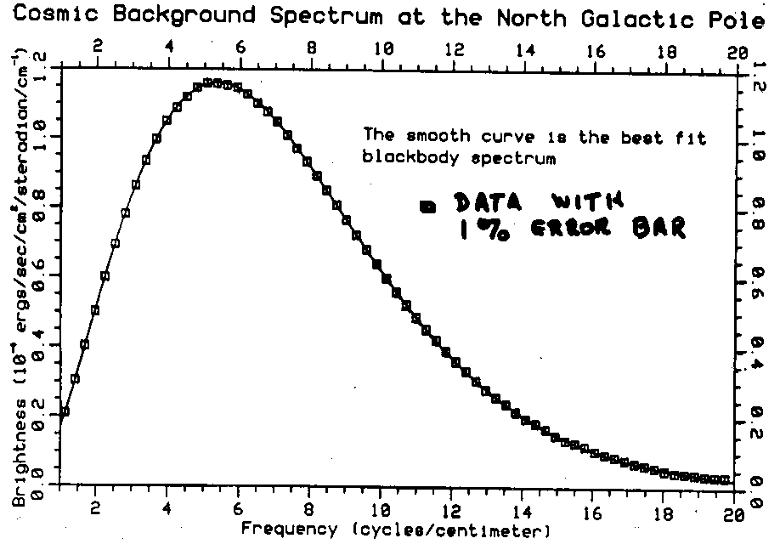

Based on 9 minutes of data
Presented at American Astronomical Society, January 1990

Slide 28
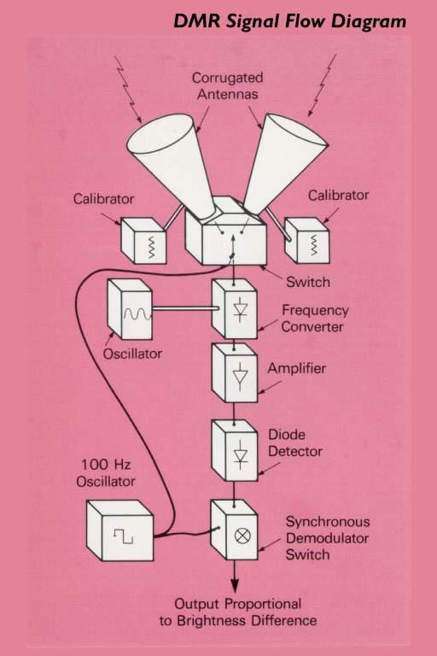
Differential Microwave Radiometers
George Smoot
Chuck Bennett
Bernie Klein
Steve Leete

Slide 29
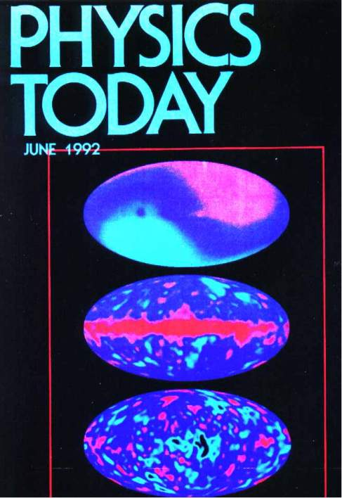
Sky map from DMR, 2.7 K +/- 0.003 K
Doppler Effect of Sun’s motion removed (v/c = 0.001)
Cosmic temperature/density variations at 389,000 years, +/- 0.00003 K (part in 100,000)

Slide 30
Mark Halpern

Slide 31


Palestine Tx, 1981
Dirk and Rai flew a series of balloon borne radiometers to search for anisotropy of the CMB. D.Kingston Owens and Dick Benford were involved.
In 1976 a flight used bolometers which were hand made by me and by Rai. In 1981 we flew a four- channel radiometer using monolithic bolometers Pat Downey made.

Slide 32





Slide 33


One important lesson from this series of flights is that the Galaxy is bright, a lot brighter than anticipated in the early 1970’s.
30 GHz
300 GHz
100 μm
Fixsen ‘83
Lubin ‘85
MIT Balloon
IRAS ‘86
Rai and Dick Benford, Palestine
Texas, October 1981

Slide 34



When I started as a student the lab, the name for a candy bar—specifically a candy bar from the vending machine down the hall-- was a Zorc
Our runs to characterize radiometers always started in the evening, when Rai and Dirk were done teaching. We would transfer Helium, go for dinner, and then work all night.
These runs were fueled on Zorcs and coffee, especially if they did not go well.
One of the more bizarre components of the campaign to undermine Oppenheimer was the 1953 Fortune article accusing Oppenheimer of being the leader of a cabal of scientists scheming to undermine the policies of the American military.
It charged that Oppenheimer was one of the leaders of group ominously titled “ZORC,” an acronym derived from Oppenheimer’s last name as well as those of his alleged conspirators, Jerrold Zacharias, Isidor I. Rabi, and Charles Lauritsen.
According to the article, ZORC met in secret during the spring of 1952 with a singular goal: to create a nuclear air defense model that would “undercut the ‘Deterrent-Retaliatory’ argument.”

Slide 35
Sam Day-Weiss

Slide 36

The Simons Observatory: New Measurements of the CMB
Samuel Day-Weiss
Princeton University
Photo credit: Hironobu Nakata

Slide 37

Outline
Simons Observatory (SO) Overview
The Small Aperture Telescopes (SATs)
A search for gravitational waves from the Big Bang
A journey to the Atacama
Initial observations
A SAT observes Jupiter
Photo credit: Allen Foster

Slide 38

The Simons Observatory (SO)
Cerro Toco, Parque Astronómico, Chile, 5200 m

Slide 39


The SATs: a search for primordial gravitational waves
ACT DR6 + Planck (Naess+2025)
Temperature
E-mode
Temperature anisotropies: scalar perturbations with ~110 uK rms
CMB ~5% linearly polarized
Contribution from scalar perturbations: ~ 6.4 uK rms (“E-modes”)
Contribution from gravitational waves: < 57 nK rms (primordial “B-modes”, BICEP/Keck 2021)

Slide 40
The SATs: a search for primordial gravitational waves
In summary:
<57 nK RMS signal through a 12K fluctuating atmosphere
Need high signal-to-noise over a large sky area to capture the primordial signal at the ~2 deg scale

Slide 41


The SATs: a tiny signal on large angular scales
35° FOV
3x O(10,000) TES detectors on-sky
Yamada+2024

Slide 42

The SATs: decoupling from the unpolarized atmosphere
30 kg sapphire HWP modulates incident polarization at 2 Hz
35° FOV
Yamada+2024

Slide 43



A journey to the Atacama: Princeton, NJ
In-lab testing: 2019 → 2023

Slide 44




A journey to the Atacama: Cerro Toco, Chile
In-field: 2023 → Present

Slide 45

Initial observations: the Crab Nebula
PRELIMINARY
Crab Nebula
Flux (temperature) with polarization direction
28’ resolution
90 GHz

Slide 46

Initial observations: CMB E-modes
Credit: SO Collaboration
PRELIMINARY
SO Initial Science Data
Notes:
2 SATs, 90 + 150 GHz, several months of data, detectors exceeding the baseline sensitivity goal set in the SO white paper

Slide 47

Initial observations: EE angular power spectrum
Credit: SO Collaboration
1x SO SAT
Overall calibration factor to LCDM (Planck) applied
No dust subtraction
PRELIMINARY
SO Initial Science Data
Dust not subtracted

Slide 48





Thank You

