Slide 1
Rai Stories
Rainer Weiss Symposium
February 27, 2026

Slide 2
Richard Isaacson
Former Program Director of Gravitational Physics
National Science Foundation

Slide 3
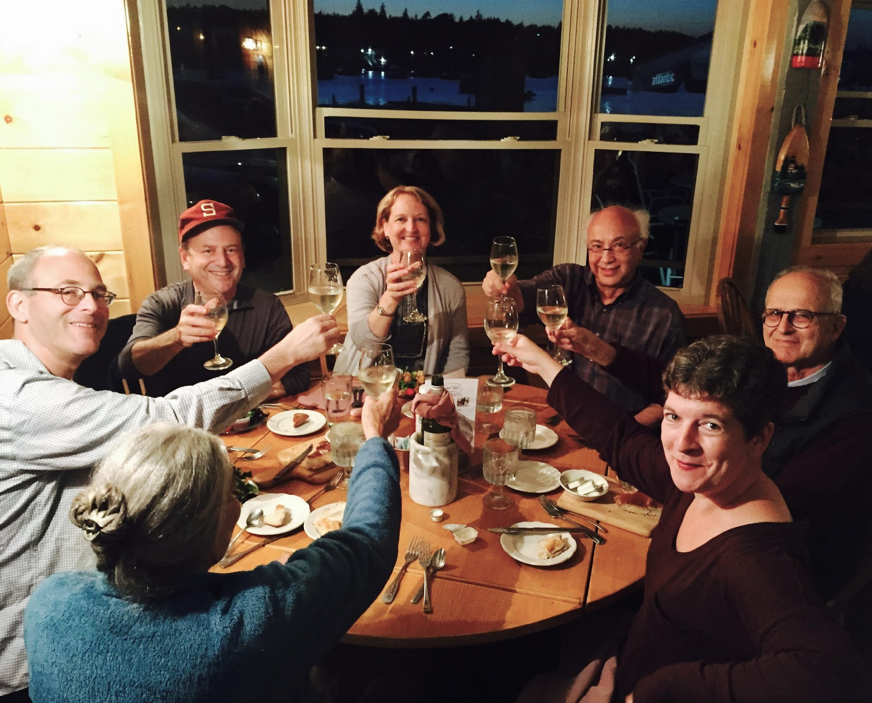
Photo taken by waitress in restaurant. September 18, 2015.
Clockwise around table from right: Rainer, Carla, Rebecca, Ben, Peter, Sarah, Richard
Isaacson

Slide 4
Fred Raab
Former Director of LIGO Hanford Observatory
Caltech

Slide 5


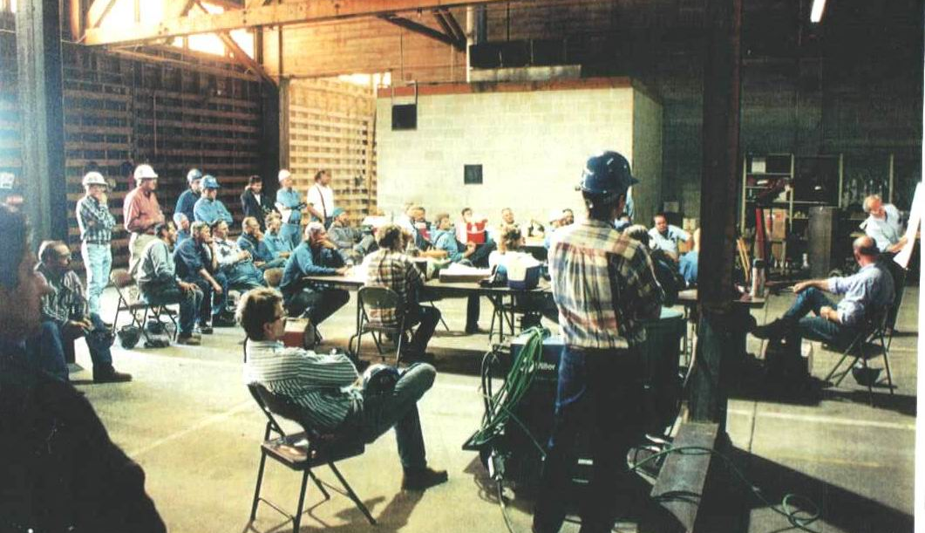
How to win the Nobel Prize.
Rai Weiss
Caltech/MIT/LIGO Lab
Boilermakers learning about critical role of their work on LIGO beam-tube fabrication and its connection to Einstein and the future of science.
Raab

Slide 6
B. S. Sathyaprakash
Professor of Physics, Astronomy and Astrophysics
Pennsylvania State University

Slide 7
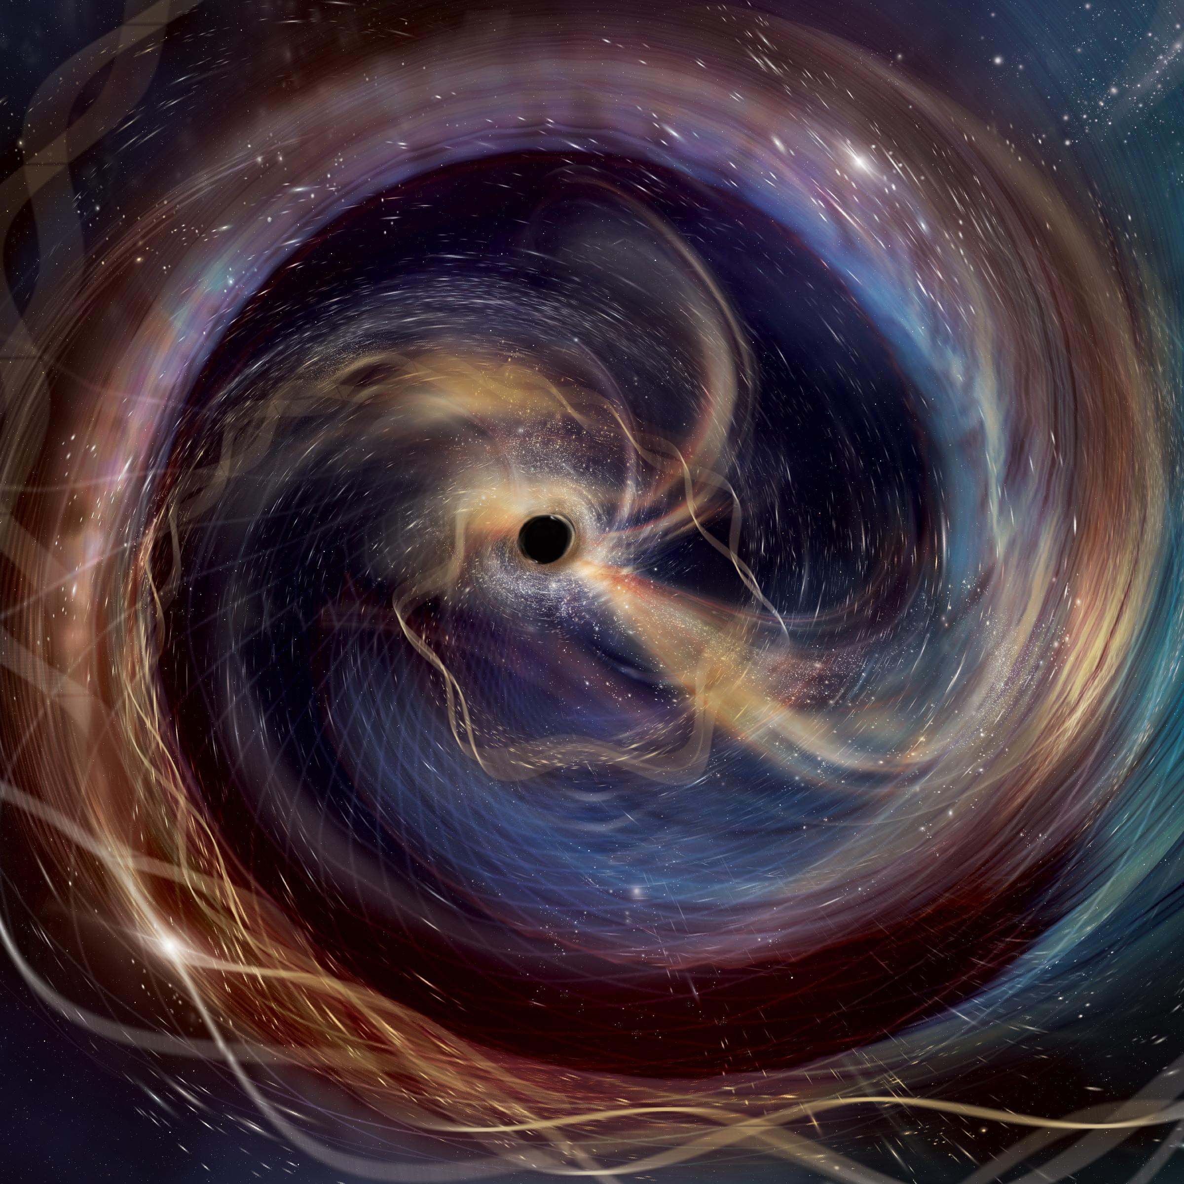

  Rai Weiss: Humility, Persistence, and the Promise of Discovery
B. S. Sathyaprakash
Department of Physics and Department of Astronomy and Astrophysics, Eberly College of Science
The Pennsylvania State University, University Park
Notes:
Abstract: Gravitational-wave observations have ushered in a new era in physics and astronomy, giving us the ability to witness the dynamics of spacetime directly. In less than a decade, detections by LIGO and Virgo have revealed unexpected populations of black holes and neutron stars, challenging long-standing ideas of how massive stars form, evolve, and die. The multi-messenger event GW170817 was transformative: it demonstrated the cosmic origin of heavy elements, established gravitational waves as “standard sirens” for cosmology, confirmed that gravity and light travel at the same speed. Gravitational-wave observations have also provided unprecedented tests of general relativity in the strong-field, dynamical regime—and Einstein’s theory remains unshaken. Yet current detectors can probe only the nearby Universe. Next-generation observatories—Cosmic Explorer and the Einstein Telescope—will open access to black hole mergers at cosmic dawn and neutron star mergers beyond the epoch of peak star formation. Together, they promise discoveries that will reshape astrophysics, cosmology, and fundamental physics.

Slide 8
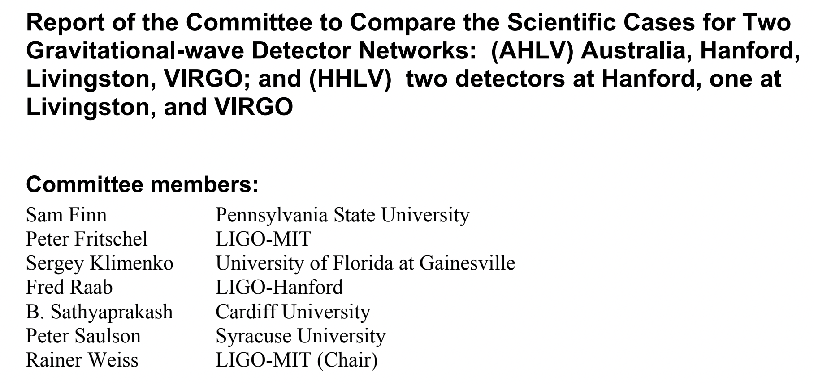
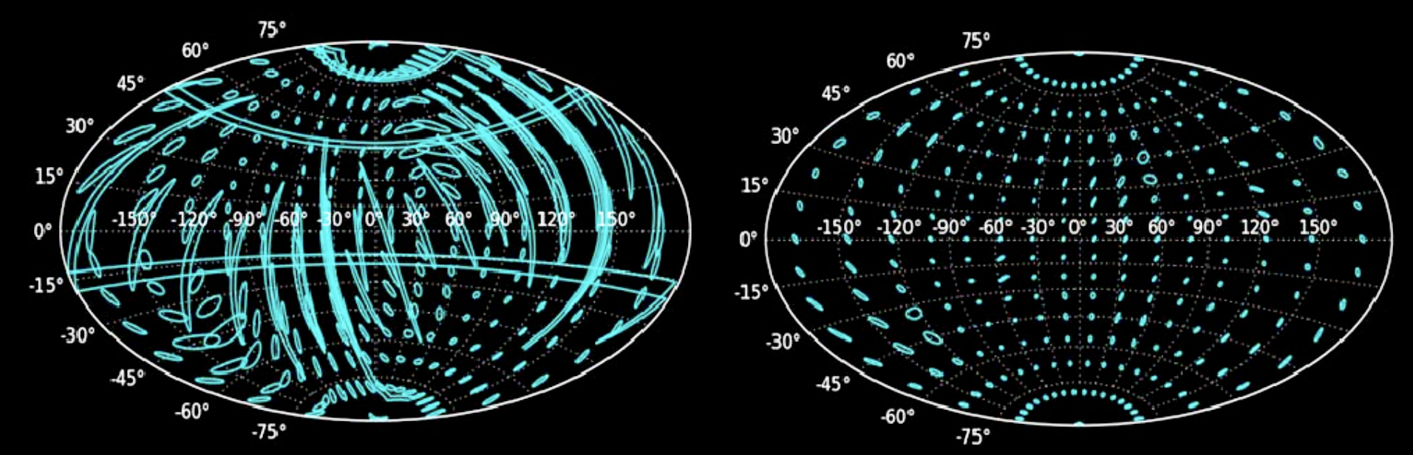
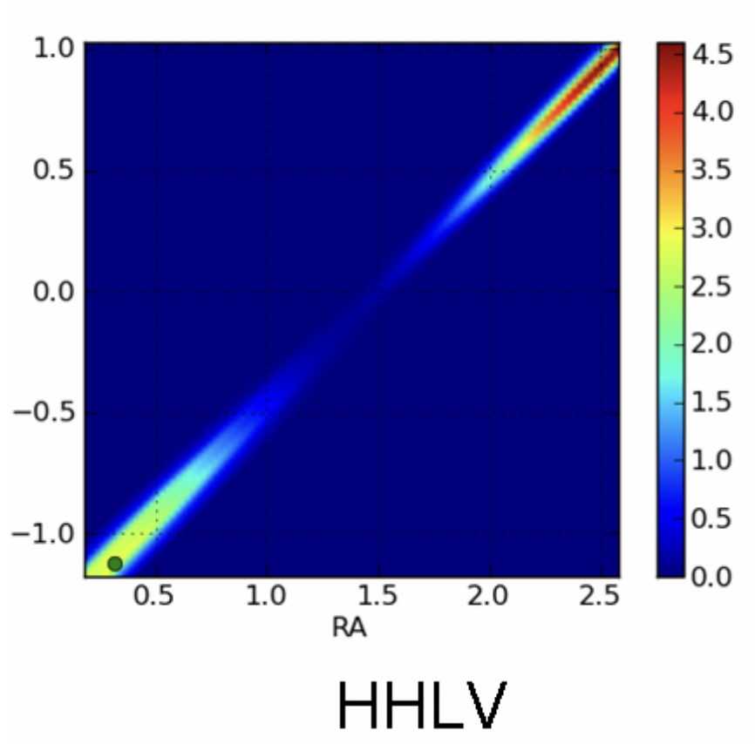
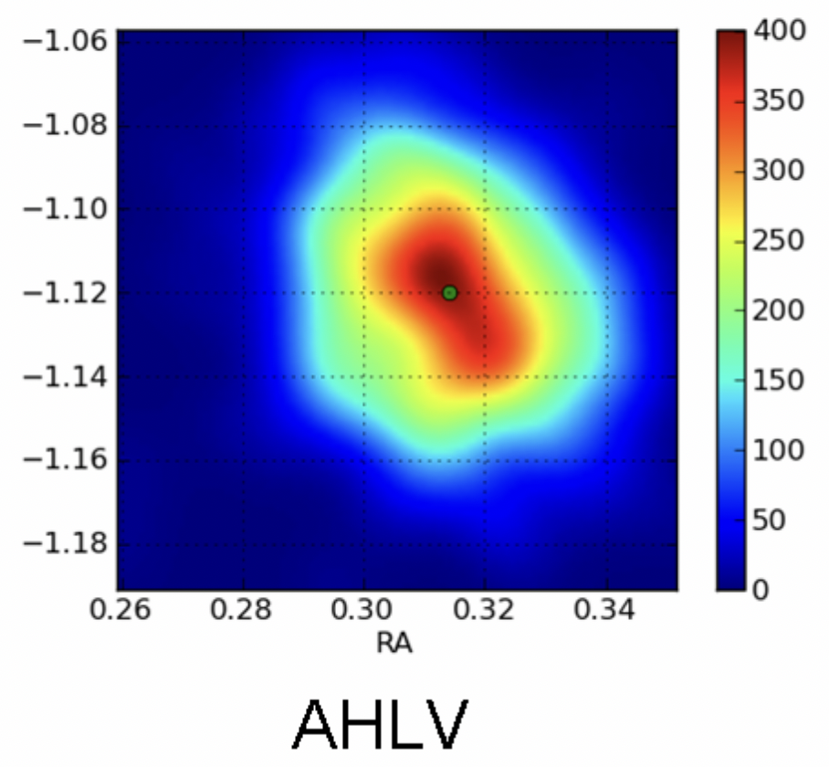
RAI’S COMMITTEE ON ON LIGO SOUTH/LIGO-INDIA
Hanford-Hanford-Livingston-Virgo Australia-Hanford-Livingston-Virgo
Incredible experience: Rai was not just conducting meetings but deeply engaged in the work of each group.
communicated often directly asking technical questions
wouldn’t be satisfied until he was totally convinced he could explain the results for himself.
Sathya

Slide 9
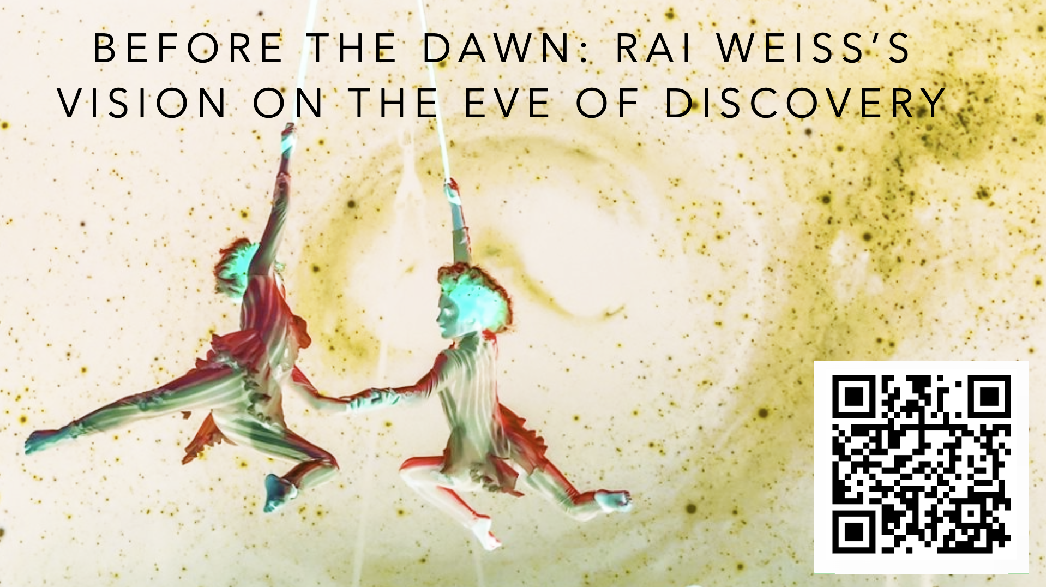

Slide 10
RAI BEGINS BY TALKING ABOUT EINSTEIN’S PAPER 2016 ON GRAVITATIONAL WAVES: INSIGHT AND MISSTEPS
Einstein’s 1916 perturbative treatment already contained the essentials of gravitational waves.
He identified traveling metric perturbations and an energy flux expression remarkably close to modern usage.
Yet the first radiation formula was flawed: it predicted waves from spherically symmetric motion.
In 1918 Einstein revisited the calculation, admitted an arithmetic error, and obtained the quadrupole formula (with a lingering factor-of-two issue).
Rai’s message:
  Scientific progress is nonlinear—even Einstein’s discovery involved confusion, correction, and reinterpretation.
Sathya

Slide 11
THEN HE POINTS TO A CENTURY OF SKEPTICISM AND CONTROVERSY
Gravitational waves were historically controversial.
Einstein himself doubted their existence in the 1930s.
The field experienced experimental uncertainty and debate (e.g., Weber’s claims).
Detection would therefore represent not only a measurement but the resolution of a century-long question.
Key quote:
  “Just imagine all the controversy that this field has been through.”
Rai’s Message
  The quest for gravitational waves is as much a story of perseverance as of theory and experiment.
Sathya

Slide 12
THE MOST INSPIRATIONAL PART –– A STRATEGIC GOAL: DETECT BEFORE THE CENTENARY
Weiss proposes an internal community goal: aim for detection around 2016.
This is a motivational target, not a promise to funding agencies.
Setting such a goal creates urgency and discipline across the collaboration.
Key quote:
  “We don’t tell the NSF a word about this… but we keep it to ourselves that we have a goal.”
Message
  Ambitious internal goals can catalyze coordinated progress without external pressure.
Sathya

Slide 13
RAI CONCLUDES WITH WHAT THE GOAL DEMANDS
Data analysis readiness: pipelines and methods must be prepared in advance.
Instrumentation readiness: fix known issues proactively rather than sequentially.
Avoid the “serial” approach that slowed progress during Initial LIGO.
Key quotes
  “We have everything ready — especially in the data analysis.”
  “We don’t wait making fixes… we already know things that have to be changed.”
  “It would be wonderful to settle this whole thing in exactly 100 years.”
Message
  Detection is not just a technical milestone — it is the culmination of decades of persistence and collective effort.
Sathya

Slide 14
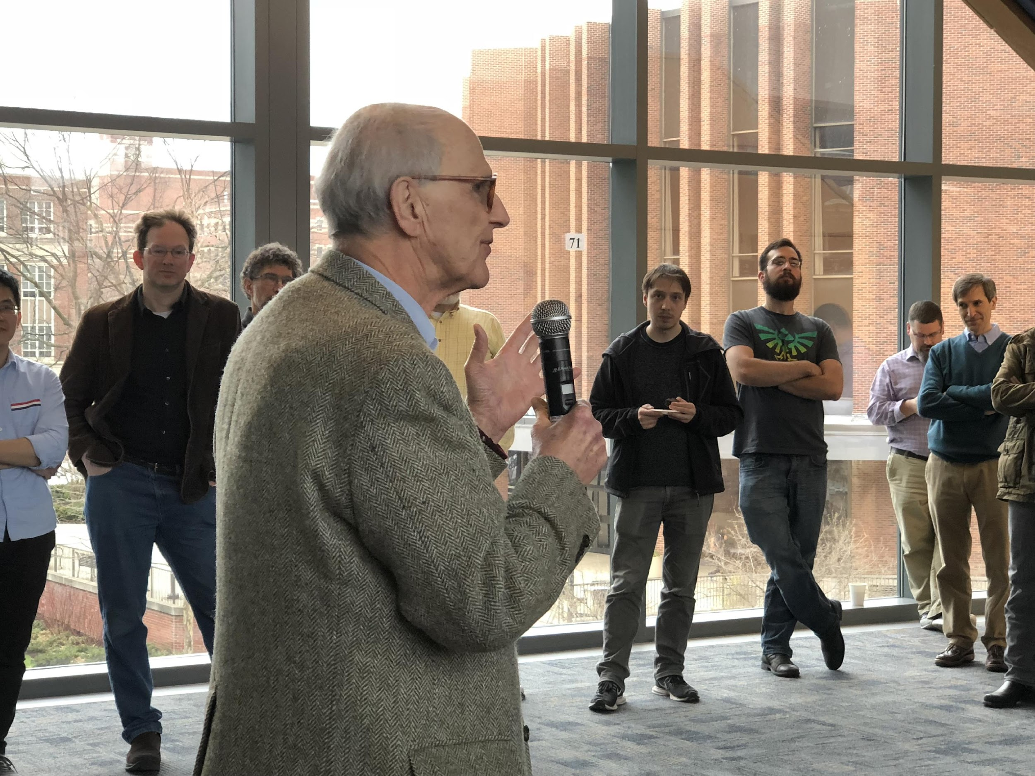
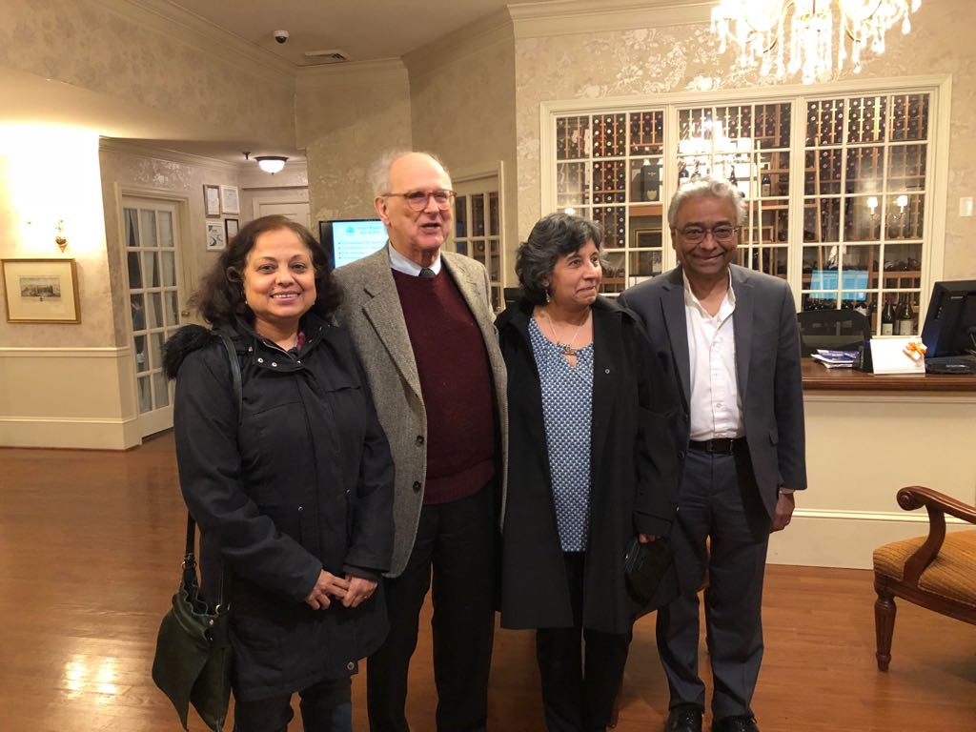
RAI’S UNDERLYING MESSAGE:
Progress in gravitational-wave astronomy, like Einstein’s own journey, requires bold goals, self-criticism, and sustained collaboration — but the reward is settling one of physics’ longest-standing questions.
Sathya

Slide 15
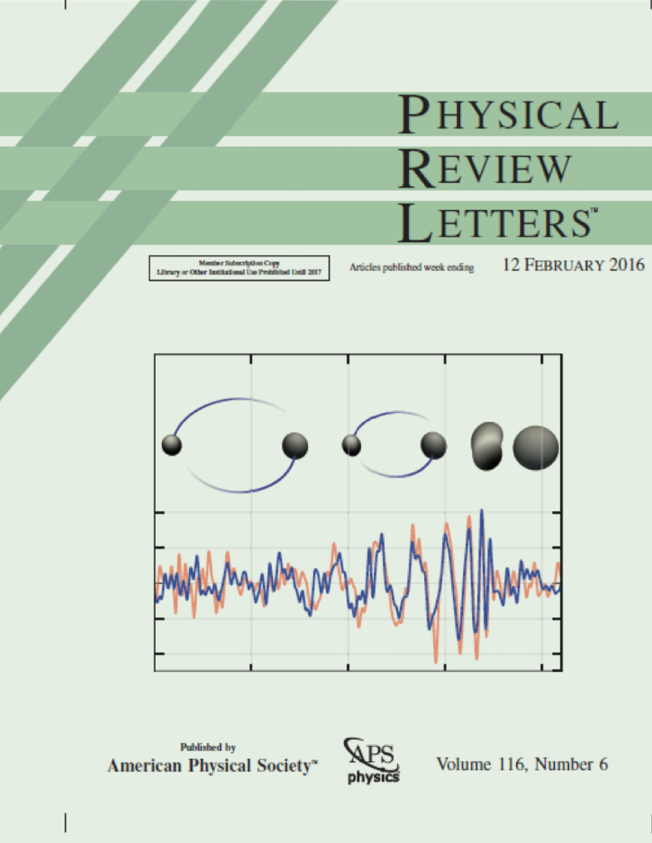
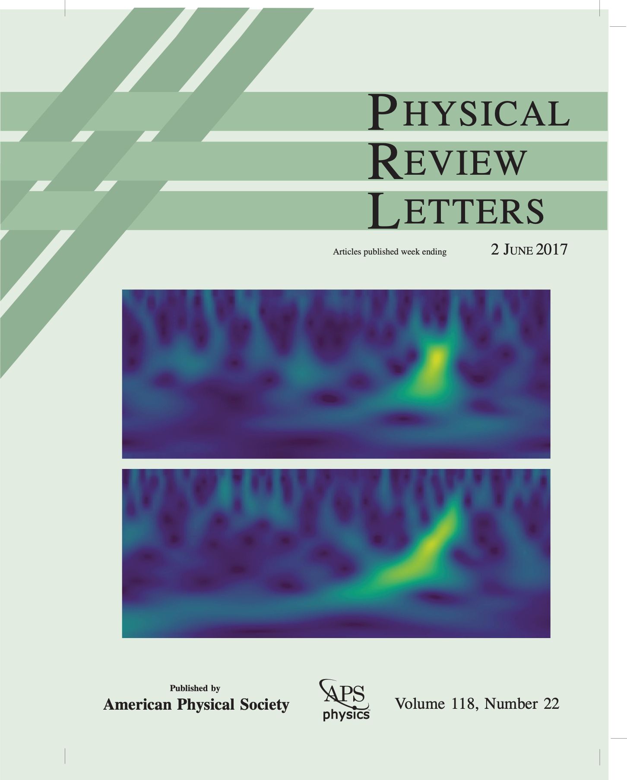
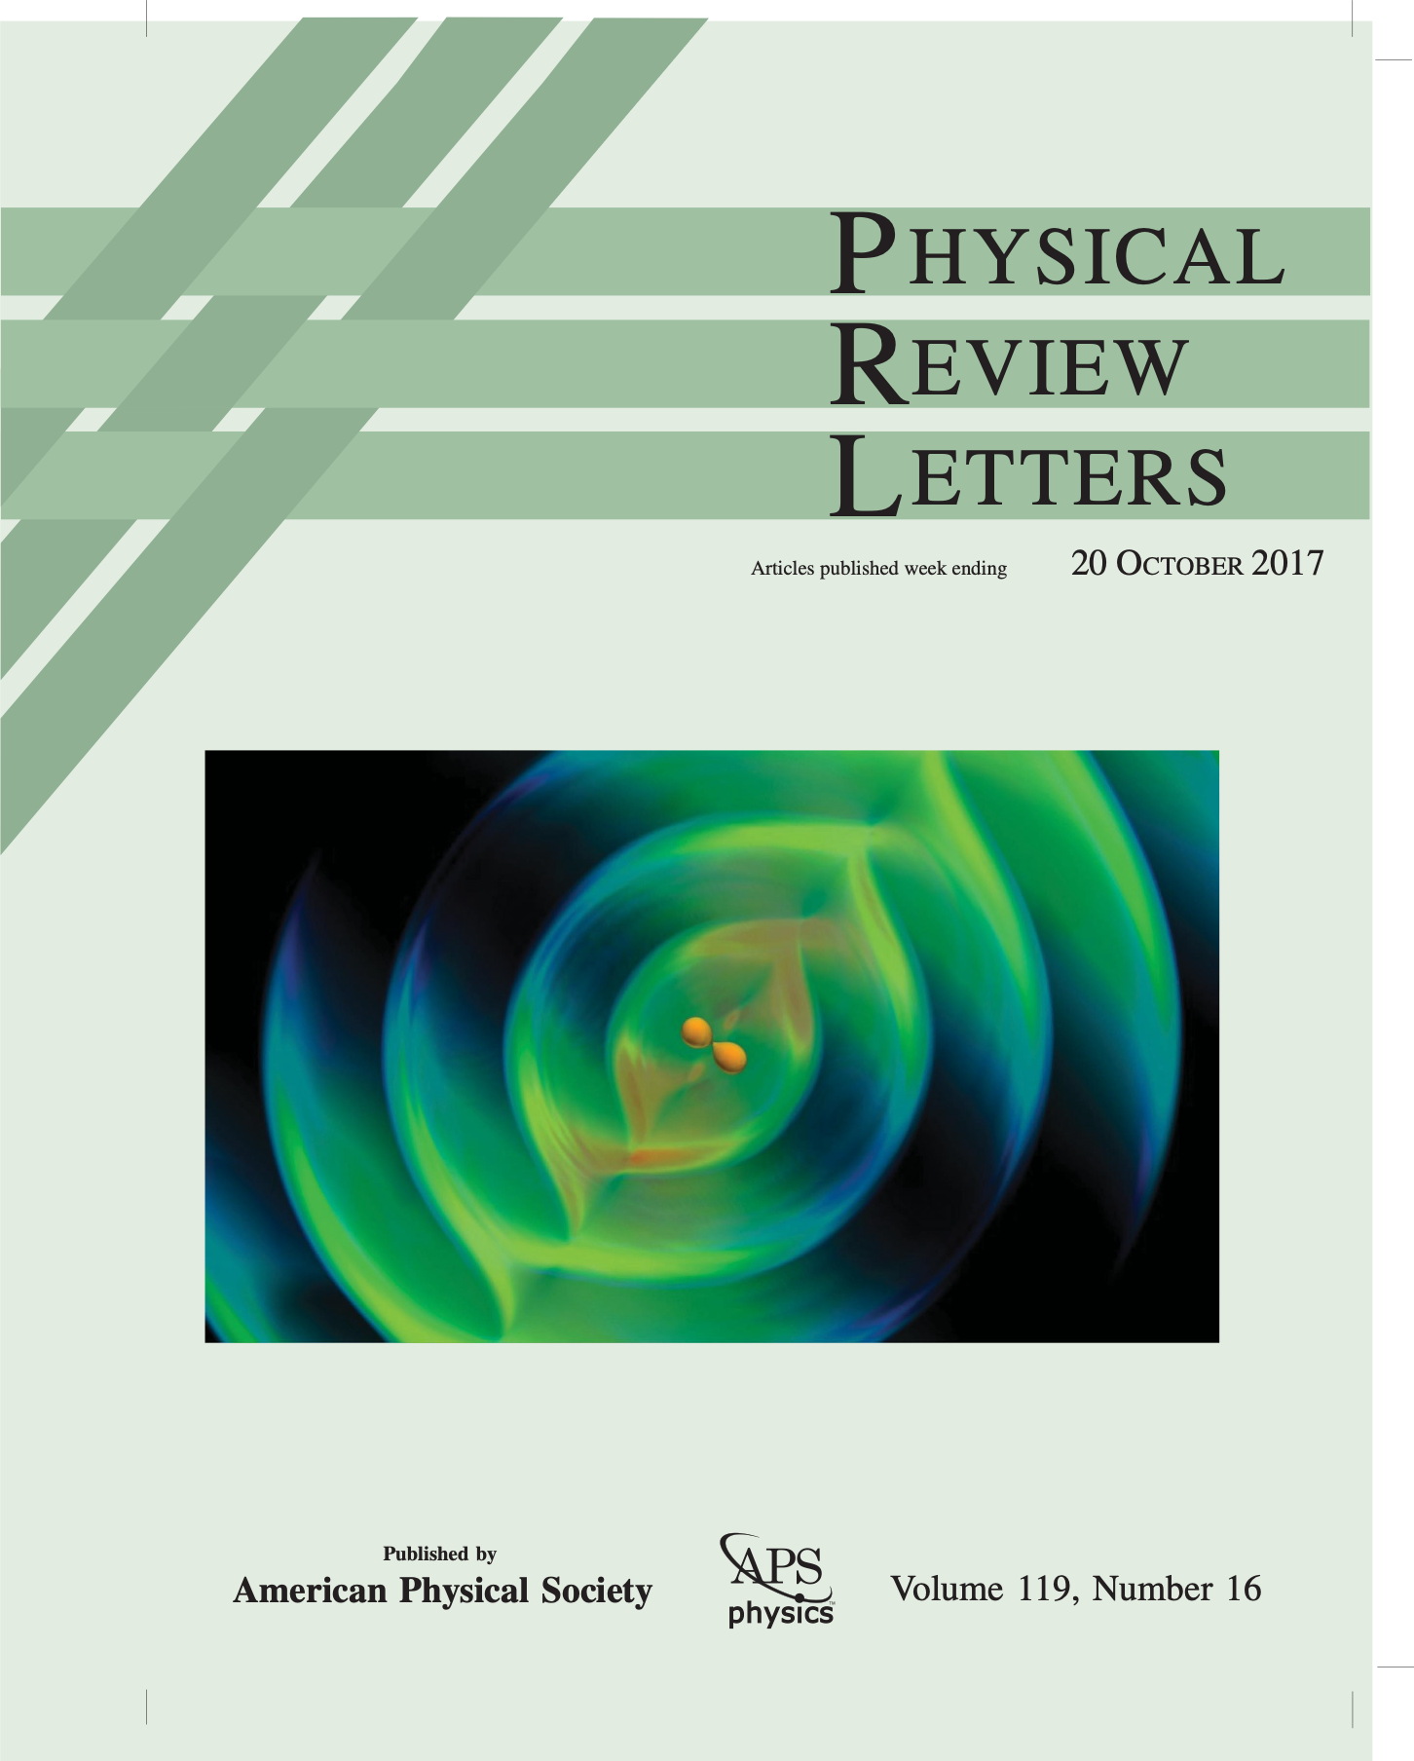
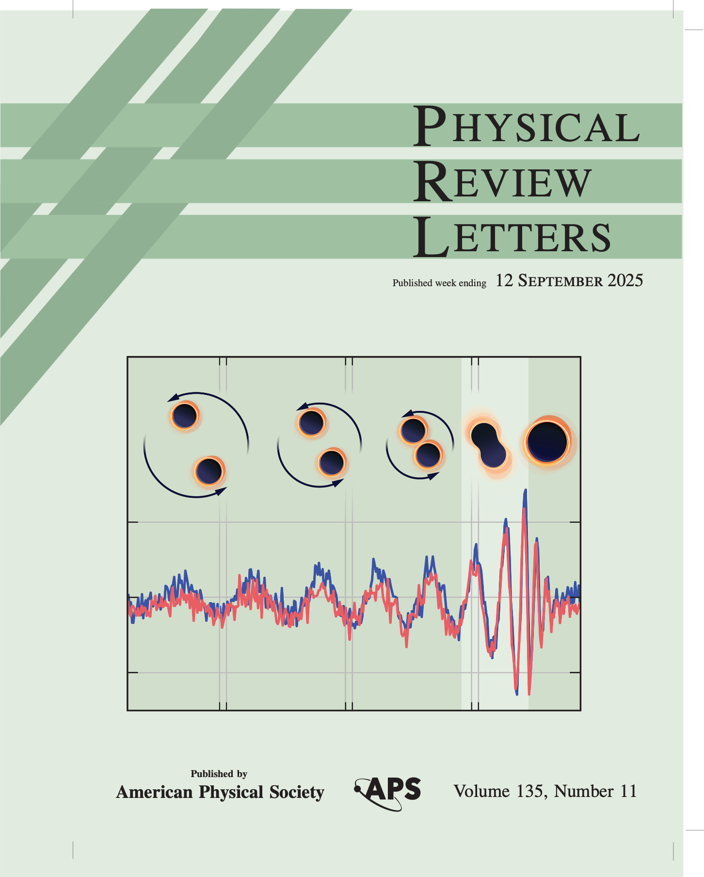
RAI’S GOAL WAS NOT ONLY MET BUT GW DISCOVERY HAS SO FAR MADE PRL COVER FOUR TIMES
GW150914
GW170104
GW170817
GW250114
Sathya

Slide 16
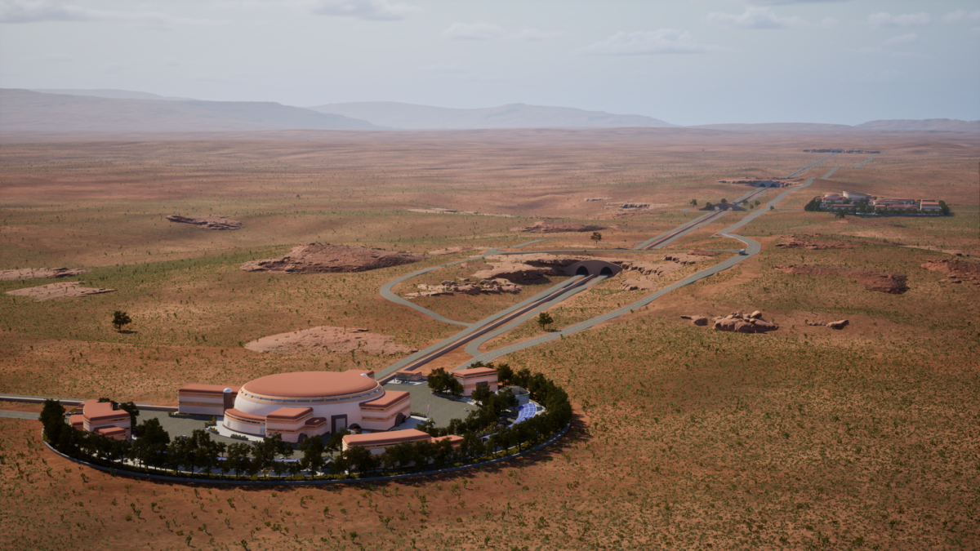
COSMIC EXPLORER
Sathya

Slide 17
David Tanner
Professor of Physics (emeritus)
University of Florida

Slide 18
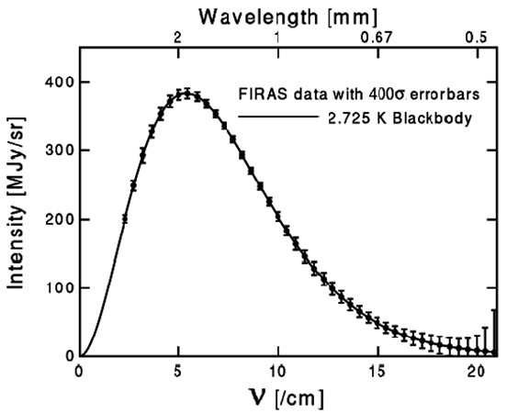
Memories of Rai Weiss
In winter 1996 a UF group went to Aspen and then visited Caltech to learn about LIGO; an outcome was a chance to build the IOO.
Rai and Stan visited UF in May ’96.
By fall our work on the IOO was underway.
I learned that Rai was a technical genius. Electronics, vacuum, mechanics, optics …
I see the genius in the Cobe experiment too.
He also had an amazing vision for the future of GW detection.
Tanner

Slide 19
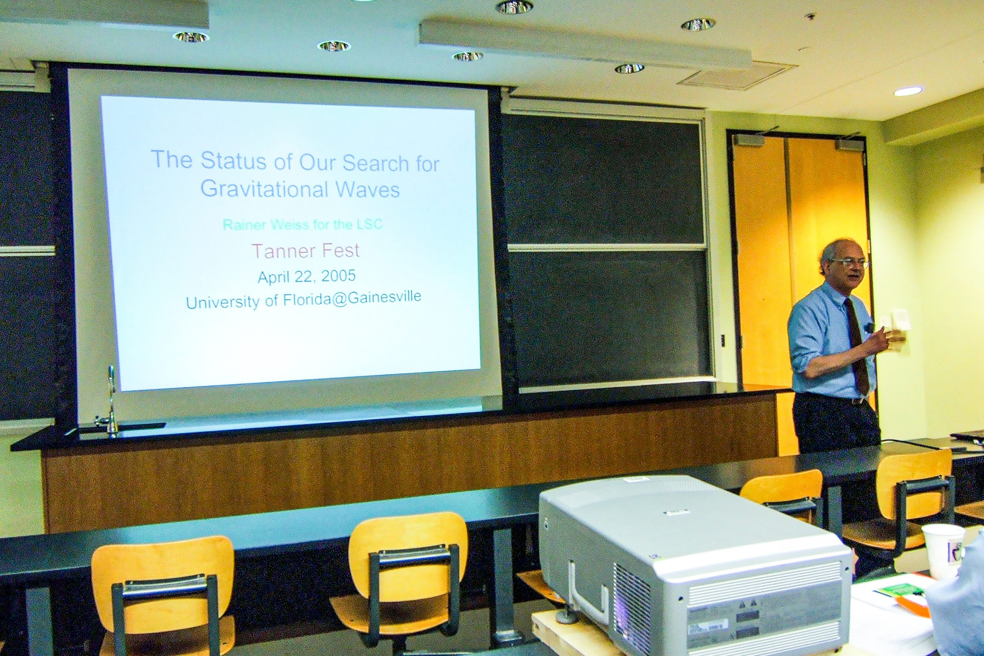
Rai came to Gainesville for a very nice meeting
Tanner

Slide 20
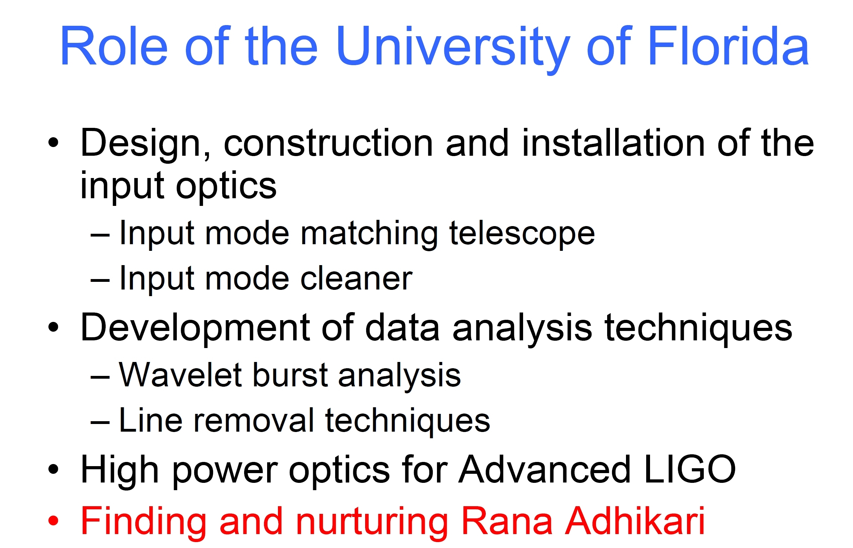
He described LIGO’s design and prospects, and then commented on UF
Tanner

Slide 21
Bruno Coppi
Professor of Physics (emeritus)
MIT

Slide 22


Slide 23
Steven Penn
Associate Professor of Physics
Hobart and William Smith College

Slide 24
Valery Frolov
Scientist, LIGO Livingston Observatory
Caltech

Slide 25
Stefan Ballmer
Professor of Physics
Syracuse University

Slide 26
2001: Livingston Louisiana
I first met Rai as prospective grad student, with a purely theoretical Master’s Thesis under my belt….
  ”…I told him that I wanted to get my hands dirty”
Rai: “Doing theory alone was dishonest. You were farting around—in effect—with ideas, and not doing anything. So you had to do an experiment—but you shouldn’t do an experiment without understanding the theory.”
  From Caltech Oral History Archive, Interview from year 2000, by Shirley K. Cohen
  https://digital.archives.caltech.edu/collections/OralHistories/OH_Weiss_R/

Slide 27
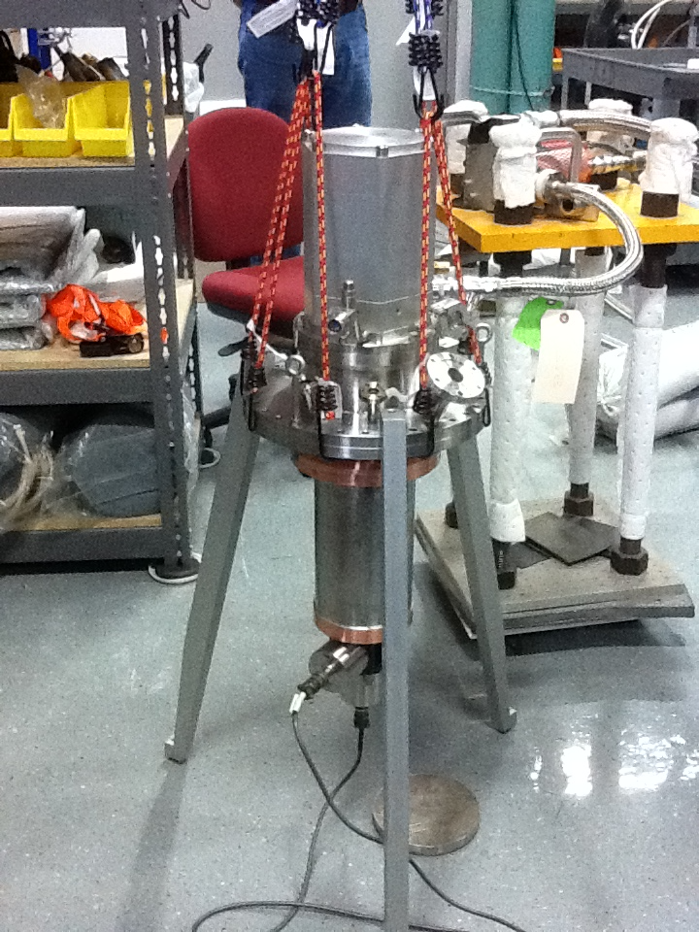
Dec 13, 2011: Cryomech Syracuse

Slide 28
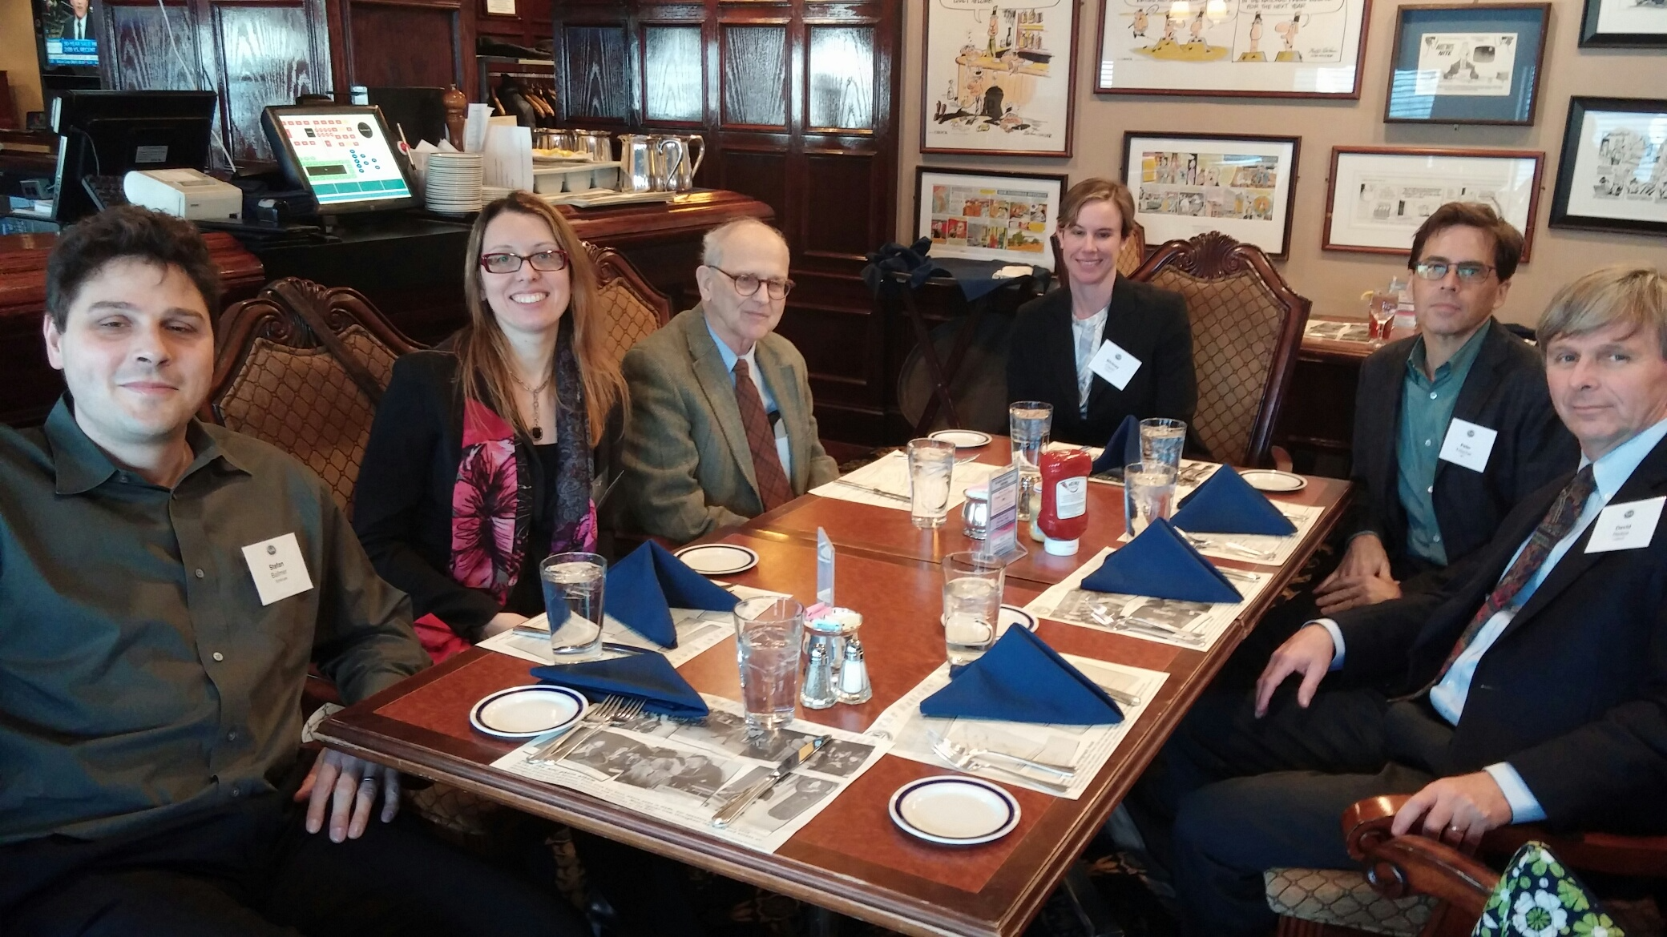
National Press Club Feb 11, 2016

Slide 29
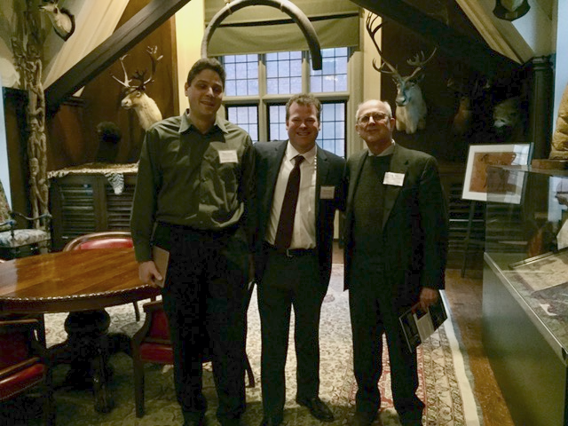
Explorer’s Club New York City, 2/2/2017

Slide 30
Words to live by
“I’m going to work on a problem that’s important; I don’t give a g*****n how long it takes.”
Rainer Weiss 1932-2025

Slide 31
Vivishek Sudhir
Associate Professor of Mechanical Engineering
MIT

Slide 32
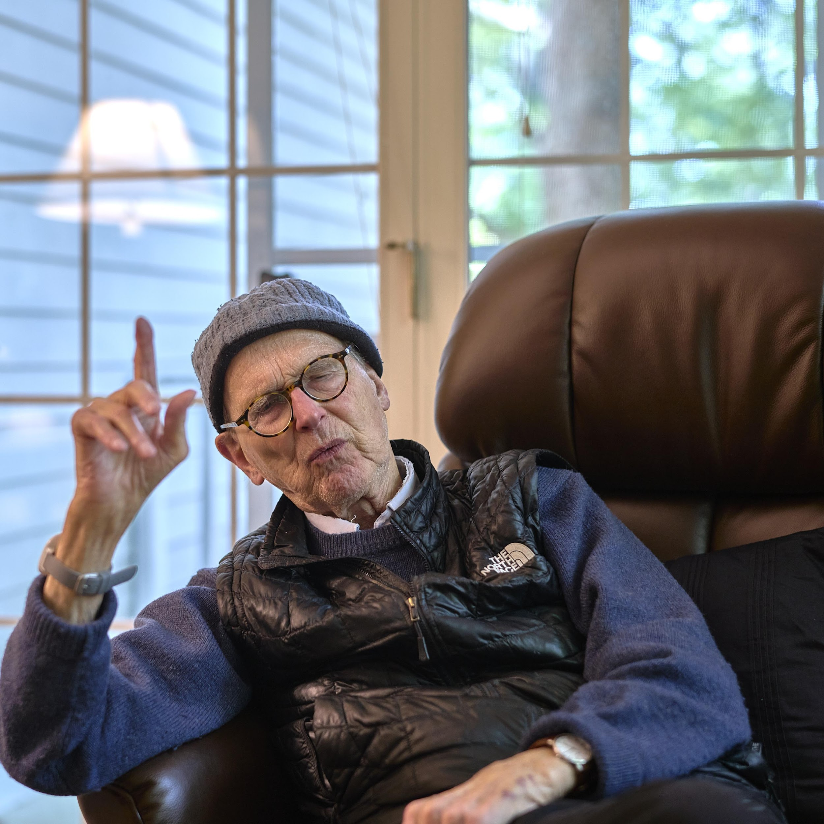

Slide 33
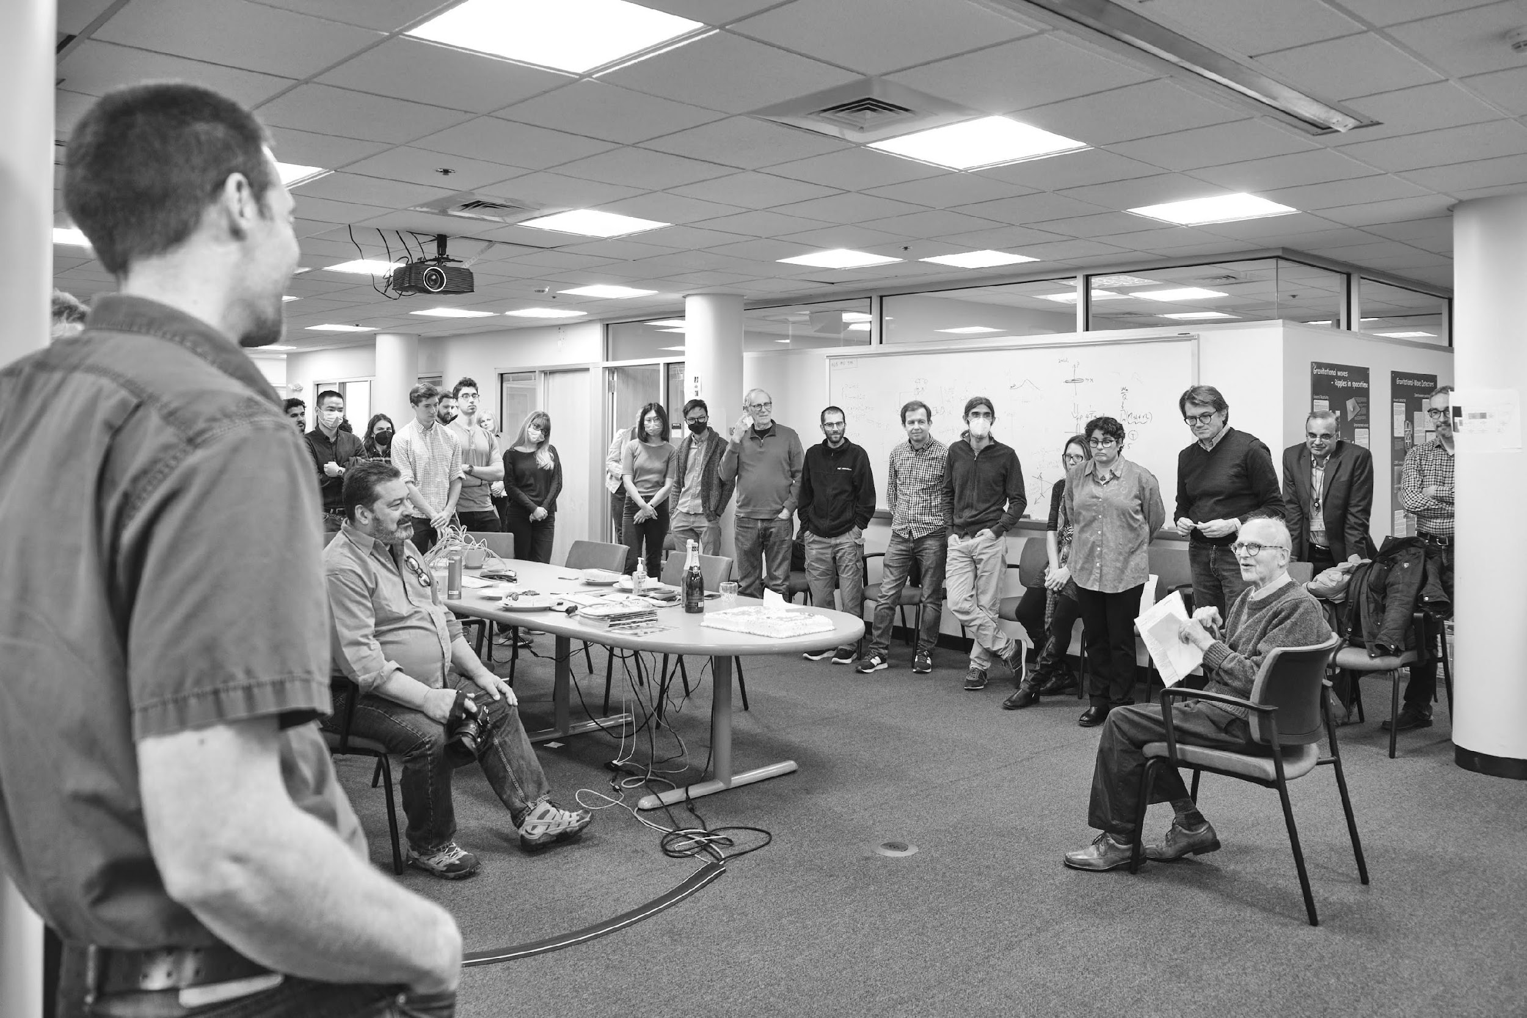

Slide 34
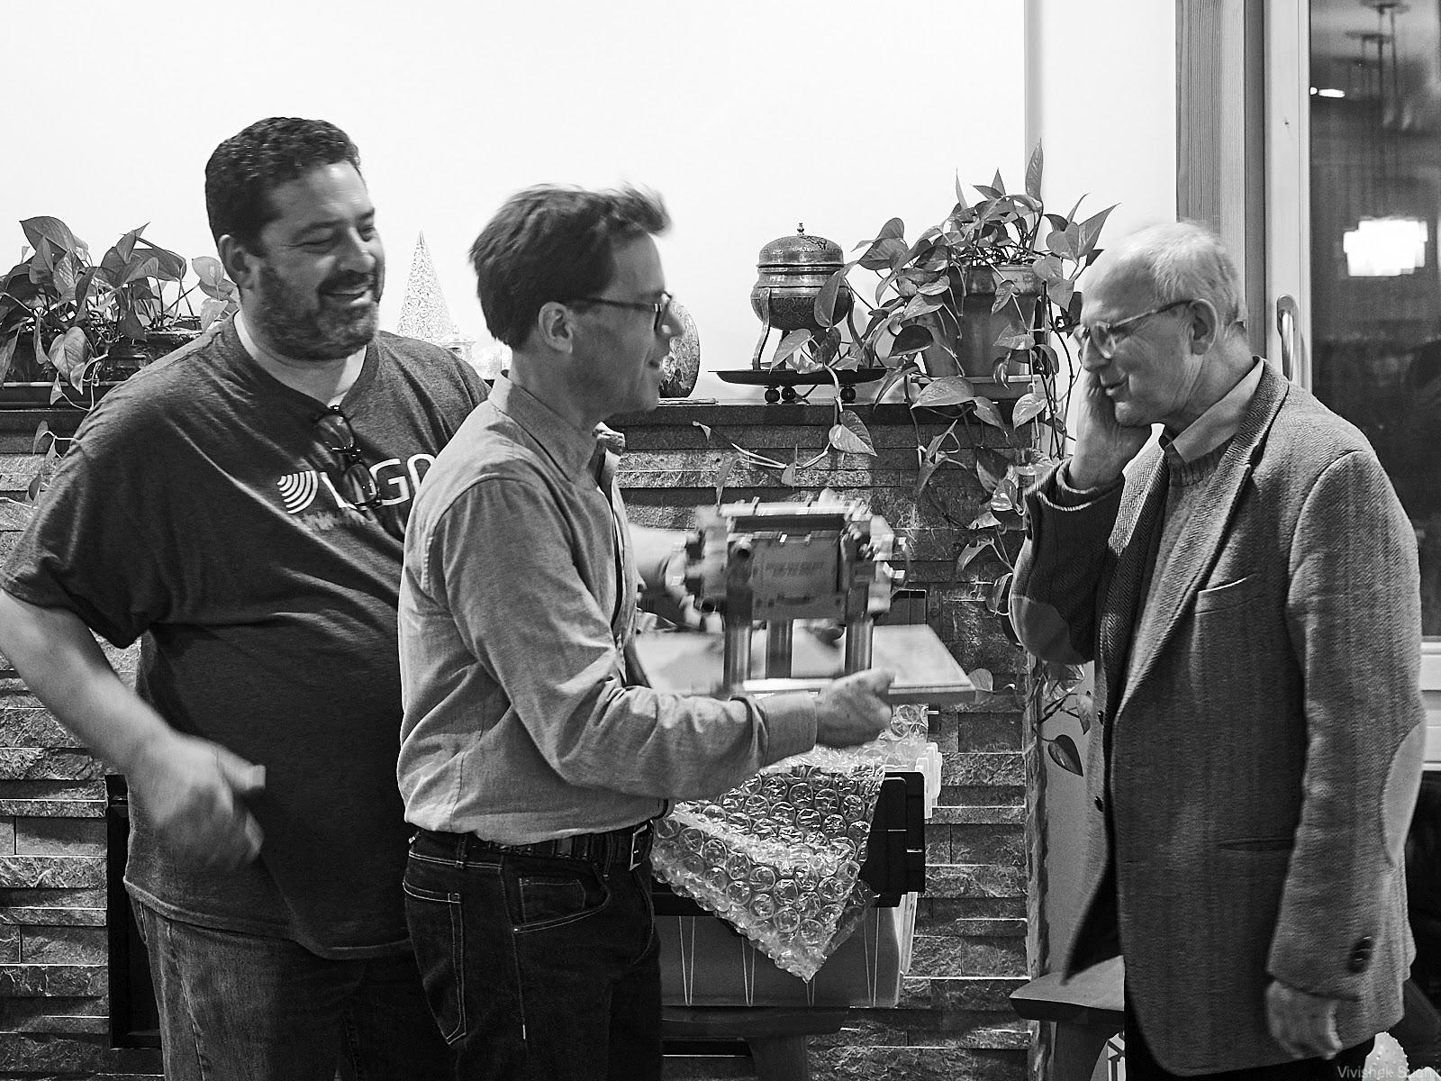

Slide 35
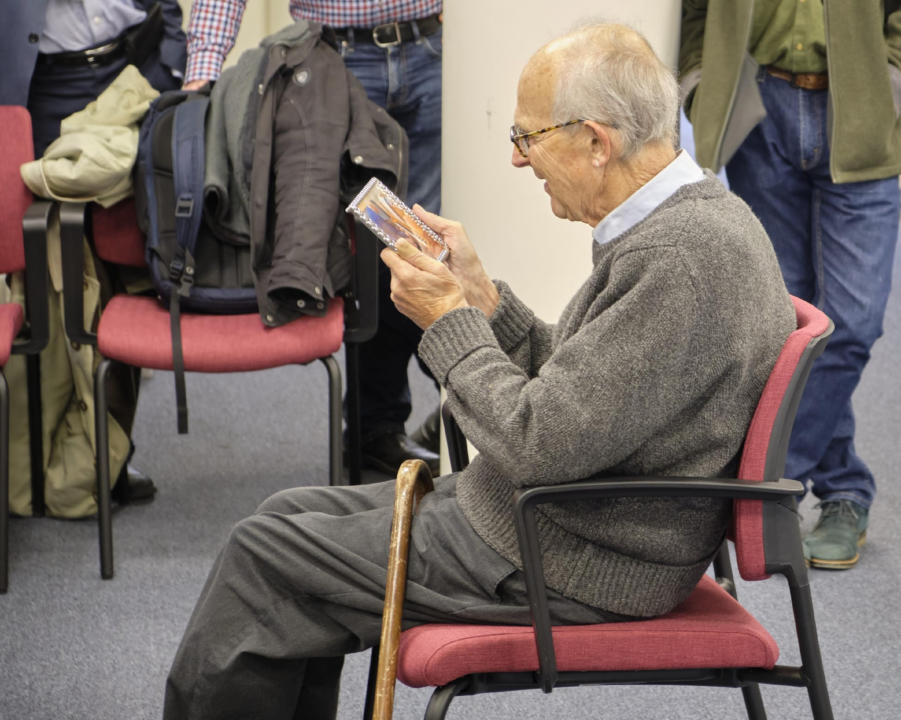
“Half a good idea is good enough, you’ll spend the rest of your life figuring out the other half”

Slide 36
Salvatore Vitale
Associate Professor of Physics
MIT

